Slide 1
Spring Microservices
May 28, 2020

Slide 2
Audience
All Levels

Slide 3
Objective
To give a basic idea on microservices.
API Gateway
Naming Server
Spring Cloud Config Server
Centralized logging
Fault Tolerance

Slide 4
Contents
Definition
Architecture
API Gateways
Naming Server
Load Balancing
Cloud Configuration Server
Distributed Log Tracing
Fault Tolerance

Slide 5
Definition
Small autonomous services that work together - Sam Newman

Slide 6
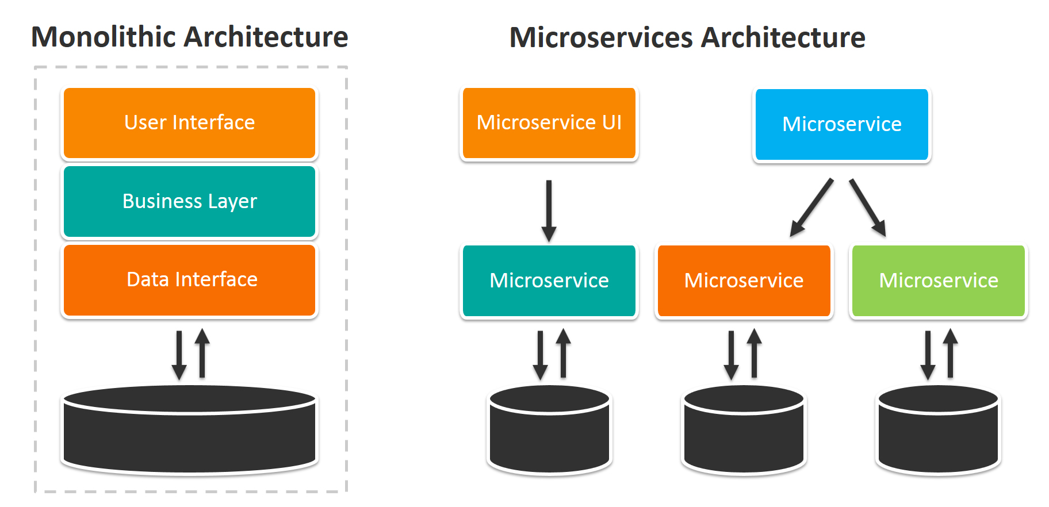
Architecture

Slide 7
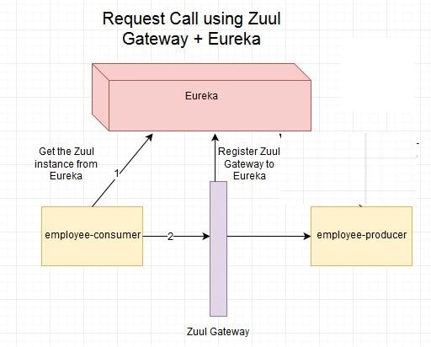
API Gateway
single entry point into a system
Other Responsibilities such as
Authentication
Monitoring
Caching
Load Balancing
Request Shaping
Logging

Slide 8
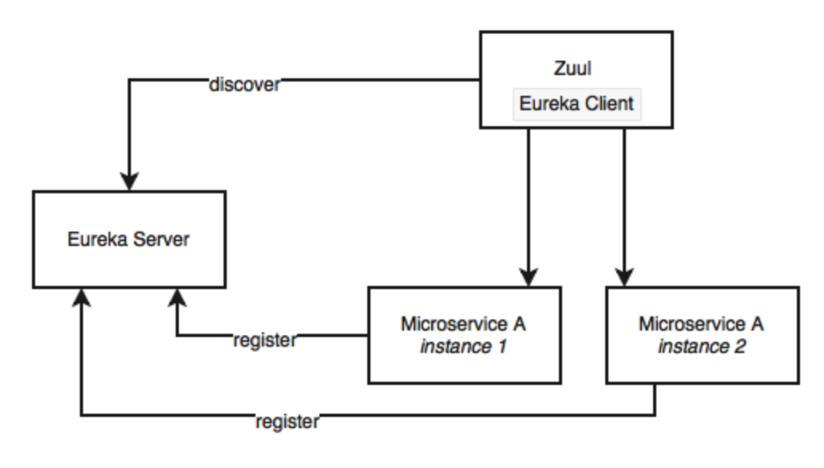
Naming Server
Service Discovery
Service Registration

Slide 9
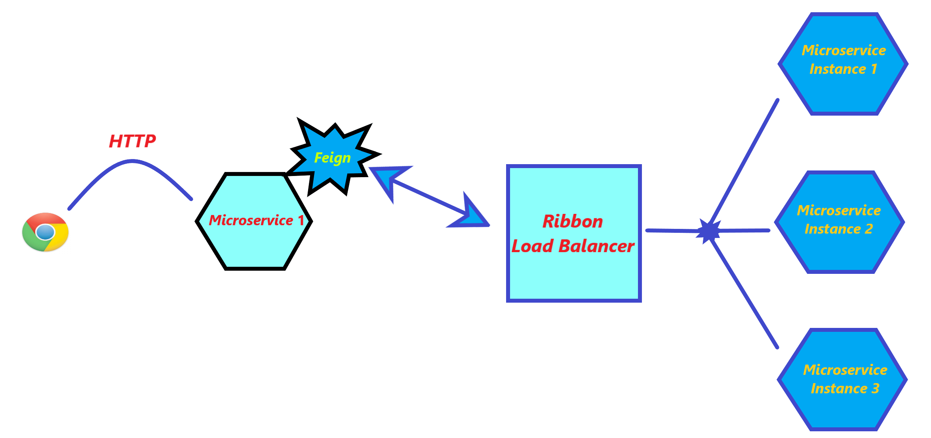
Load Balancing
Load balancers will designate a Server for the request when request comes from client.
NetFlix Ribbon is a client side load balancer And automatically distributes the load among all the services when any service internally talks with help of naming server
Feign is another component where we it is used along with Ribbon for interaction with microservice.

Slide 10
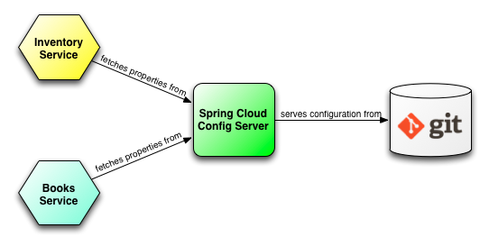
Spring Cloud Config Server
Stores and Serves distributed configurations across multiple applications and environments.
Uses Git Repository For all Storage purpose

Slide 11
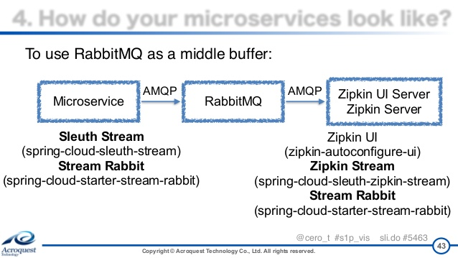
Distributed Log Tracing
Spring Sleuth For unique ID for Log
RabbitMQ and ZipKin for Distributed Logging under one place
Kibana also do the same

Slide 12
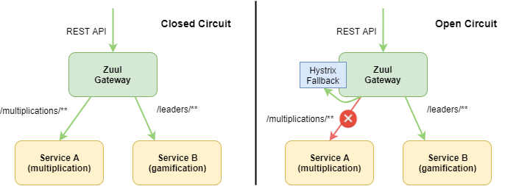
Fault Tolerance
Use Hystrix as a fallback if any dependant service Failed

Slide 13
GitHub
Limit-service (used for spring cloud config and hystrix fallback)
currency-exchange-service(getting data from h2 database and configured with eureka naming server)
currency-conversion-service(talks with currency-exchange-service so implemented feign,ribbon load balancing )
Zipkin and RabbitMQ: we have to install them docs available with complete details
Git Repository URL for all the above Services We Discussed to go through for configurations
https://github.com/Ratna1992/microservices.git
netfix-eureka-naming-server(service registry)
netfix-zuul-api-gateway-server(API gateway)
spring-cloud-config-server(configuration)

Slide 14
Thank You

