Slide 1

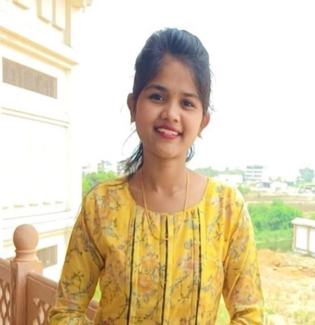



Ratnmala Gajanan Patil
Education and certificates BACHELORS IN COMPUTER SCIENCE: 2019 - 2022
Associate/Software Associate
Base Location: Mumbai
Email ID:ratnmala-gajanan.patil@capgemini.com
Mobile No: +91 9689639638
Grade: A3
Skills
C# | C# Basics, OOPS, Generics, Collections, Array, Loops
Database | Microsoft SQL Server
Angular | Components, Services, Routing, Form & Validation
.NET | ADO.NET, ASP.NET with MVC and WEB API, Entity framework
UI Tech | HTML5 & CSS3, JavaScript
Tools | Git, Postman, SSMS, Visual studio, Visual Studio Code.
Add On skills | Peer learning
Strengths
Achievement
Full Stack Developer
Hands on experience on SQL,C#,ADO.NET, Server, ASP.NET MVC5 with WEBAPI
Online Banking System
Case study on Online Banking System using ASP.NET Core with Entity Framework, Web API, and SQL Server Management Studio, Created UI using HTML,CSS, JavaScript and Angular. And for backend used WEB API and Frontend with Angular. It is website for bank user so that they can make transaction online without visiting bank no need to visit Bank for transaction.
Knowledge on creating Single page web applications using Angular
Hands on experience in developing web pages using HTML5, CSS3, JavaScript
Having knowledge on Git and GitHub.
Attended training on iTransform-Microsoft.Net
DEGREED
Successfully completed the degreed training in Git, HTML, CSS, SQL, C#, .NET Core
Cloud Certification
Certified AZ-900
Ongoing AZ-104
Check out my work here
Presentation Title | Author | Date © Capgemini 2017. All rights reserved | 1

