Slide 1
Risk Assessment
Kelvin Hilton
S307
k.c.hilton@staffs.ac.uk

Slide 2
Understanding Risk
We live in a risk indifferent society
Travel
Finance
Sport
…
When was the last time you considered “the risks” of one of your actions?
Given that there is so much that can go wrong, is there any point worrying about it in the first place?

Slide 3

Understanding Software Projects Risks
“Simplistically, [risk is] something that you’d prefer not to happen.” - Ian Sommerville
Can be:
Project related
Directly associated with the project resources or schedule
Artefact related
Impacting upon quality or performance of the artefact
Business related
The artefact is no longer viable for either the producer or the consumer
Not mutually exclusive!
Increasingly important part of PM role

Slide 4
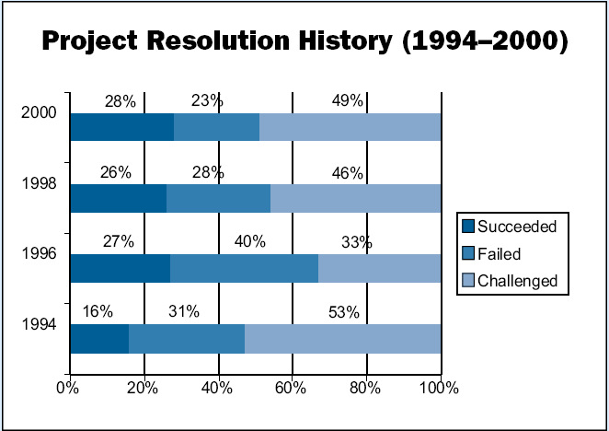
Writing Software is a Risky Business
Perception is that Agile has made significant improvements
https://projectjournal.co.uk/2016/02/20/66-of-it-projects-fail/
Source: The Standish Group International plc, 2001

Slide 5
Characteristics
Consensus is
Risks involve uncertainty
A 100% risk is fact, therefore a constraint not a risk
Risks involve loss
If it occurs something bad will happen, the question is what?
Categories
Technical
Business
Project

Slide 6
Types
Generic risks
These may occur on any project
Therefore need focus
Product specific
People
Environment
Technology
Require knowledge and understanding of what is to be developed

Slide 7
Examples of Software Project Risks
Risk | Type | Description
Staff turnover | Project | Experienced staff may leave the project before completion.
Management change | Project | Organisation changes managers, new appointees my have different agenda.
Hardware unavailability | Project | Delays in providing access to required hardware.
Requirements Change | Project and Artefact | Customers changes their mind or adds new requirements once project underway.
Specification is delayed | Project and Artefact | Delays in delivering a specification or part of.
Scope underestimated | Project and Artefact | Death Star syndrome.
Technology is superseded | Business | A new version of a core component is released.
Competitor product launch | Business | New market entrant before our artefact is completed.
Source: [paraphrased] Ian Sommerville, Software Engineering 7. 2004

Slide 8
Assessing Risk
Need to ask:
Has the project got the necessary support?
Are the actual end-users committed to the product?
Do both the developers and the customer understand the requirements?
Have customers been fully involved in the development of the requirements?
Are end-user expectations realistic?
Is the project scope stable?
Does the development team have the right skills mix?
Are the requirements stable?
Does the development team have experience with the technology?
Is the team big enough to do the job?
Is there consensus amongst the customer/end-user on the importance of the project and the identified requirements?

Slide 9
What are the risk components?
Performance Risk
What is the degree of uncertainty that the product will be fit for use?
Cost risk
What is the degree of uncertainty that the project budget will be maintained?
Support risk
What is the degree of uncertainty that the product will be easy to maintain, correct, adapt and enhance?
Schedule risk
What is the degree of uncertainty that the project schedule will be maintained ensuring the project is delivered on time?

Slide 10
Managing Risks
Four key stages
Risk identification
Risk analysis
Risk planning
Risk monitoring
Non-static
Iterative process throughout project duration
Risks can emerge as project progresses
Scale and impact can change the closer we get to the activity(s) associated with the risk

Slide 11
Risk Identification
List potential risks
Brainstorming
Experience
Try to categorise under common headings
Technological
Resource – human/non-human
Organisational
Estimation
Requirement
DO NOT TRY TO ELIMINATE AT THIS STAGE!

Slide 12
Risk Analysis (1)
Consider the identified risks
Apply some form of priority and estimate of probability and impact
Accuracy comes with experience
Quantify probability
High: 80 – 99%
Significant: 60 – 79%
Moderate: 40 – 59%
Tolerable: 20 – 39%
Low: 1 – 19%
Quantify Impact
Catastrophic: 1, Critical: 2, Marginal: 3, Negligible: 4
Visualise the data (usually in a table)

Slide 13
Risk Analysis (2)
Risk | Probability | Impact
Reduction in project budget | 10% | 1
Absence of key staff through illness | 45% | 2
Underestimate activity durations | 90% | 2
Underestimate cost of third party resource | 40% | 3
Unable to recruit additional staff with appropriate skills | 85% | 1
Rank by probability and risk
Risk | Probability | Impact
Unable to recruit additional staff with appropriate skills | 85% | 1
Reduction in project budget | 10% | 1
Underestimate activity durations | 90% | 2
Absence of key staff through illness | 45% | 2
Underestimate cost of third party resource | 40% | 3

Slide 14
Risk Planning
Examine the analysed risks and develop a management strategy
Avoidance
Mitigation
Contingency
Recovery
Basically, if you cannot avoid it, try to mitigate, if you cannot mitigate try to have a contingency and if all else fails…make sure you can recover

Slide 15
Risk Monitoring
Continually re-evaluate and readjust your Risk Management plan
Try to anticipate by reading-the-signs
If a key developer fails to get the salary rise they were expecting odds are that their motivation level will fall!
If a customer avoids answering your calls odds are you are not going to get your requirements signed off on time

Slide 16
Strategies for Managing Risks
Reactive
Monitor for risks
Set aside contingency
Basically, do nothing until something goes wrong, fire-fighting mode
Proactive
Plan well in advance
When risks occur have a managed approach
Identify risks
Assess probability/impact

Slide 17
Review, review and review again
Team needs to know risks and risk management strategy
Risks should be part of all project discussions
Strategy should be constantly reviewed
Problem
What do you do if
A team member is a constant risk
A tool is a constant risk
A manager is a constant risk

Slide 18
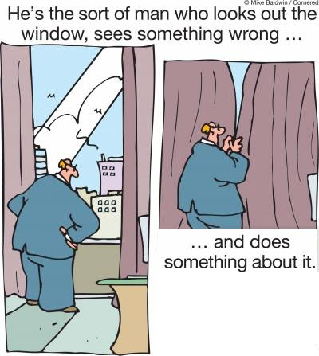
Don’t be shy…
Often risks are first identified by the people closest to them
Need to have courage
Need to have a record!

Slide 19
Summary on Risks
Risk evaluation and analysis skills only come with experience
Odds are that the experience will be expensively gained!

Slide 20
Questions?

