Slide 1
User Documentation & Support
Kelvin Hilton
S307
k.c.hilton@staffs.ac.uk

Slide 2

Software is complicated

Slide 3


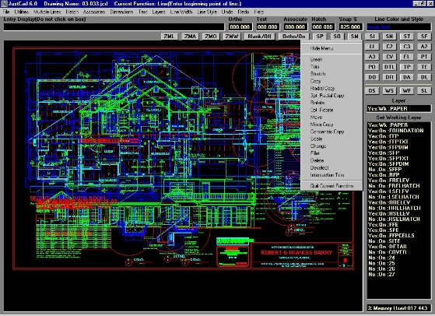

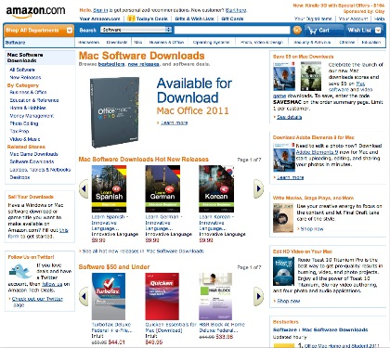




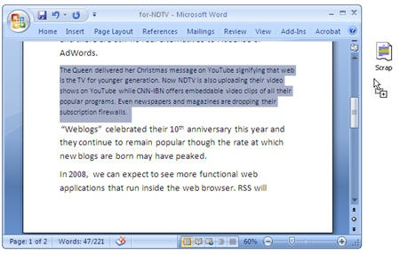



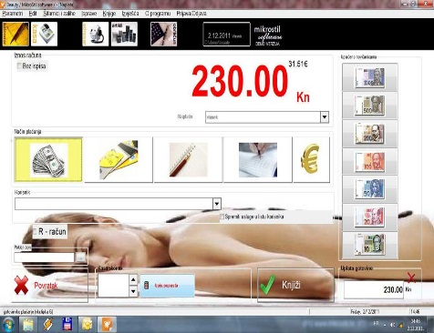



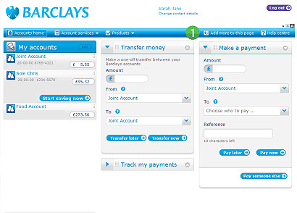
Software is diverse

Slide 4





Users are complicated
Home
Personal, ad hoc use
Small Business
Low volume, task related
Mobile
On demand, snapshot
Corporate Business
High volume, distributed
Power
Specialist, sophisticated

Slide 5
Users are diverse
Age
Ability
Experience
Special Needs
Motivation
Culture

Slide 6



The Challenge
User Support
Users
Developers

Slide 7
Importance of Documentation
Only tangible way to represent the software/system
Good documentation
Aids
Understanding
Support
Maintenance
Confidence
Bad documentation
Worthless

Slide 8
Importance of Standards
Achieves consistency
Establishes good practice
3 Types
Process standards
Format standards
Interchange standards

Slide 9
Process standards
What process we follow for document production

Slide 10
Formal/Informal
What standard to follow is dictated by
Company quality procedures
International standards
ISO
The customer
Ministry of Defence
Process should integrate
Change management
Version control
Accountability

Slide 11
Need to know
Who is the owner
Who is the author (if different/multiple)
What is current version of the document
Change record
Circulation process
Validity period
Archive procedure
Document revision process

Slide 12
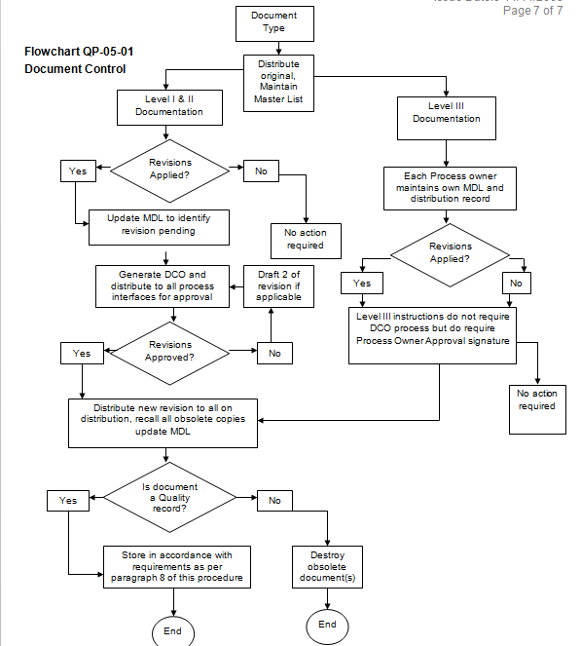
Sample ISO Document Flow

Slide 13
Document standards
What standards govern the document itself

Slide 14
All Documents should have
Consistency
Structure and style
Page numbering, headers, footers, section/subsection numbering
Unique identifier
Same Font, logos, names
Terminology
Change record

Slide 15
Interchange standards
Ensuring everyone uses has access to the correct document

Slide 16
Need to ensure
Document is presented correctly
Particularly image, diagrams, tables
Ideally symmetric applications
Notification of updates/version changes
Control of edit/append
Privacy/confidentiality

Slide 17
User documentation
Support manuals

Slide 18
Help not hinder
Consider the audience
Technical / non-technical
Consist of:
Functional Description
Introductory Manual
Reference Manual
Installation Manual (if relevant)
Administrator manual (if relevant)

Slide 19
Functional Description
Overview of the system
Present key functionality
What it is for
What it is not for!
Division by major functional area
Sales, purchasing, accounts
Tutor, student
Link to Introductory manual
See section xyz for details…

Slide 20
Introductory Manual
Describe normal usage
Always have a “getting started” section
Use of illustrated examples (but not excessive)
Should have a “how to” section
Should have a “troubleshooting” section
Should have an “error reporting” section
Ideally with contact information
May be paper based, electronic or mixture
Explicitly state version covered

Slide 21
Reference Manual
An encyclopaedia of the system
All functions
Navigation structure
Outputs (e.g. reports)
Error codes
Document guide

Slide 22
Installation Manual
Full up-to-date instructions on how to install the software
Standard operational environment (SOE)
Known compatibility issues
Required software items (DLLs, resources)
Required hardware items (networks, disc space, i/o devices)
Licence restrictions
Back-up instructions (if local)

Slide 23
Administrator Manual
System architecture
Physical
Log access
User management guide
Configuration guide
Component diagrams
Error tables
Back-up and recovery strategy

Slide 24
Questions?

