Slide 1
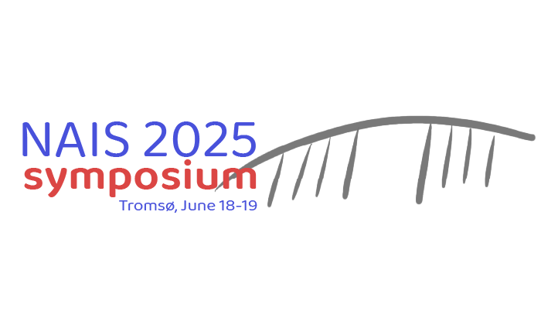

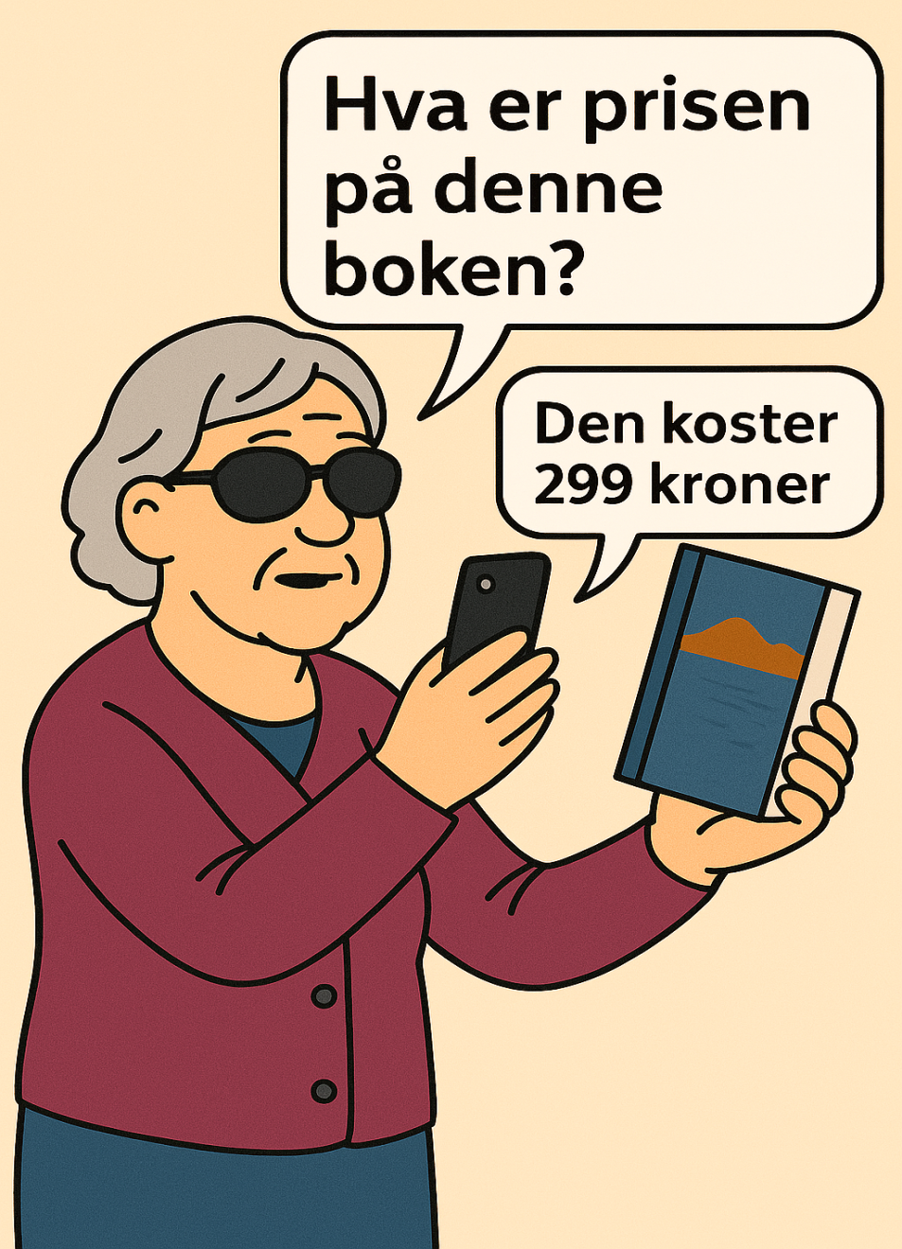
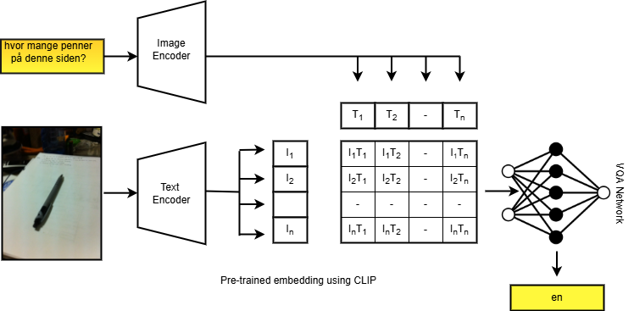
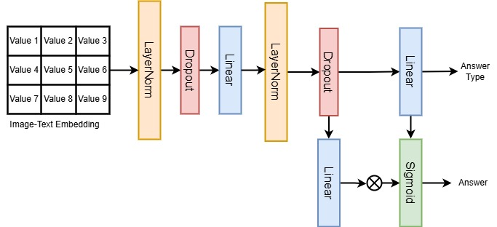
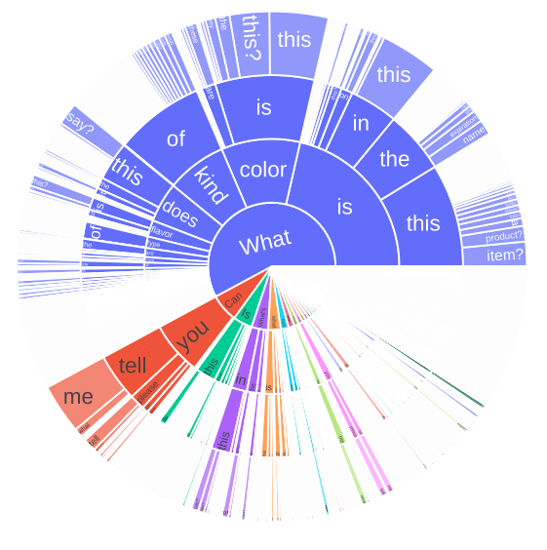
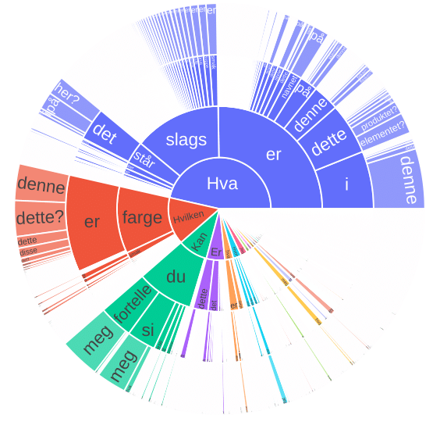

2025 NAIS Symposium
NorViVQA: Visual Question Answering for Visually Impaired in Norwegian Language
Ratnabali Pal ¹, Samarjit Kar¹, Dilip K.Prasad²
¹ National Institute of Technology Durgapur, India, ² UiT The Arctic University of Norway
Figure: Proposed CLIP pipeline that learns visual concepts from natural language supervision.
Background
Contributions
Recent Low-resource VQA methods suffers:
Most VQA systems are developed for English
Limited Accessibility for VI Users
High Computational Demands of LLMs and LVMs
Need for Inclusive, Sustainable AI
Introduced NorViVQA for low-vision users
Real-World Accessibility Focus
CLIP-based Learning Pipeline [1]
Baseline Benchmarking
Methods and Results
Figure: Architecture of the proposed VQA module
Figure: Sunburst diagram showing the distribution of the first four words in questions from the VizWiz-VQA [2]
(English on the left) and NorViVQA (Norwegian on the right) datasets.
Text Embedding | Metric | Score
ltg/norbert3-large [3] | TestTYPEAccuracy(%) TestANSAccuracy(%) AverageTESTAccuracy(%) Test Loss | 67.09 34.86 50.97 120.97
NorGLM/NorGPT-3B | TestTYPEAccuracy(%) TestANSAccuracy(%) AverageTESTAccuracy(%) Test Loss | 67.09 34.50 51.12 122.25
Openai-gpt | TestTYPEAccuracy(%) TestANSAccuracy(%) AverageTESTAccuracy(%) Test Loss | 29.02 0.06 14.51 170.73
M-CLIP/XLM-Roberta -Large-Vit-L-14 | TestTYPEAccuracy(%) TestANSAccuracy(%) AverageTESTAccuracy(%) Test Loss | 15.68 0.00 7.84 176.81
References
Table: Results of proposed baseline VQA module varying different text embeddings
1. Shen, S., Li, L. H., Tan, H., Bansal, M., Rohrbach, A., Chang, K. W., ... & Keutzer, K. How Much Can CLIP Benefit Vision-and-Language Tasks?. In International Conference on Learning Representations.
2. D. Gurari, Q. Li, A. J. Stangl, A. Guo, C. Lin, K. Grauman, J. Luo, J. P. Bigham, Vizwiz grand challenge: Answering visual questions from blind people, in: Proceedings of the IEEE conference on computer vision and pattern recognition, 2018, pp. 3608–3617.
3. T. M. Doan, D. Baumgartner, B. Kille, J. A. Gulla, Automatically detecting political viewpoints in norwegian text, in: International Symposium on Intelligent Data Analysis, Springer, 2024, pp. 242–253.
Conclusion
Our proposed approach highlights the potential of combining language translation and CLIP models in a small VQA module and addresses inclusivity for Norwegian-speaking users. Our work enhances support for low-vision or visually impaired people by enhancing contextual comprehension in VQA, allowing them to interact with visual content in their local language more successfully.
Acknowledgement: The authors would like to thank eHORIZON-ERC-POCProject(Spermotile,ProjectID:10112725), theH2020Project(OrganVision,ProjectID:964800),HORIZONEurope(BETTER,ProjectID:101136262) and the Research Council of Norway Project (nanoAI, Project ID: 325).

