Slide 1





RUTSOM201807DATA5
Team RatnaAllenMatt:
New York City School Performance
Notes:
Overview of what we are trying to do…
RATNA

Slide 2
Project Description
What are some of the most likely major impacts on school performance?
Study the correlation between New York City school safety and performance records to socio-economic census data
Is there a correlation between school safety records and school performance?
Does a higher income increase the likelihood of safer schools?
What is the impact of school crime rates to school performance?
What is the correlation between income and school performance?
What is the correlation between educational attainment and school performance?
Notes:
Briefly mention the different criteria and why
MATT

Slide 3
Data Contents and Connections
NYC School Safety Report (NYC Open data 2013-2014)
NYC DOE High School Performance Directory (NYC Open data 2013-2014)
Demographics and profiles at the Neighborhood Tabulation Area (NTA) level NYC Department of Planning (2008-2012)
Crime by Precincts (NYPD) (2008-2013)
Notes:
Incidents where the students are learning
Graduation rates
Income and educational attainment
NYPD Crime – after we found issues with the correlation.

Slide 4
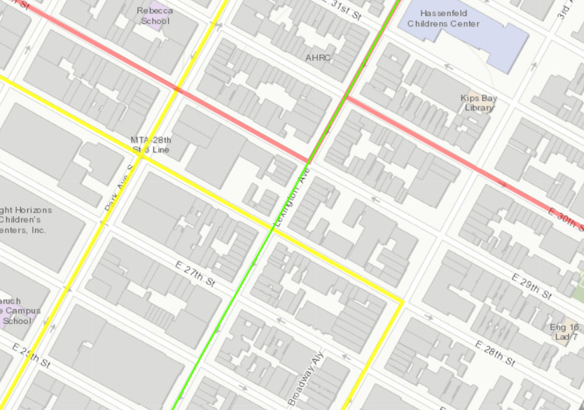
Key data development decisions
School Safety
School Performance
Census Data
Neighborhood Tabulation Areas (NTA) as the common geography
Single Census Data File
School Crime Data – Not sufficient
Notes:
Explain how different geographies connect
Explain the connection string – school safety, performance, and then census
Briefly explain why school crime data did not work well. – low number of results, minimal overlap in years.
School performance did not have NTA. Used School crime data to connect to performance using District Borough Number (DBN) and THEN to census

Slide 5
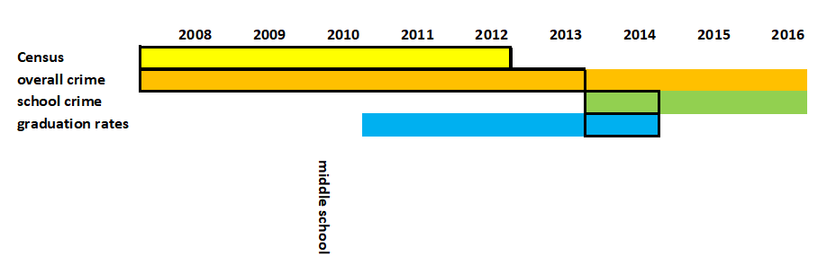
Data Contents and Connections
School Crime Data → School Performance
School Crime Data + Performance → Median Income & Educational Attainment
Overall Crime…
Notes:
Why we chose the years we used for analysis – census data during formative years, crime up until graduation.
MATT

Slide 6
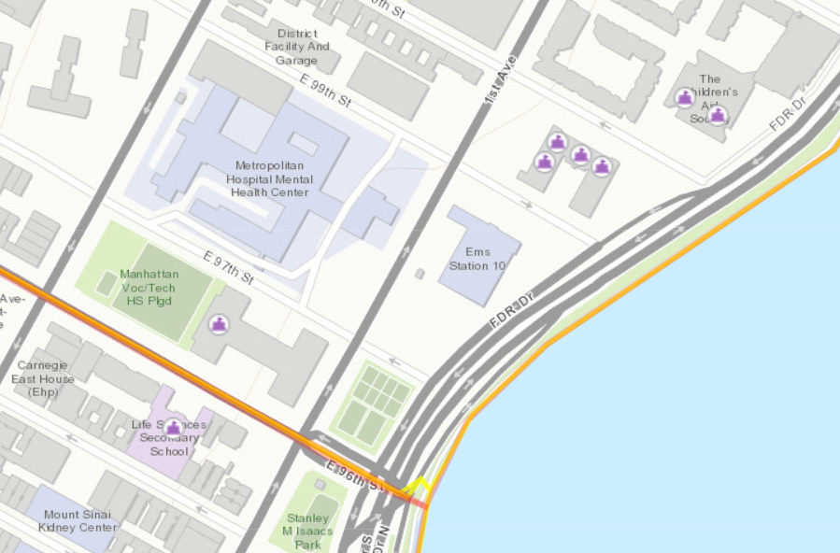
Issues to resolve/overcome
NTA name was primary key. Using names instead of IDs are always concerning.
School crime = buildings, not schools.
Educational Attainment – measured for population of 25 and older
Notes:
NTA – names instead of code. Needed to strip out spaces from names to connect
School crime was by building and not by school
Educational attainment – had to add up pieces to get overall population 25 and older (only those ages were used)

Slide 7
Story of findings (overview)
Who your parents are (and where they come from) matters
Notes:
Do we need this?

Slide 8
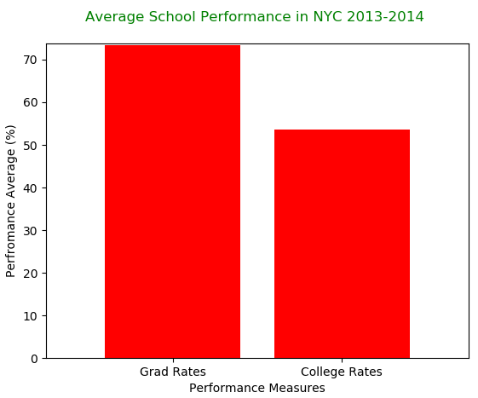
What is the Overall Average School Performance in NYC vs School Safety numbers for 2013 & 2014
For the Neighborhood Tabulation Area (NTA) in NYC the total number of incidents for the year 2013-2014 near 10K
For the NTA the Average High School Graduation rate is 75% and the students that make it to college is 55%
Notes:
RATNA

Slide 9
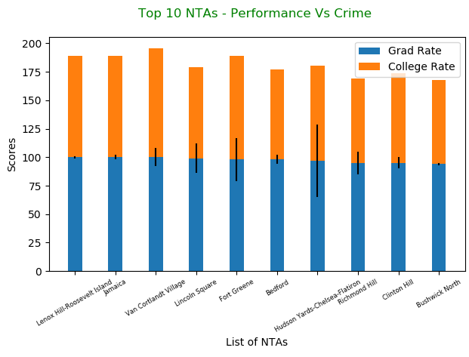
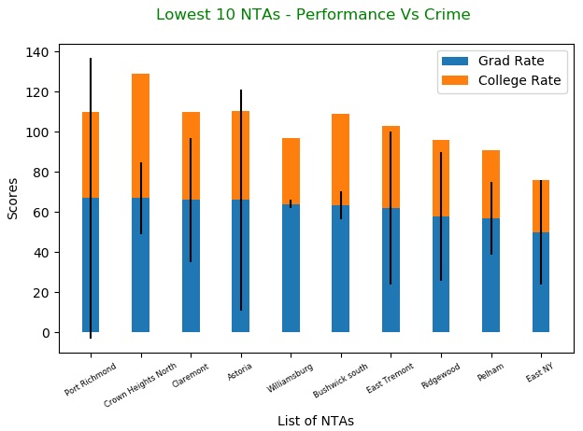
What is the correlation between school performance and crime incidents in schools?
For the Neighborhood Tabulation Area ( NTA) in NYC the Top 10 performing schools with high graduation rate the no. of incidents were low.
For 10 lowest performing schools with low rates of graduation the number of incidents are high.
Notes:
RATNA

Slide 10
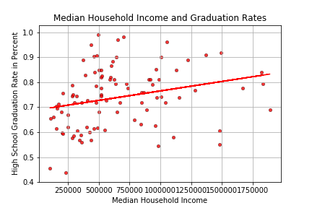
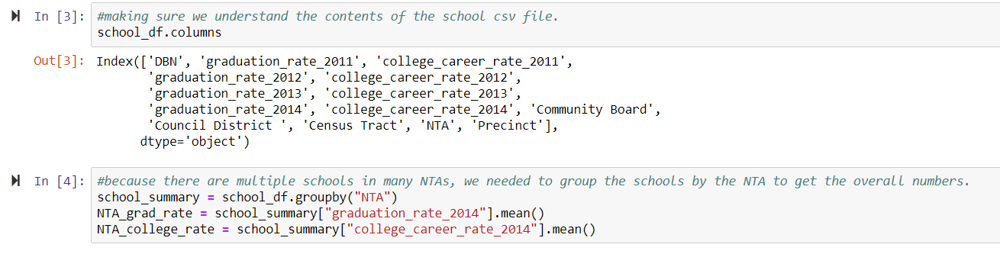
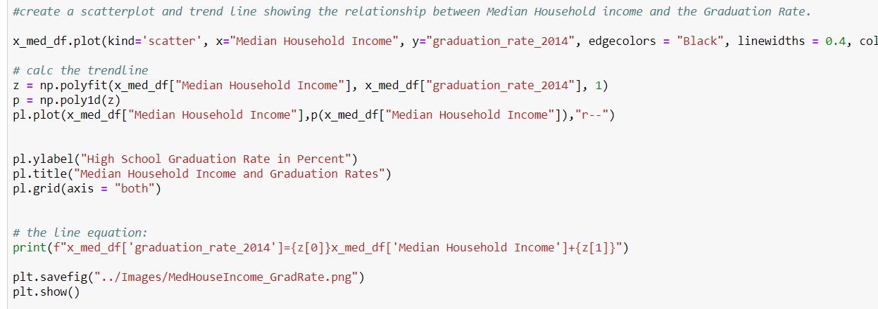
Income and School Performance
Notes:
Decent correlation, but connections are scattered around regression line.
MATT

Slide 11
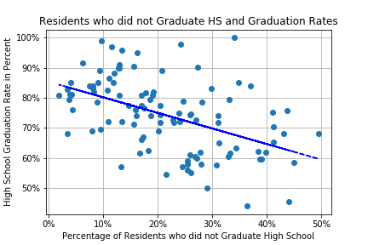
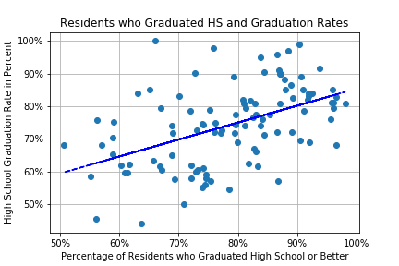
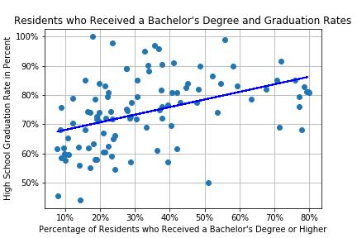
Educational Attainment and Performance
Notes:
Big correlation between HS graduation of parents and kids.
Parents graduated HS or better is subset of Bachelor’s Degree or better.
Using only HS graduation for attainment did not work well. No idea if correlation was because of part of population that had less education or more.

Slide 12
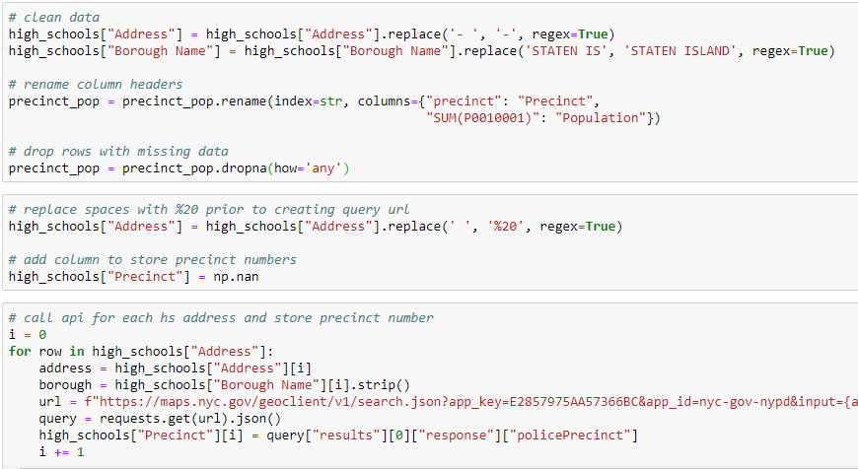
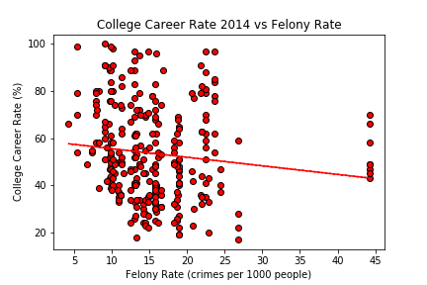
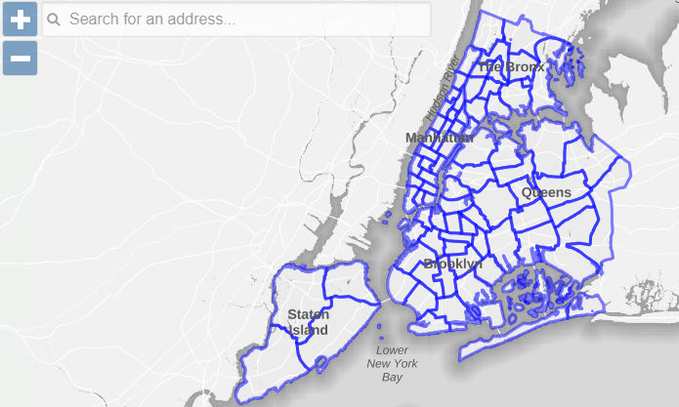
Overall Crime and Performance

Slide 13
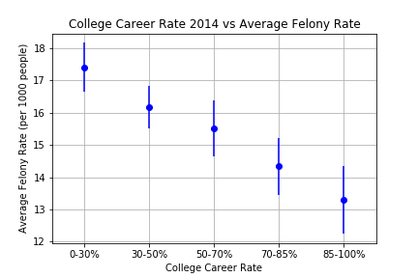
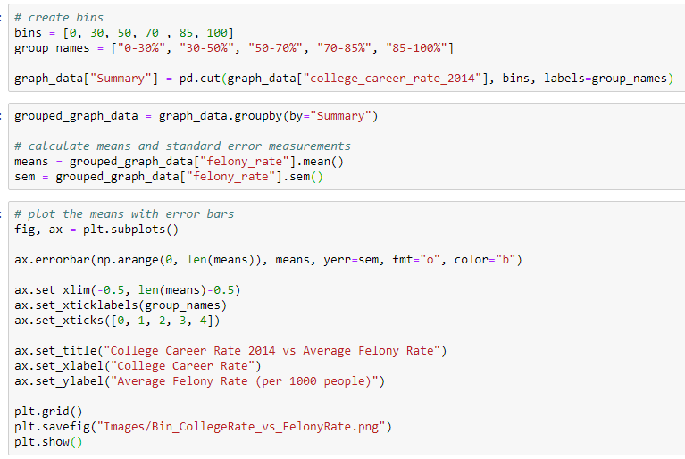
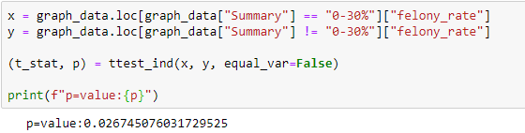
Overall Crime and Performance
Group | P-Value
0-30% | 0.022
30-50% | 0.365
50-70% | 0.913
70-85% | 0.152
85-100% | 0.036

Slide 14
Final Conclusions and lessons learned
Felony Rates & Performance
School Safety & Performance
Educational attainment & performance
Understand the connections between your data
The results are not always what you expect

