Slide 1
Database Management System
Case Study Of Library Management System In Relational Database

Slide 2
LIBRARY MANAGEMENT SYSTEM
TITLE :
Guide : Mrs. Aditi Moudgil
Student’s Names and Roll numbers :
Ridham Gupta 2010990584
Priyanshu Garg 2010990553
Ratnakar Dhruv Vats 2010990579
Ritesh Kumar 2010990597
Shivansh Dhingra 2010990669
Suraj Sankhyan 2010990711

Slide 3
Contents
Acknowledgments
Chapter 1 : Introduction
Chapter 2 : Name of Case study
2.1…..Case Study Informal Description
2.2….Termenologies and Symbols of ER diagram
2.3….Case study LOGICAL MODEL (ER Diagram)
2.4….Case study Physical Schema
2.5….Case Study Interactive Queries
Chapter 3 : Conclusion
Bibliography

Slide 4
Abstract
Library Management System is a system which maintains the information about the books present in the library, their authors, the members of library to whom books are issued, library staff and all. This is very difficult to organize manually. Maintenance of all this information manually is a very complex task. Owing to the advancement of technology, organization of a Library becomes much simple. The Library Management has been designed to computerize and automate the operations performed over the information about the members, book issues and returns and all other operations. This computerization of library helps in many instances of its maintenances. It reduces the workload of management as most of the manual work done is reduced .

Slide 5
Acknowledgments
I would like to express my gratitude to all of those who made it possible to complete this thesis, in particular to my supervisors Ma’am Aditi Moudgil, my Teammates. I would also like to thank my family for their understanding and continuous support .

Slide 6
Introduction
Database Management Systems
The Database Library System is intended to Automate the library activities such as creating a new borrower, giving books to the borrowers, maintaining the details of all the item that were available in the books. This also helps the librarians by providing information such as total copies available each book, list of books that belong to a particular category (Short, Long Loan, Reference items, etc.).

Slide 7
Introduction
Relational Database Management Systems
The back-end relational database management systems (RDBMS) are effective in organizing the data in standard formats avoiding data redundancy and thereby facilitating to share the same as per standard protocols.

Slide 8
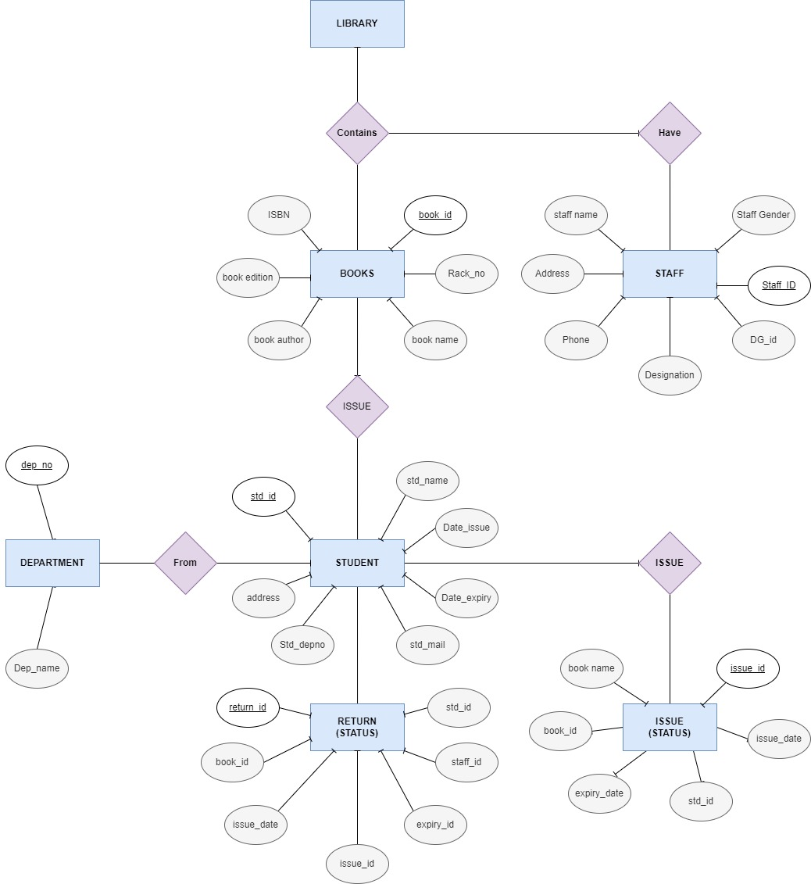
ER
Diagram

Slide 9
Brief introduction of case study
As You Know that a Library is collection of books in any institute. Librarian responsibility is to manage all the records of books issued and also returned Manually. All the Transaction (books issues & books returned) are manually recorded(registers.) Students search books by racks it so time consuming and there is no arrangement. Also threat of losing record.
Objectives of case study
To eliminate the paper –work in library
to record every transaction in computerized system so that problem such as record file missing won’t happen again
Improvement in control and performance
Save time
Save Cost

Slide 10
Library Management System
Informal Description
Library information system project provide facility of storing and maintaining details of members, books, publisher database and book issue – receive work. User operations in this project are kept very simple. Any new user can handle records with very little or no training.

Slide 11
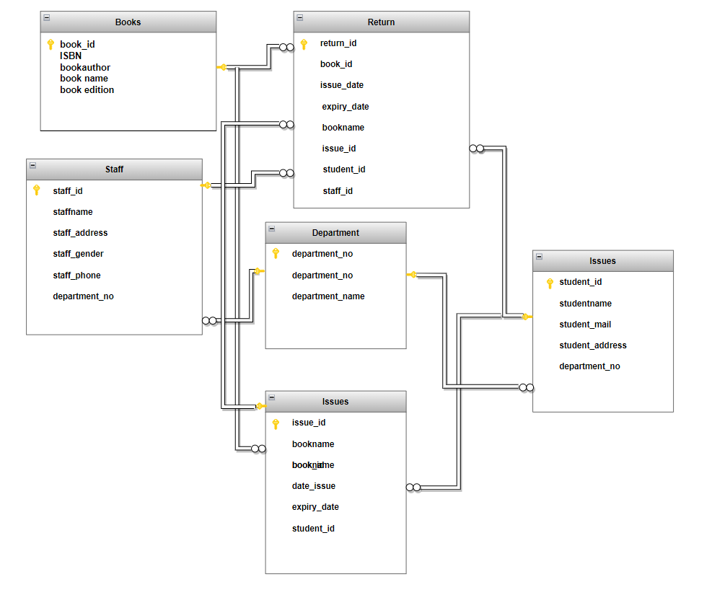
(Return)
Logical
Model

Slide 12
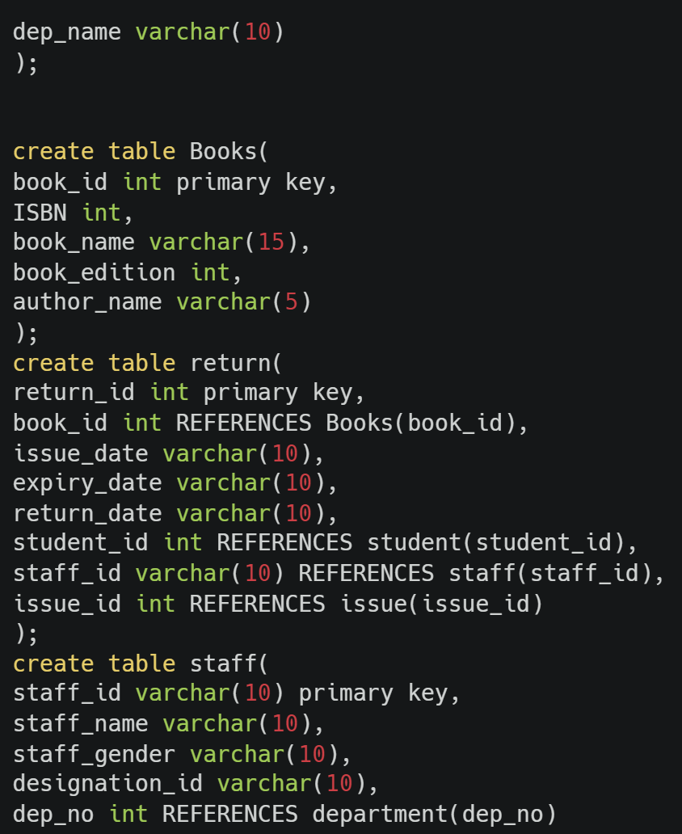
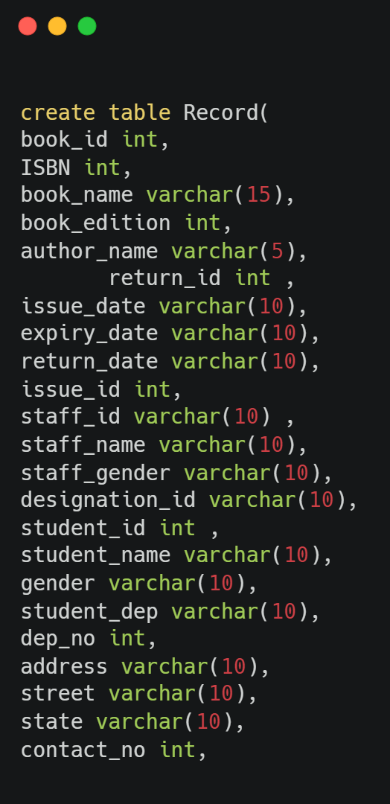
Physical Model
2
1

Slide 13
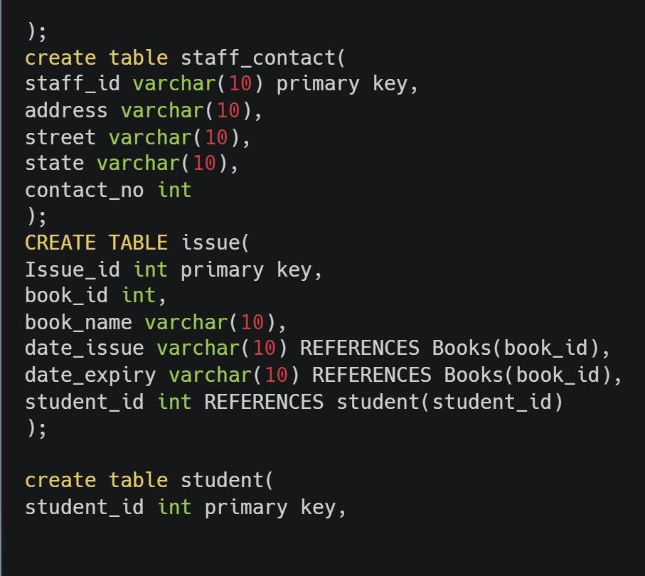
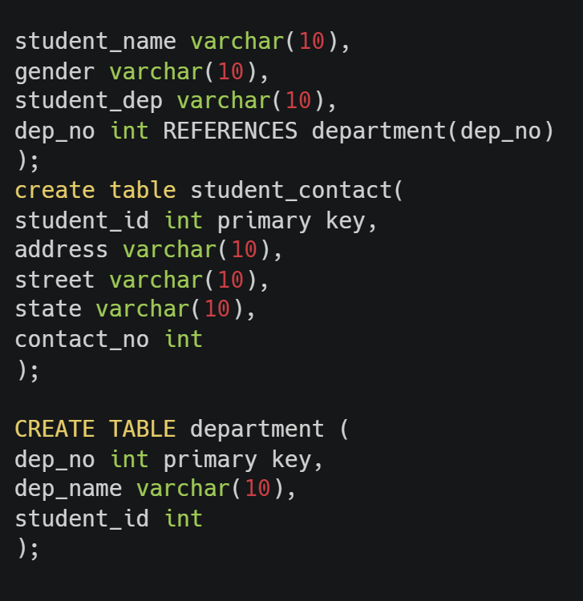
Physical Model
3
4

Slide 14
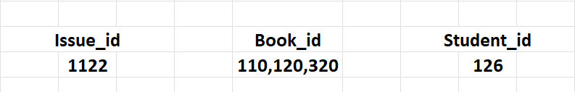
Normalization of Table
In the ISSUE Table there is repeating book_id. A student has
issued 3 books.

Slide 15
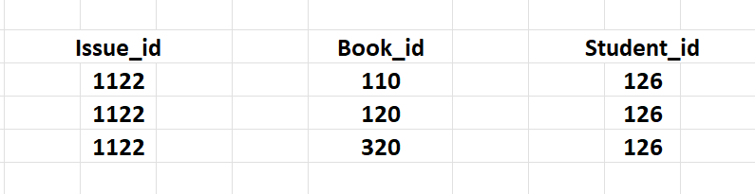
Normalization of Table
After Normalization :

Slide 16
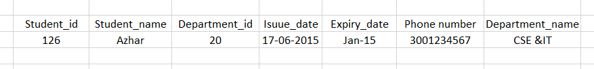
Normalization of Table
Second Normalized Form
In the following Student relation, all attributes are dependent on
the primary key Student_id.

Slide 17
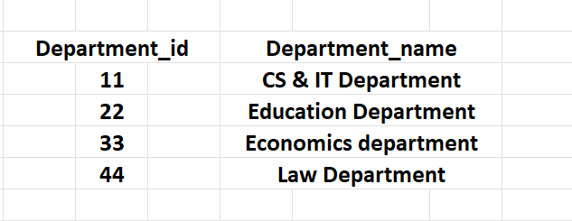
Normalization of Table
We can create two other relations from Student Table one is
Department fields are fully dependent on the primary keys
Department_id.

Slide 18
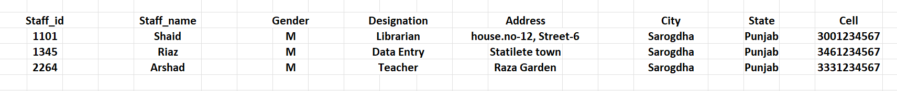
Normalization of Table
Before Third Normal Form :

Slide 19

Normalization of Table
After Third Normal Form,
Staff Table :
Staff Contact :

Slide 20
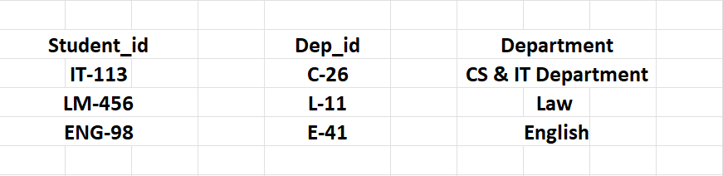
Normalization of Table
Student Table before Third Normal Form :
After Third Normal form :

Slide 21
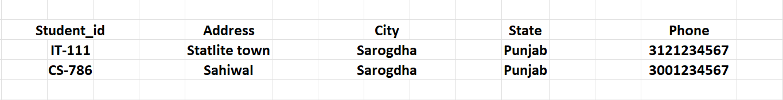
Normalization of Table
Student Contact Table:
Student Table :
*Normalization End*

Slide 22
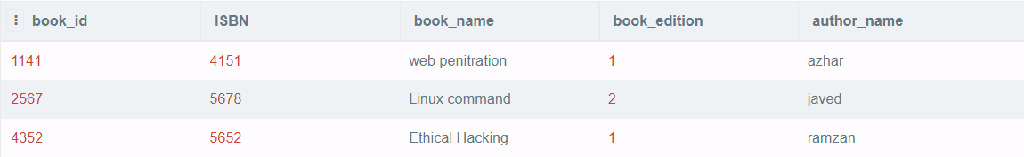
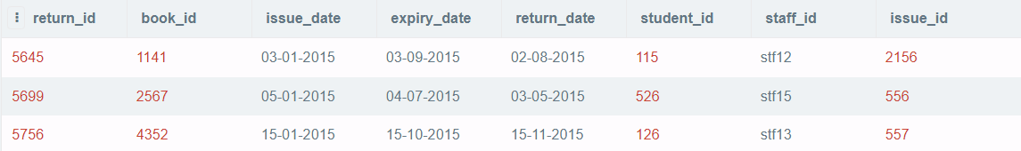
Interactive Queries :
Q1 Select * from Books;
Q2 Select * from return;

Slide 23
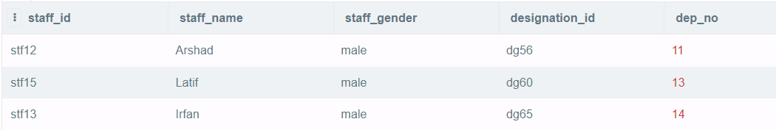
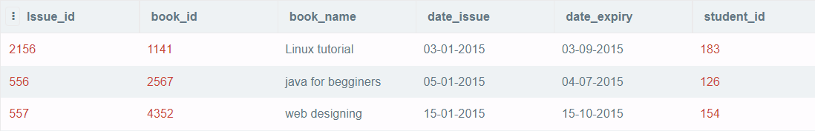
Interactive Queries :
Q3 Select * from staff;
Q4 Select * from issue;

Slide 24
Interactive Queries :
Q5 Select * from staff_contact;
Q6 Select * from student;
Q7 Select * from student_contact;
Q8 Select * from department;
Q9 UPDATE student SET student_name = 'Manish' WHERE student_id = 183;

Slide 25

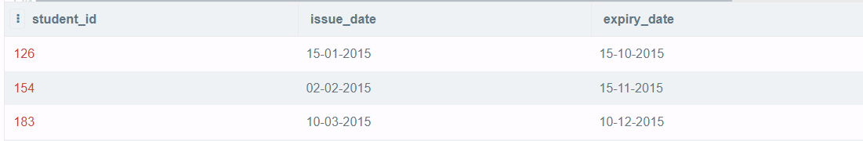
Interactive Queries :
Q10 Select book_id,book_name,book_edition from Books where author_name='javed';
Q11 Select student_id, issue_date,expiry_date from return where return_date>expiry_date;

Slide 26
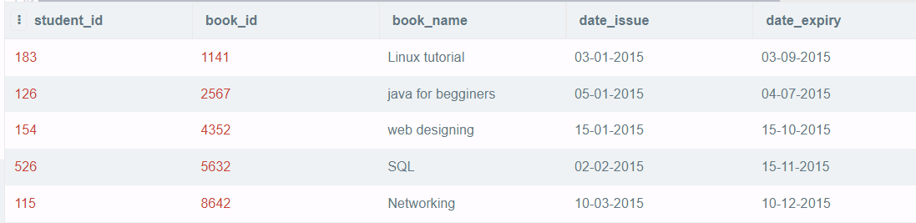
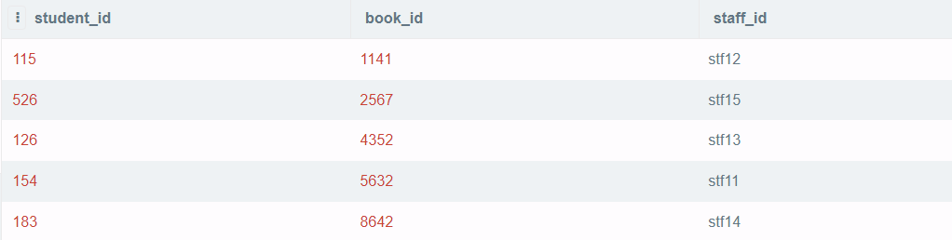
Interactive Queries :
Q12
Select student.student_id,issue.book_id,issue.book_name,issue.date_issue,issue.date_expiry from issue INNER join student on issue.student_id=student.student_id;
Q13 SELECT return.student_id,return.book_id,return.staff_id FROM return INNER JOIN staff WHERE return.staff_id=staff.staff_id;

Slide 27
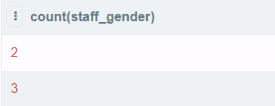
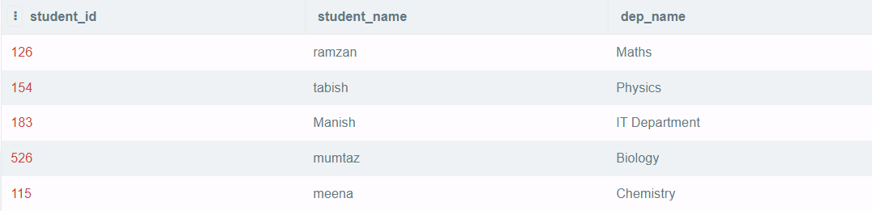
Interactive Queries :
Q14 Select count(staff_gender) from staff group by staff_gender;
Q15 Select student.student_id,student.student_name,department.dep_name from student inner join department on department.dep_no=student.dep_no

Slide 28
Conclusion and Future Work
After we have completed the project, we are sure the problems in the existing system would overcome. The “LIBRARY MANAGEMENT SYSTEM” process made computerized to reduce human errors and to increase the efficiency. The main focus of this project is to lessen human efforts. The maintenance of the records is made efficient, as all the records are stored in the ACCESS database, through which data can be retrieved easily. The navigation control is provided in all the forms to navigate through the large number of records. If the numbers of records are very large then user has to just type in the search string and user gets the results immediately. The editing is also made simpler. The user has to just type in the required field and press the update button to update the desired field.
The Books and Students are given a particular unique id no. So that they can be accessed correctly and without errors. Our main aim of the project is to get the correct information about a particular student and books available in the library.

Slide 29
Bibliography
Geeks for Geeks (https://www.geeksforgeeks.org/)
W3 schools (https://www.w3schools.com/)
Tutorials point (https://www.tutorialspoint.com)

Slide 30
Thank You!

