Slide 1

Subject Name: Fundamentals of Machine Learning
Module 1: Introduction to Machine Learning
Faculty Name : Dr. Prakash Andugula

Slide 2
Module 1: Introduction to Machine Learning
Lecture No: 2 & 3
Supervised learning & Unsupervised learning

Slide 3
Machine Learning
Machine learning was defined in 1959 by Arthur Samuel as the "field of study that gives computers the ability to learn without being explicitly programmed." This means imbibing knowledge to machines without hard-coding it.
A branch of artificial intelligence, concerned with the design and development of algorithms that allow computers to evolve behaviors based on empirical data.
Machine learning is about predicting the future based on the past

Slide 4
Machine Learning
Tom Mitchell “A computer program is said to learn from experience E with respect to some task T and some performance measure P, if its performance on T, as measured by P, improves with experience E.”
“Optimizing a performance criterion using example data and past experience”, said by E. Alpaydin, gives an easy but faithful description about machine learning.
Peter Harrington, “turning data into information.”
…develop methods that can automatically detect patterns in data, and then to use the uncovered patterns to predict future data or other outcomes of interest. -- Kevin P. Murphy

Slide 5
Machine Learning - Terminology
Expert system
Features or Attributes
Instance
Classification
Training set
Training examples
Target variable
Classes (target variables)
Test set
Knowledge representation
Coefficients / Parameters / Tuning Parameters

Slide 6
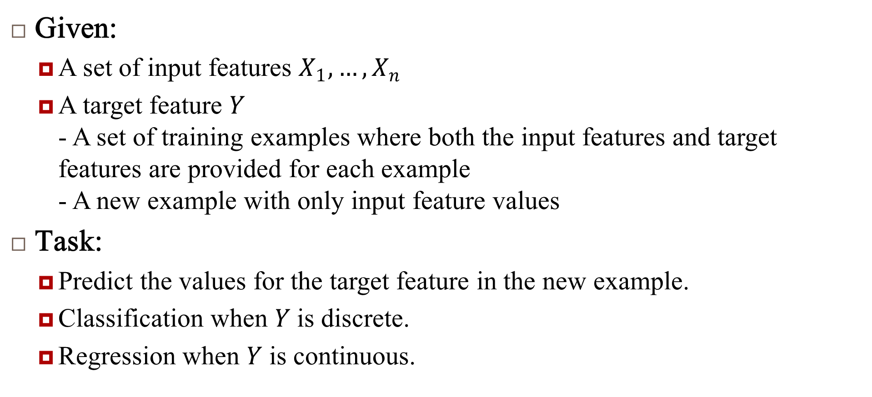
Machine Learning
Given:
A set of input features $X_{1},…,X_{n}$
A target feature $Y$ - A set of training examples where both the input features and target features are provided for each example - A new example with only input feature values
Task:
Predict the values for the target feature in the new example.
Classification when $Y$ is discrete.
Regression when $Y$ is continuous.

Slide 7
Supervised Learning
Learning from labelled data where the model is trained on input-output pairs.
Examples
Classification: Email spam detection.
Regression: Predicting house prices.

Slide 8
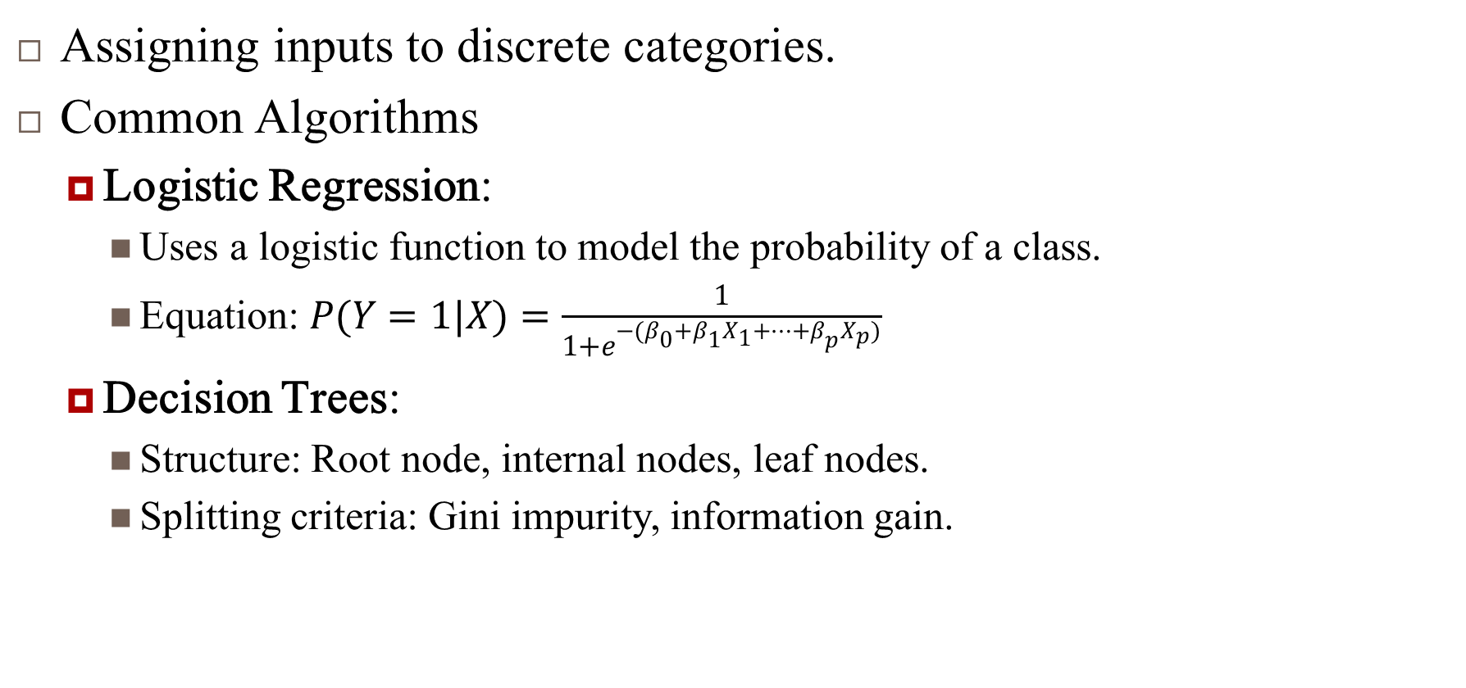
Classification
Assigning inputs to discrete categories.
Common Algorithms
Logistic Regression:
Uses a logistic function to model the probability of a class.
Equation: $P(Y=1|X)=\frac{1}{1+e^{−(β_{0}+β_{1}X_{1}+⋯+β_{p}X_{p})}}$
Decision Trees:
Structure: Root node, internal nodes, leaf nodes.
Splitting criteria: Gini impurity, information gain.

Slide 9
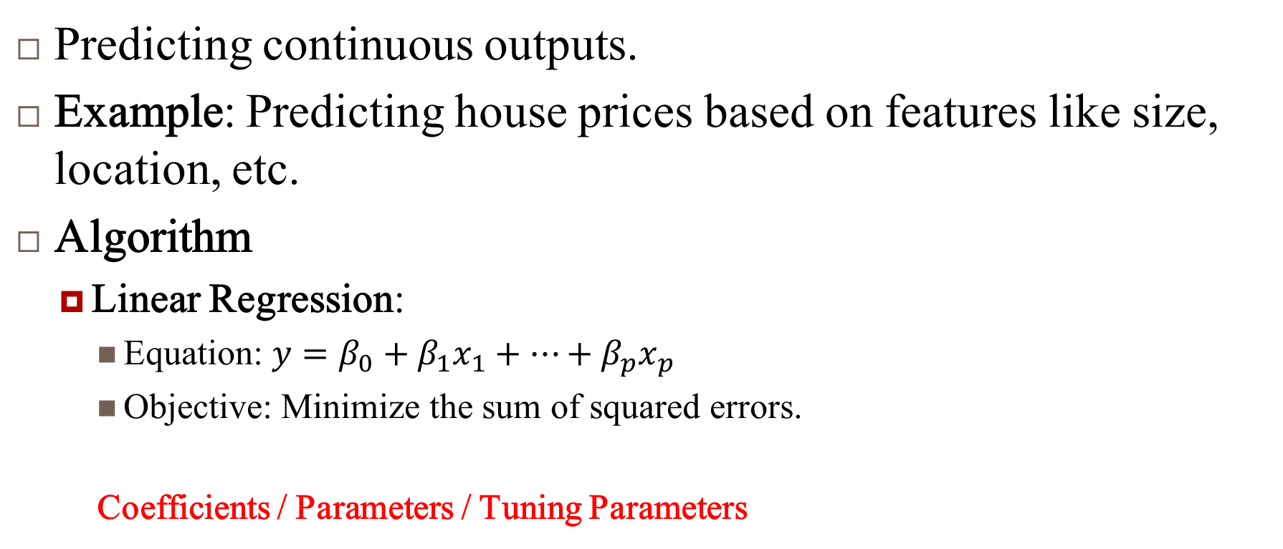
Regression
Predicting continuous outputs.
Example: Predicting house prices based on features like size, location, etc.
Algorithm
Linear Regression:
Equation: $y=β_{0}+β_{1}x_{1}+⋯+β_{p}x_{p}$
Objective: Minimize the sum of squared errors.
Coefficients / Parameters / Tuning Parameters

Slide 10
Support Vector Machines (SVM)
A powerful classifier that finds the optimal hyperplane separating different classes.
Key Concepts:
Margin: The distance between the hyperplane and the closest data points from each class.
Kernel Trick: Allows SVM to operate in high-dimensional space without explicit transformation.

Slide 11
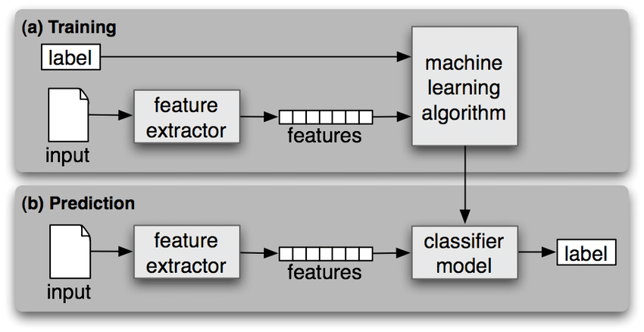
Supervised learning steps
Islam, Md & Poudyal, Subash & Gupta, Kishor Datta. (2019). Map Reduce Implementation for Malicious Websites Classification. International Journal of Network Security & Its Applications. 11. 10.5121/ijnsa.2019.11503.

Slide 12
Unsupervised Learning
Learning from unlabeled data where the model tries to find patterns and relationships.
Examples:
Clustering: Customer segmentation.
Dimensionality Reduction: Reducing the number of features while preserving information.

Slide 13
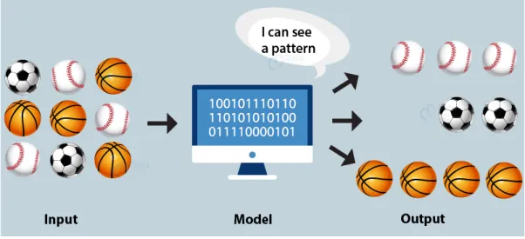
Unsupervised Learning (1)
https://miro.medium.com/v2/resize:fit:640/format:webp/1*IW4VPYveyXyFvRD3FyBxEw.png

Slide 14
Unsupervised Learning (2)
Learning useful structure without labeled classes, optimization criterion, feedback signal, or any other information beyond the raw data.
To explore the data to find some intrinsic structures in them
The data have no target attribute.
There is no supervisor and only input data
Task of inferring a function to describe hidden structure from "unlabelled" data

Slide 15
Clustering
Grouping data points into clusters based on similarity.
Examples:
K-Means Clustering:
Steps: Initialization, Assignment, Update, Repeat.
Objective: Minimize within-cluster sum of squares.
Hierarchical Clustering:
Types: Agglomerative (bottom-up) and Divisive (top-down).
Representation: Dendrogram.

Slide 16
Dimensionality Reduction
Principal Component Analysis (PCA):
Purpose: Reduce the number of features while preserving variance.
Steps: Standardize data, compute covariance matrix, find eigenvalues and eigenvectors, select top components.

Slide 17
Reinforcement Learning (RL)
Reinforcement Learning (RL) is a type of machine learning where an agent learns to make decisions by performing actions in an environment to maximize cumulative reward.
Unlike supervised learning, where the model is trained with labeled data, RL relies on the agent learning from the consequences of its actions through trial and error.

Slide 18
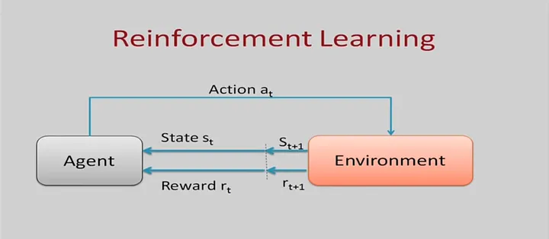
Reinforcement Learning (RL)
A learning paradigm where an agent interacts with an environment to learn a policy that maximizes cumulative reward.
https://miro.medium.com/v2/resize:fit:720/format:webp/1*hdsw8CEHFFte5maSDnPeEg.png

Slide 19
Reinforcement Learning (RL)
A learning paradigm where an agent interacts with an environment to learn a policy that maximizes cumulative reward.
Key Concepts:
Agent: The learner or decision maker.
Environment: Everything the agent interacts with.
State: A representation of the current situation.
Action: Choices the agent can make.
Reward: Feedback from the environment based on the action taken.

Slide 20
Reinforcement Learning (RL)
Given a sequence of examples/states and a reward after completing that sequence, learn to predict the action to take in for an individual example/state
In reinforcement learning (RL) there’s no answer key, but your reinforcement learning agent still has to decide how to act to perform its task. In the absence of existing training data, the agent learns from experience. It collects the training examples (“this action was good, that action was bad”) through trial-and-error as it attempts its task, with the goal of maximizing long-term reward.
Applications:
Game playing, Robot in a maze
Technique: Markov Decision Processes

Slide 21
Issues in Machine Learning
Insufficient Quantity of Training Data: Most Machine Learning Algorithm needs lot of data to work properly. Even for very simple problems need thousand of examples. For complex problems such as image or speech recognition need millions of examples.
Nonrepresentative Training Data: In order to generalize well, it is crucial that your training data be representative of the new cases you want to generalize to. This is true whether you use instance-based learning or model based learning.
Poor Quality Data : If training data is full of errors, outliers and noise, it will make it harder for the system to detect the underlying patterns, so system is less likely to perform well. More Cleaning is required.
Irrelevant Features: System will only be capable of learning if the training data contains enough relevant features and not too many irrelevant ones. System will need Feature Selection and Feature Extraction.

Slide 22
Issues in Machine Learning
Overfitting the Training Data: Performs very well for training data but has poor performance with test data (new data)
Underfitting the data: It is opposite to overfitting. It occurs when model is too simple to learn the underlying structure of the data. Poor performance on the training data and will result in unreliable predictions and leads to poor performance of test data as well

