Slide 1

Subject Name: Project Management
Unit No: 02
Project Initialization
Faculty Name : Dr. Bhawana Garg
1

Slide 2

Index
Lecture 1 – Definition of a project, Necessity of project management
Lecture 2 – Triple constraints, Project life cycles
Lecture3 – Project Phases
2

Slide 3

Unit No: 1
Project Management Fundamentals
Lecture No: 7

Slide 4
Project initiation: The first step to successful project management
Project initiation ensures that you lay a strong foundation for a new project.
It’s the first of five project management phases, when you outline why you’re doing the project and what business value it will deliver.
you can use that information to secure buy-in from key stakeholders.

Slide 5
The term “project initiation” comes from a five-phase model created by the Project Management Institute (PMI).
The model divides a project’s lifecycle into these five stages:
Project initiation: Broadly define your project and secure buy-in.
Project planning: Create detailed goals and a project roadmap.
Project execution: Launch your project using information from the first two steps.
Project performance: Measure effectiveness using key performance indicators (KPIs).
Project closure: Debrief with stakeholders.

Slide 6
Why does the project initiation phase matter?
Starting a new project is exciting, but it’s important to make sure your initiative will actually add value before jumping into the planning phase.
That’s where project initiation comes in—it offers a structured approach to demonstrate your project’s business case and prove that the work you’ll do is feasible.
Project initiation also ensures that you loop in stakeholders early on, so you can secure essential resources, gain visibility for your project, and prevent costly roadblocks down the road.

Slide 7
The project initiation process: 4 steps to get started
Create a project charter or business case
Identify key stakeholders and pitch your project
Run a feasibility study
Assemble your team and tools

Slide 8
Create a project charter or business case
In this first step, you demonstrate why your project is necessary and what benefit it will bring.
You can do this with either a project charter or a business case. These two documents follow the same fundamental idea, since they’re both used to outline key project details and pitch your initiative to stakeholders.
The main difference between them is scope—you can use a project charter for smaller initiatives, and a business case for larger projects that require significant resources. For example, you might create a project charter for a redesign of your company homepage, and a business case for a company-wide rebrand.

Slide 9
Project charter
A project charter demonstrates why your project is important, what it will entail, and who will work on it—all through the following elements:
Why: The project’s goals and purpose
What: The scope of the project, including an outline of your project budget
Who: Key stakeholders, project sponsors, and project team members

Slide 10
Business case
A business case includes all the components of a project charter, along with these additional elements:
A comprehensive financial analysis, including an estimate of the return on investment (ROI) your project will bring
An analysis of project risks and a risk management plan
An action plan that includes how decisions will be made (such as a RACI chart), a communication plan, and next steps you’ll take if your business case is approvedhttps://asana.com/templates/project-initiation

Slide 11
Identify key stakeholders and pitch your project
Determine who needs to sign off on your project charter or business case. This includes key stakeholders who have a say in the outcome of your project
for example, executive leaders, project sponsors, or cross-functional teams that you’re requesting budget or resources from.
If you’re not sure who your key stakeholders are, ask yourself the following questions:
Who needs to approve my project?
Who will provide resources for my project?
Who can influence my project?

Slide 12
Unit No: 2
Lecture No: 8

Slide 13
PROJECT SELECTION CRITERIA AND MODELS
Project selection is the process of evaluating proposed projects or groups of projects, and then choosing to implement some set of them so that the objectives of the parent organization will be achieved.
Examples
a manufacturing firm can use evaluation/selection techniques to choose which machine to adopt in a part-fabrication process;
a TV station can select which of several syndicated comedy shows to rerun in its 7:30 p.m. weekday time-slot;
a construction firm can select the best subset of a large group of potential projects on which to bid;
a hospital can find the best mix of psychiatric, orthopedic, obstetric, and other beds for a new wing.

Slide 14
Project selection is only one of many decisions associated with project management. To deal with all of these problems, we use models. We need such models because they abstract the relevant issues about a problem from the mass of detail in which the problem is embedded

Slide 15
When a firm chooses a project selection model, the following criteria, based on Souder (1973), are most important.
Realism
Capability
Flexibility
Ease of use
Cost
Easy computerization

Slide 16
There are two basic types of project selection models, numeric and nonnumeric.
efore examining specific kinds of models within the two basic types, let us consider just what we wish the model to do for us, never forgetting two critically important, but often overlooked, facts.
Models do not make decisions—people do. The manager, not the model, bears responsibility for the decision. The manager may “delegate” the task of making the decision to a model, but the responsibility cannot be abdicated.
All models, however sophisticated, are only partial representations of the reality they are meant to reflect. Reality is far too complex for us to capture more than a small fraction of it in any model. Therefore, no model can yield an optimal decision except within its own, possibly inadequate, framework.

Slide 17
Nonnumeric Models
The Sacred Cow : In this case the project is suggested by a senior and powerful official in the organization.
The Operating Necessity: the project is required in order to keep the system operating, the primary question becomes: Is the system worth saving at the estimated cost of the project? If the answer is yes, project costs will be examined to make
sure they are kept as low as is consistent with project success, but the project will be funded.
The Competitive Necessity : project is necessary to sustain a competitive position
The Product Line Extension In this case, a project to develop and distribute new products would be judged on the degree to which it fits the firm’s existing product line, fills a gap, strengthens a weak link, or extends the line in a new, desirable direction. Sometimes careful calculations of profitability are not required. Decision makers can act on their beliefs about what will be the likely impact on the total system performance if the new product is added to the line.

Slide 18
Comparative Benefit Model For this situation, assume that an organization has many projects to consider.
The concept of comparative benefits, if not a formal model, is widely adopted for selec- tion decisions on all sorts of projects. Most United Way organizations use the concept to make decisions about which of several social programs to fund. Senior management of the funding organization then examines all projects with positive recommendations and attempts to con- struct a portfolio that best fits the organization’s aims and its budget.

Slide 19
Q-Sort Method
Of the several techniques for ordering projects, the Q-Sort (Helin et al., 1974) is one of the most straightforward. First, the projects are divided into three groups—good, fair, and poor— according to their relative merits.
If any group has more than eight members, it is subdivided into two categories, such as fair-plus and fair-minus.
When all categories have eight or fewer members, the projects within each category are ordered from best to worst.
Again, the order is determined on the basis of relative merit. The rater may use specific criteria to rank each proj- ect, or may simply use general overall judgment.

Slide 20
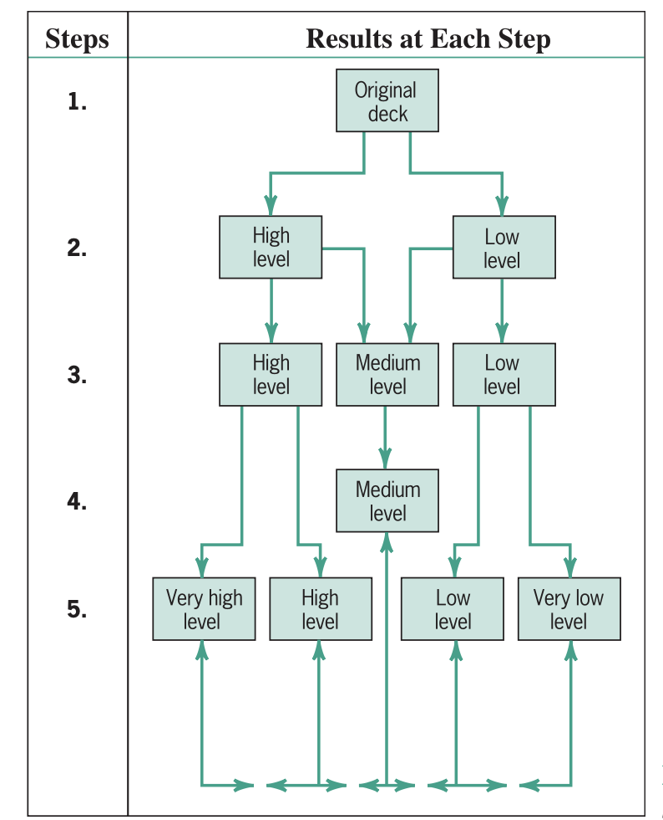

Slide 21
Numeric Models: Profit/Profitability :
A large majority of all firms using project evaluation and selection models use profitability as the sole measure of acceptability.
Payback Period The payback period for a project is the initial fixed investment in the project divided by the estimated annual net cash inflows from the project. The ratio of these quantities is the number of years required for the project to repay its initial fixed investment.
For example, assume a project costs $100,000 to implement and has annual net cash inflows of $25,000. Then Payback period $100,000/$25,000 is 4 years
The method also serves as an (inadequate) proxy for risk. The faster the investment is recovered, the less the risk to which the firm is exposed.

Slide 22
Drawback
The Time Value of Money: This concept means that money today is worth more than the same amount of money in the future because you can invest it and earn interest or returns. For example, $100 today is more valuable than $100 five years from now. If a method ignores this, it treats all money the same, no matter when it’s received.
2. Returns Beyond the Payback Period: The payback period only focuses on how long it takes to recover your initial investment. It doesn’t consider any profits or returns that come after that point. For example, if a project continues to make money for years after the payback period, those extra earnings are ignored.
In simple terms, this method might make a project seem less valuable because it overlooks how money grows over time and doesn’t count the full benefits of the project.

Slide 23
Discounted Cash Flow Method
The Discounted Cash Flow (DCF) Method is a financial technique used to determine the value of an investment, project, or company by estimating the future cash flows it will generate and then discounting those cash flows back to their present value. This method takes into account the time value of money, which recognizes that money today is worth more than the same amount in the future.

Slide 24
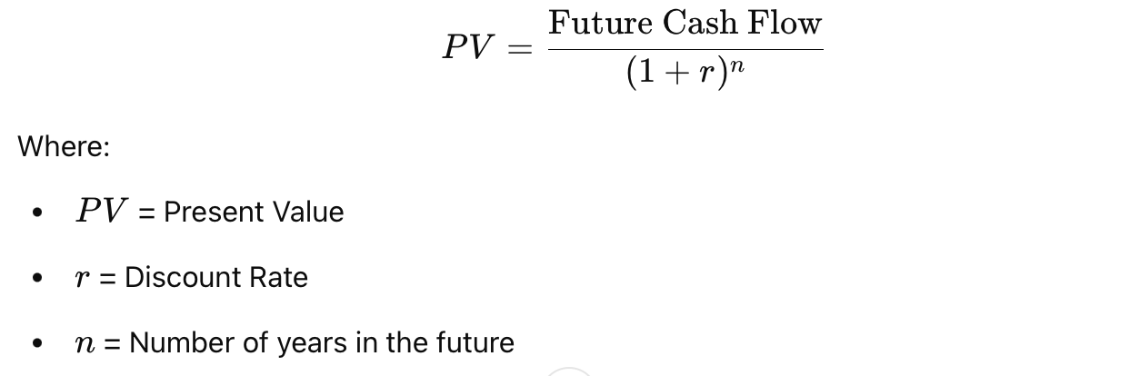
Steps in the DCF Method:
Estimate Future Cash Flows: Predict the cash inflows and outflows the investment or project will generate over a specific time period.
Determine the Discount Rate: Choose an appropriate discount rate (often the weighted average cost of capital or a required rate of return). This reflects the risk and opportunity cost of investing in the project.
Discount Future Cash Flows: Use the discount rate to calculate the present value of each future cash flow using the formula:

Slide 25
5. Sum the Present Values: Add up the discounted cash flows to find the total present value of the investment or project.
6. Subtract Initial Investment: If evaluating a project, subtract the initial investment cost from the total present value to calculate the Net Present Value (NPV).

Slide 26
Advantages:
Accounts for the time value of money.
Provides a detailed evaluation of future cash flows.
Helps in comparing different investments or projects.
Limitations:
Requires accurate estimates of future cash flows and the discount rate.
Sensitive to changes in assumptions, such as cash flow projections or the discount rate.

Slide 27
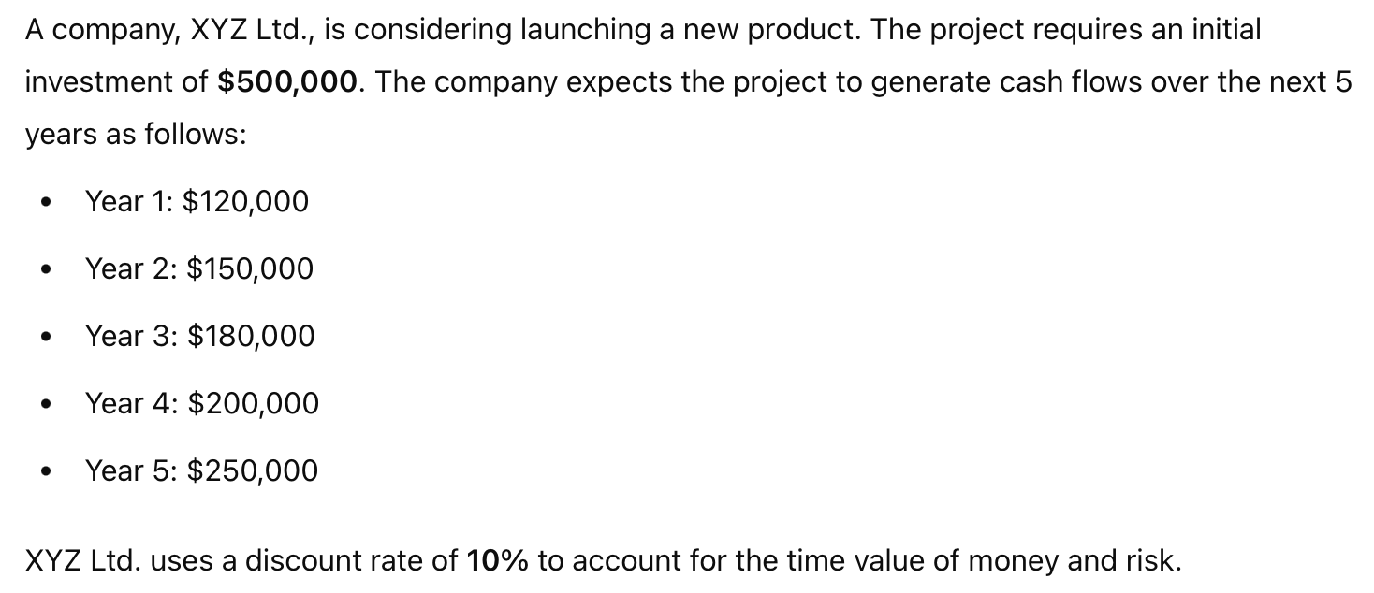
Case Study

Slide 28

Thank You

