Slide 1
Subject Name: Reinforcement Learning
Unit No:1
Unit Name: Introduction to Reinforcement Learning
Faculty Name:
Dr. Chandrakant Gaikwad

Slide 2
Unit :1 Unit Name: Introduction
Lecture No: 02
Reinforcement Learning Overview

Slide 3
Components of Machine Learning
Supervised Learning
Unsupervised Learning
Reinforcement Learning

Slide 4
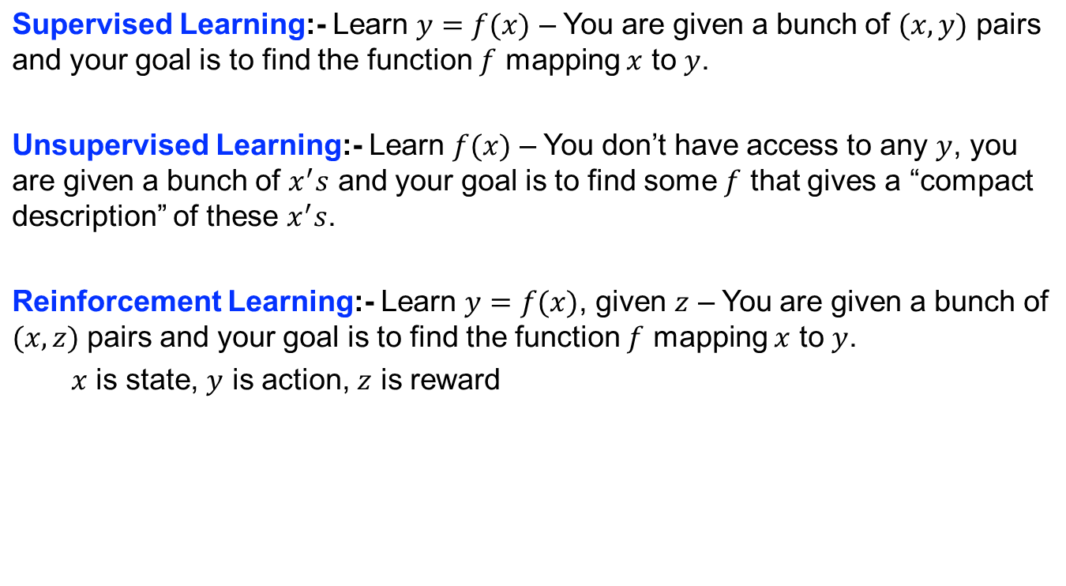
Supervised, Unsupervised and Reinforcement Learning

Slide 5
Supervised, Unsupervised and Reinforcement Learning
Supervised Learning:- Does not involve the problem of temporal credit assignment and exploration.
Unsupervised Learning:- Here, in addition, the correct labels are not available

Slide 6
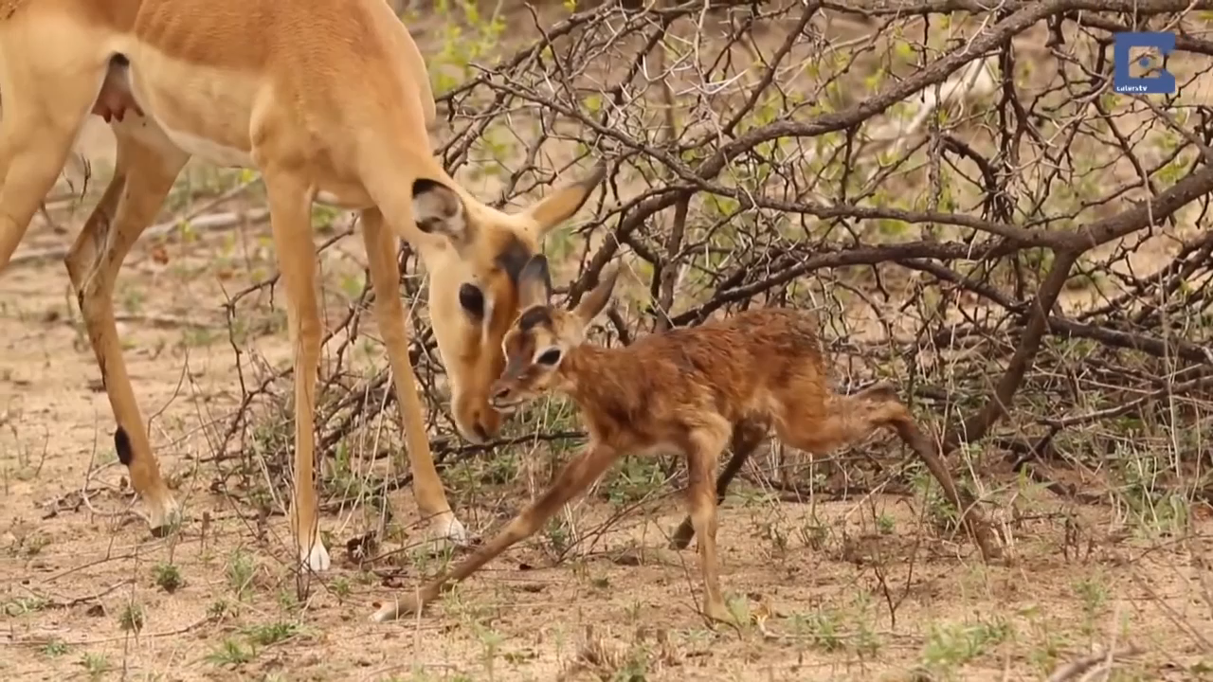
Reinforcement Learning
“Goal-directed learning from interaction in an uncertain environment” – Reinforcement Learning: An Introduction, Sutton and Barto, Second Edition
Video courtesy: Brendan Cole, youtube link

Slide 7
Useful Online Courses:
Reinforcement Learning by David Silver
Deep Reinforcement Learning by Sergey Levine
NPTEL Reinforcement Learning by Balaraman Ravindran

Slide 8
Thank You

