Slide 1
Generalized Linear Models and Exponential Family
Exponential Families
Log Partition Function
Dr. Prakash Andugula
CSE, RAIT
Advanced Machine Learning

Slide 2
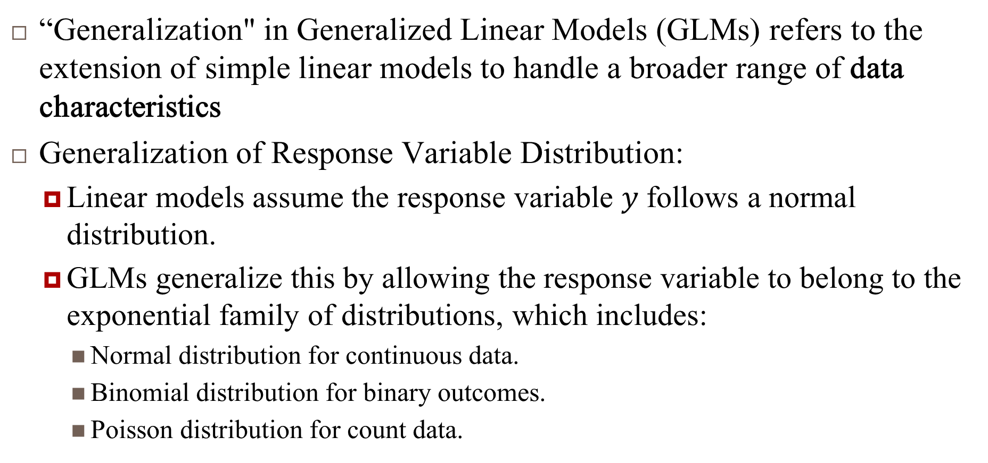
Generalization in GLMs
“Generalization" in Generalized Linear Models (GLMs) refers to the extension of simple linear models to handle a broader range of data characteristics
Generalization of Response Variable Distribution:
Linear models assume the response variable $y$ follows a normal distribution.
GLMs generalize this by allowing the response variable to belong to the exponential family of distributions, which includes:
Normal distribution for continuous data.
Binomial distribution for binary outcomes.
Poisson distribution for count data.

Slide 3
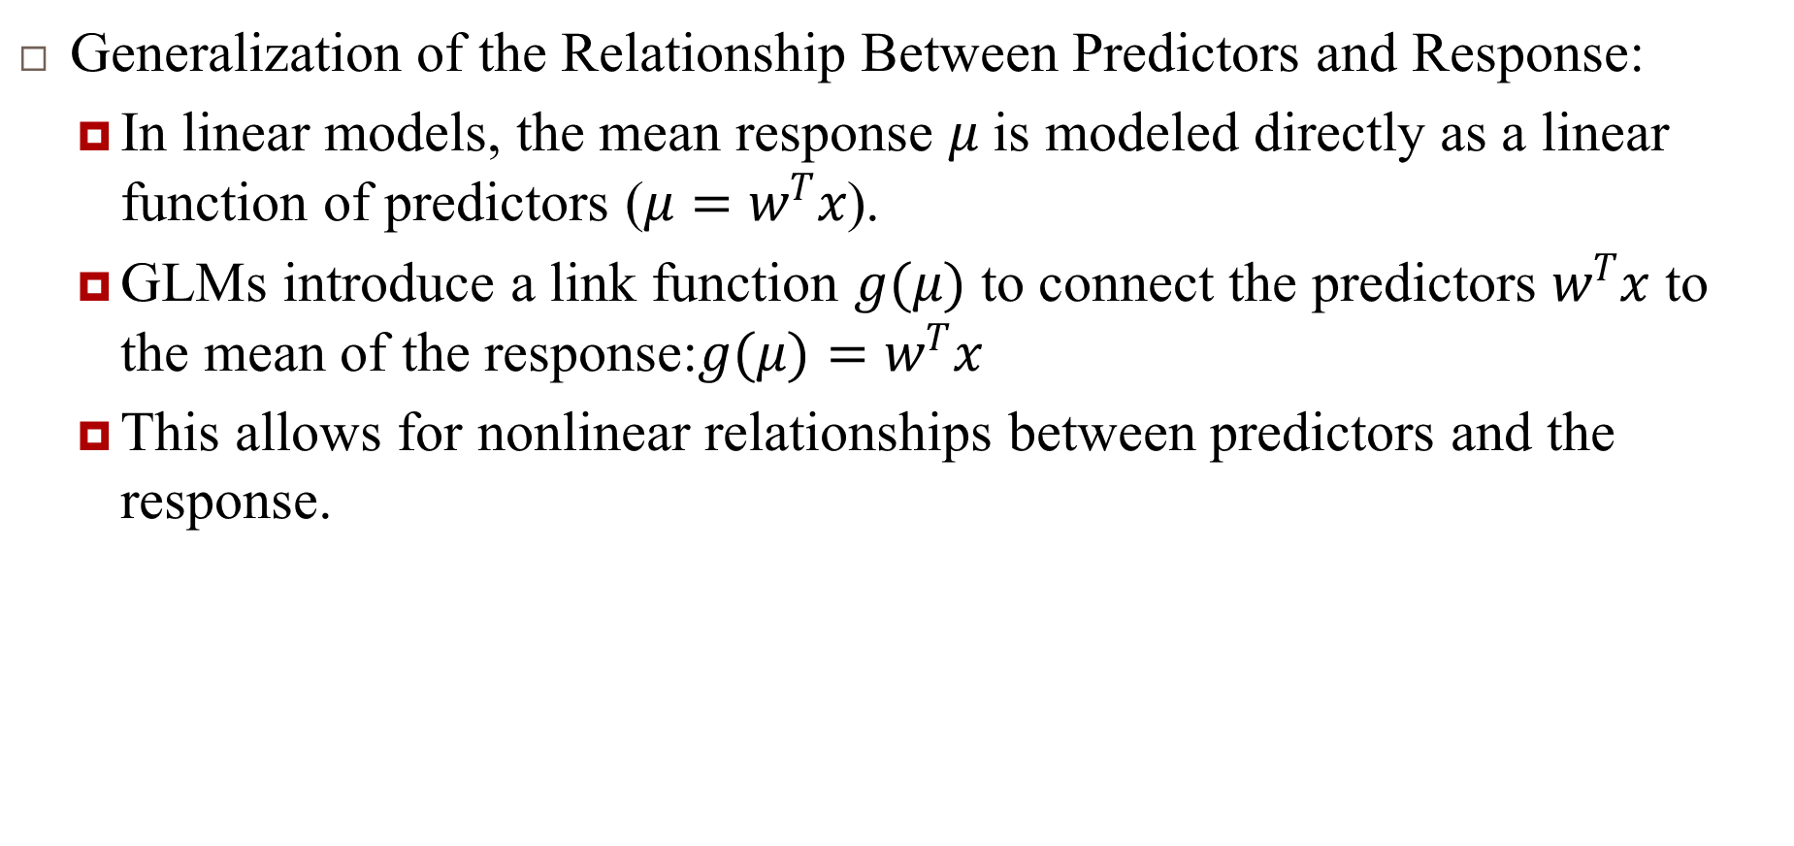
Generalization in GLMs…
Generalization of the Relationship Between Predictors and Response:
In linear models, the mean response $μ$ is modeled directly as a linear function of predictors ($μ=w^{T}x$).
GLMs introduce a link function $g(μ)$ to connect the predictors $w^{T}x$ to the mean of the response:$g(μ)=w^{T}x$
This allows for nonlinear relationships between predictors and the response.

Slide 4
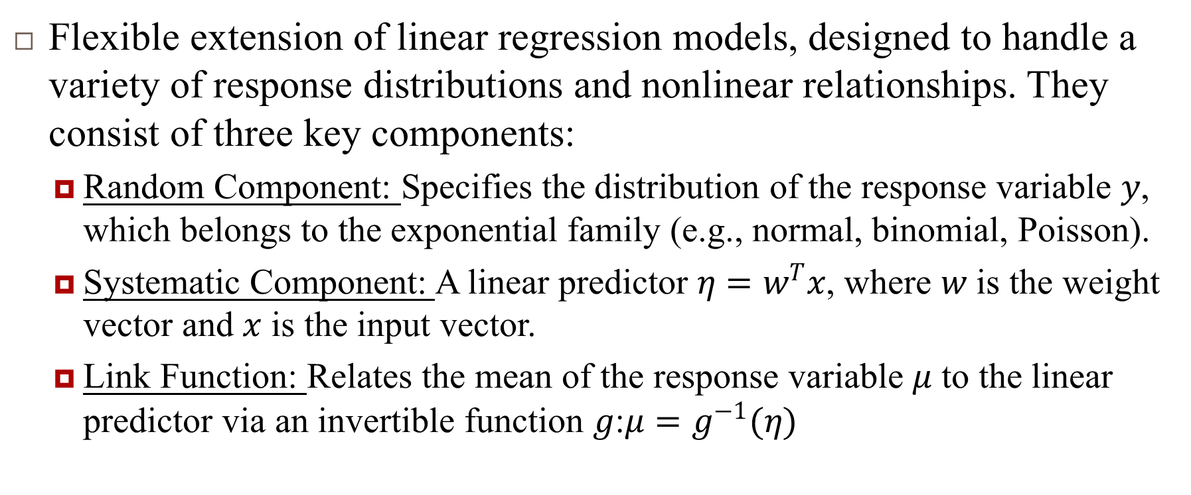
Generalization in GLMs…
Flexible extension of linear regression models, designed to handle a variety of response distributions and nonlinear relationships. They consist of three key components:
Random Component: Specifies the distribution of the response variable $y$, which belongs to the exponential family (e.g., normal, binomial, Poisson).
Systematic Component: A linear predictor $η=w^{T}x$, where $w$ is the weight vector and $x$ is the input vector.
Link Function: Relates the mean of the response variable $μ$ to the linear predictor via an invertible function $g$:$μ=g^{−1}(η)$

Slide 5
Exponential Families

Slide 6
Exponential Families
The exponential family of distributions forms a broad and essential class of probability distributions widely used in statistical modeling and machine learning. These distributions share a canonical form, simplifying inference, parameter estimation, and theoretical analysis. Key benefits include:
Unified Framework: Many common distributions like Gaussian, Bernoulli, and Multinomial can be expressed in this form.
Efficient Estimation: Maximum likelihood estimation (MLE) and Bayesian inference are straightforward for this family.
Sufficient Statistics: They encapsulate all necessary information about the data in compact forms (e.g., mean, variance).
Applications: Regression, Bayesian modeling, and Learning algorithms.

Slide 7
Derivation : Exponential Form and Families

Slide 8
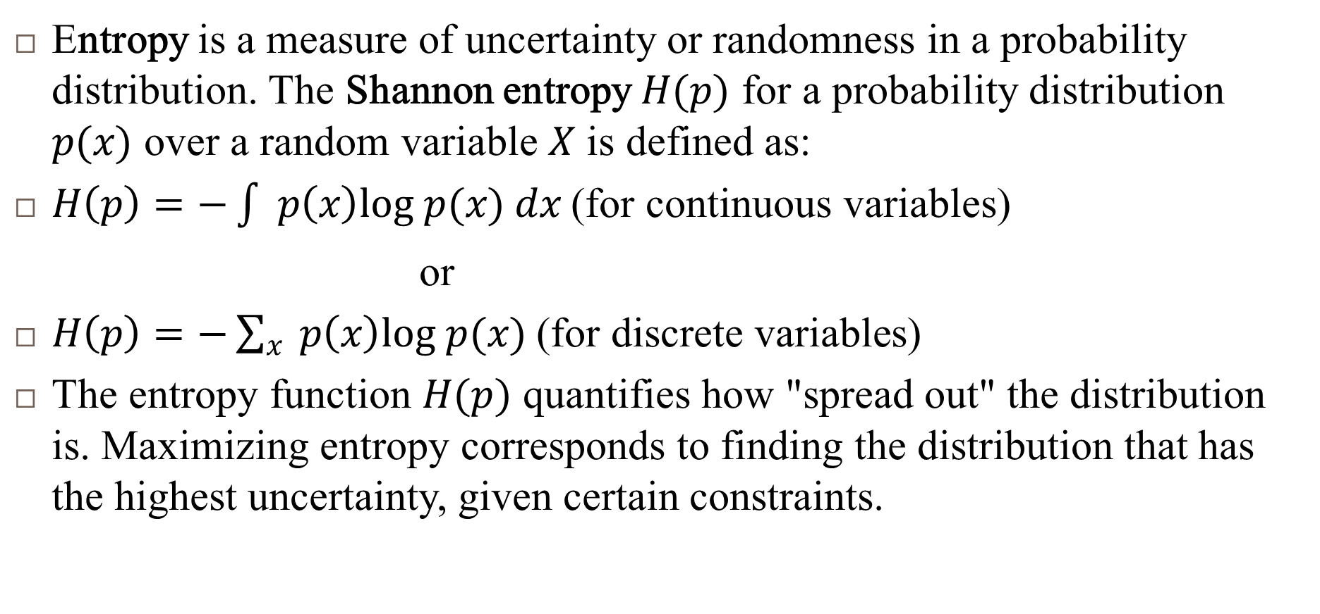
Entropy
Entropy is a measure of uncertainty or randomness in a probability distribution. The Shannon entropy $H(p)$ for a probability distribution $p(x)$ over a random variable $X$ is defined as:
$H\left(p\right)=−\int{ }p\left(x\right)log p(x) dx \text{(}\text{for} \text{continuous} \text{variables}\text{)}$
or
$H\left(p\right)=−\sum_{x}{ }p\left(x\right)log p(x) \text{(}\text{for} \text{discrete} \text{variables}\text{)}$
The entropy function $H(p)$ quantifies how "spread out" the distribution is. Maximizing entropy corresponds to finding the distribution that has the highest uncertainty, given certain constraints.

Slide 9
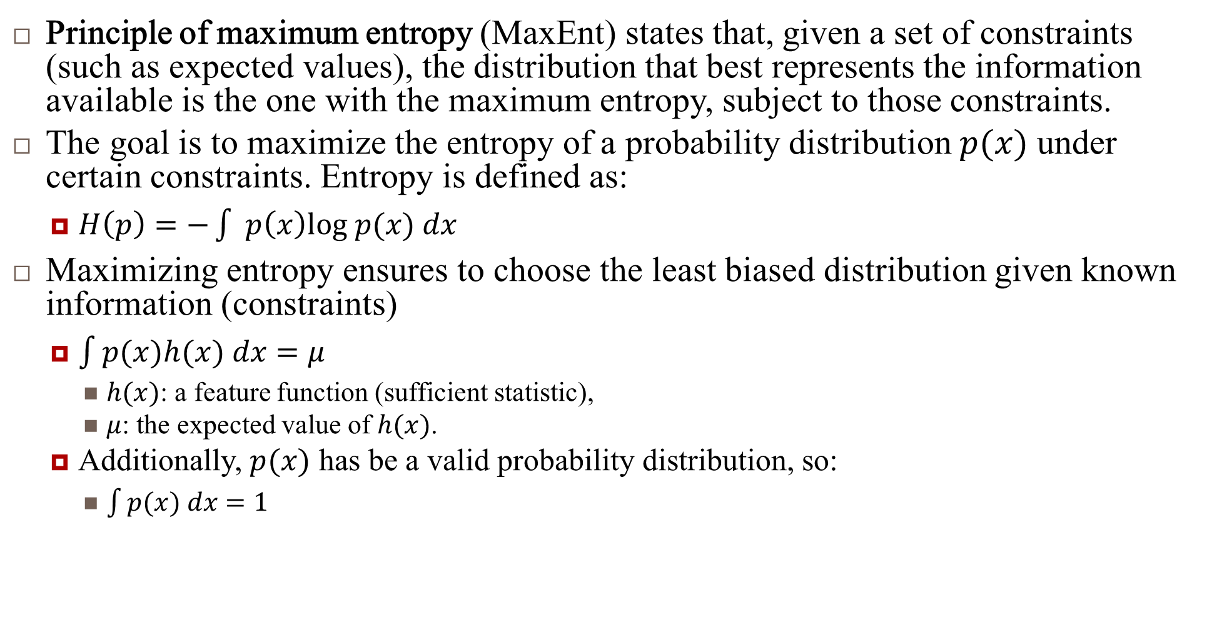
Principle of maximum entropy
Principle of maximum entropy (MaxEnt) states that, given a set of constraints (such as expected values), the distribution that best represents the information available is the one with the maximum entropy, subject to those constraints.
The goal is to maximize the entropy of a probability distribution $p(x)$ under certain constraints. Entropy is defined as:
$H\left(p\right)=−\int{ }p\left(x\right)log p(x) dx$
Maximizing entropy ensures to choose the least biased distribution given known information (constraints)
$\int{p(x)h(x) dx}=μ$
$h(x)$: a feature function (sufficient statistic),
$μ$: the expected value of $h(x)$.
Additionally, $p(x)$ has be a valid probability distribution, so:
$\int{p(x) dx}=1$

Slide 10
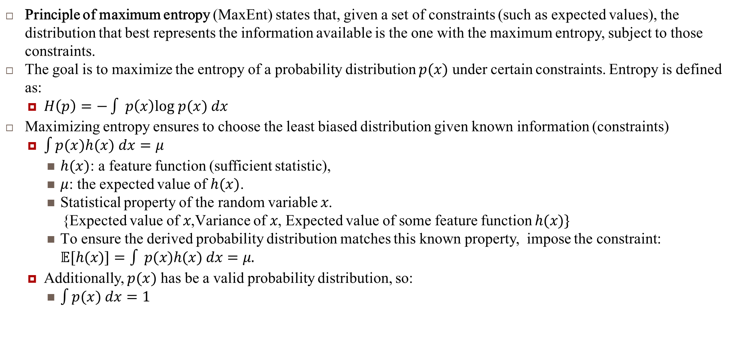
Principle of maximum entropy
Principle of maximum entropy (MaxEnt) states that, given a set of constraints (such as expected values), the distribution that best represents the information available is the one with the maximum entropy, subject to those constraints.
The goal is to maximize the entropy of a probability distribution $p(x)$ under certain constraints. Entropy is defined as:
$H\left(p\right)=−\int{ }p\left(x\right)log p(x) dx$
Maximizing entropy ensures to choose the least biased distribution given known information (constraints)
$\int{p(x)h(x) dx}=μ$
$h(x)$: a feature function (sufficient statistic),
$μ$: the expected value of $h(x)$.
Statistical property of the random variable $x$.
{Expected value of $x$,Variance of $x$, Expected value of some feature function $h(x)\}$
To ensure the derived probability distribution matches this known property, impose the constraint: $𝔼[h(x)]=\int{ }p(x)h(x) dx=μ.$
Additionally, $p(x)$ has be a valid probability distribution, so:
$\int{p(x) dx}=1$

Slide 11
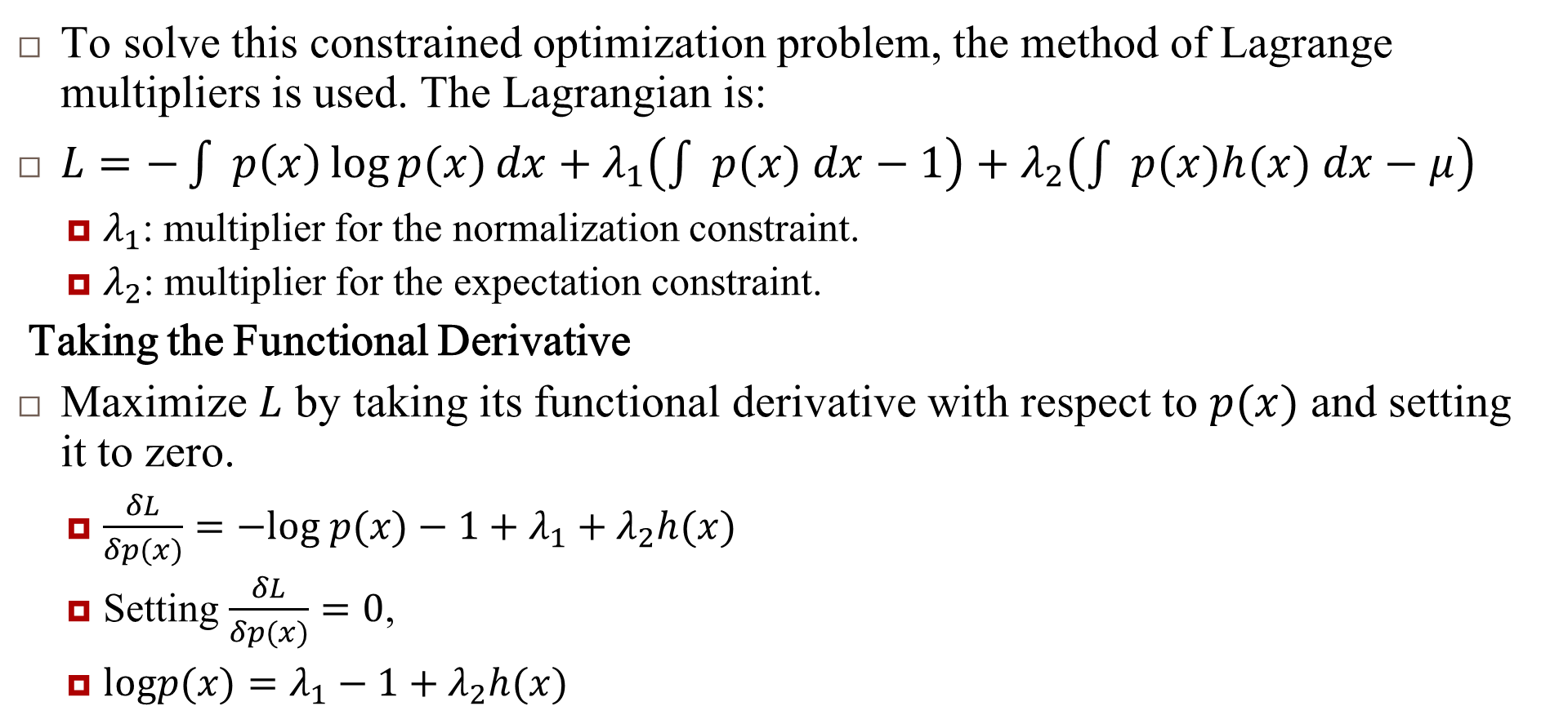
Solve constrained optimization problem
To solve this constrained optimization problem, the method of Lagrange multipliers is used. The Lagrangian is:
$L=−\int{ }p\left(x\right)\log{p(x)}dx+λ_{1}\left(\int{ }p(x) dx−1\right)+λ_{2}\left(\int{ }p(x)h(x) dx−μ\right)$
$λ_{1}$: multiplier for the normalization constraint.
$λ_{2}$: multiplier for the expectation constraint.
Taking the Functional Derivative
Maximize $L$ by taking its functional derivative with respect to $p(x)$ and setting it to zero.
$\frac{δL}{δp(x)}=−log p(x)−1+λ_{1}+λ_{2}h(x)$
Setting $\frac{δL}{δp(x)}=0$,
$logp(x)=λ_{1}−1+λ_{2}h(x)$

Slide 12
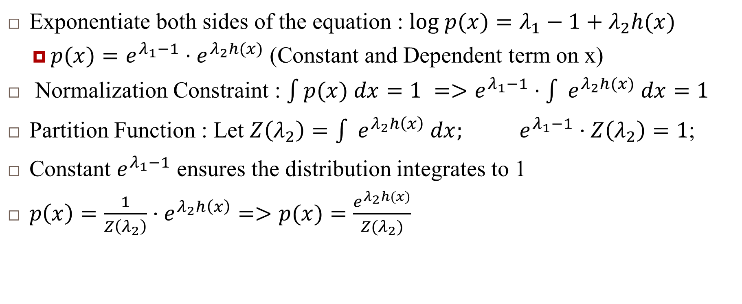
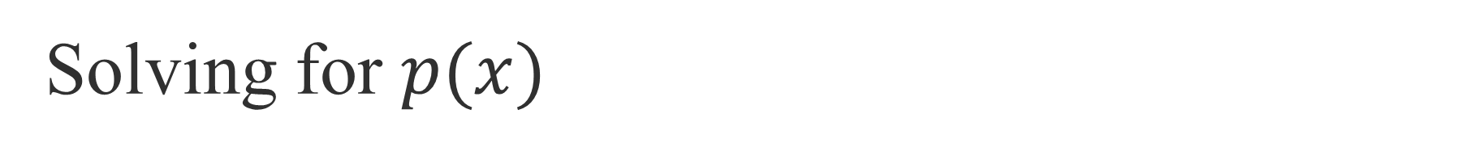
Solving for $p(x)$
Exponentiate both sides of the equation : $log p(x)=λ_{1}−1+λ_{2}h(x)$
$p(x)=e^{λ_{1}−1}⋅e^{λ_{2}h(x)}$ (Constant and Dependent term on x)
Normalization Constraint : $\int{p(x) dx}=1 =>e^{λ_{1}−1}⋅\int{ }e^{λ_{2}h(x)} dx=1$
Partition Function : Let $Z\left(λ_{2}\right)=\int{ }e^{λ_{2}h\left(x\right)} dx;$ $e^{λ_{1}−1}⋅Z\left(λ_{2}\right)=1$;
Constant $e^{λ_{1}−1}$ ensures the distribution integrates to 1
$p\left(x\right)=\frac{1}{Z\left(λ_{2}\right)}⋅e^{λ_{2}h\left(x\right)}=>p(x)=\frac{e^{λ_{2}h(x)}}{Z(λ_{2})}$

Slide 13
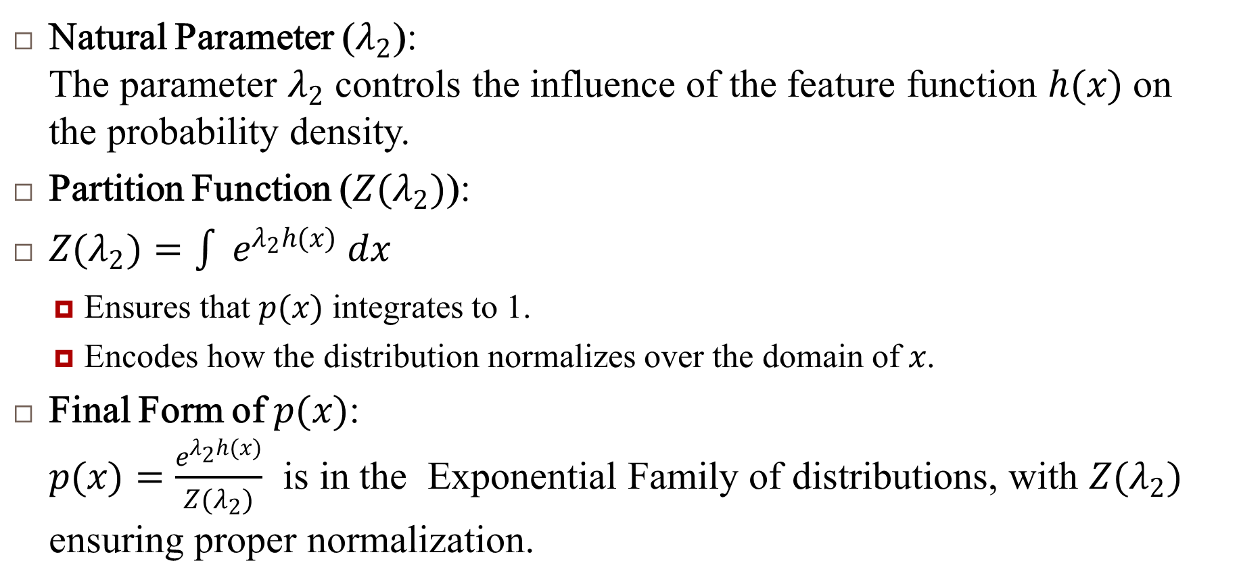
Interpreting
Natural Parameter ($λ_{2}$): The parameter $λ_{2}$ controls the influence of the feature function $h(x)$ on the probability density.
Partition Function ($Z(λ_{2})$):
$Z(λ_{2})=\int{ }e^{λ_{2}h(x)} dx$
Ensures that $p(x)$ integrates to 1.
Encodes how the distribution normalizes over the domain of $x$.
Final Form of $p(x)$: $p(x)=\frac{e^{λ_{2}h(x)}}{Z(λ_{2})}$ is in the Exponential Family of distributions, with $Z(λ_{2})$ ensuring proper normalization.

Slide 14
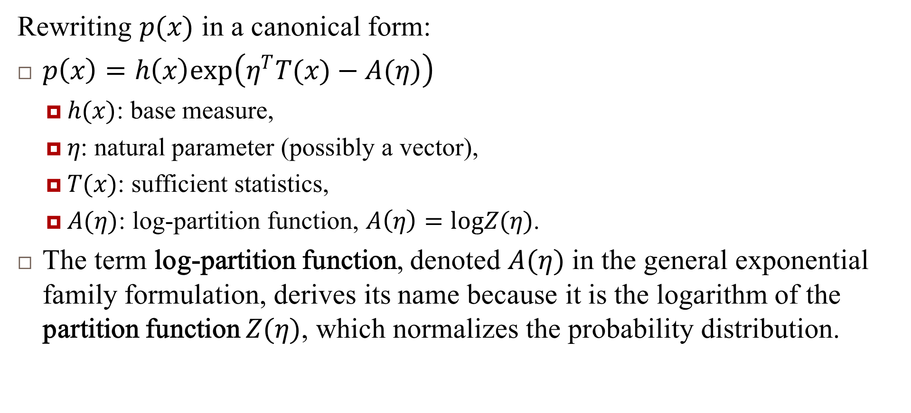
General Form of the Exponential Family
Rewriting $p(x)$ in a canonical form:
$p\left(x\right)=h\left(x\right)exp\left(η^{T}T(x)−A(η)\right)$
$h(x)$: base measure,
$η$: natural parameter (possibly a vector),
$T(x)$: sufficient statistics,
$A(η)$: log-partition function, $A\left(η\right)=logZ(η)$.
The term log-partition function, denoted $A(η)$ in the general exponential family formulation, derives its name because it is the logarithm of the partition function $Z(η)$, which normalizes the probability distribution.

Slide 15
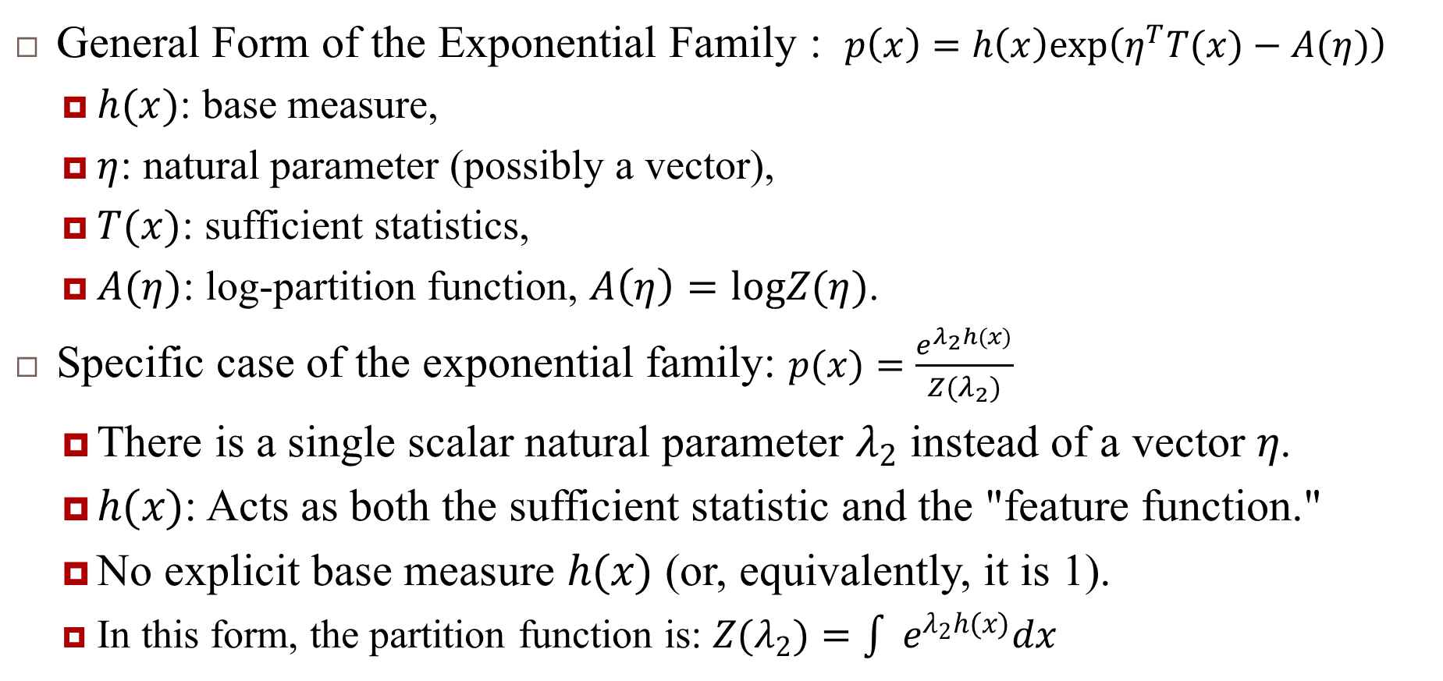
Relation between General Form vs Simplified Exponential Distribution
General Form of the Exponential Family : $p\left(x\right)=h\left(x\right)exp\left(η^{T}T(x)−A(η)\right)$
$h(x)$: base measure,
$η$: natural parameter (possibly a vector),
$T(x)$: sufficient statistics,
$A(η)$: log-partition function, $A\left(η\right)=logZ(η)$.
Specific case of the exponential family: $p(x)=\frac{e^{λ_{2}h(x)}}{Z(λ_{2})}$
There is a single scalar natural parameter $λ_{2}$ instead of a vector $η$.
$h(x)$: Acts as both the sufficient statistic and the "feature function."
No explicit base measure $h(x)$ (or, equivalently, it is 1).
In this form, the partition function is: $Z(λ_{2})=\int{ }e^{λ_{2}h(x)}dx$

Slide 16
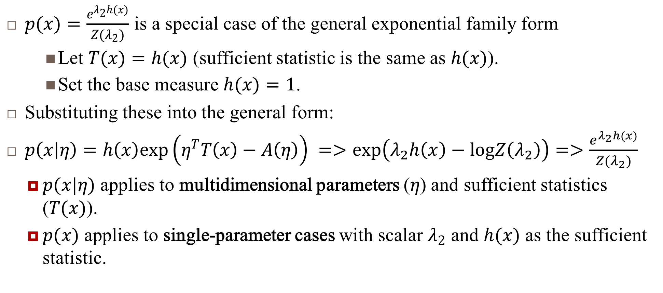
Relation between General Form vs Simplified Exponential Distribution..
$p(x)=\frac{e^{λ_{2}h(x)}}{Z(λ_{2})}$ is a special case of the general exponential family form
Let $T(x)=h(x)$ (sufficient statistic is the same as $h(x)$).
Set the base measure $h(x)=1$.
Substituting these into the general form:
$p\left(x | η\right)=h\left(x\right)exp\left(η^{T}T\left(x\right)−A\left(η\right)\right) =>exp\left(λ_{2}h\left(x\right)−logZ\left(λ_{2}\right)\right)=>\frac{e^{λ_{2}h(x)}}{Z(λ_{2})}$
$p(x|η)$ applies to multidimensional parameters ($η$) and sufficient statistics ($T(x)$).
$p(x)$ applies to single-parameter cases with scalar $λ_{2}$ and $h(x)$ as the sufficient statistic.

Slide 17
Log Partition Function

Slide 18
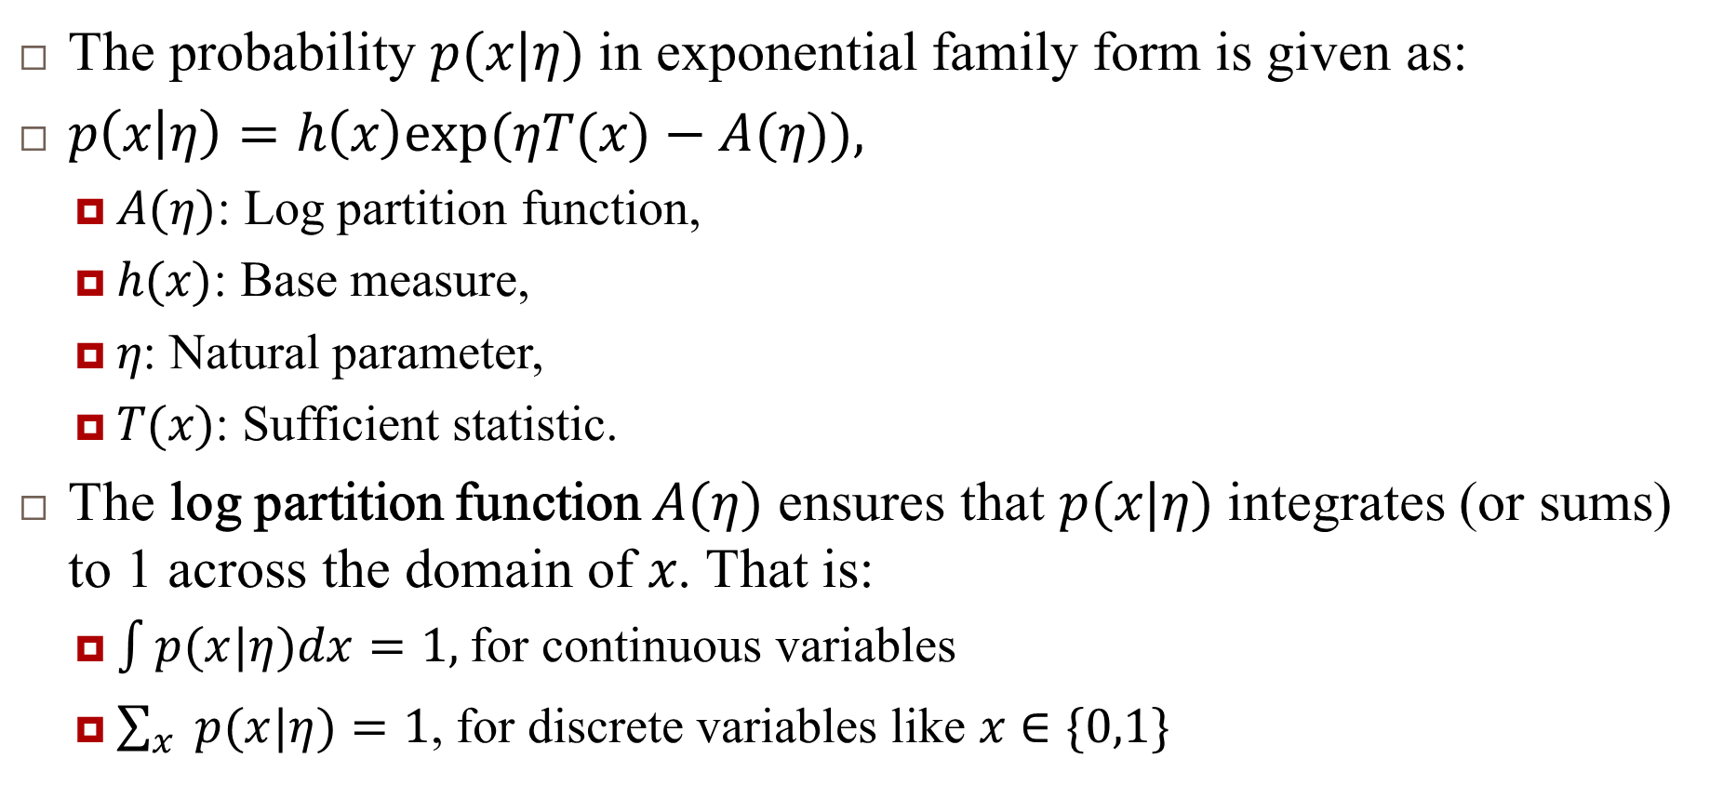
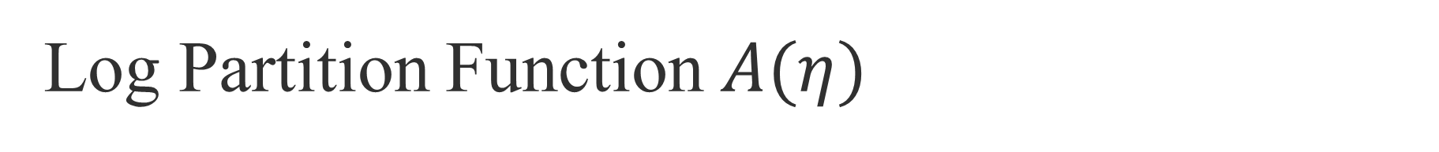
Log Partition Function $A(η)$
The probability $p(x|η)$ in exponential family form is given as:
$p\left(x | η\right)=h\left(x\right)exp(ηT(x)−A(η)),$
$A(η)$: Log partition function,
$h(x)$: Base measure,
$η$: Natural parameter,
$T(x)$: Sufficient statistic.
The log partition function $A(η)$ ensures that $p(x|η)$ integrates (or sums) to 1 across the domain of $x$. That is:
$\int{p(x|η)dx}=1,$for continuous variables
$\sum_{x}{ }p(x|η)=1$, for discrete variables like $x∈\{0,1\}$

Slide 19
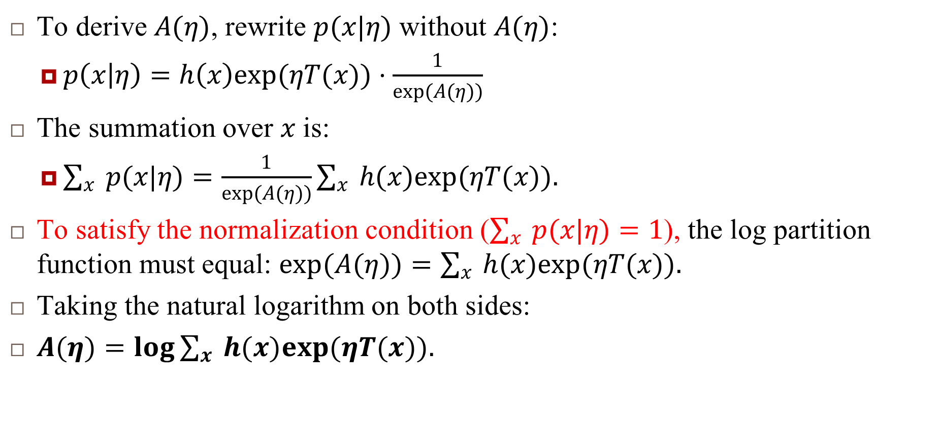
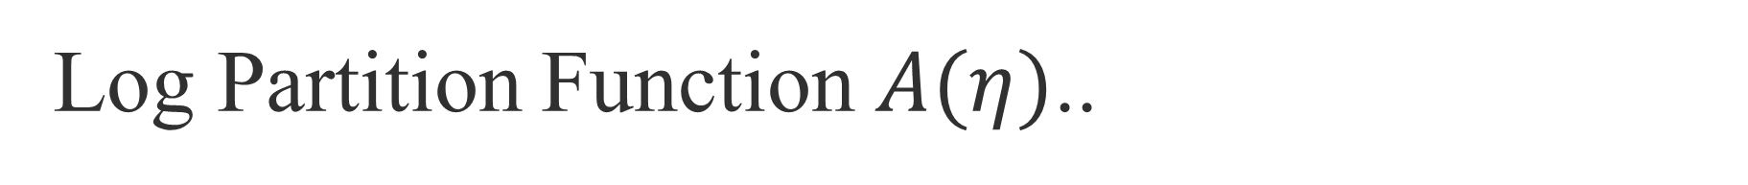
Log Partition Function $A(η)$..
To derive $A(η)$, rewrite $p(x|η)$ without $A(η)$:
$p\left(x | η\right)=h\left(x\right)exp(ηT(x))⋅\frac{1}{exp(A(η))}$
The summation over $x$ is:
$\sum_{x}{ }p(x|η)=\frac{1}{exp(A(η))}\sum_{x}{ }h(x)exp(ηT(x)).$
To satisfy the normalization condition ($\sum_{x}{ }p(x|η)=1$), the log partition function must equal: $exp(A(η))=\sum_{x}{ }h(x)exp(ηT(x)).$
Taking the natural logarithm on both sides:
$A(η)=log\sum_{x}{ }h(x)exp(ηT(x)).$

Slide 20
Reference
Murphy, Kevin P. Machine learning: a probabilistic perspective. MIT press, 2012.
Chapter 9

