Slide 1
Generalized Linear Models and Exponential Family
Probit Regression
Dr. Prakash Andugula
CSE, RAIT
Advanced Machine Learning

Slide 2
Probit Regression

Slide 3
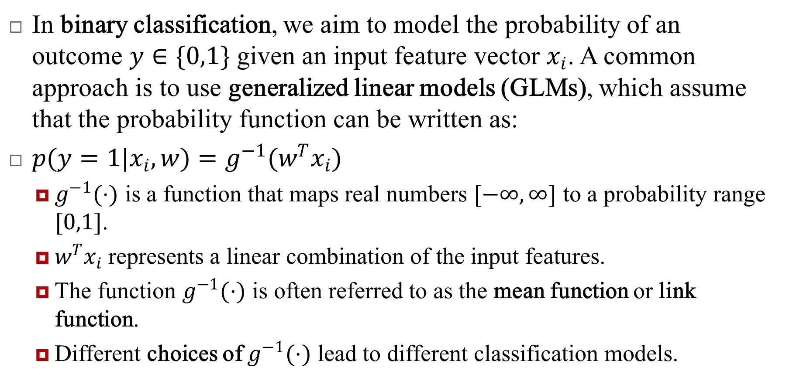
Generalized Linear Models for Binary Classification
In binary classification, we aim to model the probability of an outcome $y∈\{0,1\}$ given an input feature vector $x_{i}$. A common approach is to use generalized linear models (GLMs), which assume that the probability function can be written as:
$p(y=1|x_{i},w)=g^{−1}(w^{T}x_{i})$
$g^{−1}(⋅)$ is a function that maps real numbers $[−∞,∞]$ to a probability range $[0,1]$.
$w^{T}x_{i}$ represents a linear combination of the input features.
The function $g^{−1}(⋅)$ is often referred to as the mean function or link function.
Different choices of $g^{−1}(⋅)$ lead to different classification models.

Slide 4
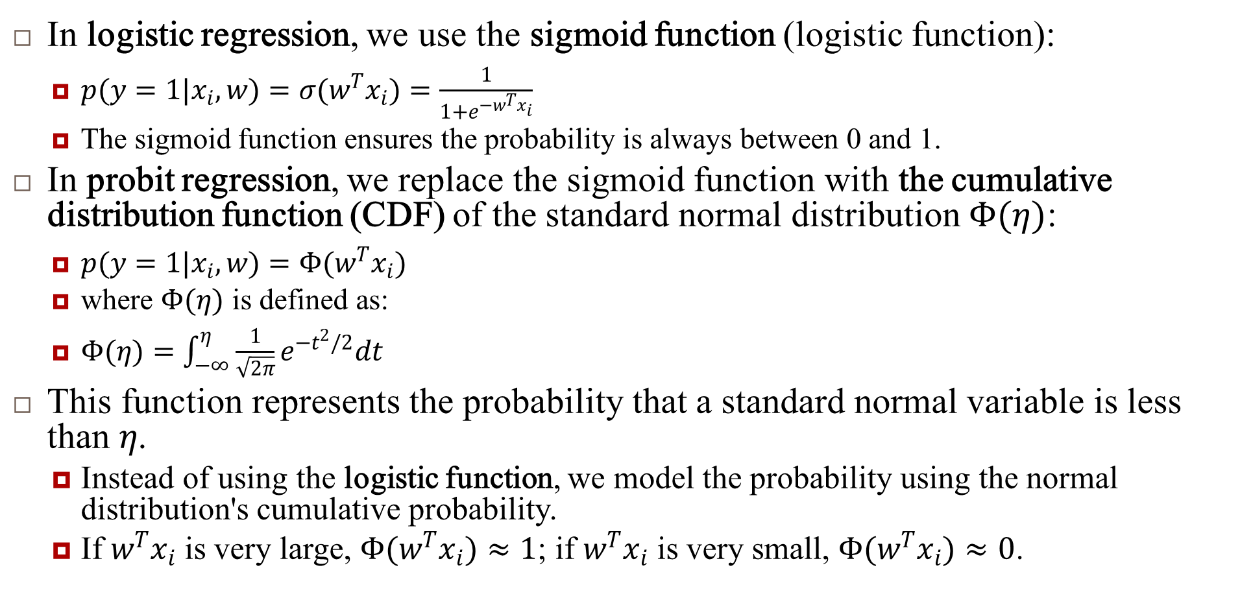
Probit Regression vs. Logistic Regression
In logistic regression, we use the sigmoid function (logistic function):
$p(y=1|x_{i},w)=σ(w^{T}x_{i})=\frac{1}{1+e^{−w^{T}x_{i}}}$
The sigmoid function ensures the probability is always between 0 and 1.
In probit regression, we replace the sigmoid function with the cumulative distribution function (CDF) of the standard normal distribution $Φ(η)$:
$p(y=1|x_{i},w)=Φ(w^{T}x_{i})$
where $Φ(η)$ is defined as:
$Φ(η)=\int_{−∞}^{η}{ }\frac{1}{\sqrt{2π}}e^{−t^{2}/2}dt$
This function represents the probability that a standard normal variable is less than $η$.
Instead of using the logistic function, we model the probability using the normal distribution's cumulative probability.
If $w^{T}x_{i}$ is very large, $Φ(w^{T}x_{i})≈1$; if $w^{T}x_{i}$ is very small, $Φ(w^{T}x_{i})≈0$.

Slide 5
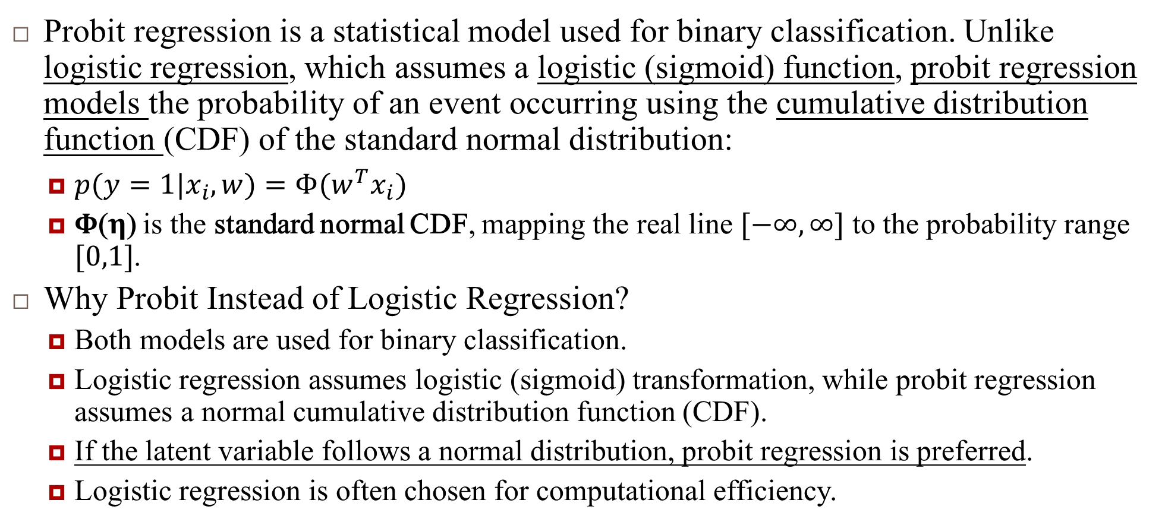
Probit Regression
Probit regression is a statistical model used for binary classification. Unlike logistic regression, which assumes a logistic (sigmoid) function, probit regression models the probability of an event occurring using the cumulative distribution function (CDF) of the standard normal distribution:
$p(y=1|x_{i},w)=Φ(w^{T}x_{i})$
Φ(η) is the standard normal CDF, mapping the real line $[−∞,∞]$ to the probability range $[0,1]$.
Why Probit Instead of Logistic Regression?
Both models are used for binary classification.
Logistic regression assumes logistic (sigmoid) transformation, while probit regression assumes a normal cumulative distribution function (CDF).
If the latent variable follows a normal distribution, probit regression is preferred.
Logistic regression is often chosen for computational efficiency.

Slide 6

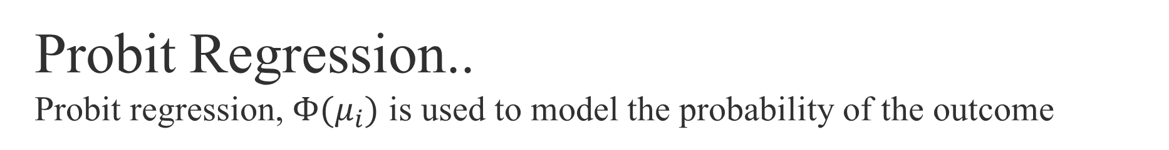
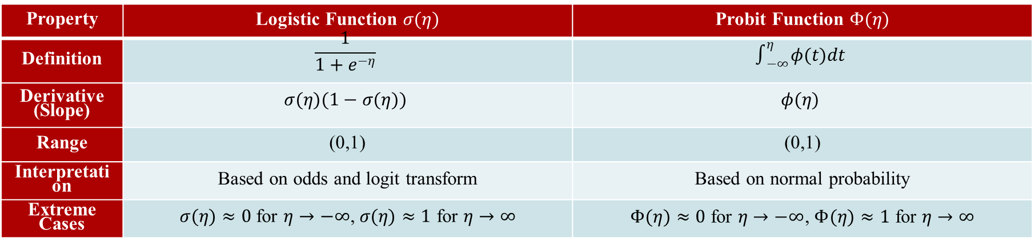
Probit Regression.. Probit regression, $Φ(μ_{i})$ is used to model the probability of the outcome
$φ(μ_{i})$ - Standard Normal PDF (Probability Density Function):
Represents the height of the normal distribution curve at $μ_{i}$.
Measures the relative likelihood of $μ_{i}$ occurring.
Defined as:$φ(μ_{i})=\frac{1}{\sqrt{2π}}e^{−\frac{μ_{i}^{2}}{2}}$
$Φ(μ_{i})$ - Standard Normal CDF (Cumulative Distribution Function):
Represents the probability that a standard normal variable is less than or equal to $μ_{i}$.
Defined as the integral of the PDF: $Φ(μ_{i})=\int_{−∞}^{μ_{i}}{ }φ(t)dt$
Property | Logistic Function $σ(η)$ | Probit Function $Φ(η)$
Definition | $$\frac{1}{1+e^{−η}}$$ | $$∫_{−∞}^{η} φ(t)dt$$
Derivative (Slope) | $$σ(η)(1−σ(η))$$ | $$φ(η)$$
Range | (0,1) | (0,1)
Interpretation | Based on odds and logit transform | Based on normal probability
Extreme Cases | $σ(η)≈0$ for $η→−∞$, $σ(η)≈1$ for $η→∞$ | $Φ(η)≈0$ for $η→−∞$, $Φ(η)≈1$ for $η→∞$

Slide 7
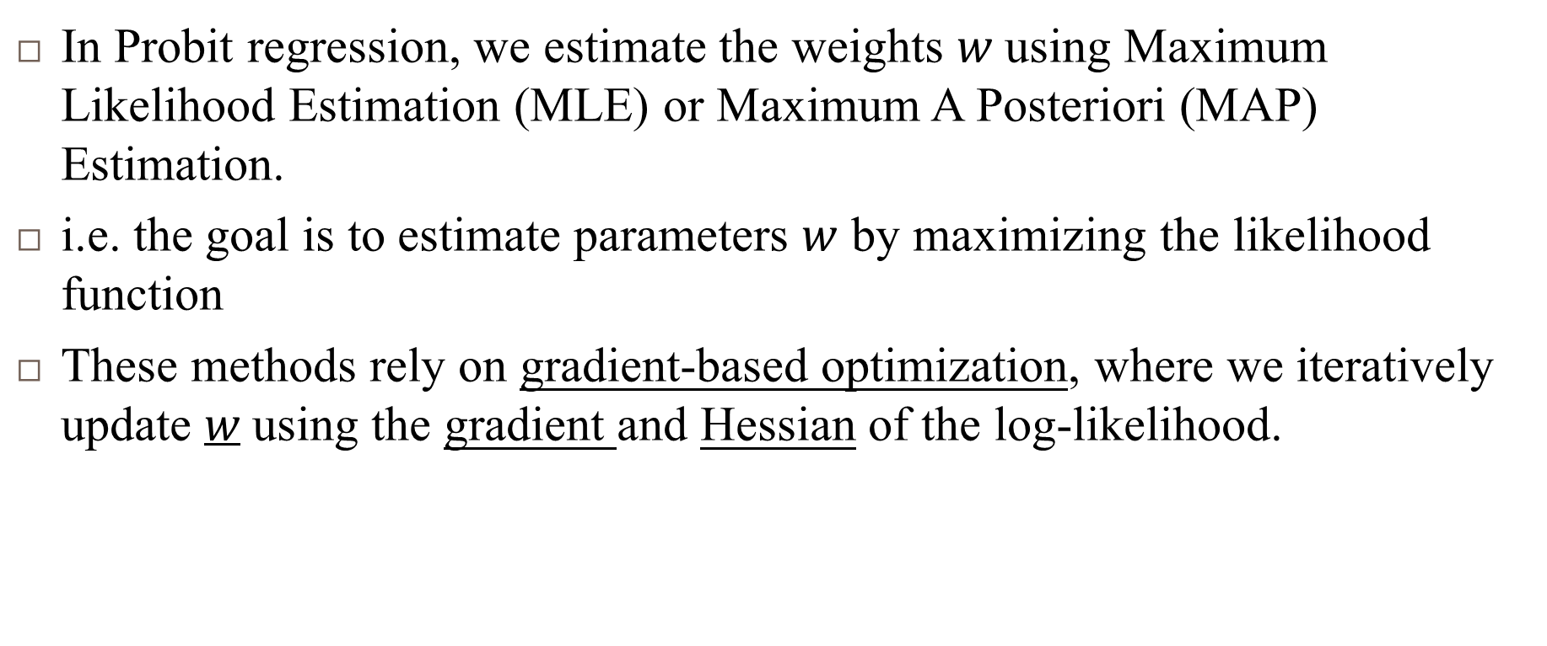
Estimating parameters $w$ of $p(y=1|x_{i},w)=Φ(w^{T}x_{i})$
In Probit regression, we estimate the weights $w$ using Maximum Likelihood Estimation (MLE) or Maximum A Posteriori (MAP) Estimation.
i.e. the goal is to estimate parameters $w$ by maximizing the likelihood function
These methods rely on gradient-based optimization, where we iteratively update $w$ using the gradient and Hessian of the log-likelihood.

Slide 8
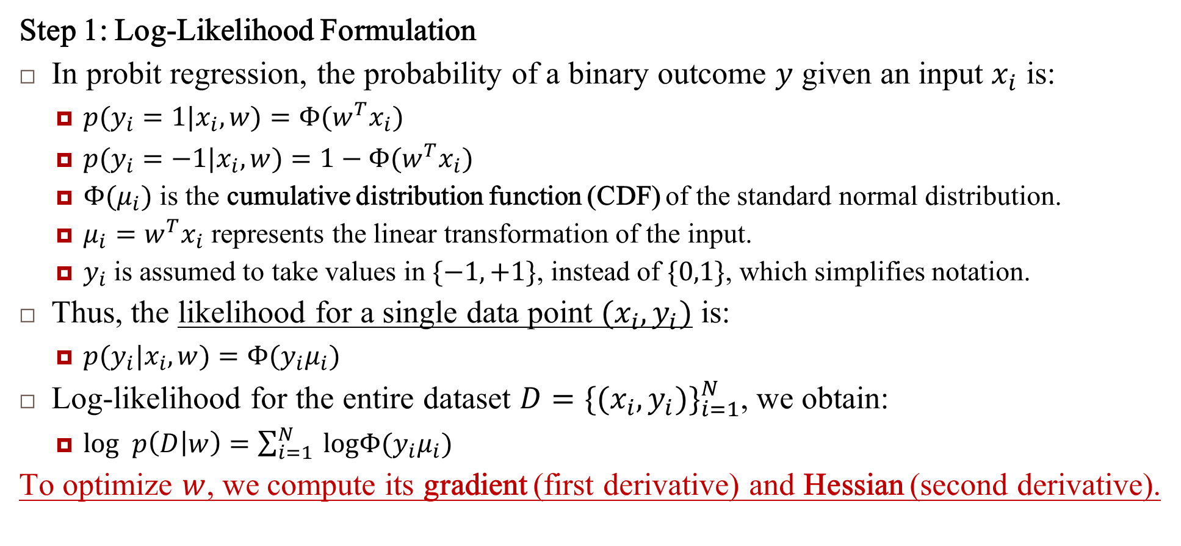
Estimating parameters $w$ …
Step 1: Log-Likelihood Formulation
In probit regression, the probability of a binary outcome $y$ given an input $x_{i}$ is:
$p(y_{i}=1|x_{i},w)=Φ(w^{T}x_{i})$
$p(y_{i}=−1|x_{i},w)=1−Φ(w^{T}x_{i})$
$Φ(μ_{i})$ is the cumulative distribution function (CDF) of the standard normal distribution.
$μ_{i}=w^{T}x_{i}$ represents the linear transformation of the input.
$y_{i}$ is assumed to take values in $\{−1,+1\}$, instead of $\{0,1\}$, which simplifies notation.
Thus, the likelihood for a single data point $(x_{i},y_{i})$ is:
$p(y_{i}|x_{i},w)=Φ(y_{i}μ_{i})$
Log-likelihood for the entire dataset $D=\{(x_{i},y_{i})\}_{i=1}^{N}$, we obtain:
$log p\left(D | w\right)=\sum_{i=1}^{N}{ }logΦ(y_{i}μ_{i})$
To optimize $w$, we compute its gradient (first derivative) and Hessian (second derivative).

Slide 9
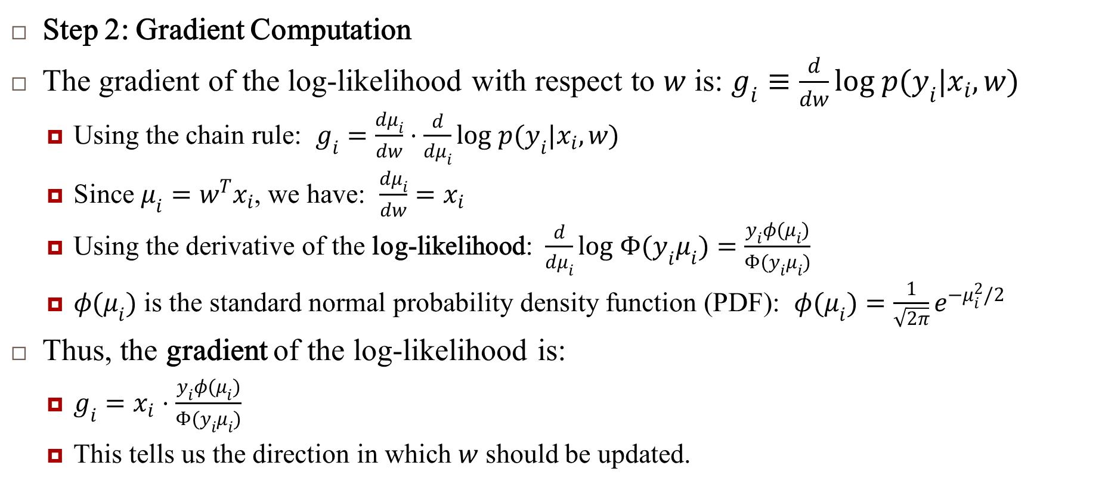
Estimating parameters $w$ …
Step 2: Gradient Computation
The gradient of the log-likelihood with respect to $w$ is: $g_{i}≡\frac{d}{dw}log p(y_{i}|x_{i},w)$
Using the chain rule: $g_{i}=\frac{dμ_{i}}{dw}⋅\frac{d}{dμ_{i}}log p(y_{i}|x_{i},w)$
Since $μ_{i}=w^{T}x_{i}$, we have: $\frac{dμ_{i}}{dw}=x_{i}$
Using the derivative of the log-likelihood: $\frac{d}{dμ_{i}}log Φ(y_{i}μ_{i})=\frac{y_{i}φ(μ_{i})}{Φ(y_{i}μ_{i})}$
$φ(μ_{i})$ is the standard normal probability density function (PDF): $φ(μ_{i})=\frac{1}{\sqrt{2π}}e^{−μ_{i}^{2}/2}$
Thus, the gradient of the log-likelihood is:
$g_{i}=x_{i}⋅\frac{y_{i}φ(μ_{i})}{Φ(y_{i}μ_{i})}$
This tells us the direction in which $w$ should be updated.

Slide 10
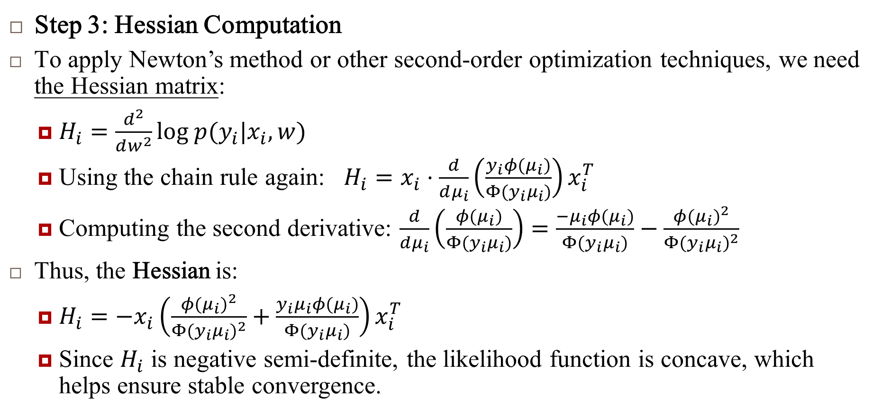
Estimating parameters $w$ …
Step 3: Hessian Computation
To apply Newton’s method or other second-order optimization techniques, we need the Hessian matrix:
$H_{i}=\frac{d^{2}}{dw^{2}}log p(y_{i}|x_{i},w)$
Using the chain rule again: $H_{i}=x_{i}⋅\frac{d}{dμ_{i}}\left(\frac{y_{i}φ(μ_{i})}{Φ(y_{i}μ_{i})}\right)x_{i}^{T}$
Computing the second derivative: $\frac{d}{dμ_{i}}\left(\frac{φ(μ_{i})}{Φ(y_{i}μ_{i})}\right)=\frac{−μ_{i}φ(μ_{i})}{Φ(y_{i}μ_{i})}−\frac{φ(μ_{i})^{2}}{Φ(y_{i}μ_{i})^{2}}$
Thus, the Hessian is:
$H_{i}=−x_{i}\left(\frac{φ(μ_{i})^{2}}{Φ(y_{i}μ_{i})^{2}}+\frac{y_{i}μ_{i}φ(μ_{i})}{Φ(y_{i}μ_{i})}\right)x_{i}^{T}$
Since $H_{i}$ is negative semi-definite, the likelihood function is concave, which helps ensure stable convergence.

Slide 11
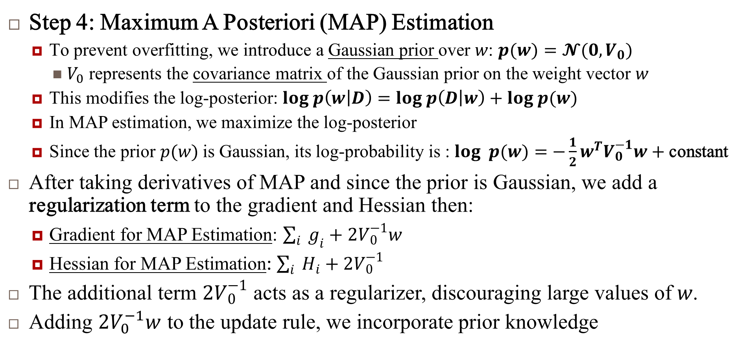
Estimating parameters $w$ …
Step 4: Maximum A Posteriori (MAP) Estimation
To prevent overfitting, we introduce a Gaussian prior over $w$: $p(w)=𝓝(0,V_{0})$
$V_{0}$​ represents the covariance matrix of the Gaussian prior on the weight vector $w$
This modifies the log-posterior: $log p\left(w | D\right)=log p\left(D | w\right)+log p(w)$
In MAP estimation, we maximize the log-posterior
Since the prior $p(w)$ is Gaussian, its log-probability is : $log p(w)=−\frac{1}{2}w^{T}V_{0}^{−1}w+\text{constant}$
After taking derivatives of MAP and since the prior is Gaussian, we add a regularization term to the gradient and Hessian then:
Gradient for MAP Estimation: $\sum_{i}{ }g_{i}+2V_{0}^{−1}w$
Hessian for MAP Estimation: $\sum_{i}{ }H_{i}+2V_{0}^{−1}$
The additional term $2V_{0}^{−1}$ acts as a regularizer, discouraging large values of $w$.
Adding $2V_{0}^{−1}w$ to the update rule, we incorporate prior knowledge

Slide 12
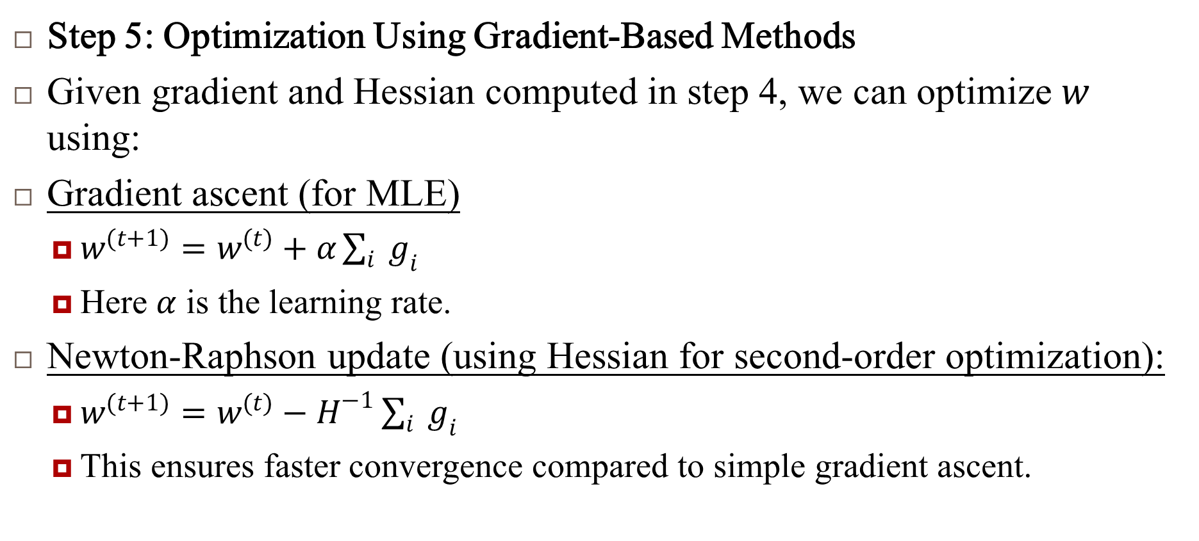
Estimating parameters $w$ …
Step 5: Optimization Using Gradient-Based Methods
Given gradient and Hessian computed in step 4, we can optimize $w$ using:
Gradient ascent (for MLE)
$w^{(t+1)}=w^{(t)}+α\sum_{i}{ }g_{i}$
Here $α$ is the learning rate.
Newton-Raphson update (using Hessian for second-order optimization):
$w^{(t+1)}=w^{(t)}−H^{−1}\sum_{i}{ }g_{i}$
This ensures faster convergence compared to simple gradient ascent.

Slide 13
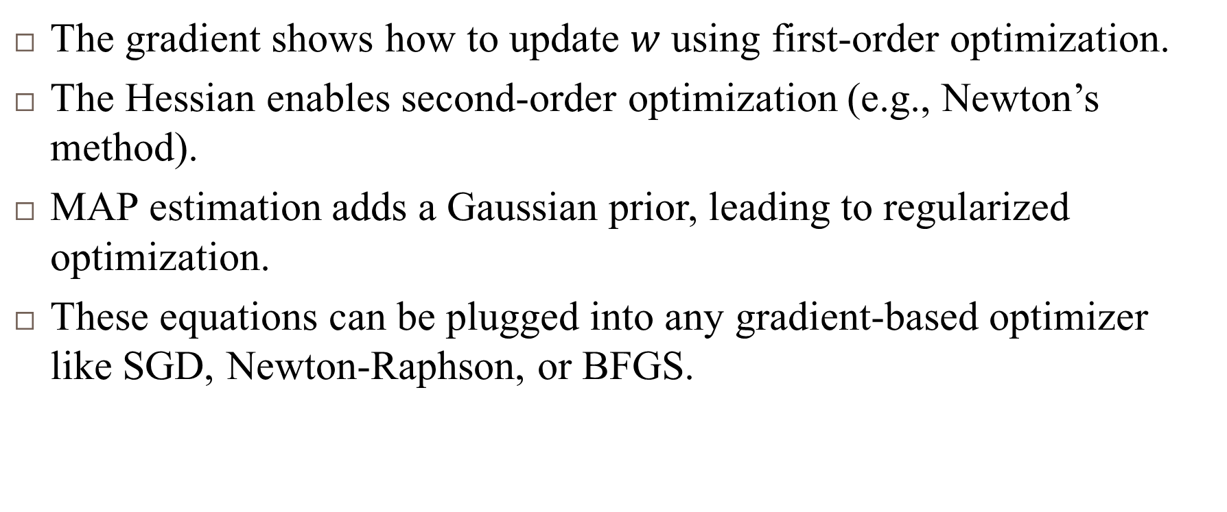

Summary Estimating parameters $w$ …
The gradient shows how to update $w$ using first-order optimization.
The Hessian enables second-order optimization (e.g., Newton’s method).
MAP estimation adds a Gaussian prior, leading to regularized optimization.
These equations can be plugged into any gradient-based optimizer like SGD, Newton-Raphson, or BFGS.

Slide 14
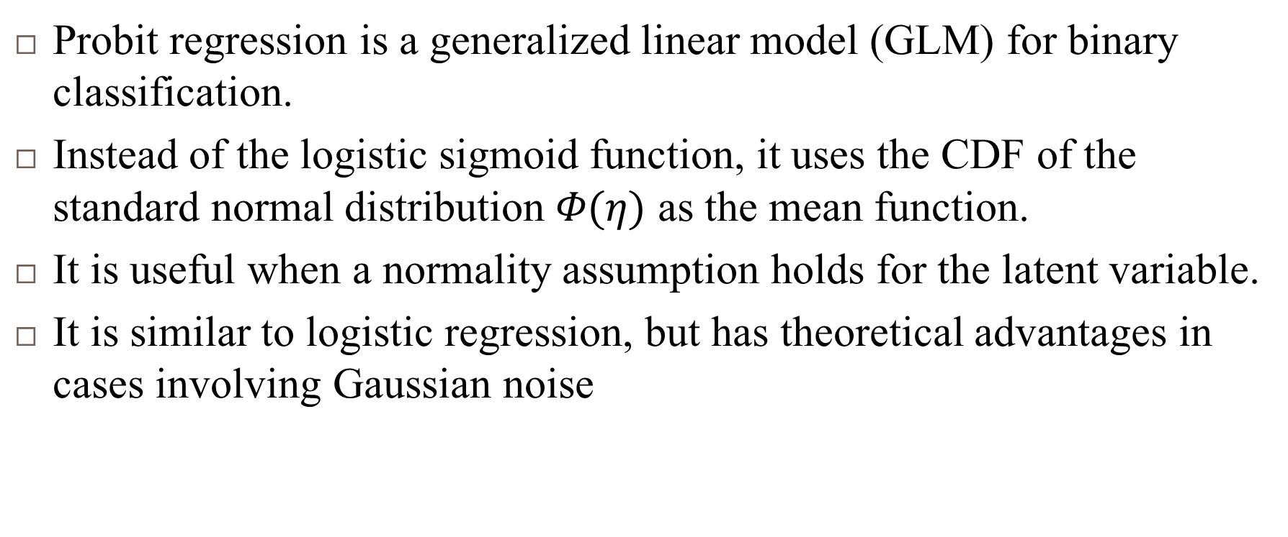
Important Points
Probit regression is a generalized linear model (GLM) for binary classification.
Instead of the logistic sigmoid function, it uses the CDF of the standard normal distribution $Φ(η)$ as the mean function.
It is useful when a normality assumption holds for the latent variable.
It is similar to logistic regression, but has theoretical advantages in cases involving Gaussian noise

Slide 15
Reference
Murphy, Kevin P. Machine learning: a probabilistic perspective. MIT press, 2012.
Chapter 9

