Slide 1
Generalized Linear Models and Exponential Family
Multi-Task Learning (MTL)
Dr. Prakash Andugula
CSE, RAIT
Advanced Machine Learning

Slide 2
Multi-Task Learning (MTL)

Slide 3
Introduction
In many real-world scenarios, we need to train multiple related models simultaneously.
Instead of training separate models for each task, Multi-Task Learning (MTL) leverages shared information among tasks to improve overall performance.
This approach assumes that different tasks share some common structure in their input-output relationships.
By jointly learning the tasks, the model generalizes better, especially when some tasks have limited training data.

Slide 4
Examples of Multi-Task Learning
Speech Recognition: Learning phoneme recognition across multiple languages. ¹
Medical Diagnosis: Predicting multiple related diseases based on patient history. ²
Computer Vision: Object detection and segmentation trained together. ³
Natural Language Processing (NLP): Sentiment analysis and emotion detection trained together. ⁴
Pironkov, Gueorgui, Stephane Dupont, and Thierry Dutoit. "Multi-task learning for speech recognition: an overview." In ESANN. 2016.
Bi, J., Xiong, T., Yu, S., Dundar, M., & Rao, R. B. An improved multi-task learning approach with applications in medical diagnosis. In Machine Learning and Knowledge Discovery in Databases: European Conference, ECML PKDD 2008
Standley, Trevor, et al. "Which tasks should be learned together in multi-task learning?." International conference on machine learning. PMLR, 2020.
Chen, Shijie, Yu Zhang, and Qiang Yang. "Multi-task learning in natural language processing: An overview." ACM Computing Surveys 56, no. 12 (2024):

Slide 5
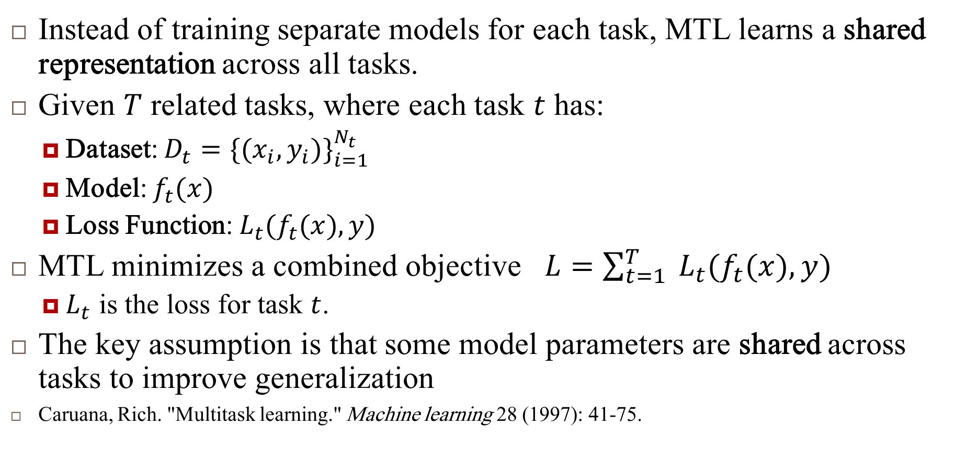
Multi-Task Learning
Instead of training separate models for each task, MTL learns a shared representation across all tasks.
Given $T$ related tasks, where each task $t$ has:
Dataset: $D_{t}=\{(x_{i},y_{i})\}_{i=1}^{N_{t}}$
Model: $f_{t}(x)$
Loss Function: $L_{t}(f_{t}(x),y)$
MTL minimizes a combined objective $L=\sum_{t=1}^{T}{ }L_{t}(f_{t}(x),y)$
$L_{t}$ is the loss for task $t$.
The key assumption is that some model parameters are shared across tasks to improve generalization
Caruana, Rich. "Multitask learning." Machine learning 28 (1997): 41-75.

Slide 6
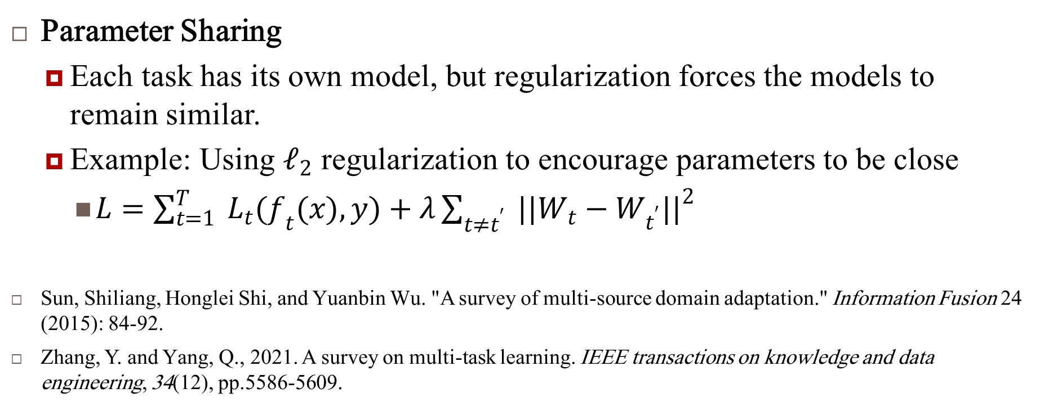
Approaches to Multi-Task Learning
Parameter Sharing
Each task has its own model, but regularization forces the models to remain similar.
Example: Using $𝓁_{2}$ regularization to encourage parameters to be close
$L=\sum_{t=1}^{T}{ }L_{t}(f_{t}(x),y)+λ\sum_{t≠t^{′}}{ }||W_{t}−W_{t^{′}}||^{2}$
Sun, Shiliang, Honglei Shi, and Yuanbin Wu. "A survey of multi-source domain adaptation." Information Fusion 24 (2015): 84-92.
Zhang, Y. and Yang, Q., 2021. A survey on multi-task learning. IEEE transactions on knowledge and data engineering, 34(12), pp.5586-5609.

Slide 7
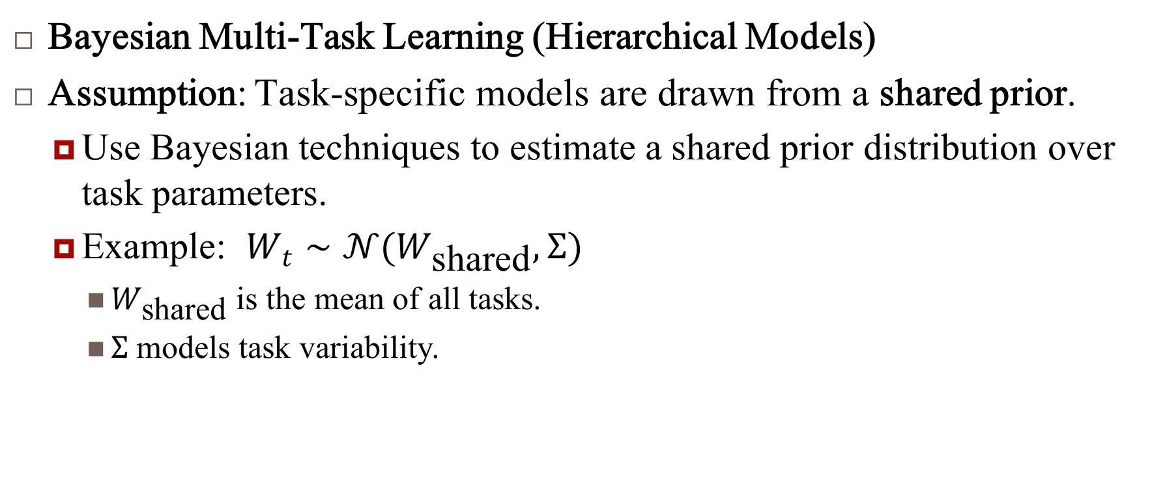
Approaches to Multi-Task Learning…
Bayesian Multi-Task Learning (Hierarchical Models)
Assumption: Task-specific models are drawn from a shared prior.
Use Bayesian techniques to estimate a shared prior distribution over task parameters.
Example: $W_{t}∼𝒩(W_{\text{shared}},Σ)$
$W_{\text{shared}}$ is the mean of all tasks.
$Σ$ models task variability.

Slide 8
Use of Hierarchical Bayesian Models
Some groups (or tasks) may have a lot of data, allowing us to estimate parameters reliably.
Other groups may have very little data, making parameter estimation difficult.
A hierarchical Bayesian approach shares information across groups, so groups with less data can "borrow strength" from groups with more data.

Slide 9
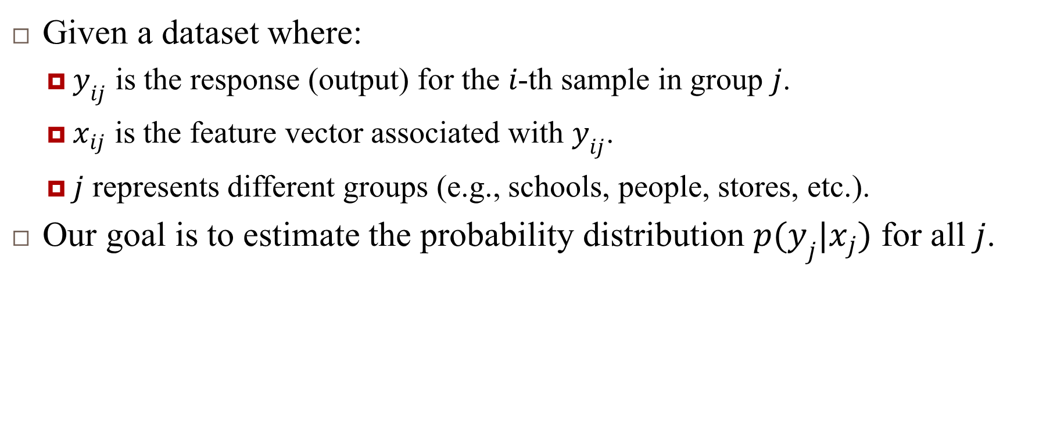
Example Formulation: Hierarchical Bayesian Models
Given a dataset where:
$y_{ij}$ is the response (output) for the $i$-th sample in group $j$.
$x_{ij}$ is the feature vector associated with $y_{ij}$.
$j$ represents different groups (e.g., schools, people, stores, etc.).
Our goal is to estimate the probability distribution $p(y_{j}|x_{j})$ for all $j$.

Slide 10
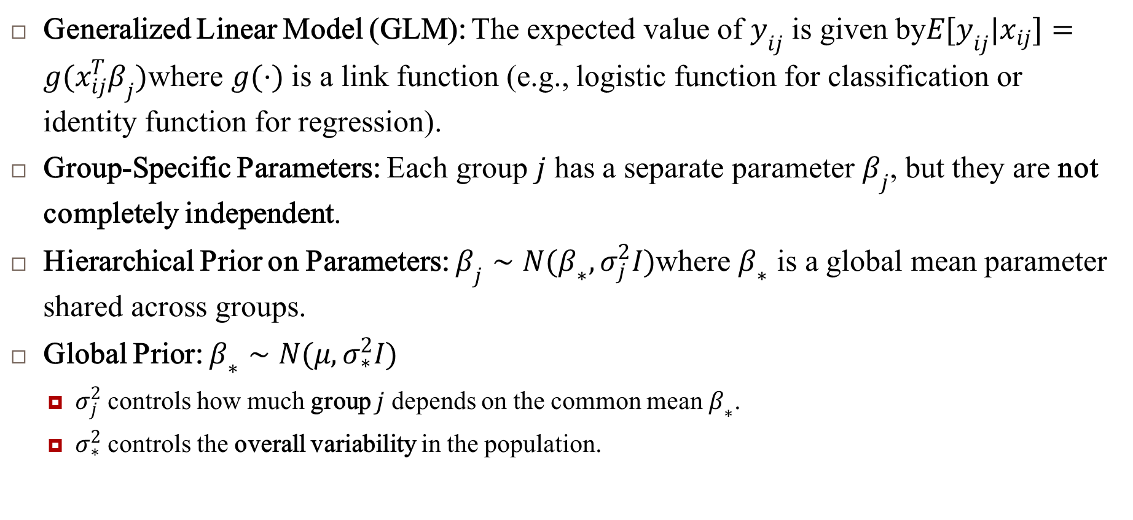
Example Formulation: Hierarchical Bayesian Models..
Generalized Linear Model (GLM): The expected value of $y_{ij}$ is given by$E[y_{ij}|x_{ij}]=g(x_{ij}^{T}β_{j})$where $g(⋅)$ is a link function (e.g., logistic function for classification or identity function for regression).
Group-Specific Parameters: Each group $j$ has a separate parameter $β_{j}$, but they are not completely independent.
Hierarchical Prior on Parameters: $β_{j}∼N(β_{∗},σ_{j}^{2}I)$where $β_{∗}$ is a global mean parameter shared across groups.
Global Prior: $β_{∗}∼N(μ,σ_{∗}^{2}I)$
$σ_{j}^{2}$ controls how much group $j$ depends on the common mean $β_{∗}$.
$σ_{∗}^{2}$ controls the overall variability in the population.

Slide 11
Example Formulation: Hierarchical Bayesian Models..
Generalized Linear Model (GLM): The expected value of $y_{ij}$ is given by$E[y_{ij}|x_{ij}]=g(x_{ij}^{T}β_{j})$where $g(⋅)$ is a link function (e.g., logistic function for classification or identity function for regression).
Group-Specific Parameters: Each group $j$ has a separate parameter $β_{j}$, but they are not completely independent.
Hierarchical Prior on Parameters: $β_{j}∼N(β_{∗},σ_{j}^{2}I)$where $β_{∗}$ is a global mean parameter shared across groups.
Global Prior: $β_{∗}∼N(μ,σ_{∗}^{2}I)$
$σ_{j}^{2}$ controls how much group $j$ depends on the common mean $β_{∗}$.
$σ_{∗}^{2}$ controls the overall variability in the population.

Slide 12
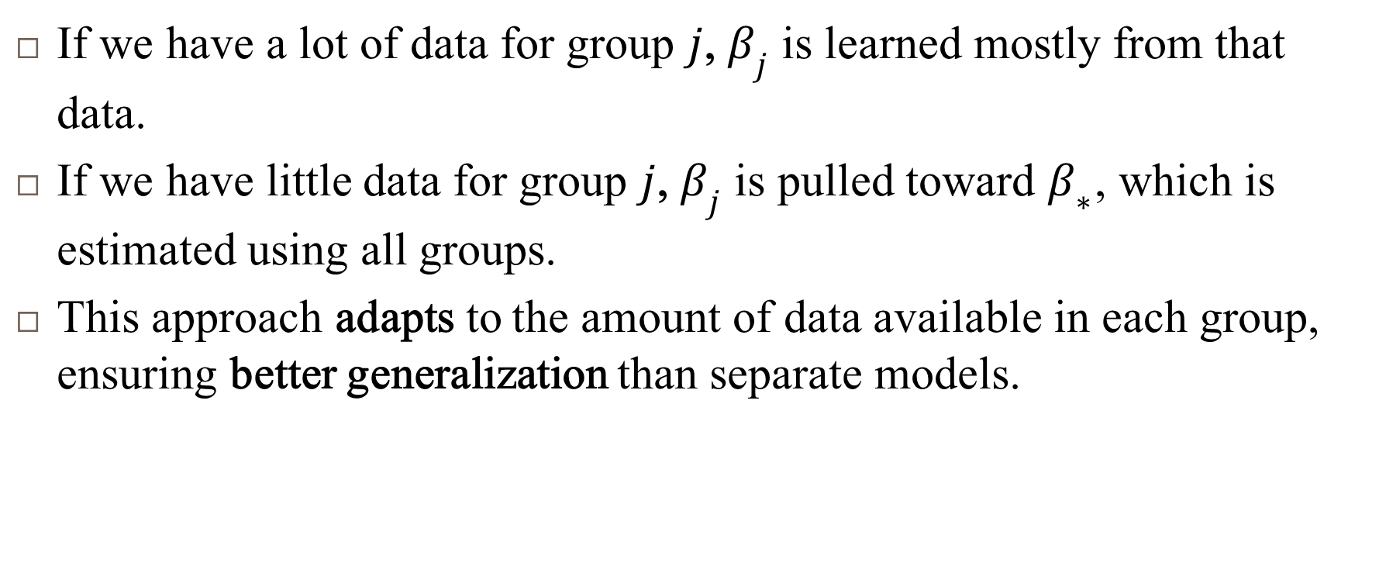
Example Formulation: Hierarchical Bayesian Models..
If we have a lot of data for group $j$, $β_{j}$ is learned mostly from that data.
If we have little data for group $j$, $β_{j}$ is pulled toward $β_{∗}$, which is estimated using all groups.
This approach adapts to the amount of data available in each group, ensuring better generalization than separate models.

Slide 13
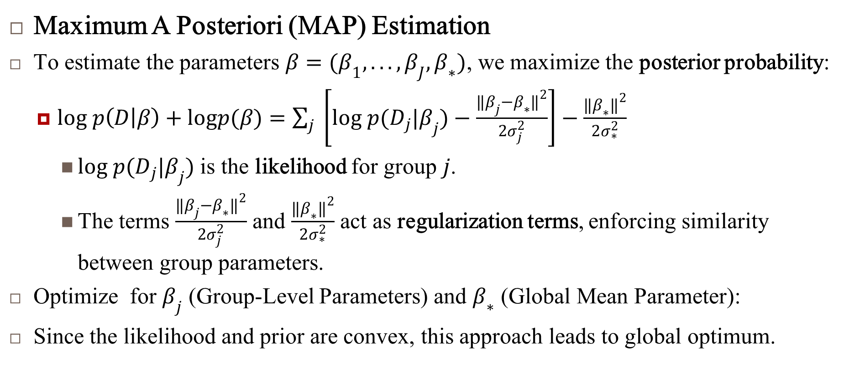
Example Formulation: Hierarchical Bayesian Models..
Maximum A Posteriori (MAP) Estimation
To estimate the parameters $β=(β_{1},...,β_{J},β_{∗})$, we maximize the posterior probability:
$log p\left(D | β\right)+logp(β)=\sum_{j}{ }\left[log p(D_{j}|β_{j})−\frac{‖β_{j}−β_{∗}‖^{2}}{2σ_{j}^{2}}\right]−\frac{‖β_{∗}‖^{2}}{2σ_{∗}^{2}}$
$log p(D_{j}|β_{j})$ is the likelihood for group $j$.
The terms $\frac{‖β_{j}−β_{∗}‖^{2}}{2σ_{j}^{2}}$ and $\frac{‖β_{∗}‖^{2}}{2σ_{∗}^{2}}$ act as regularization terms, enforcing similarity between group parameters.
Optimize for $β_{j}$ (Group-Level Parameters) and $β_{∗}$ (Global Mean Parameter):
Since the likelihood and prior are convex, this approach leads to global optimum.

Slide 14
Applications
Education Modeling:
Groups: Schools
Features: Student demographics, teacher quality, etc.
Output: Average test scores per school
Advantage: Small schools benefit from data from larger schools.
Customer Purchase Prediction (Discrete Choice Modeling):
Groups: Individuals
Features: Browsing history, age, location, etc.
Output: Purchased product category
Advantage: New customers benefit from similar existing customers.
Healthcare Prediction:
Groups: Hospitals
Features: Patient demographics, symptoms, etc.
Output: Disease diagnosis probability
Advantage: Small hospitals leverage data from larger hospitals.
Zhang, Y. and Yang, Q., 2021. A survey on multi-task learning. IEEE transactions on knowledge and data engineering, 34(12), pp.5586-5609.
Bi, Jinbo, Tao Xiong, Shipeng Yu, Murat Dundar, and R. Bharat Rao. "An improved multi-task learning approach with applications in medical diagnosis." In Machine Learning and Knowledge Discovery in Databases: European Conference, ECML PKDD 2008, Antwerp, Belgium, September 15-19, 2008, Proceedings, Part I 19, pp. 117-132. Springer Berlin Heidelberg, 2008.

Slide 15
Reference
Murphy, Kevin P. Machine learning: a probabilistic perspective. MIT press, 2012.
Chapter 9

