Slide 1
Generalized Linear Models and Exponential Family
Generalized Linear Mixed Models
Dr. Prakash Andugula
CSE, RAIT
Advanced Machine Learning

Slide 2
Generalized Linear Mixed Models

Slide 3
Generalized Linear Mixed Models (GLMMs)
Generalized Linear Mixed Models (GLMMs) extend the traditional Generalized Linear Models (GLMs) by incorporating both fixed effects and random effects.
These models allow us to model complex data structures where some effects are fixed across groups, while others randomly vary across groups.

Slide 4
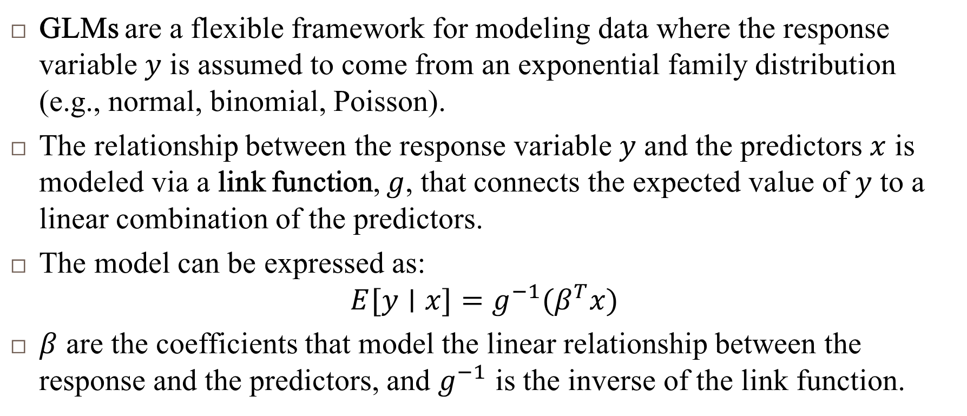
Generalized Linear Models (GLMs)
GLMs are a flexible framework for modeling data where the response variable $y$ is assumed to come from an exponential family distribution (e.g., normal, binomial, Poisson).
The relationship between the response variable $y$ and the predictors $x$ is modeled via a link function, $g$, that connects the expected value of $y$ to a linear combination of the predictors.
The model can be expressed as:
$$E[y∣x]=g^{−1}(β^{T}x)$$
$β$ are the coefficients that model the linear relationship between the response and the predictors, and $g^{−1}$ is the inverse of the link function.

Slide 5
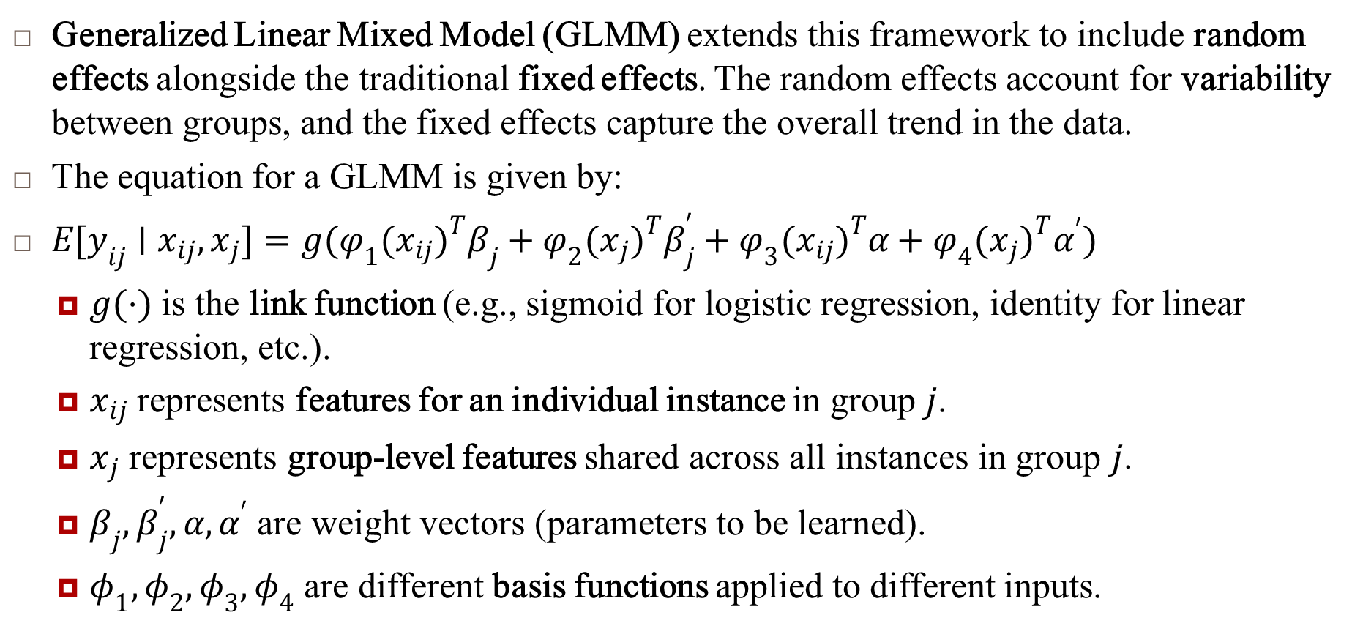
Generalized Linear Mixed Models (GLMMs)..
Generalized Linear Mixed Model (GLMM) extends this framework to include random effects alongside the traditional fixed effects. The random effects account for variability between groups, and the fixed effects capture the overall trend in the data.
The equation for a GLMM is given by:
$E[y_{ij}∣x_{ij},x_{j}]=g(φ_{1}(x_{ij})^{T}β_{j}+φ_{2}(x_{j})^{T}β_{j}^{′}+φ_{3}(x_{ij})^{T}α+φ_{4}(x_{j})^{T}α^{′})$
$g(⋅)$ is the link function (e.g., sigmoid for logistic regression, identity for linear regression, etc.).
$x_{ij}$ represents features for an individual instance in group $j$.
$x_{j}$ represents group-level features shared across all instances in group $j$.
$β_{j},β_{j}^{′},α,α^{′}$ are weight vectors (parameters to be learned).
$φ_{1},φ_{2},φ_{3},φ_{4}$ are different basis functions applied to different inputs.

Slide 6
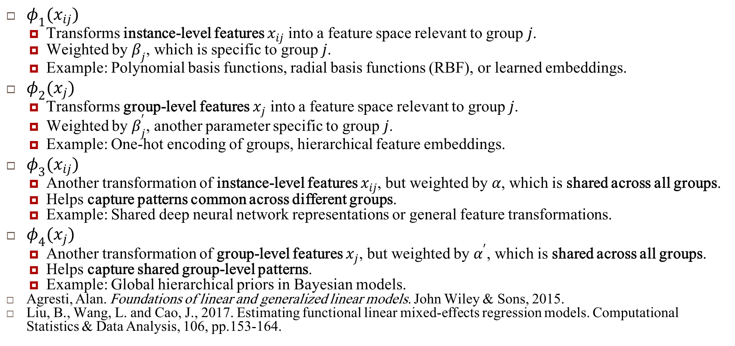
Different Basis functions
$φ_{1}(x_{ij})$
Transforms instance-level features $x_{ij}$ into a feature space relevant to group $j$.
Weighted by $β_{j}$, which is specific to group $j$.
Example: Polynomial basis functions, radial basis functions (RBF), or learned embeddings.
$φ_{2}(x_{j})$
Transforms group-level features $x_{j}$ into a feature space relevant to group $j$.
Weighted by $β_{j}^{′}$, another parameter specific to group $j$.
Example: One-hot encoding of groups, hierarchical feature embeddings.
$φ_{3}(x_{ij})$
Another transformation of instance-level features $x_{ij}$, but weighted by $α$, which is shared across all groups.
Helps capture patterns common across different groups.
Example: Shared deep neural network representations or general feature transformations.
$φ_{4}(x_{j})$
Another transformation of group-level features $x_{j}$, but weighted by $α^{′}$, which is shared across all groups.
Helps capture shared group-level patterns.
Example: Global hierarchical priors in Bayesian models.
Agresti, Alan. Foundations of linear and generalized linear models. John Wiley & Sons, 2015.
Liu, B., Wang, L. and Cao, J., 2017. Estimating functional linear mixed-effects regression models. Computational Statistics & Data Analysis, 106, pp.153-164.

Slide 7
Reference
Murphy, Kevin P. Machine learning: a probabilistic perspective. MIT press, 2012.

