Slide 1
Directed Graphical models
Learning
Dr. Prakash Andugula
CSE, RAIT
Advanced Machine Learning Topics Overview

Slide 2
Learning

Slide 3
Learning in Graphical Models
In probabilistic graphical models (PGMs), learning refers to estimating the model parameters from data.
This section
Differentiates between inference and learning,
Introduces plate notation for efficient representation of repeated structures,
Explains learning from complete data,
Discusses learning with missing and/or latent variables.

Slide 4
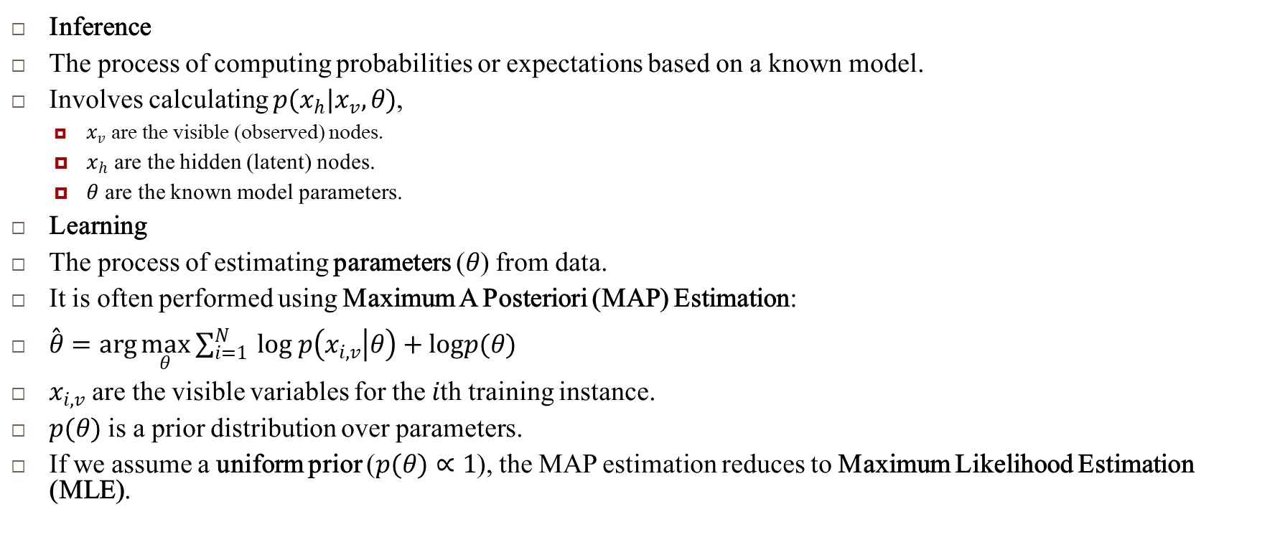
Inference vs. Learning
Inference
The process of computing probabilities or expectations based on a known model.
Involves calculating $p(x_{h}|x_{v},θ)$,
$x_{v}$ are the visible (observed) nodes.
$x_{h}$ are the hidden (latent) nodes.
$θ$ are the known model parameters.
Learning
The process of estimating parameters ($θ$) from data.
It is often performed using Maximum A Posteriori (MAP) Estimation:
$\overset{ˆ}{θ}=\arg{\max_{θ}} \sum_{i=1}^{N}{ }log p\left(x_{i,v} | θ\right)+logp(θ)$
$x_{i,v}$ are the visible variables for the $i$th training instance.
$p(θ)$ is a prior distribution over parameters.
If we assume a uniform prior ($p(θ)∝1$), the MAP estimation reduces to Maximum Likelihood Estimation (MLE).

Slide 5
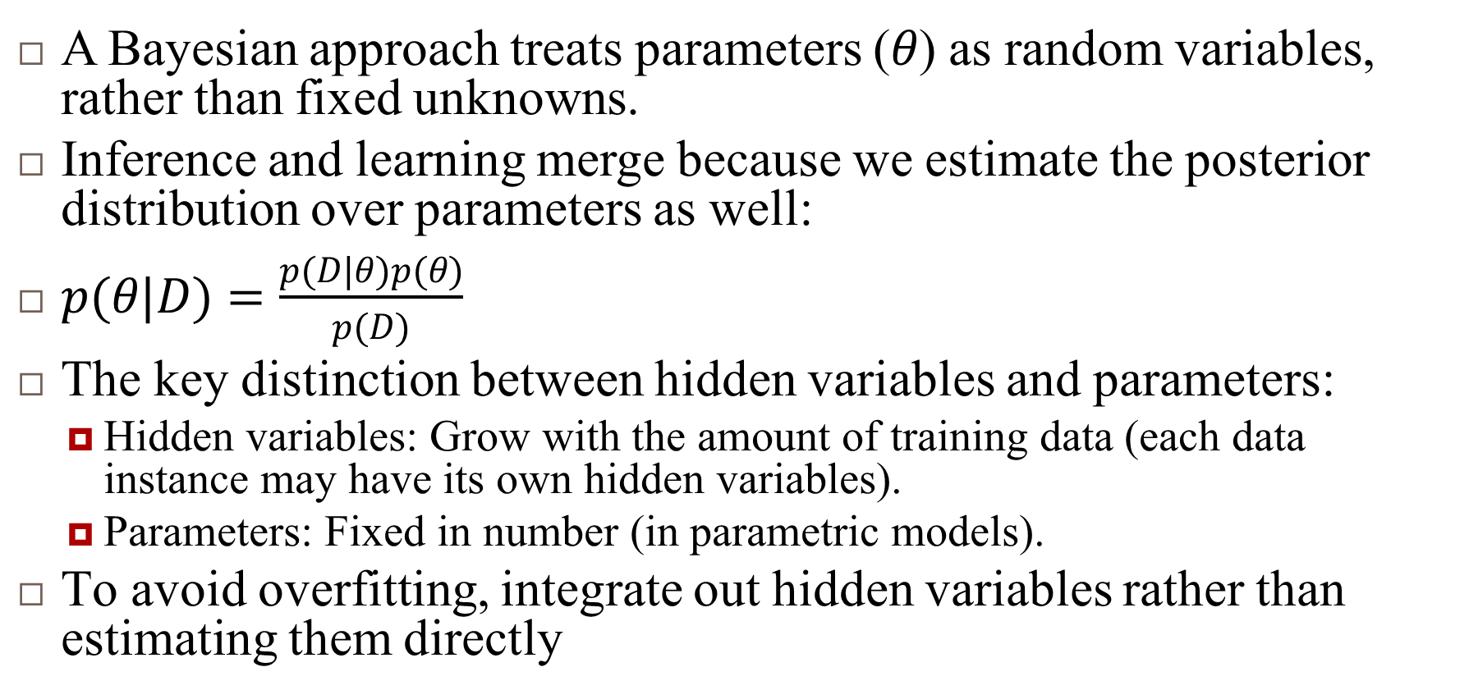
Bayesian View on Learning
A Bayesian approach treats parameters ($θ$) as random variables, rather than fixed unknowns.
Inference and learning merge because we estimate the posterior distribution over parameters as well:
$p(θ|D)=\frac{p(D|θ)p(θ)}{p(D)}$
The key distinction between hidden variables and parameters:
Hidden variables: Grow with the amount of training data (each data instance may have its own hidden variables).
Parameters: Fixed in number (in parametric models).
To avoid overfitting, integrate out hidden variables rather than estimating them directly

Slide 6
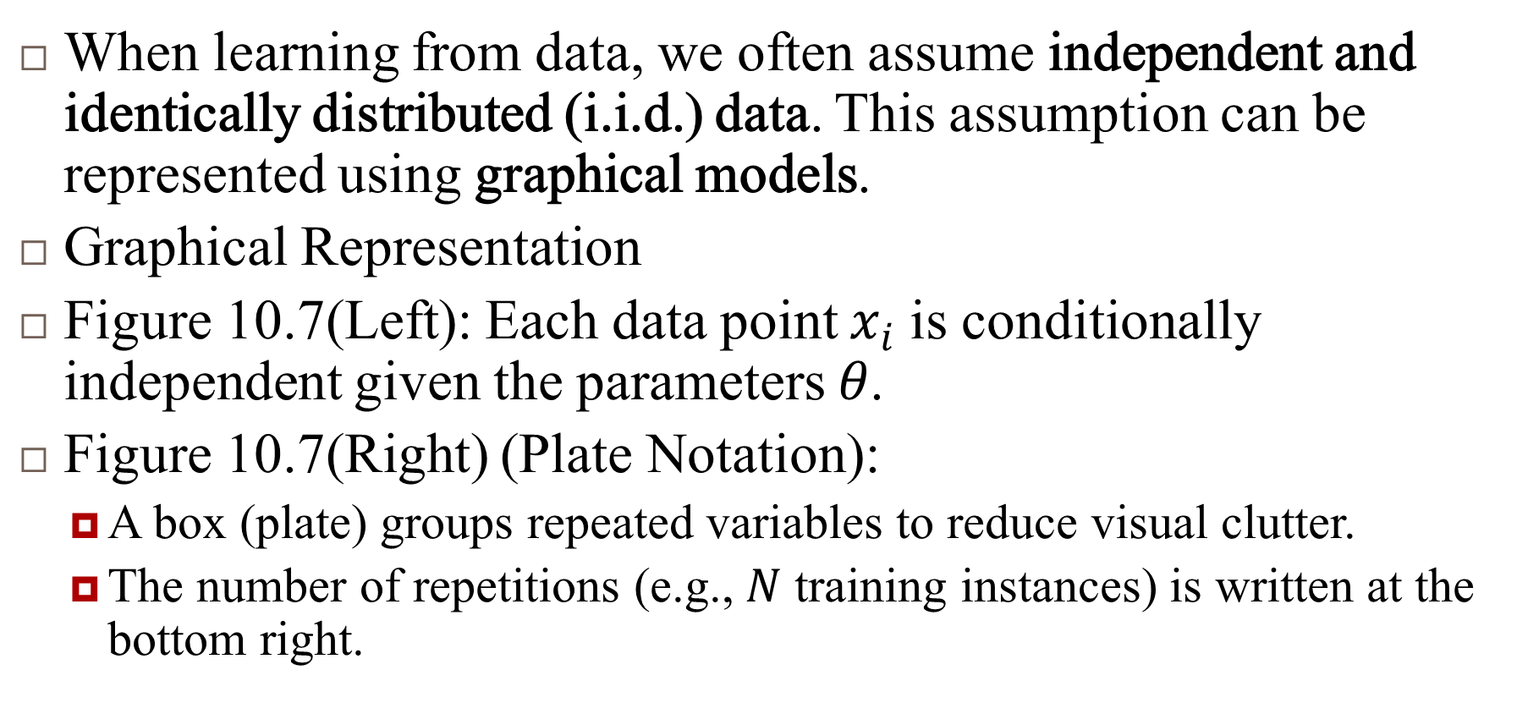
Plate Notation
When learning from data, we often assume independent and identically distributed (i.i.d.) data. This assumption can be represented using graphical models.
Graphical Representation
Figure 10.7(Left): Each data point $x_{i}$ is conditionally independent given the parameters $θ$.
Figure 10.7(Right) (Plate Notation):
A box (plate) groups repeated variables to reduce visual clutter.
The number of repetitions (e.g., $N$ training instances) is written at the bottom right.

Slide 7
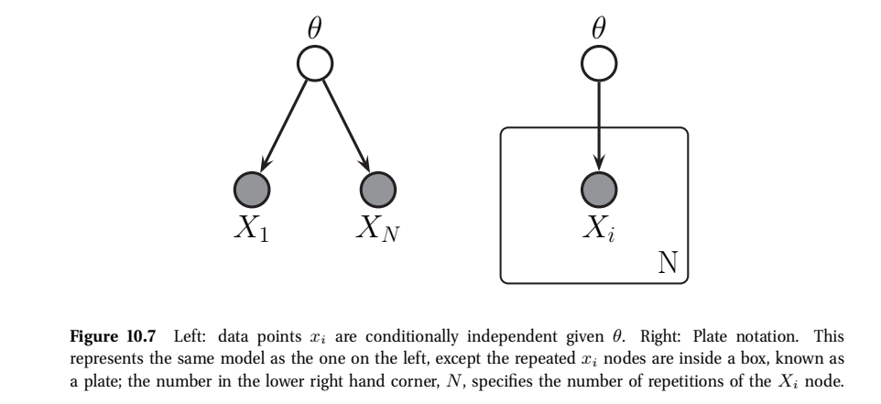
Plate Notation..

Slide 8
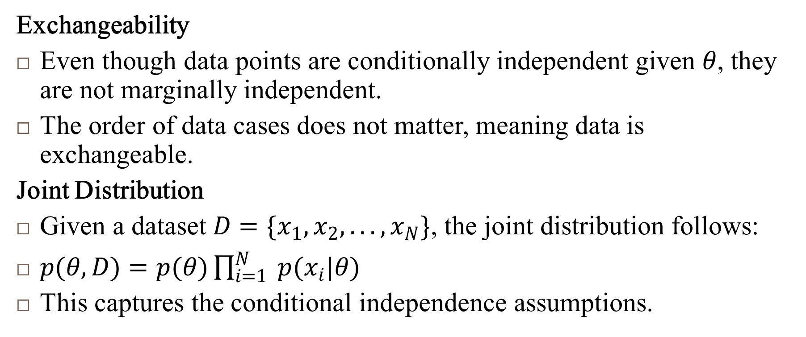
Plate Notation..
Exchangeability
Even though data points are conditionally independent given $θ$, they are not marginally independent.
The order of data cases does not matter, meaning data is exchangeable.
Joint Distribution
Given a dataset $D=\{x_{1},x_{2},...,x_{N}\}$, the joint distribution follows:
$p(θ,D)=p(θ)\prod_{i=1}^{N}{ }p(x_{i}|θ)$
This captures the conditional independence assumptions.

Slide 9
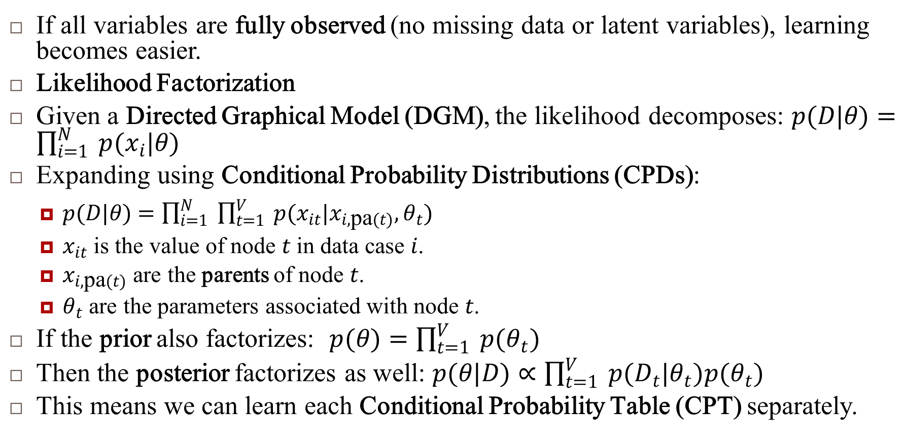
Learning from Complete Data
If all variables are fully observed (no missing data or latent variables), learning becomes easier.
Likelihood Factorization
Given a Directed Graphical Model (DGM), the likelihood decomposes: $p(D|θ)=\prod_{i=1}^{N}{ }p(x_{i}|θ)$
Expanding using Conditional Probability Distributions (CPDs):
$p(D|θ)=\prod_{i=1}^{N}{ }\prod_{t=1}^{V}{ }p(x_{it}|x_{i,\text{pa}(t)},θ_{t})$
$x_{it}$ is the value of node $t$ in data case $i$.
$x_{i,\text{pa}(t)}$ are the parents of node $t$.
$θ_{t}$ are the parameters associated with node $t$.
If the prior also factorizes: $p(θ)=\prod_{t=1}^{V}{ }p(θ_{t})$
Then the posterior factorizes as well: $p(θ|D)∝\prod_{t=1}^{V}{ }p(D_{t}|θ_{t})p(θ_{t})$
This means we can learn each Conditional Probability Table (CPT) separately.

Slide 10
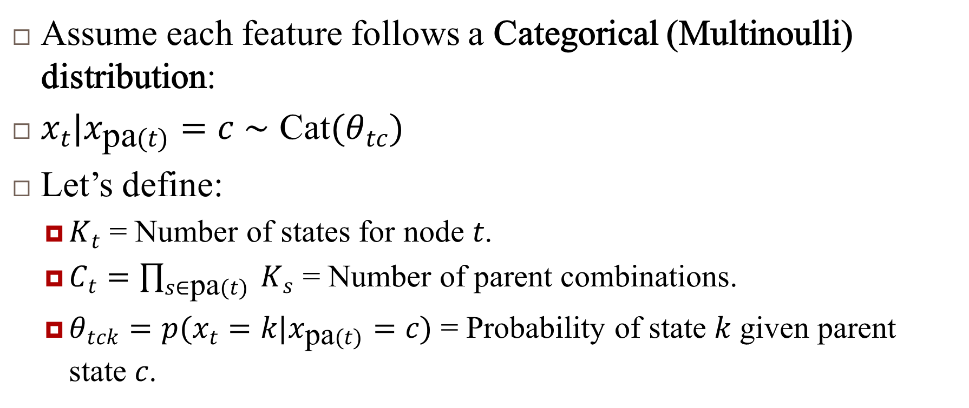
Learning Example: Naïve Bayes Model
Assume each feature follows a Categorical (Multinoulli) distribution:
$x_{t}|x_{\text{pa}(t)}=c∼\text{Cat}(θ_{tc})$
Let’s define:
$K_{t}$ = Number of states for node $t$.
$C_{t}=\prod_{s∈\text{pa}(t)}{ }K_{s}$ = Number of parent combinations.
$θ_{tck}=p(x_{t}=k|x_{\text{pa}(t)}=c)$ = Probability of state $k$ given parent state $c$.

Slide 11
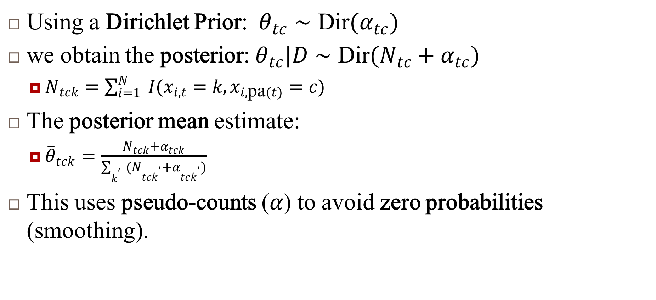
Learning Example: Naïve Bayes Model..
Using a Dirichlet Prior: $θ_{tc}∼\text{Dir}(α_{tc})$
we obtain the posterior: $θ_{tc}|D∼\text{Dir}(N_{tc}+α_{tc})$
$N_{tck}=\sum_{i=1}^{N}{ }I(x_{i,t}=k,x_{i,\text{pa}(t)}=c)$
The posterior mean estimate:
${\overset{‾}{θ}}_{tck}=\frac{N_{tck}+α_{tck}}{\sum_{k^{′}}{ } (N_{tck^{′}}+α_{tck^{′}})}$
This uses pseudo-counts ($α$) to avoid zero probabilities (smoothing).

Slide 12
Learning with Missing or Latent Variables
When data is incomplete (i.e., missing values or hidden variables), the likelihood no longer factorizes, making learning more challenging.
Key Challenges
Likelihood Function is No Longer Convex:
In MLE, we cannot directly compute a closed-form solution.
Optimization becomes more difficult, often requiring iterative methods.
Hidden Variables Must Be Integrated Out:
Direct summation over all possible hidden variables is infeasible.
Requires approximate inference techniques.
Approximate Inference Methods To deal with missing data or latent variables, we use:
Expectation-Maximization (EM) Algorithm: Alternates between estimating hidden variables and maximizing parameters.
Variational Inference: Uses a simpler distribution to approximate the true posterior.
Markov Chain Monte Carlo (MCMC): Samples from the posterior distribution.

Slide 13
Summary
Inference vs. Learning:
Inference computes probability distributions over hidden variables given parameters.
Learning estimates parameters from data (MLE, MAP, Bayesian methods).
Plate Notation:
Simplifies graphical models by grouping repeated variables.
Used for i.i.d. data and exchangeable distributions.
Learning from Complete Data:
The likelihood factorizes over CPDs.
Bayesian learning uses Dirichlet priors for smoothing.
Learning with Missing Data or Latent Variables:
Requires approximate inference methods (e.g., EM, Variational Inference, MCMC).

Slide 14
Reference
Murphy, Kevin P. Machine learning: a probabilistic perspective. MIT press, 2012.
Chapter 10

