Slide 1
Mixture Models and EM algorithm
EM Algorithm (2)
Dr. Prakash Andugula
CSE, RAIT
Advanced Machine Learning

Slide 2
EM Algorithm (2)

Slide 3
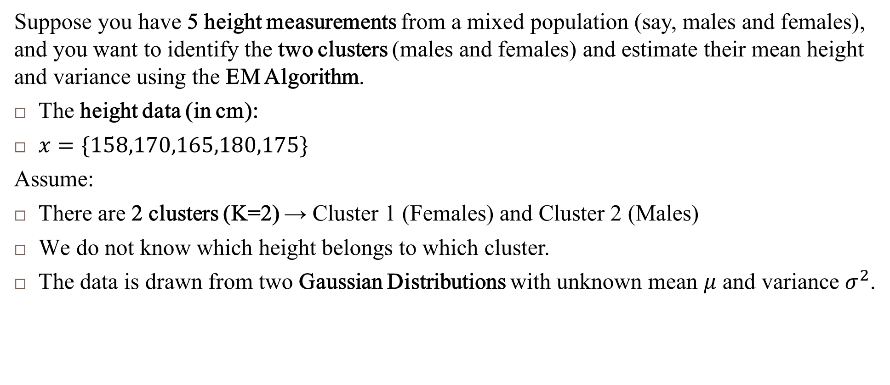
EM Algorithm Step-by-Step
Suppose you have 5 height measurements from a mixed population (say, males and females), and you want to identify the two clusters (males and females) and estimate their mean height and variance using the EM Algorithm.
The height data (in cm):
$x=\{158,170,165,180,175\}$
Assume:
There are 2 clusters (K=2) → Cluster 1 (Females) and Cluster 2 (Males)
We do not know which height belongs to which cluster.
The data is drawn from two Gaussian Distributions with unknown mean $μ$ and variance $σ^{2}$.

Slide 4
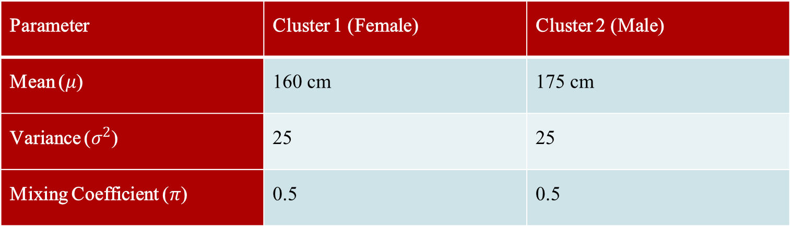
EM Algorithm Step-by-Step
Step 1: Initialize the Parameters (Random Guess)
Since we have no prior knowledge about the clusters, we start with random initial estimates:
Parameter | Cluster 1 (Female) | Cluster 2 (Male)
Mean ($μ$) | 160 cm | 175 cm
Variance ($σ^{2}$) | 25 | 25
Mixing Coefficient ($π$) | 0.5 | 0.5

Slide 5
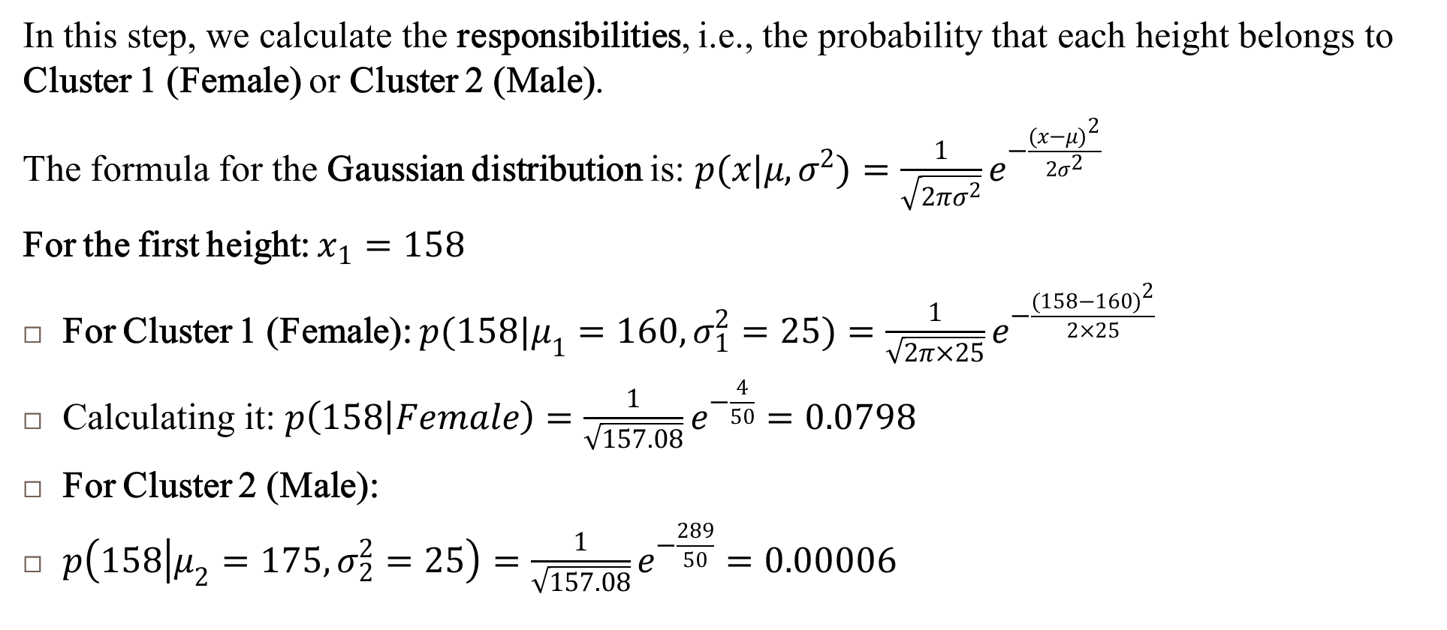
EM Algorithm Step-by-Step : Expectation Step (E-Step)
In this step, we calculate the responsibilities, i.e., the probability that each height belongs to Cluster 1 (Female) or Cluster 2 (Male).
The formula for the Gaussian distribution is: $p(x|μ,σ^{2})=\frac{1}{\sqrt{2πσ^{2}}}e^{−\frac{(x−μ)^{2}}{2σ^{2}}}$
For the first height: $x_{1}=158$
For Cluster 1 (Female): $p(158|μ_{1}=160,σ_{1}^{2}=25)=\frac{1}{\sqrt{2π×25}}e^{−\frac{(158−160)^{2}}{2×25}}$
Calculating it: $p\left(158 | Female\right)=\frac{1}{\sqrt{157.08}}e^{−\frac{4}{50}}=0.0798$
For Cluster 2 (Male):
$p\left(158 | μ_{2}=175,σ_{2}^{2}=25\right)=\frac{1}{\sqrt{157.08}}e^{−\frac{289}{50}}=0.00006$

Slide 6
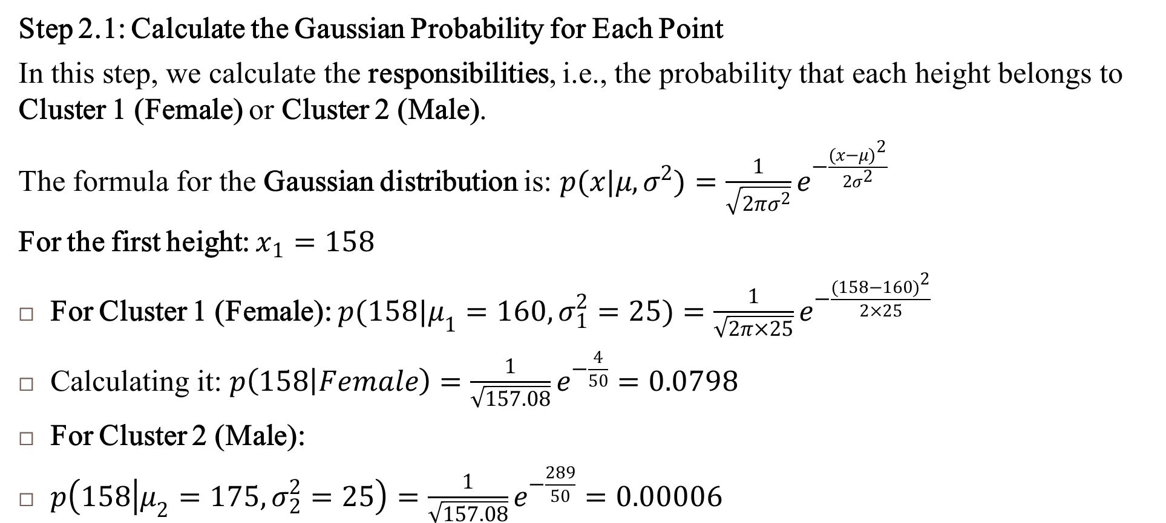
EM Algorithm Step-by-Step : Expectation Step (E-Step)
Step 2.1: Calculate the Gaussian Probability for Each Point
In this step, we calculate the responsibilities, i.e., the probability that each height belongs to Cluster 1 (Female) or Cluster 2 (Male).
The formula for the Gaussian distribution is: $p(x|μ,σ^{2})=\frac{1}{\sqrt{2πσ^{2}}}e^{−\frac{(x−μ)^{2}}{2σ^{2}}}$
For the first height: $x_{1}=158$
For Cluster 1 (Female): $p(158|μ_{1}=160,σ_{1}^{2}=25)=\frac{1}{\sqrt{2π×25}}e^{−\frac{(158−160)^{2}}{2×25}}$
Calculating it: $p\left(158 | Female\right)=\frac{1}{\sqrt{157.08}}e^{−\frac{4}{50}}=0.0798$
For Cluster 2 (Male):
$p\left(158 | μ_{2}=175,σ_{2}^{2}=25\right)=\frac{1}{\sqrt{157.08}}e^{−\frac{289}{50}}=0.00006$

Slide 7
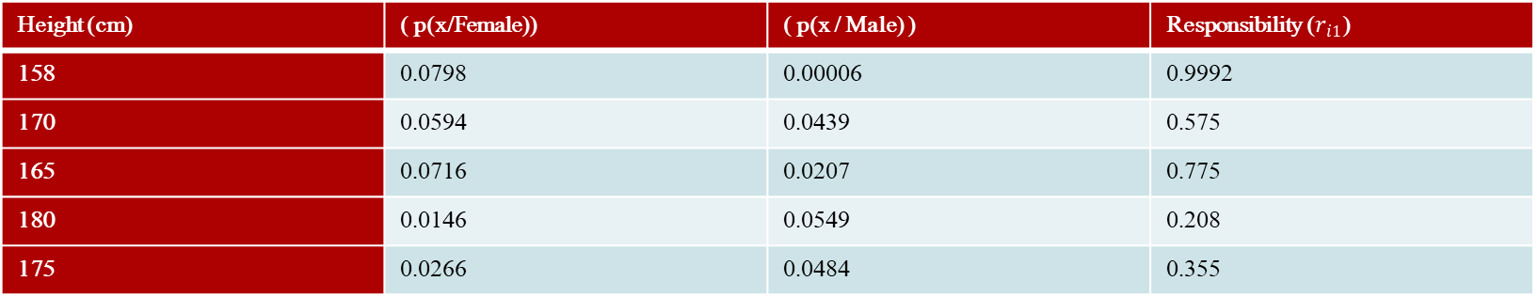
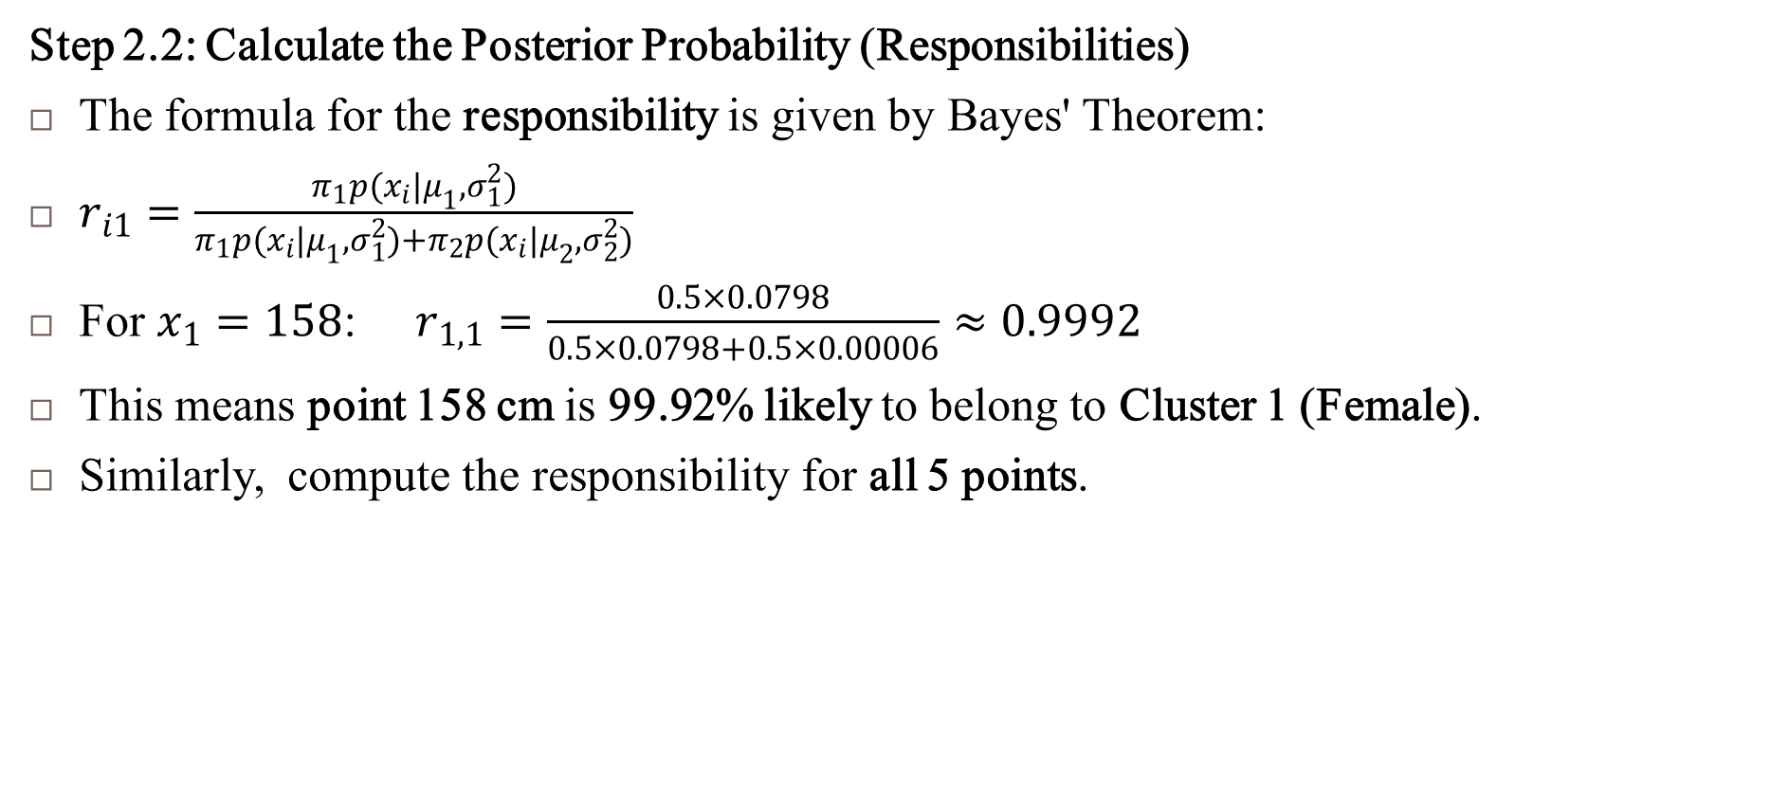
EM Algorithm Step-by-Step : Expectation Step (E-Step)
Step 2.2: Calculate the Posterior Probability (Responsibilities)
The formula for the responsibility is given by Bayes' Theorem:
$r_{i1}=\frac{π_{1}p(x_{i}|μ_{1},σ_{1}^{2})}{π_{1}p(x_{i}|μ_{1},σ_{1}^{2})+π_{2}p(x_{i}|μ_{2},σ_{2}^{2})}$
For $x_{1}=158$: $r_{1,1}=\frac{0.5×0.0798}{0.5×0.0798+0.5×0.00006}≈0.9992$
This means point 158 cm is 99.92% likely to belong to Cluster 1 (Female).
Similarly, compute the responsibility for all 5 points.
Height (cm) | ( p(x/Female)) | ( p(x / Male) ) | Responsibility ($r_{i1}$)
158 | 0.0798 | 0.00006 | 0.9992
170 | 0.0594 | 0.0439 | 0.575
165 | 0.0716 | 0.0207 | 0.775
180 | 0.0146 | 0.0549 | 0.208
175 | 0.0266 | 0.0484 | 0.355

Slide 8

EM Algorithm Step-by-Step : Expectation Step (E-Step)
Step 3 : Compute the Expected Log-Likelihood (Optional)
The expected log-likelihood is computed as:
$Q(θ,θ^{\left(t−1\right)})=\sum_{i=1}^{N}{ }\sum_{k=1}^{K}{ }r_{ik}[log (π_{k})+log(p(x_{i}|μ_{k},σ_{k}^{2}))]$
It's essentially maximizing the probability based on the calculated responsibilities.

Slide 9
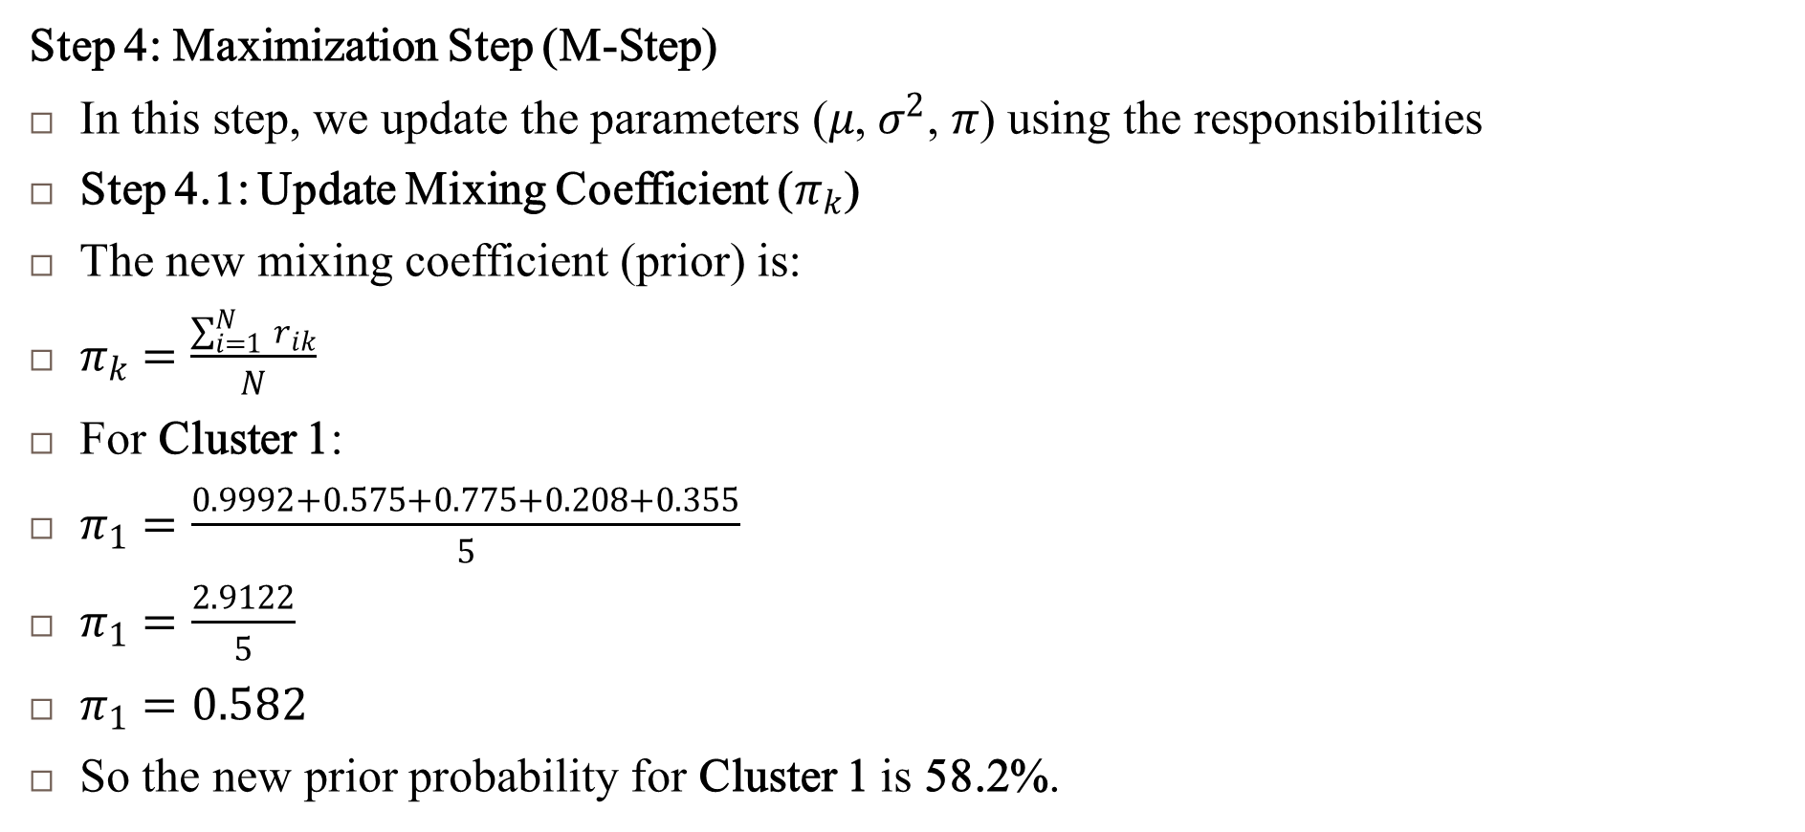
EM Algorithm Step-by-Step : Expectation Step (E-Step)
Step 4: Maximization Step (M-Step)
In this step, we update the parameters ($μ$, $σ^{2}$, $π$) using the responsibilities
Step 4.1: Update Mixing Coefficient ($π_{k}$)
The new mixing coefficient (prior) is:
$π_{k}=\frac{\sum_{i=1}^{N}{ } r_{ik}}{N}$
For Cluster 1:
$π_{1}=\frac{0.9992+0.575+0.775+0.208+0.355}{5}$
$π_{1}=\frac{2.9122}{5}$
$π_{1}=0.582$
So the new prior probability for Cluster 1 is 58.2%.

Slide 10
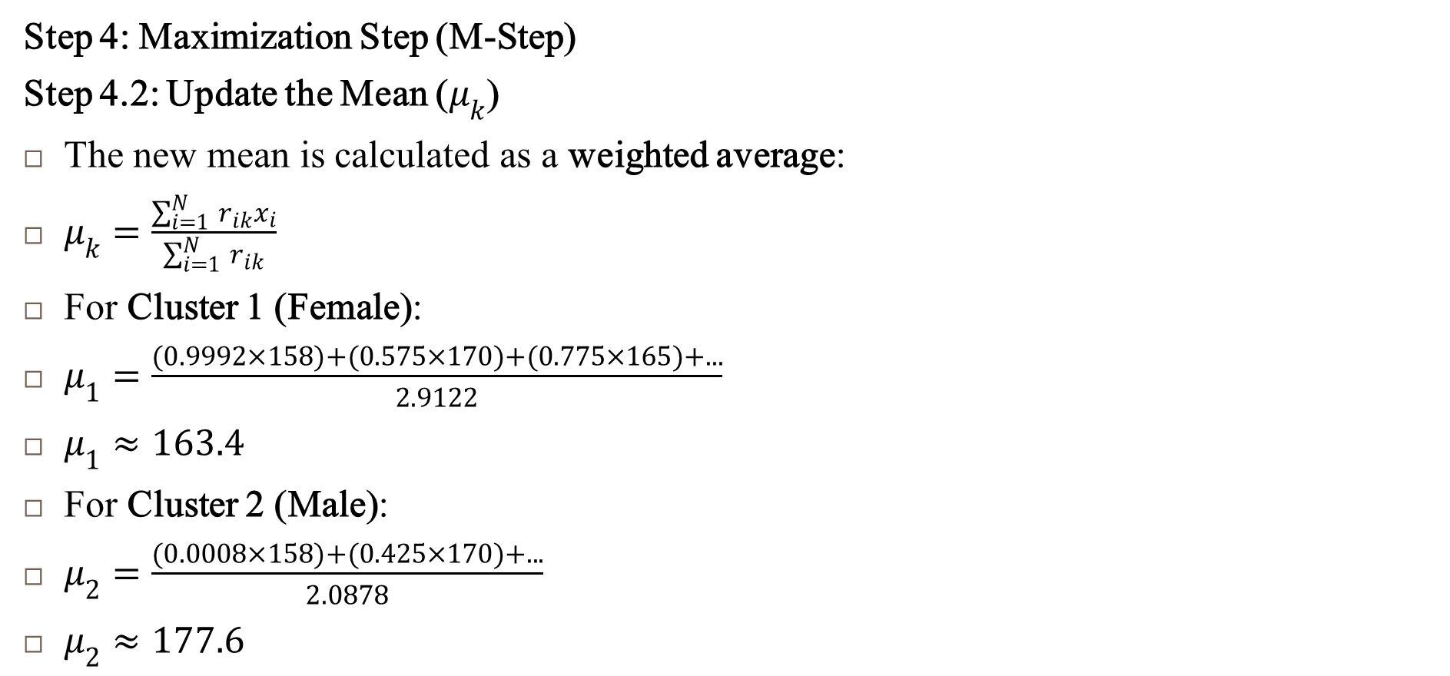
EM Algorithm Step-by-Step : Expectation Step (E-Step)
Step 4: Maximization Step (M-Step)
Step 4.2: Update the Mean ($μ_{k}$)
The new mean is calculated as a weighted average:
$μ_{k}=\frac{\sum_{i=1}^{N}{ } r_{ik}x_{i}}{\sum_{i=1}^{N}{ } r_{ik}}$
For Cluster 1 (Female):
$μ_{1}=\frac{(0.9992×158)+(0.575×170)+(0.775×165)+...}{2.9122}$
$μ_{1}≈163.4$
For Cluster 2 (Male):
$μ_{2}=\frac{(0.0008×158)+(0.425×170)+...}{2.0878}$
$μ_{2}≈177.6$

Slide 11

EM Algorithm Step-by-Step : Expectation Step (E-Step)
Step 4: Maximization Step (M-Step)
Step 4.3: Update the Variance ($σ_{k}^{2}$)
The new variance is:
$σ_{k}^{2}=\frac{\sum_{i=1}^{N}{ } r_{ik}(x_{i}−μ_{k})^{2}}{\sum_{i=1}^{N}{ } r_{ik}}$
For Cluster 1:
$σ_{1}^{2}=\frac{(0.9992×(158−163.4)^{2})+...}{2.9122}$
$σ_{1}^{2}≈18.6$
For Cluster 2:
$σ_{2}^{2}≈20.4$

Slide 12
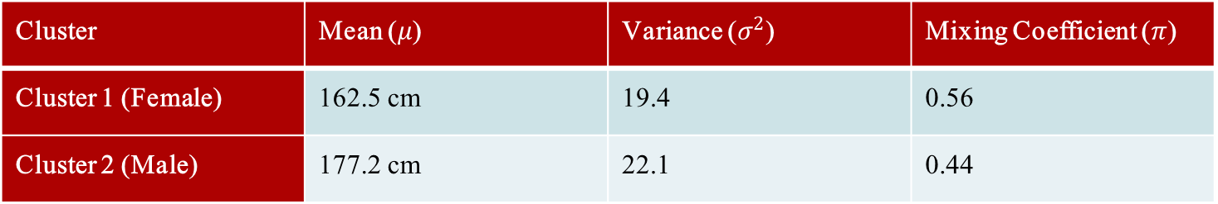
EM Algorithm Step-by-Step : Expectation Step (E-Step)
Step 5: Repeat E-Step and M-Step
Use the new means, variances, and priors to recalculate responsibilities (E-step).
Again maximize the log-likelihood (M-step).
Repeat until convergence.
Result after 3 Iterations
Cluster | Mean ($μ$) | Variance ($σ^{2}$) | Mixing Coefficient ($π$)
Cluster 1 (Female) | 162.5 cm | 19.4 | 0.56
Cluster 2 (Male) | 177.2 cm | 22.1 | 0.44

Slide 13
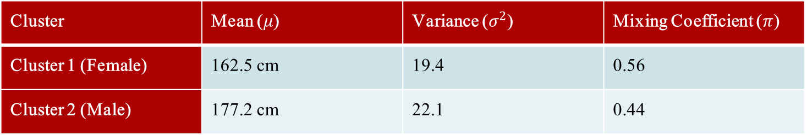
EM Algorithm Step-by-Step : Expectation Step (E-Step)
Step 5: Repeat E-Step and M-Step
Use the new means, variances, and priors to recalculate responsibilities (E-step).
Again maximize the log-likelihood (M-step).
Repeat until convergence.
Result after 3 Iterations
Cluster | Mean ($μ$) | Variance ($σ^{2}$) | Mixing Coefficient ($π$)
Cluster 1 (Female) | 162.5 cm | 19.4 | 0.56
Cluster 2 (Male) | 177.2 cm | 22.1 | 0.44
The EM Algorithm automatically separated the data into two clusters based on height without any labels.

Slide 14
References
Murphy, Kevin P. Machine learning: a probabilistic perspective. MIT press, 2012.
Chapter 11

