Slide 1
Mixture Models and EM algorithm
Expectation-Maximization
EM for Gaussian Mixture Models (GMMs)
EM for Mixture of Experts (MOEs)
Dr. Prakash Andugula
CSE, RAIT
Advanced Machine Learning

Slide 2
Expectation-Maximization (EM) for Gaussian Mixture Models (GMMs)

Slide 3
EM for GMMs
Expectation-Maximization (EM) algorithm is used to fit Gaussian Mixture Models (GMMs) when the data has multiple clusters but the cluster labels are hidden (latent variables).
It iteratively estimates the most likely cluster assignments and updates the Gaussian parameters.
EM is guaranteed to increase the likelihood at each iteration.
It finds a local maximum, so initialization matters.
The process generalizes to higher dimensions and different mixture models.

Slide 4
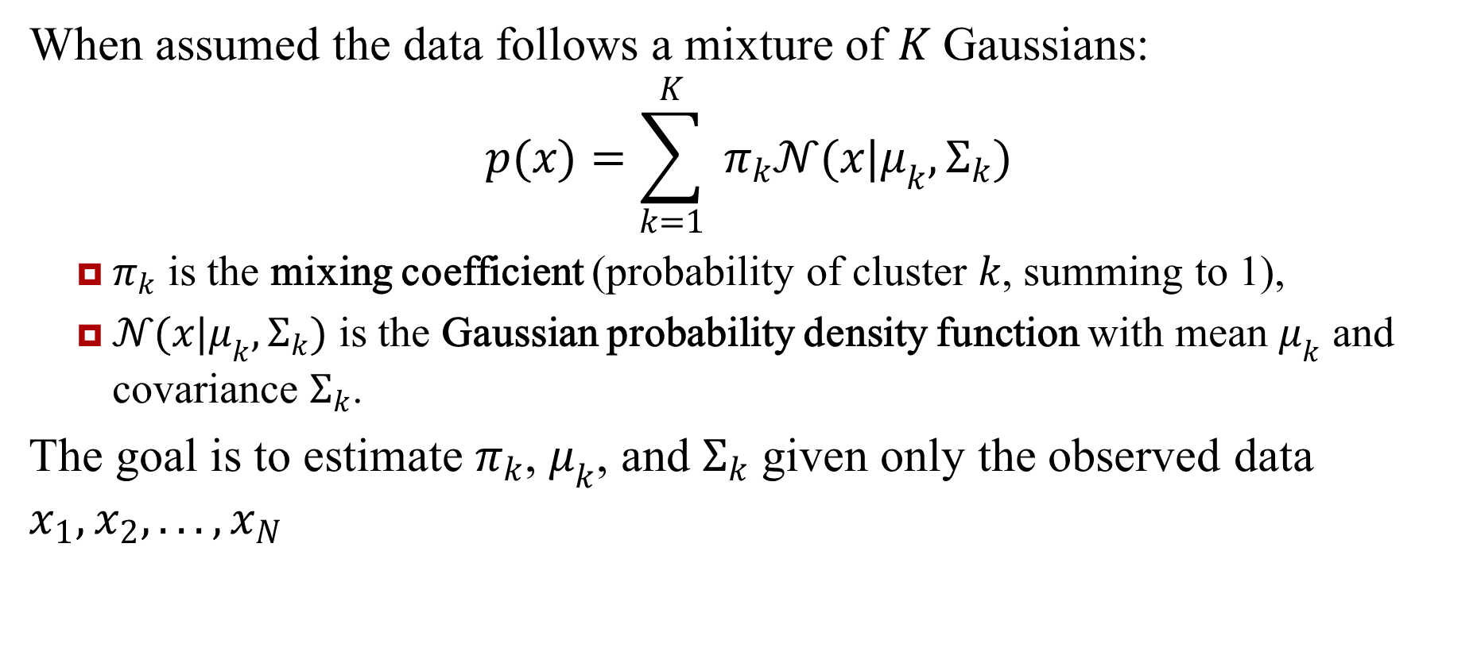
Mixture of Gaussians (MoG)
When assumed the data follows a mixture of $K$ Gaussians:
$$p(x)=\sum_{k=1}^{K}{ }π_{k}𝒩(x|μ_{k},Σ_{k})$$
$π_{k}$ is the mixing coefficient (probability of cluster $k$, summing to 1),
$𝒩(x|μ_{k},Σ_{k})$ is the Gaussian probability density function with mean $μ_{k}$ and covariance $Σ_{k}$.
The goal is to estimate $π_{k}$, $μ_{k}$, and $Σ_{k}$ given only the observed data $x_{1},x_{2},...,x_{N}$

Slide 5
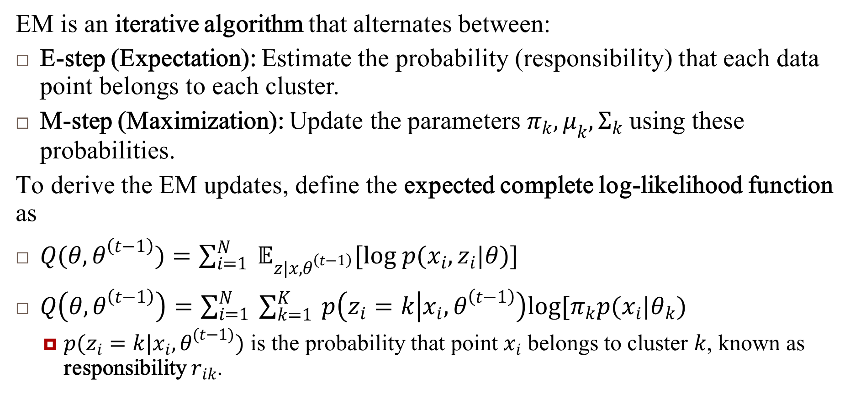
EM Algorithm (MoG)
EM is an iterative algorithm that alternates between:
E-step (Expectation): Estimate the probability (responsibility) that each data point belongs to each cluster.
M-step (Maximization): Update the parameters $π_{k},μ_{k},Σ_{k}$ using these probabilities.
To derive the EM updates, define the expected complete log-likelihood function as
$Q(θ,θ^{\left(t−1\right)})=\sum_{i=1}^{N}{ }𝔼_{z|x,θ^{\left(t−1\right)}}[log p(x_{i},z_{i}|θ)]$
$Q\left(θ,θ^{\left(t−1\right)}\right)=\sum_{i=1}^{N}{ }\sum_{k=1}^{K}{ }p\left(z_{i}=k | x_{i},θ^{\left(t−1\right)}\right)log[π_{k}p(x_{i}|θ_{k})$
$p(z_{i}=k|x_{i},θ^{(t−1)})$ is the probability that point $x_{i}$ belongs to cluster $k$, known as responsibility $r_{ik}$.

Slide 6
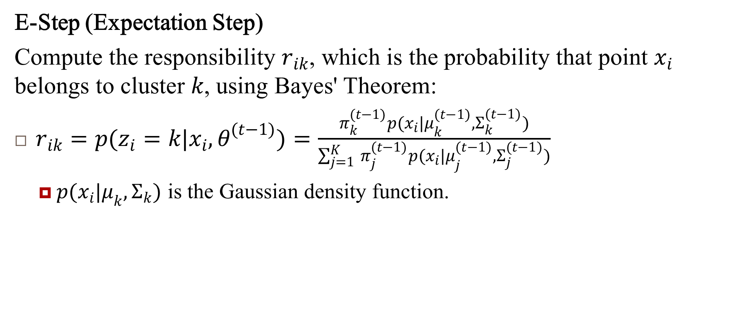
EM Algorithm for GMM (MoG)
E-Step (Expectation Step)
Compute the responsibility $r_{ik}$, which is the probability that point $x_{i}$ belongs to cluster $k$, using Bayes' Theorem:
$r_{ik}=p(z_{i}=k|x_{i},θ^{(t−1)})=\frac{π_{k}^{(t−1)}p(x_{i}|μ_{k}^{(t−1)},Σ_{k}^{(t−1)})}{\sum_{j=1}^{K}{ } π_{j}^{(t−1)}p(x_{i}|μ_{j}^{(t−1)},Σ_{j}^{(t−1)})}$
$p(x_{i}|μ_{k},Σ_{k})$ is the Gaussian density function.

Slide 7
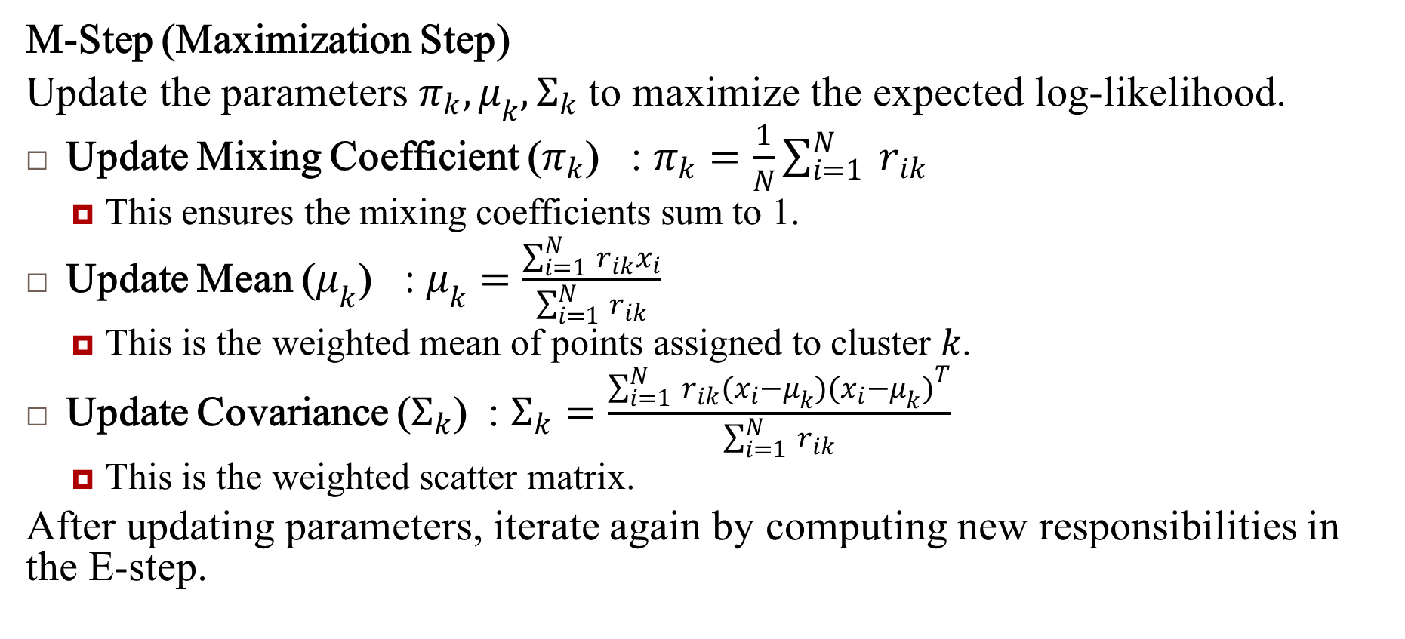
EM Algorithm for GMM.. (MoG)
M-Step (Maximization Step)
Update the parameters $π_{k},μ_{k},Σ_{k}$ to maximize the expected log-likelihood.
Update Mixing Coefficient ($π_{k}$) : $π_{k}=\frac{1}{N}\sum_{i=1}^{N}{ }r_{ik}$
This ensures the mixing coefficients sum to 1.
Update Mean ($μ_{k}$) : $μ_{k}=\frac{\sum_{i=1}^{N}{ } r_{ik}x_{i}}{\sum_{i=1}^{N}{ } r_{ik}}$
This is the weighted mean of points assigned to cluster $k$.
Update Covariance ($Σ_{k}$) : $Σ_{k}=\frac{\sum_{i=1}^{N}{ } r_{ik}(x_{i}−μ_{k})(x_{i}−μ_{k})^{T}}{\sum_{i=1}^{N}{ } r_{ik}}$
This is the weighted scatter matrix.
After updating parameters, iterate again by computing new responsibilities in the E-step.

Slide 8
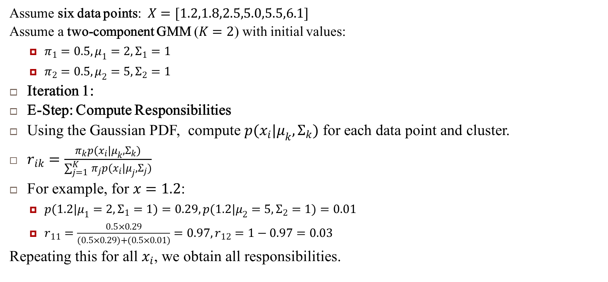
Applying EM to a 1D GMM
Assume six data points: $X=[1.2,1.8,2.5,5.0,5.5,6.1]$
Assume a two-component GMM ($K=2$) with initial values:
$π_{1}=0.5, μ_{1}=2, Σ_{1}=1$
$π_{2}=0.5, μ_{2}=5, Σ_{2}=1$
Iteration 1:
E-Step: Compute Responsibilities
Using the Gaussian PDF, compute $p(x_{i}|μ_{k},Σ_{k})$ for each data point and cluster.
$r_{ik}=\frac{π_{k}p(x_{i}|μ_{k},Σ_{k})}{\sum_{j=1}^{K}{ } π_{j}p(x_{i}|μ_{j},Σ_{j})}$
For example, for $x=1.2$:
$p(1.2|μ_{1}=2,Σ_{1}=1)=0.29, p(1.2|μ_{2}=5,Σ_{2}=1)=0.01$
$r_{11}=\frac{0.5×0.29}{(0.5×0.29)+(0.5×0.01)}=0.97, r_{12}=1−0.97=0.03$
Repeating this for all $x_{i}$, we obtain all responsibilities.

Slide 9
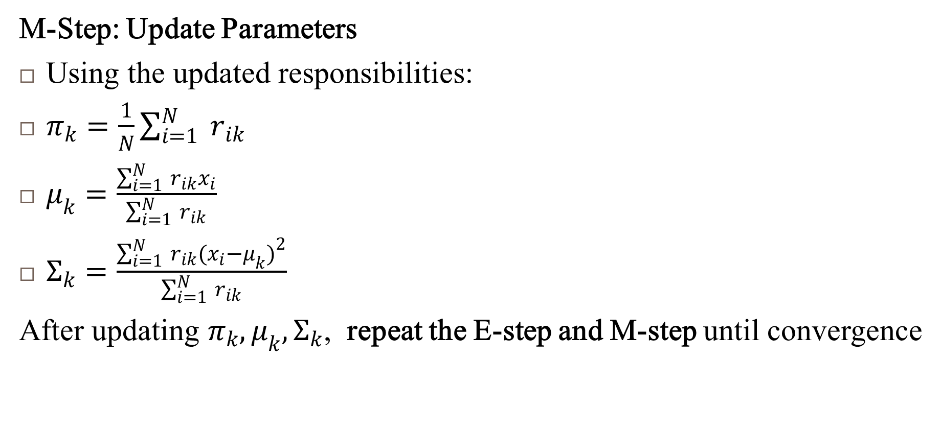
Applying EM to a 1D GMM..
M-Step: Update Parameters
Using the updated responsibilities:
$π_{k}=\frac{1}{N}\sum_{i=1}^{N}{ }r_{ik}$
$μ_{k}=\frac{\sum_{i=1}^{N}{ } r_{ik}x_{i}}{\sum_{i=1}^{N}{ } r_{ik}}$
$Σ_{k}=\frac{\sum_{i=1}^{N}{ } r_{ik}(x_{i}−μ_{k})^{2}}{\sum_{i=1}^{N}{ } r_{ik}}$
After updating $π_{k},μ_{k},Σ_{k}$, repeat the E-step and M-step until convergence

Slide 10
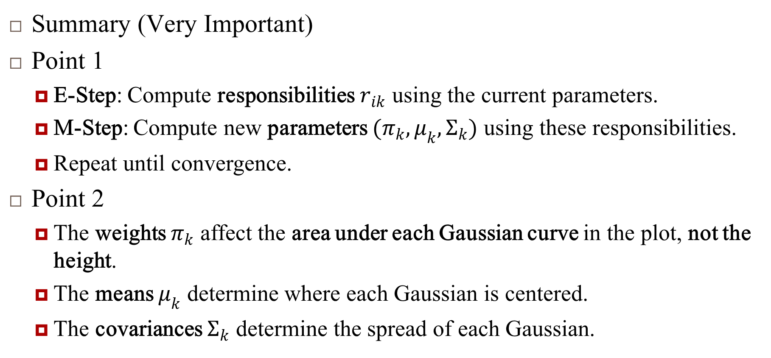
Applying EM to a 1D GMM..
Summary (Very Important)
Point 1
E-Step: Compute responsibilities $r_{ik}$ using the current parameters.
M-Step: Compute new parameters $(π_{k},μ_{k},Σ_{k})$ using these responsibilities.
Repeat until convergence.
Point 2
The weights $π_{k}$ affect the area under each Gaussian curve in the plot, not the height.
The means $μ_{k}$ determine where each Gaussian is centered.
The covariances $Σ_{k}$ determine the spread of each Gaussian.

Slide 11
Expectation-Maximization (EM) for Mixture of Experts (MoEs)

Slide 12
Mixture of Experts (MoEs)
Mixture of Experts (MoE) model is a type of mixture model where each component is a different expert (typically a regression model), and a gating function determines the probability of selecting each expert.
The EM algorithm is used to optimize this model, similar to Gaussian Mixture Models (GMMs), but with some key differences.

Slide 13
EM for MoE
EM in a Mixture of Experts model is to find the best parameters for both the experts (regression models) and the gating function that determines which expert is responsible for which data point.
Expected Complete Data Log-Likelihood (Q-function)
E-step: Computing Responsibilities
M-step: Updating Parameters

Slide 14
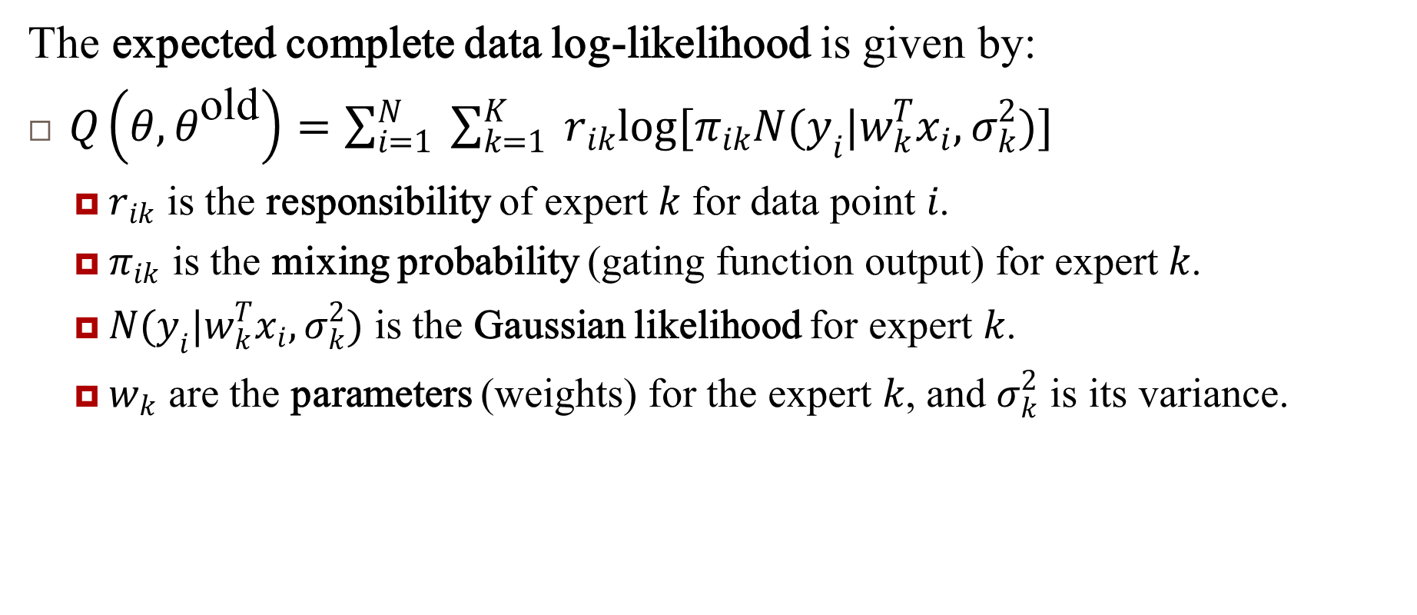
Expected Complete Data Log-Likelihood (Q-function)
The expected complete data log-likelihood is given by:
$Q\left(θ,θ^{\text{old}}\right)=\sum_{i=1}^{N}{ }\sum_{k=1}^{K}{ }r_{ik}log[π_{ik}N(y_{i}|w_{k}^{T}x_{i},σ_{k}^{2})]$
$r_{ik}$ is the responsibility of expert $k$ for data point $i$.
$π_{ik}$ is the mixing probability (gating function output) for expert $k$.
$N(y_{i}|w_{k}^{T}x_{i},σ_{k}^{2})$ is the Gaussian likelihood for expert $k$.
$w_{k}$ are the parameters (weights) for the expert $k$, and $σ_{k}^{2}$ is its variance.

Slide 15
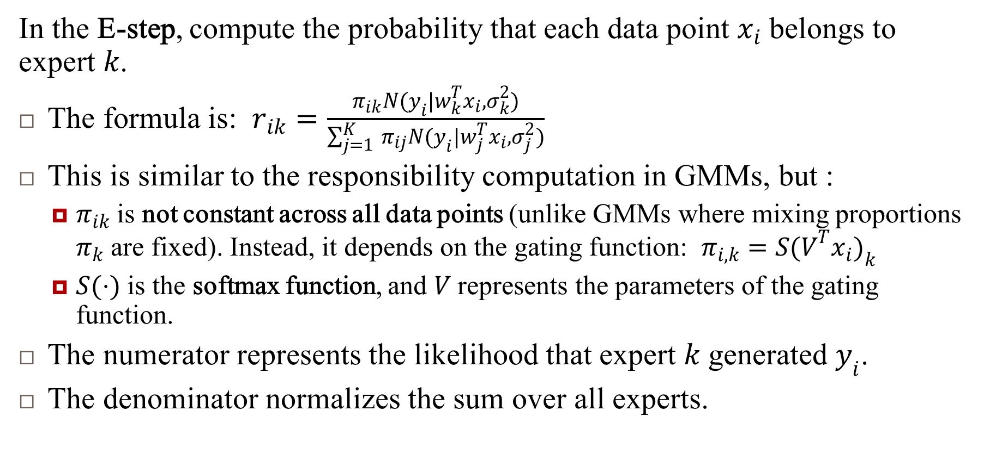
E-step: Computing Responsibilities
In the E-step, compute the probability that each data point $x_{i}$ belongs to expert $k$.
The formula is: $r_{ik}=\frac{π_{ik}N(y_{i}|w_{k}^{T}x_{i},σ_{k}^{2})}{\sum_{j=1}^{K}{ } π_{ij}N(y_{i}|w_{j}^{T}x_{i},σ_{j}^{2})}$
This is similar to the responsibility computation in GMMs, but :
$π_{ik}$ is not constant across all data points (unlike GMMs where mixing proportions $π_{k}$ are fixed). Instead, it depends on the gating function: $π_{i,k}=S(V^{T}x_{i})_{k}$
$S(⋅)$ is the softmax function, and $V$ represents the parameters of the gating function.
The numerator represents the likelihood that expert $k$ generated $y_{i}$.
The denominator normalizes the sum over all experts.

Slide 16
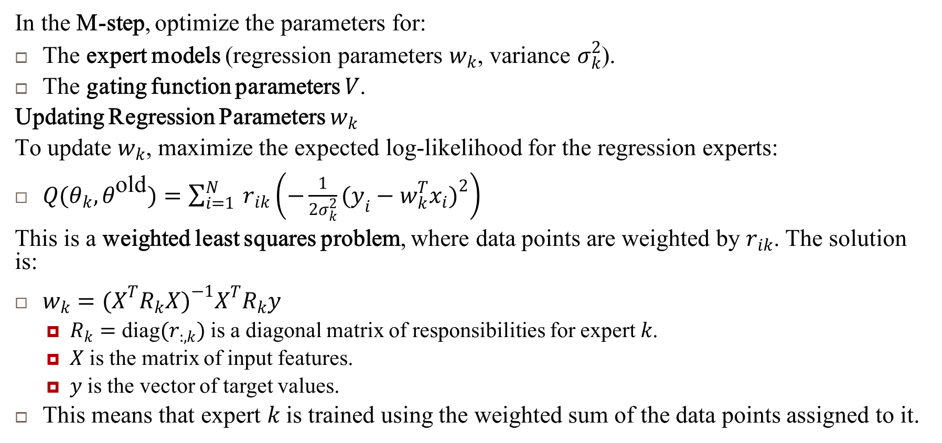
M-step: Updating Parameters (1)
In the M-step, optimize the parameters for:
The expert models (regression parameters $w_{k}$, variance $σ_{k}^{2}$).
The gating function parameters $V$.
Updating Regression Parameters $w_{k}$
To update $w_{k}$, maximize the expected log-likelihood for the regression experts:
$Q(θ_{k},θ^{\text{old}})=\sum_{i=1}^{N}{ }r_{ik}\left(−\frac{1}{2σ_{k}^{2}}(y_{i}−w_{k}^{T}x_{i})^{2}\right)$
This is a weighted least squares problem, where data points are weighted by $r_{ik}$. The solution is:
$w_{k}=(X^{T}R_{k}X)^{−1}X^{T}R_{k}y$
$R_{k}=\text{diag}(r_{:,k})$ is a diagonal matrix of responsibilities for expert $k$.
$X$ is the matrix of input features.
$y$ is the vector of target values.
This means that expert $k$ is trained using the weighted sum of the data points assigned to it.

Slide 17
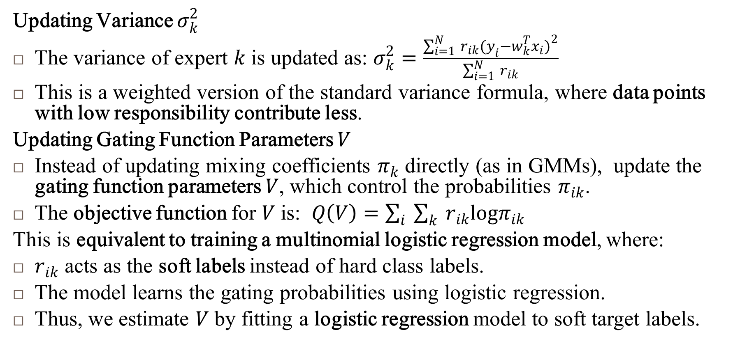
M-step: Updating Parameters (2)
Updating Variance $σ_{k}^{2}$
The variance of expert $k$ is updated as: $σ_{k}^{2}=\frac{\sum_{i=1}^{N}{ } r_{ik}(y_{i}−w_{k}^{T}x_{i})^{2}}{\sum_{i=1}^{N}{ } r_{ik}}$
This is a weighted version of the standard variance formula, where data points with low responsibility contribute less.
Updating Gating Function Parameters $V$
Instead of updating mixing coefficients $π_{k}$ directly (as in GMMs), update the gating function parameters $V$, which control the probabilities $π_{ik}$.
The objective function for $V$ is: $Q\left(V\right)=\sum_{i}{ }\sum_{k}{ }r_{ik}logπ_{ik}$
This is equivalent to training a multinomial logistic regression model, where:
$r_{ik}$ acts as the soft labels instead of hard class labels.
The model learns the gating probabilities using logistic regression.
Thus, we estimate $V$ by fitting a logistic regression model to soft target labels.

Slide 18
Summary : EM for MoE (1)
E-step: Assign responsibilities to each expert based on how well it explains the data.
M-step:
Update regression models using weighted least squares.
Update variances using weighted residual errors.
Update gating function using logistic regression.
This process iterates until convergence, refining the experts and the gating function to best fit the data.

Slide 19
Summary : EM for MoE (2)
The EM algorithm for the Mixture of Experts (MoE) model extends the traditional GMM framework by introducing:
Expert models (regressors) instead of simple Gaussian distributions.
A gating function (softmax) that dynamically assigns mixing probabilities.
This allows MoE to be a framework for adaptive regression models, where different subsets of the data can be modeled by different experts, and a gating network determines which expert to use based on the input features.
(This is a very important point)

Slide 20
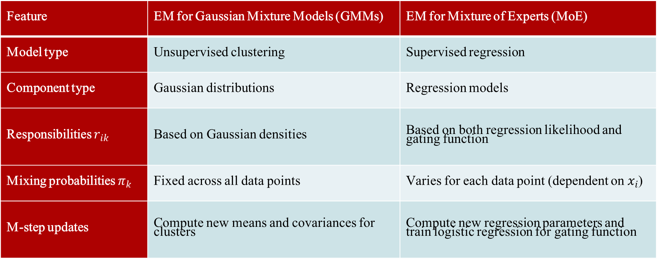
Differences Between EM for GMMs and MoE
Feature | EM for Gaussian Mixture Models (GMMs) | EM for Mixture of Experts (MoE)
Model type | Unsupervised clustering | Supervised regression
Component type | Gaussian distributions | Regression models
Responsibilities $r_{ik}$ | Based on Gaussian densities | Based on both regression likelihood and gating function
Mixing probabilities $π_{k}$ | Fixed across all data points | Varies for each data point (dependent on $x_{i}$)
M-step updates | Compute new means and covariances for clusters | Compute new regression parameters and train logistic regression for gating function

Slide 21
References
Murphy, Kevin P. Machine learning: a probabilistic perspective. MIT press, 2012.
Chapter 11

