Slide 1
Mixture Models and EM algorithm
Fitting Models with Missing Data
Model Selection for Latent Variable Models
Dr. Prakash Andugula
CSE, RAIT
Advanced Machine Learning

Slide 2
Fitting Models with Missing Data

Slide 3
Missing Data
In many real-world scenarios, datasets are incomplete due to missing values.
Missing data can occur due to various reasons, such as sensor failures, survey non-responses, or errors in data collection.
Handling missing data is crucial because standard machine learning and statistical methods assume complete data.
The Expectation-Maximization (EM) algorithm provides an efficient way to estimate parameters in models when data is missing.

Slide 4
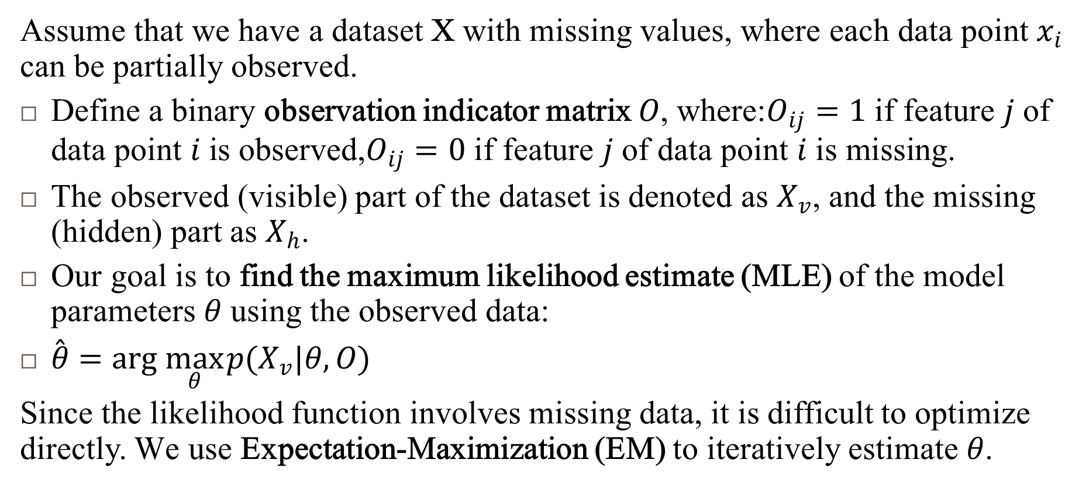
Issues with Missing Data
Assume that we have a dataset X with missing values, where each data point $x_{i}$ can be partially observed.
Define a binary observation indicator matrix $O$, where:$O_{ij}=1 \text{if} \text{feature} j \text{of} \text{data} \text{point} i \text{is} \text{observed}\text{,}O_{ij}=0 \text{if} \text{feature} j \text{of} \text{data} \text{point} i \text{is} \text{missing}\text{.}$
The observed (visible) part of the dataset is denoted as $X_{v}$, and the missing (hidden) part as $X_{h}$.
Our goal is to find the maximum likelihood estimate (MLE) of the model parameters $θ$ using the observed data:
$\overset{ˆ}{θ}=arg \max_{θ} p(X_{v}|θ,O)$
Since the likelihood function involves missing data, it is difficult to optimize directly. We use Expectation-Maximization (EM) to iteratively estimate $θ$.

Slide 5
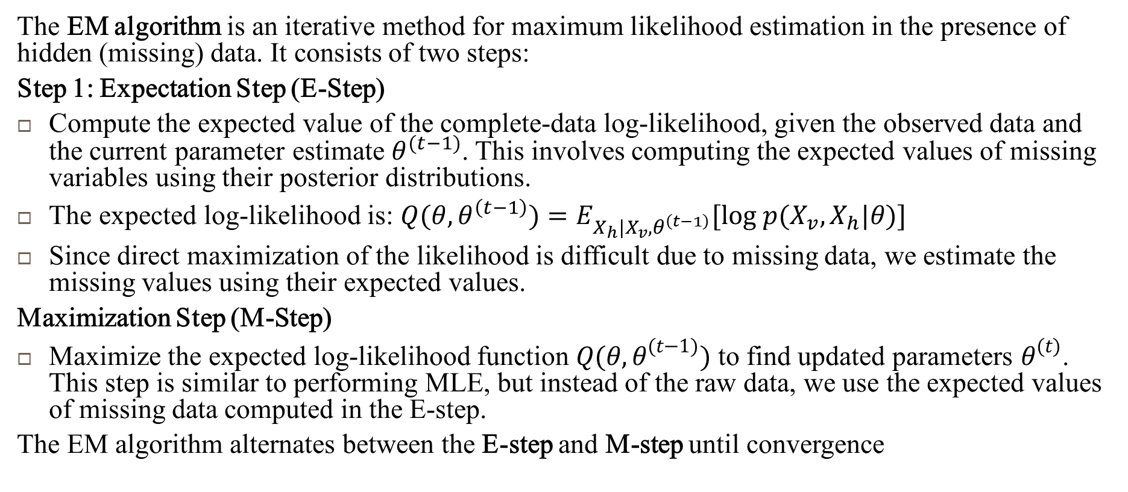
Expectation-Maximization (EM) Algorithm for Missing Data
The EM algorithm is an iterative method for maximum likelihood estimation in the presence of hidden (missing) data. It consists of two steps:
Step 1: Expectation Step (E-Step)
Compute the expected value of the complete-data log-likelihood, given the observed data and the current parameter estimate $θ^{(t−1)}$. This involves computing the expected values of missing variables using their posterior distributions.
The expected log-likelihood is: $Q(θ,θ^{\left(t−1\right)})=E_{X_{h}|X_{v},θ^{\left(t−1\right)}}[log p(X_{v},X_{h}|θ)]$
Since direct maximization of the likelihood is difficult due to missing data, we estimate the missing values using their expected values.
Maximization Step (M-Step)
Maximize the expected log-likelihood function $Q(θ,θ^{(t−1)})$ to find updated parameters $θ^{(t)}$. This step is similar to performing MLE, but instead of the raw data, we use the expected values of missing data computed in the E-step.
The EM algorithm alternates between the E-step and M-step until convergence

Slide 6
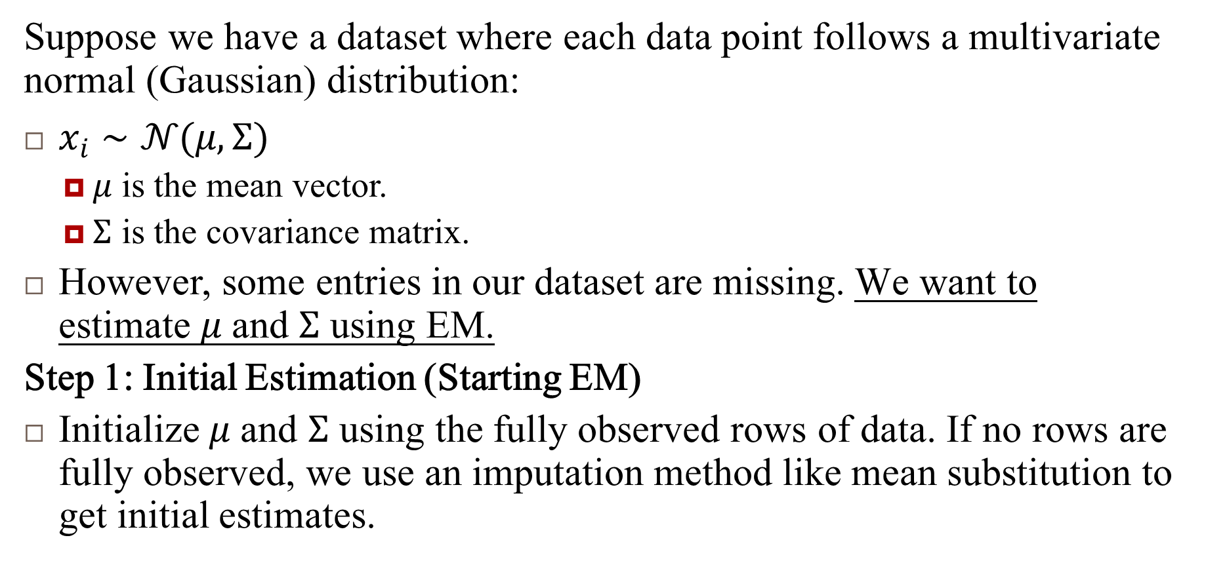
Example: Fitting a Multivariate Normal (MVN) Distribution with Missing Data
Suppose we have a dataset where each data point follows a multivariate normal (Gaussian) distribution:
$x_{i}∼𝒩(μ,Σ)$
$μ$ is the mean vector.
$Σ$ is the covariance matrix.
However, some entries in our dataset are missing. We want to estimate $μ$ and $Σ$ using EM.
Step 1: Initial Estimation (Starting EM)
Initialize $μ$ and $Σ$ using the fully observed rows of data. If no rows are fully observed, we use an imputation method like mean substitution to get initial estimates.

Slide 7
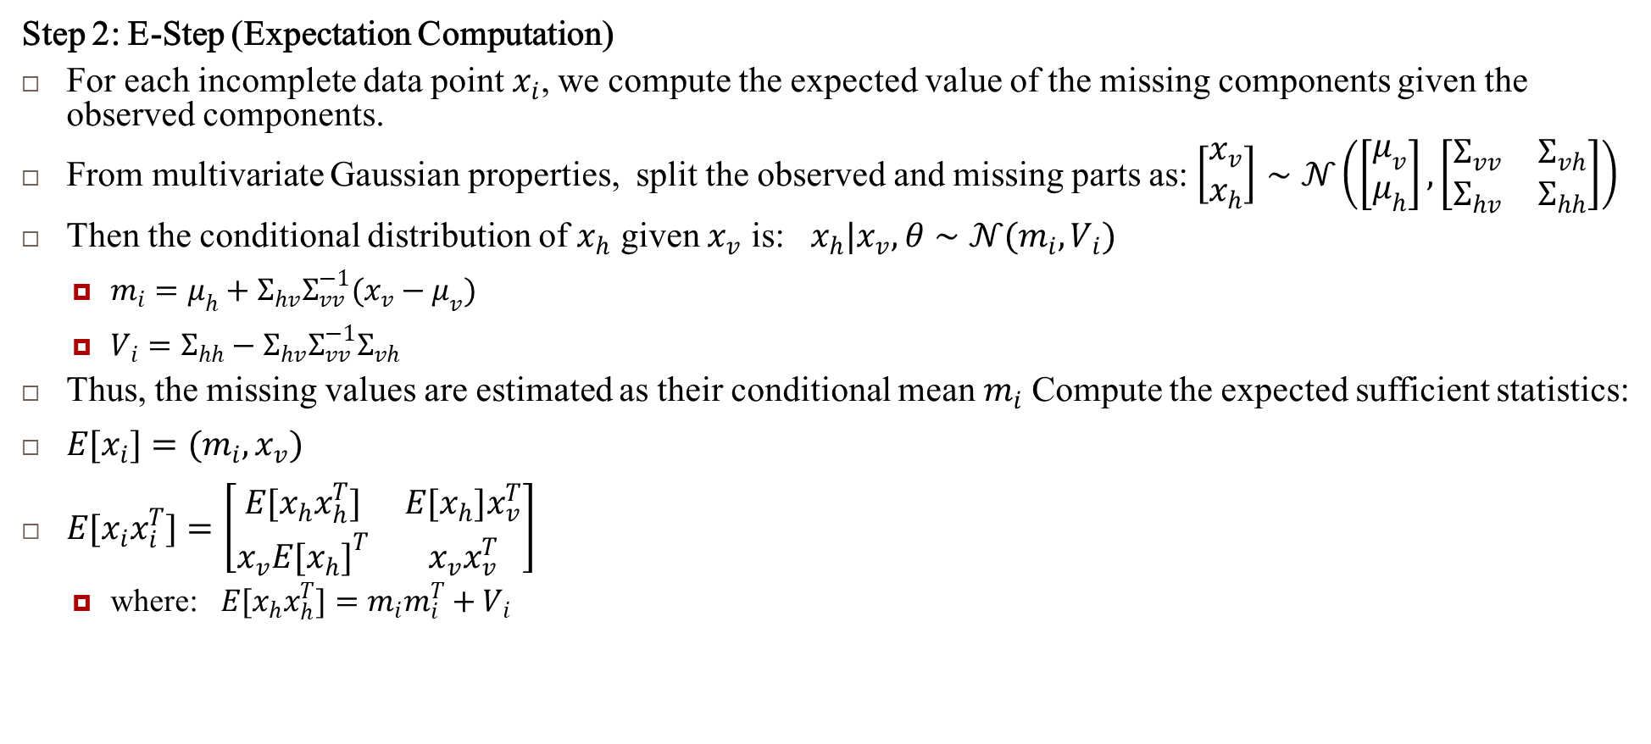
Example: Fitting a Multivariate Normal (MVN) Distribution with Missing Data
Step 2: E-Step (Expectation Computation)
For each incomplete data point $x_{i}$, we compute the expected value of the missing components given the observed components.
From multivariate Gaussian properties, split the observed and missing parts as: $\left[\begin{matrix}x_{v} \\ x_{h}\end{matrix}\right]∼𝒩\left(\left[\begin{matrix}μ_{v} \\ μ_{h}\end{matrix}\right],\left[\begin{matrix}Σ_{vv} & Σ_{vh} \\ Σ_{hv} & Σ_{hh}\end{matrix}\right]\right)$
Then the conditional distribution of $x_{h}$ given $x_{v}$ is: $x_{h}|x_{v},θ∼𝒩(m_{i},V_{i})$
$m_{i}=μ_{h}+Σ_{hv}Σ_{vv}^{−1}(x_{v}−μ_{v})$
$V_{i}=Σ_{hh}−Σ_{hv}Σ_{vv}^{−1}Σ_{vh}$
Thus, the missing values are estimated as their conditional mean $m_{i}$ Compute the expected sufficient statistics:
$E[x_{i}]=(m_{i},x_{v})$
$E[x_{i}x_{i}^{T}]=\left[\begin{matrix}E[x_{h}x_{h}^{T}] & E[x_{h}]x_{v}^{T} \\ x_{v}E[x_{h}]^{T} & x_{v}x_{v}^{T}\end{matrix}\right]$
where: $E[x_{h}x_{h}^{T}]=m_{i}m_{i}^{T}+V_{i}$

Slide 8
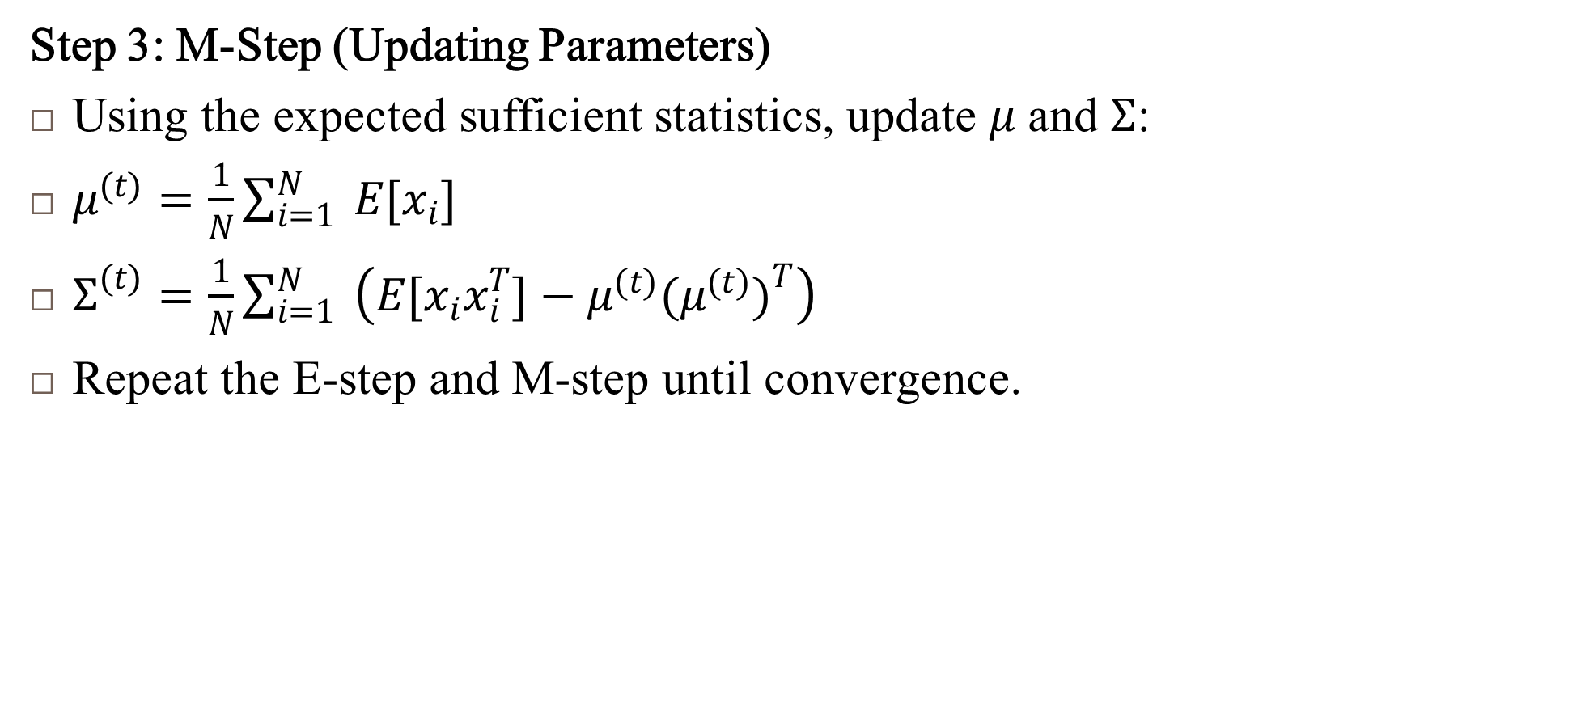
Example: Fitting a Multivariate Normal (MVN) Distribution with Missing Data
Step 3: M-Step (Updating Parameters)
Using the expected sufficient statistics, update $μ$ and $Σ$:
$μ^{(t)}=\frac{1}{N}\sum_{i=1}^{N}{ }E[x_{i}]$
$Σ^{(t)}=\frac{1}{N}\sum_{i=1}^{N}{ }\left(E[x_{i}x_{i}^{T}]−μ^{(t)}(μ^{(t)})^{T}\right)$
Repeat the E-step and M-step until convergence.

Slide 9
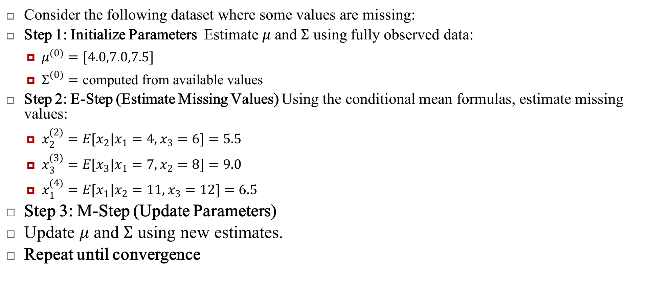
Example: Fitting a Multivariate Normal (MVN) Distribution with Missing Data
Consider the following dataset where some values are missing:
Step 1: Initialize Parameters Estimate $μ$ and $Σ$ using fully observed data:
$μ^{(0)}=[4.0,7.0,7.5]$
$Σ^{(0)}=\text{computed} \text{from} \text{available} \text{values}$
Step 2: E-Step (Estimate Missing Values) Using the conditional mean formulas, estimate missing values:
$x_{2}^{(2)}=E[x_{2}|x_{1}=4,x_{3}=6]=5.5$
$x_{3}^{(3)}=E[x_{3}|x_{1}=7,x_{2}=8]=9.0$
$x_{1}^{(4)}=E[x_{1}|x_{2}=11,x_{3}=12]=6.5$
Step 3: M-Step (Update Parameters)
Update $μ$ and $Σ$ using new estimates.
Repeat until convergence

Slide 10
Summary
The EM algorithm provides an iterative way to estimate missing data and learn model parameters.
E-Step: Compute expected values of missing data using conditional distributions.
M-Step: Update parameters using expected sufficient statistics.
EM guarantees that the likelihood increases at each iteration, leading to a local maximum.
EM is widely used in Gaussian Mixture Models (GMMs), Hidden Markov Models (HMMs), and Bayesian Networks.

Slide 11
Model Selection for Latent Variable Models

Slide 12
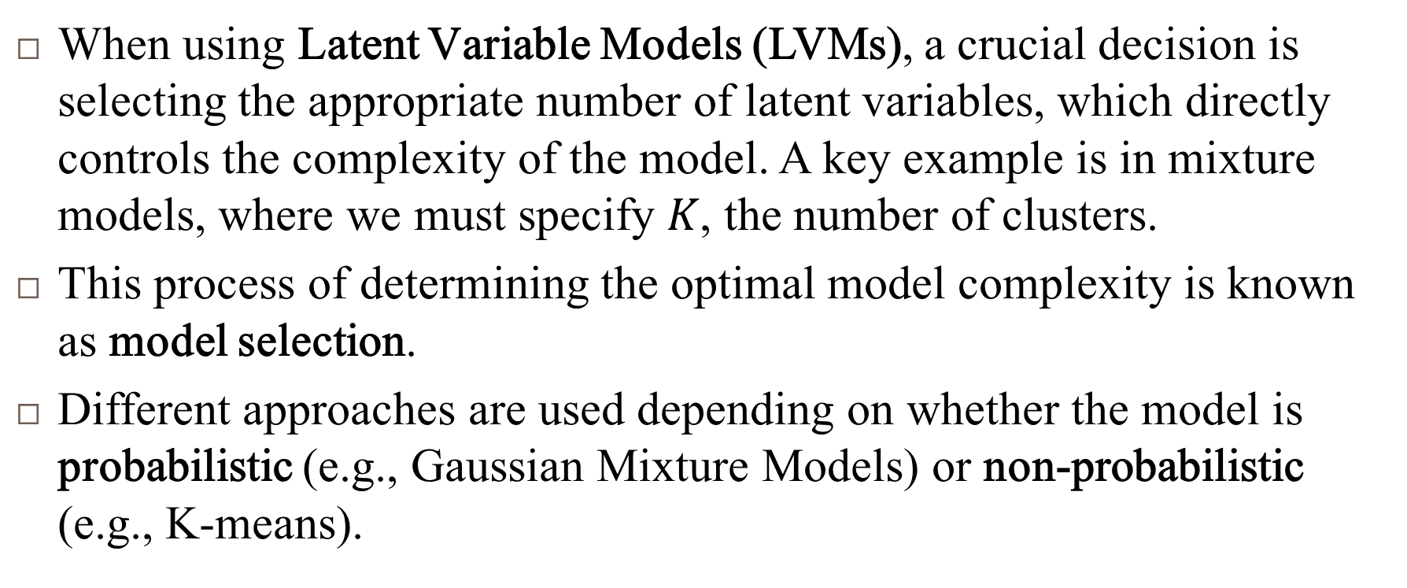
Latent Variable Models
When using Latent Variable Models (LVMs), a crucial decision is selecting the appropriate number of latent variables, which directly controls the complexity of the model. A key example is in mixture models, where we must specify $K$, the number of clusters.
This process of determining the optimal model complexity is known as model selection.
Different approaches are used depending on whether the model is probabilistic (e.g., Gaussian Mixture Models) or non-probabilistic (e.g., K-means).

Slide 13
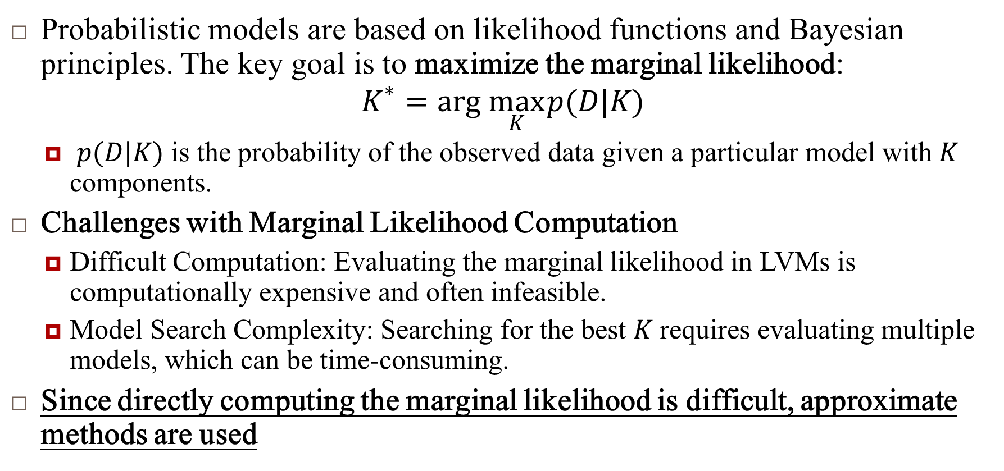
Model Selection for Probabilistic Models
Probabilistic models are based on likelihood functions and Bayesian principles. The key goal is to maximize the marginal likelihood:
$$K^{∗}=arg \max_{K} p(D|K)$$
$p(D|K)$ is the probability of the observed data given a particular model with $K$ components.
Challenges with Marginal Likelihood Computation
Difficult Computation: Evaluating the marginal likelihood in LVMs is computationally expensive and often infeasible.
Model Search Complexity: Searching for the best $K$ requires evaluating multiple models, which can be time-consuming.
Since directly computing the marginal likelihood is difficult, approximate methods are used

Slide 14
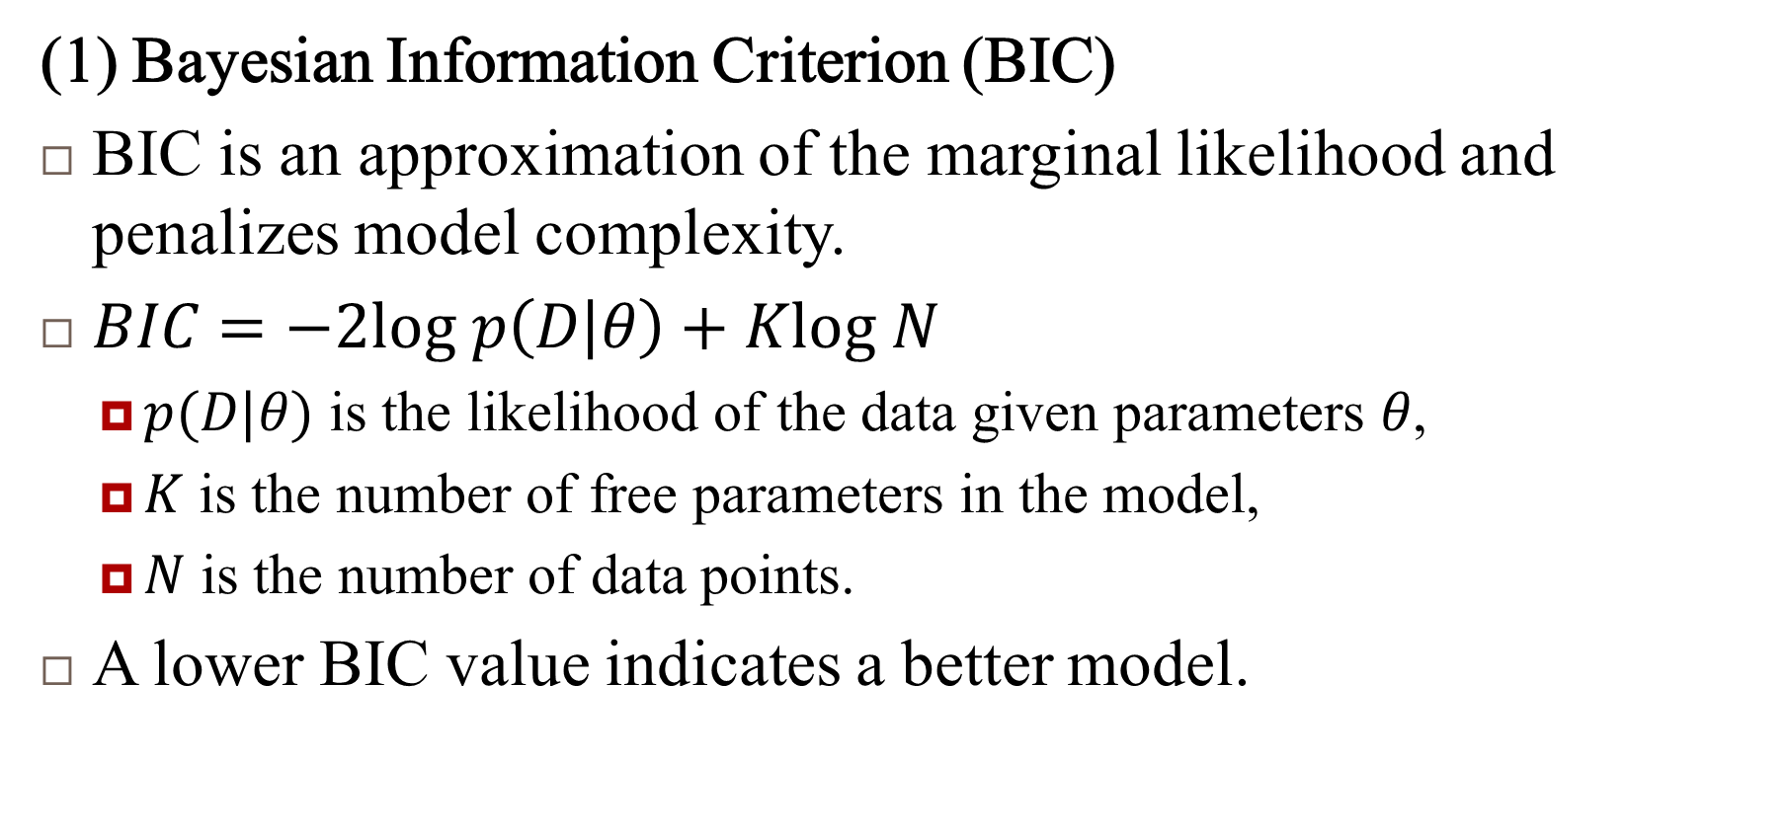
Alternative Approaches for Model Selection in Probabilistic Models
(1) Bayesian Information Criterion (BIC)
BIC is an approximation of the marginal likelihood and penalizes model complexity.
$BIC=−2log p\left(D | θ\right)+Klog N$
$p(D|θ)$ is the likelihood of the data given parameters $θ$,
$K$ is the number of free parameters in the model,
$N$ is the number of data points.
A lower BIC value indicates a better model.

Slide 15
Alternative Approaches for Model Selection in Probabilistic Models
(2) Cross-Validated Likelihood
Uses cross-validation (CV) to estimate the likelihood of the model on unseen data.
Computationally expensive as the model must be fit multiple times for different folds of the data.
Typically used when BIC is unreliable.
(3) Bayesian Occam’s Razor
The idea that simpler models should be preferred unless more complexity is justified.
A model is initialized with a large number of components, but Bayesian inference automatically removes unnecessary components.

Slide 16
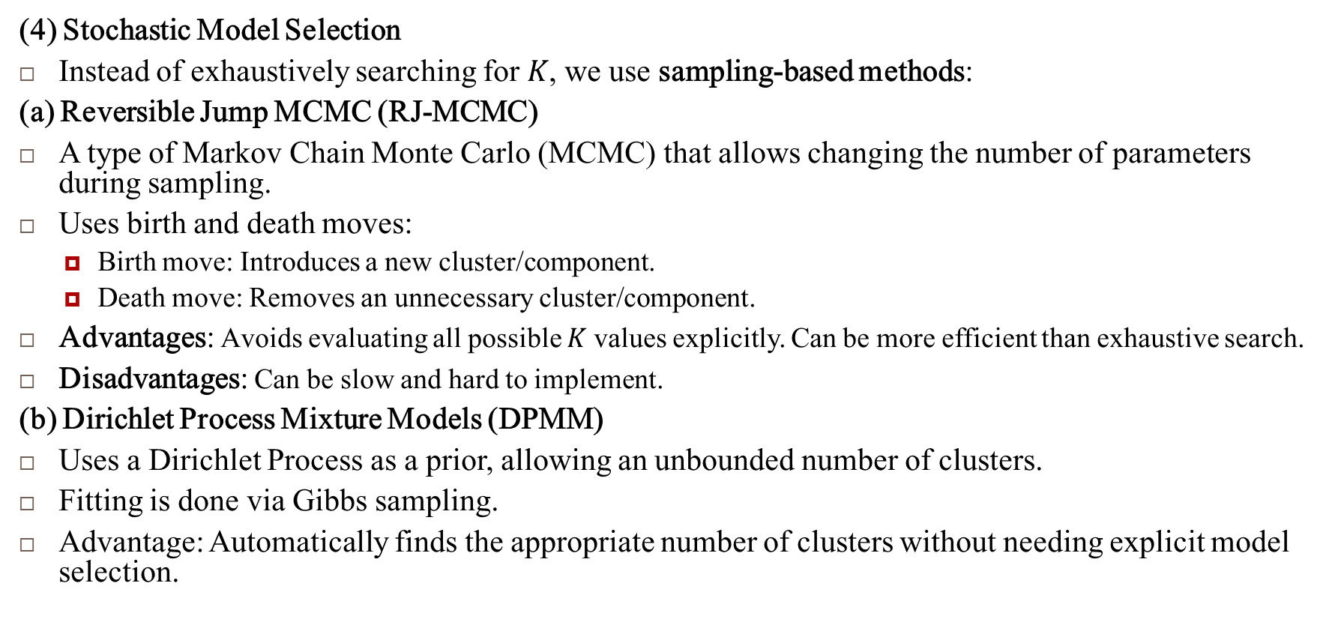
Alternative Approaches for Model Selection in Probabilistic Models
(4) Stochastic Model Selection
Instead of exhaustively searching for $K$, we use sampling-based methods:
(a) Reversible Jump MCMC (RJ-MCMC)
A type of Markov Chain Monte Carlo (MCMC) that allows changing the number of parameters during sampling.
Uses birth and death moves:
Birth move: Introduces a new cluster/component.
Death move: Removes an unnecessary cluster/component.
Advantages: Avoids evaluating all possible $K$ values explicitly. Can be more efficient than exhaustive search.
Disadvantages: Can be slow and hard to implement.
(b) Dirichlet Process Mixture Models (DPMM)
Uses a Dirichlet Process as a prior, allowing an unbounded number of clusters.
Fitting is done via Gibbs sampling.
Advantage: Automatically finds the appropriate number of clusters without needing explicit model selection.

Slide 17
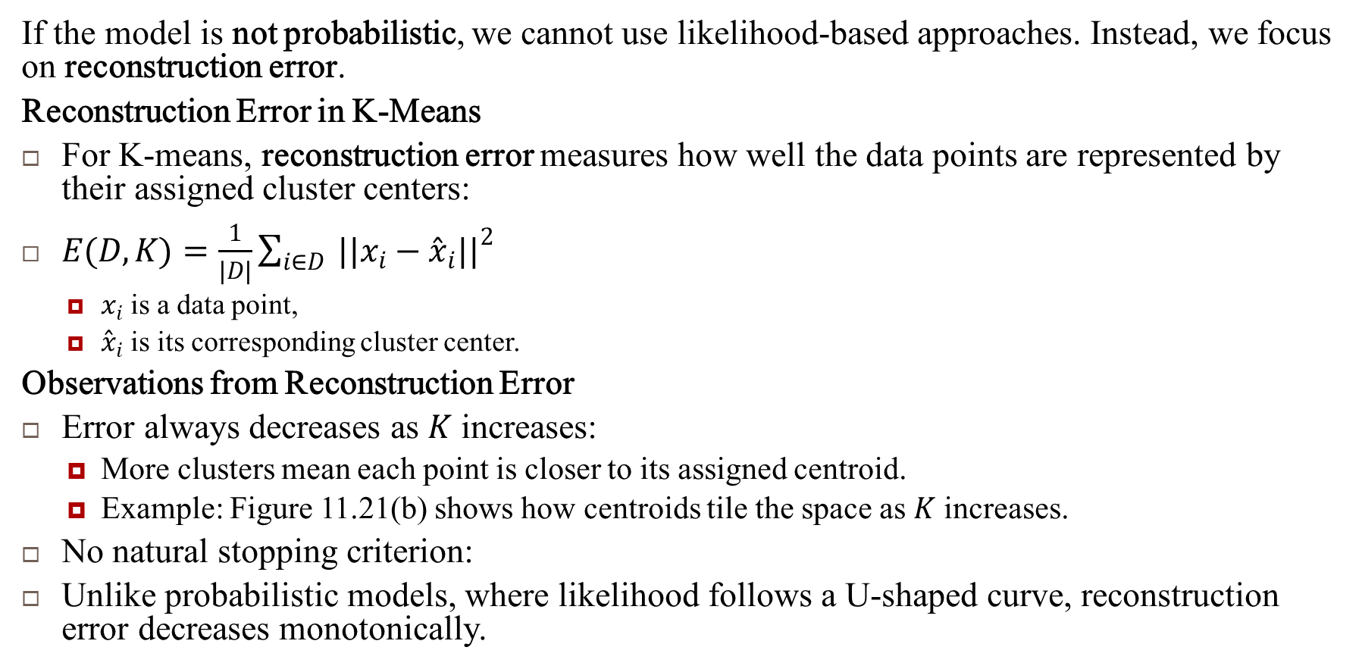
Model Selection for Non-Probabilistic Methods
If the model is not probabilistic, we cannot use likelihood-based approaches. Instead, we focus on reconstruction error.
Reconstruction Error in K-Means
For K-means, reconstruction error measures how well the data points are represented by their assigned cluster centers:
$E(D,K)=\frac{1}{|D|}\sum_{i∈D}{ }||x_{i}−{\overset{ˆ}{x}}_{i}||^{2}$
$x_{i}$ is a data point,
${\overset{ˆ}{x}}_{i}$ is its corresponding cluster center.
Observations from Reconstruction Error
Error always decreases as $K$ increases:
More clusters mean each point is closer to its assigned centroid.
Example: Figure 11.21(b) shows how centroids tile the space as $K$ increases.
No natural stopping criterion:
Unlike probabilistic models, where likelihood follows a U-shaped curve, reconstruction error decreases monotonically.

Slide 18
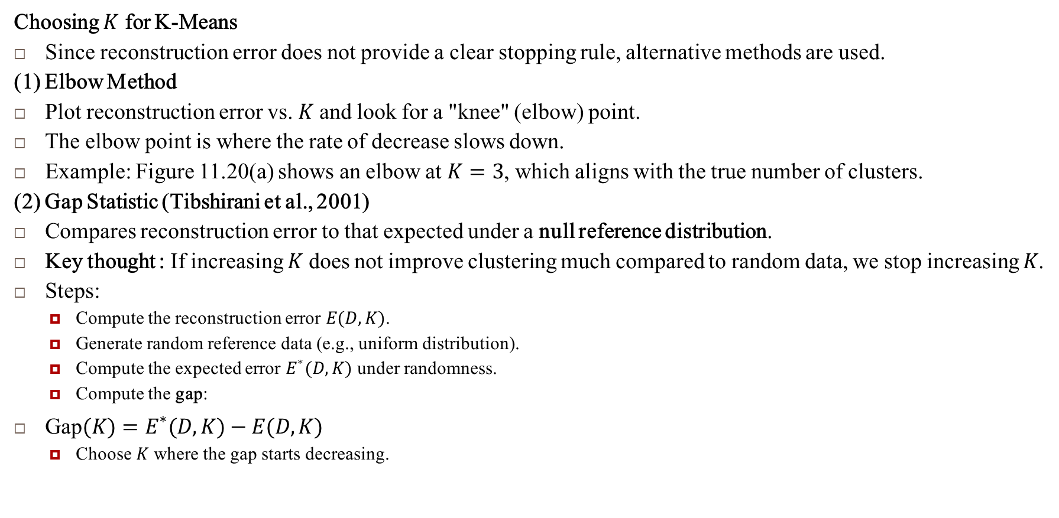

Choosing $K$ for K-Means
Choosing $K$ for K-Means
Since reconstruction error does not provide a clear stopping rule, alternative methods are used.
(1) Elbow Method
Plot reconstruction error vs. $K$ and look for a "knee" (elbow) point.
The elbow point is where the rate of decrease slows down.
Example: Figure 11.20(a) shows an elbow at $K=3$, which aligns with the true number of clusters.
(2) Gap Statistic (Tibshirani et al., 2001)
Compares reconstruction error to that expected under a null reference distribution.
Key thought : If increasing $K$ does not improve clustering much compared to random data, we stop increasing $K$.
Steps:
Compute the reconstruction error $E(D,K)$.
Generate random reference data (e.g., uniform distribution).
Compute the expected error $E^{∗}(D,K)$ under randomness.
Compute the gap:
$\text{Gap}(K)=E^{∗}(D,K)−E(D,K)$
Choose $K$ where the gap starts decreasing.

Slide 19
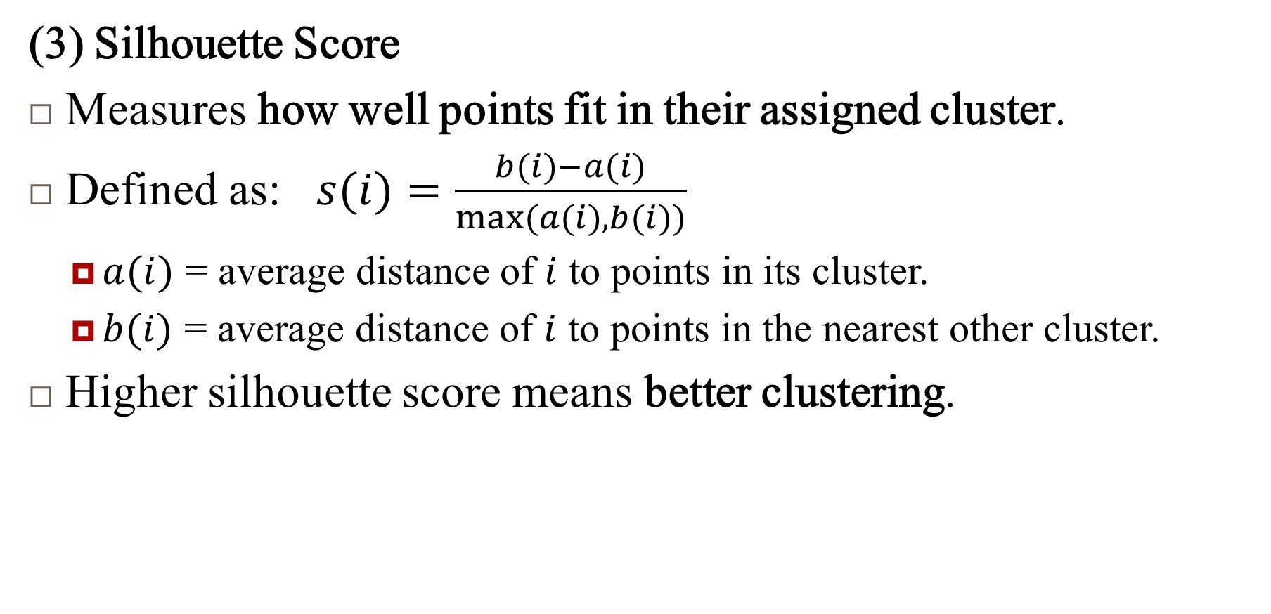
Choosing $K$ for K-Means
(3) Silhouette Score
Measures how well points fit in their assigned cluster.
Defined as: $s(i)=\frac{b(i)−a(i)}{max(a(i),b(i))}$
$a(i)$ = average distance of $i$ to points in its cluster.
$b(i)$ = average distance of $i$ to points in the nearest other cluster.
Higher silhouette score means better clustering.

Slide 20
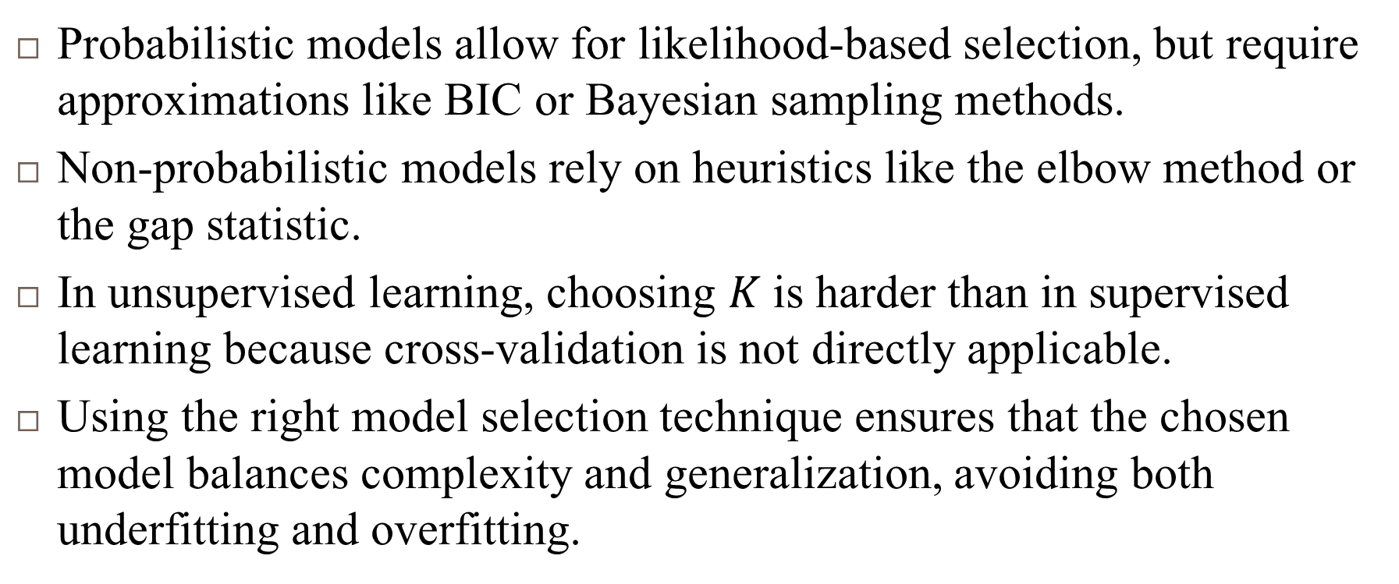
Summary
Probabilistic models allow for likelihood-based selection, but require approximations like BIC or Bayesian sampling methods.
Non-probabilistic models rely on heuristics like the elbow method or the gap statistic.
In unsupervised learning, choosing $K$ is harder than in supervised learning because cross-validation is not directly applicable.
Using the right model selection technique ensures that the chosen model balances complexity and generalization, avoiding both underfitting and overfitting.

Slide 21
References
Murphy, Kevin P. Machine learning: a probabilistic perspective. MIT press, 2012.
Chapter 11

