Slide 1
Online awaresness and Security

Slide 2
Online awaresness and Security
Module :1 Introduction to Cybercrime

Slide 3

Index - Week 1
Lecture 1 - Introduction to Online crime ,Cybercrime definition and origins of the world, | 15
Lecture 2 – Cybercrime and Information security | 22
Lecture 3 – Classifications of Cybercrime | 27

Slide 4
Lecture 1
Introduction to Cybercrime

Slide 5
Cybercrime : Related Terms
  Cyberspace
  Cybercrime
  Cyber law
  Cyber security
  Cyber terrorism
Lecture 1-Introduction to Cybercrime

Slide 6
Cybercrime definition and Origin of the Word
Computer Crime: A Crime conducted in which a computer was directly and significantly instrumented.
  This definition is not universally accepted. It, however, initiates further discussion to narrow the scope of the definition for “cybercrime”.
    Any illegal act where a special knowledge of computer technology is essential for its perpetration, investigation or prosecution.
    Any traditional crime that has acquired a new dimension or order of magnitude through the aid of a computer, and abuses that have come into being because of computers.
    Any financial dishonesty that takes place in a computer environment.
    Any threats to the computer itself, such as theft of hardware or software, sabotage and demand for ransom.
Cybercrime (Computer crime) is any illegal behaviour, directed by means of electronic operations, that targets the security of computer system and the data processed by them.
Lecture 1-Introduction to Cybercrime

Slide 7
Cybercrime definition and Origin of the Word
Computer-related crime can be any illegal behavior committed by means of, or in relation to, a computer system or network; however, this is not cybercrime.
Cybercrime sometimes interchangeably used to describe computer-related crime, Computer Crime, Internet Crime, E- Crime, High-tech Crime.
Definition of Cybercrime:
  A crime committed using a computer and the Internet to steal a person’s identity (identity theft) or sell contraband or stalk victims or disrupt operations with malevolent program.
  Crime completed either on or with a computer.
  Any illegal activity done through the Internet or on the computer.
  All criminal activities done using the medium of computers, the Internet, Cyberspace and the WWW.
Lecture 1-Introduction to Cybercrime

Slide 8
Cybercrime definition and Origin of the Word
Cybercrime is not a new phenomena.
The first recorded cyber crime took place in the year 1820.
. In 1820, Joseph Marie Jacquard, a textile manufacturer in France, produced the loom. This device allowed the repetition of a series of steps in the weaving of special fabrics. This resulted in a fear amongst Jacquard's employees that their traditional employment and livelihood were being threatened. They committed acts of sabotage to discourage Jacquard from further use of the new technology. This is the first recorded cyber crime!
Lecture 1-Introduction to Cybercrime

Slide 9
Difference from traditional crime
Cybercrimes differ from most terrestrial crimes in four ways:
  How to commit them is easier to learn
  They require few resources relative to potential damage caused.
  They can be committed in a jurisdiction without being physically present in it.
  They are often not clearly illegal.
Lecture 1-Introduction to Cybercrime

Slide 10
Cybercrime definition and Origin of the Word
The term Cyber has some interesting synonyms: fake, replicated, pretended, imitation, virtual, computer generated.
Cyber means combining forms relating to Information Technology, the Internet and Virtual Reality.
The term owes its origin to the word “Cybernetics” which deals with Information and its use.
  Cybernetics is also the science that overlaps the fields of Neurophysiology, Information Theory, Computing Machinery and Automation.
Lecture 1-Introduction to Cybercrime

Slide 11
Lecture 2
Cybercrime and Information Security

Slide 12
Cybercrime and Information Security
Lack of Information Security gives rise to Cybercrimes.
Cybersecurity means protecting information, equipment, devices, computer resources, communication device and information stored therein from unauthorized access, use, disclosure, disruption, modification or destruction.
The term incorporates both the physical security of devices as well as the information stored therein.
Lecture 2-Cybercrime and Information Security

Slide 13
Information Security
The elements involved are:
Confidentiality
Integrity
Availability
Authentication
Non-repudiation
Lecture 2-Cybercrime and Information Security

Slide 14
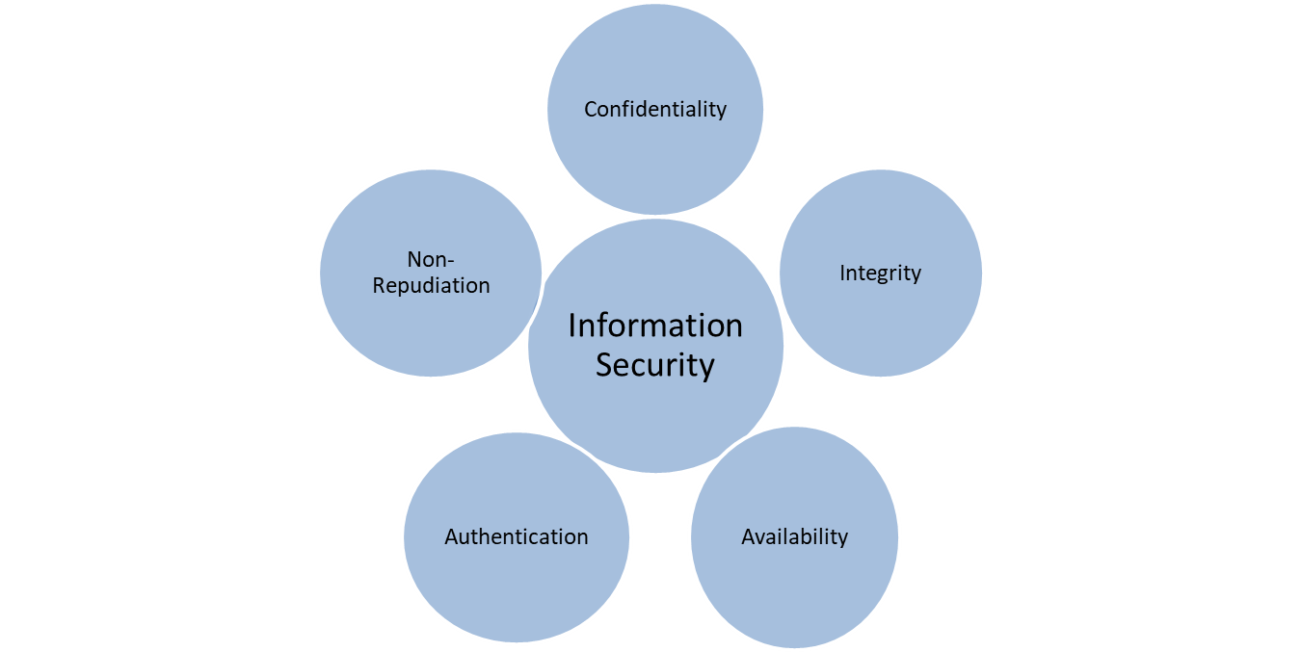
Information Security
fig: Principles to protect cyber aspects
Lecture 2-Cybercrime and Information Security

Slide 15
Cyber – related crimes
Cyber-related crimes are the crimes which use cyber technology but are not cybercrimes.
Can be divided into two categories:
Cyber-exacebated crimes
cyber-assisted crimes
Lecture 2-Cybercrime and Information Security

Slide 16
Who are Cybercriminals?
Cybercriminals are those who involved in activities such as
child pornography,
credit card fraud,
cyber stalking, defaming another online,
gaining unauthorized access to computer systems,
ignoring copyright, software licensing and trade mark protection,
overriding encryption to make illegal copies,
software piracy and
stealing another’s identity to perform criminal acts.
Lecture 2-Cybercrime and Information Security

Slide 17
Who are Cybercriminals?
They can be categorized into three groups that reflect their motivation:
  Type I: Cybercriminals – hungry for recognition
  Type II: Cybercriminals – not interested in recognition
  Type III: Cybercriminals – the insiders
Lecture 2-Cybercrime and Information Security

Slide 18
Who are Cybercriminals?
Type I: Cybercriminals – hungry for recognition
  Hobby hackers
  IT Professionals (Social engineering is one of the biggest threat)
  Politically motivated hackers
  Terrorist Organizations
Lecture 2-Cybercrime and Information Security

Slide 19
Who are Cybercriminals?
Type II: Cybercriminals – not interested in recognition
  Psychological Perverts
  Financially motivated hackers (corporate espionage)
  State-sponsored hacking (national espionage, sabotage)
  Organized criminals
Lecture 2-Cybercrime and Information Security

Slide 20
Who are Cybercriminals?
Type III: Cybercriminals – the insiders
  Disgruntled or former employees seeking revenge
  Competing companies using employees to gain economic advantage through damage and/or theft.
Lecture 2-Cybercrime and Information Security

Slide 21
Who are Cybercriminals?
The hackers can further be divided as:
Black hat hackers
Crackers
Cyber-Terrorists/ cybercriminal
Phreakers
Whackers
White hat hackers
Lecture 2-Cybercrime and Information Security

Slide 22
Lecture 3
Classifications of Cybercrime

Slide 23
Cybercrime definition and Origin of the Word
Based on definition there are three categories:
Cyber Piracy
Cyber Trespass
Cyber Vandalism
Lecture 3-Classification of Cybercrime

Slide 24
Classifications of Cybercrimes
Based on target Cybercrimes are classified as follows:
  Cybercrime against Individual
  Cybercrime against Property
  Cybercrime against Organization
  Cybercrime against Society
  Crimes emanating from Usenet newsgroup
Lecture 3-Classification of Cybercrime

Slide 25
Classifications of Cybercrimes
Cybercrime against Individual
  Electronic mail(E-Mail) Spoofing and other online frauds.
  Phishing (sends scam emails or text messages), Spear Phishing and its forms (i.e. Vishing-voice phising and Smishing-uses fake mobile text messages)
  Spamming (sending unwanted messages to many people)
  Cyber defamation
  Cyberstalking and harassment
  Computer sabotage
  Pornographic offenses
  Password sniffing
Lecture 3 – Classifications of cybercrime

Slide 26
Classifications of Cybercrimes
Cybercrime against property
  Credit card frauds
  Intellectual property (IP) crimes
    Software piracy, copyright infringement, trademarks violations, theft of computer source code.
  Internet time theft
Lecture 3 – Classifications of cybercrime

Slide 27
Classifications of Cybercrimes
Cybercrime against organization
  Unauthorized accessing of computer
    Hacking
  Password sniffing
  Denial-of-service attacks
  Virus attack/dissemination of viruses
  E-mail bombing/Salami technique (an attacker uses an online database to obtain customer information such as bank/credit card details)
  Logic bomb (a type of malicious code emdedded in software that remains dormant until specific conditions are met)
  Trojan Horse (a type of malware that downloads onto a computer disguised as a legitimate program)
  Data diddling (data is altered as it is entered into a computer system)
  Crimes emanating from Usenet newsgroup ( a worldwide network of news discussion groups)
  Industrial spying/industrial espionage (illegal theft of business trade secrets)
  Computer network intrusions
  Software piracy
Lecture 3 – Classifications of cybercrime

Slide 28
Classifications of Cybercrimes
Cybercrime against Society
  Forgery (the crime of altering a document)
  Cyberterrorism (politically motivated use of computers and information technology to cause severe disruption or widespread fear in society)
  Web jacking (attackers illegally gain control of an organisations or individuals website)
Lecture 3 – Classifications of cybercrime

Slide 29
Classifications of Cybercrimes
Crimes emanating from Usenet newsgroup
  By its very nature, Usenet groups may carry very offensive, harmful, inaccurate or otherwise inappropriate material, or in some cases, posting that have been mislabelled or deceptive in another way.
Lecture 3 – Classifications of cybercrime

Slide 30
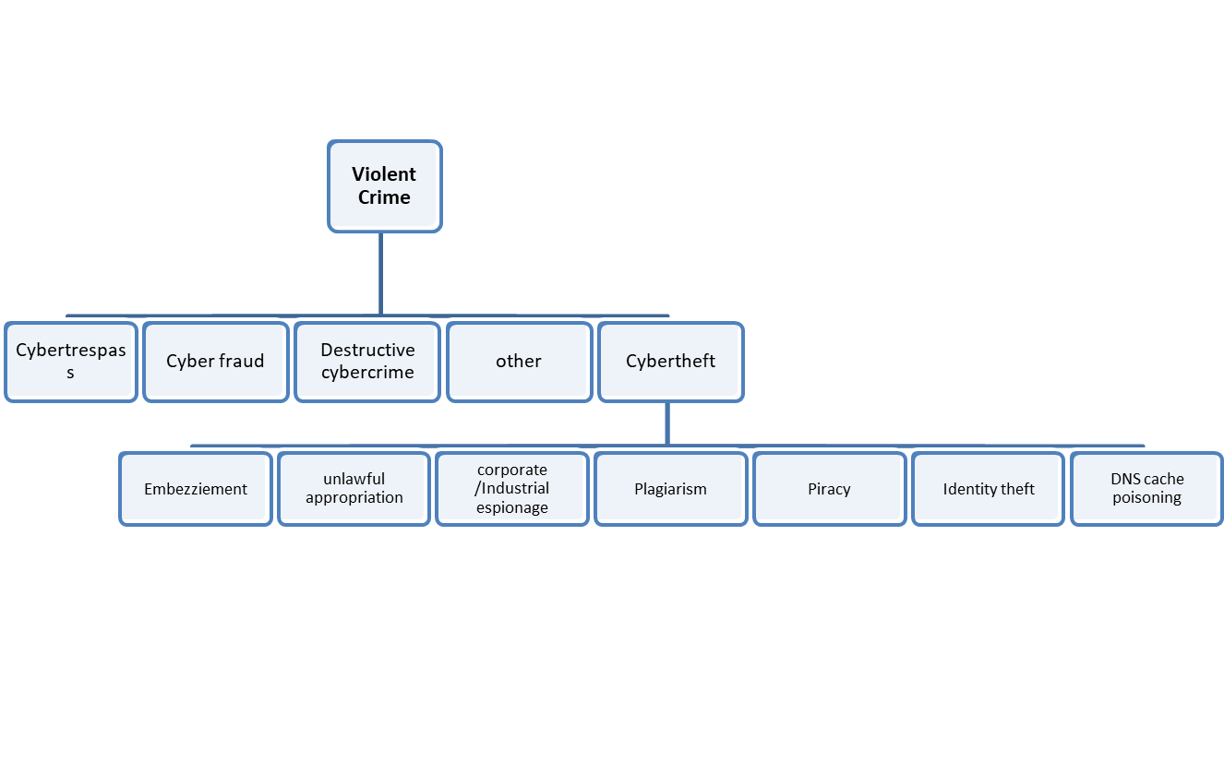
Classifications of Cybercrimes
Lecture 3 – Classifications of cybercrime

Slide 31
Classifications of Cybercrimes
Potentially Violent Cybercrimes Examples
Cyberterrorism
Assault by threat Cyberstalking
Child pornography
Lecture 3 – Classifications of cybercrime

Slide 32
Classifications of Cybercrimes
Some more examples of non-violent cybercrimes
Advertising/soliciting prostitution services over the Internet
Internet gambling
Internet drug sales (both illegal drugs and prescription drugs)
Cyber Laundering
Cyber Contraband (any item that relating to its nature is illegal to be possessed or sold)
Email spoofing
Could include attractive offers and or viruses!
Forgery/Falsification
Creation of a wrongly written document
Phishing (attackers send scam emails or text messages that contain link to malicious websites)
Attempt to obtain sensitive information from a victim. Redirects the victim to a malicious site
Lecture 3 – Classifications of cybercrime

