Slide 1
Cyber Security and Laws
Module :1 Introduction to Cybercrime

Slide 2
Index - Module :1 Introduction to Cybercrime
Lecture 4 : A global Perspective on cybercrimes | 3

Slide 3
Lecture 4
Cybercrime and the Indian ITA 2000

Slide 4


Slide 5
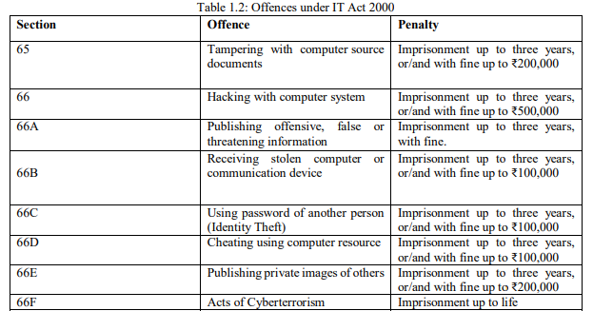
Information Technology Act (ITA)2000
IT Act 2000 is an act of the Indian Parliament to deal with cyber crime and e-commerce. This is a law which applies to India as well as outside India.
Lecture 4 – Cybercrime and the Indian ITA 2000

Slide 6
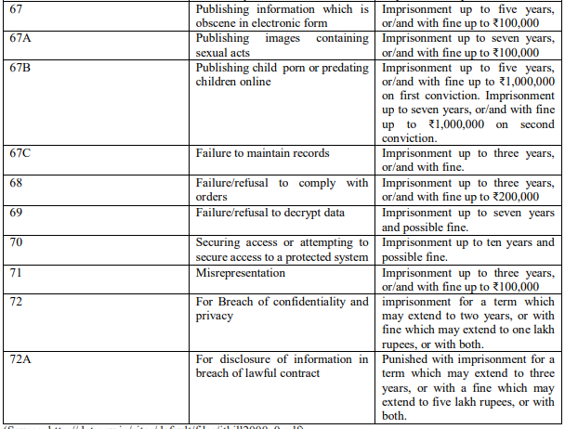
Information Technology Act (ITA)2000
(Source: http://dot.gov.in/sites/default/files/itbill2000_0.pdf)
Lecture 4 – Cybercrime and the Indian ITA 2000

Slide 7
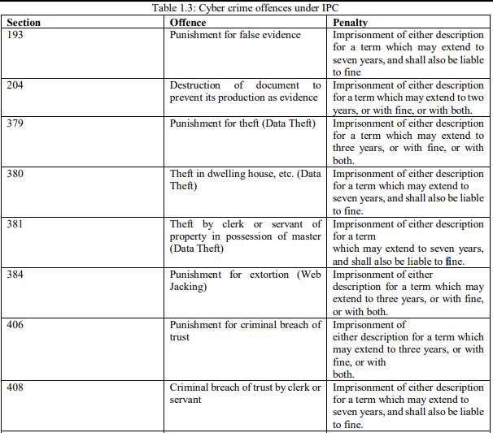
Indian Penal Code(IPC)
Lecture 4 – Cybercrime and the Indian ITA 2000

Slide 8
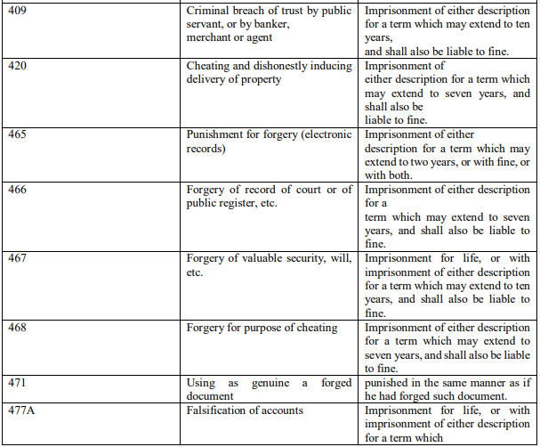
Indian Penal Code(IPC)
Lecture 4 – Cybercrime and the Indian ITA 2000

Slide 9
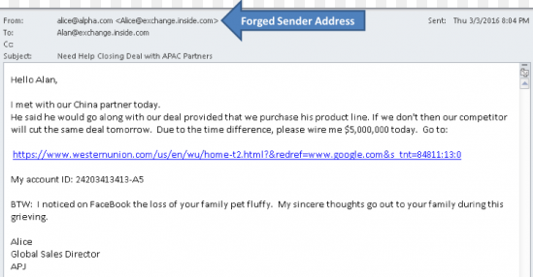
Cybercrime and the Indian ITA 2000
Lecture 4 – Cybercrime and the Indian ITA 2000

Slide 10
Case Study 1: Phishing
The 5 most famous phishing scams in history
1. Operation Phish Phry-
2. Walter Stephan Scam
3. The Target/FMS Scam
4. The Ukrainian Power Grid Attack
5. The Moscow World Cup Vacation Rental Scam
Lecture 4 – Cybercrime and the Indian ITA 2000

Slide 11
Operation Phish phry
Cyber thieves “phish” for personal information such as usernames, passwords, and financial account details by tricking users into thinking their sensitive information is being given to trusted websites when, in fact, the sites are traps.
The defendants in Operation Phish Phry (2009 )targeted U.S. banks and victimized hundreds and possibly thousands of account holders by stealing their financial information and using it to transfer about $1.5 million to bogus accounts they controlled. More than 50 individuals in California, Nevada, and North Carolina, and nearly 50 Egyptian citizens have been charged with crimes including computer fraud, conspiracy to commit bank fraud, money laundering, and aggravated identify theft

Slide 12
Walter Stephan Scam
In January 2016, an employee at the Austrian aerospace parts manufacturer FACC received an email asking the organisation to transfer €42 million to another account as part of an “acquisition project”. The message appeared to come from the organisation's CEO, Walter Stephan, but was in fact a scam

Slide 13
Target/FMS Scam
FMS scam or the targetIt turns out cybercriminals didn't directly attack the target. They targeted a third-party vendor named Fazio Mechanical Services (FMS), which had confident access to Target's servers. Gaining complete access to Target's was simple after compromising the servers of FMS.

Slide 14
2015 Ukraine power grid hack
On December 23, 2015, the power grid in two western oblasts of Ukraine was hacked, which resulted in power outages for roughly 230,000 consumers in Ukraine for 1-6 hours.
The attack took place during the ongoing Russo-Ukrainian War (2014-present) and is attributed to a Russian advanced persistent threat group known as "Sandworm".
It is the first publicly acknowledged successful cyberattack on a power grid

Slide 15
The Moscow World Cup Vacation Rental Scam
The Moscow world cup vacation rental scam is one of the biggest and most recent scams in the history of the world. FIFA world cup is an extremely famous event which attracts fans from across the globe to watch it live. A similar chain of events unfolded in the FIFA world cup held in Moscow in 2018. A lot of people from different countries planned to fly to Moscow.
This created a growing enthusiasm in phishing scammers from all over the world as well, which ultimately resulted in the financial loss of a lot of people. This scam cannot be accredited to one organization carrying out a systemised fraudulent attempt. Many scammers made individual attempts at making financial benefits at the behest of innocent football fans.
The most common mediums used for doing the same were emails, WhatsApp and SMS. Multitudinous emails were sent to different customers by these frauds. These mails often guaranteed discounted rooms, free tickets to Moscow etc.
In another famous high profile case, bookings.com’s users were targeted via SMS and WhatsApp. The messages that were sent to their innocent customers contained their legitimate information, obtained by hacking into hotel systems.

Slide 16
Lecture 5
A Global Perspective on Cybercrimes

Slide 17
A Global Perspective on Cybercrimes
The linkage of cyber security and critical infrastructure protection has become a big issue as a number of countries have began assessment of threats, vulnerabilities and started mechanisms to redress them.
Recently, there have been a number of significant development such as
  August 4, 2006 Announcement: The US Senate ratifies CoE (council of Europe) Convention on Cyber Crime. The convention targets hackers, those spreading destructive computer viruses, those using the Internet for the sexual exploitation of children or the distribution of racist material, and terrorists attempting to attack infrastructure facilities or financial institution.
  In August 18, 2006, there was a news article published “ISP Wary About ‘Drastic Obligations’ on Web Site Blocking.” European Union (EU) officials want to debar suspicious websites as part of a 6-point plan to boost joint antiterrorism activities. They want to block websites that incite terrorist action.
  CoE Cyber Crime Convention (1997-2001) was the first international treaty seeking to address Internet crimes by harmonizing national laws, improving investigate techniques and increasing cooperation among nations. More than 40 countries have ratified the Convention to date.
Lecture 4-A Global Perspective on Cybercrimes

Slide 18
Cyber Security and Laws
Module :2 Cyber offenses & Cybercrime

Slide 19
Lecture 6
How criminal plan the attacks,

Slide 20
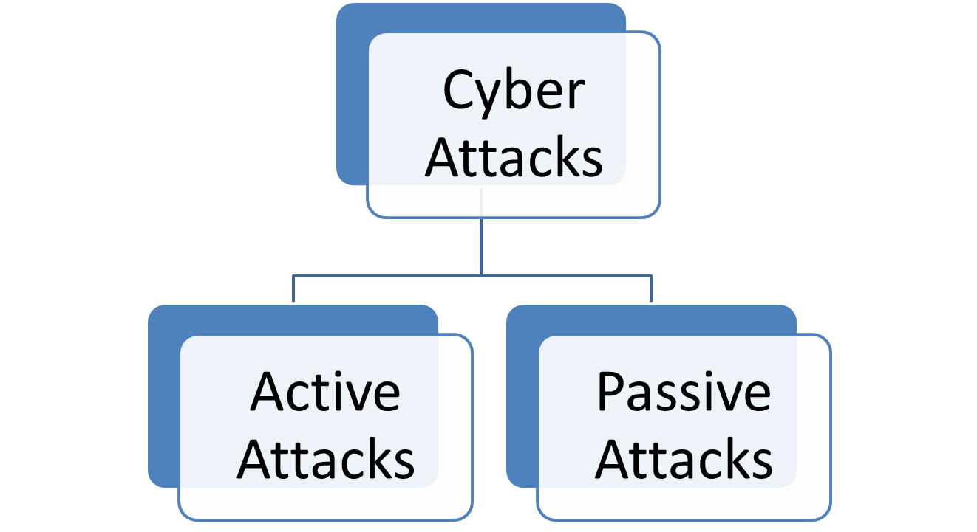
How Criminals Plan the Attacks
Lecture 5-How criminal plan the attacks, Social Engg, Cyber stalking

Slide 21
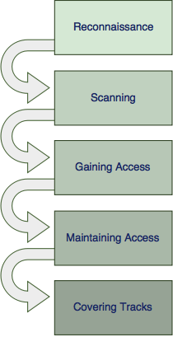
How Criminals Plan the Attacks
Fig: Phases for Attack
Lecture 5-How criminal plan the attacks, Social Engg, Cyber stalking

Slide 22
How Criminals Plan the Attacks
Phase 1: Reconnaissance
  The first phase is all about gathering preliminary data on the target and learning as much as possible about how it operates.
  Reconnaissance can be performed actively or passively and sets the basis for further planning the attack. The target usually does not notice anything during this phase.
  The used methods typically include identifying the target and discovering the target IP address range, network, domain name, mail server, DNS records, etc... Depending on the target and approach, this may also include non-technical information like employee registers, organizational charts and company relations.
  Phase 1 techniques may include the following:
    Internet sources
    Social engineering
    Dumpster diving
    Observation
Lecture 5-How criminal plan the attacks, Social Engg, Cyber stalking

Slide 23
How Criminals Plan the Attacks
Reconnaissance for Passive attacks :
Ways to gather information are :
Search engine
Social media
Organisation website
Blog or press releases
Job Posting
Network Sniffing
Lecture 5-How criminal plan the attacks, Social Engg, Cyber stalking

Slide 24
Tools used for Passive Attacks
CheckUserNames
BuiltWith
WHOIS
Nslookup
TraceRoute
eMailTrackPro
HTTrack
Lecture 5-How criminal plan the attacks, Social Engg, Cyber stalking

Slide 25
Tools used for Active Attacks
Arphound
Arping
Bing
Dig
DNStracer
Fping
Dsniff
Filesnarf
Fragroute
Lecture 5-How criminal plan the attacks, Social Engg, Cyber stalking

Slide 26
Tools used for Active Attacks
10. Hmap
11. Hping
12. Httping
13. Mailsnarf
14. Urisnarf
15. NBTscan
16. Netcat
17. Nmap
18. Nikto
Lecture 5-How criminal plan the attacks, Social Engg, Cyber stalking

Slide 27
Tools used for Active Attacks
19. ScanSSH
20. SMTPscan
21. TCPdump
22. TCPreplay
23. THCAmap
24. XProbe2
Lecture 5-How criminal plan the attacks, Social Engg, Cyber stalking

Slide 28
How Criminals Plan the Attacks
Phase 2: Scanning
  In this phase, the information gathered during the reconnaissance phase is used to scan the perimeter and internal network devices looking for weaknesses. This phase requires the use of technical tools to gather further intelligence on the target and about the systems that they have in place.
  It includes scanning the target for services running, open ports, firewall detection, finding vulnerabilities, OS detection, etc.
  Phase 2 techniques may include the following:
    Port scanners
    Vulnerability scanners
    Network mappers
Lecture 5-How criminal plan the attacks, Social Engg, Cyber stalking

Slide 29
How Criminals Plan the Attacks
Phase 3: Gaining access
  In phase 3 the attacker would exploit a vulnerability to gain access to the target.
  This typically involves taking control of one or more network devices to extract data from the target or use that device to perform attacks on other targets.
  Phase 3 techniques may include the following:
    Abusing a username/password that was found
    Exploiting a known vulnerability
    Breaking into a weakly secured network
    Sending malware to an employee via E-mail or a USB stick (USB flash drive).
Lecture 5-How criminal plan the attacks, Social Engg, Cyber stalking

Slide 30
How Criminals Plan the Attacks
Phase 4: Maintaining access
  After having gained access, the attacker will now need to maintain access long enough to gather as much data as possible.
  In order to maintain access for a longer time, the attacker must remain stealthy to not get caught using the host environment.
  Phase 4 techniques may include the following:
    Privilege escalation
    Installation of a backdoor or remote access Trojan
    Creating own credentials
Lecture 5-How criminal plan the attacks, Social Engg, Cyber stalking

Slide 31
How Criminals Plan the Attacks
Phase 5: Covering tracks
  In the final phase, the attacker will take steps necessary to hide the intrusion and any controls he may have left behind for future visits.
  Any changes that were made, installed trojans, backdoors, escalated authorizations, etc. must return to a state in which the attacker's presence cannot be recognized by the network's administrators.
  Phase 5 techniques may include the following:
    Remove logging
    Exfiltration of data via DNS tunnelling or steganography
    Installation of rootkits
Lecture 5-How criminal plan the attacks, Social Engg, Cyber stalking

Slide 32
Protect yourself : What to do and what not to do?
Do not post information on social media that can be related to challenge questions
Use passwords that cannot be broken by brute force or guessing.
Consider 2 factor authentication when possible.
Be careful of password requests emails. Services like Heroku, Gmail and others will not request to type in passwords for additional promotion or service.
Verify source of contact.
Before clicking a link, investigate it.
Always scan a file and never click on batch files.
Always see the background services that are running in your device and never rely on others’ device.
Be sure to have a antivirus installed and set root passwords for installation.
Log out of sessions and clean the cache.
Lecture 5-How criminal plan the attacks, Social Engg, Cyber stalking

Slide 33
Thank You

