Slide 1
Lecture 7
Social Engineering

Slide 2
Social Engineering
What is Social Engineering?
Social engineering is the art of manipulating users of a computing system into revealing confidential information that can be used to gain unauthorized access to a computer system. The term can also include activities such as exploiting human kindness, greed, and curiosity to gain access to restricted access buildings or getting the users to installing backdoor software.
Knowing the tricks used by hackers to trick users into releasing vital login information among others is fundamental in protecting computer systems
Lecture 5-How criminal plan the attacks, Social Engg, Cyber stalking

Slide 3
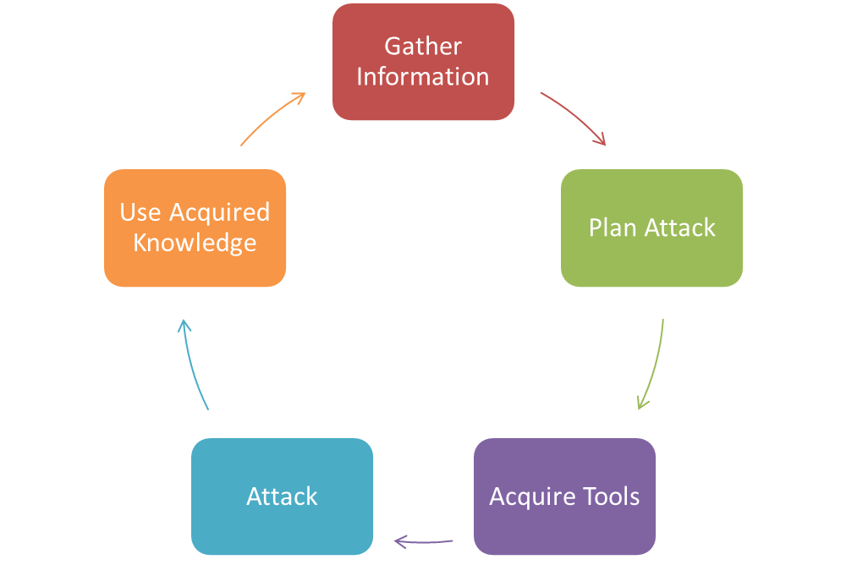
Social Engineering
How social engineering Works?
System Users
Lecture 5-How criminal plan the attacks, Social Engg, Cyber stalking

Slide 4
Social Engineering
Most common examples of social engineering are:
Phishing
Spear Phishing
Baiting
Malware
Pretexting
Quid Pro Quo
Tailgating
Vishing
Water-Holing
Lecture 5-How criminal plan the attacks, Social Engg, Cyber stalking

Slide 5
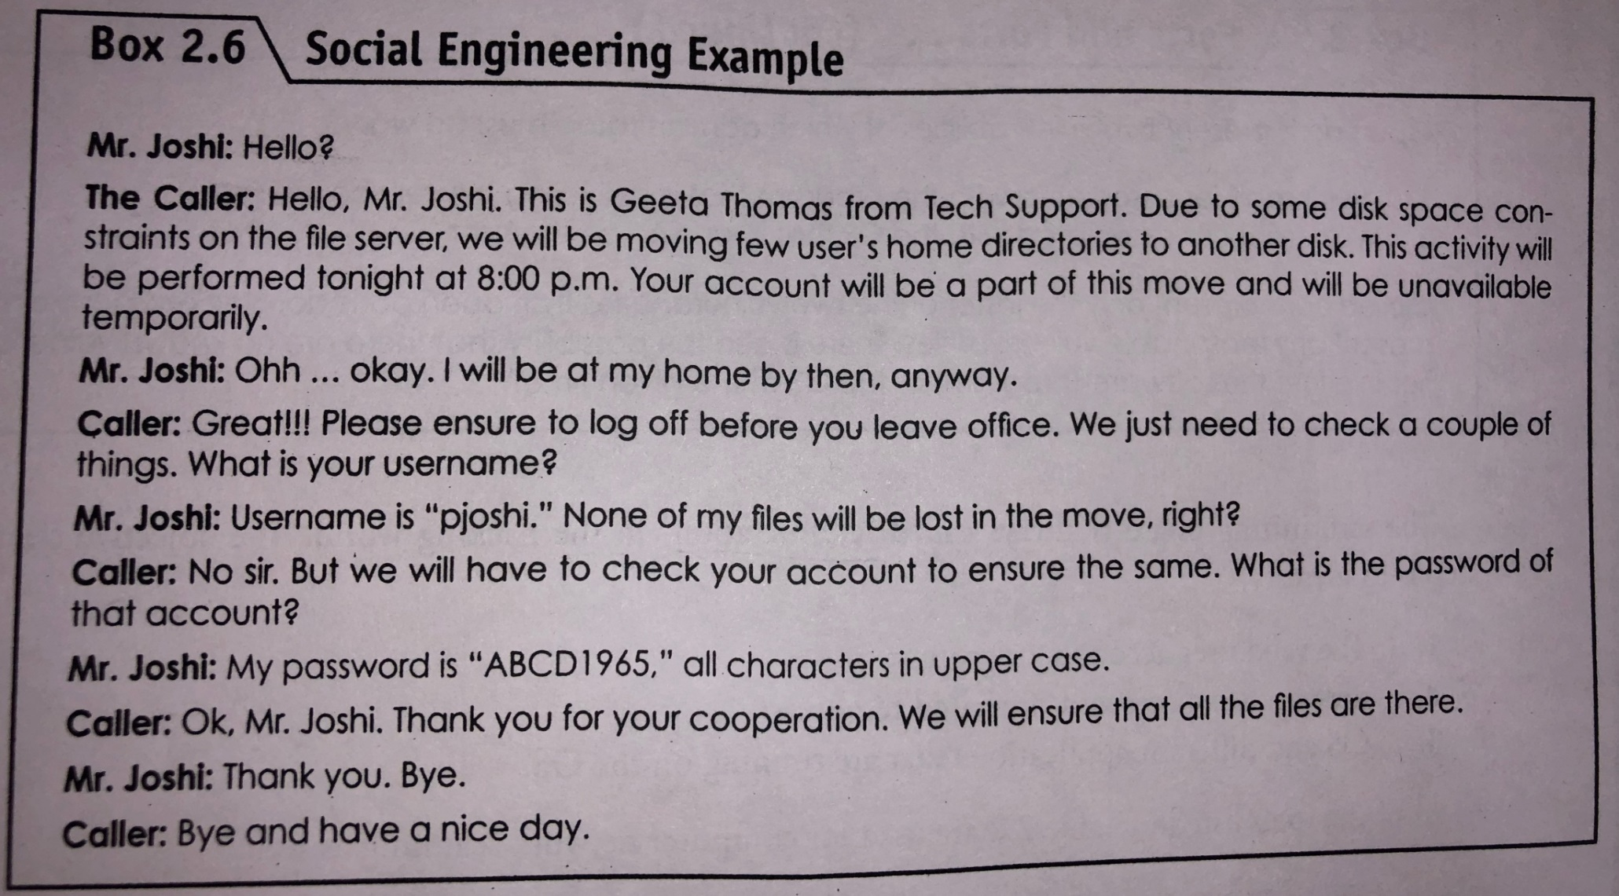
Social Engineering
Lecture 5-How criminal plan the attacks, Social Engg, Cyber stalking

Slide 6
Social Engineering
Emotions in Social Engineering
Fear
Greed
Curiosity
Helpfulness
Urgency
Lecture 5-How criminal plan the attacks, Social Engg, Cyber stalking

Slide 7
Social Engineering
How to Protect Against Social Engineering
“People affect security outcomes more than technology, policies or processes. The market for security awareness computer-based training (CBT) is driven by the recognition that, without perfect cybersecurity protection systems, people play a critical role in an organization’s overall security and risk posture. This role is defined by inherent strengths and weaknesses: people’s ability to learn and their vulnerability to error, exploitation and manipulation. End-user-focused security education and training is a rapidly growing market. Demand is fueled by the needs of security and risk management (SRM) leaders to help influence the behaviors that affect the security of employees, citizens and consumers.”
(Gartner Magic Quadrant for Security Awareness Computer-Based Training, Joanna Huisman, 18 July 2019)
Lecture 5-How criminal plan the attacks, Social Engg, Cyber stalking

Slide 8
Social Engineering : Precautions
Consider the source.
Slow down.
If it sounds too odd to be true
Install an antivirus software or a security suite
Your email software can help you.
Lecture 5-How criminal plan the attacks, Social Engg, Cyber stalking

Slide 9
Social Engineering : Precautions for Individuals
DO NOT open emails in the spam folder or emails whose recipients you do not know.
DO NOT open attachments in emails of unknown origin.
Use a reputable antivirus software - I recommend Kaspersky or Symentec.
Perform a regular backup to an external medium (external hard drive or the cloud).
After backing up, disconnect your drive. Current ransomware is known to encrypt your backup drive as well.
DO NOT pay the ransom. The reason why the criminals keep utilizing this form of blackmailing attacks is that people keep paying. To try to get your data back, consult a professional in your area.
Lecture 5-How criminal plan the attacks, Social Engg, Cyber stalking

Slide 10
Social Engineering : Precautions For Employes
Humans need to be trained
Employees should be tested by having an outside party conduct a social engineering test. These kinds of tests help keep the employee on their toes and more likely to avoid the attacks.
Since these attacks are on the rise, a number of new defences have been developed. AppRiver is a great Spam and Virus email filter that can block a large number of phishing exploits before they even reach the internal servers.
If they happen to get through, an endpoint protection system that can block the latest malware is probably your best bet at stopping the attack.
As a last line of defence, Cyphort has a good IDS/IPS solution that can help detect known attacks and how far they managed to get into the network by signature, behaviour, and by community knowledge.
Lecture 5-How criminal plan the attacks, Social Engg, Cyber stalking

Slide 11
Lecture 8
Cyber Stalking

Slide 12
Cyberstalking
Stalking is an “act or process of following prey stealthily – trying to approach somebody or something.”
Cyberstalking is defined as online stalking.
It involves the repeated use of the internet or other electronic means to harass, intimidate or frighten a person or group. Common characteristics of cyberstalking may include false accusations or posting derogatory statements, monitoring someone’s online activity or physical location, threats, identity theft, and data destruction or manipulation by sending a virus to a victim’s devices.
Lecture 5-How criminal plan the attacks, Social Engg, Cyber stalking

Slide 13
Examples of cyberstalking
Social media stalking is not the same as cyberstalking
Catfishing
Monitoring location check-ins on social media
Visiting you virtually via Google Maps Street View
Hijacking your webcam
Installing stalkerware
Looking at geotags to track your location
Lecture 5-How criminal plan the attacks, Social Engg, Cyber stalking

Slide 14
Anti-cyberstalking tips
Be careful about allowing physical access to your devices
Be sure you always log out of your computer programs
Make sure to practice good password management and online account security.
Delete or make private any online calendars or itineraries
Limit or make private personal details on social media
Take care of metadata or geotagging
Use a security software program
Change credentials if shared with someone
Lecture 5-How criminal plan the attacks, Social Engg, Cyber stalking

Slide 15
Report cyberstalking
Report it to the police.
Keep a copy of proof
If you suspect that someone is using spyware software to track your everyday activities, and you believe you may be in danger, only use public computers or telephones to seek help.
What about cyberstalking laws?
While some countries apply older laws, others have enacted specific cyberstalking laws. These laws are relatively new and usually still have room for improvement.
Lecture 5-How criminal plan the attacks, Social Engg, Cyber stalking

Slide 16
Cyber cafe and Cybercrimes
In the past several years, many instances have been reported in India, where cybercafés are known to be used for either real or false terrorist communication, stealing bank password and subsequent fraudulent withdrawal of money and so on.
Public computers, usually referred to the system, available in cyber cafe, hold two types of risks.
  First, we do not know what programs are installed on the computer- that is, risk of malicious program such as keyloggers or spyware.
  Second, over –the-shoulder peeping (i.e. Shoulder surfing) can enable others to find out your passwords.
Lecture 6 – Cyber café and Cybercrimes

Slide 17
Cyber cafe and Cybercrimes
Observations about Cyber cafe
  Pirated software(s) such as OS, browser, office automation software(s), are installed in all the computers.
  Antivirus software is found to be not updated to the latest patch and/or antivirus signature.
  Annual maintenance contract(AMC) found to be not in a place for servicing the computers.
  Pornographic websites and other similar websites with indecent contents are not blocked.
  Cybercafé owners have very less awareness about IT Security and IT Governance guidelines to cybercafé owners.
Lecture 6 – Cyber café and Cybercrimes

Slide 18
Cyber café and Cybercrimes
Few Tips for safety and security while using the computer un a cybercafé.
  Always logout: After checking your mail or login in to any system don't forget to logout before leaving.
  Stay with the computer: While surfing/browsing, one should not leave the system unattended for any period of time.
  Clear history and temporary files: Browsers saves pages that you have visited in the history folder and in temporary Internet files. Your password may also be saved so clear history before leaving system.
  Be alert: One should have to stay alert and aware of surrounding while sing a public computers to avoid shoulder surfing.
  Virtual keyboard: Especially for banking activity use virtual keyboard to avoid risk of password theft.
Lecture 6 – Cyber café and Cybercrimes

Slide 19
Lecture 9
Botnets, Attack vector, Cloud computing

Slide 20
Botnets
What is a Botnet?
Botnet (Bot Army): network of bots controlled by criminals
Definition: “A coordinated group of malware instances that are controlled by a botmaster via some C&C channel”
  Coordinated: do coordinated actions
  Group: yes, it’s a group of bots!
  Botmaster: meet the cybercriminal
  C&C channel: command and control channel
  A botnet is a network of infected devices that are used to perform cyberattacks. The term is a combination of the words "robot" and "network"
Lecture 7- Botnets, Attack vector, Cloud computing

Slide 21
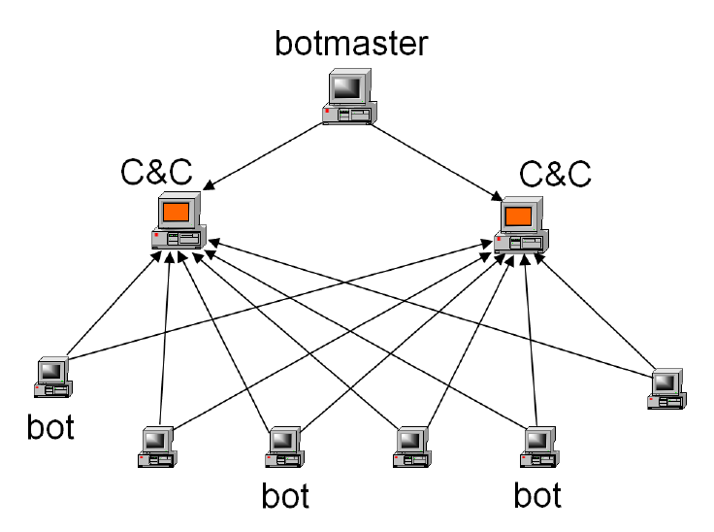
Botnets : Architecture
Lecture 7- Botnets, Attack vector, Cloud computing

Slide 22
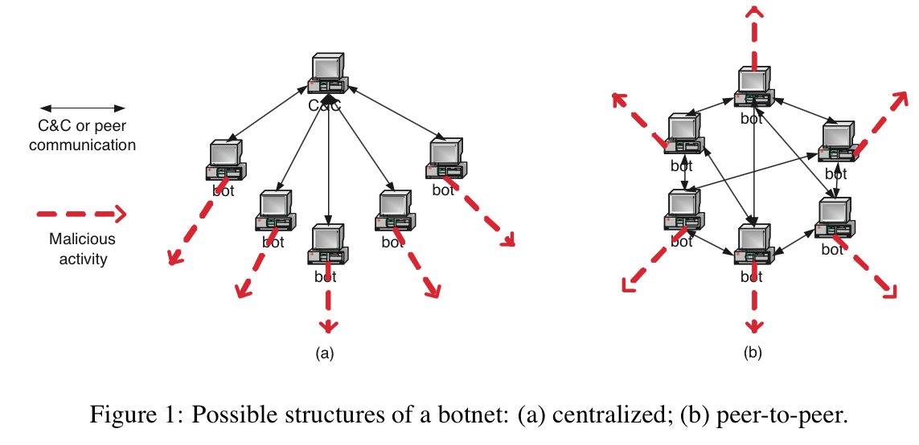
Botnets : Structures
Centralized
  IRC (Internet Relay chats )channels
  HTTP
Distributed
  P2P
Lecture 7- Botnets, Attack vector, Cloud computing

Slide 23

https://www.youtube.com/watch?v=NbvBQRXL7WQ

Slide 25
Botnets
How Do Botnets Work?
They perform large operations while remaining small
They compromise open-source and unsecured devices
Why do Cybercriminals use Botnet Attacks?
To steal financial and personal information
To attack legitimate web services
To extort money from victims
To make money from zombie and botnet systems
Lecture 7- Botnets, Attack vector, Cloud computing

Slide 26
Botnets
Tips to Prevent a Botnet Attack
Set your antivirus and antispyware programs to update automatically.
Routinely check for browser and operating system updates and patches.
Only click internet links or open emails if you trust the source.
Lecture 7- Botnets, Attack vector, Cloud computing

Slide 27
Attack Vectors
What is an Attack Vector?
In cyber security, an attack vector is a method or pathway used by a hacker to access or penetrate the target system.
An attack vector is a method used by cybercriminals to gain unauthorized access to a system, network, or application. Attack vectors can be technical or human-based
Lecture 7- Botnets, Attack vector, Cloud computing

Slide 28
Technical attack vectors
Software bugs: Exploiting weaknesses in the coding of a web application
Outdated security protocols: Using outdated security protocols to gain access to a system
Unpatched systems: Exploiting systems that are not patched with the latest security updates
Malware: Sharing viruses or malware to infect a device
Ransomware: Using ransomware to encrypt a victim's data and demand payment to release it

Slide 29
Human-based attack vectors
Phishing
Tricking users into revealing sensitive information through emails, phone calls, or pop-up windows
Social engineering
Using social engineering tactics to influence human behavior and gain access to sensitive information
Account takeover
Stealing a user's credentials, such as username and password, and using them to gain access to their account

Slide 30
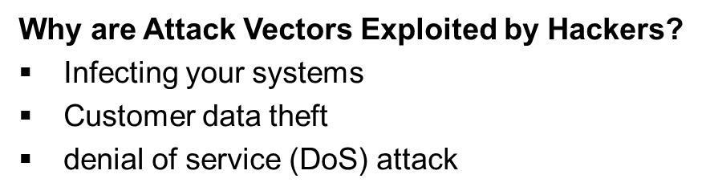

Slide 31
Attack Vectors
How do Hackers Exploit Attack Vectors?
Hackers identify a target system that they wish to penetrate or exploit
Hackers use data collection and observation tools such as sniffing, emails, malware or social engineering to obtain more information about the target
Hackers use this information to identify the best attack vector, then create tools to exploit it
Hackers break the security system using the tools they created, then install malicious software applications
Hackers begin to monitor the network, stealing your personal and financial data or infecting your computers and other endpoint devices with malware bots
Lecture 7- Botnets, Attack vector, Cloud computing

Slide 32
Attack Vectors : common types
Compromised credentials
Weak credentials
Malicious insiders
Missing or poor encryption
Misconfiguration
Ransomware
Phishing
Vulnerabilities
Lecture 7- Botnets, Attack vector, Cloud computing

Slide 33
Attack Vectors : common types
Brute force
Distributed Denial of Service (DDoS)
SQL injections
Trojans
Cross-site scripting (XSS)
Session hijacking
Man-in-the-middle attacks
Third and fourth-party vendors
Lecture 7- Botnets, Attack vector, Cloud computing

Slide 34
Attack Vectors
Mitigating Strategies
Phishing Emails
Malware
Unpatched Vulnerabilities
https://www.youtube.com/watch?v=cr56BR8A83w
Lecture 7- Botnets, Attack vector, Cloud computing

Slide 36
Cloud Computing
What is cloud computing?
The “cloud” is just a server where you store the data, applications and software that you can access from any device, as long as you have an Internet connection.
What types of services exist in the cloud?
Software as a Service (SaaS)
Platform as a Service (PaaS)
Infrastructure as a Service (IaaS)
Lecture 7- Botnets, Attack vector, Cloud computing

Slide 37
Cloud Computing : Threats associated
key cyber security threats that could affect your cloud computing services:
Crytopjacking
Data breaches
Denial of service
Insider threats
Hijacking accounts
Insecure applications
Inadequate training
Lecture 7- Botnets, Attack vector, Cloud computing

Slide 38
Cloud Computing : Best Practices
Implement user access control
Use SSH keys where possible
Require multi-factor authentication (MFA)
Perform monitoring
Institute patch management
Integrate with core directory
Lecture 7- Botnets, Attack vector, Cloud computing

Slide 39
Cloud Computing : Safety Measures
Backing up data
Understanding the cloud providers service agreement
Updating the backups created
Password protection
Two step authentication
Encryption and Decryption
Disciplined online behaviour
Not storing Sensitive information on cloud servers
Lecture 7- Botnets, Attack vector, Cloud computing

Slide 40
Thank You

