Slide 1
Cyber Security and Laws
Module :2 Cyber offenses & Cybercrime

Slide 2
Lecture 10
Proliferation of Mobile and Wireless Devices, Trends in Mobility

Slide 3
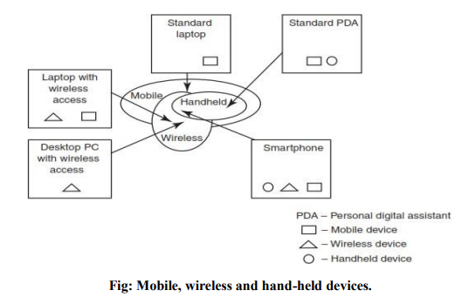
Mobile, Wireless Devices and hand-held devices
Lecture 8 – Proliferation of Mobile and Wireless Devices, Trends in Mobility

Slide 4
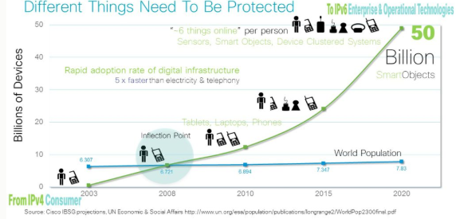
Technology Evolution
Lecture 8 – Proliferation of Mobile and Wireless Devices, Trends in Mobility

Slide 5
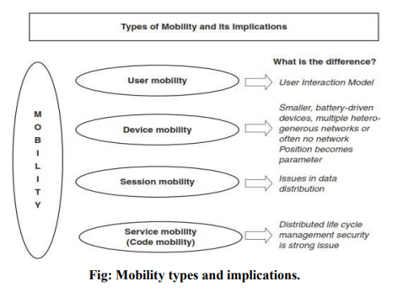
Trends in Mobility
Lecture 8 – Proliferation of Mobile and Wireless Devices, Trends in Mobility

Slide 6
Users are increasing risk
Kaspersky Labs describes seven ways employees’ mobile devices put corporate networks at risk:
Data leakage
Unsecured WiFi
Network spoofing
Phishing
Spyware
Broken cryptography
Improper session handling
But the companies are to blame too
Lecture 8 – Proliferation of Mobile and Wireless Devices, Trends in Mobility

Slide 7
Key Findings for Mobile Computing Security Scenario
With usage experience, awareness of mobile users gets enhanced
People continue to remain the weakest link for laptop security
Wireless connectivity does little to increase burden of managing laptops
Laptop experience changes the view of starting a smart hand-held pilot
There is naivety and/or neglect in smart hand-held security
Rules rather than technology keep smart hand-helds’ usage in check
Lecture 8 – Proliferation of Mobile and Wireless Devices, Trends in Mobility

Slide 8
Popular types of attacks against 3G mobile networks
1. Malwares, viruses and worms
Skull Trojan, Cabir Worm, Mosquito Trojan, Brador Trojan, Lasco worm
2. Denial-of-service (DoS)
3. Overbilling attack
4. Spoofed Policy Development Process(PDP)
5. Signaling-level attacks
Lecture 8 – Proliferation of Mobile and Wireless Devices, Trends in Mobility

Slide 9
Cybersecurity and Threat Prevention Mechanism
Example 1: St. Jude Merlin Home Monitor
Example 2 : Hacking mobile application & IoT
Next generation Firewall
Security model with Authentication, Authorization, Visibility and Control
Security from third parties
Lecture 8 – Proliferation of Mobile and Wireless Devices, Trends in Mobility

Slide 10
Lecture 11
Credit Card Frauds in Mobile and Wireless Computing Era, Security Challenges Posed by Mobile Devices

Slide 11
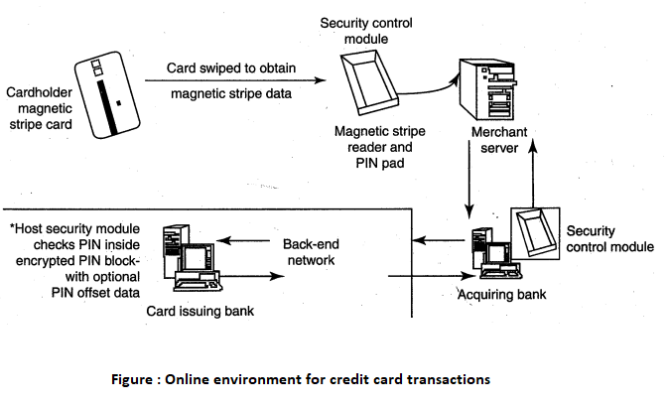
Basic flow of transactions in purchases with Credit Card
Ref : Nina Godbole(2009), Information Systems Security, Wiely Inndia
Lecture 9 – Credit Card Frauds in Mobile and Wireless Computing Era, Security Challenges Posed by Mobile Devices

Slide 12
How Does Credit Card Fraud Happen?
Theft
Trash
Dishonest person
Online offer
And so on.
Lecture 9 – Credit Card Frauds in Mobile and Wireless Computing Era, Security Challenges Posed by Mobile Devices

Slide 13
How to Report?
Call card issuer
Use24x7 or toll free number
Complaint for transactions not done by you.
Lecture 9 – Credit Card Frauds in Mobile and Wireless Computing Era, Security Challenges Posed by Mobile Devices

Slide 14
Tips to Prevent Credit Card Frauds : Do's
Put your signature on the card immediately upon its receipt.
Make the photocopy of both the sides of your card and preserve it at a safe place to remember the card number, expiration date in case of loss of card.
Change the default personal identification number (PIN) received from the bank before doing any transaction.
Always carry the details about contact numbers of your bank in case of loss of your card.
Carry your cards in a separate pouch/card holder than your wallet.
Keep an eye on your card during the transaction, and ensure to get it back immediately.
Preserve all the receipts to compare with credit card invoice.
Lecture 9 – Credit Card Frauds in Mobile and Wireless Computing Era, Security Challenges Posed by Mobile Devices

Slide 15
Tips to Prevent Credit Card Frauds : Do's (continued)
Reconcile your monthly invoice/statement with your receipts.
Report immediately any discrepancy observed in the monthly invoice/statement.
Destroy all the receipts after reconciling it with the monthly invoice/statement.
Inform your bank in advance, about any change in your contact details such as home address, cell phone number and E-Mail address.
Ensure the legitimacy of the website before providing any of your card details,
Report the loss of the card immediately in your bank and at the police station, if necessary.
Lecture 9 – Credit Card Frauds in Mobile and Wireless Computing Era, Security Challenges Posed by Mobile Devices

Slide 16
Tips to Prevent Credit Card Frauds : Don'ts
Store your card number and PINs in your cell.
Lend your cards to anyone.
Leaf cards or transaction receipts lying around.
Sign a blank receipt (if the transaction details are not legible, ask for another receipt to ensure the amount instead of trusting the seller).
Write your card number/PIN on a postcard or the outside of an envelope.
Give out immediately your account number over the phone (unless you are calling to company / to your bank).
Destroy credit card receipts by simply dropping into garbage box/dustbin.
Lecture 9 – Credit Card Frauds in Mobile and Wireless Computing Era, Security Challenges Posed by Mobile Devices

Slide 17
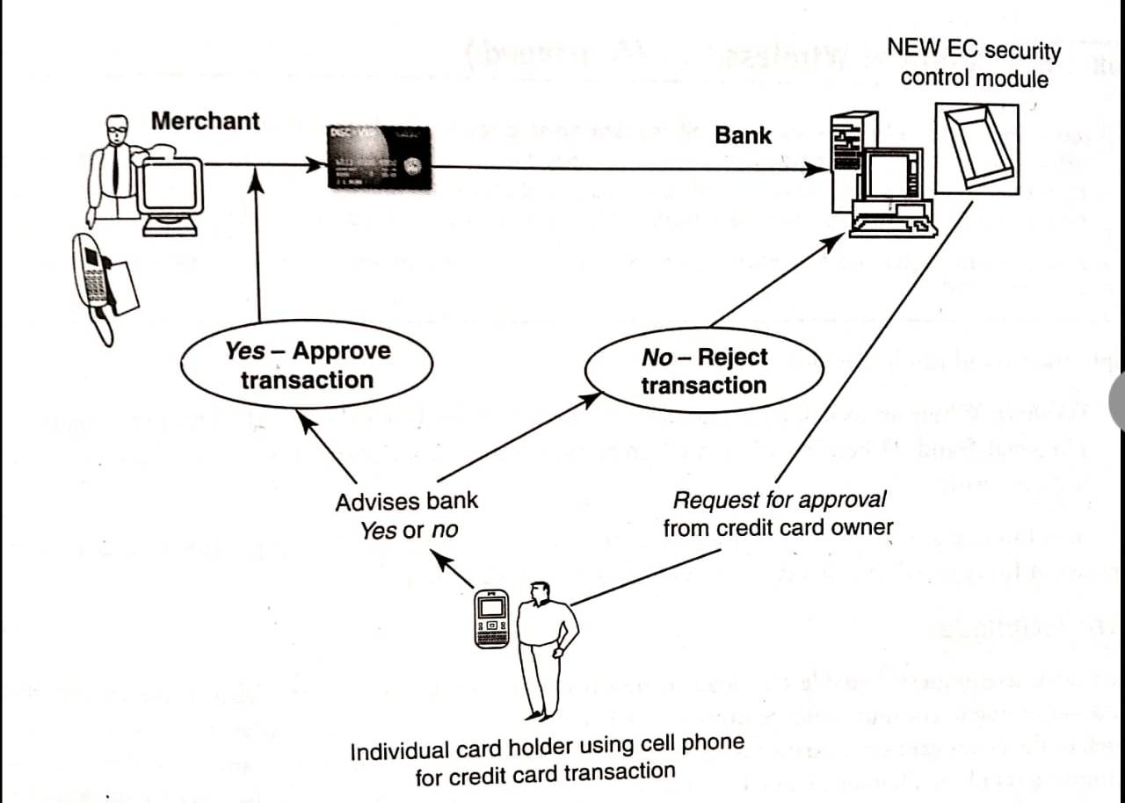
Closed – Loop Environment for Wireless(CLEW)
This is a system available from an Australian company “Alacrity”
Ref : Nina Godbole(2009), Information Systems Security, Wiely Inndia
Lecture 9 – Credit Card Frauds in Mobile and Wireless Computing Era, Security Challenges Posed by Mobile Devices

Slide 18
Closed – Loop Environment for Wireless(CLEW)
Basic Flow :
Merchant sends transaction to bank.
Bank transmits the request to authorized card holder
The card holder approves or rejects.
The bank/ merchant is notified.
Credit card transaction is completed.
Lecture 9 – Credit Card Frauds in Mobile and Wireless Computing Era, Security Challenges Posed by Mobile Devices

Slide 19
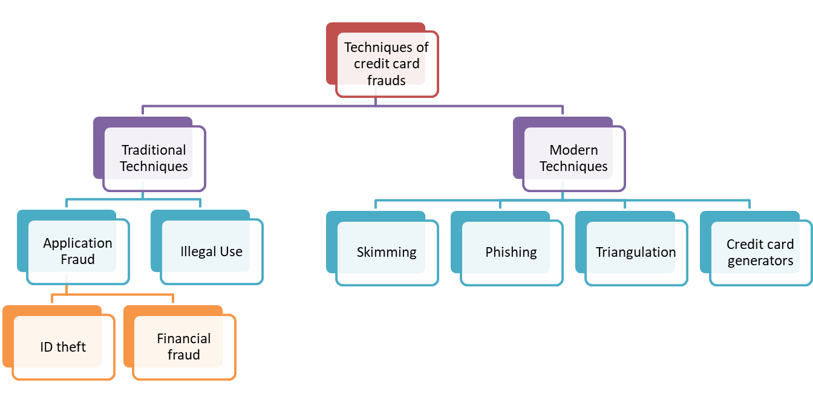
Types of techniques of credit card frauds
Lecture 9 – Credit Card Frauds in Mobile and Wireless Computing Era, Security Challenges Posed by Mobile Devices

Slide 20
Drawbacks of Wireless Processing
Wireless processing Equipment is expensive.
Wireless processing comes with extra fees.
Wireless credit card machines are subject to cellular coverage blackouts.
You cannot process cheques or debit card transactions over a wireless network.
Lecture 9 – Credit Card Frauds in Mobile and Wireless Computing Era, Security Challenges Posed by Mobile Devices

Slide 21
https://www.youtube.com/watch?v=fy-RSQfwLDw&feature=youtu.be

Slide 22
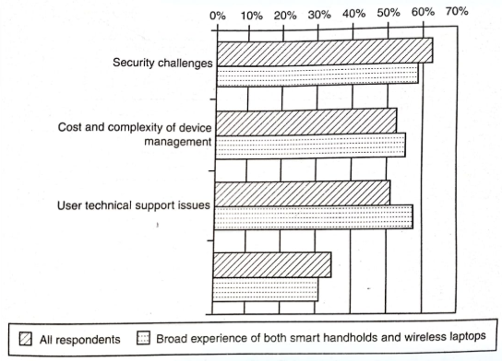
Security Challenges Posed by Mobile Devices
Ref : Nina Godbole(2009), Information Systems Security, Wiely Inndia
Lecture 9 – Credit Card Frauds in Mobile and Wireless Computing Era, Security Challenges Posed by Mobile Devices

Slide 23
Lecture 12
Registry Settings for Mobile Devices, Authentication Service Security, Attacks on Mobile/Cell Phones

Slide 24
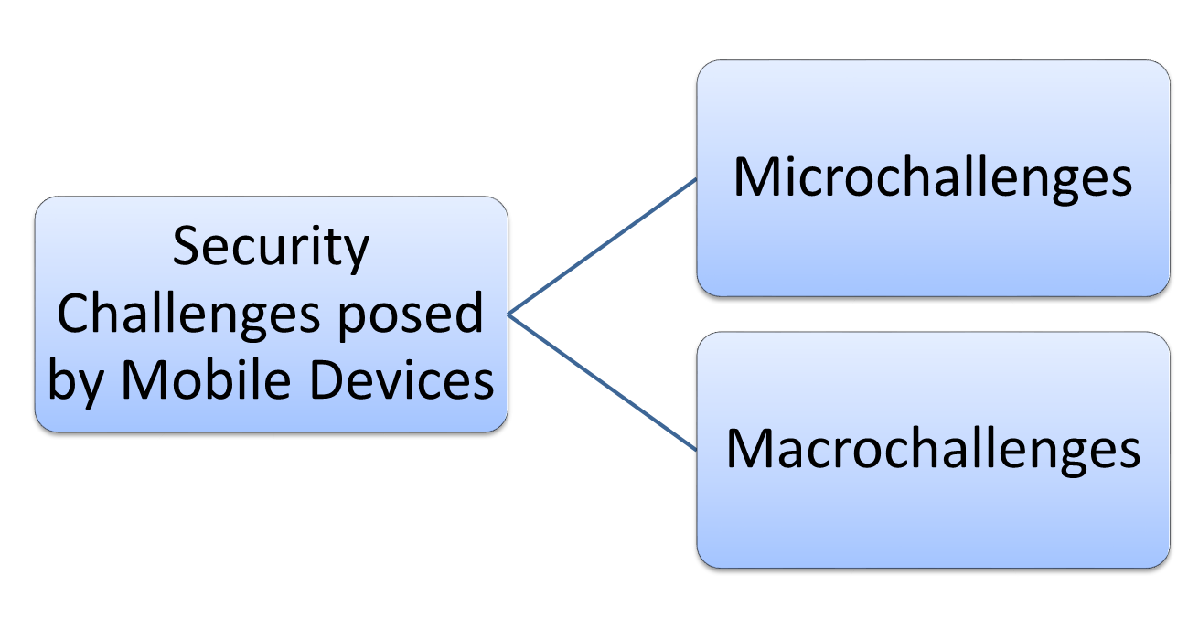
Security Challenges posed by Mobile Devices
Lecture 10 – Registry Settings for Mobile Devices, Authentication Service Security, Attacks on Mobile/Cell Phones

Slide 25
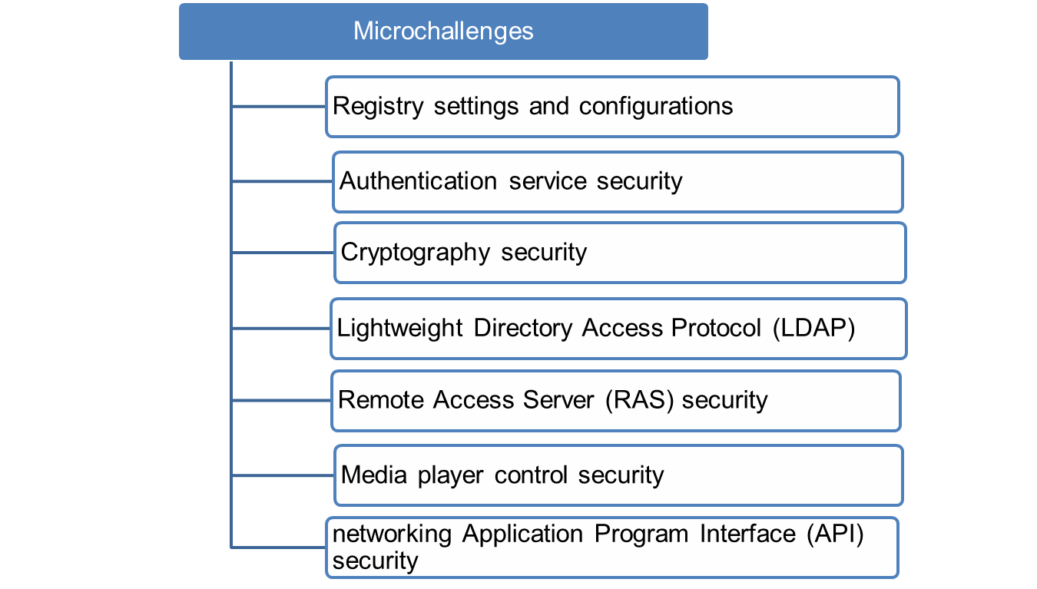
Security Challenges posed by Mobile Devices
Lecture 10 – Registry Settings for Mobile Devices, Authentication Service Security, Attacks on Mobile/Cell Phones

Slide 26
Security Challenges posed by Mobile Devices
Registry Settings for Mobile Devices
Microsoft Activesync
Group Policy
Addressing core problem
Authentication Service Security
Security of Device
Security in Networks
  Push attacks
  Pull attacks
  Crash attacks
Lecture 10 – Registry Settings for Mobile Devices, Authentication Service Security, Attacks on Mobile/Cell Phones

Slide 27
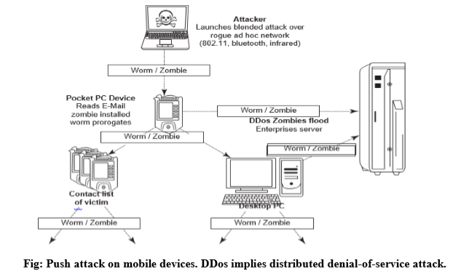
Authentication Service Security : Push Attack
Lecture 10 – Registry Settings for Mobile Devices, Authentication Service Security, Attacks on Mobile/Cell Phones

Slide 28
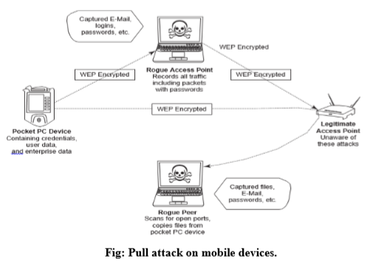
Authentication Service Security : Pull Attack
Lecture 10 – Registry Settings for Mobile Devices, Authentication Service Security, Attacks on Mobile/Cell Phones

Slide 29
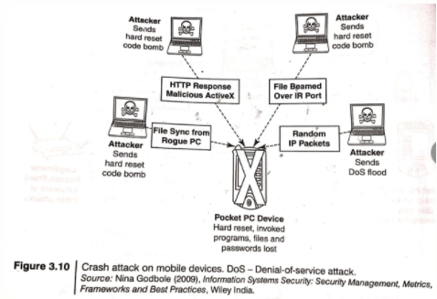
Authentication Service Security : Crash Attack
Lecture 10 – Registry Settings for Mobile Devices, Authentication Service Security, Attacks on Mobile/Cell Phones

Slide 30
Security Challenges posed by Mobile Devices
3. Cryptographic Security for Mobile Devices
CGA – Cryptographically Generated Addresses
PKI – Public Key Infrastructure
CPM – Cryptographic Provider Manager
Lecture 10 – Registry Settings for Mobile Devices, Authentication Service Security, Attacks on Mobile/Cell Phones

Slide 31
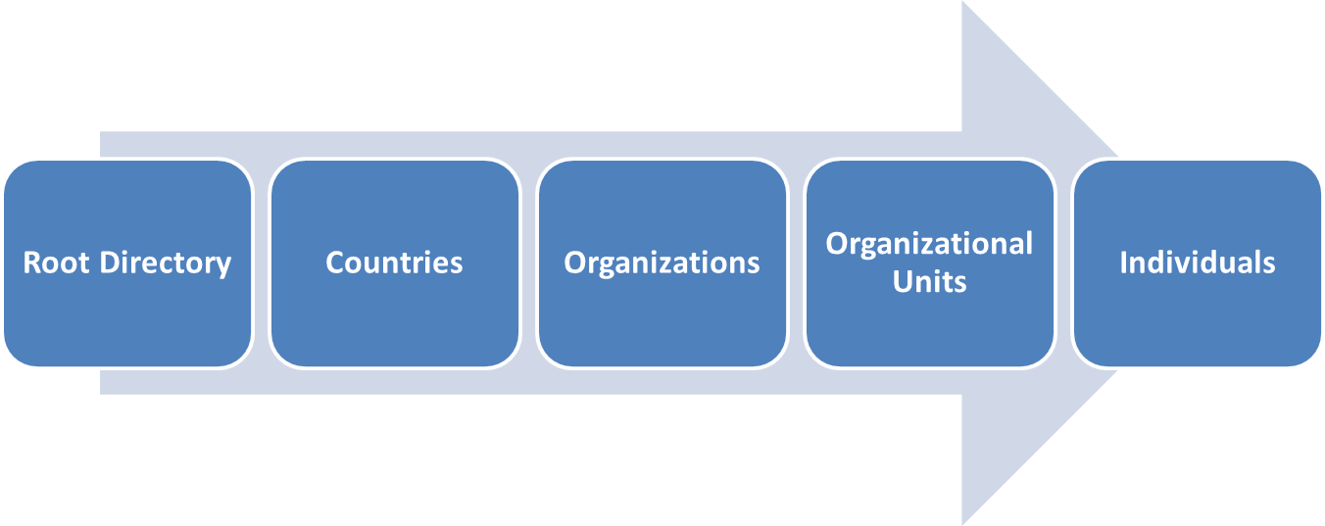
Security Challenges posed by Mobile Devices
4. LDAP Security for Hand – Held mobile computing Devices
Light weight version of Direct Access Protocol(DAP)
Lecture 10 – Registry Settings for Mobile Devices, Authentication Service Security, Attacks on Mobile/Cell Phones

Slide 32
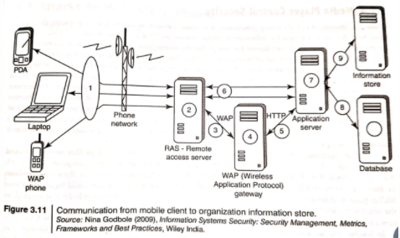
5. RAS Security for Mobile devices
Remote Access Server (RAS)
Lecture 10 – Registry Settings for Mobile Devices, Authentication Service Security, Attacks on Mobile/Cell Phones

Slide 33
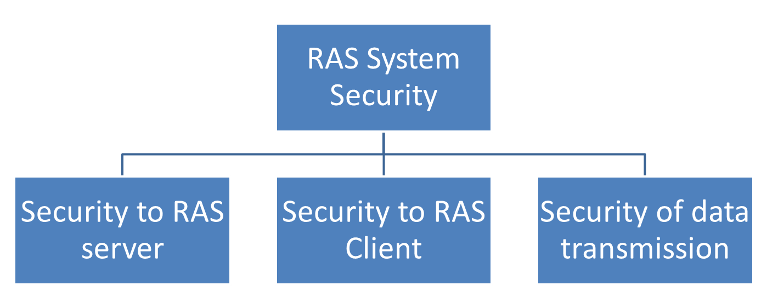
RAS Security for Mobile devices
For protecting business-sensitive data on employees terminal
Threats – impersonating, port scanning
RAS system security for mobile device clients
Lecture 10 – Registry Settings for Mobile Devices, Authentication Service Security, Attacks on Mobile/Cell Phones

Slide 34
Security Challenges posed by Mobile Devices
Media Player Control Security
- threat through Music Gateways
- examples : 2002 Microsoft
2004 Corrupt files
Vulnerabilities :
Files could be created that will open a website on user’s browser from where JavaScript can be operated,
Files could be created which allow attacker to download and use the code on user’s machine, or
Media files could be created that will create buffer overrun errors.
Lecture 10 – Registry Settings for Mobile Devices, Authentication Service Security, Attacks on Mobile/Cell Phones

Slide 35
Security Challenges posed by Mobile Devices
7. Networking API Security for Mobile Computing Applications :
Various APIs for single application that can be used to target multiple security platforms
Securing a range of embedded and consumer products including OSs
Lecture 10 – Registry Settings for Mobile Devices, Authentication Service Security, Attacks on Mobile/Cell Phones

Slide 36
Attacks on Mobile Phones
Theft
Mobile Viruses
Mishing
Vishing
Smishing
Hacking Bluetooth
Lecture 10 – Registry Settings for Mobile Devices, Authentication Service Security, Attacks on Mobile/Cell Phones

Slide 37
Attacks on Mobile Phones :Theft
Decrease in cost and increase in functionality.
Its not luxury now a bare necessity.
Theft usually happens at public places.
In case of theft complaint at police station.
Install antitheft softwares.
Backup your data and don’t save PII in mobile.
Lecture 10 – Registry Settings for Mobile Devices, Authentication Service Security, Attacks on Mobile/Cell Phones

Slide 38
Attacks on Mobile Phones : Mobile Viruses , example
"All mobile users pay attention!!!!
If you receive a phone call and your mobile phone displays (XALAN) on the screen don't answer the call, END THE CALL IMMEDIATELY, if you answer the call, your phone will be infected by a virus. This virus WILL ERASE all IMEI and IMSI information from both your phone and your SIM card which will make your phone unable to connect with the telephone network. You will have to buy a new phone. This information has been confirmed by both Motorola and Nokia. There are over 3 Million mobile phones being infected by this virus in all around the world now. You can also check this news in the CNN website.
PLEASE FORWARD THIS PIECE OF INFORMATION TO ALL YOUR FRIENDS HAVING A MOBILE PHONE.”
Lecture 10 – Registry Settings for Mobile Devices, Authentication Service Security, Attacks on Mobile/Cell Phones

Slide 39
Attacks on Mobile Phones : Mobile Viruses
40 virus families, 300+ mobile viruses
Get spread through Bluetooth and MMS
How to protect:
  Use genuine resources
  Turn on Bluetooth when required
  For IR beam use trusted sources
  Antivirus
Lecture 10 – Registry Settings for Mobile Devices, Authentication Service Security, Attacks on Mobile/Cell Phones

Slide 40
Attacks on Mobile Phones : Mishing
Mobile + Phishing = Mishing
Target is online banking / online shopping customers.
Through Voice call or SMS.
Attackers are creative.
Lecture 10 – Registry Settings for Mobile Devices, Authentication Service Security, Attacks on Mobile/Cell Phones

Slide 41
Attacks on Mobile Phones : Vishing
Uses social engineering over telephone.
Done used to steal credit card details or other ID theft
Information gained through Vishing attack include:
  ID theft
  Purchasing luxury goods and services.
  Transferring money/ funds
  Monitoring the victim’s bank account
  Making application for loans and credit cards
Lecture 10 – Registry Settings for Mobile Devices, Authentication Service Security, Attacks on Mobile/Cell Phones

Slide 42
Attacks on Mobile Phones : Vishing
How Vishing Works :
Email
Mobile text message
Voicemail
Direct phone call
Example:
Automated message
Authentication
Extra information
PIN, password
End of call.
Lecture 10 – Registry Settings for Mobile Devices, Authentication Service Security, Attacks on Mobile/Cell Phones

Slide 43
Attacks on Mobile Phones : Vishing
How to protect :
Be suspicious about unknown callers.
Do not trust caller ID.
Ask questions
Call them back.
Report Incidents.
Lecture 10 – Registry Settings for Mobile Devices, Authentication Service Security, Attacks on Mobile/Cell Phones

Slide 44
Attacks on Mobile Phones : Smishing
SMS + Phishing = Smishing
Abuse by three different methods:
  Pretexting
  Sexting
  VoIP Spam
Victim is forced to call on given phone number or access given fake URL to steal PI.
How to Protect
  Do not answer to message asking PI.
  Avoid calling on phone numbers given in messages.
  Do not click on link through message.
SMS Blocker – Optino Mobitech Pvt Ltd
Lecture 10 – Registry Settings for Mobile Devices, Authentication Service Security, Attacks on Mobile/Cell Phones

Slide 45
Mobile Devices: Security Implications for Organizations
Macrochallenges In Security of mobile devices
Managing Diversity and Proliferation of Handheld Devices
Unconventional / Stealth Storage Devices
Threats through lost & stolen devices
Protecting Data on Lost Devices
Educating Laptop users
Lecture 11 – Mobile Devices: Security Implications for Organizations

Slide 46
Attacks on Mobile Phones : Hacking Bluetooth
Bluetooth enabled device broadcasts “ I’m here and I’m able to connect.”
Common attacks :
  Blue Jacking
  Bluesnarfing
  Bluebugging
  Car whisperer
Bluetooth hacking Tools
  BlueScanner
  BlueSniff
  BlueBugger
  Bluesnarfer
  BlueDiving
Lecture 10 – Registry Settings for Mobile Devices, Authentication Service Security, Attacks on Mobile/Cell Phones

Slide 47
Thank You

