Slide 1
Cyber Security and Laws
Module :2 Cyber offenses & Cybercrime

Slide 2
Lecture 13
Mobile Devices: Security Implications for Organizations

Slide 3
I. Managing Diversity and Proliferation of Handheld Devices
Security procedures and tools
Cost and convenience
Care of special access rights to senior executives
Track of who owns what kind of mobile devices
Remove logical and physical access of left employee’s devices
Collect back devices given by company to employees while leaving
Lecture 11 – Mobile Devices: Security Implications for Organizations

Slide 4
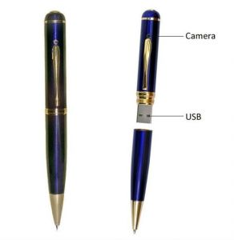
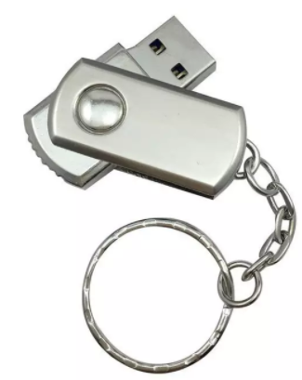
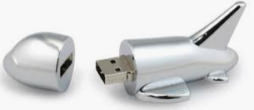
II. Unconventional / Stealth Storage Devices
Fig : Unconventional mobile devices
Lecture 11 – Mobile Devices: Security Implications for Organizations

Slide 5
II. Unconventional / Stealth Storage Devices
Prohibit usage of such devices
Firewalls and antivirus softwares give no protection
Entry to viruses, worms, Trojans
Threat fro disgruntled employees
Policy to block
Devicelock software solution
Lecture 11 – Mobile Devices: Security Implications for Organizations

Slide 6
II. Unconventional / Stealth Storage Devices
Features of Devicelock software :
Monitor devices being used
Control the access according to time
Create white list
Set in ‘read only’ mode
Protection against formatting
Lecture 11 – Mobile Devices: Security Implications for Organizations

Slide 7
III. Threats through Lost & Stolen Devices
These devices keep risk of sabotage
If have wireless access to corporate network and have little security then big issue
IV. Protecting Data on Lost Devices
Individual precautions : encrypting sensitive data
: Encrypting entire file system
Third party solutions/ tools
Self destruct policy
Lecture 11 – Mobile Devices: Security Implications for Organizations

Slide 8
V. Educating Laptop Users
Downloading non_work_related files
Software assets become more complex with number of applications
Access of websites and downloads with business network
Lecture 11 – Mobile Devices: Security Implications for Organizations

Slide 9
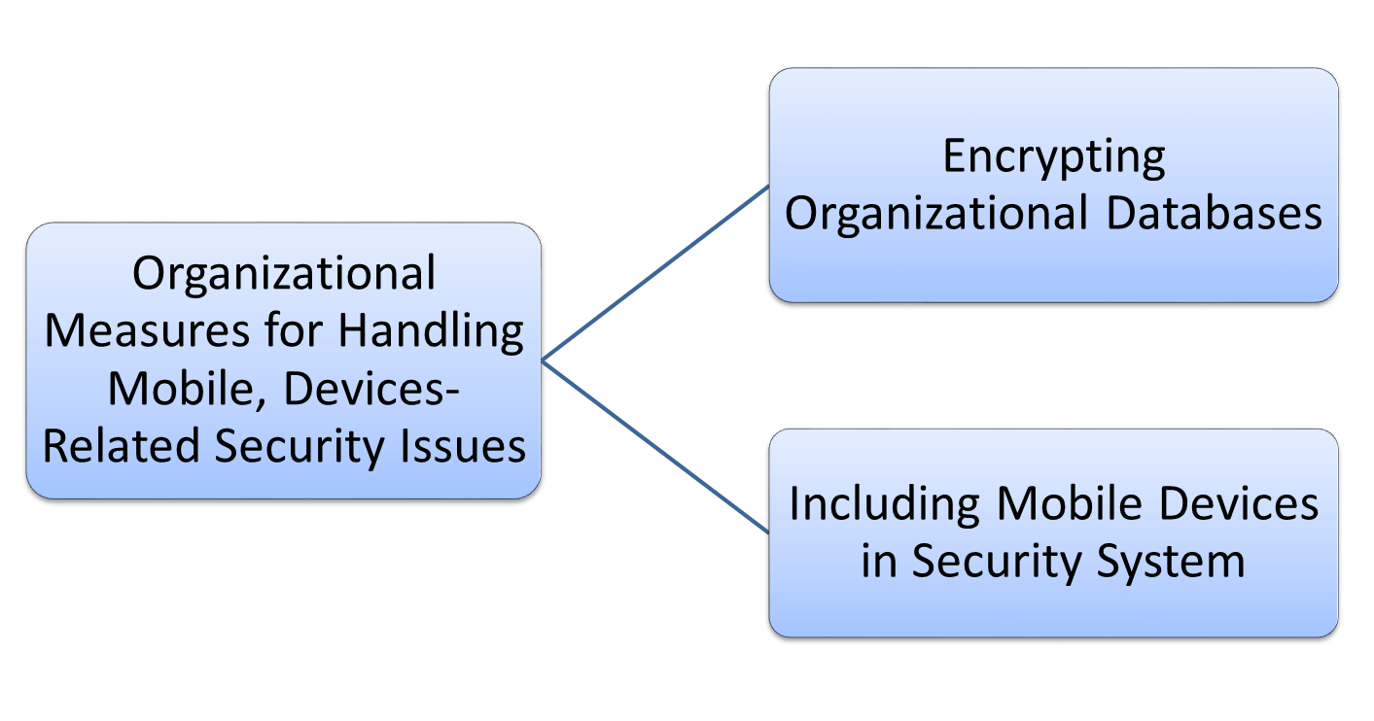
Organizational Measures for Handling Mobile, Devices-Related Security Issues
Lecture 12 – Organizational Measures for Handling Mobile, Devices-Related Security Issues

Slide 10
Encrypting Organizational Databases
Strong encryption :
Rijndael : AES- Advanced Encryption Standard
MSDR – Multi Dimensional Space Rotation
Not to store key on mobile devices
Additional Security by self destruct program
Lecture 12 – Organizational Measures for Handling Mobile, Devices-Related Security Issues

Slide 11
Including Mobile Devices in Security System
Strong asset management
Investigate alternatives for secure access
Security audits
Security awareness training
Law enforcement agency, close monitoring
Lecture 12 – Organizational Measures for Handling Mobile, Devices-Related Security Issues

Slide 12
Cyber Security and Laws
Module :3 Tools and Methods Used in Cybercrime

Slide 13
Index - Module :3 Tools and Methods Used in Cyberline
Lecture 14 : | Phishing, Password Cracking, Key loggers and Spywares
Lecture 15 : | Virus and Worms, Steganography

Slide 14
Lecture 14
Phishing, Password Cracking, Key loggers and Spywares

Slide 15
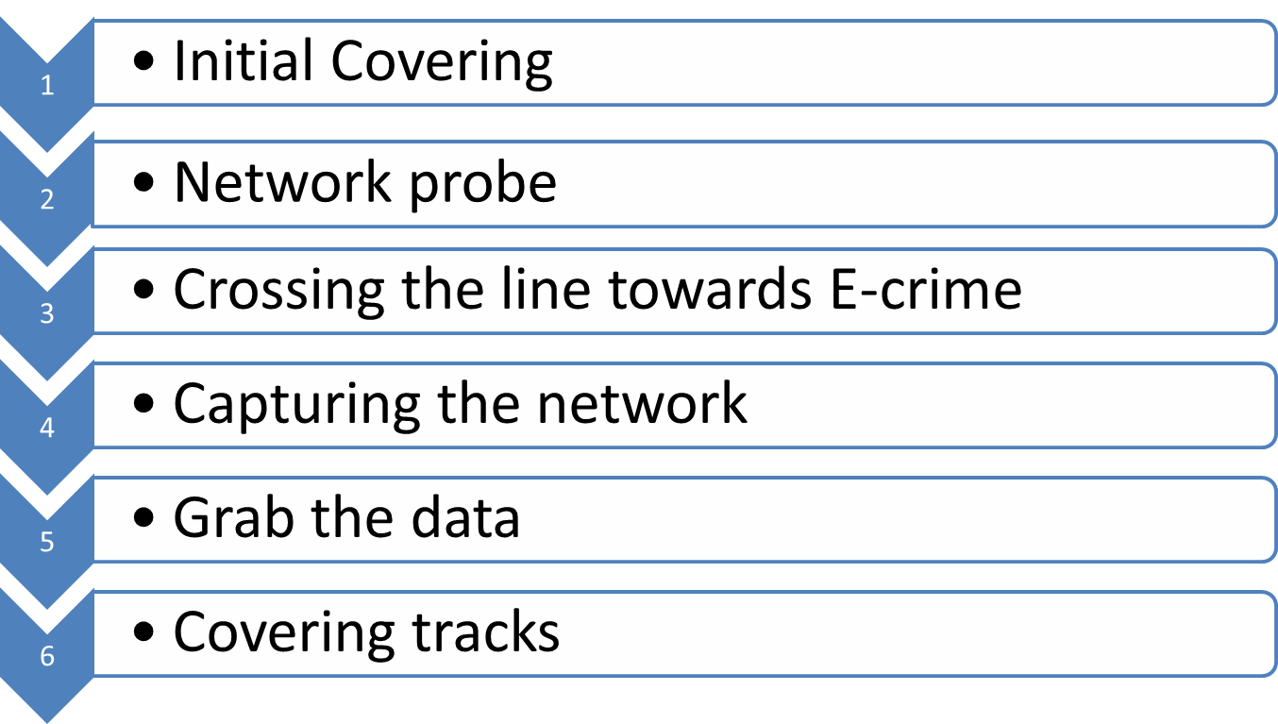
Basic Stages of attack
Lecture 14 – Phishing, Password Cracking, Key loggers and Spywares

Slide 16
Tools and Techniques used
Scareware
Malvertising
Click jacking
Ransomeware
Lecture 14 – Phishing, Password Cracking, Key loggers and Spywares

Slide 17
Proxy Severs
Proxy server is a computer on a network which acts as an intermediary for connections with other computers on that network.
Purposes:
  Keep systems behind the curtain
  Speed up access to a resource
  Specialized proxy servers for filtering unwanted content
  Can be used as IP address
Lecture 14 – Phishing, Password Cracking, Key loggers and Spywares

Slide 18
Anonymizers
It is a tool that attempts to make activity on the internet untraceable
Protect PI
Services used to make web surfing anonymous
Ensures privacy of users
First Anonymizer – 1997, Lance Cottrell
Lecture 14 – Phishing, Password Cracking, Key loggers and Spywares

Slide 19
Being Anonymous : Cookies
Google Cookie
Cookie
  Persistent cookie
  Session cookie
DoubleClick
G-zapper
Lecture 14 – Phishing, Password Cracking, Key loggers and Spywares

Slide 20
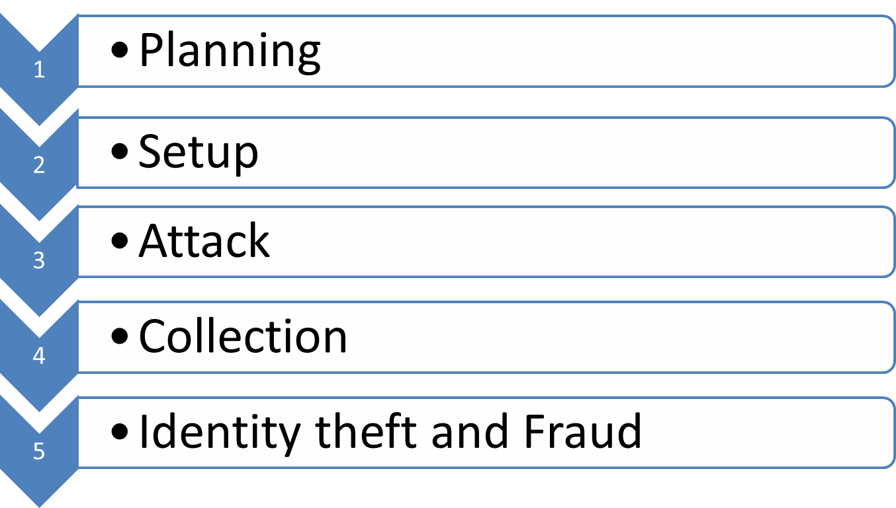
Phishing : How phishing works?
Lecture 14 – Phishing, Password Cracking, Key loggers and Spywares

Slide 21
Password Cracking : Purposes
To recover a forgotten password.
As a preventive measure by system administrator to check for easily crackable password.
To gain unauthorised access to a system.
Lecture 14 – Phishing, Password Cracking, Key loggers and Spywares

Slide 22
Password Cracking : Steps
Find a valid user account
Create list of possible passwords
Rank them
Key in each
Try until successful login
Lecture 14 – Phishing, Password Cracking, Key loggers and Spywares

Slide 23
Password Cracking : Examples of easily guessable passwords
Blank
Words like password, passcode, admin
Series of letters like QWERTY, ASDF etc
User’s name
Name of spouse/ children/friend
Birthplace/date of birth
Vehicle no, residence number
Name of celebrity who is considered as idol
1234 or 4321 etc
Lecture 14 – Phishing, Password Cracking, Key loggers and Spywares

Slide 24
Password Cracking : Attacks
Online Attacks
Offline Attacks
Non-electronic attacks
Lecture 14 – Phishing, Password Cracking, Key loggers and Spywares

Slide 25
Strong, Weak and Random Passwords
Strong Password examples
3249742304G
MonO297
Hat#72
Weak Password examples
Name
Repeated letters, numbers
Consecutive letters, numbers
Date of birth, anniversary
Admin
Password
december12
Lecture 14 – Phishing, Password Cracking, Key loggers and Spywares

Slide 26
Random Passwords : General Guidelines
It should be unique to each user
Minimum 8 Alphanumeric
There should be computer controlled lists
Keep private
Change after every 30/45 days
After 5 wrong attempts, freeze
Suspend session after 15minutes
Successful logon should display date ad time
Ids and passwords should be suspended after specified time
High risk systems should generate alarms
Lecture 14 – Phishing, Password Cracking, Key loggers and Spywares

Slide 27
Random Passwords : Guidelines to avoid attack
Personal and professional passwords should be different
Minimum 8 Alphanumeric
Keep private
Change after every 30/45 days
Avoid using old ones
After using at public places change them
Verify legitimacy of email, site before clicking
In case of attacked/hacked, report concerned party immediately.
Lecture 14 – Phishing, Password Cracking, Key loggers and Spywares

Slide 28
Lecture15
Virus and Worms, Steganography

Slide 29
Viruses
Computer virus is a program that can “infect” legitimate programs by modifying them to include a possibly “evolved” copy of itself.
Typical Actions taken by Viruses :
Display a message to prompt an action which may set of the virus.
Delete files inside the system into which virus enetrs
Scramble data on hard disk.
Cause erratic screen behaviour
Halt the system
Just replicate themselves to propagate further harm.
Lecture 12 – Virus and Worms, Steganography

Slide 30
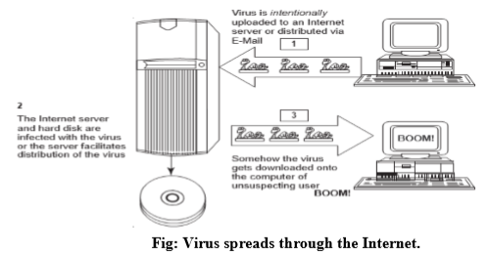
Viruses : How they spread
Lecture 12 – Virus and Worms, Steganography

Slide 31
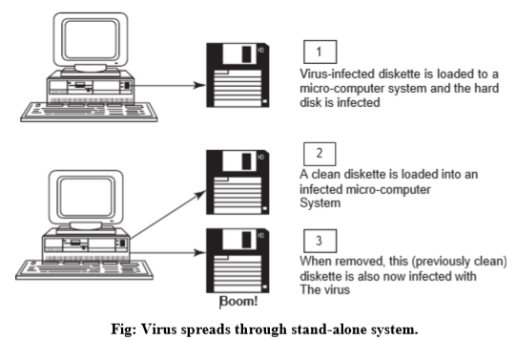
Viruses : How they spread
Lecture 12 – Virus and Worms, Steganography

Slide 32
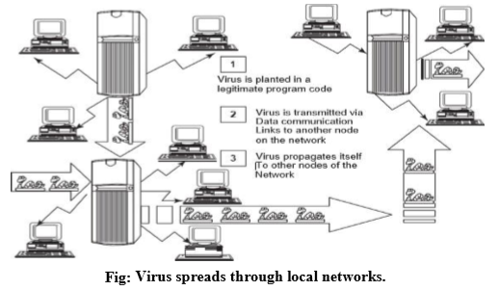
Viruses : How they spread
Lecture 12 – Virus and Worms, Steganography

Slide 33
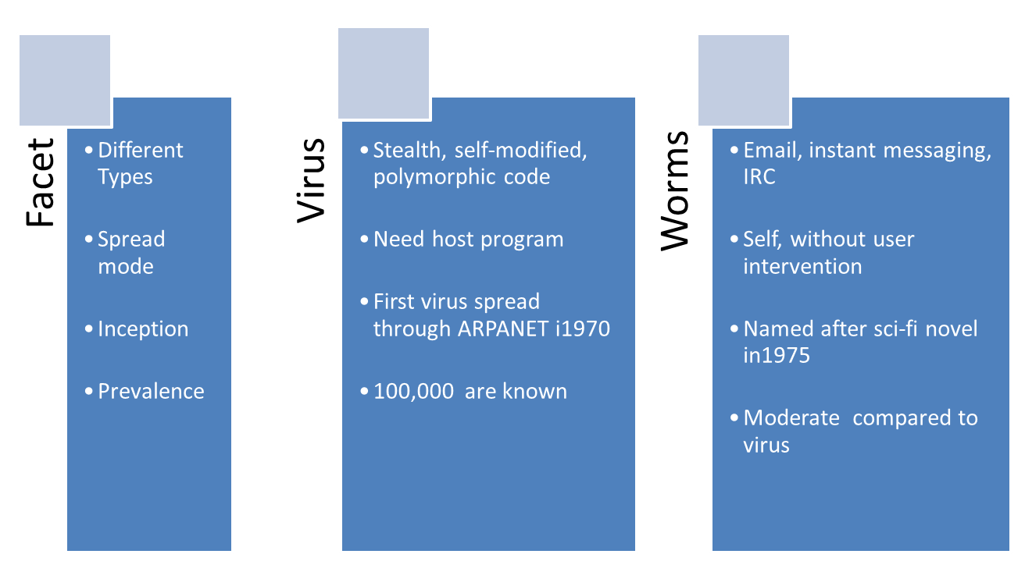
Difference between Virus and Worm
Lecture 12 – Virus and Worms, Steganography

Slide 34
Viruses : Types
Boot sector viruses
Program viruses
Multipartite viruses
Stealth viruses
Polymorphic viruses
Macroviruses
Active X and Java control
World’s famous Virus attacks :
Conficker, AutoRun, FlyStudio etc
Lecture 12 – Virus and Worms, Steganography

Slide 35
Viruses and Worms
In summary, a typical definition of Virus/worm is :
A virus attacks specific file types
A virus manipulates a program to execute the tasks unintentionally
An infected program produces more viruses
An infected program may run without error for longer time
Viruses can modify themselves and may possible escape detection this way.
Lecture 12 – Virus and Worms, Steganography

Slide 36
Trojan Horses
It is a malicious program which contains harmful code inside and is apparently harmless programming or data
Get into the system from web browser, via E-mail, from soft wares downloaded or through USB devices.
Trojans Do not Replicate but are equally harmful as viruses and worms.
Ex :
Waterfalls.scr – screensaver file
Lecture 12 – Virus and Worms, Steganography

Slide 37
Trojan Horse : Threats
They erase, overwrite or corrupt data on a computer.
They help to spread other malware such as viruses (by a dropper Trojan).
They deactivate or interfere with antivirus and firewall programs.
They allow remote access to your computer (by a remote access Trojan).
They upload and download files without your knowledge.
They gather E-Mail addresses and use them for Spam.
They log keystrokes to steal information such as passwords and credit card numbers.
They copy fake links to false websites, display porno sites, play sounds/videos and display images.
They slow down, restart or shutdown the system.
They reinstall themselves after being disabled.
They disable the task manager.
They disable the control panel.
Lecture 12 – Virus and Worms, Steganography

Slide 38
Backdoor
It is a means of access to a computer program that bypasses security mechanisms.
It works in background and hide from user
Most of them are automatic malicious programs that must be somehow installed to a computer.
Programmers leave such backdoors in their software for diagnostics and troubleshooting purposes.
Lecture 12 – Virus and Worms, Steganography

Slide 39
What Backdoor Does?
Manipulate
Control and modify
Steal sensitive data
Record keystrokes
Send gathered data to a predefined email address
Infect and corrupt
Spread infection
Install FTP servers for illegal actions
Degrades security, speed and performance.
Hides uninstall.
Examples :
Back Orifice, Bifrost, SAP backdoors etc.
Lecture 12 – Virus and Worms, Steganography

Slide 40
How to protect ?
Stay away from suspicious websites and weblinks
Surf on web cautiously
Install antivirus/ Trojan remover software
Lecture 12 – Virus and Worms, Steganography

Slide 41
Steganography
Steganography = Steganos + graphein
        covered to write
Countless methods of protecting such data
It is art and science of hiding information
Data hiding or digital watermarking
Ex: Digital watermarking with image
Lecture 12 – Virus and Worms, Steganography

Slide 42
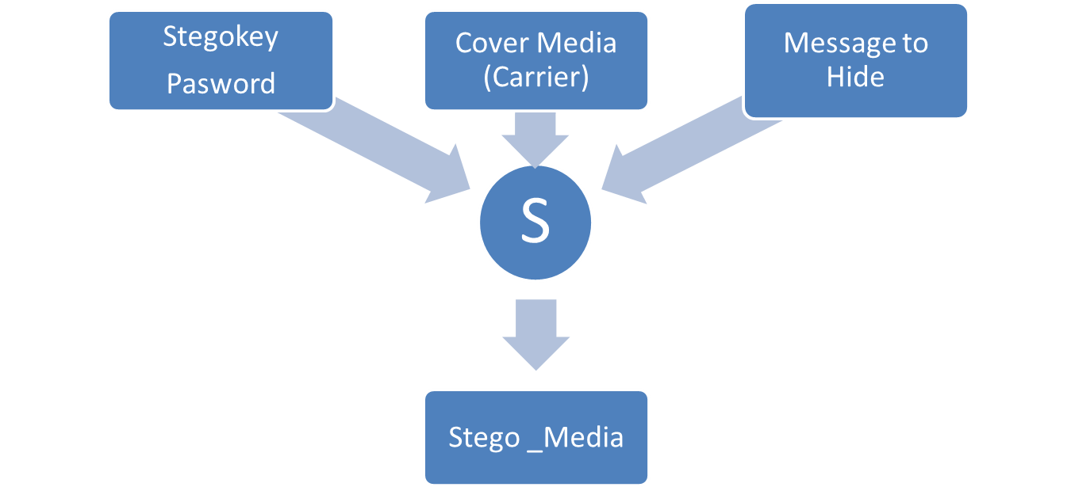
Steganography : How it works?
Cover medium + Embedded message + Stegokey = Stego-medium
Lecture 12 – Virus and Worms, Steganography

Slide 43
Thank You

