Slide 1
Cyber Security and Laws
Module :3 Tools and Methods Used in Cybercrime

Slide 2
Index - Module :3 Tools and Methods Used in Cyberline
Lecture 16 : | Covert channels, storage and timing covert channels, counter measures for covert communication
Lecture 17 : | DoS and DDos attacks, SQL injection, Buffer overflow
Lecture 18 : | Attacks on wireless networks, Identity Theft-ID Theft

Slide 3
Lecture 16
DoS and DDos attacks,

Slide 4
DoS and DDoS Attack
An attempt to make a computer resources unavailable to its intended users
DoS attack:
Attacker floods the BW of the victim’s N/W or fills his E-Mail box with Spam mail depriving him of the services he is entitled to access or provide
Attacker typically target sites or services hosted on high-profile web servers such as banks, credit card payment gateways, mobile phone networks and even root name servers
Lecture 17 – DoS and DDoS Attacks

Slide 5
DDoS Attack
Buffer overflow technique is employed to commit such kind of criminal attack
Attacker spoofs the IP address and floods the N/W of victim with repeated requests
As the IP address is fake, the victim machine keeps waiting for response from the attacker’s machine for each request
This consumes the BW of the N/W which then fails to server the legitimate responses and ultimately breaks down
Lecture 18 – DoS and DDoS Attacks

Slide 6
Symptoms DDoS Attack
US Computer Emergency Response defines it:
Unusually slow n/w performance(opening file or accessing websites)
Unavailability of a particular website
Inability to access any website
Dramatic increase in the no. of Spam E-Mails received
Lecture 18 – DoS and DDoS Attacks

Slide 7
What DDoS Attack does?
Goal of DoS is not to gain unauthorized access to systems or data, but to prevents intended users of a service from using it.
Activity done by DoS
Flood a n/w with traffic
Disrupt connection between 2 systems
Prevent a particular individual from accessing service
Disrupt service to a specific system or person
Lecture 18 – DoS and DDoS Attacks

Slide 8
Classification DoS Attack
Bandwidth attacks
Consuming all the bandwidth of site
Logic attack
Exploit vulnerabilities in n/w s/w such as web server or TCP/IP stack
Protocol attacks
Exploit specific feature or implementation bug of some protocol installed at victim’s system to consume excess amount of its resources
Unintentional DoS attack
This is a scenario where website ends up denied due to sudden enormous spike in popularity.
*Protocols are rules that are to be followed to send data over network.
Lecture 18 – DoS and DDoS Attacks

Slide 9
Types and Levels of DDoS Attacks:
Flood Attack
Ping of Death Attacks
Syn Attack
Teardrop Attack
Smurf Attacks
Nuke Attacks

Slide 10
Types or Level of DoS Attack
Flood attack: (Ping flood)
Attacker sending no. of ping packets, using “ping” command, which result into more traffic than victim can handle
This requires the attacker to have faster n/w connection than the victim
Prevention is difficult
Ping of death attack:
Sends oversized ICMP(Internet Control Message Protocol) packets
Receiving this packet, will crash, freeze or reboot system
Lecture 18 – DoS and DDoS Attacks

Slide 11
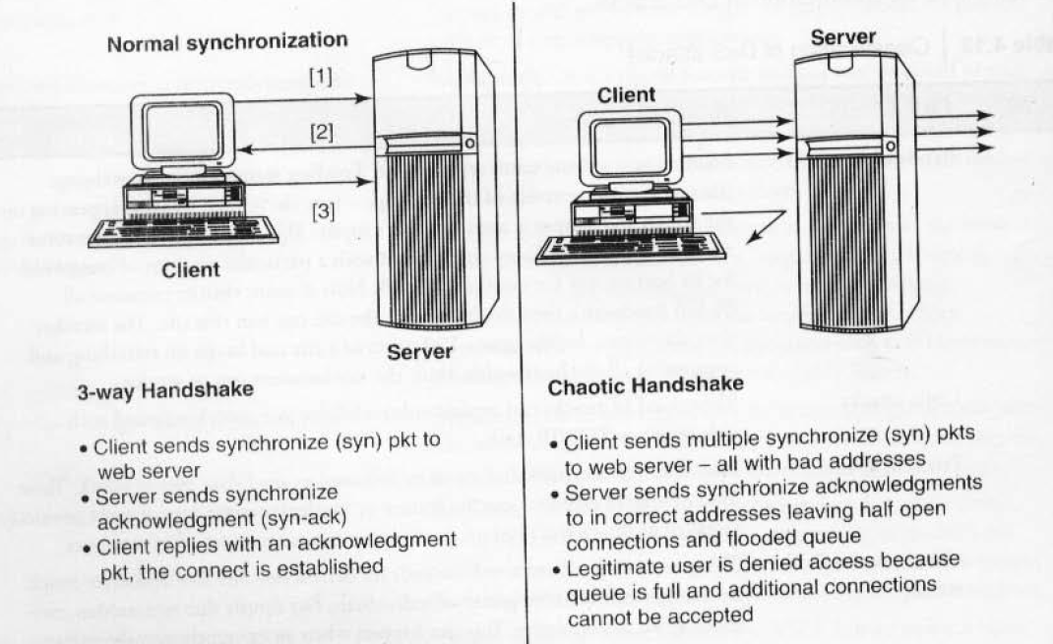
Types or Level of DoS Attack SYN attack: (TCP SYN flooding):
Lecture 18 – DoS and DDoS Attacks

Slide 12
Types or Level of DoS Attack
Teardrop attack:
A Teardrop DoS (Denial of Service) attack is a type of cyberattack that exploits vulnerabilities in the way some older operating systems handle fragmented network packets. The attack gets its name from the way fragmented packets are reassembled into full packets during transmission. Teardrop DoS attack is a type of cyberattack where an attacker sends broken or confusing pieces of data to a computer, causing it to crash or freeze. The attack takes advantage of how the computer puts those pieces back together. Older computers were especially vulnerable to this kind of attack.
Attack where fragmented packets are forged to overlap each other when the receiving host tries to reassemble them
IP’s packet fragmentation algo is used to send corrupted packets to confuse the victim and may hang the system
Windows 3.1x, 95 and NT , Linux versions 2.0.32, 2.1.63 are vulnerable to this attack

Slide 13
Types or Level of DoS Attack
Smurf attack
A Smurf Attack is a type of attack that exploits Internet Protocol (IP) broadcasting to flood a target with large amounts of traffic. It is named after the "Smurf" malware program used in this attack, which takes advantage of certain vulnerabilities in network devices and protocols.
Generating significant computer n/w traffic on victim n/w, using floods via spoofed broadcast ping message
Attack consists of a host sending ICMP echo request to n/w broadcast ping address
Every host receive this packet & send back ICMP echo response
Internet relay chat(IRC)servers are primarily victim of smurf attack
Lecture 18 – DoS and DDoS Attacks

Slide 14
Types or Level of DoS Attack
Nuke:
An old DoS attack against computer n/w s consisting of fragmented or otherwise invalid ICMP packets sent to target
Achieved by using a modified ping utility to repeatedly send this corrupt data, thus slowing down the affected computer until it comes to complete stop
Eg. Win Nuke, which is exploited the vulnerability in the NetBIOS handler in windows 95. A string of out-of band data was sent to TCP port 139 of victim’s machine, causing it to lock up and display Blue Screen Of Death (BSOD)
Lecture 18 – DoS and DDoS Attacks

Slide 15
Tools used to Launch DoS Attack
Jolt2: attack against window based machine consume 100% of CPU time on processing of illegal packets
Nemesy: generates random packets of spoofed source IP
Targa: used to run 8 different DoS attack
Crazy Pinger: send large packets of ICMP
Some Trouble: remote flooder and bomber– developed in Delphi
Lecture 18 – DoS and DDoS Attacks

Slide 16
Blended Threat
It is a more sophisticated attack that bundles some of the worst aspects of viruses, worms, Trojan Horses and Malicious code into one single threat
Use server & Internet vulnerabilities to initiate, transmit and thereafter spread attack
Characteristics:
Cause harm to the infected system or n/w
They propagate using multiple methods as attack may come from multiple point
Exploit vulnerability
Rather than a specific attack on predetermined “.exe” files, it could do multiple malicious acts, such as modify your “.exe” files, HTML files and registry keys
Lecture 18 – DoS and DDoS Attacks

Slide 17
Permanent DoS Attack
Damages a system so badly that it requires replacement or reinstallation of h/w
Pure h/w sabotage
Phlash Dance is a tool created by Rich Smith who detected and demonstrated PDoS
Lecture 18 – DoS and DDoS Attacks

Slide 18
DDoS Attack
Attacker use your computer to attack another computer
By taking advantage of security vulnerabilities or weaknesses, an attacker could take control of your computer, then force your computer to send huge amounts of data to a website or send spam to particular E-Mail addresses
The attack is “distributed” because the attacker is using multiple computers to launch the DoS attack
Large no. of zombie systems are synchronized to attack a particular system. Zombie systems are called “secondary victims” and main target is called “primary victim”
Lecture 18 – DoS and DDoS Attacks

Slide 19
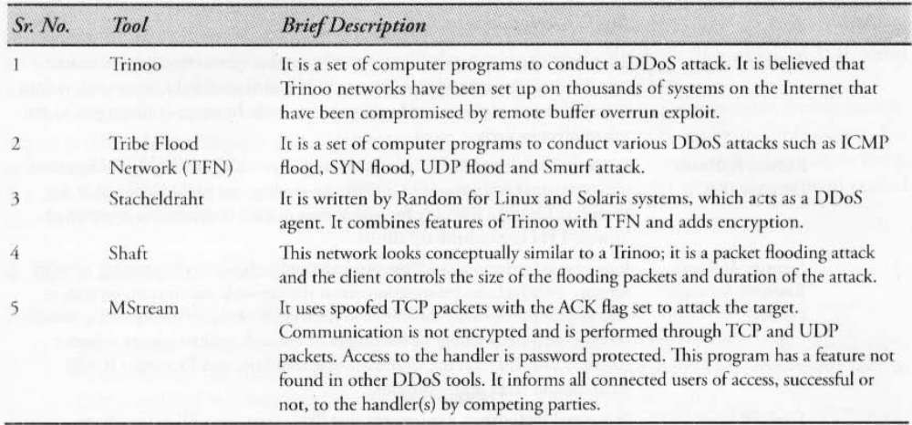
Tools Used in DDOS Attacks

Slide 20
How to Protect from DoS/DDoS Attack
Implement router filter
If such filters are available in your system, install patches to guard against TCP SYN flooding
Disable any unused or inessential n/w service
Observe your system performance and establish baselines for ordinary activity
Routinely examine your physical security
Use tools to detect changes in configuration info or other files
Invest in redundant and fault-tolerant n/w configuration
Establish and maintain regular backup schedules and policies
Establish and maintain appropriate password policies
Lecture 18 – DoS and DDoS Attacks

Slide 21
Lecture 17
SQL injection

Slide 22
SQL Injection
Structured Query Language (SQL) is a database computer language designed for managing data in a relational database management system (RDBMS).
The SQL injection is a type of injection attack that makes it possible to execute malicious SQL statements.
Exploits security vulnerability occurring in database layer of an application.
Performing database fingerprinting
Extracting, adding or modifying data
Performing denial of service
Evading detection
Bypassing authentication
Executing remote commands
Lecture 20 – SQL Injection, Buffer over flow

Slide 23
Types of SQL Injection attacks
Piggy-based queries ((or Union-based SQL Injection) allow attackers to directly inject additional queries to retrieve or manipulate data from the database in a single request.)
Insert additional queries to be executed by the database. If the normal query is “SELECT info FROM user Table WHERE” + “login+ “AND pin=“;
The injected query would be:
“SELECT info FROM user Table WHERE login=‘name’ AND pin=0;
DROP database WebApp”
Thus, the database gets deleted on the execution of this query
Lecture 20 – SQL Injection, Buffer over flow

Slide 24
Blind SQL Injection
Blind SQL injection occurs when data input by a user is interpreted as an SQL command rather than as normal data. In this type of SQL injection attack, when the database does not output data to a webpage, the attacker is forced to steal data by asking the database a series of true or false questions.
SELECT * FROM users WHERE username = 'admin' AND password = '' OR 1=1; -- (True)
SELECT * FROM users WHERE username = 'admin' AND password = '' OR 1=2; -- (False)
Blind SQL Injection relies on indirect feedback (either true/false or time-based delays) to infer information from the database without directly seeing the data.
To Summarize, by using the SQL injection
obtain basic information for reconnaissance
Gain access to the database by obtaining username and password
Add new data to a database
Modify the data currently in the data base.
Lecture 20 – SQL Injection, Buffer over flow

Slide 25
Tools SQL Injection
Netsparker:
Acutenix:
BSQL Hacker:
SQLmap
SQLninja:
Lecture 20 – SQL Injection, Buffer over flow

Slide 26
Preventing SQL Injection Attacks
Use input validation and sanitization
Update and Patch
Use firewall
Use appropriate Privileges
Never use default system accounts of SQL server
Isolate database server and web server
Lecture 20 – SQL Injection, Buffer over flow

Slide 27
Lecture 18
Buffer overflow

Slide 28
Buffer overflow
A buffer overflow, or buffer overrun, occurs when more data is put into a fixed-length buffer than the buffer can handle.
The extra information can overflow into adjacent memory space, corrupting or overwriting the data held in that space, resulting in incorrect results or program termination.
Many programming languages are prone to buffer overflow attacks.
Coding errors are typically the cause of buffer overflow.
Lecture 20 – SQL Injection, Buffer over flow

Slide 29
Executing a Buffer overflow Attack
In some cases, an attacker injects malicious code into the memory that has been corrupted by the overflow.
In other cases, the attacker simply takes advantage of the overflow and its corruption of the adjacent memory.
E.g.Program that requests a user password in order to grant the user access to the system.
Lecture 20 – SQL Injection, Buffer over flow

Slide 30
Types of Buffer overflow
Stack-Based buffer overflow
A stack buffer overflow occurs when data overflows from a buffer located on the stack (the region of memory that stores function parameters, return addresses, local variables, and the function call stack).
In this type of overflow:
  The attacker attempts to overwrite the return address of a function call or other important data stored on the stack, such as saved registers or function pointers.
  By manipulating the return address, the attacker can redirect the program's control flow to malicious code (e.g., shellcode), allowing them to take control of the program.
.
Lecture 20 – SQL Injection, Buffer over flow

Slide 31
Types of Buffer Overflow
Heap-Based buffer overflow
A heap buffer overflow happens when data overflows from a buffer located on the heap (the region of memory used for dynamic memory allocation, typically managed via functions like malloc() and free() in C/C++).
In this type of overflow :
The attacker can overwrite adjacent memory that is used by other variables or control structures in the heap.
This can lead to unexpected behavior, such as overwriting function pointers, data structures, or other critical information, and can even result in arbitrary code execution.

Slide 32
Types of Overflow
Integer Overflow and Buffer Overflow
Integer overflow occurs when an integer value exceeds its maximum possible value and "wraps around" to a lower value (or vice versa). This can cause unexpected behavior in programs, especially when it's used to calculate buffer sizes or allocate memory.
In the context of a buffer overflow:
An attacker might exploit an integer overflow to allocate a smaller buffer than expected, which can cause subsequent writes to overflow beyond the allocated memory.
This is often used in combination with other vulnerabilities like a stack or heap overflow.

Slide 33
Mitigating Buffer overflow attacks
The easiest way to prevent buffer overflow attacks is to use a language that does not allow them. C allows these vulnerabilities due to lack of strong object typing.
However, changing the language of development can not always be the solution.
Open source provides strlcpy and strlcat, which work similarly to the strn-functions, except they truncate the string one character early to make room for a null terminator.
Lecture 20 – SQL Injection, Buffer over flow

Slide 34
Mitigating Buffer overflow attacks
Assessment of secure code manually:
Buffer overflow occurs when a program or process tries to store more data in buffer than it is intended to hold. Limited use of vulnerable functions such as : strcpy(), strcat(), sprint(),
Disable stack execution: Code execution from stack must be restricted.
Compiler Tools: Various compiler tools already offer warnings on the use of unsafe constructs such as gets(), strcpy() etc. Programming restructuring warning must be displayed.
Dynamic run time checks
Various tools are used to detect/defend buffer overflow: StackGuard, Propolice, LibSafe
Lecture 20 – SQL Injection, Buffer over flow

Slide 35
Lecture 18
Attacks on wireless networks, Identity Theft-ID Theft

Slide 36
Introduction
Wired networks are easier to secure than wireless networks
If vulnerabilities exist, they can be exploited by cybercriminals. Because of these security flaws, and the ease of exploiting them, wireless network attacks are common.
Lecture 21 - Attacks on Wireless Networks & Steganography

Slide 37
Reconnaissance attacks in wireless Networks
An attackers uses reconnaissance to discover and analyse the targets of his/her attacks.
The security problem with wireless LANs is that the data can be received by anyone who is in the range of the signal, Although sniffing has a legitimate purpose for administrators, it is also one of the best ways for an attacker to figure.
Lecture 21 - Attacks on Wireless Networks & Steganography

Slide 38
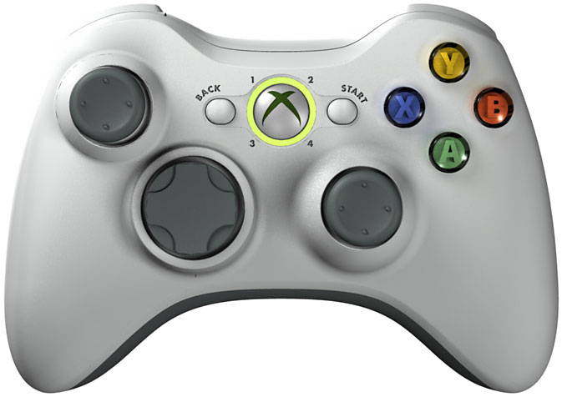
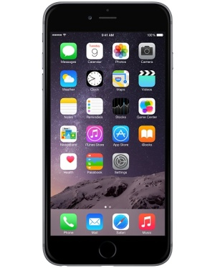

Bluetooth Devices
Invented by Ericcson in 1994
Has roughly a range of 10 meters
Common Bluetooth items
  Cell phones
  Computers
    External devices
  Video game consoles
  Wireless speakers
Lecture 21 - Attacks on Wireless Networks & Steganography

Slide 39

Bluetooth Devices
Bluetooth devices are a Personal Area Network(PAN)
  Short-range RF
  All versions backwards compatible (ice with Bluetooth 5.0 can communicate with devices that support earlier versions, like Bluetooth 4.0 or Bluetooth 3.0.)
Two types:
  Piconet: instance of two Bluetooth devices in close contact which automatically connect (You have a smartphone (master) and connect to a Bluetooth speaker, smartwatch, and wireless earbuds (slaves). These devices form a piconet where the smartphone controls the communication between the connected devices.)
  Scatternet: a set of interconnected piconets
Attack types:
  Bluejacking
  Bluesnarfing
Lecture 21 - Attacks on Wireless Networks & Steganography

Slide 40
Bluejacking
Attack that involves unwarranted messages being sent to Bluetooth devices
  Usually text, but can be image or sound
Not often used as an attack but as a means of bypassing carrier fees
Primary uses:
  Advertising / spam (first known use)
  Close proximity messaging
Preventive measures:
  Disabling discovery
  Setting a period of inactivity (like a screen saver)
Lecture 21 - Attacks on Wireless Networks & Steganography

Slide 41

Bluesnarfing
The unauthorized access of information from a wireless device through Bluetooth connection without the users knowledge. Typically results in copied emails, contacts, or media.
Even when hidden a device can be Bluesnarfed by an attacker detecting the MAC address of the device; however, generally unlikely.
Preventive measures:
  Disabling discovery remains most effective
  Pins on devices can be overcome
Lecture 21 - Attacks on Wireless Networks & Steganography

Slide 42

Wireless LANs
Networking linking two devices together over a small area, called a coverage area.
  Operate over two primary frequencies 2.4 GHz, and 5 GHz
A computer will access the WLAN through use of an access point (AP) consisting of three major parts:
  An atenna & radio transmitter, receiver
  Bridging software
  Hardwire connection
Types of attacks
  Discovering the network
  Attacks through the RF spectrum
  Attacks on Access points
Lecture 21 - Attacks on Wireless Networks & Steganography

Slide 43
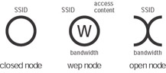
Discovering LANs
Beaconing: Beaconing refers to a method of communication where a device (typically a wireless router, access point, or beacon) regularly broadcasts a signal to announce its presence and availability. This signal is sent out at regular intervals to make the device discoverable by other devices that are listening for it.
Two major ways to accomplish this:
  War driving: searching or wireless signals while mobile using a portable device. This requires a mobile device, wireless access adapter, (option) antenna, software, and GPS.
  War chalking: adopted practice from the Great Depression involving the use of marked symbols indicating networks in the area.
Lecture 21 - Attacks on Wireless Networks & Steganography

Slide 44
Discovering LANs
War Driving is the act of searching for wireless signals while moving around, typically by car, on foot, or any other form of mobile transportation. This practice involves using a portable device to detect wireless networks and map their locations.
War Chalking is a practice that dates back to the Great Depression and involves the use of symbols (typically chalk marks or graffiti) to visually indicate the presence of wireless networks or hotspots, often for others to see. The practice of war chalking is usually associated with Wi-Fi networks but can also apply to Bluetooth or other wireless signals.
Origin of War Chalking:
Historical Context: The practice was inspired by hobo codes used during the Great Depression, where homeless individuals would use chalk symbols to indicate useful locations or information (like a place to get food or shelter).
Modern War Chalking: Today, war chalking involves drawing a series of standardized symbols on sidewalks, buildings, or other surfaces to indicate the availability of wireless networks. These symbols communicate information about the network's presence, security, and accessibility.
Common War Chalking Symbols:
A circle with a “W” inside: Indicates the presence of a Wi-Fi network.
A circle with a “W” and a line through it: Indicates that the Wi-Fi network is secured (password required).

Slide 45
Attacks on the RF Spectrum
Two notable examples:
  Use of Wireless Protocol Analyzer: setting a wireless NIC to monitor mode allowing it to capture frames without being identified with a particular AP.
  Interference: an attack that consists of intentional flood of interference on an RF spectrum (2.4 GHz, or 5 GHz). This type of attack is costly, and can be easily identified due to required close proximity, and bulky equipment.
Lecture 21 - Attacks on Wireless Networks & Steganography

Slide 46
A Wireless Protocol Analyzer is a tool used to capture and analyze wireless network traffic. It allows the user to monitor network activity, troubleshoot network issues, and detect malicious or unauthorized activity.
Monitor Mode: This is a special mode on a wireless network interface card (NIC) that allows it to capture all wireless frames transmitted in the vicinity, without the NIC being connected to a specific Access Point (AP). This mode allows the NIC to listen to all traffic on a channel, even if the device is not part of the communication.
Frame Capture: In monitor mode, the wireless NIC can capture packets (frames) being transmitted between devices. This helps in monitoring network behavior and can be used for network diagnostics, security analysis, and malicious activity detection.
Usage: Security professionals and network administrators use protocol analyzers (such as Wireshark, Aircrack-ng, Kismet) to perform activities like:
  Detecting unauthorized devices (rogue APs or clients).
  Capturing network traffic to analyze vulnerabilities.
  Identifying potential attacks, including jamming, eavesdropping, and spoofing.

Slide 47
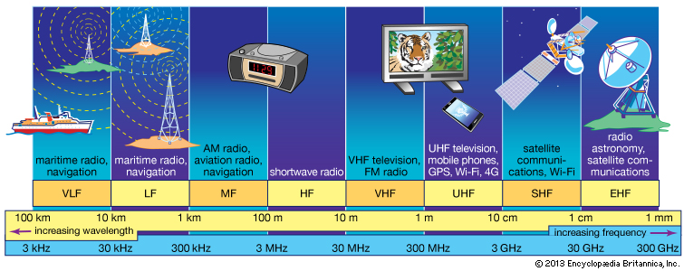
Attacks on the RF Spectrum
Lecture 21 - Attacks on Wireless Networks & Steganography

Slide 48
Preventive Measures
Wireless LAN attacks can be combated in a number of ways:
  Setting up secure passwords in WEP2
  Being mindful of any suspicious people in vicinity of a network
  Making use of multiple radio frequencies
  Only connecting to verified, or vetted networks
  Etc..
Lecture 21 - Attacks on Wireless Networks & Steganography

Slide 49
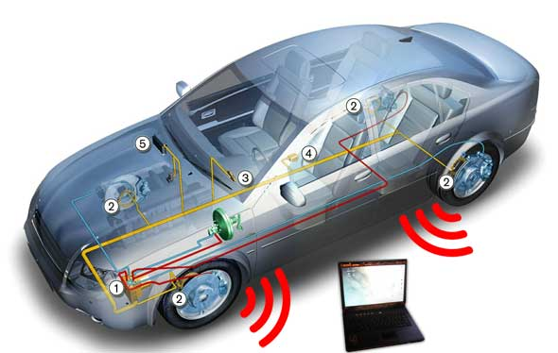
Car Jacking(Hacking)
Due to the overreliance of embedded computer systems in an automobile, hacking of an automobile has become a new threat.
  Software controls breaking (ABS), steering (auto-parking), dash devices (built-in GPS), accelerator (cruise control), etc..
Ways to accomplish this:
  Hardwire connection through the On-Board Diagnostic system
  Bluetooth connection on newer model cars
  External media (viruses implanted on CDs, USB)
Lecture 21 - Attacks on Wireless Networks & Steganography

Slide 50
Wireless Hijacking
Isolate the guest network
Secure infrastructure
Encrypt Wi-Fi traffic with WPA2 or WPA3
Create a secure SSID
Use a Web Filter
Enable MAC address Filtering
Disable remote login
Lecture 21 - Attacks on Wireless Networks & Steganography

Slide 51
Wireless Attacks tools
Netstumbler
Kismet
Airodumps
Aircrack-ng
Lecture 21 - Attacks on Wireless Networks & Steganography

Slide 52

Theft of Identity
Identity theft is the crime of obtaining the personal or financial information of another person for the sole purpose of assuming that person's name or identity to make transactions or purchases.
Identity theft occurs when someone uses another's personally identifying information, like their name, identifying number, or credit card number, without their permission, to commit fraud or other crimes.
The person whose identity has been assumed may suffer adverse consequences.
Lecture 22: Theft of Identity

Slide 53
Types of Identity Theft
Identity cloning and concealment: In this situation the identity thief impersonates someone else in order to conceal their own true identity. Examples are illegal immigrants hiding their illegal status.
Criminal identity theft: When a criminal fraudulently identifies themselves to police as another individual at the point of arrest, it is sometimes referred to as "Criminal Identity Theft." In some cases, criminals have previously obtained state-issued identity documents using credentials stolen from others, or have simply presented a fake ID.
Synthetic identity theft: Synthetic identity theft is a type of fraud in which a criminal combines real and fake information to create a new identity. The real information used in this fraud is usually stolen. This information is used to open fraudulent accounts and make fraudulent purchases.
Medical identity theft: A thief may use your name or health insurance numbers to see a doctor, get prescription drugs, file claims with your insurance provider, or get other care. If the thief’s health information is mixed with yours, your treatment, insurance and payment records, and credit report may be affected.
Lecture 22: Theft of Identity

Slide 54
Types of Identity Theft
Child identity theft: Child identity theft occurs when a minor's identity is used by another person for the impostor's personal gain. The impostor can be a family member, a friend, or even a stranger who targets children.
Financial identity theft: The most common type is financial identity theft, where someone wants to gain economical benefits in someone else's name. This includes getting credits, loans, goods and services, claiming to be someone else.
Tax identity Theft: One of the major identity theft categories is tax identity theft. The most common method is to use a person's authentic name, address, and Social Security Number to file a tax return with false information, and have the resulting refund direct-deposited into a bank account controlled by the thief.
Lecture 22: Theft of Identity

Slide 55
Techniques used for Identity Theft
Phishing
Dumpster Driving
Shoulder-surfing
Malware activity
Password cracking
Wi-Fi Haking
ATM- Skimmers
Mobile phone theft
Advertising bogus job offers
Credit card Theft
Lecture 20: Theft of Identity

Slide 56
Techniques used for Identity Theft
Check credit card statements periodically.
Encrypt the personal information.
Use of strong passwords.
Always shred the papers which contains personal details before dumping it in dustbin.
Follow up with creditors in case of any fraudulent transactions.
Do not respond to any spam e-mails.
Lecture 22: Theft of Identity

Slide 57
Thank You

