Slide 1

Project Title -Seasonal Agriculture Performance Analysis
Student Name: Gurija Venkata Ratna Kumari
College Name: Andhra University College Of Engineering
AICTE STU ID : STU688a337fa82181753887615

Slide 2

PROBLEM STATEMENT
Agricultural activities are influenced by seasonal variations in environmental conditions, farming practices, resource availability and market conditions. As a result, agricultural performance may differ from one season to another. However, raw agricultural data does not clearly explain how agricultural performance changes across seasons or what patterns can be observed in different seasonal conditions. The problem is to analyze the given agricultural dataset and investigate seasonal differences in agricultural performance by identifying meaningful patterns, trends, relationships and variations within the available data.

Slide 3
Seasonal Agriculture Performance Analysis is a data analytics project that examines how agricultural performance changes across Kharif, Rabi and Zaid seasons. The analysis uses 4,000 agricultural records containing 28 variables related to crop production, environmental conditions, farming practices, resource utilization and economic performance.
The project includes data exploration, data quality checking, seasonal performance comparison, crop-level analysis, environmental analysis, resource utilization analysis, economic analysis, correlation analysis, statistical testing, regional analysis and outlier detection.
The objective is to identify meaningful patterns and relationships in the data and develop evidence-based insights that can support better seasonal agricultural planning.
Project Description :

Slide 4

WHO ARE THE END USERS?
👨‍🌾 Farmers — understand seasonal crop performance and resource use.
🌾 Agricultural Planners — support seasonal crop and resource planning.
📊 Agricultural Analysts/Researchers — analyze patterns and relationships in agricultural data.
🏛️ Government & Agricultural Departments — support evidence-based agricultural planning.
💧 Resource Management Stakeholders — understand water and other resource utilization.

Slide 5

Technology Used
Programming & Analysis
Python
Pandas
NumPy
SciPy
Visualization
Matplotlib
Seaborn
Environment
Google Colab
Jupyter Notebook
Statistical Analysis
Correlation Analysis
One-Way ANOVA

Slide 6
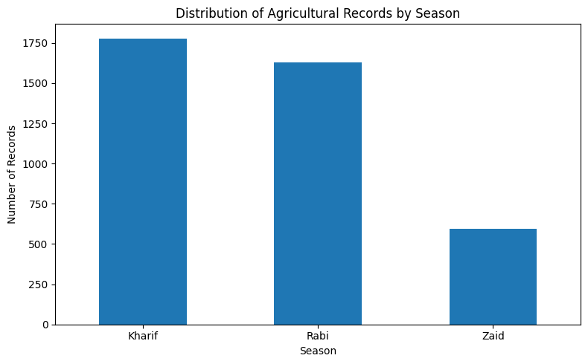
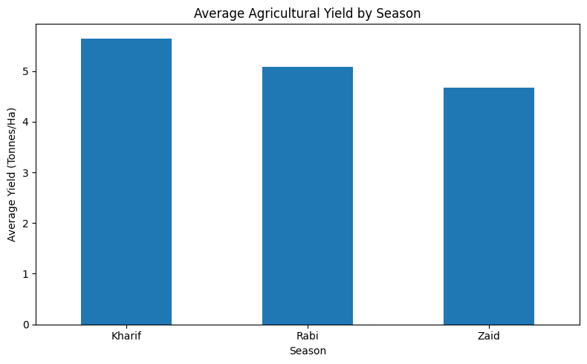
RESULTS
plt.figure(figsize=(8, 5))
yield_by_season.plot(kind="bar")
plt.title("Average Agricultural Yield by Season")
plt.xlabel("Season")
plt.ylabel("Average Yield (Tonnes/Ha)")
plt.xticks(rotation=0)
plt.tight_layout()
plt.show()
plt.figure(figsize=(8, 5))
season_counts.plot(kind="bar")
plt.title("Distribution of Agricultural Records by Season")
plt.xlabel("Season")
plt.ylabel("Number of Records")
plt.xticks(rotation=0)
plt.tight_layout()
plt.show()

Slide 7
RESULTS
Seasonal Performance Table
season_performance = df.groupby("Season").agg(
Average_Yield=("Yield_Tonnes_Ha", "mean"),
Average_Production=("Production_Tonnes", "mean"),
Average_Revenue=("Revenue_INR", "mean"),
Average_Cost=("Total_Cost_INR", "mean"),
Average_Profit=("Profit_INR", "mean"),
Average_Water_Efficiency=("Water_Efficiency_t_per_1000m3", "mean"),
Average_Risk=("Disease_Pest_Risk_pct", "mean")
).round(2)
season_performance
Season | Average_Yield | Average_Production | Average_Revenue | Average_Cost | Average_Profit | Average_Water_Efficiency | Average_Risk
Kharif | 5.64 | 46.31 | 710,719.06 | 531,804.41 | 178,914.65 | 5.89 | 54.47
Rabi | 5.08 | 41.49 | 601,526.05 | 513,836.58 | 87,689.47 | 5.19 | 40.48
Zaid | 4.67 | 38.89 | 519,171.90 | 543,976.73 | -24,804.82 | 4.41 | 38.22

Slide 8
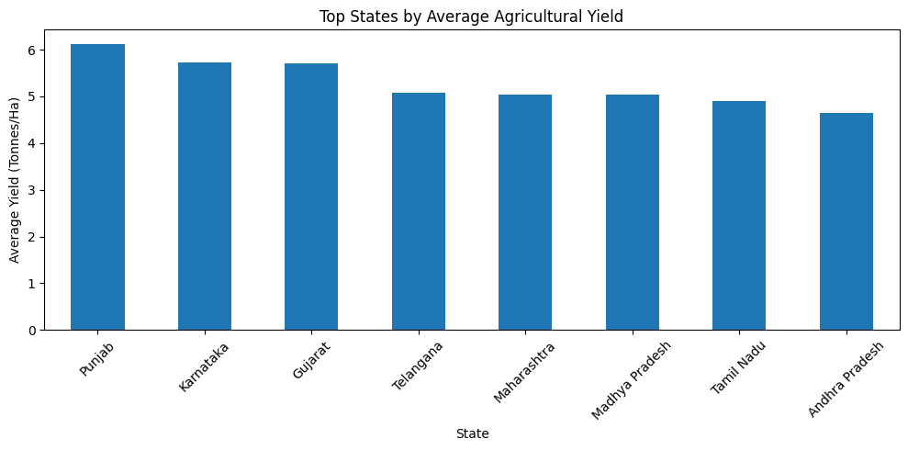
RESULTS
State | Average_Yield | Average_Profit | Average_Revenue | Average_Water_Efficiency | Average_Risk
Punjab | 6.12 | 136,025.64 | 686,225.70 | 5.62 | 46.00
Karnataka | 5.73 | 119,422.34 | 653,426.18 | 5.56 | 46.06
Gujarat | 5.70 | 117,568.24 | 654,692.86 | 5.58 | 45.95
Telangana | 5.08 | 108,829.62 | 628,784.53 | 5.46 | 46.36
Maharashtra | 5.03 | 135,428.86 | 650,032.67 | 5.28 | 46.44
Madhya Pradesh | 5.03 | 86,840.76 | 597,558.36 | 5.27 | 47.08
Tamil Nadu | 4.90 | 117,744.75 | 629,093.42 | 5.31 | 46.28
Andhra Pradesh | 4.65 | 73,453.53 | 606,663.66 | 5.03 | 46.72
state_performance = df.groupby("State").agg(
Average_Yield=("Yield_Tonnes_Ha", "mean"),
Average_Profit=("Profit_INR", "mean"),
Average_Revenue=("Revenue_INR", "mean"),
Average_Water_Efficiency=("Water_Efficiency_t_per_1000m3", "mean"),
Average_Risk=("Disease_Pest_Risk_pct", "mean")
).sort_values("Average_Yield", ascending=False)
state_performance.round(2)
top_states = state_performance.head(10)
top_states = state_performance.head(10)
plt.figure(figsize=(10, 5))
top_states["Average_Yield"].plot(kind="bar")
plt.title("Top States by Average Agricultural Yield")
plt.xlabel("State")
plt.ylabel("Average Yield (Tonnes/Ha)")
plt.xticks(rotation=45)
plt.tight_layout()
plt.show()

Slide 9
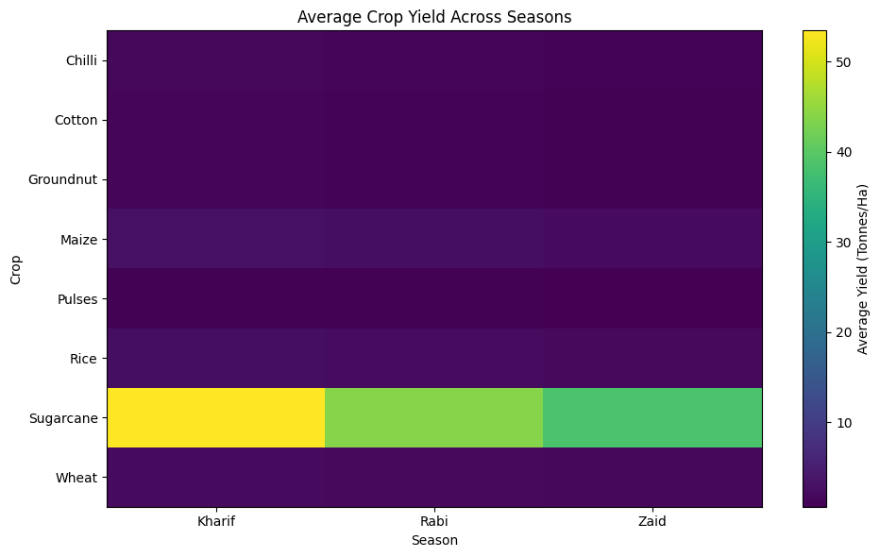
RESULTS
Average Crop Yield Across Seasons
plt.figure(figsize=(10, 6))
plt.imshow(crop_season_yield, aspect="auto")
plt.colorbar(label="Average Yield (Tonnes/Ha)")
plt.xticks(
range(len(crop_season_yield.columns)),
crop_season_yield.columns
)
plt.yticks(
range(len(crop_season_yield.index)),
crop_season_yield.index
)
plt.title("Average Crop Yield Across Seasons")
plt.xlabel("Season")
plt.ylabel("Crop")
plt.tight_layout()
plt.show()

Slide 10
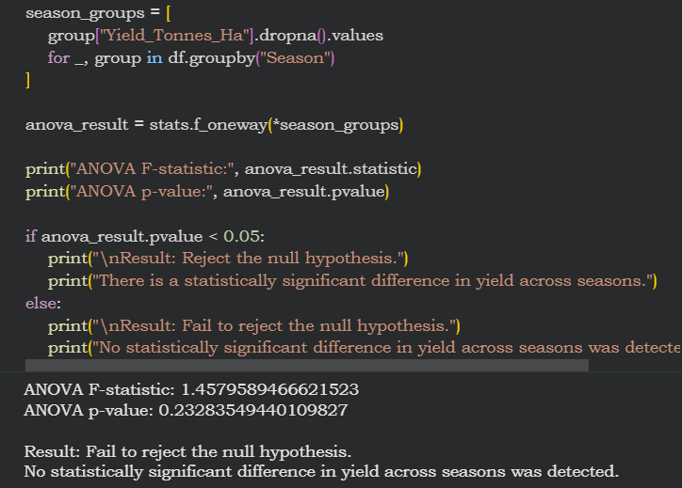
RESULTS
Statistical Analysis

Slide 11
Future scope
Develop an interactive agricultural dashboard using Power BI or Streamlit.
Integrate real-time weather and environmental data.
Build predictive models for crop yield forecasting.
Develop seasonal crop recommendation systems.
Add real-time market price information.
Expand the analysis to more regions and agricultural datasets.
Develop early-warning systems for disease, pest and environmental risks.
Use machine learning to identify factors influencing crop performance.

Slide 12
GitHub Link
Ratnakmri/Seasonal-Agriculture-Project

Slide 13

VOIS Course completion certificate -
Course name- Data Visualization

Slide 14
Thank you
.
.

