Slide 1

Human resources slide 1
CHICAGO CRIME ANALYSIS
Presented By : Ratnam Dubey

Slide 2
Human resources slide 2
AGENDA
Chicago Crime Data Understanding.
Chicago Crime Exploratory Data Analysis.
Predict the Arrest ?
Questions ?

Slide 3
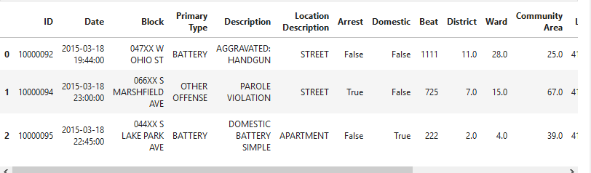
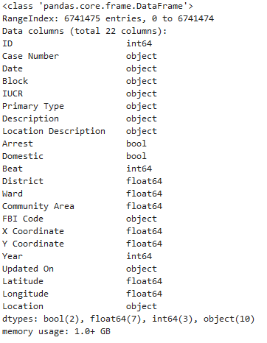
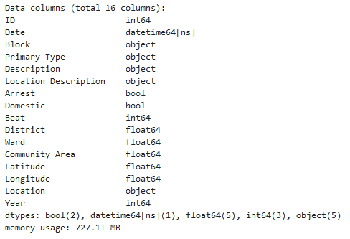

Human resources slide 5
Data Understanding
Data Downloaded and Collected from City of Chicago Portal (Open Dataset Used)
Crime Data Used in Analysis from 2001 – 2016
Post Data Cleanup ?
The City of Chicago provides data on all reported incidents of crime in the city of Chicago from 2001 to present (minus seven days). At the time of download that included 6.03 million lines of data, or approximately 400,000 crimes per year, or almost 8,000 crimes per week..
Total Crimes Count with total features?

Slide 4
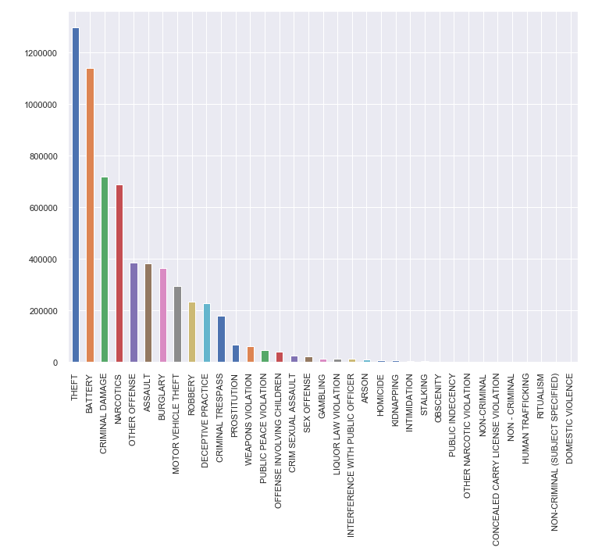
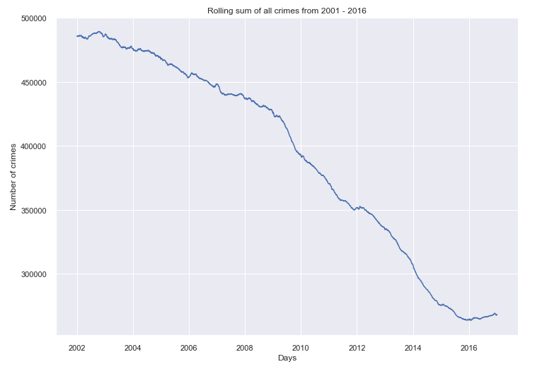
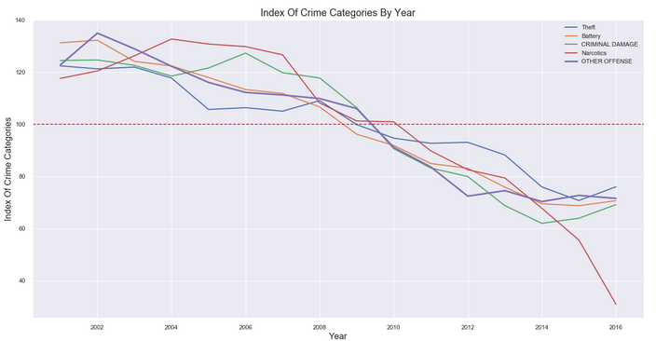
Human resources slide 6
Chicago Crime Trend
Analysis on the Popular Crime vs Crime Trends in Chicago
Although crime is decreasing overall, let's see if each type of crime decreases the same. News reports are focusing on very high rates of homicide and gun violence and that appears to be true. In order to compare different values we index each type against its average, so a score of 100 represents an average incidence of crime.

Slide 5
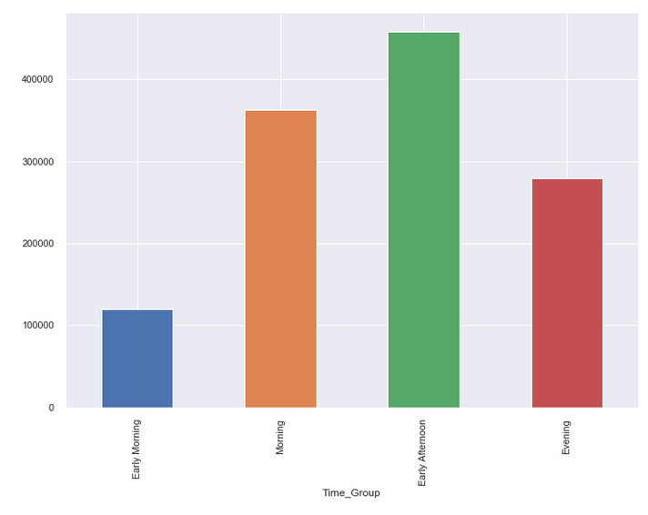
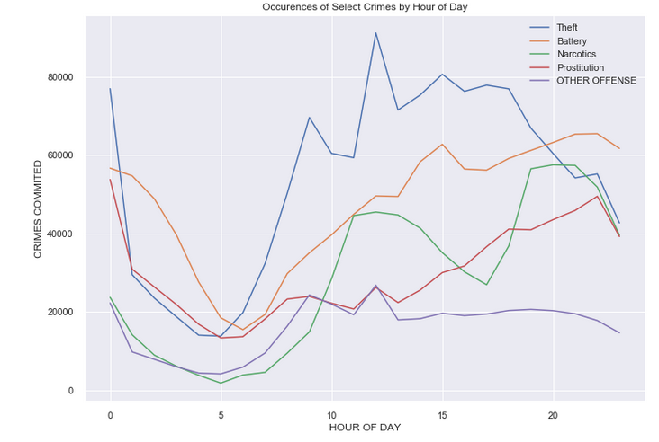
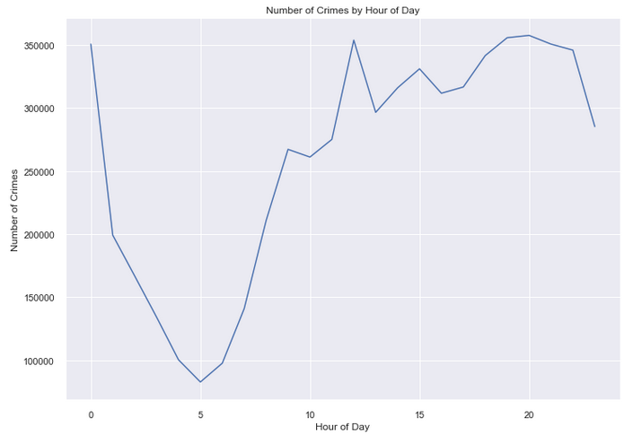
Human resources slide 6
Chicago Crime Time Analysis
Analysis on the Popular Crime vs Crime Time Analysis
The most popular hours for crime are 8PM, 7PM, and 12PM. Interesting that we see a spike in the middle of the day compared to other hours. Crime is very low during the early morning periods from 1AM to 5AM likely because most people are still asleep.

Slide 6
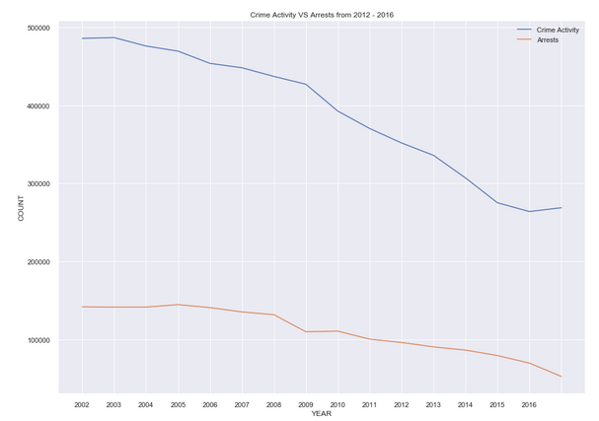
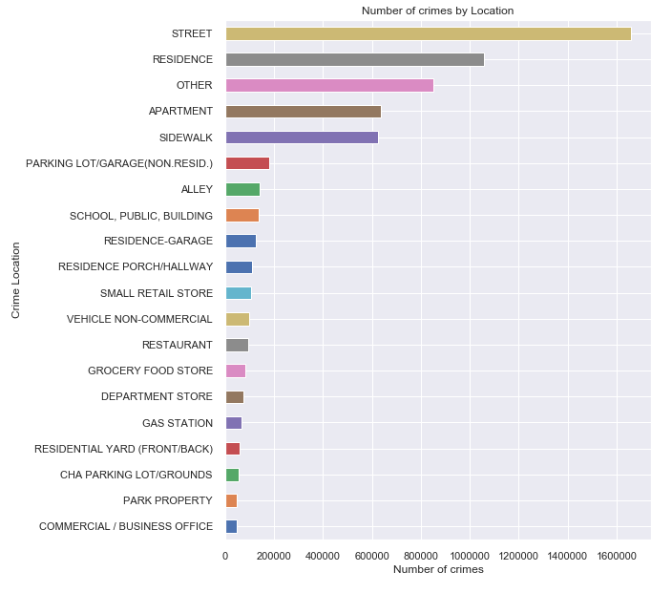
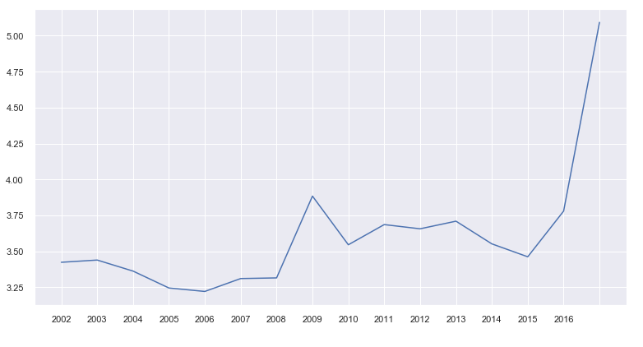
Human resources slide 11
Crime Location vs Arrest Analysis
So from the line plot above, truly there has been a decrease in crime activity over the last five years which has lead to fewer arrests.
But Sudden Spike
Shows least arrest
Rate in year of
2016.
Residences are number two on the list, which is rather scary , shocking and surprising!

Slide 7
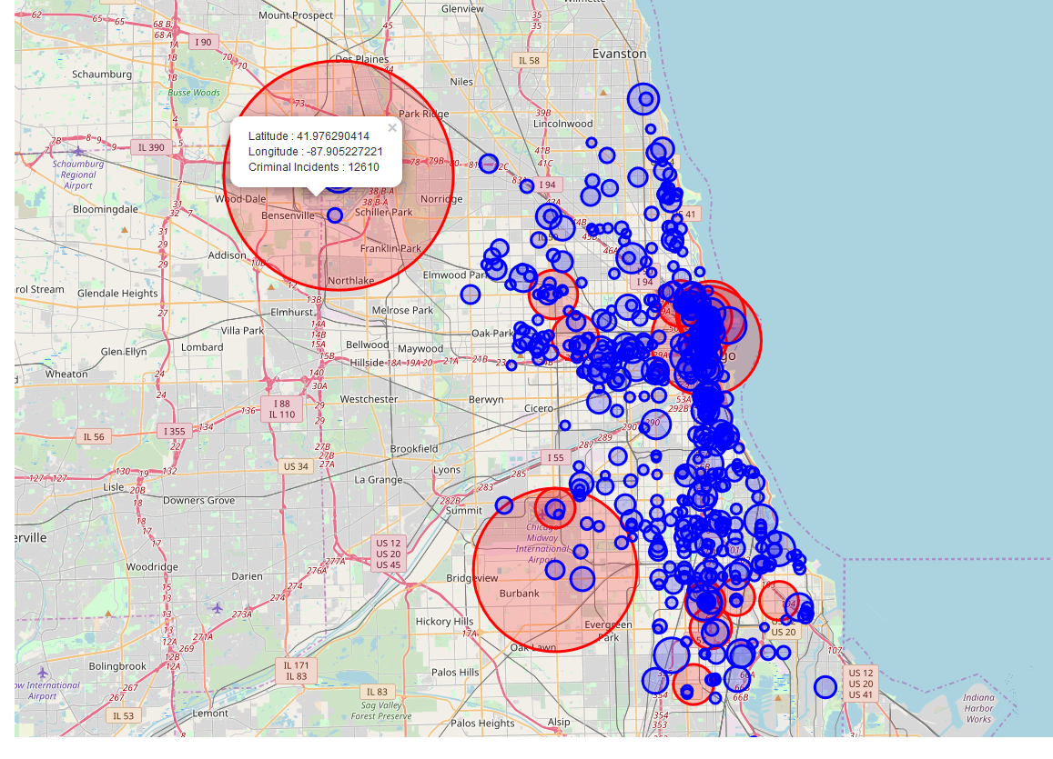
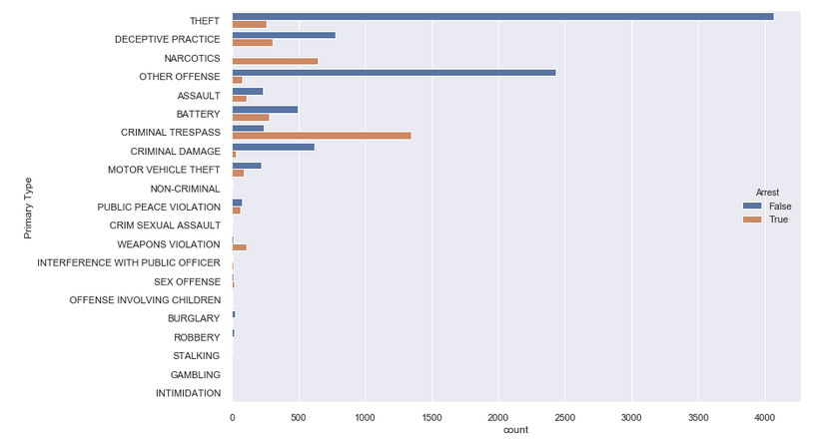
Human resources slide 9
Crime Location Analysis
Arrest Analysis near Airport Area
Here, the Red Circles means that crimes taken place at that location are above 2000, while others are self explanatory. Clicking on those maps would show the Coordinates and the number of crimes taken place at that (Latitude, Longitude)
Highest Crime
Near Airport
Reason ?
“The Transportation Security Administration has paid passengers $3 million for losing, damaging or stealing items, according to a report Thursday.
The money was shelled out during the last five years, USA Today reported after a review of 50,000 complaints.”
https://www.chicagotribune.com/lifestyles/travel/sc-trav-0702-tsa-baggage-loss-claims-20150702-story.html

Slide 8
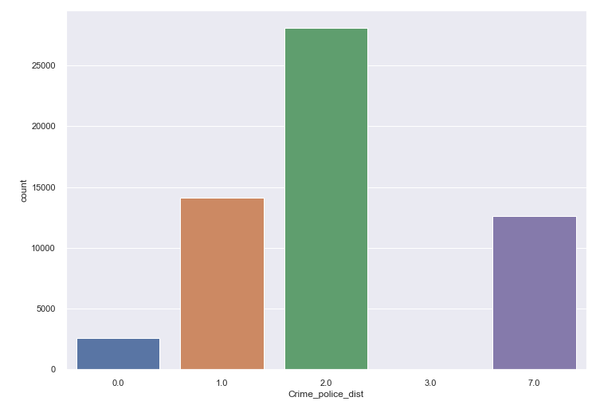
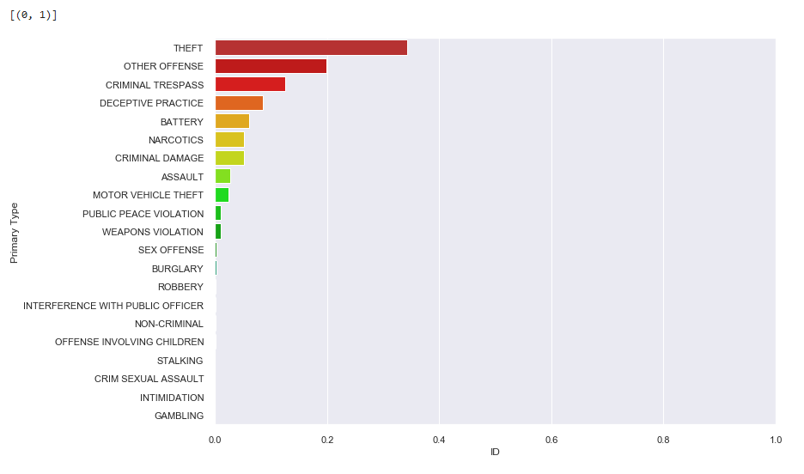
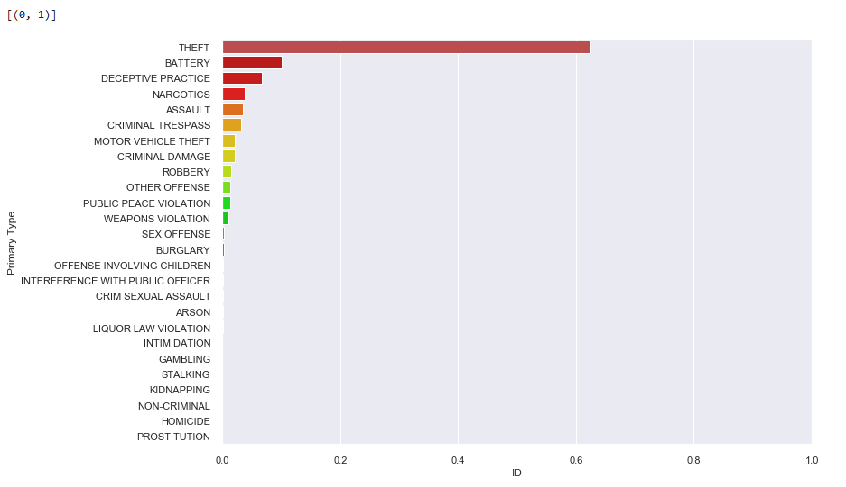

Human resources slide 6
Crime vs Police Station
Does Police Station Distance Create Difference in Crime type ?
Criminal distance decay is the fundamental notion that a relationship exists between the distance from an offender’s home base to a potential target location and the likelihood that the offender chooses to offend in that location. This relationship is important both for its operational effect on police agencies and on models for offender behavior. A number of factors influence the distance decay function of an offender, including the local geography and the offender’s decision-making process – Gov Website
Less than < 2 miles
Greater than > 2 miles
There is significant evidence that if there is increase in the distance from a police station then chances of other crimes will significantly increase

Slide 9
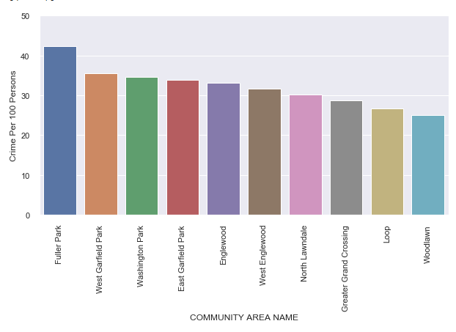
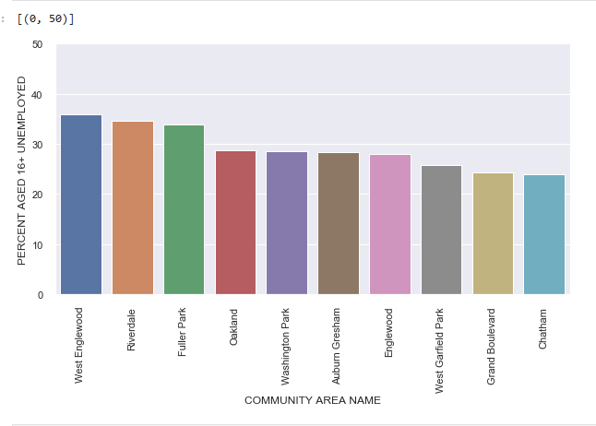
Human resources slide 5
Unsafe Communities
These are the top 10 Unsafe communities where the Crime per 100 persons are highest.
Communities where unemployment after the age 16 is Highest
'Englewood', 'Fuller Park', 'Washington Park', 'West Englewood', 'West Garfield Park'
These are the Unsafe communities where the Crime per 100 persons and Unemployment is Highest.

Slide 10
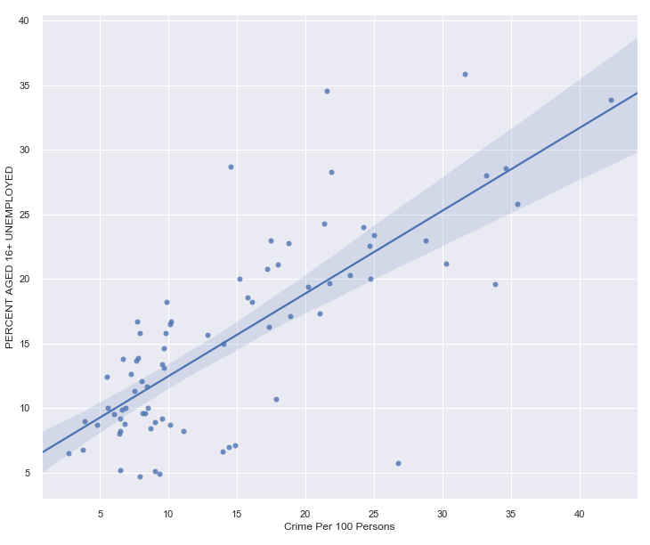
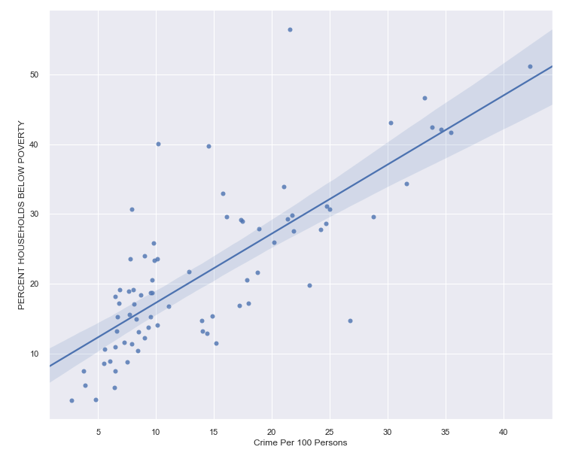
Human resources slide 8
Socio Economic Analysis
Relation Between Crimes and Socio-Economic Factors.
76
76% of Correlation is there between Unemployment and Crime per 100 Persons
Using Chicago state data, we estimate the effect of unemployment and Poverty on the rates of seven felony offenses.
77
77% of Correlation is there between “PERCENT HOUSEHOLDS BELOW POVERTY” and Crime per 100 Persons
!!! There is evidence that suggests there are correlations between high levels of poverty and high levels of crime.

Slide 11


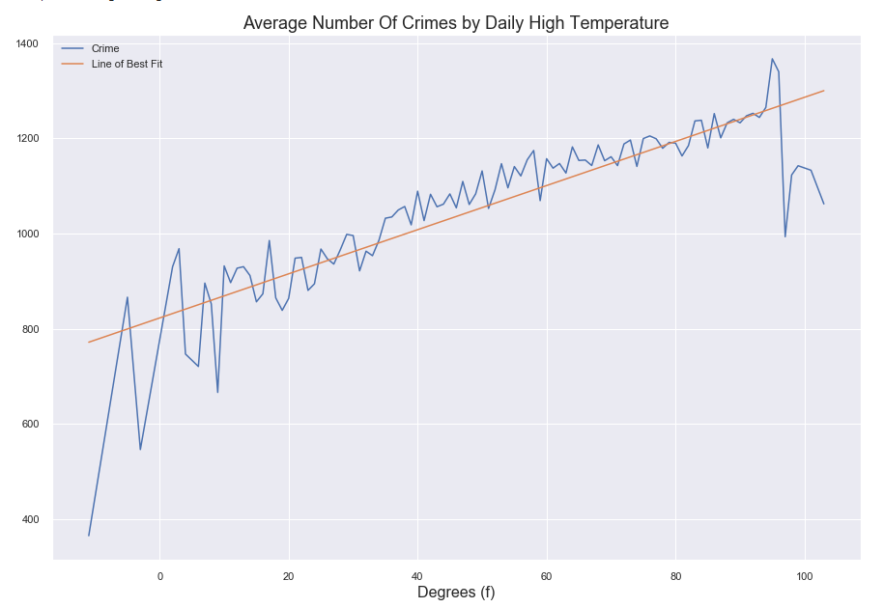

Human resources slide 4
Temperature Impact on Crime Analysis
Normal Weather
Extreme Sunny
On normal days, where weather are not extreme the crime rate is high
Sudden Drop in Crime on temperature above 100° F
41%
Extreme Winter
Correlation:
Drop in Crime in event of temperature below 10° F
41% Correlation between crime and weather.
Chicago Crime Analysis
“More police officers are required on the field when the climate are not on extreme end.”

Slide 12

Human resources slide 7
Model development Timeline
45%
10%
35%
10%
Data Cleaning
Data Visualization
Machine learning Model
Model Deployment
Analysis on Socio Economic factor
Weather Analysis
Police to Crime Distance Analysis
Crime trend Analysis
Develop machine learning Model that can predict the chances of getting arrested for a crime done ?
Share Insight with Chicago police to further enhance the capabilities.
Duplicate Drop
Null Value rectification
Outlier Data

Slide 13
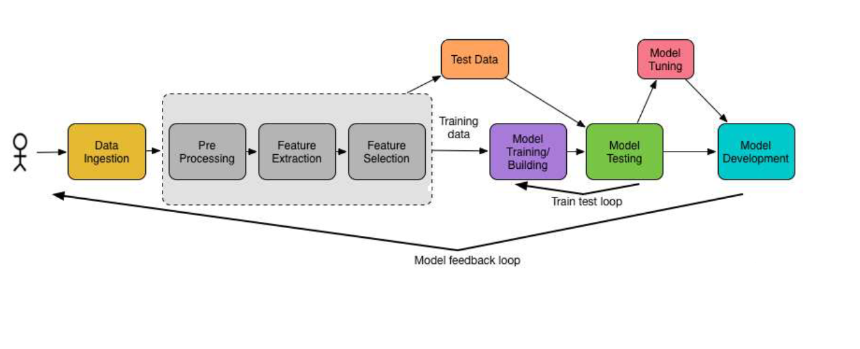
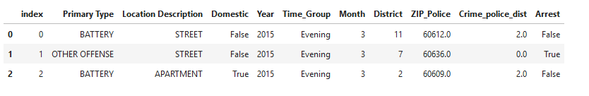
Machine-Learning Model development analytical process
Development of the Machine learning Models Include process
Develop expectations
Match expectations with data
Collect the data
Establish the specific modeling question
Perform EDA, adjust the data
Build model(s)
Make assumptions
Define “best fit” function
Recognize concerns
Evaluation
Produce predictions
Interpret model(s)
Communicate results

Slide 14

Human resources slide 3
Random forest Algorithms
Random forest builds multiple decision trees and merges them together to get a more accurate and stable prediction
Model Comparisons :
Random forest Model
Decision Tree Algorithms
Different
Model Accuracy
Comparison
A decision tree is a decision support tool that uses a tree-like model of decisions and their possible consequences, including chance event outcomes, resource costs, and utility.
61%
Decision Tree Model.
62%
Gradient Boosting algorithms
Gradient Boosting Trees
The algorithm for Boosting Trees evolved from the application of boosting methods to regression trees. The general idea is to compute a sequence of (very) simple trees, where each successive tree is built for the prediction residuals of the preceding tree.
59%
Predicted the Chances of getting arrested for the crime.

Slide 15
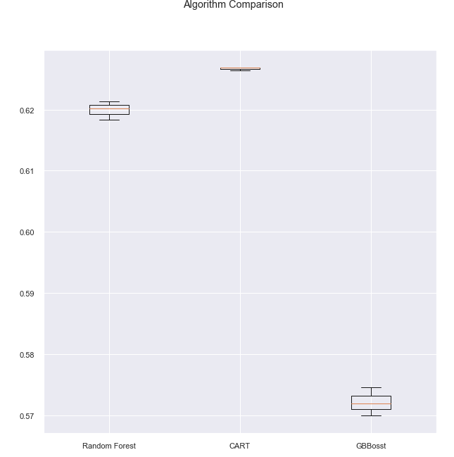

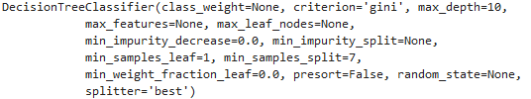
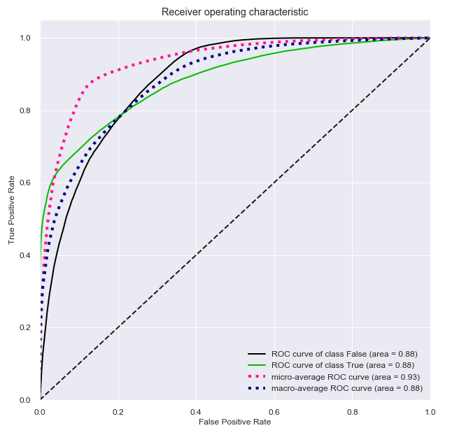
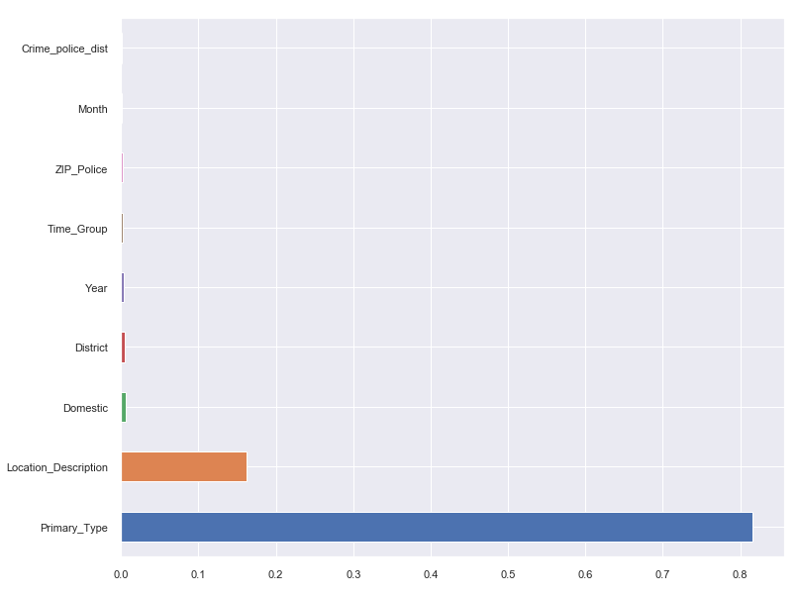
Human resources slide 5
Model Tuning & Testing
Different Machine learning model development
Machine learning model tuning
Final Model Results :-
Choosing Best Parameters and Model.
Feature Importance

Slide 16

Human resources slide 10
Conclusions
Localities where the crime rate are highest more officers in the area.
Able to find Locations where the Crime rate are highest.
Deploy more officers where the chances of arrest are least so that chances can be increased
Crime to police station location should be within two-mile radius so that other serious offence can be avoided.
Able to predict that if crime happens weather arrest will be made or not .
Create more Job opportunities so that crime can be reduced.
Undercover officers in the Theft and Battery zones.
More officers on the field on the normal temperature days.

Slide 17
Human resources slide 10
Thank You

