Slide 1
MINOR PROJECT · PROGRESS REVIEW
Cerealia
AI-Based Crop Recommendation for Indian Farmers
Not “what can grow here?” but “what is worth growing, and why?”
246,091
official records
36
states & UTs
22
crops ranked
98.7%
model CV accuracy

Slide 2
PART ONE
Motivation
Why crop choice is the highest-stakes decision in Indian agriculture
Cerealia
01

Slide 3
MOTIVATION
The Human Problem
Around 46% of India's workforce depends on agriculture, on an average holding of about 1.08 hectares
Income, not yield, is the crisis
A farmer can raise yield and still lose money. Choosing the wrong crop for the soil, the rainfall and the market is the difference between a season that pays and one that adds to debt.
The decision is made blind
Crop choice is largely habit, or copying a neighbour. Soil Health Cards exist, but arrive as a twelve-parameter lab report with no action attached to the numbers.
Advice answers the wrong question
Existing tools predict what can grow. A farmer already knows rice grows in his village. He needs to know what is worth growing this year, on his land, at his scale.
Support goes unclaimed
Insurance, credit, irrigation subsidy and solar pumps all exist. The eligibility rules sit in PDFs across a dozen portals, in English, behind logins.
Cerealia
02

Slide 4
MOTIVATION
What Changes for the Farmer
A concrete example: two hectares in Maharashtra
TODAY
— Plants what he planted last year, or what the neighbouring field is planting
— No idea what the soil is short of, so fertiliser is applied by habit and often wasted
— Discovers the price only at the mandi, after harvest, when he has no choice but to sell
— Learns about a subsidy after the application window has closed
— Carries all the weather risk himself, uninsured
WITH KRISHIMITRA
✓ Six crops ranked for his district, each with the net return per hectare at his farm size
✓ The exact nutrient gap, converted into bags of urea, DAP and MOP with a rupee cost
✓ Irrigation need in millimetres beyond local rainfall, before committing to the crop
✓ Which schemes apply to that specific crop and holding, answered in his own language
✓ Every number shown with its source and confidence
The system never tells a farmer to trust it. It shows the ideal range for every condition, the source of every figure, and how confident it is — so the advice can be checked by an extension officer before it is acted on.
Cerealia
03

Slide 5
PART TWO
The System
Architecture, data foundation, and the four signals behind every recommendation
Cerealia
04

Slide 6
THE SYSTEM
Objective
Turn a crop classifier into an advisor a farmer could actually act on
01
Pick a region
A 3D globe opens onto a map of India. Click any state to load its soil profile, climate normals and real cropping history.
02
Rank the crops
Four signals combined: can it grow, is it grown here, what does it earn, and can the farmer water and afford it.
03
Explain the answer
Every condition compared against the crop's ideal band, with the fertiliser gap costed in bags and rupees.
04
Answer the follow-up
A grounded chatbot for the government schemes that apply to that crop and that holding.
Cerealia
05

Slide 7
THE SYSTEM
System Architecture
CLIENT
React 18 + Vite
d3-geo canvas globe · India state map, 85 KB bundled offline · recommendation panel · scheme chat drawer
API
FastAPI + Pydantic
/api/states · /api/overview · /api/recommend/state · /api/recommend/custom · /api/schemes · /api/chat
ENGINE
recommender.py · chatbot.py
Four-signal ranking · percentile-envelope explainability · fertiliser planner · grounded scheme retrieval with offline fallback
MODEL
scikit-learn RandomForest
300 trees · 7 features · 22 classes · trained and evaluated by train.py, artefacts versioned with metrics
DATA
Official + curated
246,091 GoI production records · 36 state agro-climatic profiles · CACP costs and MSP · 12 schemes
Every layer runs locally. The demo needs no network connection and no API key.
Cerealia
06

Slide 8
THE SYSTEM
Data Foundation
Three of the four signals are derived from official Government of India data, not estimated
246,091
production records
Ministry of Agriculture
645
districts covered
33 states
19 yrs
of yield history
1997–2015
81,347
records used
after crop mapping
District-wise crop production statistics
Directorate of Economics & Statistics, MoA&FW
Sown area and production by district, season, crop and year. Gives the regional cultivation prior and measured yields.
CACP cost of production, 2024-25
Commission for Agricultural Costs & Prices
A2+FL cost per quintal for field crops, and the MSP set at roughly 1.5× that cost.
IMD climatological normals
India Meteorological Department
Temperature, humidity and rainfall normals per state, used for agro-climatic fitness and the irrigation gap.
Soil Health Card portal aggregates
Department of Agriculture & Farmers Welfare
District-averaged N, P, K and pH, forming the soil half of each state profile.
Scheme guidelines
12 central schemes across 8 categories
PM-KISAN, PMFBY, KCC, Soil Health Card, PMKSY, PM-KUSUM, e-NAM, MSP, MIDH, FPO, AIF, Natural Farming.
Cerealia
07

Slide 9
THE SYSTEM
What Real Data Changed
Substituting official statistics for hand-authored estimates corrected the model, and corrected us
Cultivation prior
Was our own judgement of which crops each state grows. Now measured sown area: Punjab is 79% rice and 15% cotton; Kerala is 72% coconut. It corrected our own guess — we had listed banana as Kerala's leading crop.
Yield
Was one national figure per crop. Now state-specific and measured: Punjab paddy 3.73 t/ha against Jharkhand 0.97 t/ha. A national average erases exactly the regional gap that matters.
Risk
Was a hand-assigned score from 1 to 5. Now the coefficient of variation of yield across 19 years, blended with market risk. Moth beans at CV 0.72 genuinely fail some years; grapes at CV 0.06 genuinely do not.
Cost
Was a fixed cost per hectare, quietly calibrated against optimistic yields. Now CACP cost per quintal, so cost scales with what the land actually produces — the same basis the government uses to set MSP.
Cerealia
08

Slide 10
THE SYSTEM
The Ranking Engine
Four signals, weighted explicitly — the policy is auditable, not buried inside a model
Agro-climatic fitness
Can it survive here?
RandomForest probability blended with each crop's 10th–90th percentile envelope. The forest is accurate but spiky; the envelope gives a smooth signal across all 22 crops.
45%
Economics
What does it earn?
Measured yield × MSP or mandi price, minus CACP cost. Annualised, so a 70-day moong is comparable with a 30-year mango orchard carrying amortised establishment cost.
30%
Water feasibility
Can they irrigate it?
Crop water requirement against 70% of local rainfall. Reports the irrigation gap in millimetres and a rainfed / light / moderate / heavy verdict.
15%
Risk
How exposed are they?
Measured yield volatility for production risk, blended with perishability, price volatility and capital lock-in for market risk.
10%
Fitness is also a gate. A crop the region does not cultivate is removed outright, however profitable it looks — and profit is discounted by regional evidence, because a farmer cannot realise a national yield in a district with no supply chain for that crop.
Cerealia
09

Slide 11
THE SYSTEM
Model & Evaluation
RandomForest · 300 trees · 2,200 samples · 22 crops · trained in 0.19s
98.86%
hold-out accuracy
98.73%
5-fold cross-validation
± 0.42%
5 / 440
misclassified
0
SMOTE applied
by design
FEATURE IMPORTANCE
humidity ▌▌▌▌▌▌▌▌▌ 0.202
rainfall ▌▌▌▌▌▌▌▌▌ 0.200
P ▌▌▌▌▌▌ 0.152
K ▌▌▌▌▌▌ 0.140
N ▌▌▌▌▌▌ 0.134
temperature ▌▌▌▌ 0.104
ph ▌▌▌ 0.069
READING THE ACCURACY HONESTLY
The training set is exactly balanced — 100 samples for each of the 22 crops — so no resampling was applied. Running SMOTE here would inject synthetic noise while correcting no imbalance, and train.py asserts the balance rather than assuming it.
The clean score is high because this dataset has well-separated class boundaries, so it is not real-world performance. Training on noise-augmented readings is what makes the deployed model hold 96% at ±20% sensor error, against 87% for a clean-trained forest.
Cerealia
10

Slide 12
PART THREE
The Product
Every feature, as it appears to the farmer
Cerealia
11

Slide 13
THE PRODUCT
Feature Set
Interactive 3D globe
Canvas-rendered orthographic projection that animates to India's centroid. No three.js, no CDN textures — it runs offline.
Clickable map of India
All 36 states and UTs, dissolved from a 760-district boundary file and simplified 4 MB → 85 KB. Filled by the crop type ranked first in each state.
Ranked recommendations
Six crops per state with climate fit, water need, net return per year, MSP coverage and an honest confidence label.
Farm-size scaling
A slider from 0.5 to 10 hectares rescales every rupee figure; the backend owns the arithmetic so amortisation stays correct.
Explainability panel
Each condition compared against that crop's ideal band, mismatches surfaced first, sorted by feature importance.
Costed fertiliser plan
The NPK gap converted into kilograms of urea, DAP and MOP, 50 kg bags, and a total in rupees.
Data provenance
Every crop shows which yield source was used, the evidence that it is grown there, and its share of sown area.
Scheme advisory chatbot
Grounded retrieval over 12 central schemes, backed by Grok, degrading to local retrieval with no key and no network.
Hindi voice interface
Speak a question in Hindi, get a Hindi answer, and have it read back aloud. Works with no API key; speech output needs no network at all.
Cerealia
12

Slide 14

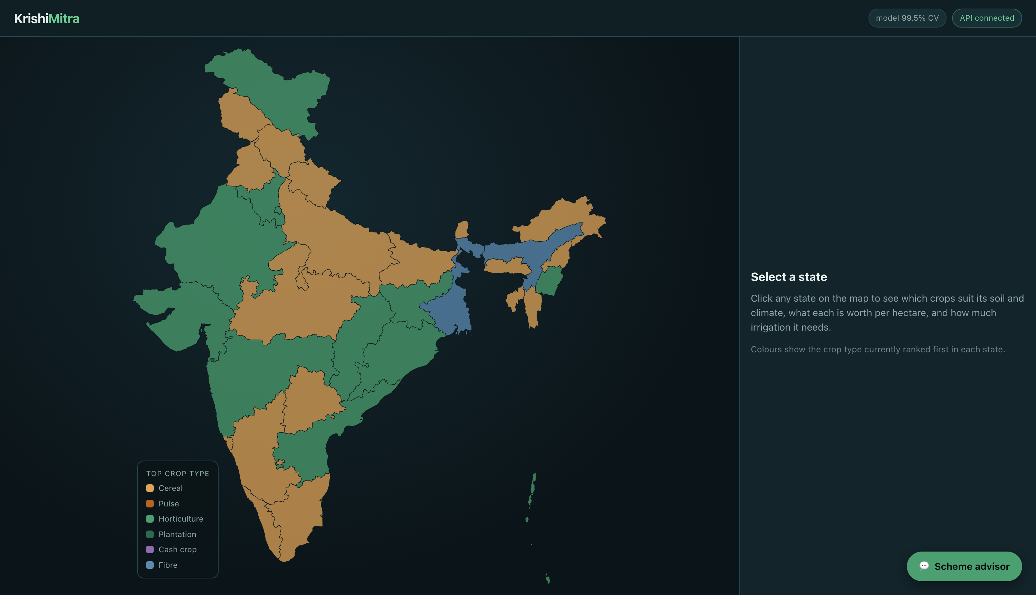
THE PRODUCT
Entry: Globe to Map
Rendered with d3-geo on canvas
The globe spins, highlights India, and animates to its centroid on click. No WebGL dependency and no texture fetch, so it cannot fail on a conference-room network.
36 states, coloured by top crop type
Boundaries dissolved from a 760-district file and simplified to 85 KB, bundled into the build. One /api/overview call scores every state in about 1.4 seconds.
Cerealia
13

Slide 15
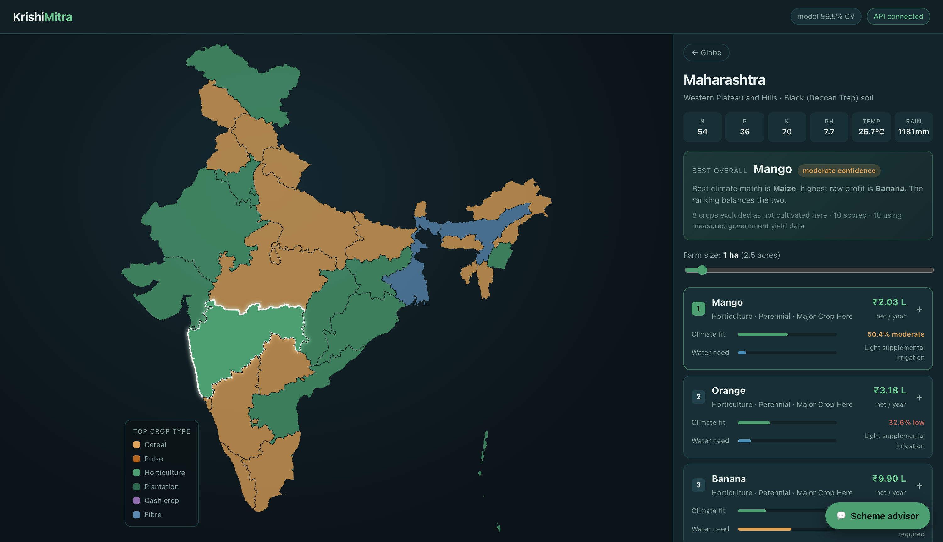
THE PRODUCT
Recommendation Panel
Maharashtra — mango, orange and banana: Konkan, Nagpur and Jalgaon respectively
Ranked, with the money shown
Net return per year for the farmer's actual holding, not an abstract score.
MSP badge
Marks crops with a guaranteed government floor price — materially lower price risk.
Honest confidence
Every card is labelled high, moderate or low. A weak match is never dressed up as certainty.
Gate transparency
The panel states how many crops were excluded as not cultivated there, and how many used measured government yield data.
Cerealia
14

Slide 16
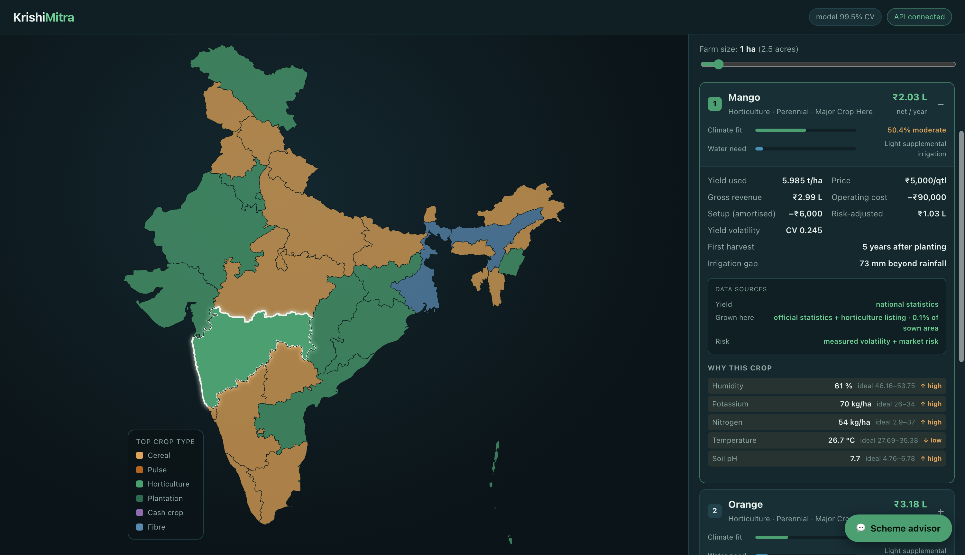
THE PRODUCT
Explainability & Provenance
A farmer will not act on a number they cannot check — and neither will an extension officer
Condition against ideal band
Every reading compared with that crop's observed 10th–90th percentile range, mismatches first.
Full cost breakdown
Gross revenue, operating cost, amortised setup, measured yield volatility and the risk-adjusted figure.
Data sources, per crop
Which yield source was used, the evidence the crop is grown there, its share of sown area, and how risk was derived.
Costed fertiliser plan
The nutrient gap as bags of urea, DAP and MOP with a rupee total — an instruction, not a diagnosis.
Cerealia
15

Slide 17
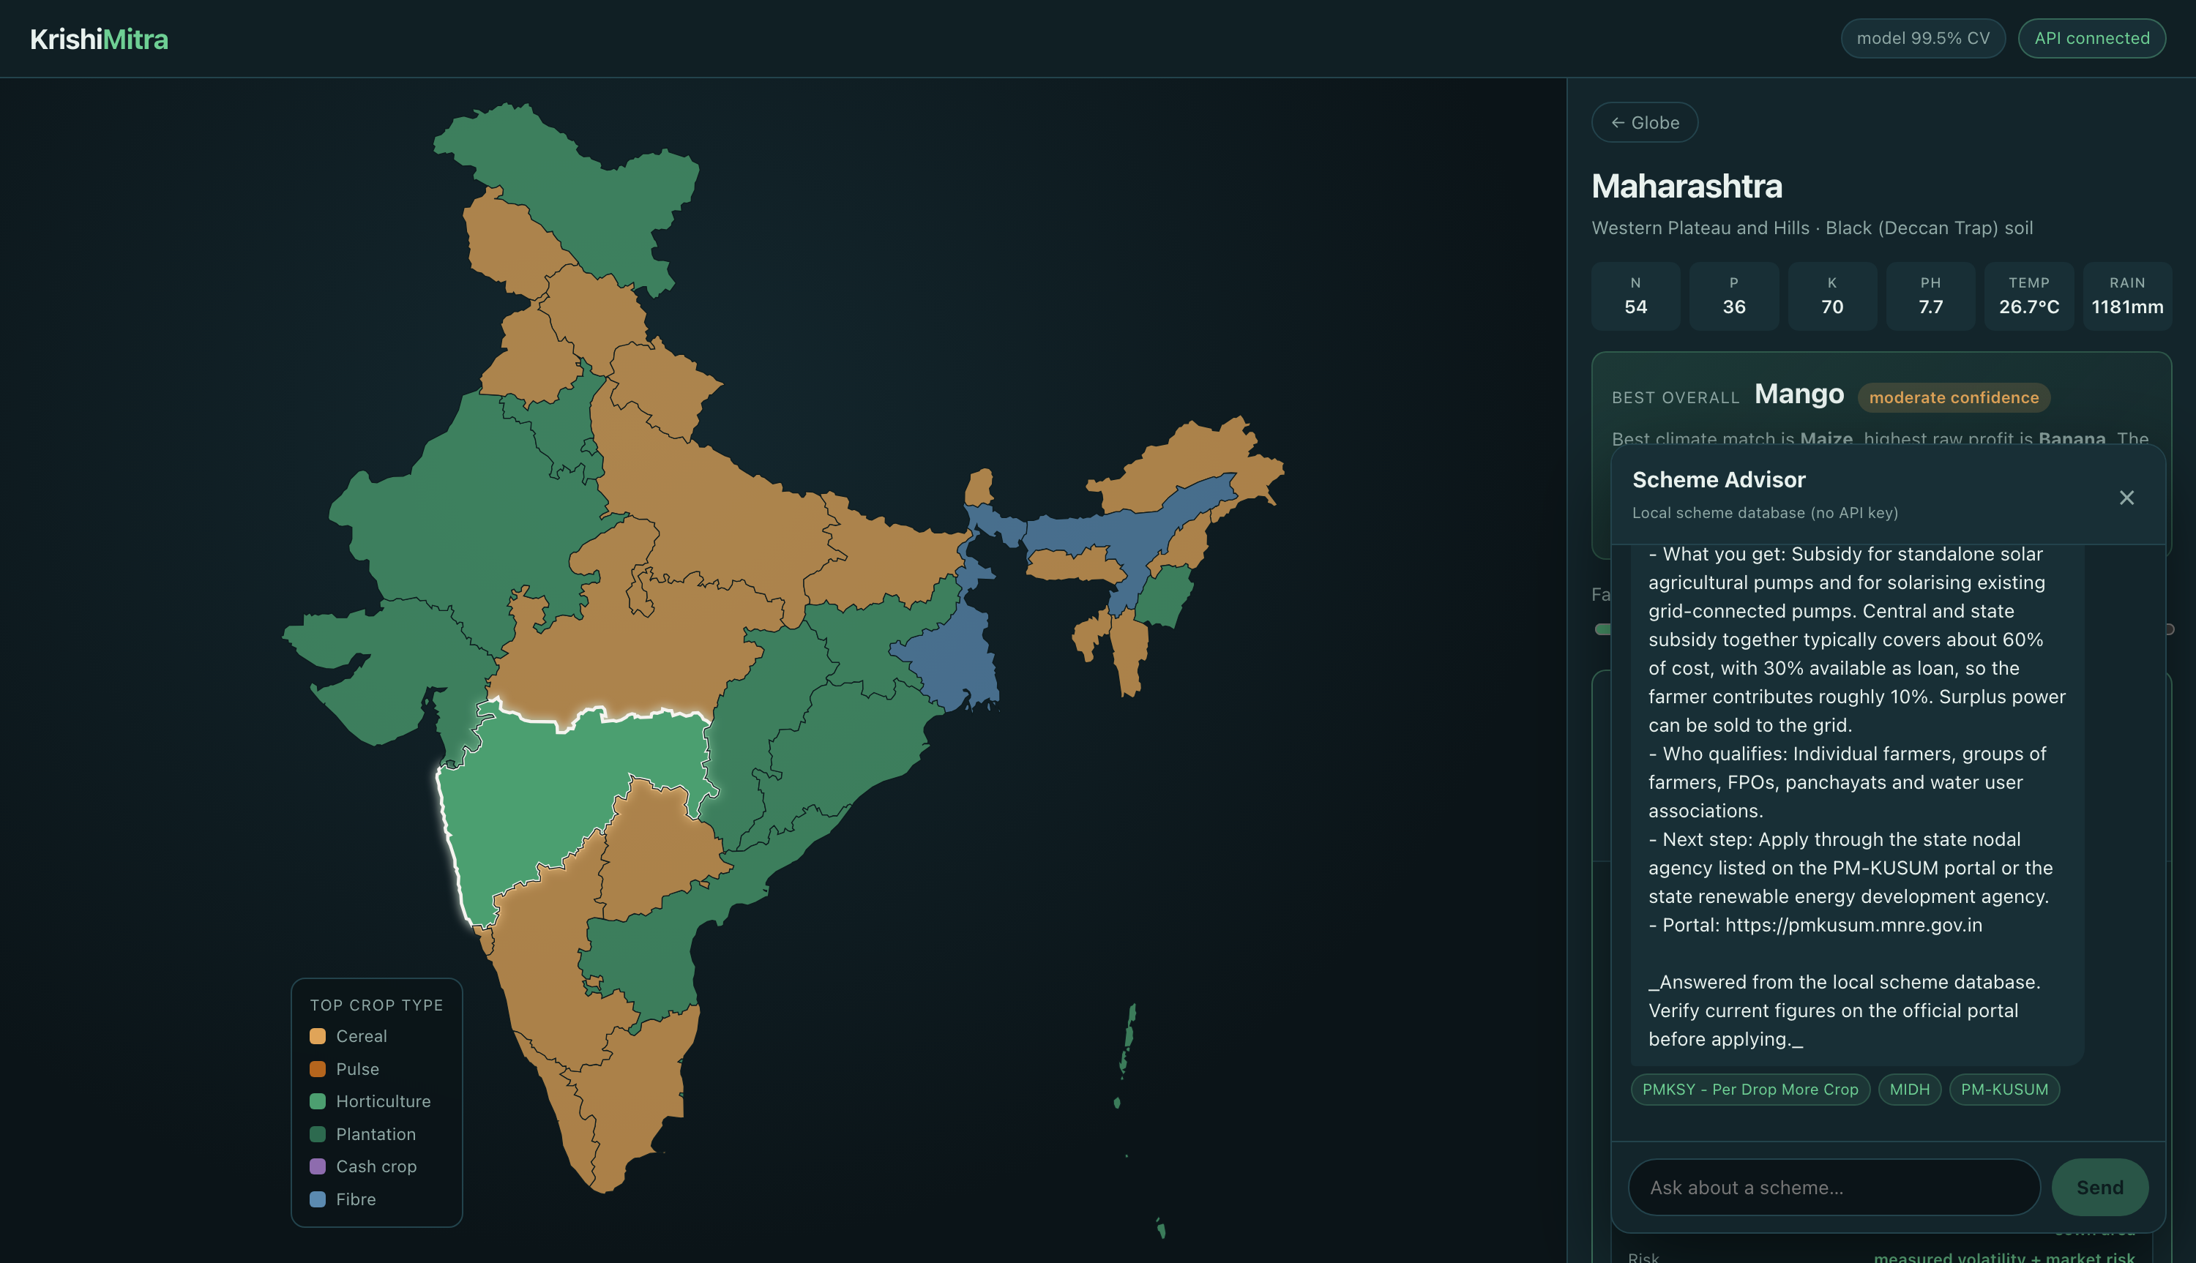
THE PRODUCT
Scheme Advisory Chatbot
Grounded on 12 central schemes · Grok (x.ai) with local retrieval fallback
Retrieval before generation
The question retrieves matching schemes first; only that verified text reaches the model as context.
Constrained deliberately
A hallucinated subsidy percentage costs a farmer real money. The model summarises verified text rather than recalling from training.
Degrades, never fails
Without an API key the same retrieval renders a structured answer directly. The feature falls back to search instead of going down.
Context aware
The selected state and recommended crop are passed in, so the farmer never has to restate them.
Cerealia
16

Slide 18
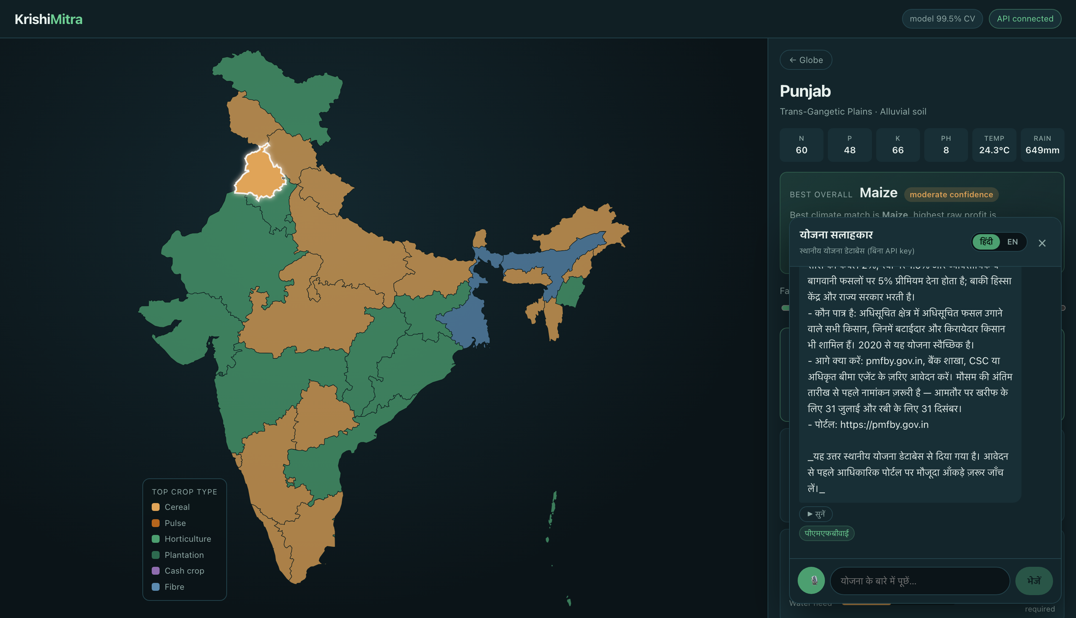
THE PRODUCT
Voice & Hindi
The literacy barrier is the real adoption barrier — a farmer who cannot type English cannot use any of this
Speak the question
Web Speech API dictation in hi-IN. The transcript submits itself — a farmer using voice should not have to find a second button.
Answered in Hindi
Script detection routes the question; all 12 schemes carry Hindi text, so the answer is Hindi even with no API key and no network.
Read back aloud
Speech synthesis in Hindi using the device's own voice, entirely offline. For a farmer who speaks Hindi but reads it slowly, this is the difference between usable and not.
Honest about the gap
Chrome's recogniser streams audio to Google, so dictation needs a network even though everything else runs offline. Bhashini, the government's own speech stack, removes that and adds 21 more languages.
Cerealia
17

Slide 19
PART FOUR
Validation
Does the engine reproduce reality — and what did building it teach us?
Cerealia
18

Slide 20
VALIDATION
Does It Match Reality?
Recommendations reproduce real Indian cropping patterns; none of them are hard-coded as answers
STATE TOP RECOMMENDATIONS REALITY CHECK
Assam
Jute · Rice
The jute and paddy belt
West Bengal
Jute · Rice · Banana
India's largest jute producer
Kerala
Rice · Banana · Coconut
Coconut is 72% of Kerala's sown area
Maharashtra
Mango · Orange · Banana
Konkan mango, Nagpur orange, Jalgaon banana
Punjab
Maize · Cotton · Lentil
Cotton is 15% of Punjab's sown area
Rajasthan
Watermelon · Moth beans
Arid-zone crops; moth beans are 22% of area
Himachal Pradesh
Maize · Orange · Rajma
Maize is 76% of HP's sown area
Cerealia
19

Slide 21
VALIDATION
It Surfaces Real Problems
The engine does not hide agronomic tension — it reports it
Punjab paddy scores 0.39 agro-climatic fitness with a 346 mm irrigation gap
649 mm of annual rainfall cannot support rice. Punjab grows it anyway, through groundwater extraction — and the engine flags the shortfall with a “check groundwater status” verdict. The state's documented water crisis falls directly out of the model output, without being told about it.
What a naive ranking does
Rank on headline profit and the system recommends pomegranate for all 36 states — including Punjab, where it scores 0% suitability. This is not hypothetical: it is what our first implementation did, and it is reproducible by setting the profit weight to 0.9.
What fixed it
Rank on risk-adjusted expected return — profit weighted by climate fitness and regional evidence, then log-compressed. A crop paying ₹6 lakh per hectare that half-fits the climate is not worth more than one paying ₹3 lakh that thrives.
Cerealia
20

Slide 22
VALIDATION
Engineering Findings
Four defects worth recording, because each one changed the design
Rainfall unit mismatch
The training data's rainfall column runs 20–299 mm per growing cycle; IMD state normals are annual totals of 108–3062 mm. Feeding annual figures in put every state outside the training distribution, the forest returned ≈0 probability for everything, and the profit term won by default.
Cost calibrated to optimistic yield
Fixed per-hectare costs had been tuned against our own generous yield estimates. Substituting real, lower yields turned paddy into a phantom loss. Fixed by costing field crops per quintal from CACP data, so cost scales with output.
Skewed profit normalisation
Net return per hectare spans ₹10,000 to ₹7 lakh. Min–max normalising that raw range gave the largest crop a score of 1.0 and squashed everything else, putting papaya first in six of ten states. A log transform restored proportion between tiers.
Yield stability read as safety
Measured volatility captures production risk only. Papaya yields reliably but rots without a cold chain and crashes in price at a local glut. Production and market risk are now blended rather than conflated.
Cerealia
21

Slide 23
VALIDATION
Current Progress
Working end to end — model, engine, API, interface and chatbot, running fully offline
DELIVERED
✓ Noise-augmented model trained, benchmarked and versioned (96% at ±20% sensor error)
✓ Four-signal ranking engine with real cultivation prior
✓ 246,091 official GoI records integrated
✓ State-specific measured yields and empirical risk
✓ CACP per-quintal cost model for field crops
✓ Agro-climatic profiles for all 36 states and UTs
✓ Explainability layer and costed fertiliser planner
✓ FastAPI service — 7 endpoints, validation, CORS
✓ React interface — globe, map, panel, chat drawer
✓ Grounded chatbot over 12 schemes with offline fallback
✓ Data provenance surfaced per recommendation
✓ Hindi voice input, Hindi answers and Hindi read-aloud
✓ Verified end to end in headless Chrome, zero console errors
IN PROGRESS
○ Grok API key wiring
○ District-level resolution
○ Live weather and mandi prices
○ More languages via Bhashini
○ ESP32 soil sensor hardware
○ Leaf-disease detection
Cerealia
22

Slide 24
VALIDATION
Requirements
SOFTWARE
· Python 3.12 · FastAPI · Uvicorn · Pydantic
· scikit-learn · pandas · NumPy · joblib · shapely
· React 18 · Vite · d3-geo · topojson-client
· httpx · python-pptx
DATA
· GoI crop production statistics (246,091 records)
· Crop_recommendation.csv (2,200 × 22) for fitness
· IMD normals · Soil Health Card aggregates
· CACP MSP and cost of production 2024-25
EXTERNAL SERVICES
· Grok / x.ai — scheme chatbot (free tier)
· Open-Meteo — live weather (planned)
· Agmarknet / data.gov.in — mandi prices (planned)
· Bhashini — Indian languages (planned)
HARDWARE
· Laptop — the demo runs entirely offline
· ESP32 + RS485 7-in-1 NPK soil sensor (planned)
· DHT22 temperature and humidity module
· Feeds live readings through the existing override API
Cerealia
23

Slide 25
PART FIVE
Future Scope
Where this goes next, and how it scales beyond a single farmer
Cerealia
24

Slide 26
FUTURE SCOPE
Roadmap
Three horizons
NEAR TERM
next iteration
· District-level resolution — Nashik ≠ Vidarbha
· Live weather via Open-Meteo
· Live mandi prices via Agmarknet
· Bhashini for 21 more Indian languages
· On-device speech, so dictation works offline
· SHAP values alongside the ideal bands
MEDIUM TERM
beyond the review
· Crop rotation planning across seasons
· Groundwater sustainability from CGWB blocks
· Mandi price forecasting before sowing
· Leaf-disease detection from a photograph
· ESP32 + NPK sensor for live soil readings
· WhatsApp bot for non-smartphone farmers
LONGER TERM
the scaled system
· Sentinel-2 NDVI crop health monitoring
· Land allocation optimised under constraints
· FPO and district-officer dashboards
· Glut and shortage early warning
· Carbon credit and sustainability scoring
· Credit scoring for KCC pre-qualification
Cerealia
25

Slide 27
FUTURE SCOPE
Scaling Beyond One Farmer
The same engine serves three progressively larger audiences
The farmer
What to plant, what it costs, what it earns, which scheme applies. Delivered by voice in the local language, over WhatsApp where there is no smartphone.
The FPO
Aggregate the intent of hundreds of members into collective input purchase, shared cold storage, and a bulk sale that commands a better price than any one farmer could.
The district officer
Aggregate cropping intent across a district becomes an early warning: if 60% of farmers intend to plant the same crop, the glut and the price crash are both predictable months ahead.
The recommendation engine does not change between these tiers. Only the unit of aggregation does — which is what makes the idea scale rather than merely grow.
Cerealia
26

Slide 28
FUTURE SCOPE
Known Limitations
Stated plainly, because they define the roadmap
1. The fitness dataset is synthetic
Crop_recommendation.csv has clean, well-separated envelopes and carries no geography. That is why 99.5% accuracy is easy, and why the official cultivation prior exists at all.
2. Apple is under-ranked for Himachal
The dataset places apple's temperature band at 21–24 °C, which ignores its ~1,000 hour winter chill requirement. A vernalisation feature is needed.
3. State-level granularity
Nashik and Vidarbha are both simply “Maharashtra”. The district boundary file is already in the repository; only the profile data is missing.
4. Production data ends in 2015
The official series covers 1997–2015. Yields and cropping patterns have moved since; the newer release needs ingesting.
5. Prices are national, not local
MSP is national by definition, but mandi prices vary by district and week. Agmarknet integration is the fix.
6. Wheat and sugarcane are absent
Two of India's largest crops are not among the 22 in the fitness dataset, though both appear in the production statistics.
Cerealia
27

Slide 29
Summary
A crop recommender that answers the question a farmer actually has —
not what can grow here, but what is worth growing, and why.
246k
official records
645
districts
36
states & UTs
22
crops
98.7%
CV accuracy
12
schemes
github.com/RatnamOjha/cerealia
Model, ranking engine, REST API, React interface and scheme chatbot — working end to end and running fully offline for this demonstration.
Cerealia
28

