Slide 1

Phishing URL Detector using ML
Department of Computer Science(AIML) / RCET
Ratnambar Baghel-301310923126
Shararat Alam-301310923140
Guided by-
Shreshtha Singh

Slide 2

✅ 2. Problem Statement
Increasing phishing attacks trick users into sharing personal info via fake websites.
Phishing URLs look like real ones (e.g., secure-paypal-login.com).
Need for a fast, accurate system to detect such threats in real-time.

Slide 3
✅ 3. Objectives
Build a web app to detect phishing URLs.
Train a machine learning model using XGBoost.
Use 19 URL-based features for detection.
Provide real-time prediction through Flask frontend.

Slide 4
✅ 4. Originality & Innovation
Uses machine learning instead of static blacklists.
Real-time prediction via lightweight Flask app.
Feature-based model ensures high accuracy.
Portable and can be integrated into browsers or systems.
joblib model saving for fast prediction load time.

Slide 5
✅ 5. Literature Review / Related Work
Blacklist-based detection (limited & outdated).
Google Safe Browsing (API-based, limited access).
Prior ML models: SVM, Random Forests — good but slower than XGBoost.
✨ “Our work improves upon these by combining speed + accuracy.”

Slide 6
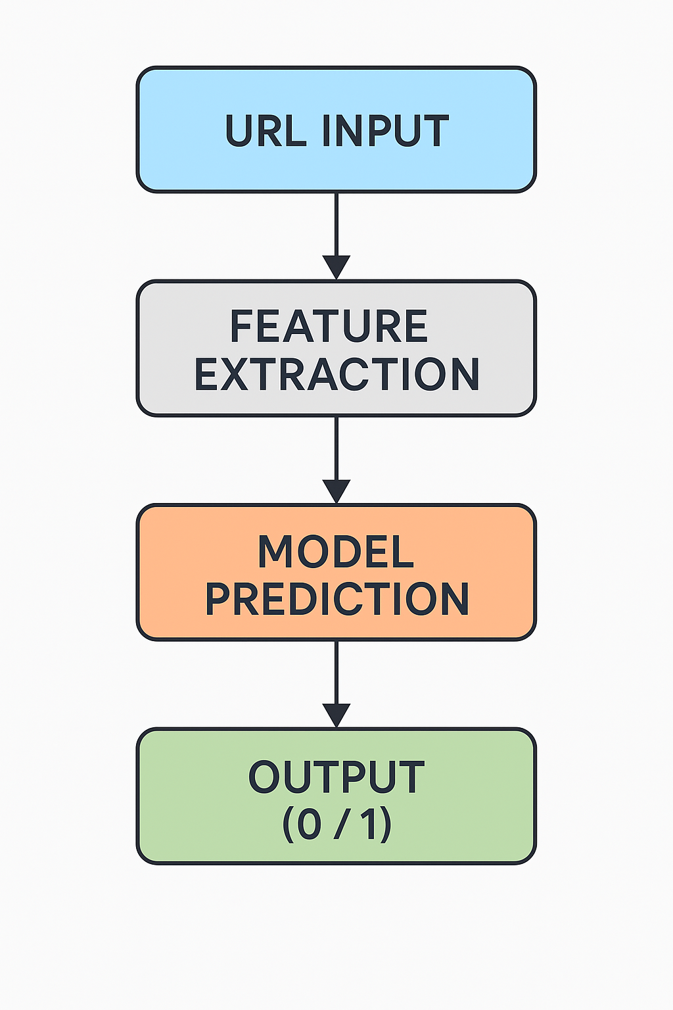
✅ 6. Methodology
Tools: Python, Flask, XGBoost, Pandas, Joblib
Dataset: 19-feature phishing dataset (phishing1.csv)
Model: Trained using XGBoost classifier
Deployment: Flask web app
URL Input → Feature Extraction → Model Prediction → Output (0/1)

Slide 7

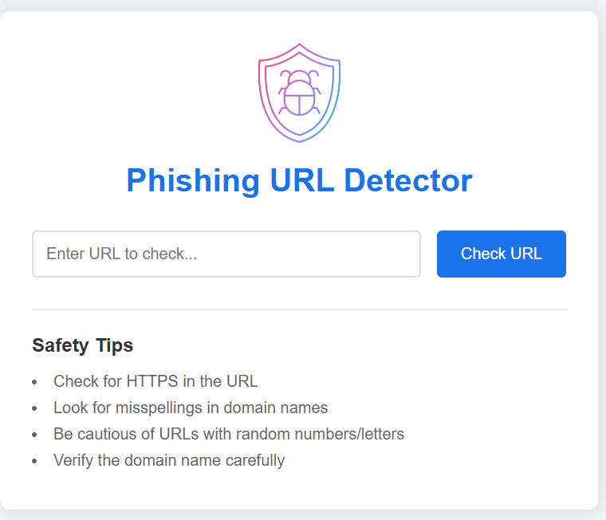
✅ 7. System Design
Mention file structure: src/, models/, templates/, etc.
Show DFD or a simple block diagram:
Frontend (HTML form)
Backend (Flask + Model)

Slide 8
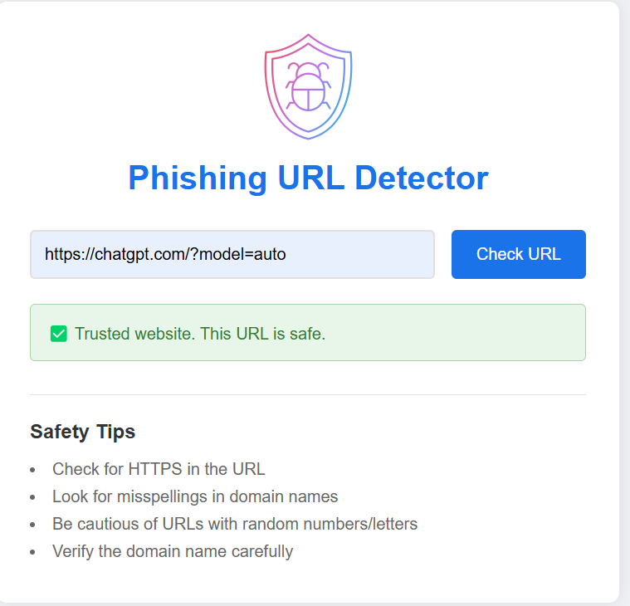
✅ 8. Implementation & Features
Features extracted from URL (like length, IP use, @ symbol)
XGBoost model trained & saved
Flask app takes URL and shows result instantly
🔥 "Real-time prediction" & "High accuracy".

Slide 9

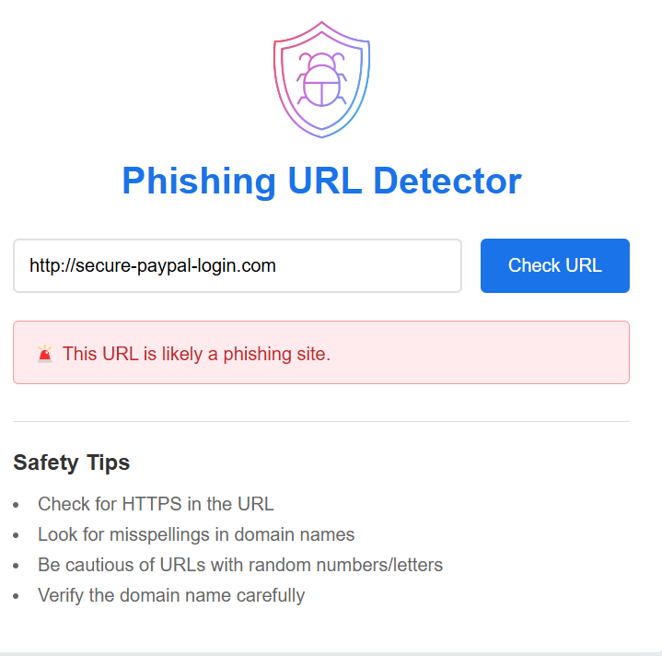
✅ 9. Results & Output
Accuracy score (e.g., 95% or your actual result)
Sample input: http://secure-paypal-login.com
Sample output: Phishing Detected!
.

Slide 10
✅ 10. Usefulness & Applications
Prevents phishing attacks
Can help individuals & companies
Easily integratable with browsers, email scanners, etc.
🙌 Make it practical — “You paste a link, and it protects you!”

Slide 11
✅ 11. Challenges Faced
Data cleaning & preprocessing
Feature engineering
Integrating ML with Flask
Frontend + backend communication

Slide 12
✅ 12. Future Work
Add more advanced features (SSL certificate checks)
Mobile/web browser extension
Train with larger, real-time datasets
Add visualizations or dashboards 🚀

Slide 13
✅ 13. Evaluation Criteria Summary
Originality ✔️ (Yes, ML-based real-time phishing detection)
Content ✔️ (Well-structured, researched)
Working ✔️ (Model + App running)
Usefulness ✔️ (High)

Slide 14
✅ 14. Conclusion
Built a fast, accurate phishing detector using ML.
Successfully integrated with a simple web app.
Helps protect users from dangerous links.
Can be extended to real-world applications.
“A small step toward a safer digital world.”

Slide 15

THANK YOU

