Slide 1

Student Details
Name : Ratnapal Vinod Shende
Email : ratnapalshende2001@gmail.com
College Name : Trinity College of Engineering and Research Pune
College State : Maharashtra
Internship Domain : Artificial Intelligence
Start date : 18 Aug 2023
End date : 30 Sep 2023

Slide 2
PROJECT TITLE/Problem Statement
Sentiment Analysis of Restaurant Reviews

Slide 3
AGENDA
Introduction
Project Overview
End Users
Solution and Value Proposition
Customization and Personalization
Modeling
Results
Conclusion
Links

Slide 4
PROJECT OVERVIEW
In the digital age, restaurant choices are heavily influenced by online reviews, making it crucial for both restaurant owners and customers to understand the sentiments expressed in these evaluations.
Sentiment analysis plays a pivotal role in understanding customer sentiment towards restaurants.
For this project, we utilized a comprehensive dataset of restaurant reviews.
The dataset contains a diverse range of reviews, covering various cuisines, dining types, and locations
Our main objective is to create a sentiment analysis model that effectively categorizes reviews of restaurants.
Data Preprocessing: We performed data cleaning and text preprocessing to prepare the reviews for analysis.
Machine Learning: We employed various machine learning algorithms, including Naive Bayes, Random Forest, and SVM, to build sentiment classifiers.

Slide 5
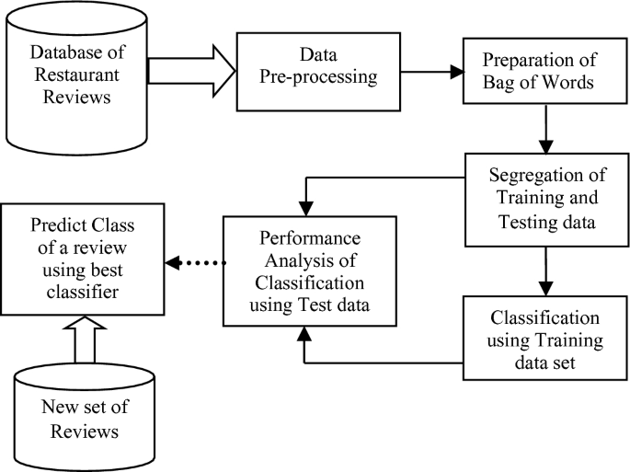

Slide 6

WHO ARE THE END USERS of this project?
Restaurant owners
Consumers
Analysts
Entrepreneurs

Slide 7

YOUR SOLUTION AND ITS VALUE PROPOSITION
Our solution leverages the power of machine learning to perform sentiment analysis on restaurant reviews.
Comprehensive Text Preprocessing: Rigorous text preprocessing ensures that our model can handle a wide range of textual data effectively.
Our solution leverages the power of machine learning to perform sentiment analysis on restaurant reviews.
Comprehensive Text Preprocessing: Rigorous text preprocessing ensures that our model can handle a wide range of textual data effectively.

Slide 8
How did you customize the project and make it your own
To enhance model performance, we engaged in feature engineering to capture nuanced sentiment signals: N-gram Analysis: We incorporated n-grams (word combinations) to capture context and sentiment nuances often missed by standard models.
Sentiment Lexicons: We integrated sentiment lexicons to bolster sentiment analysis by providing additional context.
We use different classifiers and algorithms to achieve more accuracy.
By using hyper-parameter method we have chosen the best values for the classifier.

Slide 9
MODELLING
Model Selection:
In our quest to perform sentiment analysis on restaurant reviews, we explored and implemented a range of machine learning algorithms, each with its unique characteristics:
Naive Bayes Classifier: Known for its simplicity and speed, it served as our baseline model.
Random Forest Classifier: Renowned for its ensemble nature and robustness, it added complexity and accuracy.
Support Vector Machine (SVM): A powerful model for binary classification, it offered versatility and fine-grained decision boundaries.

Slide 10
Data Preprocessing:
Before feeding our data into the models, we subjected it to rigorous preprocessing:
Text Cleaning: We removed noise and irrelevant characters while preserving essential information.
Tokenization: We segmented text into tokens (words or phrases) to facilitate feature extraction.
TF-IDF Vectorization: We transformed text data into numerical features using the TF-IDF technique, capturing the importance of words within each review.
Hyperparameter Tuning:
To optimize model performance, we embarked on hyperparameter tuning journeys for each algorithm:
Grid Search: We systematically explored hyperparameter combinations to identify the optimal settings.
Cross-Validation: We employed cross-validation techniques to ensure robust model evaluation and generalization.
Final Model Selection:
After thorough experimentation and evaluation, we selected the model that demonstrated the highest accuracy and overall performance on our restaurant review dataset.

Slide 11
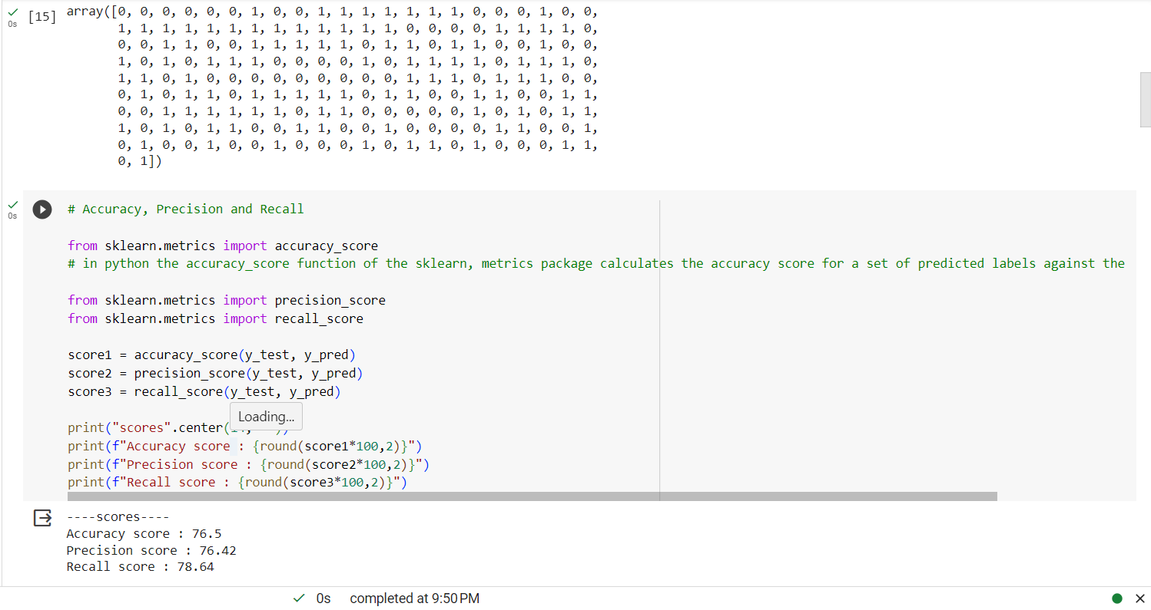
Results
Multinomial naïve bayes algorithm:

Slide 12
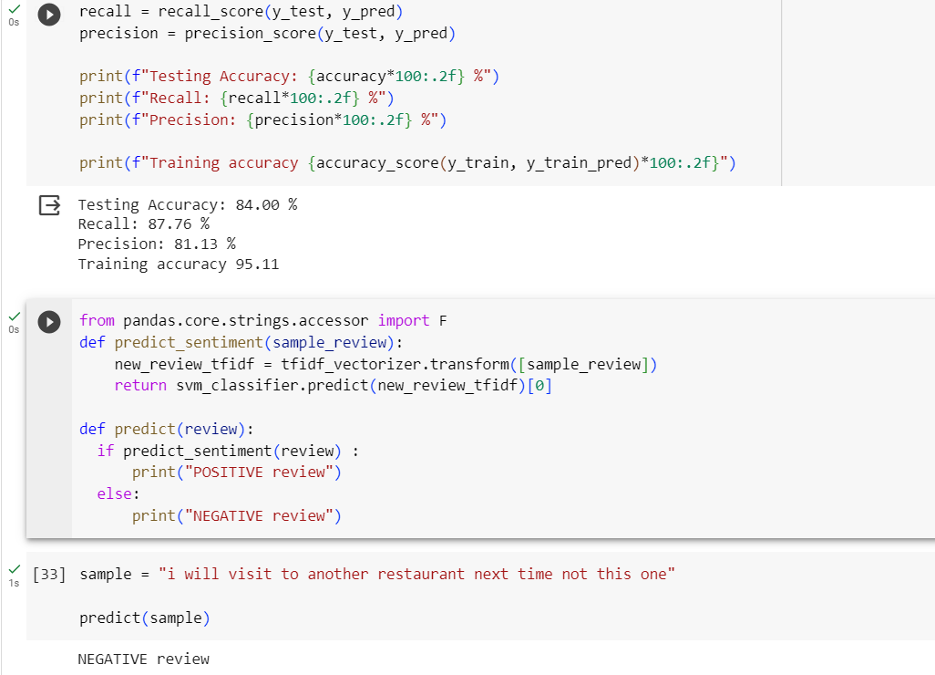
Support Vector Machine Output :

Slide 13
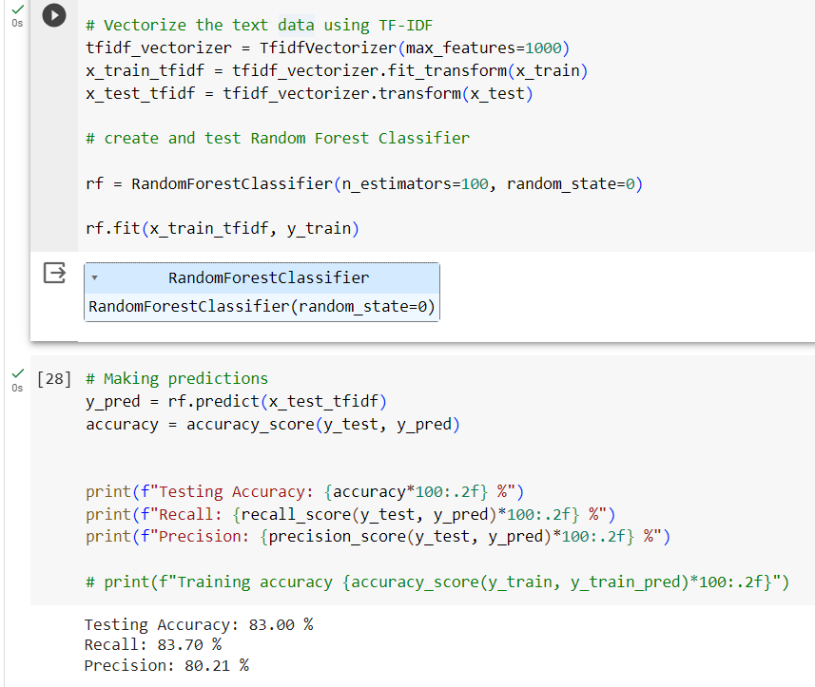
Random Forest Algorithm :

Slide 14
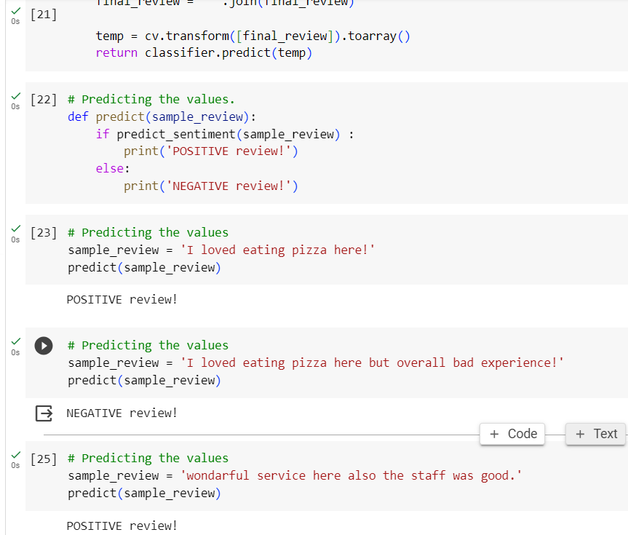
Predictions :

Slide 15

links
Google Colab Project Link
https://colab.research.google.com/drive/19wltEKRl9zK7JaFz6EVSIyublmogeKUc?usp=drive_link
GitHub Project Link
https://github.com/RatnapalHacker/Restaurant_reviews_sentiment_analysis

