Slide 1

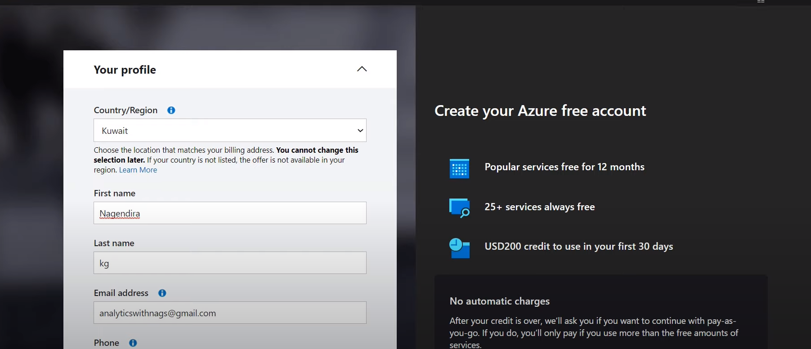
How to Create Azure account?

Slide 2
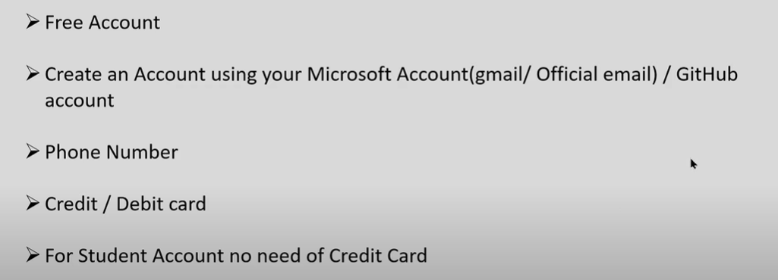
How to Create Azure account?

Slide 3
How to Create Azure account?

Slide 4
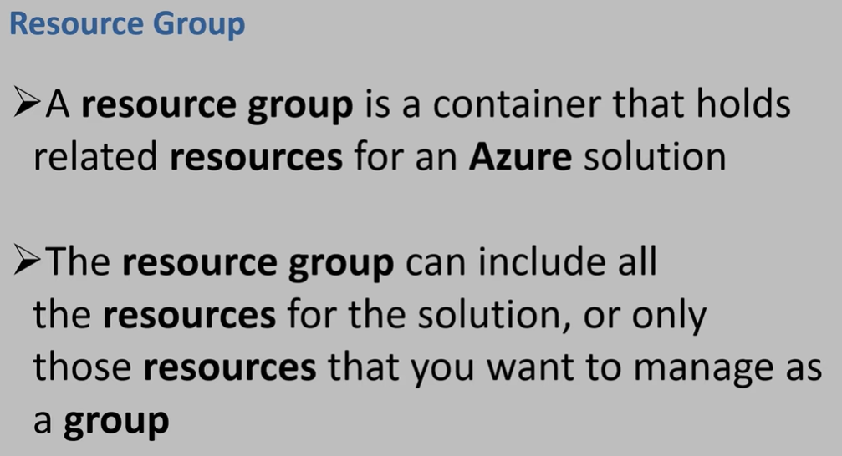
Resource Group

Slide 5
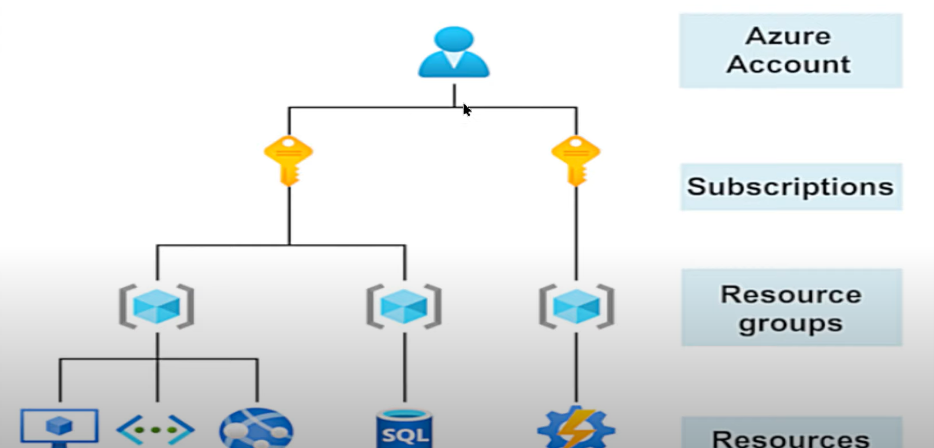
Resource Group

Slide 6

Storage

Slide 7
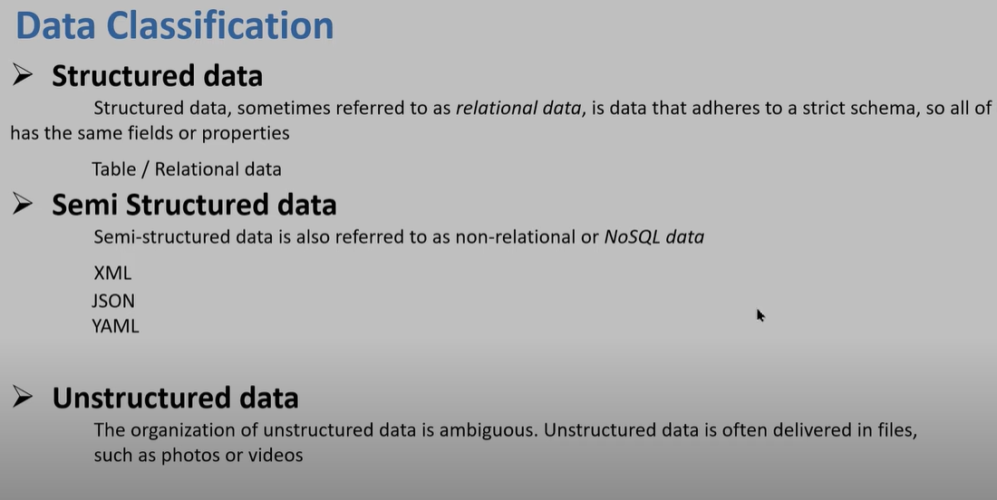
Storage
Notes:
Unstructured Data:
Media: Photos videos and audio files
Office files like word doc
Text file
Log file

Slide 8
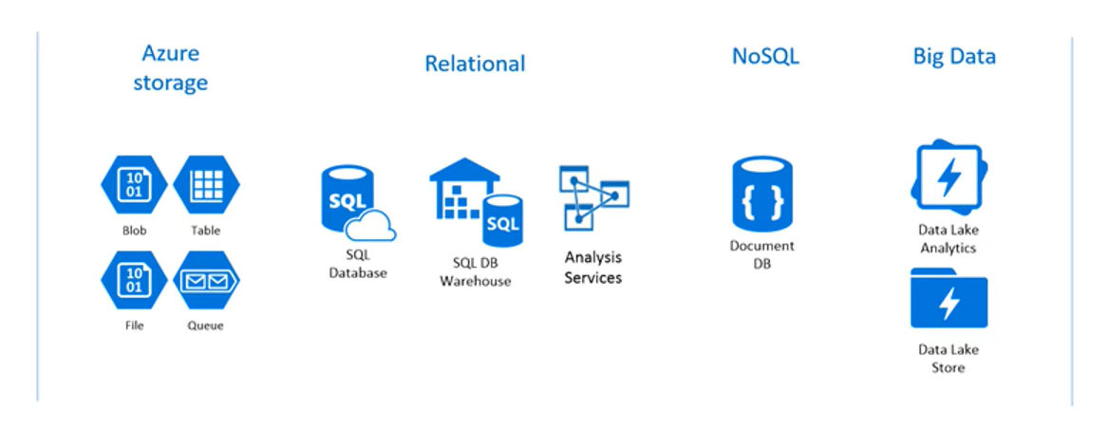
Storage
Notes:
Unstructured Data:
Media: Photos videos and audio files
Office files like word doc
Text file
Log file

Slide 9
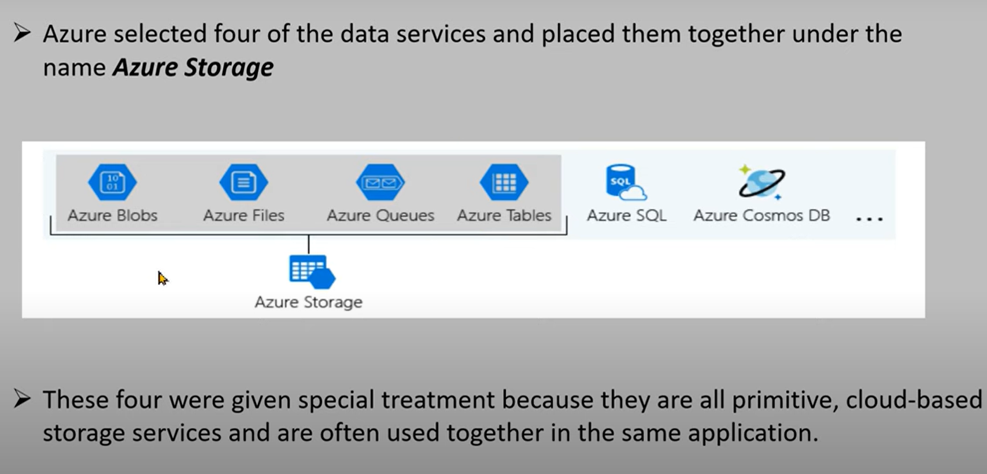
Storage
Notes:
Unstructured Data:
Media: Photos videos and audio files
Office files like word doc
Text file
Log file

Slide 10
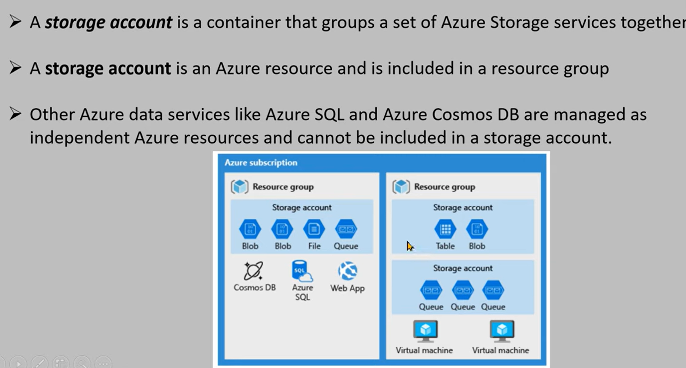
Storage Account
Notes:
Unstructured Data:
Media: Photos videos and audio files
Office files like word doc
Text file
Log file

Slide 11
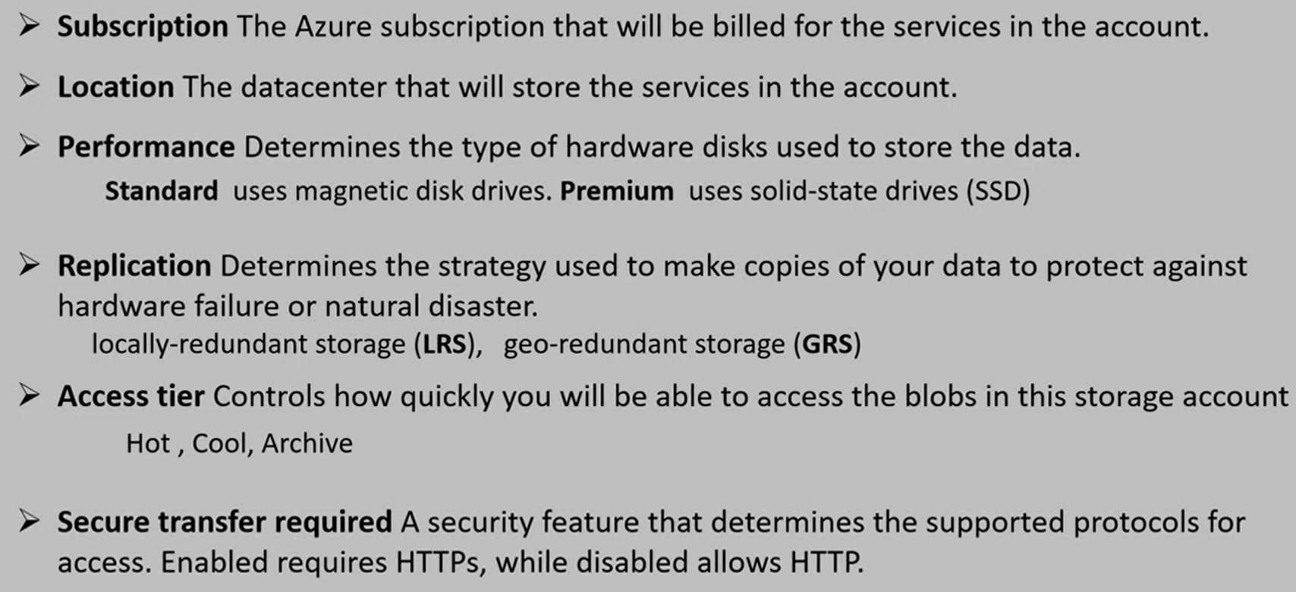
Settings/Properties
Notes:
Unstructured Data:
Media: Photos videos and audio files
Office files like word doc
Text file
Log file

Slide 12
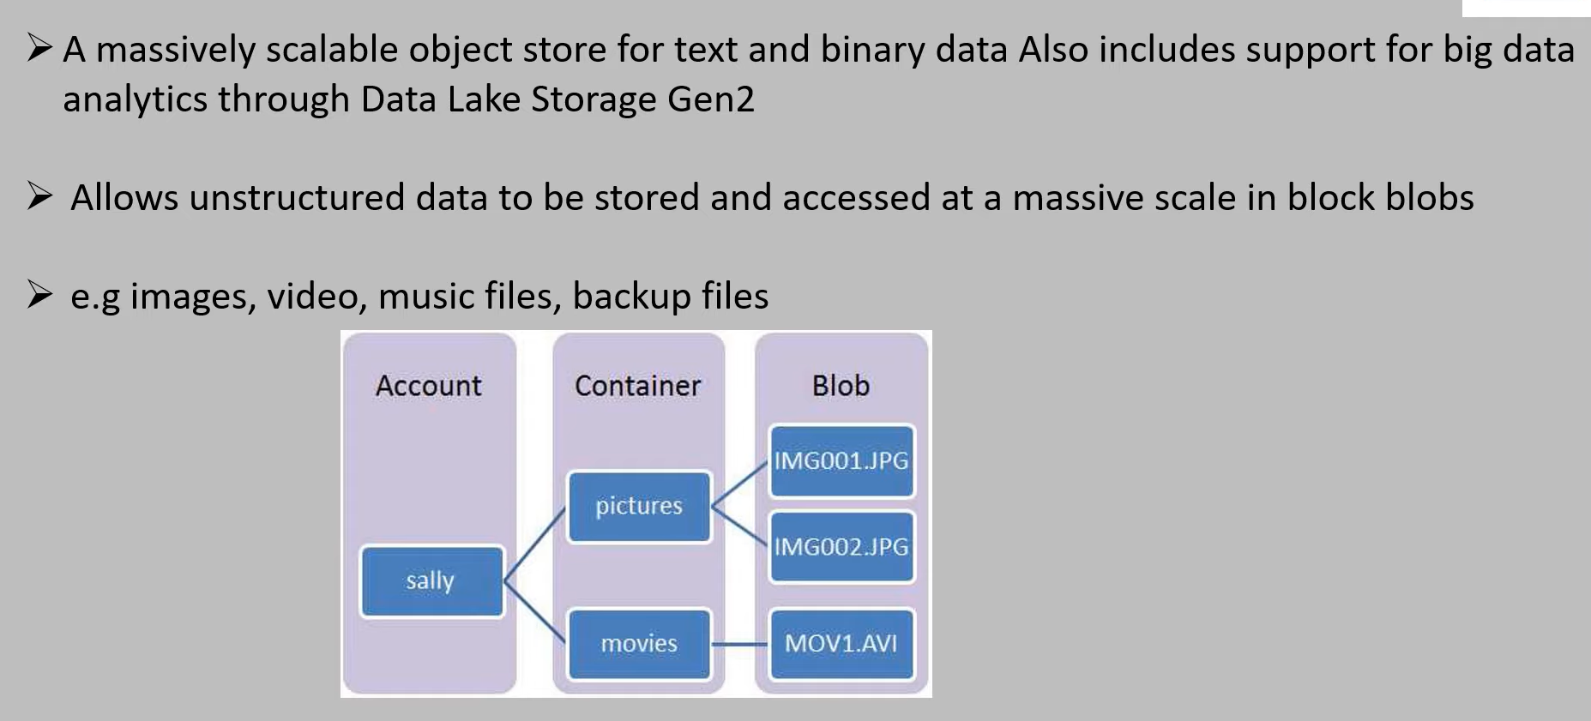
Azure Blob
Notes:
Unstructured Data:
Media: Photos videos and audio files
Office files like word doc
Text file
Log file

Slide 13
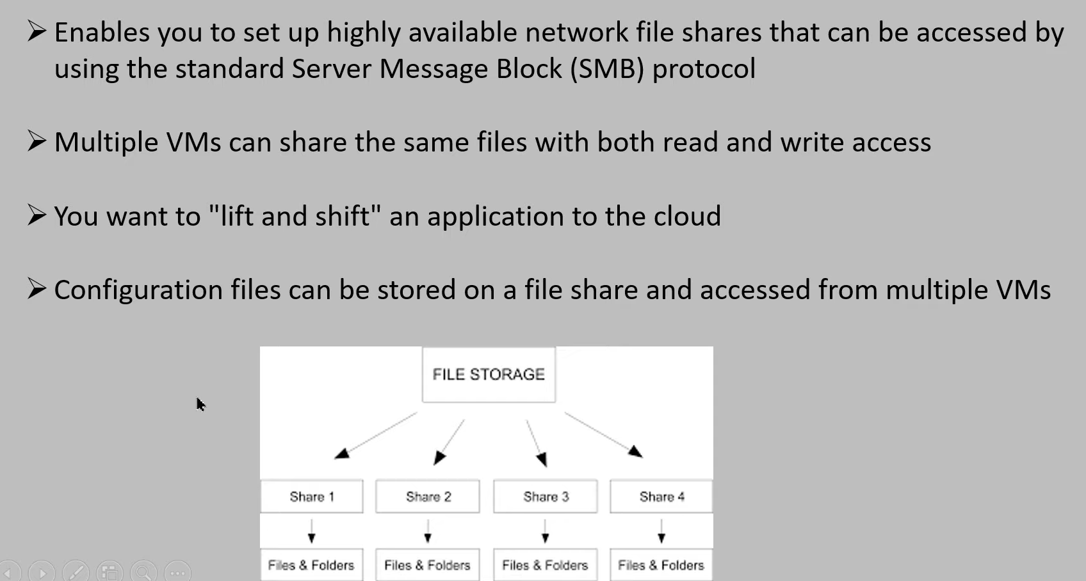
Azure Files
Notes:
Unstructured Data:
Media: Photos videos and audio files
Office files like word doc
Text file
Log file

Slide 14
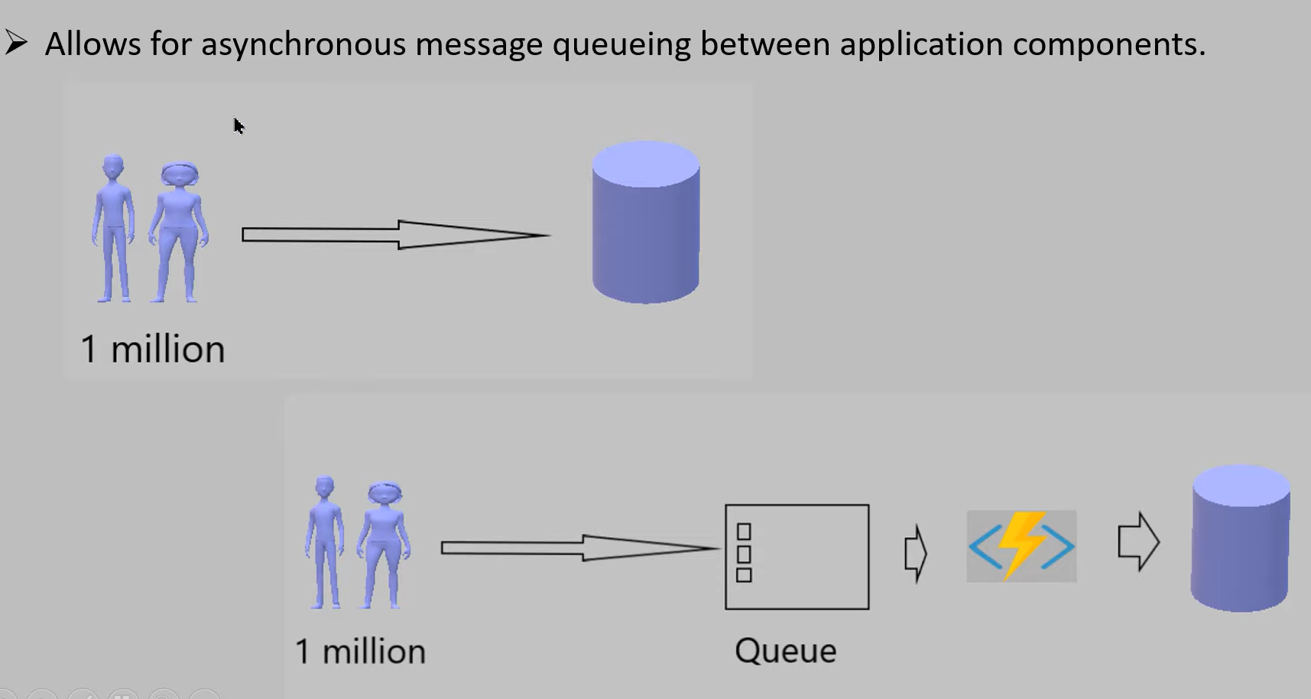
Azure Queues
Notes:
Unstructured Data:
Media: Photos videos and audio files
Office files like word doc
Text file
Log file

Slide 15
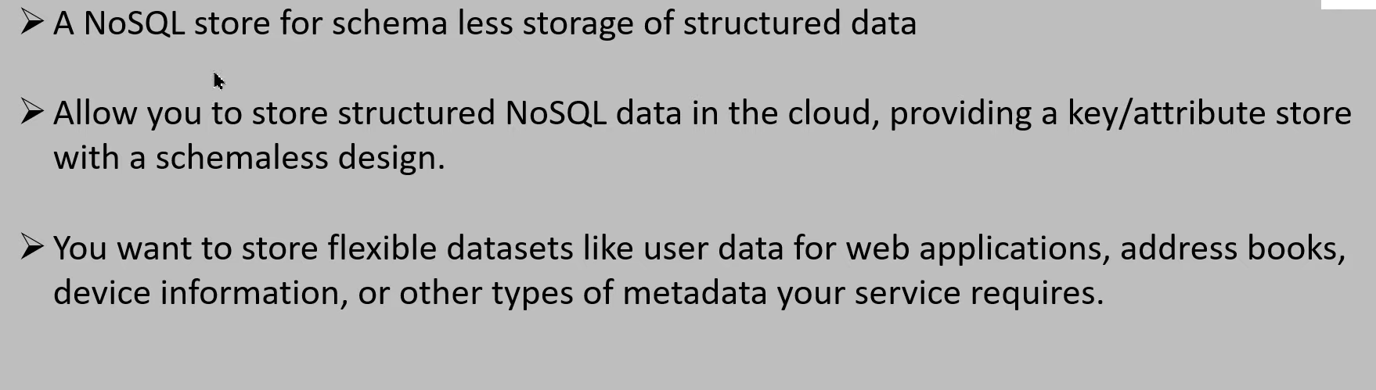
Azure Tables
Notes:
Unstructured Data:
Media: Photos videos and audio files
Office files like word doc
Text file
Log file

Slide 16
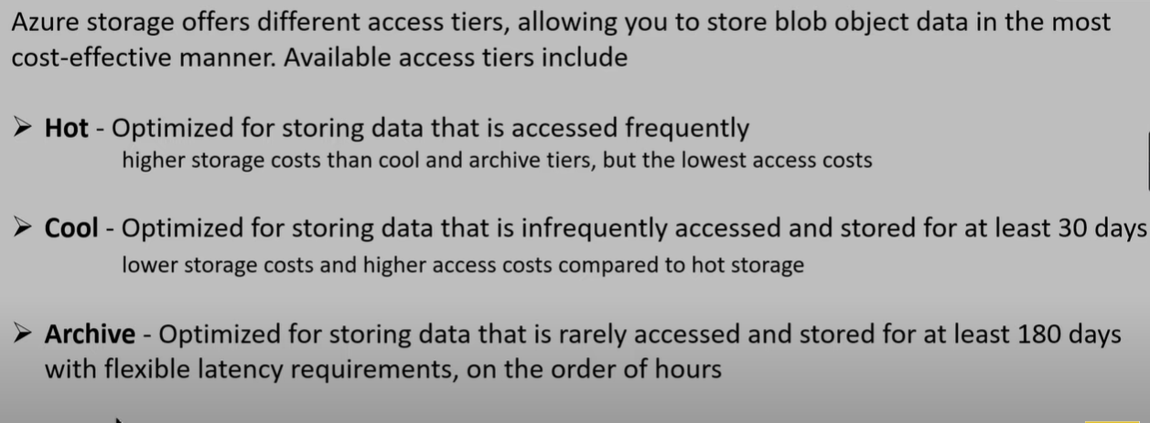
Access Tier
Notes:
Unstructured Data:
Media: Photos videos and audio files
Office files like word doc
Text file
Log file

