Slide 1
Topic
Multi-Layer Feed-Forward Neural Networks

Slide 2
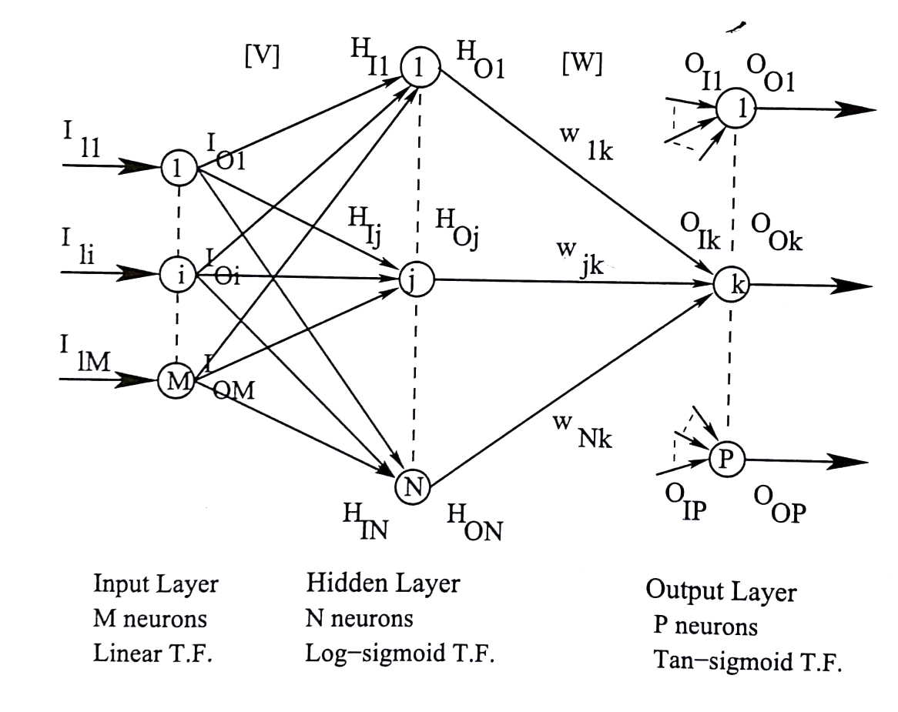
Multi-Layer Feed-Forward Neural Network (MLFFNN)
I_{I1}: Input of 1-st neuron lying on input layer
I_{O1}: Output of 1-st neuron lying on input layer

Slide 3
V₁₁ . . . . V_{1j} . . . .V_{1N}
. . .
. . .
[V] = V_{i1} . . . . V_{ij} . . . . V_{iN}
. . .
. . .
V_{M1} . . . .V_{Mj} . . .V_{MN}
W₁₁ . . . . W_{1K} . . . . W_{1P}
. . .
. . .
[W] = W_{j1} . . . . W_{jK} . . . . .W_{jP}
. . .
. . .
W_{N1} . . . . W_{Nk} . . . . W_{NP}

Slide 4
Forward Calculations
Step 1:
Step 2:
Determination of the outputs of input layer
I_{Oi} = I_{Ii},
where i = 1, 2, . . . . ., M
Calculation of inputs of hidden layer
H_{Ij} = v_{1j} I_{O1} + . . . . .+ v_{ij} I_{Oi} + ……+ v_{Mj} I_{OM},
where j = 1, 2, . . . . . , N
Determination of the outputs of hidden neurons

Slide 5
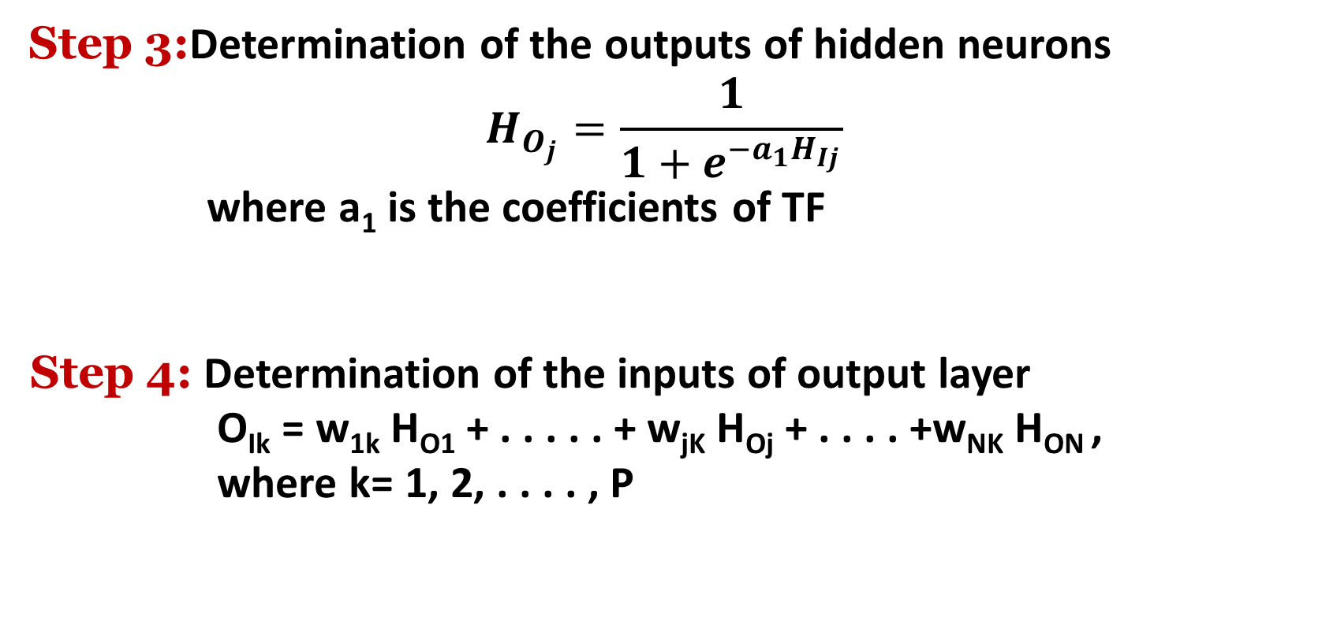
Step 3:Determination of the outputs of hidden neurons
$$H_{O_{j}}=\frac{1}{1+e^{−a_{1}H_{Ij}}}$$
where a₁ is the coefficients of TF
Step 4: Determination of the inputs of output layer
O_{Ik} = w_{1k} H_{O1} + . . . . . + w_{jK} H_{Oj} + . . . . +w_{NK} H_{ON} ,
where k= 1, 2, . . . . , P

Slide 6
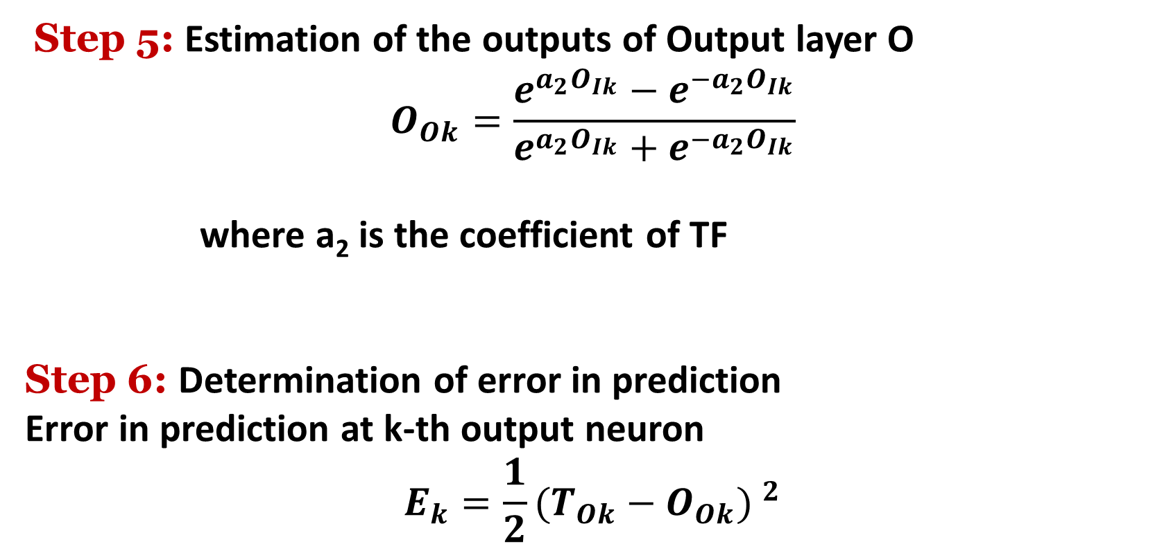
Step 5: Estimation of the outputs of Output layer O
$$O_{Ok}=\frac{e^{a_{2}O_{Ik}}−e^{−a_{2}O_{Ik}}}{e^{a_{2}O_{Ik}}+e^{{−a}_{2}O_{Ik}}}$$
where a₂ is the coefficient of TF
Step 6: Determination of error in prediction
Error in prediction at k-th output neuron
$$E_{k}=\frac{1}{2}{(T_{Ok}−O_{Ok}) }^{2}$$

Slide 7
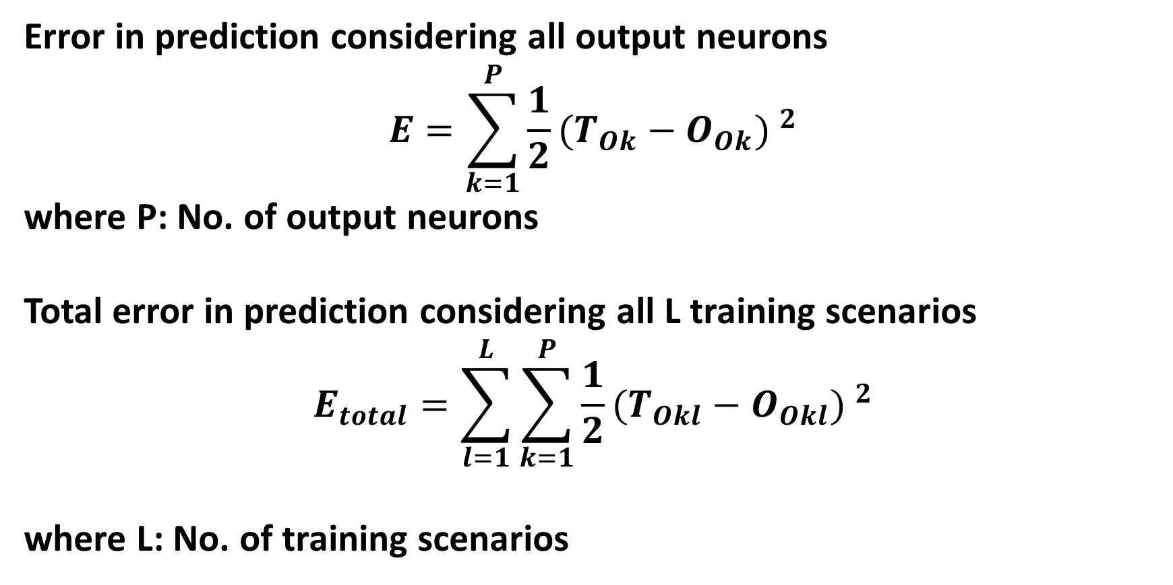
Error in prediction considering all output neurons
$$E=\sum_{k=1}^{P}{\frac{1}{2}{(T_{Ok}−O_{Ok}) }^{2}}$$
where P: No. of output neurons
Total error in prediction considering all L training scenarios
$$E_{total}=\sum_{l=1}^{L}{\sum_{k=1}^{P}{\frac{1}{2}{(T_{Okl}−O_{Okl}) }^{2}}}$$
where L: No. of training scenarios

Slide 8
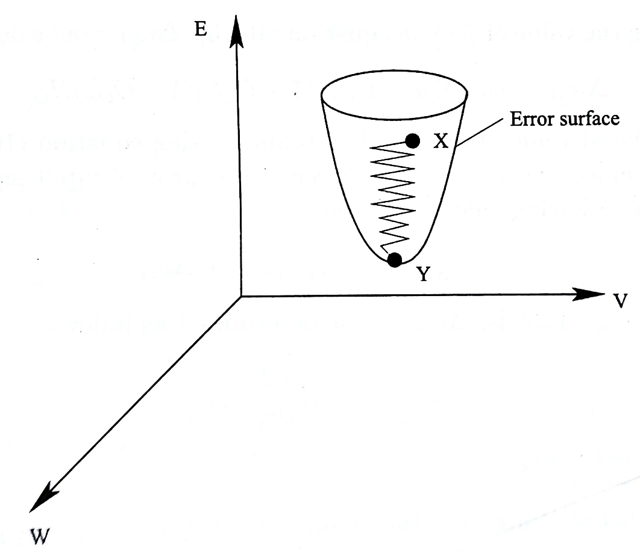
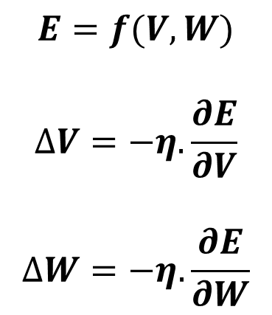
Back-Propagation Algorithm
Delta Rule
$$E=f(V,W)$$
$$∆V=−η.\frac{∂E}{∂V}$$
$$∆W=−η.\frac{∂E}{∂W}$$

Slide 9
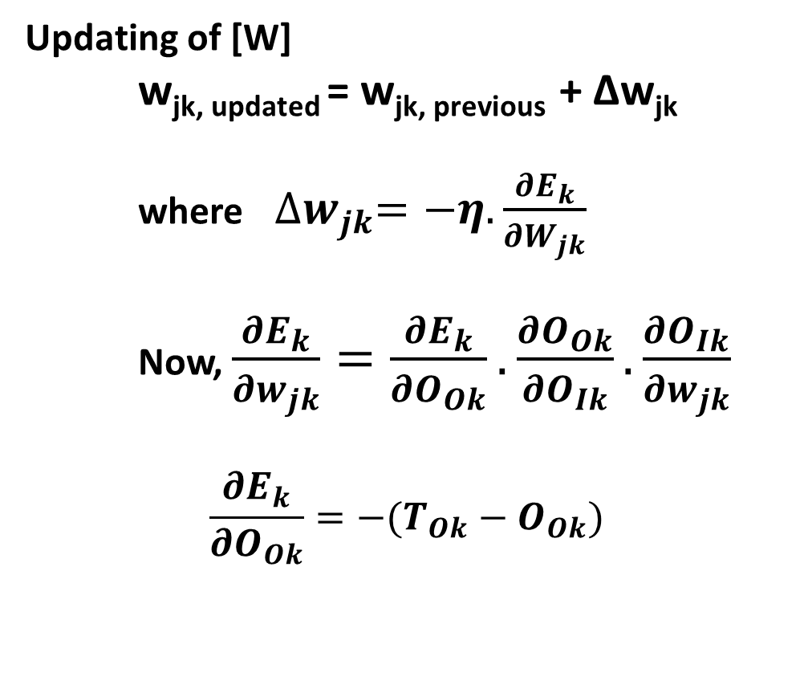
Incremental Mode of Training
Updating of [W]
w_{jk, updated} = w_{jk, previous} + Δw_{jk}
where${∆w}_{jk}=−η.\frac{{∂E}_{k}}{{∂W}_{jk}}$
Now, $\frac{{∂E}_{k}}{{∂w}_{jk}}=\frac{{∂E}_{k}}{{∂O}_{Ok}}.\frac{{∂O}_{Ok}}{{∂O}_{Ik}}.\frac{{∂O}_{Ik}}{{∂w}_{jk}}$
$$\frac{{∂E}_{k}}{{∂O}_{Ok}}=−(T_{Ok}−O_{Ok})$$

Slide 10


$$\frac{∂O_{Ok}}{∂O_{Ik}}=a_{2}(1+O_{Ok})(1−O_{Ok})$$
$$\frac{∂O_{Ik}}{∂w_{jk}}=H_{Oj}$$
$$\frac{∂E_{k}}{∂w_{jk}}=− (T_{Ok}−O_{Ok})a_{2}(1+O_{Ok})(1−O_{Ok})H_{Oj}$$
$${∆w}_{jk}=ηa_{2}(T_{Ok}−O_{Ok})(1+O_{Ok})(1−O_{Ok})H_{Oj}$$

Slide 11
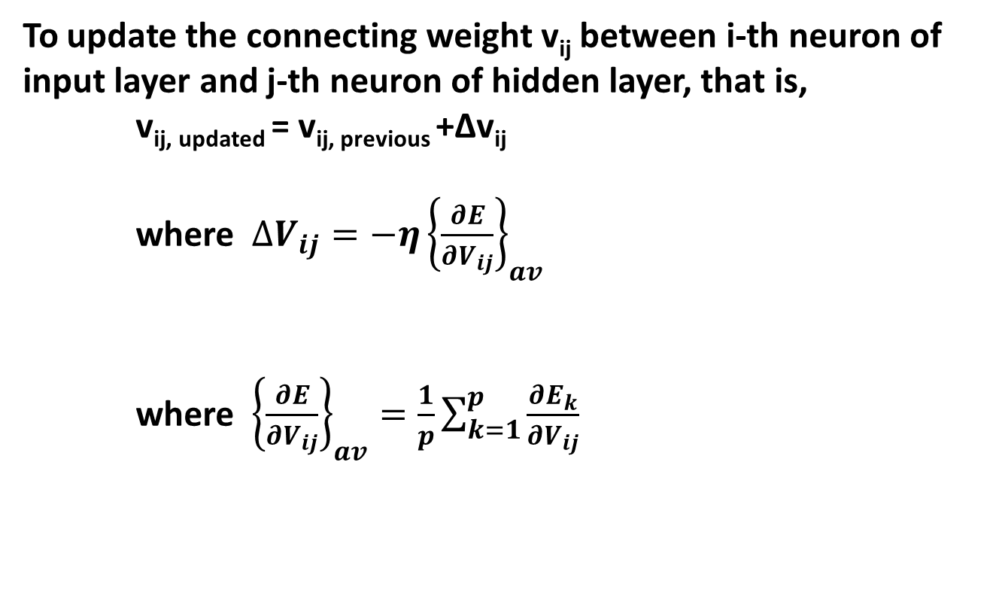
To update the connecting weight v_{ij} between i-th neuron of input layer and j-th neuron of hidden layer, that is,
v_{ij, updated} = v_{ij, previous} +Δv_{ij}
where $∆V_{ij}=−η{\left\{\frac{∂E}{∂V_{ij}}\right\}}_{av}$
where ${\left\{\frac{∂E}{∂V_{ij}}\right\}}_{av}=\frac{1}{p}\sum_{k=1}^{p}{\frac{∂E_{k}}{∂V_{ij}}}$

Slide 12
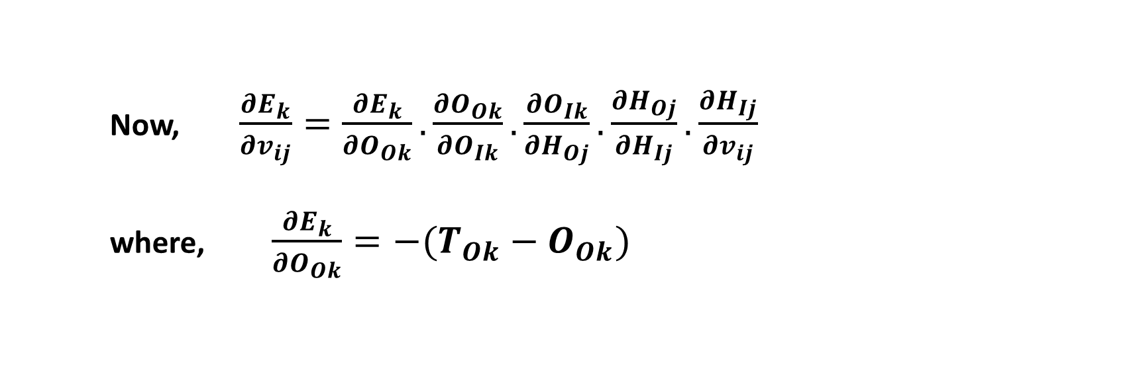

Now, $\frac{{∂E}_{k}}{{∂v}_{ij}}=\frac{{∂E}_{k}}{{∂O}_{Ok}}.\frac{{∂O}_{Ok}}{{∂O}_{Ik}}.\frac{{∂O}_{Ik}}{{∂H}_{Oj}}.\frac{{∂H}_{Oj}}{{∂H}_{Ij}}.\frac{{∂H}_{Ij}}{{∂v}_{ij}}$
where, $\frac{{∂E}_{k}}{{∂O}_{Ok}}=−(T_{Ok}−O_{Ok})$
$$\frac{∂O_{Ok}}{∂O_{Ik}}=a_{2}(1+O_{Ok})(1−O_{Ok})$$

Slide 13



$$\frac{∂O_{Ik}}{∂H_{Oj}}=w_{jk}$$
$$\frac{∂H_{Oj}}{∂H_{Ij}}=a_{1}H_{Oj}(1−H_{Oj})$$
$$\frac{∂H_{Ij}}{∂v_{ij}}=I_{Oi}=I_{Ii}$$
We get
$$\frac{∂E_{k}}{∂v_{ij}}={−a}_{1}a_{2}(T_{Ok}−O_{Ok})(1+O_{Ok})(1−O_{Ok})(1−H_{Oj})w_{jk}H_{Oj}I_{Ii}$$

Slide 14



Batch Mode of Training:
Let us consider L training scenarios. Mean Squared Deviation in prediction for k-th output neuron
The change in w_{jk} , that is , Δw_{jk} is determined as follows:
Now,
$$E^{′}=\frac{1}{2}.\frac{1}{L}\sum_{l=1}^{L}{{(T_{Okl}−O_{Okl})}^{2}}$$
$${∆w}_{jk}=−η.\frac{∂E^{′}}{∂w_{jk}}$$
$$\frac{∂E^{′}}{∂w_{jk}}=\frac{∂E^{′}}{∂E_{l}}.\frac{∂E_{l}}{∂E_{k}}.\frac{∂E_{k}}{∂O_{Ok}}.\frac{∂O_{Ok}}{∂O_{Ik}}.\frac{∂O_{Ik}}{∂w_{jk}}$$

Slide 15

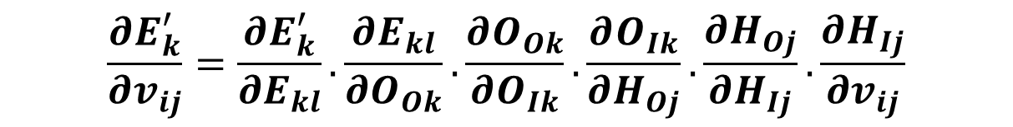

Similarly, Δv_{ij} can be calculated as follows:
Where
Now,
$${∆v}_{ij}=−η.{\left\{\frac{∂E^{′}}{∂v_{ij}}\right\}}_{av}$$
$${\left\{\frac{∂E^{′}}{∂v_{ij}}\right\}}_{av}=\frac{1}{p}\sum_{k=1}^{p}{\frac{∂E_{k}^{′}}{∂v_{ij}}}$$
$$\frac{∂E_{k}^{′}}{∂v_{ij}}=\frac{∂E_{k}^{′}}{∂E_{kl}}.\frac{∂E_{kl}}{∂O_{Ok}}.\frac{∂O_{Ok}}{∂O_{Ik}}.\frac{∂O_{Ik}}{∂H_{Oj}}.\frac{∂H_{Oj}}{∂H_{Ij}}.\frac{∂H_{Ij}}{∂v_{ij}}$$

Slide 16

Momentum Constant (α’)
Generalized Delta Rule:
$$∆w\left(t\right)=−η\frac{∂E}{∂w}\left(t\right)+α^{′}∆w\left(t−1\right)$$
η: (0.0 to 1.0)
α': (0.0 to 1.0)
α' is used to ensure a stable network even at a higher value of learning rate η

Slide 17
Notes:
BP algorithm → there is a chance of local minima problem
BP algorithm → transfer functions are to be differentiable in nature
BPNN may not be able to capture the dynamics of a highly dynamic process
Inputs are normalized
Connecting weights lie in the range of either (0.0, 1.0) or (-1.0,1.0)
Convergence Criterion: Absolute value of the rate of change of error in prediction becomes less than or equal to a pre-specified value
A neural network can be either fully-connected or partially-connected one

Slide 18
Multi-Layer Feed-Forward Neural Network (MLFFNN)
I_{I1}: Input of 1-st neuron lying on input layer
I_{O1}: Output of 1-st neuron lying on input layer

Slide 19
Advantages of BPNN
Can handle a problem having many variables
May not require so much problem information as that is needed for an FLC
Disadvantages of BPNN
Solutions of BPNN may get stuck at the local minima
Training of NN is more involved computationally compared to that of FLC
It works like a black box

Slide 20
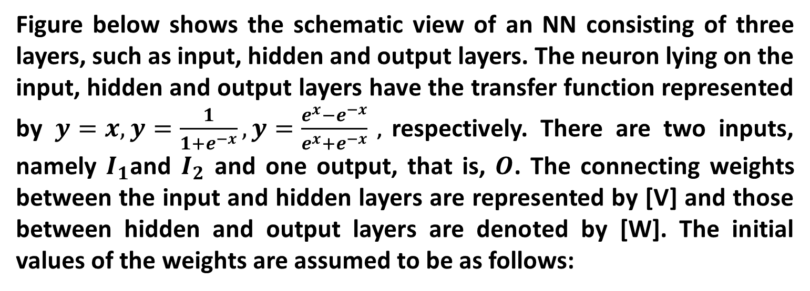
Numerical Example
Figure below shows the schematic view of an NN consisting of three layers, such as input, hidden and output layers. The neuron lying on the input, hidden and output layers have the transfer function represented by $y=x,y=\frac{1}{1+e^{−x}},y=\frac{e^{x}−e^{−x}}{e^{x}+e^{−x}}$ , respectively. There are two inputs, namely $I_{1}$and $I_{2}$ and one output, that is, $O$. The connecting weights between the input and hidden layers are represented by [V] and those between hidden and output layers are denoted by [W]. The initial values of the weights are assumed to be as follows:

Slide 21








[V]
[W]
1
$$V_{11}$$
$$V_{21}$$
$$W_{11}$$
I₁
1
$$V_{12}$$
$$W_{21}$$
O
$$V_{22}$$
2
1
I₂
$$V_{13}$$
2
$$V_{23}$$
$$W_{31}$$
3
Input
Layer
Hidden
Layer
Output
Layer

Slide 22
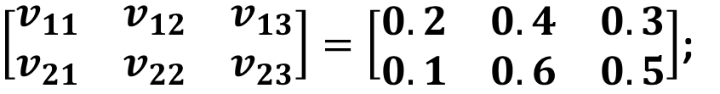
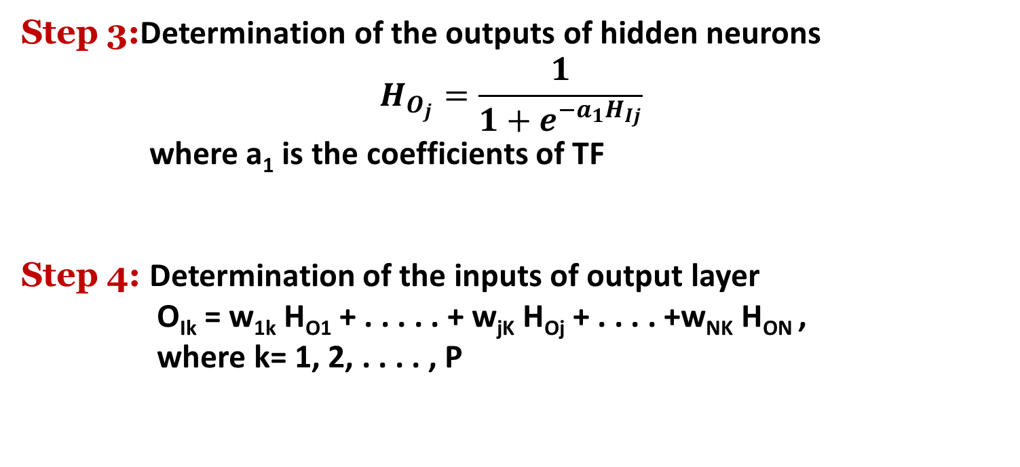
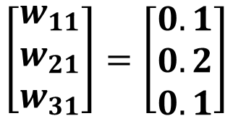
$\left[\begin{matrix}v_{11} & v_{12} & v_{13} \\ v_{21} & v_{22} & v_{23}\end{matrix}\right]=\left[\begin{matrix}0.2 & 0.4 & 0.3 \\ 0.1 & 0.6 & 0.5\end{matrix}\right]$;
Sl. No. | I₁ | I₂ | T_{O}
1 | 0.5 | -0.4 | 0.15
2 . . . | - . . . | - . . . | - . . .
$$\left[\begin{matrix}w_{11} \\ w_{21} \\ w_{31}\end{matrix}\right]=\left[\begin{matrix}0.1 \\ 0.2 \\ 0.1\end{matrix}\right]$$
Using an incremental mode of training for the case shown in the Table, calculate the changes in V (that is, $∆V$) and W (that is $∆W$) values during back-propagation of error, the learning rate $η$ is assumed to be equal to 0.2. Show only one iteration.

Slide 23
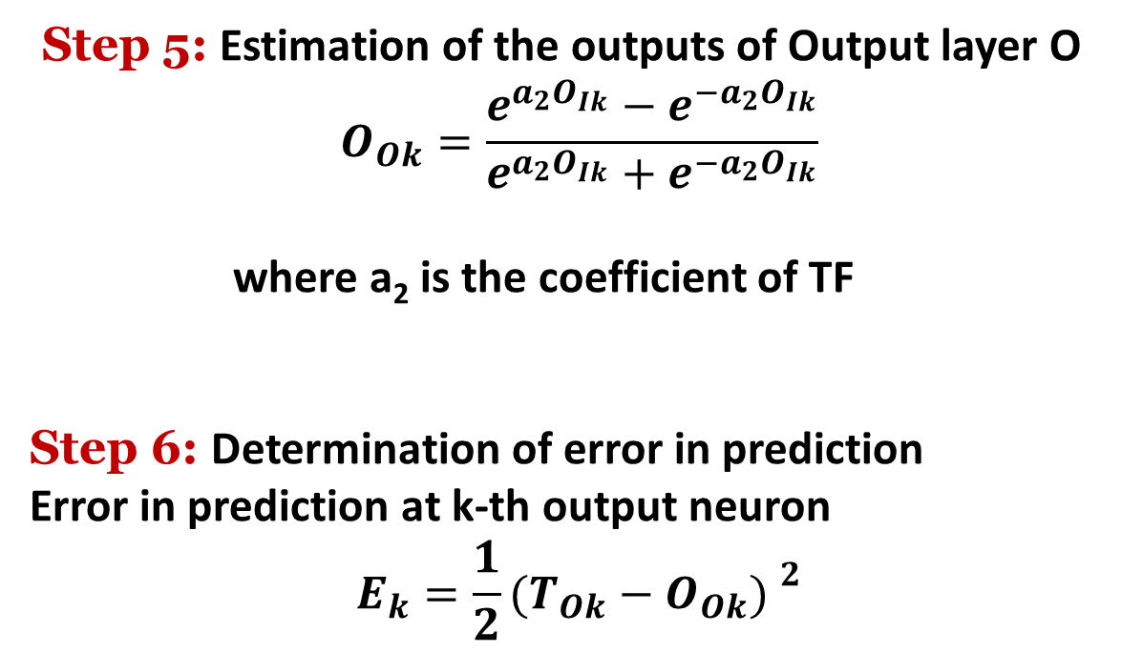
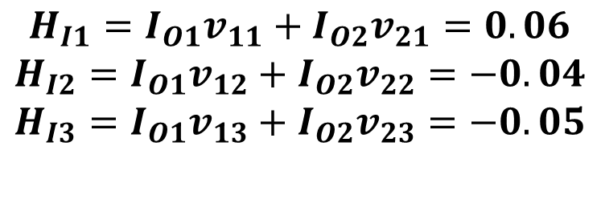
Solution:
Forward Calculations:
The neurons of input layer have linear transfer function (y=x). Therefore, the output of each input layer neuron is made equal to its corresponding input value.
$$I_{O1}=I_{I1}=0.5$$
$$I_{O2}=I_{I2}=−0.4$$
The inputs of different neurons of the hidden layer are calculated as follows:
$$H_{I1}=I_{O1}v_{11}+I_{O2}v_{21}=0.06$$
$$H_{I2}=I_{O1}v_{12}+I_{O2}v_{22}=−0.04$$
$$H_{I3}=I_{O1}v_{13}+I_{O2}v_{23}=−0.05$$

Slide 24
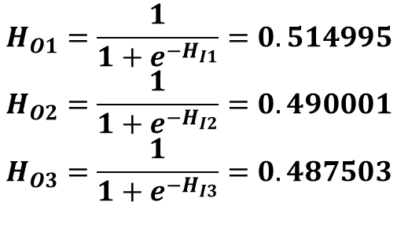
The neurons of the hidden layer are assumed to have log-sigmoid transfer function ($y=\frac{1}{1+e^{−x}}$). The outputs of different hidden neurons are determined like the following:
$$H_{O1}=\frac{1}{1+e^{−H_{I1}}}=0.514995$$
$$H_{O2}=\frac{1}{1+e^{−H_{I2}}}=0.490001$$
$$H_{O3}=\frac{1}{1+e^{−H_{I3}}}=0.487503$$

Slide 25
Now, the input of the output neuron can be calculated as follows:
$$O_{I1}=H_{O1}w_{11}+H_{O2}w_{21}+H_{O3}w_{31}=0.198249$$
As the output neuron has a tan-sigmoid transfer function, its output can be determined like the following:
$$O_{O1}=\frac{e^{OI1}−e^{−O_{I1}^{}}}{e^{OI1}{+e}^{−O_{I1}}}=0.195692$$
The squared error in prediction is found to be as follows:
$$E=\frac{1}{2}{(T_{O}−O_{O1})}^{2}=0.001044$$

Slide 26
Back-propagation Algorithm:
The change in $w_{11}$ can be determined using the procedure below.
$$∆w_{11}=−η\frac{∂E}{∂w_{11}},$$
$$\frac{∂E}{∂w_{11}}=\frac{∂E}{∂O_{O1}}\frac{∂O_{O1}}{∂O_{I1}}\frac{∂O_{I1}}{∂w_{11}}.$$
$$\frac{∂E}{∂O_{O1}}=−\left(T_{O}−O_{O1}\right)$$
$$\frac{∂O_{O1}}{∂O_{I1}}=\frac{4}{{(e^{OI1}{+e}^{−O_{I1}})}^{2}}$$
$$\frac{∂O_{I1}}{∂w_{11}}=H_{O1}.$$
where
Now,

Slide 27
Substituting the values of $T_{O}$, $O_{O1}$, $O_{I1},H_{O1}$in the last expression of $\frac{∂E}{∂w_{11}}$ we get
$$\frac{∂E}{∂w_{11}}=0.022630$$
Now, substituting the values of $\frac{∂E}{∂w_{11}}$ and $η$ in the expression of $∆w_{11},$we get
$$∆w_{11}=−0.004526$$
Similarly, we can determine $∆w_{21}$ and $∆w_{31}$ and these are found to be as follows:
$$∆w_{21}=−0.004306$$
$$∆w_{31}=−0.004284$$

Slide 28
The necessary change in $v_{11}$ can be obtained as follows:
$$∆v_{11}=−η\frac{∂E}{∂v_{11}}$$
$$\frac{∂E}{∂v_{11}}=\frac{∂E}{∂O_{O1}}\frac{∂O_{O1}}{∂O_{I1}}\frac{∂O_{I1}}{∂H_{O1}}\frac{∂H_{O1}}{∂H_{I1}}\frac{∂H_{I1}}{∂v_{11}}$$
where
$$\frac{∂E}{∂O_{O1}}=−\left(T_{O}−O_{O1}\right)$$
Now,
$$\frac{∂O_{O1}}{∂O_{I1}}=\frac{4}{{(e^{OI1}{+e}^{−O_{I1}})}^{2}}$$

Slide 29
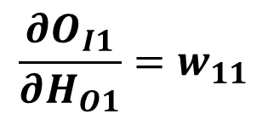
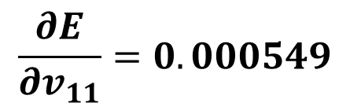
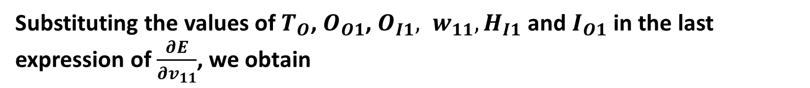
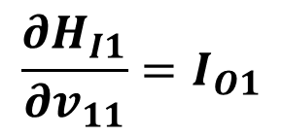
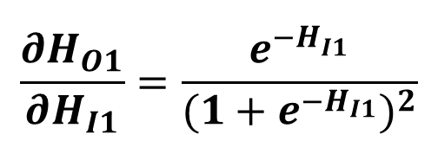
$$\frac{∂O_{I1}}{∂H_{O1}}=w_{11}$$
$$\frac{∂H_{O1}}{∂H_{I1}}=\frac{e^{−H_{I1}^{}}}{{(1+e^{−H_{I1}})}^{2}}$$
$$\frac{∂H_{I1}}{∂v_{11}}=I_{O1}$$
Substituting the values of $T_{O}$, $O_{O1}$, $O_{I1}, w_{11}, H_{I1}$and $I_{O1}$ in the last expression of $\frac{∂E}{∂v_{11}}$, we obtain
$$\frac{∂E}{∂v_{11}}=0.000549$$

Slide 30





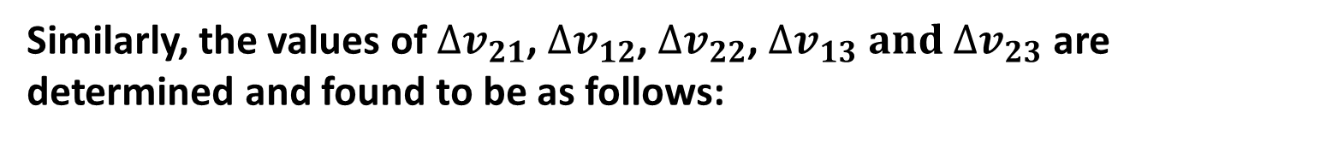
Now, substituting the values of $\frac{∂E}{∂v_{11}}$ and $η$, we get $∆v_{11}=−0.000110$
Similarly, the values of $∆v_{21}$, $∆v_{12}$, $∆v_{22}$, $∆v_{13} and$ $∆v_{23}$ are determined and found to be as follows:
$$∆v_{21}=0.000088$$
$$∆v_{12}=−0.000220$$
$$∆v_{22}=0.000176$$
$$∆v_{13}=−0.000110$$
$$∆v_{23}=0.000088$$

Slide 31
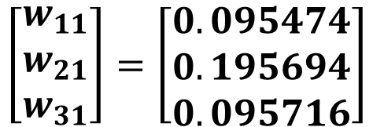
Therefore, the updated values of the weights are coming out to be as follows:
$\left[\begin{matrix}v_{11} & v_{12} & v_{13} \\ v_{21} & v_{22} & v_{23}\end{matrix}\right]=\left[\begin{matrix}0.199890 & 0.399780 & 0.299890 \\ 0.100088 & 0.600176 & 0.500088\end{matrix}\right]$;
$$\left[\begin{matrix}w_{11} \\ w_{21} \\ w_{31}\end{matrix}\right]=\left[\begin{matrix}0.095474 \\ 0.195694 \\ 0.095716\end{matrix}\right]$$

