Slide 1
Topic
Combined Genetic Algorithms and Fuzzy Logic

Slide 2
Combined Genetic Algorithms and Fuzzy Logic Technique
GAs and FLCs are combined in two different ways:
Fuzzy-Genetic Algorithm (FGA)
An FLC is used to improve the performance of a GA
Genetic-Fuzzy System (GFS)
A GA is utilized to improve the performance of an FLC
A Few Fuzzy-Genetic Algorithms
Global search power of a GA is combined with local search capability of an FLC
An FLC may be used to control the GA-parameters like probability of crossover, probability of mutation, population size etc.

Slide 3
Dynamic Parametric GA
FGA Proposed by Xu and Vukovich, 1993
Proposed by Li and Takagi, 1993
FLC’s were used to control the GA-parameters
Steps
Choose control parameters before the GA is run
Adjust the control parameters on-line to dynamically adapt to new situations
It assists the user in designing, implementing and validating the GA for a given task

Slide 4
Maximum no. of Generations
P_{m}
FLC
P_{c}
Population size
GA
3. FGA Proposed by Pratihar, 1998
A fuzzy logic technique was used to generate some feasible initial solutions for the GA
Used to solve find-path problems in robotics

Slide 5
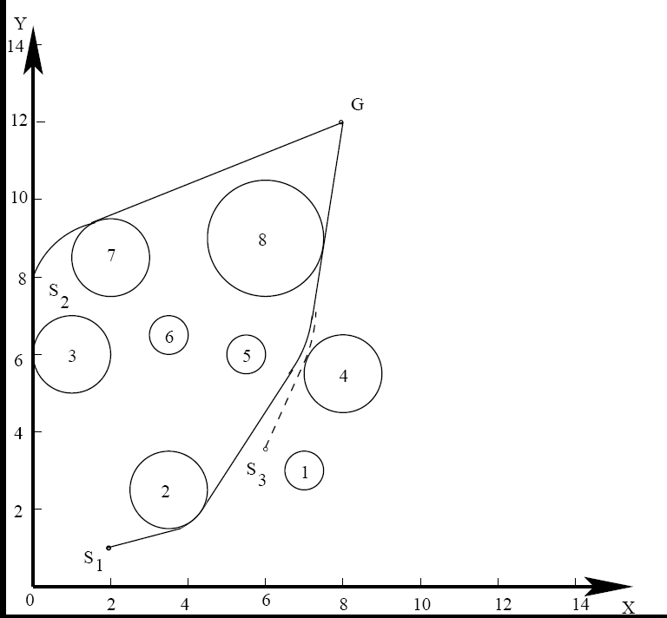
Find-Path Problems

Slide 6
Genetic-Fuzzy System
Performance of Fuzzy Logic Controller (FLC) depends on its KB
consisting of Data Base (DB) and Rule base (RB)
Nature-inspired Optimization Tool-based Tuning
Offline
KB of the FLC
Online
Inputs
FLC
Output

Slide 7
GFS (Contd.)
A GFS can be developed through the following ways:
Optimizing / Tuning the DB only
Optimizing / Tuning the RB only
Optimizing both the DB and RB

Slide 8
A Few GFS
Proposal by Karr, 1991
Proposal of Herrera etal., 1995
Proposals of RB optimization
Optimized DB of an FLC using a binary-coded GA keeping its previously defined RB fixed
Optimized DB of the FLC keeping its RB fixed
Trapezoidal memberships
Real-coded GA
Thrift (1991), Carse and Fogarity (1996), Magdalena and Monasterio (1997), velasco(1998), Ishibuchi et al.(1999), Gonzalez and Herrera (1997), Cordan et al. (1999), Golizalez and Perez (1999)

Slide 9
Pittsburgh Approach
One string or chromosome of the GA represents the entire RB of the FLC
Michigan Approach
The entire RB of the FLC is represented by the whole population of GA-strings
Iterative Rule Learning
In the first stage, a preliminary RB of the FLC is generated based on collected information of the process to be controlled. The generated RB is then modified in the second stage after removing the redundant rule(s)
4. Proposals for both DB and RB optimization
Lee and Takagi(1993), Cooper and Vidal(1993), Ng and Lee(1994), Lisk and Melsheimer(1994), Eiji Nawa etal.(1997), Pratihar (1999)

Slide 10
Working Principle of GFS
Approach 1: GA-based tuning of manually-constructed FLC
Approach 2: Automatic design of an FLC using a GA

Slide 11
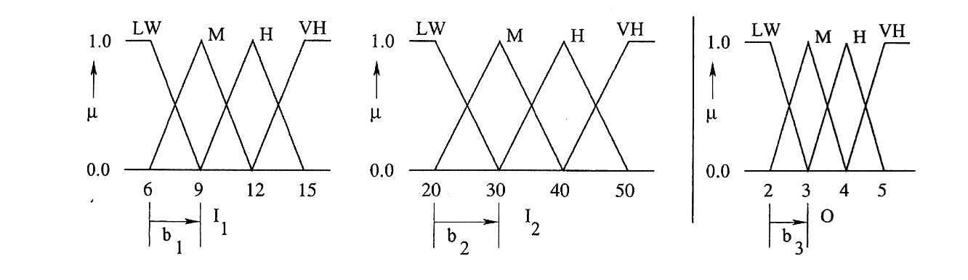
Developed Approaches
Approach 1 : GA–based tuning of manually constructed FLC
Numerical Example
A binary-coded GA is used to obtain optimal DB and RB of a fuzzy reasoning tool. There are two inputs: I₁ and I₂ and one output: O of the process. The membership function distributions of the inputs and output are shown below.

Slide 12
The manually-constructed RB is given below
 | I₂
I₁ |  | LW | M | H | VH
 | LW | LW | LW | M | H
 | M | LW | M | H | H
 | H | M | M | H | VH
 | VH | M | H | VH | VH

Slide 13
A binary-coded GA is used to optimize both DB as well as RB of the fuzzy reasoning tool with the help of a set of training cases (refer to the table given below.)
Sl. No. | I₁ | I₂ | O
1 | 10.0 | 28.0 | 3.5
2 | 14.0 | 15.0 | 4.0
. . . | . . . | . . . | . . .
T | 17.0 | 31.0 | 4.6

Slide 14
An initial population of the BCGA is created at random, as shown below
Sl. No. | GA-string
1 | 1011001101110111000101010111001
2 | 0110010110110100010101110110010
. . . | . . .
N | 1010001110101110100100110111011

Slide 15

Starting from the left most bit-position five bits are assigned to represent each of the b values (that is, b₁, b₂ and b₃) and the next 16 bits represent the RB of the fuzzy reasoning tool. Determine the deviation in prediction for the first training case by using the first GA-string. The b values are assumed to vary in the ranges given below.
$$2.0≤b_{1}≤4.0$$
$$5.0≤b_{2}≤15.0$$
$$0.5≤b_{3}≤1.5$$

Slide 16
Solution:
GA-string
10110 01101 11011 1000101010111001
b₁
b₂
b₃
RB
To determine the real value of b₁:
D.V. = 22
Using linear Mapping rule, we get
b₁ = 3.419355
Similarly, we get b₂ = 9.193548, b₃ = 1.370968

Slide 17
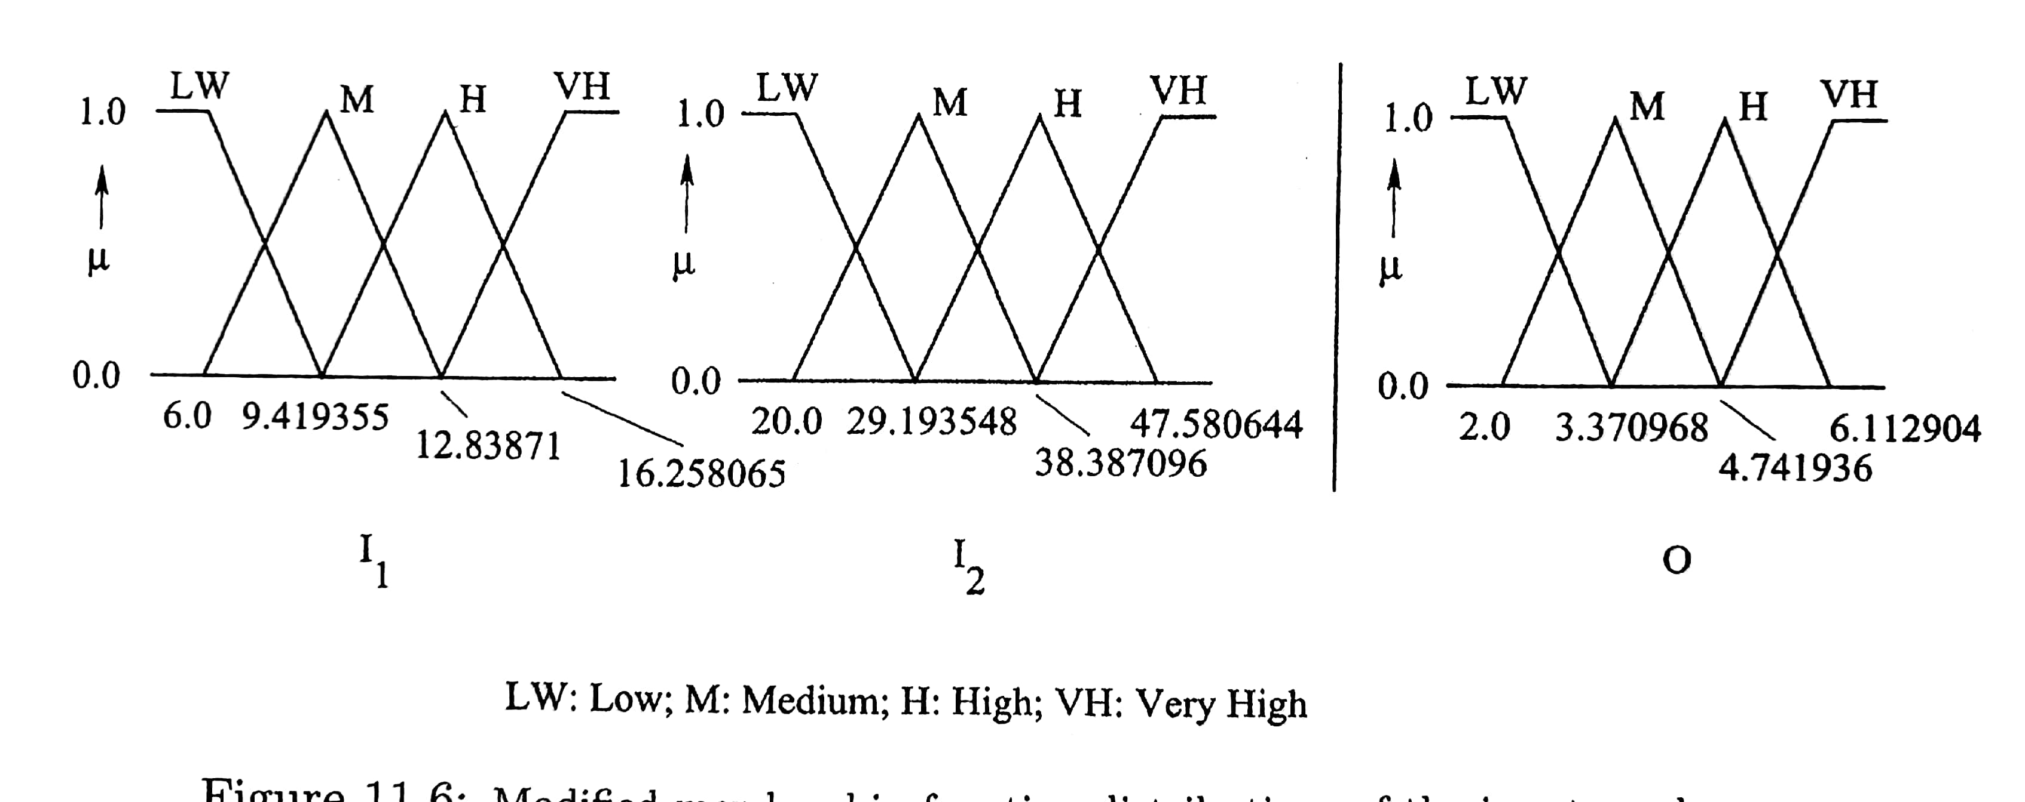
Corresponding to b₁, b₂ and b₃, the modified membership function distributions are found to be as follows:

Slide 18
Corresponding to the sub-string: 1000101010111001,
the RB is found to be as follows:
 |  |  | I₂
 |  | LW | M | H | VH
 | LW | LW | - | - | -
I₁ | M | LW | - | H | -
 | H | M | - | H | VH
 | VH | M | - | - | VH

Slide 19



For the inputs: $I_{1}=10.0,I_{2}=28.0$
The fired present rules are as follows:
If $I_{1}$ is M AND $I_{2}$ is LW Then O is LW,
If $I_{1}$ is H AND $I_{2}$ is LW Then O is M.
Membership values’ calculation
$∴μ_{M}=0.83$
M
$$\frac{μ_{M}}{1.0}=\frac{12.83871−10.0}{12.83871−9.419355}$$
1.0
$$μ_{M}$$
6.0
12.83871
9.419355
10.0

Slide 20
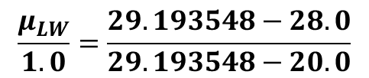


LW
1.0
$$μ_{LW}$$
29.193548
20.0
28.0
$$\frac{μ_{LW}}{1.0}=\frac{29.193548−28.0}{29.193548−20.0}$$
$$∴μ_{LW}=0.13$$

Slide 21






1st Fired Rule
M
LW
LW
$$μ_{M}$$
$$μ_{LW}$$
2.0
3.370968
$$10.0$$
$$28.0$$
$$I_{2}$$
O
$$I_{1}$$

Slide 22





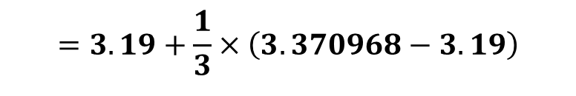



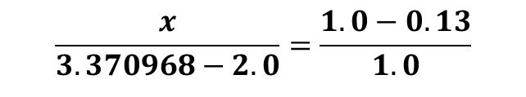
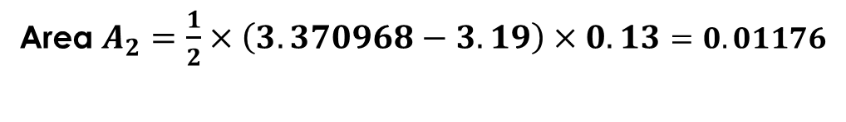
$$\frac{x}{3.370968−2.0}=\frac{1.0−0.13}{1.0}$$
A₁
1.0
A₂
$$⇒ x=1.19$$
$$x$$
Area $A_{1}=\left(3.19−2.0\right)×0.13$
0.13
$$=0.1547$$
3.370968
2.0
3.19
$C_{1}=$ Center of Area
$$=2.595$$
Area $A_{2}=\frac{1}{2}×\left(3.370968−3.19\right)×0.13=0.01176$
$C_{2}=$ Center of Area
$$=3.19+\frac{1}{3}×\left(3.370968−3.19\right)$$
$$=3.25$$

Slide 23


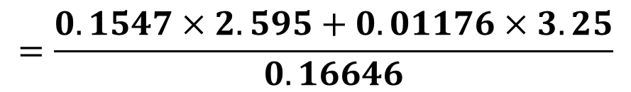


Total Area $A^{′}=A_{1}+A_{2}$
$$=0.16646$$
Center of combined area
$$C^{′}=\frac{A_{1}C_{1}+A_{2}C_{2}}{A_{1}+A_{2}}$$
$$=\frac{0.1547×2.595+0.01176×3.25}{0.16646}$$
$$=2.64$$

Slide 24







2nd Fired Rule
H
LW
M
$$μ_{H}=0.17$$
$$μ_{LW}=0.13$$
9.419355
16.258065
$$20.0$$
29.193548
2.0
4.471936
$$10.0$$
$$28.0$$
$$I_{1}$$
$$I_{2}$$
O

Slide 25



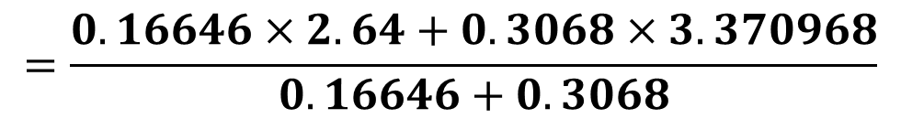
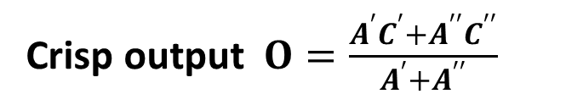
M
1.9785
Total area $A^{′′}=\frac{1}{2}×\left(1.9785+2.741936\right)×0.13$
$$=0.3068$$
0.13
Center of the fired area $C^{′′}=3.370968$
2.0
4.741936
3.370968
By using Center of Sums method of de-fuzzification:
Crisp output $O=\frac{A^{′}C^{′}+A^{′′}C^{′′}}{A^{′}+A^{′′}}$
$$=\frac{0.16646×2.64+0.3068×3.370968}{0.16646+0.3068}$$
$$=3.1138$$

Slide 26
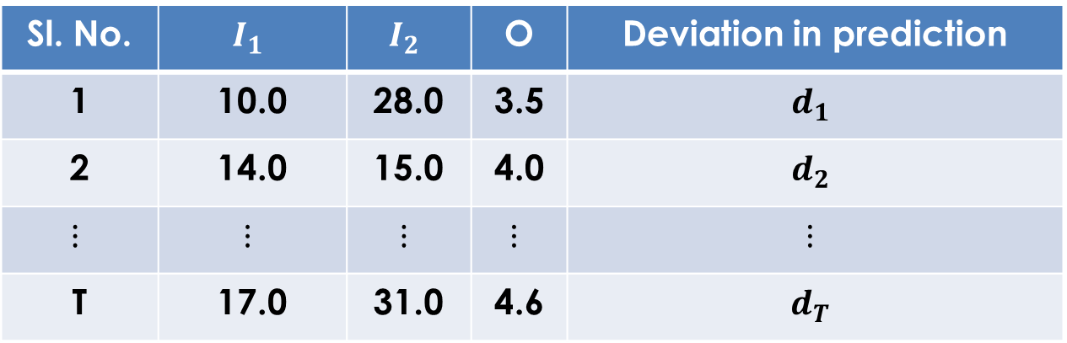
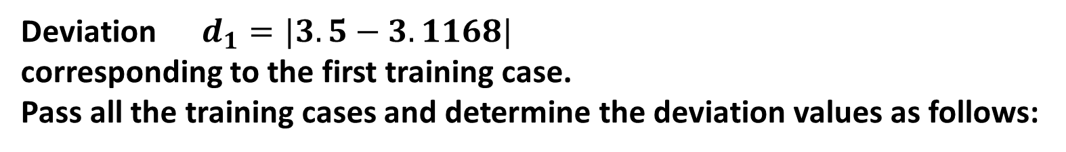

Deviation $d_{1}=|3.5−3.1168|$
corresponding to the first training case.
Pass all the training cases and determine the deviation values as follows:
$$=0.3832$$
Sl. No. | $$I_{1}$$ | $$I_{2}$$ | O | Deviation in prediction
1 | 10.0 | 28.0 | 3.5 | $$d_{1}$$
2 | 14.0 | 15.0 | 4.0 | $$d_{2}$$
$$⋮$$ | $$⋮$$ | $$⋮$$ | $$⋮$$ | $$⋮$$
T | 17.0 | 31.0 | 4.6 | $$d_{T}$$

Slide 27
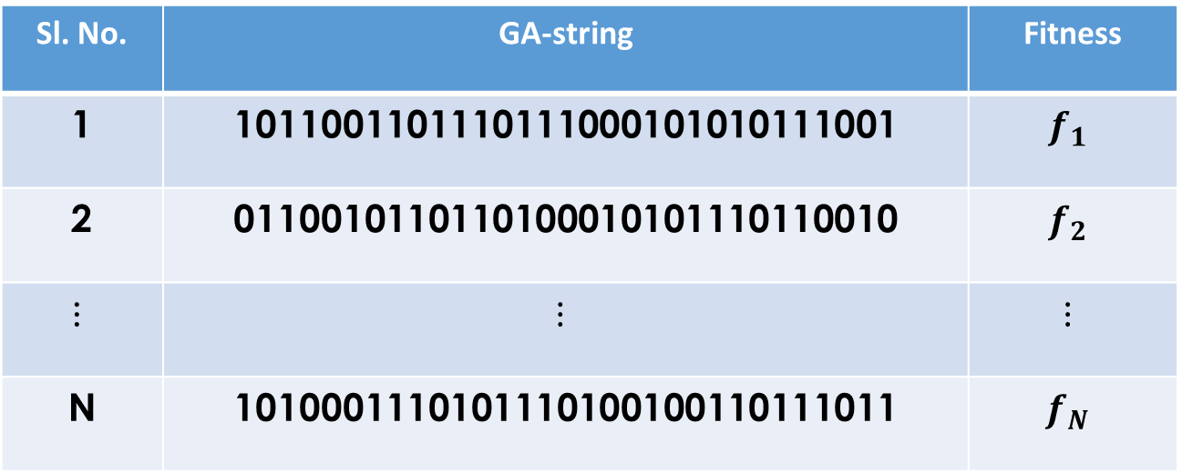
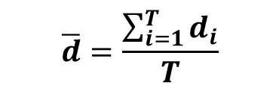
We calculate:
$$\overline{d}=\frac{\sum_{i=1}^{T}{d_{i}}}{T}$$
Sl. No. | GA-string | Fitness
1 | 1011001101110111000101010111001 | $$f_{1}$$
2 | 0110010110110100010101110110010 | $$f_{2}$$
$$⋮$$ | $$⋮$$ | $$⋮$$
N | 1010001110101110100100110111011 | $$f_{N}$$

Slide 28
Approach 2: Automatic design of FLC using GA
Let us consider the same numerical example given above for Approach 1. However, it is assumed that RB used in Approach 1 is missing. As there are four linguistic terms for each of the two variables, there are 4 x 4 = 16 possible combinations of them. The output of each of these 16 rules is not pre-defined and this task of determining an appropriate RB is given to the GA. As four linguistic terms are used to represent the output, only two bits may be used to represent each of them. For example, the linguistic terms: LW, M, H, and VH are indicated by 00, 01, 10 and 11, respectively. Thus, the GA-string will be 5 + 5 + 5 + 16 + 2 x 16 = 63-bits long. Table A shows the population of GA-strings. Determine the deviation in prediction for the first training scenario:

Slide 29
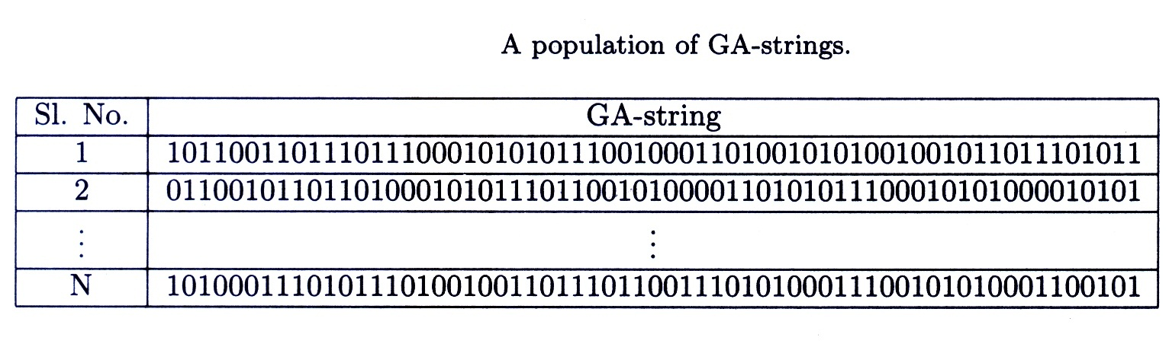
Table A

Slide 30
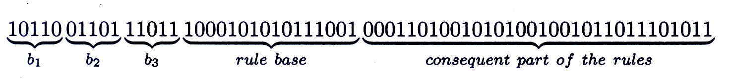
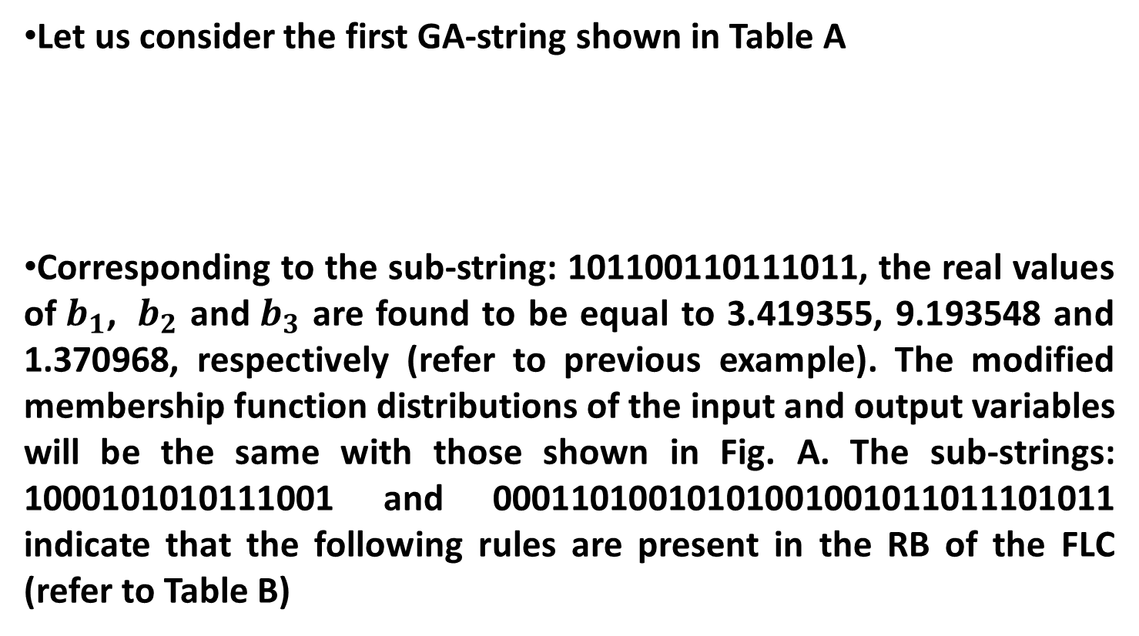
Approach 2 (contd.)
Let us consider the first GA-string shown in Table A
Corresponding to the sub-string: 101100110111011, the real values of${ b}_{1}$, ${ b}_{2}$ and${ b}_{3}$ are found to be equal to 3.419355, 9.193548 and 1.370968, respectively (refer to previous example). The modified membership function distributions of the input and output variables will be the same with those shown in Fig. A. The sub-strings: 1000101010111001 and 00011010010101001001011011101011 indicate that the following rules are present in the RB of the FLC (refer to Table B)

Slide 31
Corresponding to b₁, b₂ and b₃, the modified membership function distributions are found to be as follows:
Fig. A

Slide 32
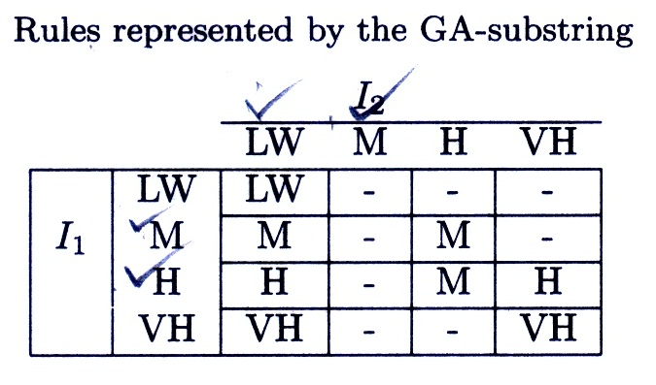
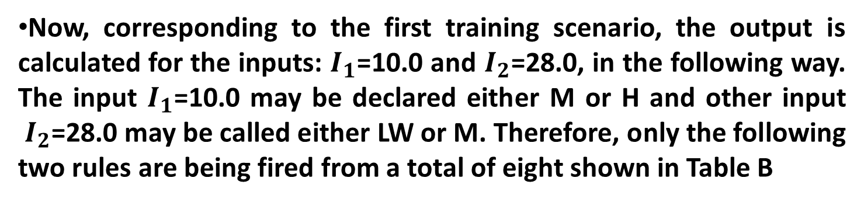
Now, corresponding to the first training scenario, the output is calculated for the inputs: $I_{1}$=10.0 and $I_{2}$=28.0, in the following way. The input $I_{1}$=10.0 may be declared either M or H and other input ${ I}_{2}$=28.0 may be called either LW or M. Therefore, only the following two rules are being fired from a total of eight shown in Table B
Table B

Slide 33
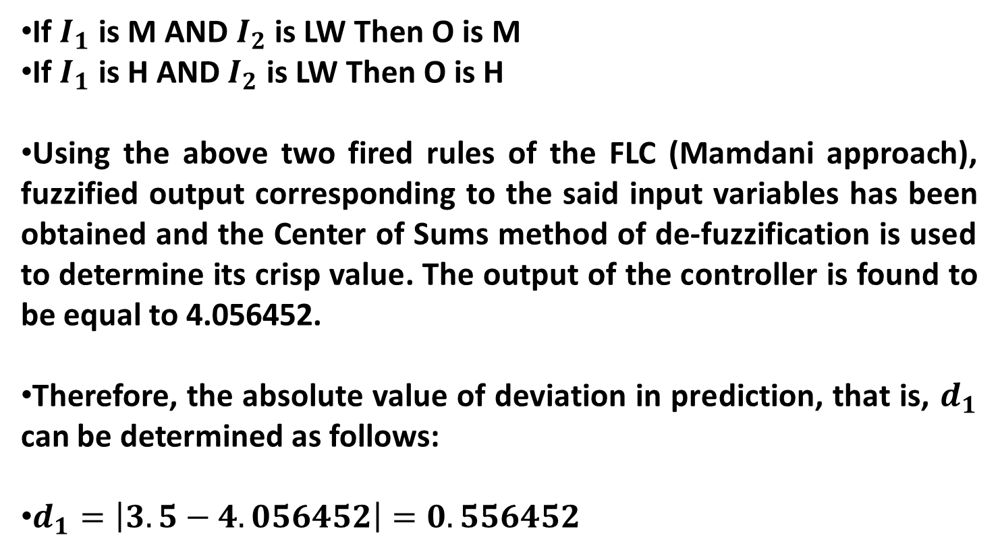
If $I_{1}$ is M AND $I_{2}$ is LW Then O is M
If $I_{1}$ is H AND $I_{2}$ is LW Then O is H
Using the above two fired rules of the FLC (Mamdani approach), fuzzified output corresponding to the said input variables has been obtained and the Center of Sums method of de-fuzzification is used to determine its crisp value. The output of the controller is found to be equal to 4.056452.
Therefore, the absolute value of deviation in prediction, that is, $d_{1}$ can be determined as follows:
$d_{1}=\left|3.5−4.056452\right|=0.556452$

Slide 34
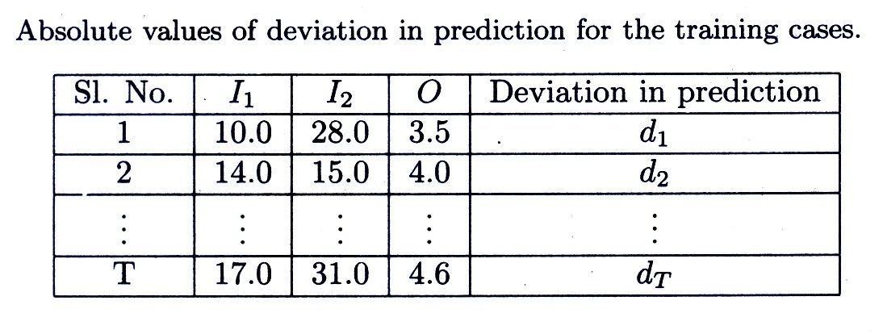
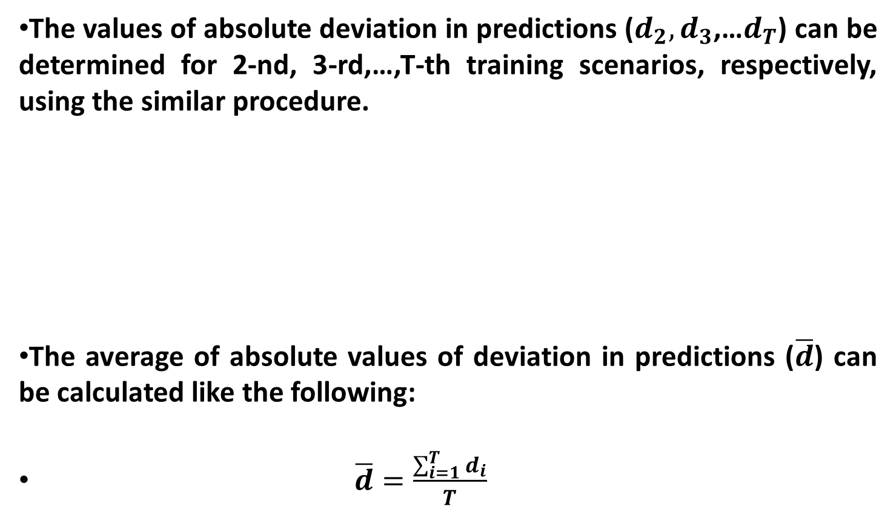
The values of absolute deviation in predictions ($d_{2},d_{3}$,…$d_{T}$) can be determined for 2-nd, 3-rd,…,T-th training scenarios, respectively, using the similar procedure.
The average of absolute values of deviation in predictions ($\overline{d}$) can be calculated like the following:
$\overline{d}=\frac{\sum_{i=1}^{T}{d_{i}}}{T}$

Slide 35
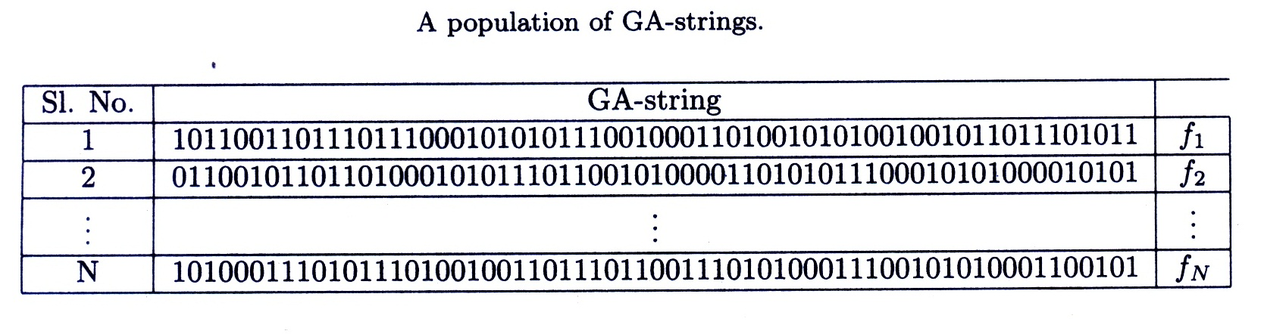
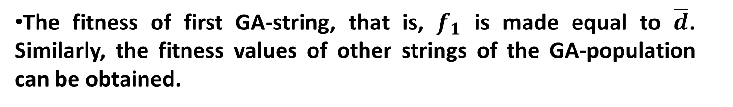
The fitness of first GA-string, that is, $f_{1}$ is made equal to $\overline{d}$. Similarly, the fitness values of other strings of the GA-population can be obtained.

Slide 36
The population of GA-strings is modified utilizing different operators, such as reproduction, crossover and mutation.
Note: The GA-optimized RB of the FLC obtained above may contain some redundant rules. To identify the redundant rules, the concept of importance factor has been used. To determine the importance of a rule, both its probability of occurrence as well as worth have been considered.

