Slide 1
Topic 1: PRINCIPLE OF OPTIMIZATION
PROF. (DR.) DILIP KUMAR PRATIHAR
MECHANICAL ENGINEERING DEPARTMENT, IIT KHARAGPUR

Slide 2
What do we mean by optimization? Why do we need it?
Optimization is the process of finding the best solution out of all feasible ones
Example: Selecting the most appropriate wooden pointer
To get efficient and cost effective design

Slide 3
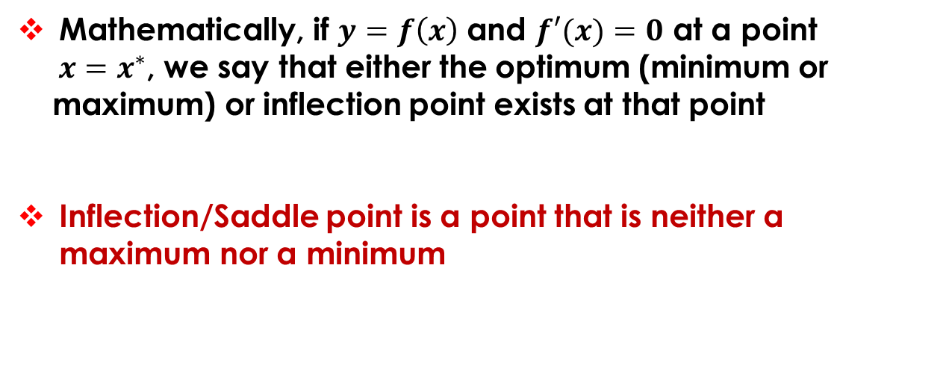
Mathematically, if $y=f\left(x\right)$ and $f′(x)=0$ at a point
$x=x^{∗}$, we say that either the optimum (minimum or
maximum) or inflection point exists at that point
Inflection/Saddle point is a point that is neither a maximum nor a minimum

Slide 4
For further investigation of the nature of the point, let n be the first non-zero higher order derivative
Two Cases:
If n is odd, x* is an inflection point,
If n is found to be an even number
If the value of derivative is seen to be positive
→ x* is a local minimum point,
If the value of the derivative is found to be negative
→ x* is a local maximum point.

Slide 5
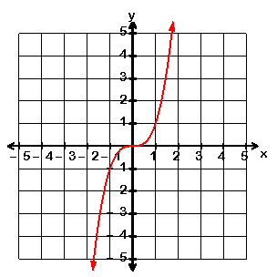
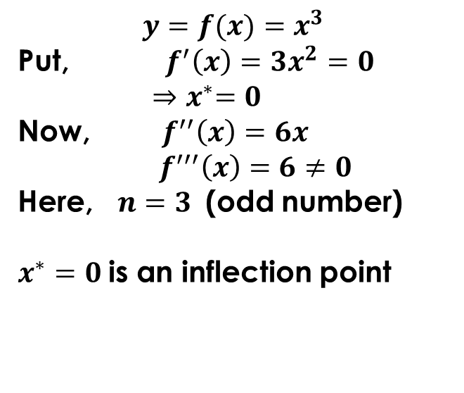
A Numerical Example
Determine the minimum/ maximum/ inflection point of $f(x)=x^{3 }$
$$y=f(x)=x^{3 }$$
Put, $f^{′}\left(x\right)=3x^{2}=0$
${⇒x}^{∗}=0$
Now, ${ f}^{′′}\left(x\right)=6x$
${ f}^{′′′}\left(x\right)=6≠0$
Here, $n=3$ (odd number)
$x^{∗}=0$ is an inflection point

Slide 6
How can we represent an optimization problem?
Wooden Pointer
d
L
Conditions: Light in weight ; No mechanical breakage ; Deflection of pointing end is negligible
Here, d and L : Design/Decision variables;
ρ : pre-assigned parameter

Slide 7
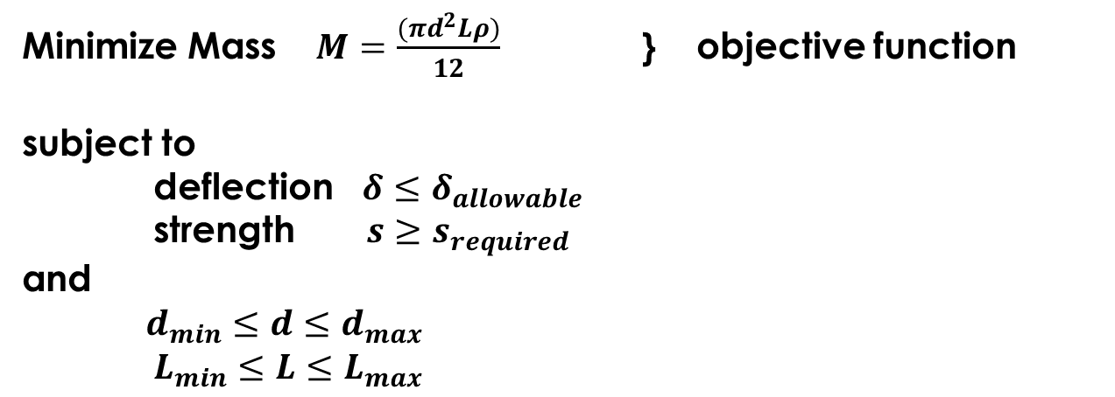
Mathematical Formulation
Minimize Mass $M=\frac{(πd^{2}Lρ)}{12}$} objective function
subject to
deflection $δ≤δ_{allowable}$
strength $s≥s_{required}$
and
$d_{min}≤d≤d_{max}$
$L_{min}≤L≤L_{max}$
}
Functional or
behavior constraints
}
Geometric or
Side constraints or
Variables’ ranges

Slide 8
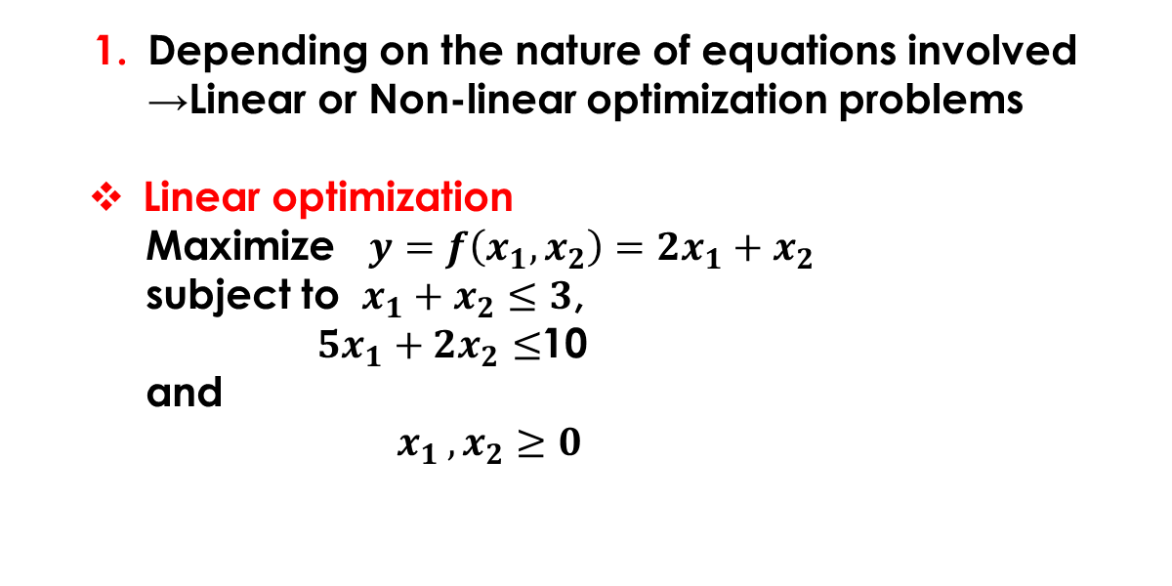
Classification of Optimization Problems
Depending on the nature of equations involved
→Linear or Non-linear optimization problems
Linear optimization
Maximize $y=f\left(x_{1},x_{2}\right)=2x_{1}+x_{2}$
subject to $x_{1}+x_{2}≤3$,
${5x}_{1}+{2x}_{2}≤$10
and
$x_{1 },x_{2}≥0$

Slide 9
Non-linear optimization
Either the objective function or any of the functional
constraints is non-linear
Based on the existence of any functional constraint
Un-constrained optimization problem: No functional constraint
Constrained optimization problem: At least one functional constraint is present

Slide 10
Depending on the nature of the design variables
Integer Programming Problem: All design variables take integer values
Real-valued Programming Problem: All design variables take real values
Mixed-integer Programming Problem: Some of the variables are integers and the remaining variables take real values

Slide 11
Static vs Dynamic Optimization Problems
Static optimization problem: a, b do not depend on L
P
a
b
L

Slide 12
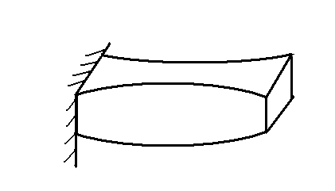
Dynamic optimization problem : a, b are dependent on L
P
a(x)
b(x)
x
L
c

Slide 13
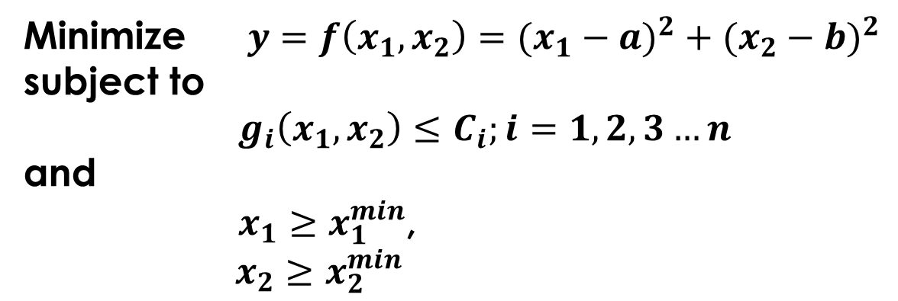
How does an optimization tool work?
Constrained Optimization Problem
Minimize $y=f\left(x_{1},x_{2}\right)=(x_{1}−a)^{2}+(x_{2}−b)^{2}$
subject to
$g_{i}\left(x_{1},x_{2}\right)≤C_{i};i=1,2,3…n$
and
$x_{1}≥x_{1}^{min}$,
$x_{2}≥x_{2}^{min}$

Slide 14
Principle of optimization

Slide 15
Free Points: The points residing the feasible zone are called free points
Bound points: The points lying on boundary of the feasible zone are called bound points
Note: Optimal solution can be either a free point or a bound point

Slide 16
Topic 2: TRADITIONAL METHODS OF OPTIMIZATION
PROF. (DR.) DILIP KUMAR PRATIHAR
MECHANICAL ENGINEERING DEPARTMENT, IIT KHARAGPUR

Slide 17
Conventional Optimization Methods
Linear Programming
Methods
Graphical Method
Simplex Method
Non-linear Programming Methods
Specialized Algorithms
Integer programming
Geometric programming
Dynamic programming

Slide 18
Single Variable problems
Multi-Variable problems
Analytical Method
Numerical Methods
Exhaustive Search
Dichotomous search
Fibonacci Method
Golden section Method

Slide 19
Direct search Methods
Random Search Methods
2. Pattern Search Methods
Gradient-based Methods
1. Steepest Descent Method etc..

Slide 20
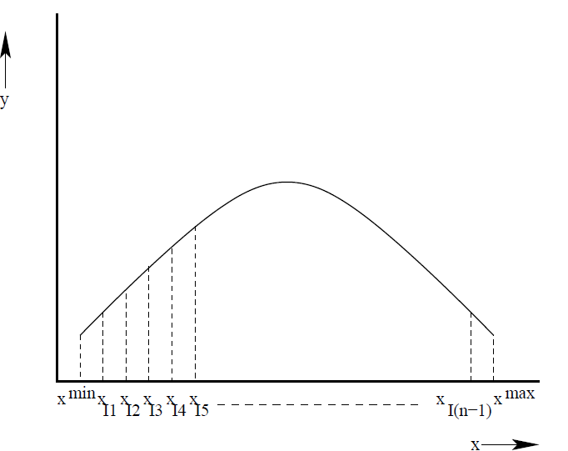
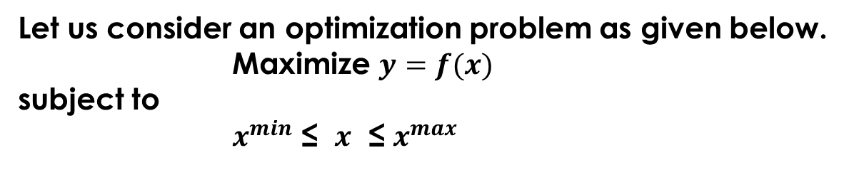
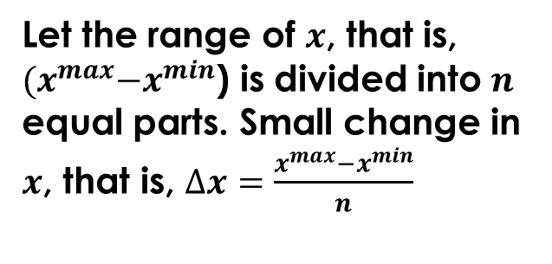
Exhaustive Search Method
Let us consider an optimization problem as given below.
Maximize $y=f(x)$
subject to
$x^{min}$ ≤ $x$ ≤ $x^{max}$
Let the range of $x$, that is, ${(x}^{max}−x^{min}$) is divided into $n$ equal parts. Small change in $x$, that is, $∆x=\frac{x^{max}−x^{min}}{n}$

Slide 21
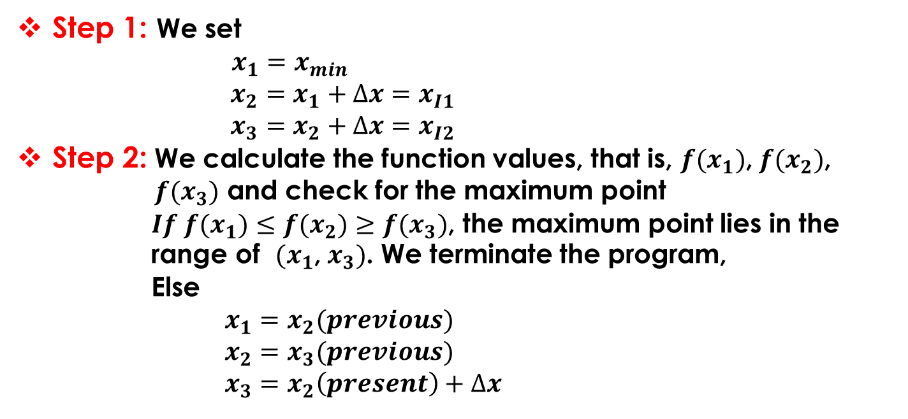
Step 1: We set
$x_{1}=x_{min}$
$x_{2}=x_{1}+∆x=x_{I1}$
$x_{3}=x_{2}+∆x=x_{I2}$
Step 2: We calculate the function values, that is, $f(x_{1})$, $f(x_{2})$,
$f(x_{3})$ and check for the maximum point
$If f(x_{1})≤f(x_{2})≥f(x_{3})$, the maximum point lies in the
range of ${(x}_{1}$, $x_{3})$. We terminate the program,
Else
$x_{1}=x_{2}(previous)$
$x_{2}=x_{3}(previous)$
$x_{3}=x_{2}\left(present\right)+∆x$

Slide 22
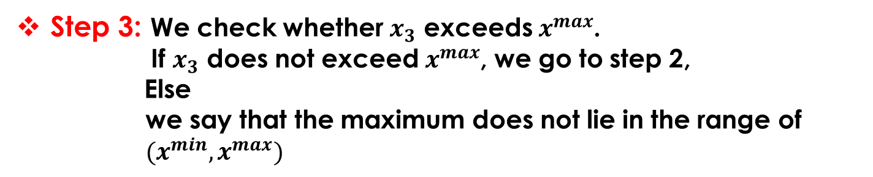
Step 3: We check whether $x_{3}$ exceeds $x^{max}$.
If $x_{3}$ does not exceed $x^{max}$, we go to step 2,
Else
we say that the maximum does not lie in the range of
$(x^{min},x^{max})$

Slide 23
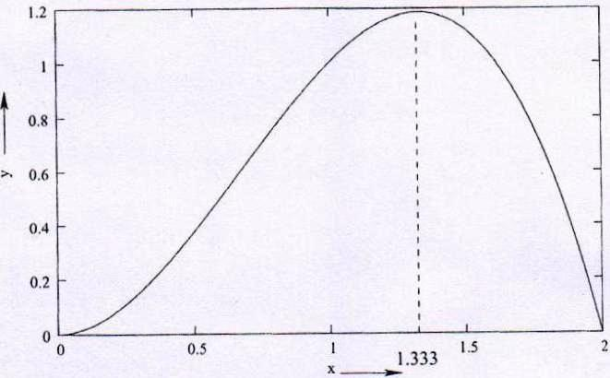
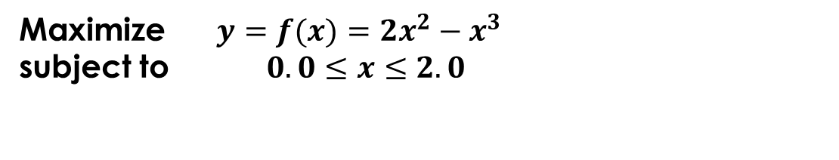
A Numerical Example
Maximize $y=f(x)={2x^{2}−x}^{3 }$
subject to $0.0≤x≤2.0$

Slide 24





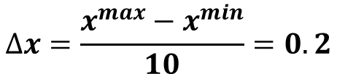

$$x^{min}=0 ;$$
$$x^{max}=2.0 ;$$
$$n=10$$
$$∆x=\frac{x^{max}−x^{min}}{10}=0.2$$
We set,
$$x_{1}=x^{min}=0.0$$
$$x_{2}=x_{1}+∆x=0.2$$
$$x_{3}=x_{2}+∆x=0.4$$

Slide 25




We determine function values:
$$f\left(x_{1}\right)=f\left(0.0\right)=0.0$$
$$f\left(x_{2}\right)=f\left(0.2\right)=0.072$$
$$f\left(x_{3}\right)=f\left(0.4\right)=0.256$$
Therefore,
$$f(x_{1})<f(x_{2})<f(x_{3})$$
Thus, the maximum does not lie in the interval (0.0, 0.4)

Slide 26
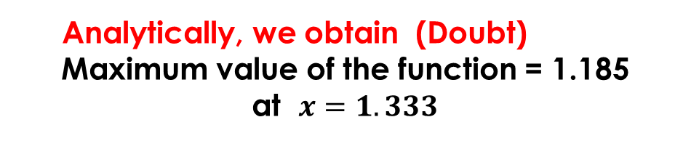



We set:
$$x_{1}=x_{2}(previous)=0.2$$
$$x_{2}=x_{3}(previous)=0.4$$
$$x_{3}=x_{2}\left(present\right)+∆x=0.6$$
Calculate the function values and check.
Analytically, we obtain (Doubt)
Maximum value of the function = 1.185
at $x=1.333$

Slide 27
Random Walk Method
Direct search method, where the search is carried out using the objective function value
No derivative information is required

Slide 28
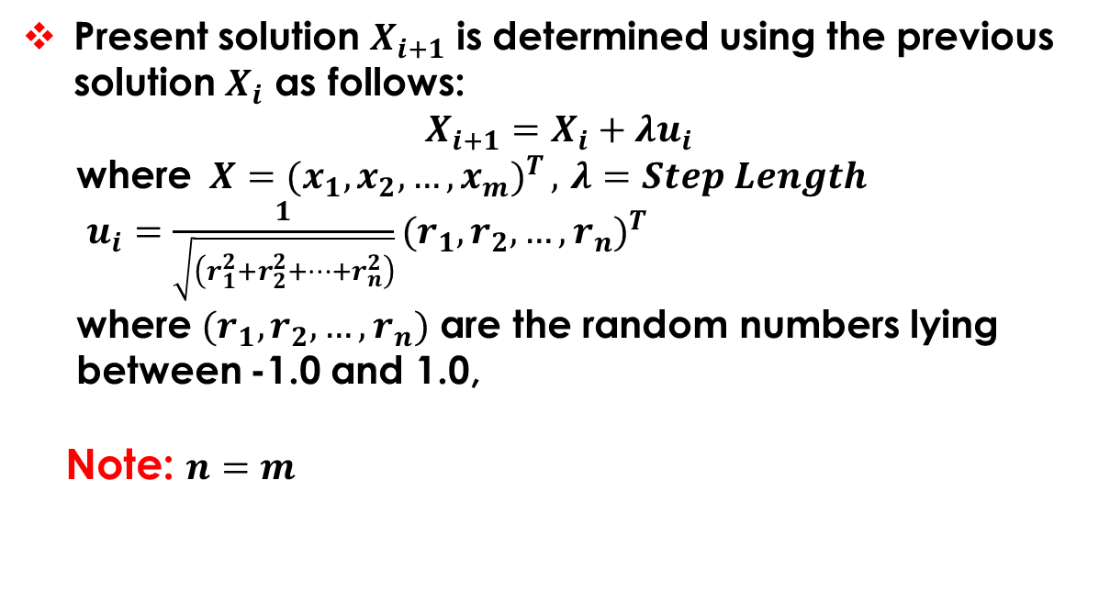
Present solution $X_{i+1}$ is determined using the previous solution $X_{i}$ as follows:
$$X_{i+1}=X_{i}+λu_{i}$$
where $X=(x_{1}{,x_{2},…,x_{m})}^{T},$ $λ=Step Length$
$u_{i}=\frac{1}{\sqrt{\left(r_{1}^{2}+r_{2}^{2}+…+r_{n}^{2}\right)}}(r_{1}{,r_{2},…,r_{n})}^{T}$
where $(r_{1},r_{2},…,r_{n})$ are the random numbers lying
between -1.0 and 1.0,
Note: $n=m$

Slide 29
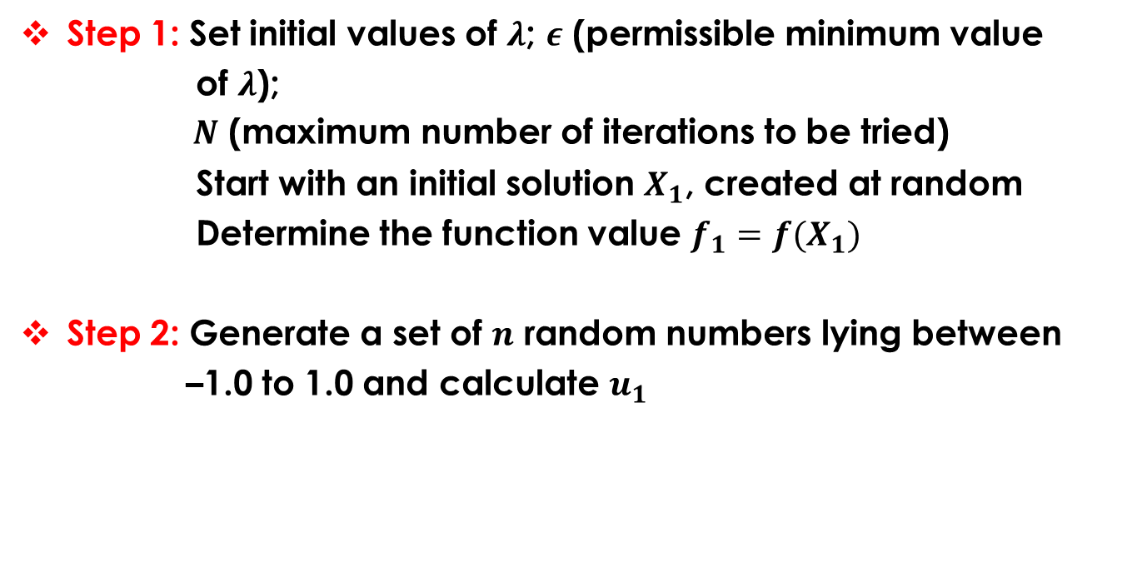
Step 1: Set initial values of $λ$; $ε$ (permissible minimum value
of $λ$);
$N$ (maximum number of iterations to be tried)
Start with an initial solution $X_{1}$, created at random
Determine the function value $f_{1}=f(X_{1})$
Step 2: Generate a set of $n$ random numbers lying between
–1.0 to 1.0 and calculate $u_{1}$

Slide 30
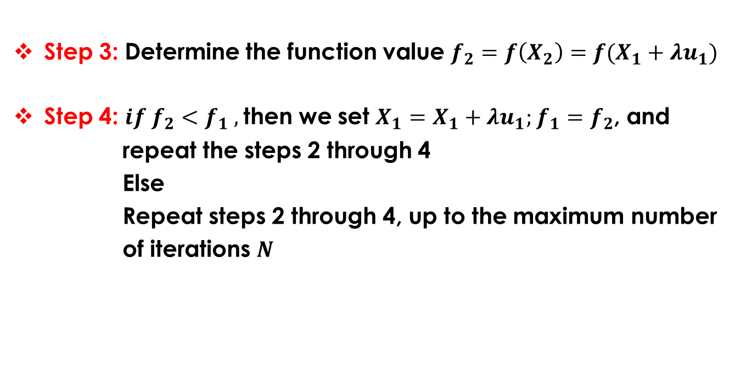
Step 3: Determine the function value $f_{2}=f\left(X_{2}\right)=f(X_{1}+λu_{1})$
Step 4: $if f_{2}<f_{1} ,$then we set $X_{1}=X_{1}+λu_{1};$ $f_{1}=f_{2}$, and
repeat the steps 2 through 4
Else
Repeat steps 2 through 4, up to the maximum number
of iterations $N$

Slide 31
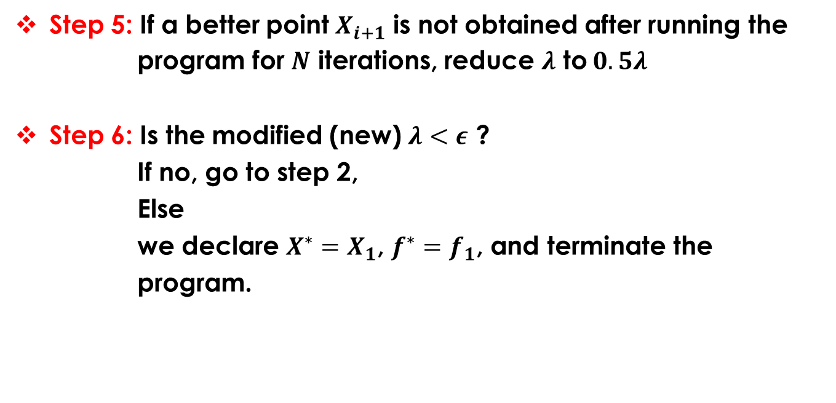
Step 5: If a better point $X_{i+1}$ is not obtained after running the
program for $N$ iterations, reduce $λ$ to $0.5λ$
Step 6: Is the modified (new) $λ<ε$ ?
If no, go to step 2,
Else
we declare $X^{∗}=X_{1}$, $f^{∗}=f_{1}$, and terminate the
program.

Slide 32
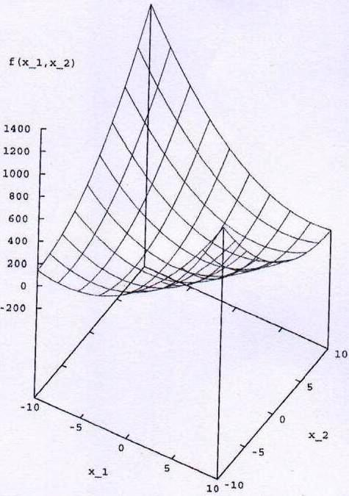
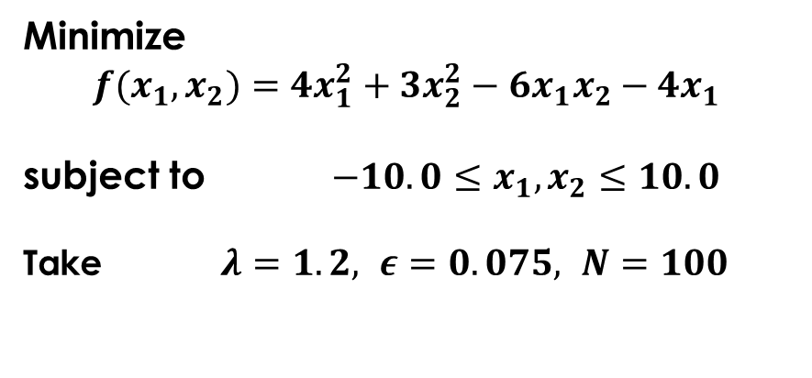
A Numerical Example
Minimize
$$f(x_{1},x_{2})={4x_{1}^{2}+3x_{2}^{2}−6x_{1}x_{2}−4x_{1}}^{ }$$
subject to $−10.0≤x_{1},x_{2}≤10.0$
Take $λ=1.2, ε=0.075, N=100$

Slide 33

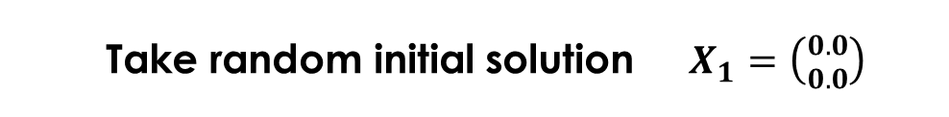
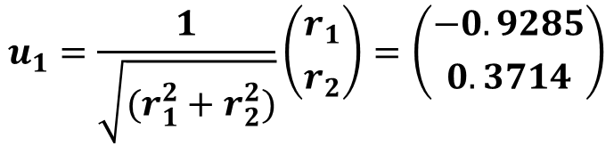
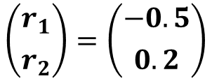
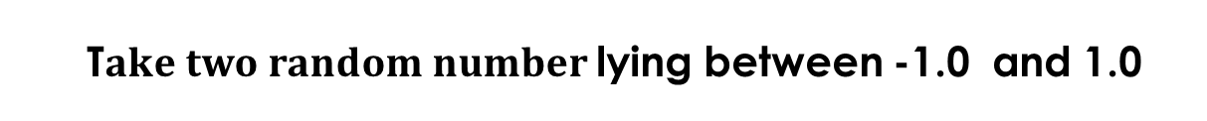
Iteration 1:
Take random initial solution $X_{1}=\left({0.0 \atop 0.0}\right)$
Function value $f_{1}=f\left(X_{1}\right)=0.0$
T$ake two random number$lying between -1.0 and 1.0
$$\left({r_{1} \atop r_{2}}\right)=\left({−0.5 \atop 0.2}\right)$$
Unit random vector
$$u_{1}=\frac{1}{\sqrt{(r_{1}^{2}+r_{2}^{2})}}\left({r_{1} \atop r_{2}}\right)=\left({−0.9285 \atop 0.3714}\right)$$

Slide 34

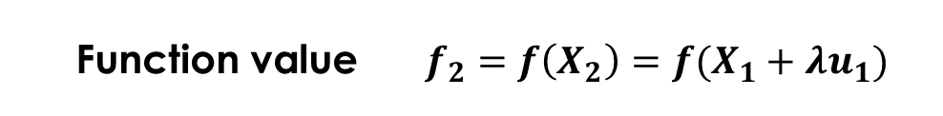

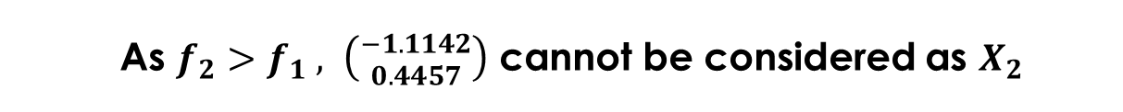
$$X_{2}=X_{1}+λu_{1}$$
Function value $f_{2}=f\left(X_{2}\right)=f(X_{1}+λu_{1})$
$$=f\left(−1.1142,0.4457\right)=12.9981$$
As $f_{2}>f_{1} , \left({−1.1142 \atop 0.4457}\right)$ cannot be considered as $X_{2}$
Go to the next iteration

Slide 35
Steepest Descent Method
It is the gradient-based method
Not applicable to a discontinuous function

Slide 36
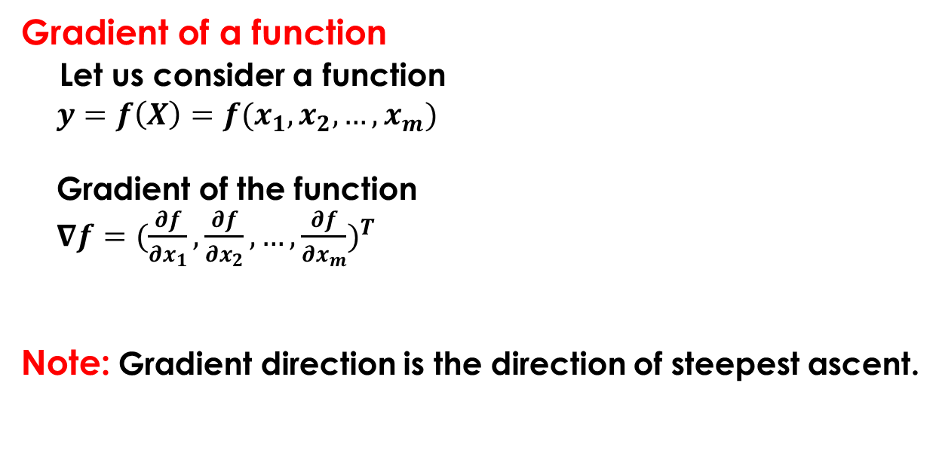
Gradient of a function
Let us consider a function
$y=f\left(X\right)=f(x_{1},x_{2},…,x_{m})$
Gradient of the function
$∇f=(\frac{∂f}{∂x_{1}}{,\frac{∂f}{∂x_{2}},…,\frac{∂f}{∂x_{m}})}^{T}$
Note: Gradient direction is the direction of steepest ascent.

Slide 37
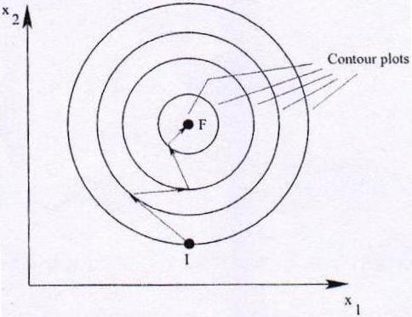

Principle of the Method
Start with an initial random solution $X_{1}$ and move along the search direction according to the rule given below.
$X_{i+1}=X_{i}+λ_{i}×S_{i}$ ,
where the search direction $S_{i}=−∇f_{i}$

Slide 38
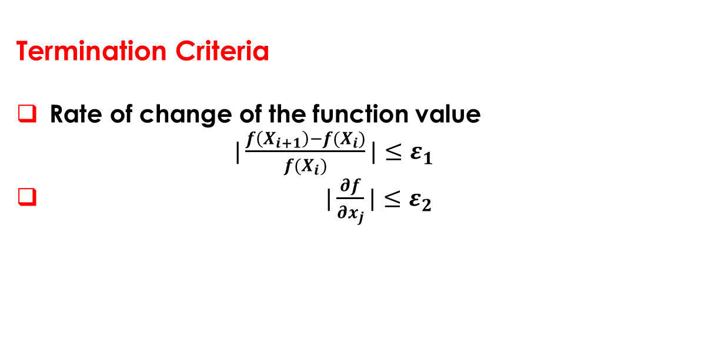
Termination Criteria
Rate of change of the function value
$|\frac{f\left(X_{i+1}\right)−f(X_{i})}{f(X_{i})}|≤ε_{1}$
$|\frac{∂f}{∂x_{j}}|≤ε_{2}$

Slide 39
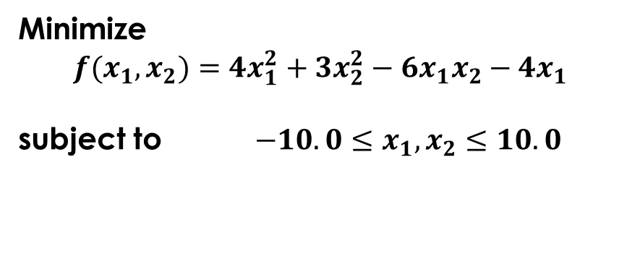
A Numerical Example
Minimize
$$f(x_{1},x_{2})={4x_{1}^{2}+3x_{2}^{2}−6x_{1}x_{2}−4x_{1}}^{ }$$
subject to $−10.0≤x_{1},x_{2}≤10.0$

Slide 40


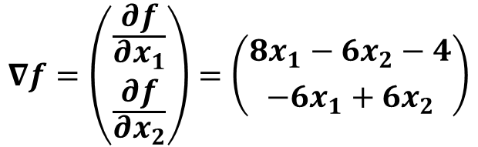
Iteration 1:
Take initial random solution $X_{1}=\left({0.0 \atop 0.0}\right)$
Function value $f_{1}=f\left(X_{1}\right)=0.0$
Gradient of the function
$$∇f=\left({\frac{∂f}{∂x_{1}} \atop \frac{∂f}{∂x_{2}}}\right)=\left({8x_{1}−6x_{2}−4 \atop −6x_{1}+6x_{2}}\right)$$
$$∇f_{1}=∇f\left(X_{1}\right)=\left({−4 \atop 0}\right)$$

Slide 41


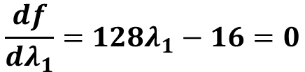




Search direction $S_{1}=−∇f_{1}=\left({4 \atop 0}\right)$
$$X_{2}=X_{1}+λ_{1}^{∗}S_{1}$$
To determine optimal step length $λ_{1}^{∗}$
$$f\left(X_{2}\right)=f\left(X_{1}+λ_{1}S_{1}\right)=f(4λ_{1} , 0)$$
$$=64 λ_{1}^{2}−16 λ_{1}$$
$$\frac{df}{dλ_{1}}=128λ_{1}−16=0$$
$$⇒ λ_{1}^{∗}=\frac{16}{128}=\frac{1}{8}$$

Slide 42



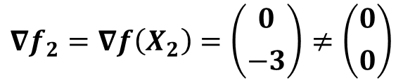

Now, ${ X}_{2}=\left({0 \atop 0}\right)+\frac{1}{8}\left({4 \atop 0}\right)=\left({\frac{1}{2} \atop 0}\right)$
$$f_{2}={f(X}_{2})=−1.0$$
G$radient of the function at X_{2}$
$$∇f_{2}=∇f\left(X_{2}\right)=\left({0 \atop −3}\right)≠\left({0 \atop 0}\right)$$
Therefore, $X_{2}$ is not the desired optimum point and
we go to the next iteration

Slide 43
Advantages
It has a faster convergence rate
This algorithm is simple and easy to understand and implement
Limitation of the Algorithm
There is a chance of the solutions of this algorithm for being trapped into the local minima

Slide 44
Drawbacks of Traditional Optimization Methods
Final solution of an optimization problem depends on the randomly chosen initial solution. If the initial solution lies in the local basin, the final solution will get stuck at local optimum
Gradient-based methods cannot be used for discontinuous objective function

Slide 45
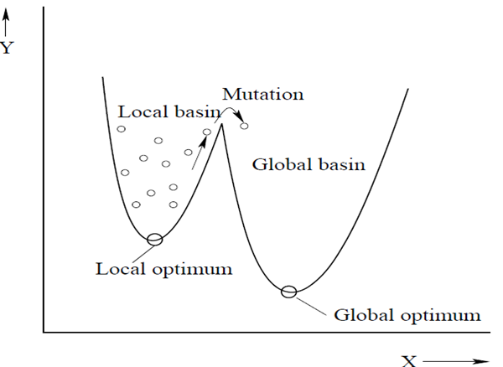

Slide 46
Drawbacks of Traditional Optimization Methods (Cont.)
There is a chance of the solutions of a gradient-based optimization method for being trapped into the local minima
These methods may not be suitable for parallel- computing

Slide 47
Drawbacks of Traditional Optimization Methods (Cont.)
Discrete/integer variables are difficult to handle using the traditional methods of optimization
A particular traditional method of optimization may not be suitable to solve a variety of problems

Slide 48
Genetic Algorithms (GA)
Genetic Programming (GP)
Simulated Annealing (SA)
Evolution Strategies (ES)
Evolutionary Programming (EP)
Ant Colony Optimization (ACO)
Differential Evolution (DE)
Particle Swarm Optimization (PSO)
Cultural Algorithm (CA), and others
Non-Traditional Optimization Tools

Slide 49
Topic 3: BINARY-CODED GENETIC ALGORITHM (BCGA)
PROF. (DR.) DILIP KUMAR PRATIHAR
MECHANICAL ENGINEERING DEPARTMENT, IIT KHARAGPUR

Slide 50
Introduction to Genetic Algorithms
Genetic Algorithm(GA) is a population-based probabilistic search and optimization technique, which works based on the Darwin’s principle of natural selection
An iterative search technique working based on the concept of probability
Introduced by Prof. John Holland of the University of Michigan, USA, in 1965

Slide 51
Working cycle of a GA
Start
Initialize a population of solutions
Gen = 0
Gen >= Max_gen
?
No
Assign fitness to all solutions in the population
Yes
End
Reproduction
Crossover
Mutation
Gen = Gen+1

Slide 52
Starts with a population of random initial solutions
Fitness/goodness value (that is, objective function value in case of maximization problem) of each solution in the population is calculated
On principle, a GA solves a maximization problem
Minimization problem is converted into a maximization problem as given below

Slide 53



Minimize f(x)
Either Maximize –f(x), Duality principle
or Maximize $\frac{1}{\left.1+f(x\right)}$ , for f(x) ≥ 0,
converted into
or Maximize $\frac{1}{\left.f(x\right)}$, for $f(x)≠0$,
or Maximize $\frac{1}{1+{\left\{f(x)\right\}}^{2}}$

Slide 54
The population of solutions is then modified using different operators: reproduction, crossover, mutation, and others
Reproduction
It forms a mating pool consisting of good solutions probabilistically various reproduction schemes: proportionate selection(such as Roulette-Wheel selection), ranking selection, tournament selection, and others.

Slide 55
Crossover
There is an exchange of properties between the parents and as a result of which, new children solutions are created. Various crossover schemes: single-point, two-point, multi-point, uniform crossovers

Slide 56
Mutation
In biology, it means a sudden change of parameter. It may help to overcome the local minima problems.
One generation of the GA includes reproduction, crossover and mutation.
Termination criteria: maximum number of generation, desired accuracy in the solution

Slide 57
Binary-Coded GA
Let us consider an optimization problem
Maximize y = f(x₁, x₂)
subject to
x₁^{min} ≤ x₁ ≤ x₁^{max},
x₂^{min} ≤ x₂ ≤ x₂^{max},
where x₁ and x₂ are the real variables

Slide 58
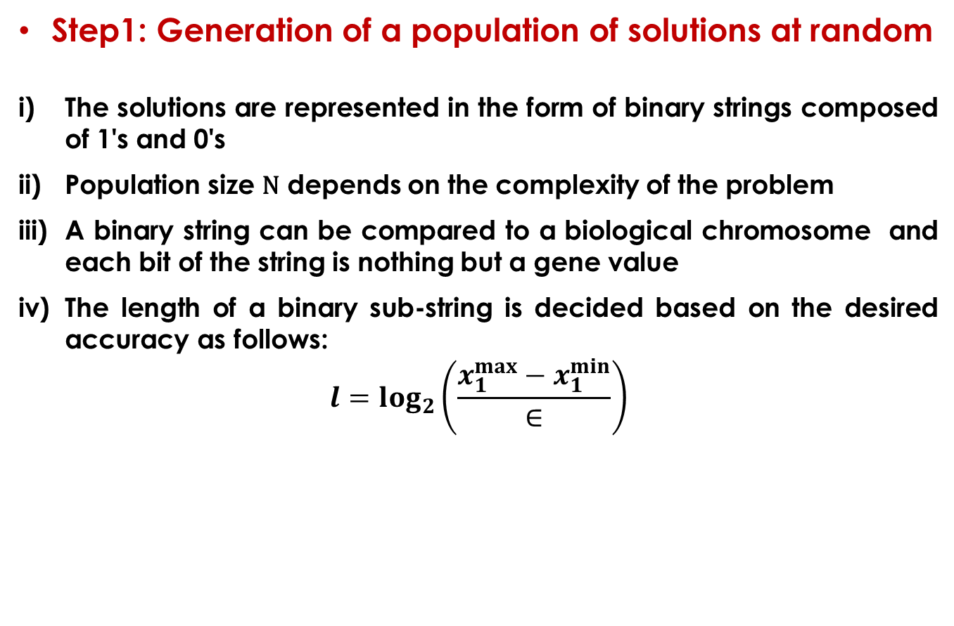
Step1: Generation of a population of solutions at random
The solutions are represented in the form of binary strings composed of 1's and 0's
Population size N depends on the complexity of the problem
A binary string can be compared to a biological chromosome and each bit of the string is nothing but a gene value
The length of a binary sub-string is decided based on the desired accuracy as follows:
$$l=\log_{2}\left(\frac{x_{1}^{max}−x_{1}^{min}}{∈}\right)$$

Slide 59
v) Computational complexity: L log L, where L represents the string length
Let us consider 10 bits for each variable
Initial population of GA-strings
1 0 0 - - - - - - - - 1
0 1 1 - - - - - - - - 0
1 1 1 - - - - - - - - 0
0 0 1 - - - - - - - - 1
- - - - - - - - - - - -
- - - - - - - - - - - -
1 0 1 - - - - - - - - 1

Slide 60
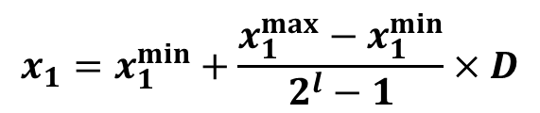
Step 2: Fitness Evaluation
i) Use Linear Mapping rule to determine real values of the
variables: x₁ and x₂
where
l: Length of the sub-string used to represent
D: Decoded value
$$x_{1}=x_{1}^{min}+\frac{x_{1}^{max}−x_{1}^{min}}{2^{l}−1}×D$$

Slide 61
ii) Function value f(x₁, x₂) can be calculated knowing the values of x₁ and x₂
1 0 0 - - - - - - - - 1 → f₁
0 1 1 - - - - - - - - 0 → f₂
1 1 1 - - - - - - - - 0 → f₃
0 0 1 - - - - - - - - 1 → f₄
- - - - - - - - - - - -
- - - - - - - - - - - -
1 0 1 - - - - - - - - 1 → f_{N}

Slide 62
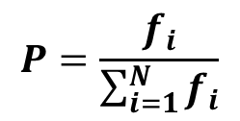
Step 3: Reproduction Scheme
i) Proportionate selection/Roulette-Wheel selection
Probability of getting selected in a mating pool α fitness
Implemented with the help of a Roulette-Wheel
f_{N}
$$P=\frac{f_{i}}{\sum_{i=1}^{N}{f_{i}}}$$
f₁
f₂

Slide 63
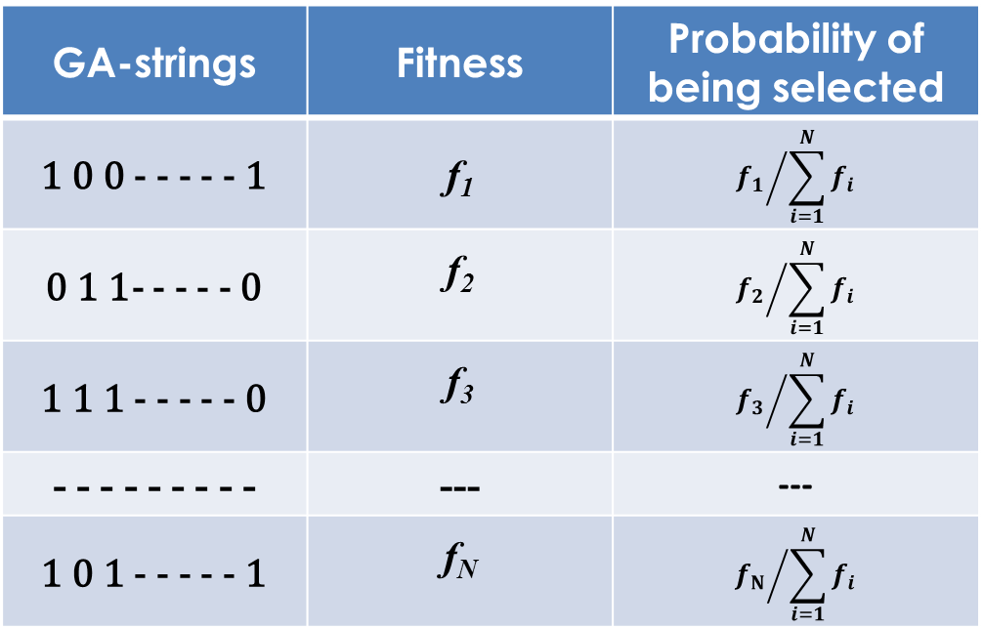
GA-strings | Fitness | Probability of being selected
1 0 0 - - - - - 1 | f₁ | $${f_{1}}/{\sum_{i=1}^{N}{f_{i}}}$$
0 1 1- - - - - 0 | f₂ | $${f_{2}}/{\sum_{i=1}^{N}{f_{i}}}$$
1 1 1 - - - - - 0 | f₃ | $${f_{3}}/{\sum_{i=1}^{N}{f_{i}}}$$
- - - - - - - - - | --- | ---
1 0 1 - - - - - 1 | f_{N} | $${f_{N}}/{\sum_{i=1}^{N}{f_{i}}}$$

Slide 64
Note:
GA-search depends on the factors like population diversity (exploration) and selection pressure (exploitation)
Chance of premature convergence and stagnation

Slide 65
ii) Ranking selection
f₄
f₁
f₁
10%
40%
f₃
80%
f₄
20%
f₂
3%
f₃
f₂
30%
7%
10%
Ranking selection

Slide 66
Strings are arranged in an ascending order of their fitness values (that is, f₄, f₃, f₂, f₁)
The strings having f₄, f₃, f₂ and f₁ will be assigned ranks 1,2,3 and 4
Apply a proportionate selection scheme based on the assigned ranks

Slide 67
The strings having f₁, f₂, f₃ and f₄ will occupy 40%, 30%, 20% and 10% of the total area, respectively
Note : Rank-based proportionate selection scheme is expected to perform better than the fitness-based proportionate selection

Slide 68
iii) Tournament Selection
Select tournament size n
Pick n strings from the population at random and select the best one in terms of fitness value
After copying the best string into the mating pool, all n strings are returned to the population
Computationally faster than Roulette Wheel selection and Ranking selection

Slide 69
Step4: Crossover
Exchange of properties between two parents and consequently, two children solutions are produced
N/2 Mating pairs/Parents are selected at random from a mating pool of size N

Slide 70
Coin tossing with a probability of appearing head (p_{c})→ to decide whether a particular mating pair will participate in crossover
(iv) p_{c} is generally kept near to 1.0
(v) No. of individuals participating in crossover = (N/2)×2×p_{c} = Np_{c}

Slide 71
Various Crossover Operators
Single-point Crossover
0 1 0 1 1 0 1 0 1 1 1 0 0 1 1 0 1 0 0 1
0 0 1 1 0 1 0 0 1 0 1 1 1 0 1 0 0 1 0 1
0 1 0 1 1 0 1 0 1 1 1 0 1 0 1 0 0 1 0 1
0 0 1 1 0 1 0 0 1 0 1 1 0 1 1 0 1 0 0 1
Parents
Children

Slide 72
Two-point Crossover
1 0 1 0 1 1 1 0 0 1 1 0 1 0 0 1 0 1 0 0
0 1 0 0 1 0 1 1 1 0 1 0 0 0 1 1 0 0 1 1
1 0 1 0 1 1 1 1 1 0 1 0 1 0 0 1 0 1 0 0
0 1 0 0 1 0 1 0 0 1 1 0 0 0 1 1 0 0 1 1
Parents
Children

Slide 73
Multi-point Crossover
Here, the bits lying between alternate pairs of sites are interchanged.
1 0 1 1 0 0 0 0 1 1 1 0 0 1 1 0 1 1 1 0
0 1 1 1 0 1 1 0 0 0 1 1 0 0 0 1 0 1 0 0
1 0 1 1 0 1 1 0 1 1 1 1 0 0 0 0 1 1 0 0
0 1 1 1 0 0 0 0 0 0 1 0 0 1 1 1 0 1 1 0
Parents
Children

Slide 74
Uniform Crossover
At each bit position of the parent strings, we toss a coin (with a probability of 0.5 for appearing head) to decide whether there will be interchanging of the bits. If the head appears there will be a swapping of bits among the parent strings.

Slide 75
1 0 1 1 0 0 0 0 1 1 1 0 0 1 1 0 1 1 1 0
0 1 1 1 0 1 1 0 0 0 1 1 0 0 0 1 0 1 0 0
Let us assume that 2nd, 4th, 5th, 8th, 9th,12th, 18th and 20th bit positions are selected for swapping.
1 1 1 1 0 0 0 0 0 1 1 1 0 1 1 0 1 1 1 0
0 0 1 1 0 1 1 0 1 0 1 0 0 0 0 1 0 1 0 0
Parents
Children

Slide 76
Note: For a large search space, uniform crossover is found to perform better than both single-point and two-point crossovers.

Slide 77
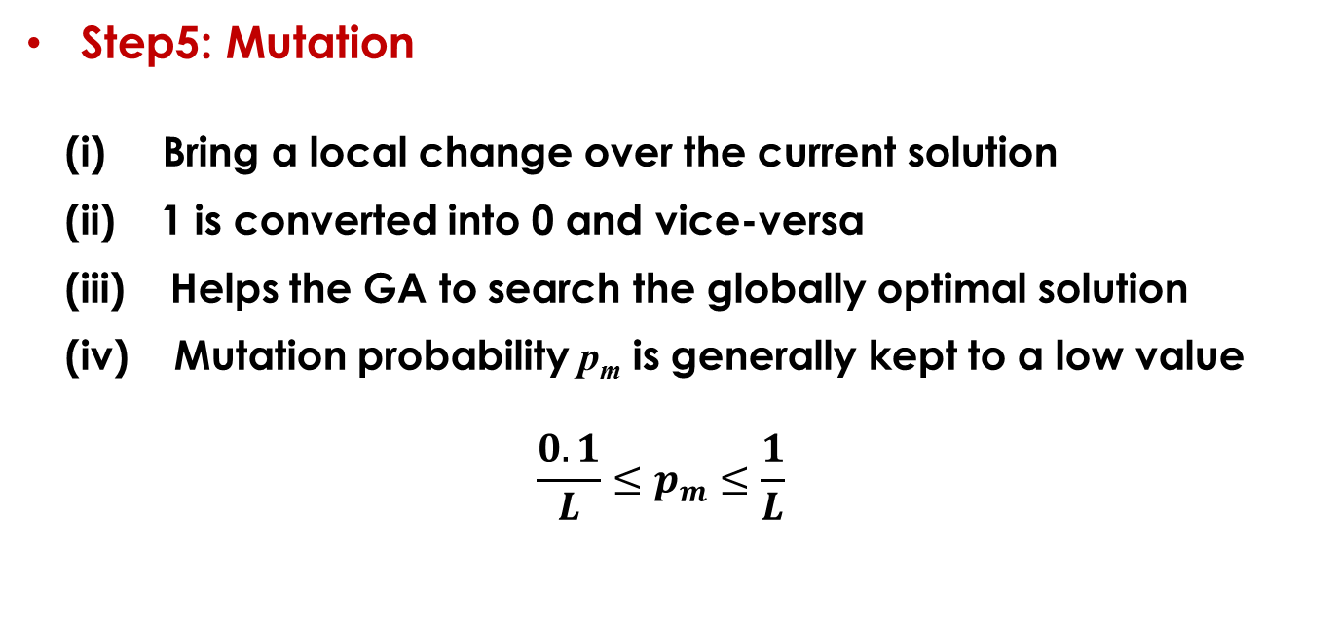
Step5: Mutation
(i) Bring a local change over the current solution
(ii) 1 is converted into 0 and vice-versa
(iii) Helps the GA to search the globally optimal solution
(iv) Mutation probability p_{m} is generally kept to a low value
$$\frac{0.1}{L}≤p_{m}≤\frac{1}{L}$$

Slide 79
Crossover or Mutation?
A genetic operator has to perform two potential roles: disruption and construction
Mutation is more powerful than crossover in terms of its disruption capability, whereas crossover outperforms mutation in terms of construction capability
GA, GP rely more on crossover, whereas ES, EP give more weightage on mutation

Slide 80
A Numerical Example
A binary-coded GA is to be used to solve an optimization problem involving one real and another integer variables. The real and integer variables are allowed to vary in the ranges of (0.2, 10.43) and (0, 63), respectively. Design a suitable GA-string to ensure a precision level of 0.01 for the real variable.

Slide 81
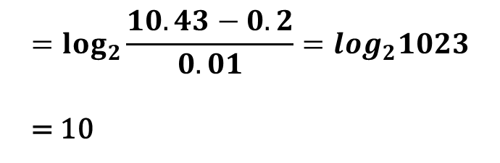

Solution:
For real variable
$$l1=\log_{2}\left(\frac{x_{1}^{max}−x_{1}^{min}}{∈}\right)$$
$$=\log_{2}\frac{10.43−0.2}{0.01}=log_{2}1023$$
= 10

Slide 82
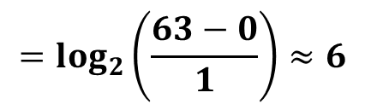
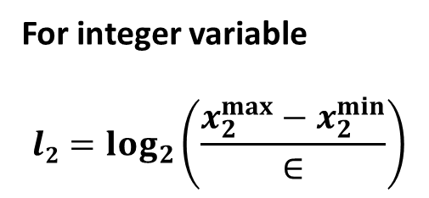
For integer variable
$$l2=\log_{2}\left(\frac{x_{2}^{max}−x_{2}^{min}}{∈}\right)$$
$$=\log_{2}\left(\frac{63−0}{1}\right)≈6$$
Therefore, 10 and 6 bits are required to represent the real and integer variables, respectively.

