Slide 1
Topic 3: BINARY-CODED GENETIC ALGORITHM (BCGA) (contd.)
PROF. (DR.) DILIP KUMAR PRATIHAR
MECHANICAL ENGINEERING DEPARTMENT, IIT KHARAGPUR

Slide 2

Hand Calculation
subject to
1.0 ≤ x ≤ 16.0
Maximize $y=\sqrt{x}$

Slide 3
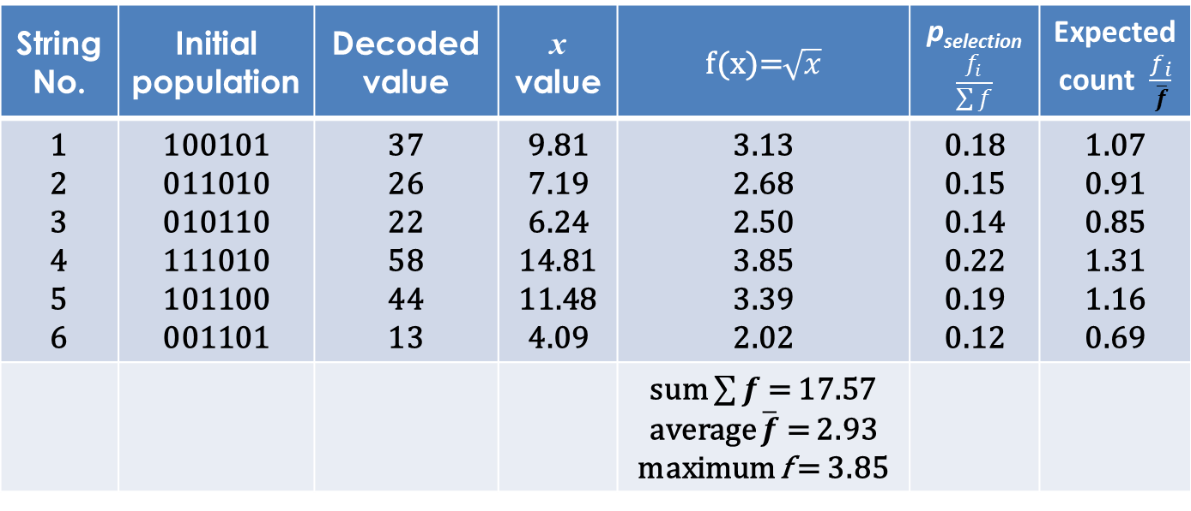
Hand Calculation (contd.)
String No. | Initial population | Decoded value | x value | f(x)=$\sqrt{x}$ | p_{selection} $$\frac{f_{i}}{\sum{f}}$$ | Expected count $\frac{f_{i}}{\overline{f}}$
1 2 3 4 5 6 | 100101 011010 010110 111010 101100 001101 | 37 26 22 58 44 13 | 9.81 7.19 6.24 14.81 11.48 4.09 | 3.13 2.68 2.50 3.85 3.39 2.02 | 0.18 0.15 0.14 0.22 0.19 0.12 | 1.07 0.91 0.85 1.31 1.16 0.69
 |  |  |  | sum $\sum{f}$ = 17.57 average $\overline{f}$ = 2.93 maximum f = 3.85

Slide 4
Hand Calculation (contd.)
Actual count Roulette wheel | Mating pool | Mating pair | Parents | Crossover site | Children strings | Mutation
1 1 0 2 2 0 | 100101 011010 111010 111010 101100 101100 | 3 6 1 5 4 2 | 100101 111010 011010 101100 111010 101100 | 10|0101 11|1010 011|010 101|100 11|1010 10|1100 | 101010 110101 011100 101010 111100 101010 | 101010 110101 011100 111010 111100 101010

Slide 5
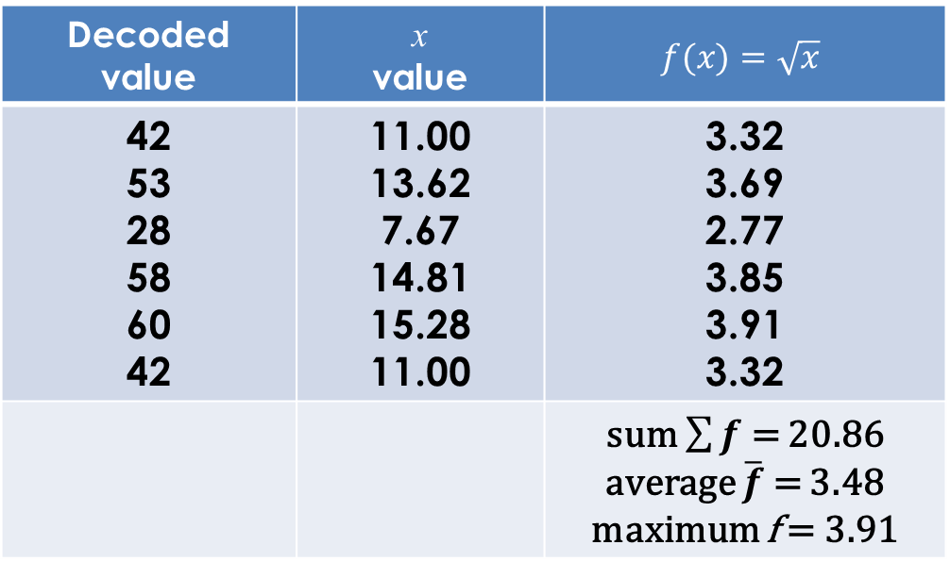
Hand Calculation (contd.)
Decoded value | x value | $$f(x)=\sqrt{x}$$
42 53 28 58 60 42 | 11.00 13.62 7.67 14.81 15.28 11.00 | 3.32 3.69 2.77 3.85 3.91 3.32
 |  | sum $\sum{f}$ = 20.86 average $\overline{f}$ = 3.48 maximum f = 3.91

Slide 6
GA- parameters Setting
To ensure a proper balance between population diversity (exploration) and selection pressure (exploitation)
Trials have been made using Regression Analysis also

Slide 7
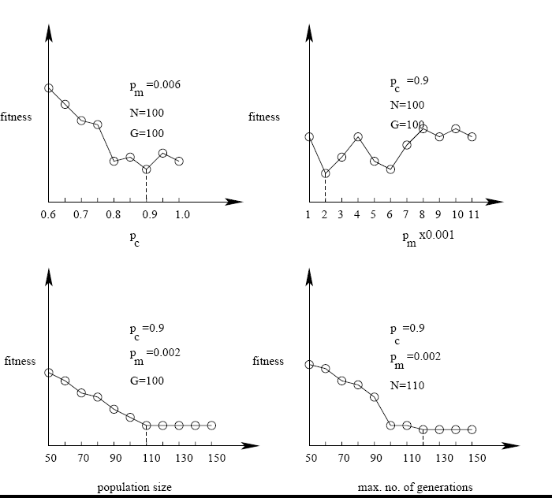

Slide 8
Topic 4: SCHEMA THEOREM OF BCGA
PROF. (DR.) DILIP KUMAR PRATIHAR
MECHANICAL ENGINEERING DEPARTMENT, IIT KHARAGPUR

Slide 9
Schema Theorem of Binary-Coded GA
Proposed by Prof. John Holland
To investigate mathematical foundation of GA

Slide 10
Let us consider a population of binary-strings created at random:
1 1 0 0 1 1
0 1 0 0 0 0
1 1 0 1 1 1
1 1 0 0 0 0

Slide 11
Let us assume the following two schemata (templates):
H₁: * 1 0 * * *
H₂: * 1 0 0 0 0
where * could be either 1 or 0

Slide 12
Two Terms:
Order of schema O(H): No. of fixed positions (bits) present in a schema.
For example: O(H₁) = 2; O(H₂) = 5
Defining length of schema δ(H): Distance between the first and last fixed positions in a string.
For example: δ(H₁) = 3-2 = 1; δ(H₂) = 6-2 = 4

Slide 13
Reproduction (Proportionate Selection)
GA operators
Probability α fitness
Let m(H, t): No. of strings belonging to schema H at t^{th} generation
m(H, t+1): No. of strings belonging to schema H at (t+1)^{th} Generation
N: Population size
f (H): Schema fitness or Average fitness of the strings represented by schema H at t^{th} generation
Σf: Total fitness

Slide 14
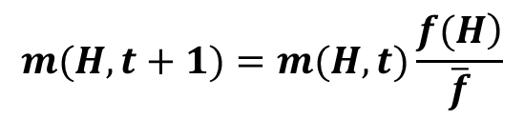
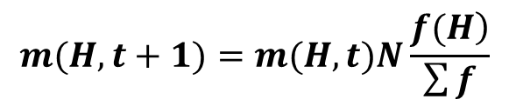

$$m(H,t+1)=m(H,t)N\frac{\left.f(H\right)}{\sum{f}}$$
$$m(H,t+1)=m(H,t)\frac{\left.f(H\right)}{\overline{f}}$$
where $\overline{f}=\frac{\sum{f}}{N}$

Slide 15
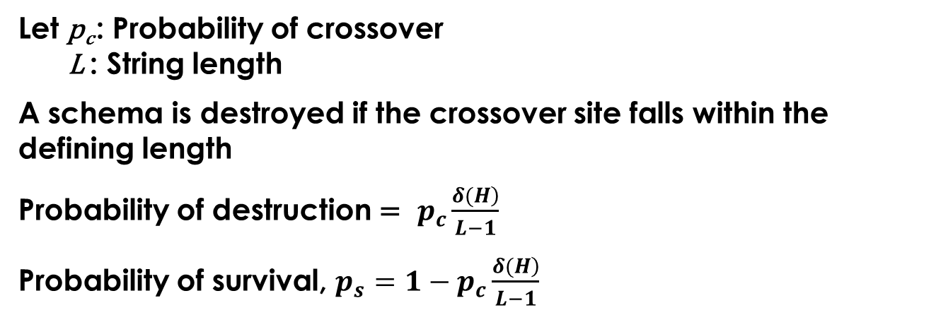
Crossover (Single-point)
Let p_{c} : Probability of crossover
L : String length
A schema is destroyed if the crossover site falls within the defining length
Probability of destruction = $p_{c}\frac{\left.δ(H\right)}{L−1}$
Probability of survival, $p_{s}=1−p_{c}\frac{\left.δ(H\right)}{L−1}$

Slide 16
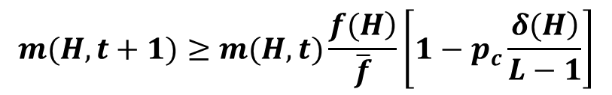
Combining the effect of reproduction and crossover, we get
$$m(H,t+1)≥m(H,t)\frac{\left.f(H\right)}{\overline{f}}\left[1−p_{c}\frac{\left.δ(H\right)}{L−1}\right]$$

Slide 17
Mutation (Bit–wise mutation)
To protect a schema, mutation should not occur at the fixed bits
Let p_{m} : probability of mutation
probability of destruction = p_{m}
probability of survival = 1- p_{m}
Probability of survival considering all the fixed bits in a schema,
p_{s} = (1- p_{m}) (1- p_{m})……….O(H)
= (1- p_{m}) ^{O(H)}
= 1- O(H) p_{m} as p_{m} ‹‹ 1

Slide 18
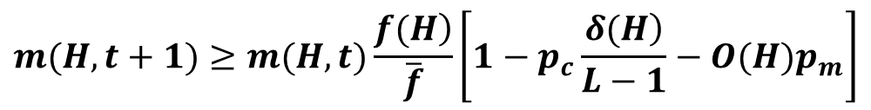
Considering the contributions of all three operators, we get
$$m(H,t+1)≥m(H,t)\frac{\left.f(H\right)}{\overline{f}}\left[1−p_{c}\frac{\left.δ(H\right)}{L−1}−O(H)p_{m}\right]$$
Building-Block Hypothesis
The schemata having low order, short defining length and fitness more than average fitness of the population will receive more and more copies in future generations

Slide 19
A Numerical Example
An initial random population of size N=10 of a binary-coded GA is given below.
1 0 0 1 0 0
0 1 0 1 0 0
0 1 0 1 1 1
1 1 1 0 0 0
0 1 0 1 1 0
1 0 0 1 1 0
0 1 1 0 0 1
1 0 0 1 0 1

Slide 20
1 1 0 0 1 1
0 1 1 0 0 1
The fitness of a GA-string is to assumed to be equal to its decoded value. Calculate the expected number of strings to be represented by the schema H: *1**1*, at the end of first generation, considering a single-point crossover of probability p_{c} = 0.9 and a bit-wise mutation of probability p_{m} = 0.01.

Slide 21
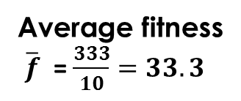
Solution:
2⁵ 2⁴ 2³ 2² 2¹ 2⁰
1 0 0 1 0 0
0 1 0 1 0 0
0 1 0 1 1 1
1 1 1 0 0 0
0 1 0 1 1 0
1 0 0 1 1 0
0 1 1 0 0 1
1 0 0 1 0 1
1 1 0 0 1 1
0 1 1 0 0 1
Fitness/ Decoded value
36
20
23
56
22
Average fitness
$\overline{f}$ = $\frac{333}{10}=33.3$
38
25
37
51
25
Total fitness = 333

Slide 22
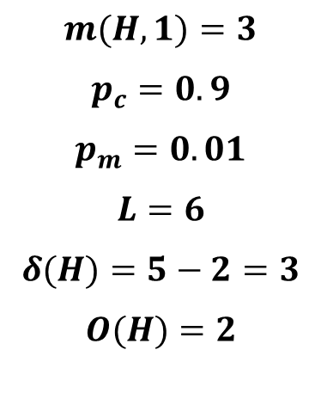
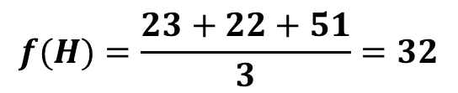
Schema H: *1**1* is followed by 3rd , 5th and 9th strings
$$f(H)=\frac{23+22+51}{3}=32$$
$$m(H,1)=3$$
$$p_{c}=0.9$$
$$p_{m}=0.01$$
$$L=6$$
$$δ(H)=5−2=3$$
$$O(H)=2$$

Slide 23
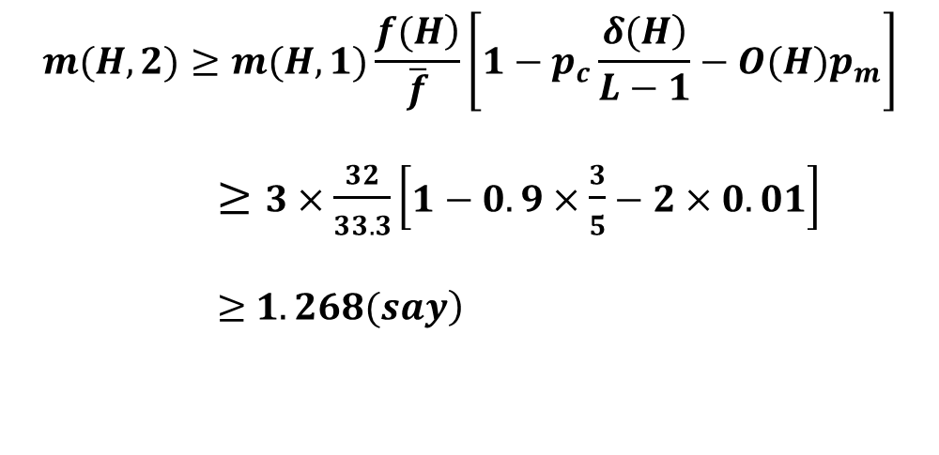
$$m(H,2)≥m(H,1)\frac{\left.f(H\right)}{\overline{f}}\left[1−p_{c}\frac{\left.δ(H\right)}{L−1}−O(H)p_{m}\right]$$
$≥3×\frac{32}{33.3}\left[1−0.9×\frac{3}{5}−2×0.01\right]$
$≥$ $\left.1.268(say\right)$
Therefore, no. of strings following schema H is going to be reduced, as it is not a good schema

Slide 24
Limitations of Binary–Coded GA
Unable to yield any arbitrary precision in the solution → real-coded GA
Hamming Cliff problem → create an artificial hindrance to the gradual search of a GA → Gray-coded GA
14 : 0 1 1 1 0
15 : 0 1 1 1 1
16 : 1 0 0 0 0
1 change
5 change

Slide 25
Topic 5: CONSTRAINTS HANDLING IN GA
PROF. (DR.) DILIP KUMAR PRATIHAR
MECHANICAL ENGINEERING DEPARTMENT, IIT KHARAGPUR

Slide 26
Constraints Handling in GA
Constrained optimization
Optimize f(x)
subject to
g_{i}(x) ≤ 0 , i = 1,2,….,n
h_{j}(x) = 0 , j = 1,2,….,p
X = (x₁,x₂,….,x_{m})^{T}
X_{min} ≤ X ≤ X_{max}

Slide 27
Let n+p = q
Functional constraints
Φ_{k}(x) , k = 1,2,….,q

Slide 28
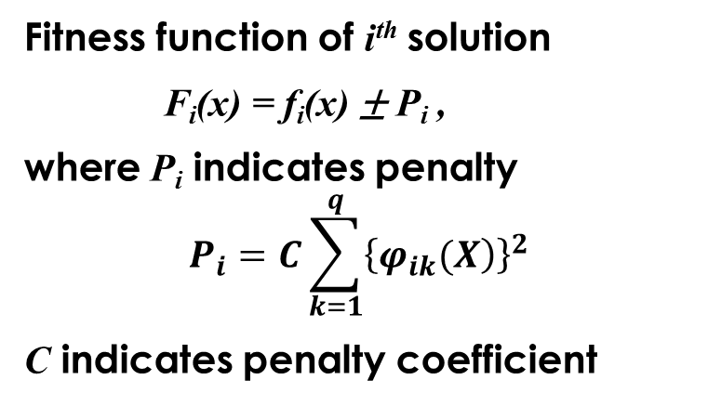
Penalty Function Approach
Fitness function of i^{th} solution
F_{i}(x) = f_{i}(x) ± P_{i} ,
where P_{i} indicates penalty
$$P_{i}=C\sum_{k=1}^{q}{{\left\{\left.φ_{ik}(X\right)\right\}}^{2}}$$
C indicates penalty coefficient

Slide 29
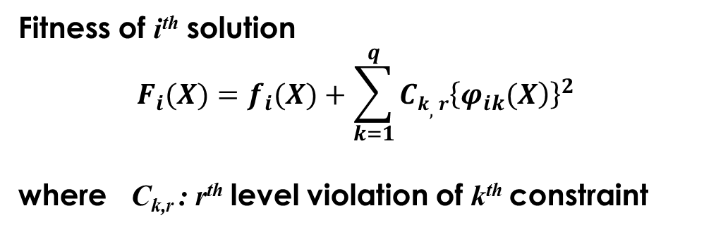
Static Penalty
Fitness of i^{th} solution
$$F_{i}(X)=f_{i}(X)+\sum_{k=1}^{q}{Ck,r{\left\{\left.φ_{ik}(X\right)\right\}}^{2}}$$
where C_{k,r} : r^{th} level violation of k^{th} constraint

Slide 30
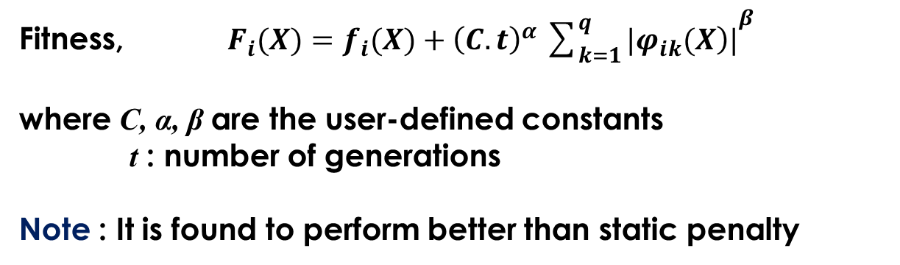
Dynamic Penalty
Fitness, $F_{i}(X)=f_{i}(X)+{\left(C.t\right)}^{α}{\sum_{k=1}^{q}{|\left.φ_{ik}(X\right)|}}^{β}$
where C, α, β are the user-defined constants
t : number of generations
Note : It is found to perform better than static penalty

Slide 31
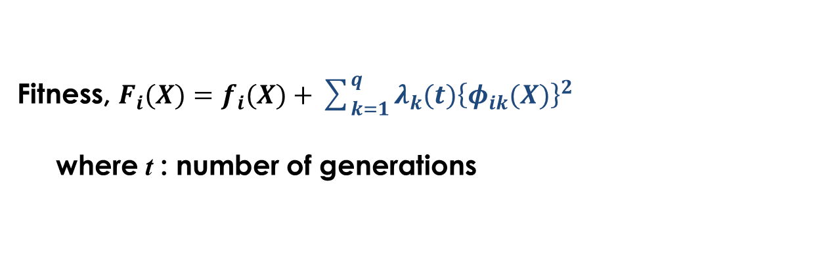
Adaptive Penalty
Fitness, $F_{i}(X)=f_{i}(X)+\sum_{k=1}^{q}{λ_{k}(t){\left\{φ_{ik}(X)\right\}}^{2}}$
where t : number of generations
λ(t+1) =
, for feasible
, for infeasible
where β₁≠β₂ and β₁, β₂ >1

Slide 32
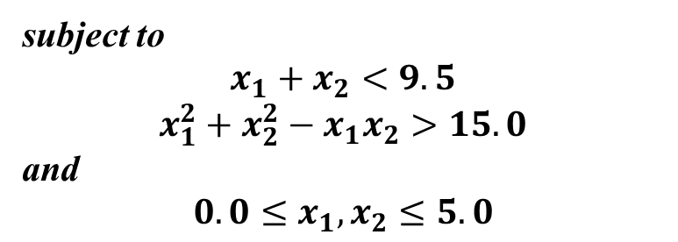
A Numerical Example
Let us consider a constrained optimization problem of two variables: x₁ and x₂ as given below.
Minimize $f(x_{1},x_{2})=x_{1}+x_{2}−2x_{1}^{2}−x_{2}^{2}+x_{1}x_{2}$
subject to
$$x_{1}+x_{2}<9.5$$
$$x_{1}^{2}+x_{2}^{2}−x_{1}x_{2}>15.0$$
and
$$0.0≤x_{1},x_{2}≤5.0$$

Slide 33
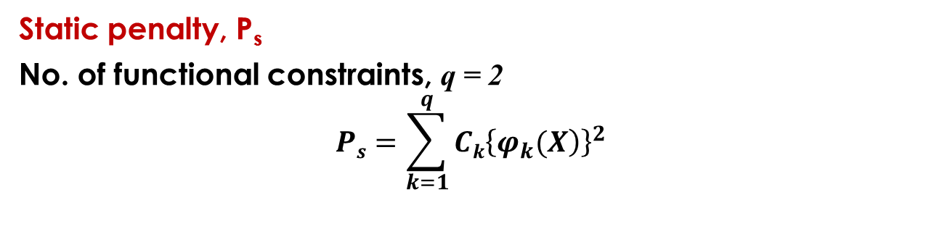
It is to be solved by a GA using the concepts of static, dynamic and adaptive penalties. Calculate the penalty values. Let us select x₁=2.0 and x₂=3.0.
Solution:
Static penalty, P_{s}
No. of functional constraints, q = 2
$$Ps=\sum_{k=1}^{q}{Ck{\left\{\left.φ_{k}(X\right)\right\}}^{2}}$$

Slide 34
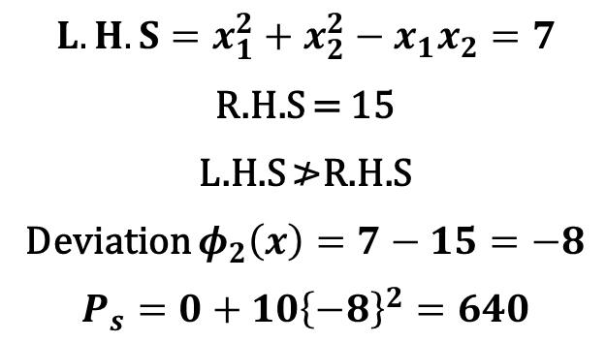
Let C₁ = C₂ = 10.0
The first functional constraint is not violated. Thus, its penalty term will be equal to 0. However, it violates the second functional constraint.
$$L.H.S=x_{1}^{2}+x_{2}^{2}−x_{1}x_{2}=7$$
R.H.S = 15
L.H.S ≯R.H.S
Deviation $φ_{2}\left(x\right)=7−15=−8$
$$P_{s}=0+10{\left\{−8\right\}}^{2}=640$$

Slide 35
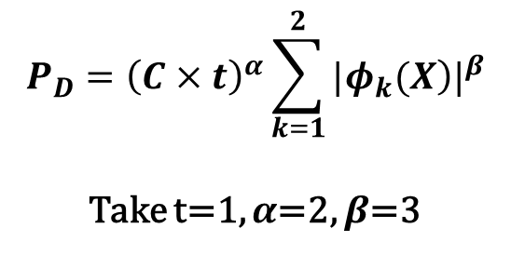
Dynamic penalty, P_{D}
$$P_{D}={\left(C×t\right)}^{α}\sum_{k=1}^{2}{{|\left.φ_{k}(X\right)|}^{β}}$$
Take t=1, $α$=2, $β$=3
No violation for the first functional constraint. However, there is violation in the second functional constraint.

Slide 36
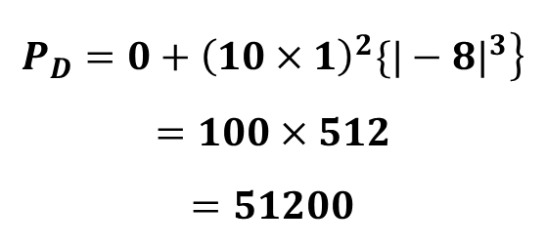
Take C=10
$$\left.P_{D}=0+{\left(10×1\right)}^{2}\{{|−8|}^{3}\right\}$$
$$=100×512$$
$$=51200$$

Slide 37
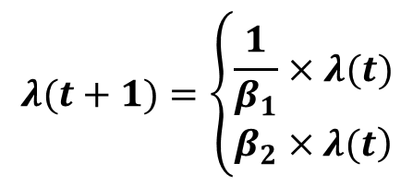
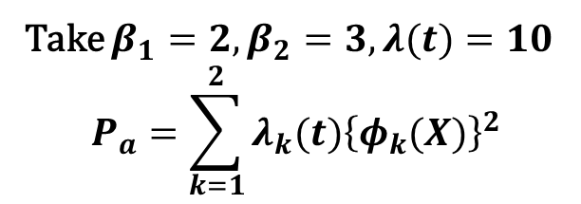
Adaptive penalty, P_{a}
Take $β_{1}=2,β_{2}=3,λ(t)=10$
$$P_{a}=\sum_{k=1}^{2}{λ_{k}(t){\left\{φ_{k}(X)\right\}}^{2}}$$
$$λ(t+1)=\left\{\begin{matrix}\frac{1}{β_{1}}×λ(t) \\ \left.β_{2}×λ(t\right)\end{matrix}\right.$$
for 1st functional constraint (no violation)
for 2nd functional constraint (with violation)

Slide 38
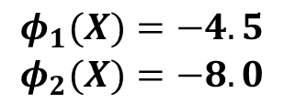
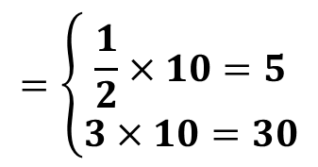
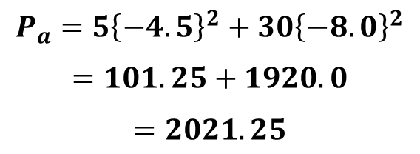
$$=\left\{\begin{matrix}\frac{1}{2}×10=5 \\ 3×10=30\end{matrix}\right.$$
for 1st functional constraint
for 2nd functional constraint
Now,
$$\begin{matrix}φ_{1}(X)=−4.5 \\ φ_{2}(X)=−8.0\end{matrix}$$
$$P_{a}=5{\left\{−4.5\right\}}^{2}+30{\left\{−8.0\right\}}^{2}$$
$$=101.25+1920.0$$
$$=2021.25$$

Slide 39
Advantages of GA
The chance of a GA’s solutions for being trapped into local minima is less
Can handle integer programming or mixed-integer programming problems effectively
Can optimize discontinuous objective functions also
Suitable for parallel implementations
It is a versatile optimization tool

Slide 40
Disadvantages of GA
Computationally expensive - slow convergence rate
Black-box optimization
No mathematical convergence proof of the GA
User should have a proper knowledge of the grammar of the GA

Slide 41
Efficient Optimization Tool
Global search of a GA is to be combined with Local search of Gradient-based tool

Slide 42
Topic 6: REAL-CODED GA
PROF. (DR.) DILIP KUMAR PRATIHAR
MECHANICAL ENGINEERING DEPARTMENT, IIT KHARAGPUR

Slide 43
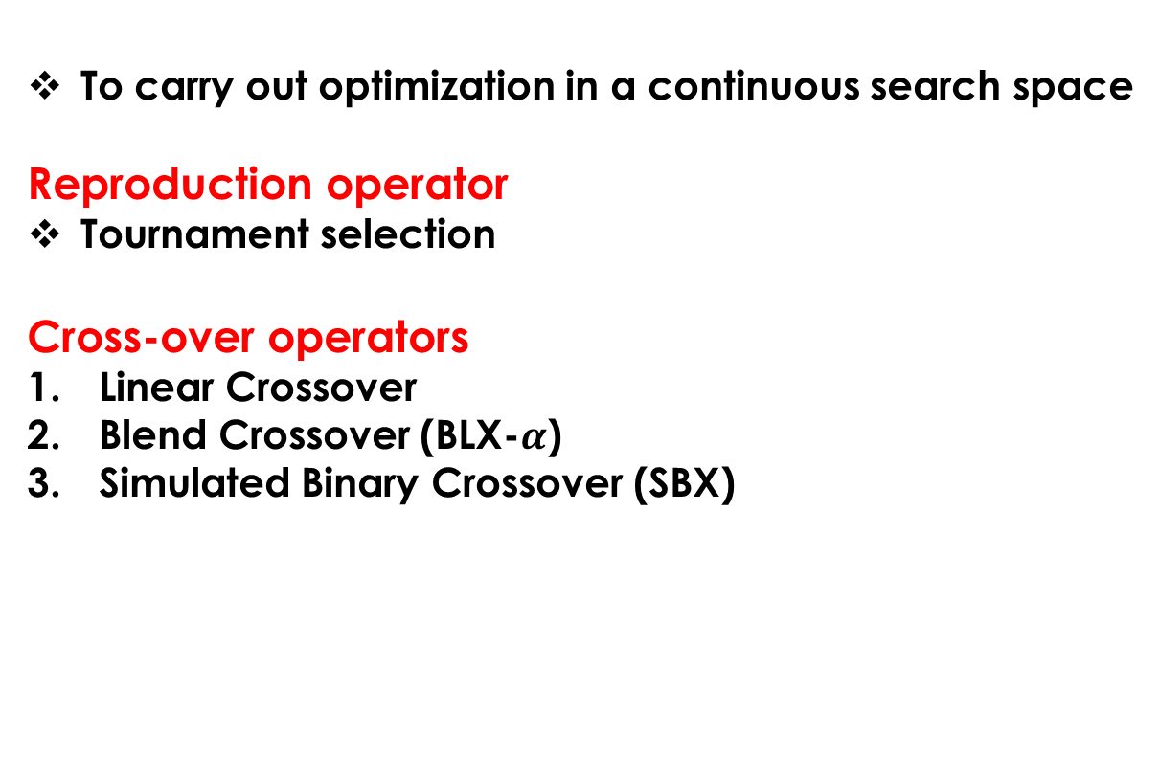
Real-Coded GA
To carry out optimization in a continuous search space
Reproduction operator
Tournament selection
Cross-over operators
Linear Crossover
Blend Crossover (BLX-$α$)
Simulated Binary Crossover (SBX)

Slide 44
1. Linear Crossover
Proposed by Wright in 1991
Two parents Pr₁ and Pr₂ participate in crossover
Three solutions are produced: 0.5(Pr₁+Pr₂); (1.5Pr₁-0.5Pr₂);
(-0.5Pr₁+1.5Pr₂)
The best two are selected as the children solutions

Slide 45
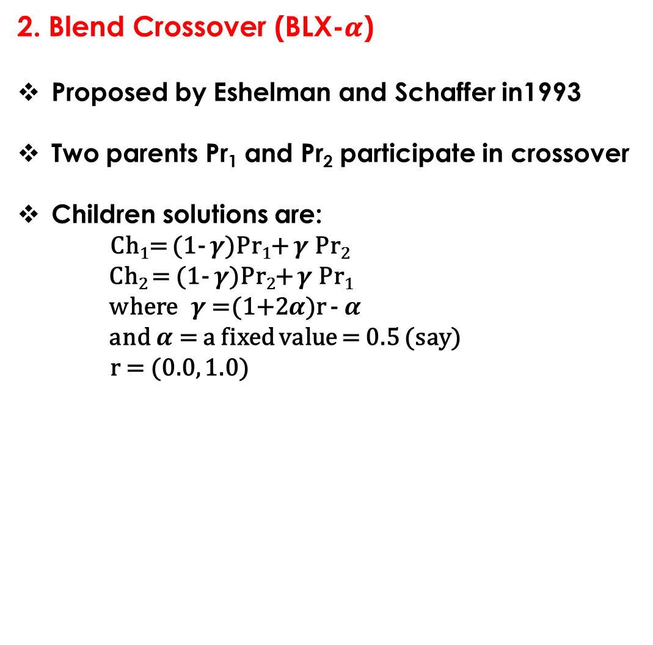
2. Blend Crossover (BLX-𝜶)
Proposed by Eshelman and Schaffer in1993
Two parents Pr₁ and Pr₂ participate in crossover
Children solutions are:
Ch₁= (1- $γ$)Pr₁+ $γ$ Pr₂
Ch₂ = (1- $γ$)Pr₂+ $γ$ Pr₁
where $γ$ =(1+2$α$)r - $α$
and $α$ = a fixed value = 0.5 (say)
r = (0.0, 1.0)

Slide 46
3. Simulated Binary Crossover (SBX)
Proposed by Deb and Agrawal in1995
Search power is represented with the help of generated
children solutions from the given parents
Spread factor

Slide 47
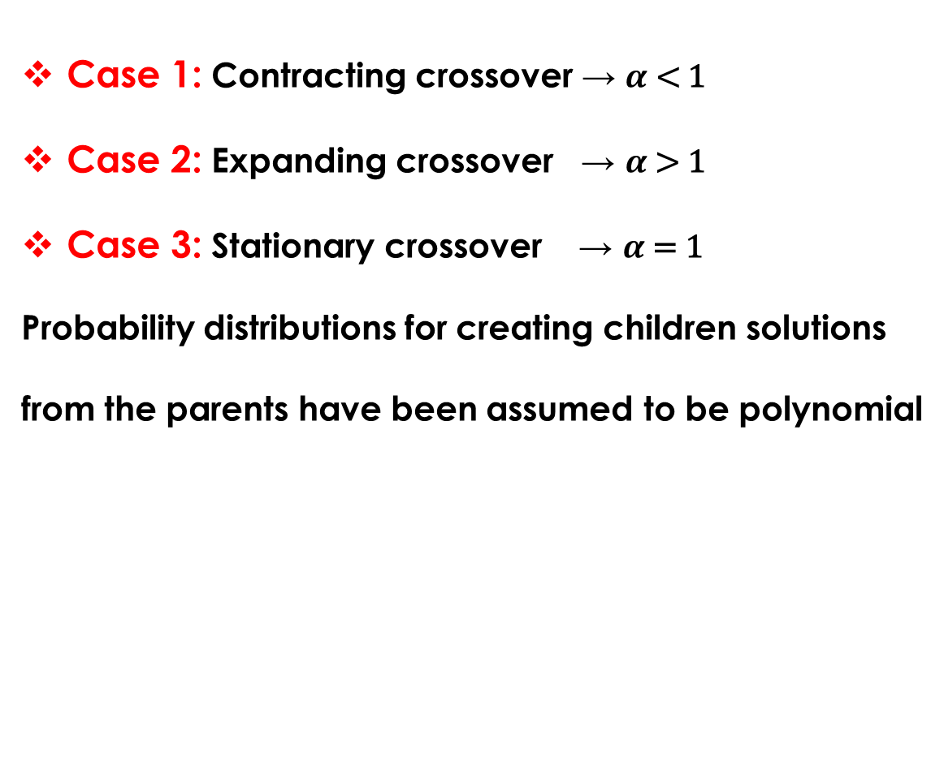
Case 1: Contracting crossover → $α$ < 1
Case 2: Expanding crossover → $α$ > 1
Case 3: Stationary crossover → $α$ = 1
Probability distributions for creating children solutions
from the parents have been assumed to be polynomial

Slide 48
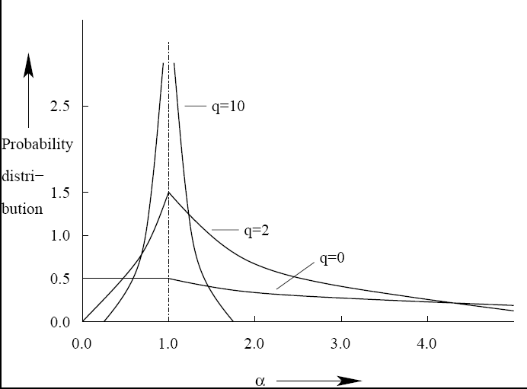
Polynomial Probability Distributions

Slide 49
Contracting Crossover :
q : positive real exponent
Expanding Crossover :

Slide 50
Note:

Slide 51

Steps :
Step1 : Create a random number r (0.0 to 1.0)
Step2 : Determine $α^{′}$ for which
, if r < 0.5
, if r > 0.5

Slide 52

Step3 : Using the value of $α^{′}$

Slide 53
A Numerical Example
Determine children solution from the two parents: Pr₁=20.65 and Pr₂=15.50 using SBX. Take exponent q=3.

Slide 54
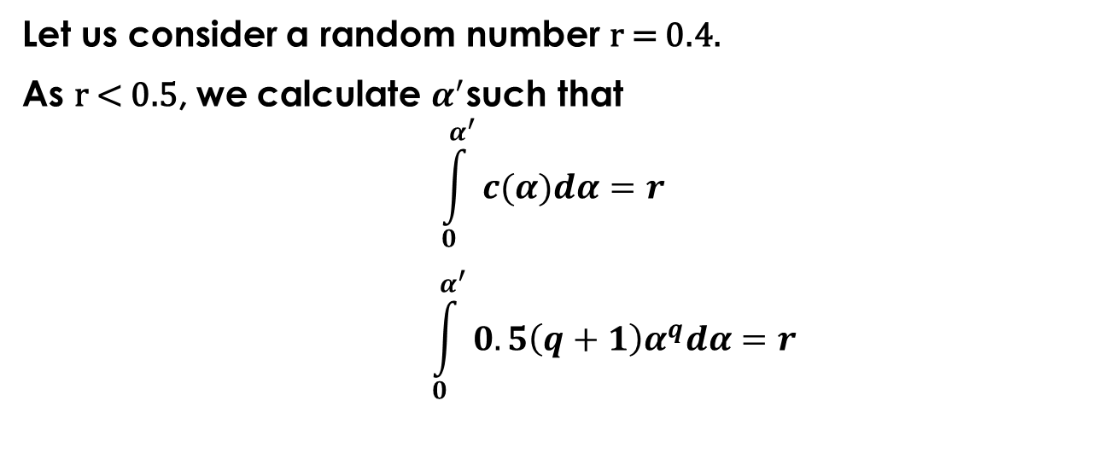
Solution:
Let us consider a random number r = 0.4.
As r < 0.5, we calculate $α^{′}$such that
$$\int_{0}^{α^{′}}{c(α)dα=r}$$
$$\int_{0}^{α^{′}}{0.5\left(q+1\right)α^{q}dα=r }$$
or,

Slide 55
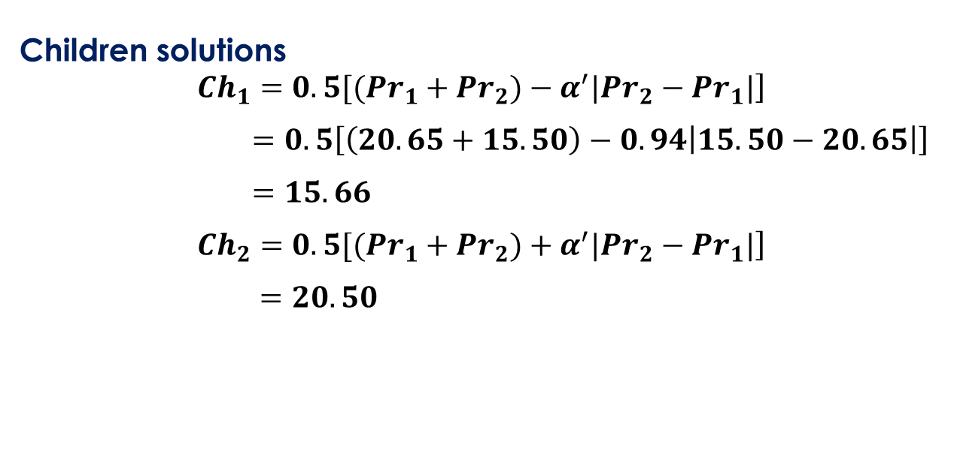
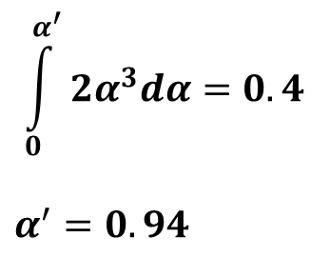
$$\int_{0}^{α^{′}}{2α^{3}dα=0.4}$$
$$α^{′}=0.94$$
or,
or,
Children solutions
$$\left.{Ch}_{1}=0.5[({Pr}_{1}+{Pr}_{2})−α^{′}|{Pr}_{2}−{Pr}_{1}|\right]$$
$=0.5\left[\left(20.65+15.50\right)−0.94\left|15.50−20.65\right|\right]$
$=15.66$
$$\left.Ch_{2}=0.5[(Pr_{1}+{Pr}_{2})+α^{′}|{Pr}_{2}−{Pr}_{1}|\right]$$
$$=20.50$$

Slide 56
Children
15.66
20.50
15.50
20.65
Parents

Slide 57
Mutation Operators
Random Mutation
where r : (0.0 , 1.0)
: Maximum value of perturbation

Slide 58
Polynomial Mutation
Step1 : Generate a random number r (0.0 , 1.0)
Step2 : Calculate the perturbation factor
, if r < 0.5
, if r ≥ 0.5

Slide 59
Step 3 : Mutated solution is determined as
δ_{max} : User-defined maximum perturbation

Slide 60
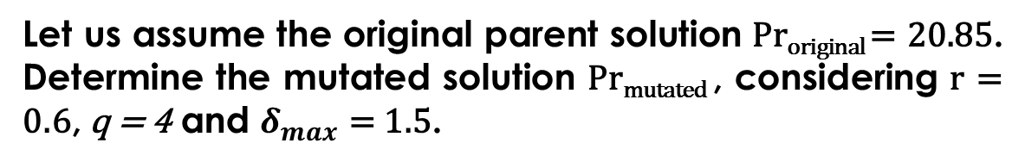
A Numerical Example
Let us assume the original parent solution Pr_{original} = 20.85. Determine the mutated solution Pr_{mutated} , considering r = 0.6, q = 4 and $δ_{max}$ = 1.5.

Slide 61
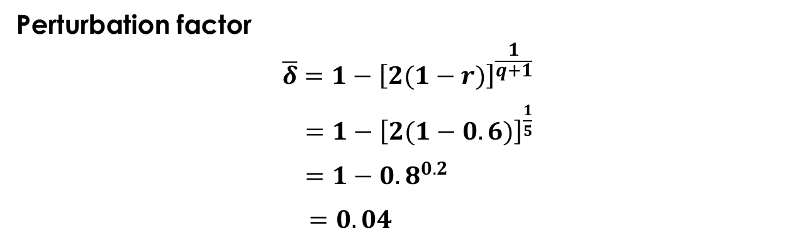
Solution:
Perturbation factor
$$\overline{δ}=1−{\left[2(1−r)\right]}^{\frac{1}{q+1}}$$
$=1−{\left[2(1−0.6)\right]}^{\frac{1}{5}}$
$=1−{0.8}^{0.2}$
$$=0.04$$

Slide 62
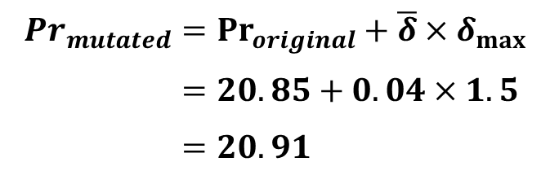
$${Pr}_{mutated}={Pr}_{original}+\overline{δ}×δ_{max}$$
$=20.85+0.04×1.5$
$=20.91$

