Slide 1
Topic 11: MULTI-OBJECTIVE OPTIMIZATION
PROF. (DR.) DILIP KUMAR PRATIHAR
MECHANICAL ENGINEERING DEPARTMENT, IIT KHARAGPUR

Slide 2
Multi-Objective Optimization
Optimization problem involving two or more than two objectives
Optimal solution depends on the weights we put on different objectives
Say, we will have to minimize both objectives 1 and 2 (cost and accident rate)
Objective 2
Objective 1

Slide 3
Multi-Objective Optimization
Pareto-optimal front: Locus of all optimal solutions obtained after putting different weights on the objectives. It is named so, according to the name of Vilfredo Pareto

Slide 4
Various Possibilities:
Pareto-Optimal
front
Pareto-Optimal
front
f₂
f₂
f₁
f₁
Pareto-Optimal
front
f₂
f₁

Slide 5
Various Possibilities:
Not
Pareto-Optimal
front
Not
Pareto-Optimal
front
f₂
f₂
f₁
f₁

Slide 6
Various Approaches
Weighted Sum Approach
Let us consider an optimization problem involving many
(say N) Objectives
Minimize f_{i}(X),
where i = 1,2,……,N
and X = (x₁, x₂,……, x_{m})^{T}

Slide 7
Multi-Objective optimization problem is transformed into a scalar (single objective) optimization problem as shown below
Minimize
where w_{i} are the weights lying between 0.0 and 1.0 and

Slide 8
w₁¹, w₂¹
f₂(X)
w₁², w₂²
w₁³, w₂³
f₁(X)

Slide 9
2. Goal Programming
The decision maker has to assign target or goal that he wishes to achieve for each objective
Minimize the absolute deviation of the objectives from their respective targets
Minimize
T_{i} : Target or goal set by the decision maker for i^{th}
objective function f_{i} (X)
It might be difficult to set T_{i} , before-hand.

Slide 10
3. Vector Evaluated GA (VEGA)
Proposed by Schaffer in 1985
Let N : population size
q : No. of objectives
Steps
Step 1:
Step 2:
Create a population of size N, at random
Carry out proportionate selection objective-wise and thus, create q sub-populations of size N/q each

Slide 11
Step 3:
Step 4:
Step 5:
Shuffling is done to put different weights on different objectives artificially. In shuffling, only the positions of the strings will be changed.
Carry out crossover
Carry out mutation

Slide 12
Concept of Non-domination and Ranks
Let us consider an optimization problem, where two objectives f₁ and f₂ are to be minimized.
3
2
1
f₂
Rank 3
Rank 2
Rank 1
f₁
Point 1 is non-dominated solution and point 2 is a dominated one.

Slide 13
3
2
1
f₂
Rank 3
Rank 2
Rank 1
f₁
All non-dominated points are assigned Rank 1.
Average fitness of Rank 1 will be better than that of Rank 2.
Reproduction will select more number of Rank 1 solutions compared to Rank 2 solutions.
Use crossover and mutation.

Slide 14
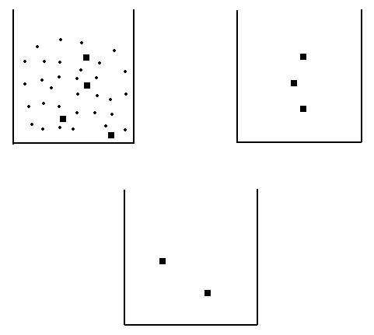
Checking for Dominance
*1: Initially selected as non-dominated point
*2: Better than all non-dominated point
*3: Better than some points of non-dominated bin but worse than some other points
*4: Worse points are put into dominated bin
*5: Worse than all non-dominated points
*1
1000 points
*2
*3
*5
Non-
dominated bin
*4
Dominated bin

Slide 15
4. Non-Dominated Sorting GA (NSGA)
Developed by Srinivas, Deb and others
Steps
Step 1:
Sort the population into a few ranks, say 1, 2 and 3 using a ranking procedure
1
f₂
2
Rank 3
3
Rank 2
12
13
Rank 1
f₁

Slide 16
1
f₂
2
Rank 3
3
Rank 2
Rank 1
Average fitness of Rank 1 solutions is better than that of Rank 2 solutions
Average fitness of Rank 2 solutions is better than that of Rank 3 solutions
12
13
f₁

Slide 17
Step 2:
Carry out proportionate selection. Thus,
there will be more copies of Rank 1
solutions in the mating pool. So, the
selection pressure is ensured.

Slide 18
Step 3:
To have a proper search, population diversity has to be maintained. Let us assume that Rank 1 front consists of 13 solutions. Solutions 1, 2, 12, 13 are far away from the other solutions, such as 3, 4, ……, 11. If by chance, the solutions: 1, 2, 12, 13 are lost from the population, a significant part of the front will be lost. To overcome this problem, the concept of sharing is used.
Sharing function
, if d_{ij} < σ_{share}
0, otherwise
We take a fixed value of σ_{share}

Slide 19
Niche count:
Summation of sharing function values
For the points: 1, 2, 12, 13: Niche count will be less
For the points: 3, 4, …., 10, 11: Niche count will have some higher values

Slide 20
Shared fitness:
Shared fitness = Individual fitness / Niche count
Shared fitness of the points: 1, 2, 12, 13 will be more compared to that of the points: 3, 4, …., 10, 11.
If proportionate selection is carried out based on shared fitness, there is a chance of getting more copies of 1, 2, 12, 13. Thus, these points will not be lost from the population and diversity will be maintained.

Slide 21
A Numerical Example
Sharing
8
(1, 8)
1
7
6
5
f₂
4
(2, 4)
2
3
(3, 3)
3
(4, 2)
2
4
(8, 1)
1
5
0
1
2
3
4
5
6
7
8
f₁

Slide 22

$$d_{12}=\sqrt{{\left(2−1\right)}^{2}+{\left(4−8\right)}^{2}}=\sqrt{17}=4.12$$
8
1
(1, 8)
7
$$d_{13}=\sqrt{{\left(3−1\right)}^{2}+{\left(3−8\right)}^{2}}=\sqrt{29}=5.38$$
6
5
f₂
$$d_{14}=\sqrt{{\left(4−1\right)}^{2}+{\left(2−8\right)}^{2}}=\sqrt{45}=6.71$$
4
2
(2, 4)
3
3
(3, 3)
2
(4, 2)
$$d_{15}=\sqrt{{\left(8−1\right)}^{2}+{\left(1−8\right)}^{2}}=\sqrt{98}=9.90$$
4
(8, 1)
1
5
0
1
2
3
4
5
6
7
8
f₁
$${Let σ}_{share}=6.00$$

Slide 23
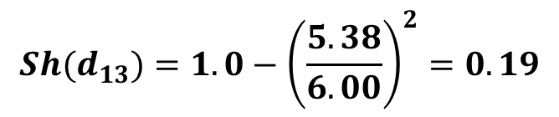
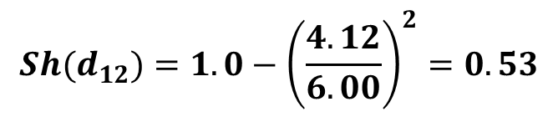


$$Sh(d_{12})=1.0−{\left(\frac{4.12}{6.00}\right)}^{2}=0.53$$
$$Sh(d_{13})=1.0−{\left(\frac{5.38}{6.00}\right)}^{2}=0.19$$
$$Sh(d_{14})=0.0$$
$$Sh(d_{15})=0.0$$
Niche count of point 1 = 0.53+0.19+0.0+0.0 = 0.72

Slide 24
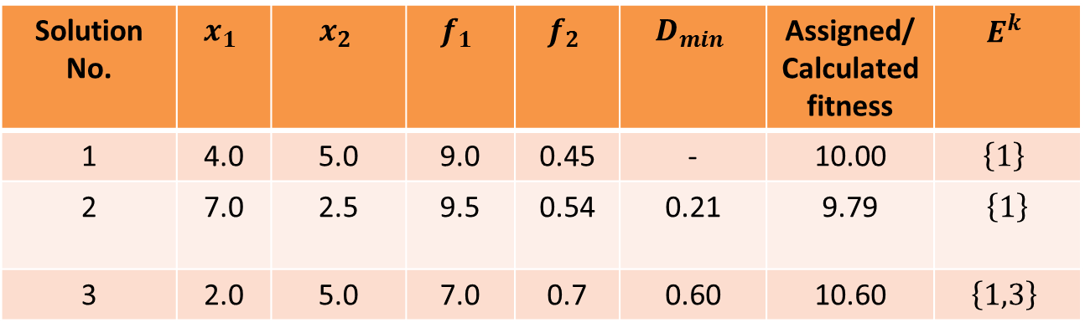

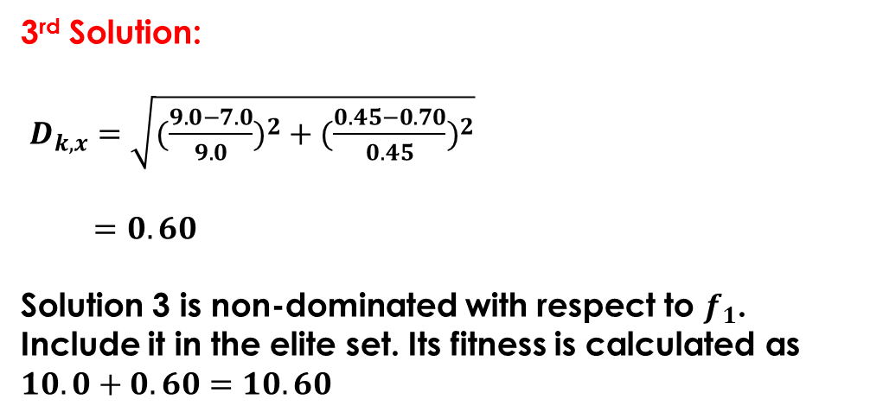
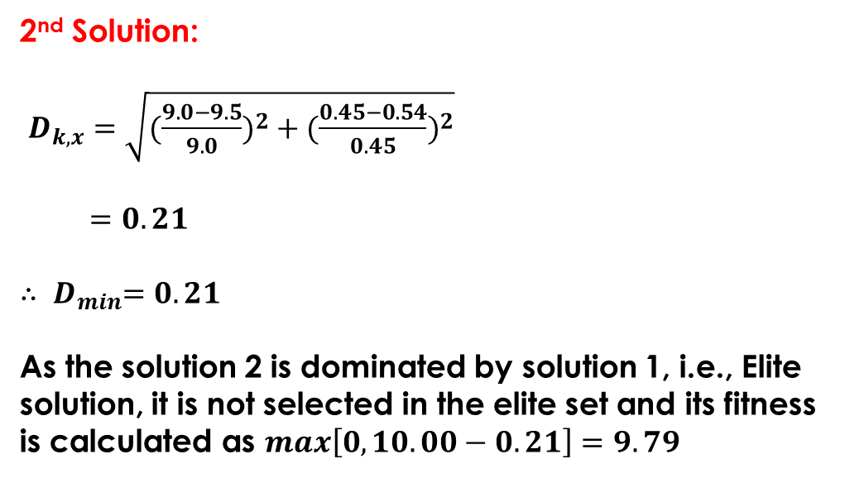
$$d_{21}=4.12$$
8
1
(1, 8)
7
6
$$d_{23}=\sqrt{{\left(3−2\right)}^{2}+{\left(3−4\right)}^{2}}=\sqrt{2}=1.41$$
5
f₂
4
(2, 4)
2
$$d_{24}=\sqrt{{\left(4−2\right)}^{2}+{\left(2−4\right)}^{2}}=\sqrt{8}=2.83$$
3
3
(3, 3)
2
(4, 2)
4
(8, 1)
1
5
$$d_{25}=\sqrt{{\left(8−2\right)}^{2}+{\left(1−4\right)}^{2}}=\sqrt{45}=6.71$$
0
1
2
3
4
5
6
7
8
f₁

Slide 25
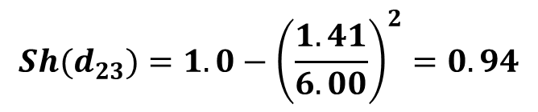
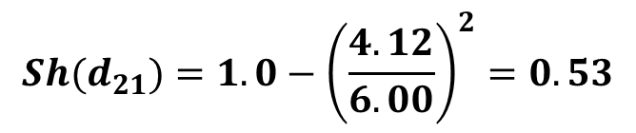

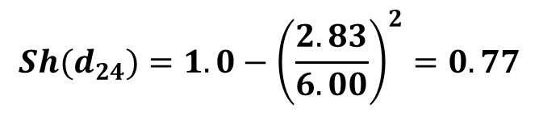
$$Sh(d_{21})=1.0−{\left(\frac{4.12}{6.00}\right)}^{2}=0.53$$
$$Sh(d_{23})=1.0−{\left(\frac{1.41}{6.00}\right)}^{2}=0.94$$
$$Sh(d_{24})=1.0−{\left(\frac{2.83}{6.00}\right)}^{2}=0.77$$
$$Sh(d_{25})=0.0$$
Niche count of point 2 = 0.53 + 0.94 + 0.77 + 0.0 = 2.24

Slide 26
$$d_{31}=\sqrt{{\left(3−1\right)}^{2}+{\left(3−8\right)}^{2}}=\sqrt{29}=5.38$$
8
1
(1, 8)
7
6
$$d_{32}=\sqrt{{\left(3−2\right)}^{2}+{\left(3−4\right)}^{2}}=\sqrt{2}=1.41$$
5
f₂
4
(2, 4)
2
3
3
(3, 3)
$$d_{34}=\sqrt{{\left(4−3\right)}^{2}+{\left(2−3\right)}^{2}}=\sqrt{2}=1.41$$
2
(4, 2)
4
(8, 1)
1
5
0
$$d_{35}=\sqrt{{\left(8−3\right)}^{2}+{\left(1−3\right)}^{2}}=\sqrt{29}=5.38$$
1
2
3
4
5
6
7
8
f₁

Slide 27
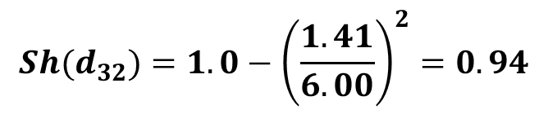
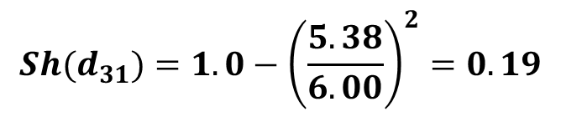
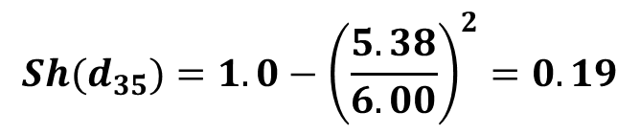
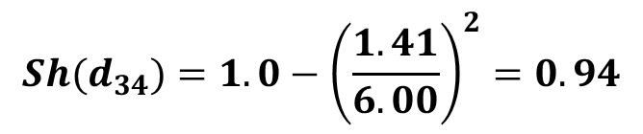
$$Sh(d_{31})=1.0−{\left(\frac{5.38}{6.00}\right)}^{2}=0.19$$
$$Sh(d_{34})=1.0−{\left(\frac{1.41}{6.00}\right)}^{2}=0.94$$
$$Sh(d_{32})=1.0−{\left(\frac{1.41}{6.00}\right)}^{2}=0.94$$
$$Sh(d_{35})=1.0−{\left(\frac{5.38}{6.00}\right)}^{2}=0.19$$
Niche count of point 3 = 0.19+0.94+.094+0.19 = 2.26

Slide 28
8
1
(1, 8)
$$d_{41}=\sqrt{{\left(4−1\right)}^{2}+{\left(2−8\right)}^{2}}=\sqrt{45}=6.71$$
7
6
5
$$d_{42}=\sqrt{{\left(4−2\right)}^{2}+{\left(2−4\right)}^{2}}=\sqrt{8}=2.83$$
f₂
4
(2, 4)
2
3
3
(3, 3)
2
(4, 2)
4
(8, 1)
$$d_{43}=\sqrt{{\left(4−3\right)}^{2}+{\left(2−3\right)}^{2}}=\sqrt{2}=1.41$$
1
5
0
1
2
3
4
5
6
7
8
$$d_{45}=\sqrt{{\left(8−4\right)}^{2}+{\left(1−2\right)}^{2}}=\sqrt{17}=4.12$$
f₁

Slide 29
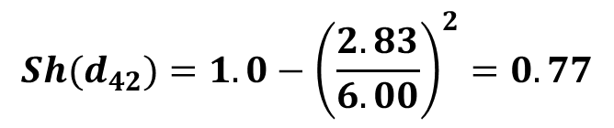

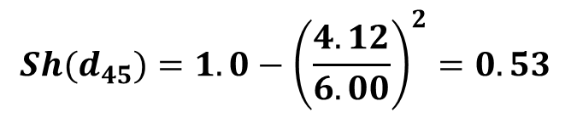
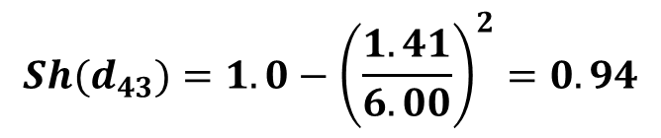
$$Sh(d_{41})=0.0$$
$$Sh(d_{42})=1.0−{\left(\frac{2.83}{6.00}\right)}^{2}=0.77$$
$$Sh(d_{43})=1.0−{\left(\frac{1.41}{6.00}\right)}^{2}=0.94$$
$$Sh(d_{45})=1.0−{\left(\frac{4.12}{6.00}\right)}^{2}=0.53$$
Niche count of point 4 = 0.00+0.77+.094+0.53 = 2.24

Slide 30
$$d_{51}=\sqrt{{\left(8−1\right)}^{2}+{\left(1−8\right)}^{2}}=\sqrt{98}=9.90$$
8
1
(1, 8)
7
$$d_{52}=\sqrt{{\left(8−2\right)}^{2}+{\left(1−4\right)}^{2}}=\sqrt{45}=6.71$$
6
5
f₂
4
(2, 4)
2
$$d_{53}=\sqrt{{\left(8−3\right)}^{2}+{\left(1−3\right)}^{2}}=\sqrt{29}=5.38$$
3
3
(3, 3)
2
(4, 2)
4
(8, 1)
1
5
$$d_{54}=\sqrt{{\left(8−4\right)}^{2}+{\left(1−2\right)}^{2}}=\sqrt{17}=4.12$$
0
1
2
3
4
5
6
7
8
f₁

Slide 31
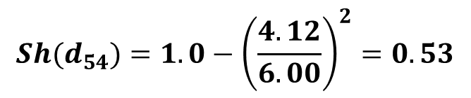
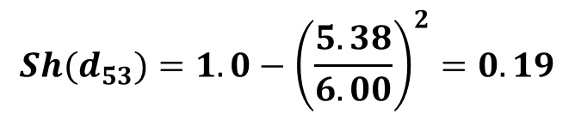


$$Sh(d_{51})=0.0$$
$$Sh(d_{52})=0.0$$
$$Sh(d_{53})=1.0−{\left(\frac{5.38}{6.00}\right)}^{2}=0.19$$
$$Sh(d_{54})=1.0−{\left(\frac{4.12}{6.00}\right)}^{2}=0.53$$
Niche count of point 5 = 0.0+0.0+0.19+0.53 = 0.72

Slide 32
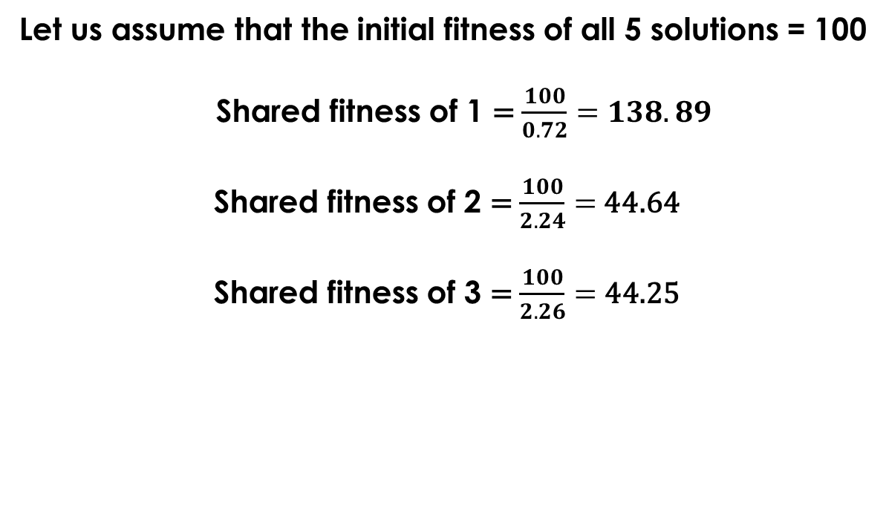
Let us assume that the initial fitness of all 5 solutions = 100
Shared fitness of 1 = $\frac{100}{0.72}=138.89$
Shared fitness of 2 = $\frac{100}{2.24}=$44.64
Shared fitness of 3 = $\frac{100}{2.26}=$ 44.25

Slide 33
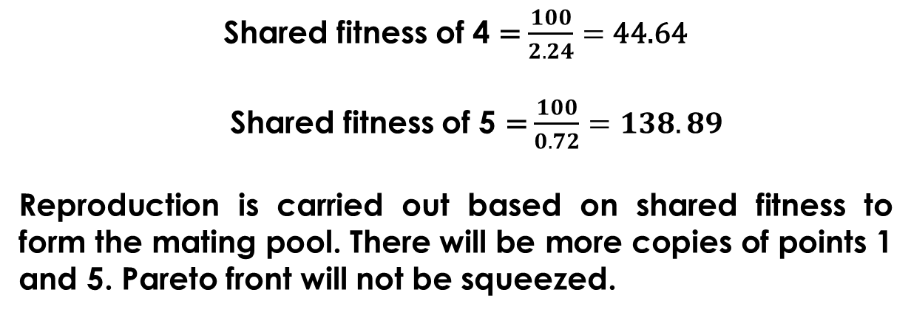
Shared fitness of 4 = $\frac{100}{2.24}=$ 44.64
Shared fitness of 5 = $\frac{100}{0.72}=138.89$
Reproduction is carried out based on shared fitness to form the mating pool. There will be more copies of points 1 and 5. Pareto front will not be squeezed.

Slide 34
Disadvantages of NSGA
Determining a proper value of σ_{share} is difficult
High computational complexity. O(MN³): where M = No. of objectives and N = Population size
Lack of elitism

Slide 35
NSGA-II
Sharing function approach is replaced by Crowding distance approach
f₂
cuboid
i-1
i
i+1
f₁

Slide 36
Crowding distance of i^{th} solution lying on the front is the side length of the cuboid
Crowding distance will be less for more crowded solutions
Solutions having more crowding distance values will be preferred in reproduction scheme to form the mating pool

Slide 37
Perimeter of cuboid surrounding point 1: infinite (high value, say 1000)
Perimeter of cuboid surrounding point 2: 14 unit
Perimeter of cuboid surrounding point 3: 8 unit
Perimeter of cuboid surrounding point 4: 14 unit
Perimeter of cuboid surrounding point 5: infinite (high value, say 1000)
Crowding distance
Cuboid
1
8
Cuboid
(1, 8)
7
6
5
Cuboid
Cuboid
f₂
(2, 4)
4
2
(3, 3)
Cuboid
3
3
(4, 2)
2
4
(8, 1)
1
5
0
1
2
3
4
5
6
7
8
f₁

Slide 38
During Reproduction, points having high crowding distance value will be preferred . Thus, points 1 and 5 will be preferred to points 2, 3 and 4. There will be more copies of the points 1 and 5 in the mating pool. Spread of the Pareto-optimal front will be maintained.

Slide 39
Advantages of NSGA-II
Computationally faster than NSGA
Principle of elitism is used

