Slide 1
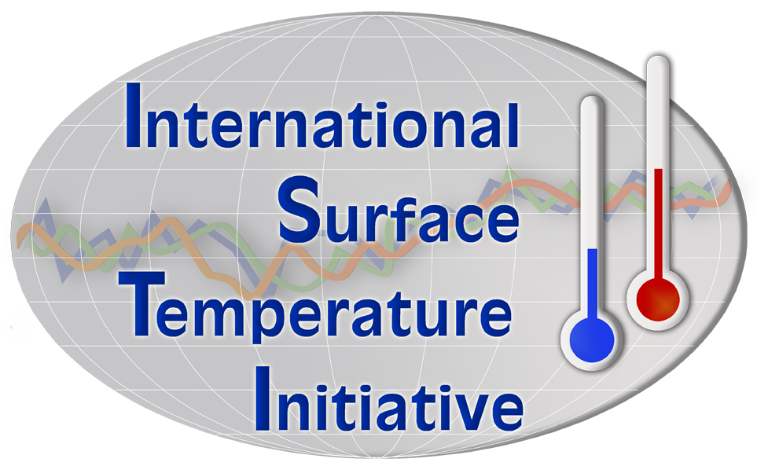

Initiative overview
30 November 2011
Jay Lawrimore
Chief, Ingest and Analysis Branch, NCDC

Slide 2
Talk Outline
Background
Global Land Surface Temperature Databank
  Stages of Data
Tour of Databank ftp site
A few thoughts regarding Metadata

Slide 3
Background
Global surface temperature records are a key line of evidence of climate change
  Backed by many other indicators (ice loss, humidity increases, sea level increases etc.)
Examples of Limitations with current global data
  Much of the work was undertaken in late 1980’s/ early 1990’s - technology and expectations have changed since then
  Little metadata in most areas of the world
  Significant spatial and temporal gaps
  Data holdings are dispersed with poor provenance / version control

Slide 4
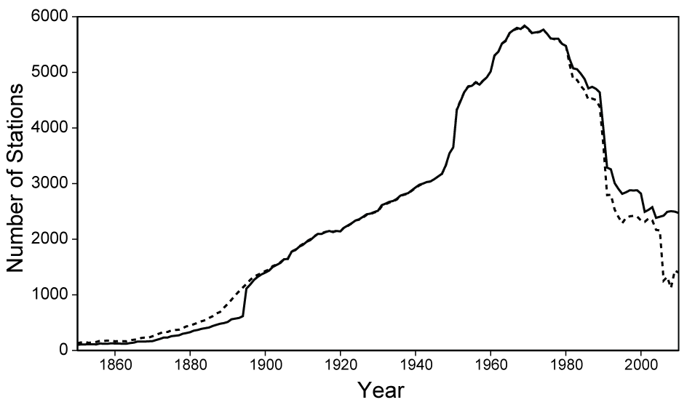
Number of Stations in GHCN-Monthly

Slide 5
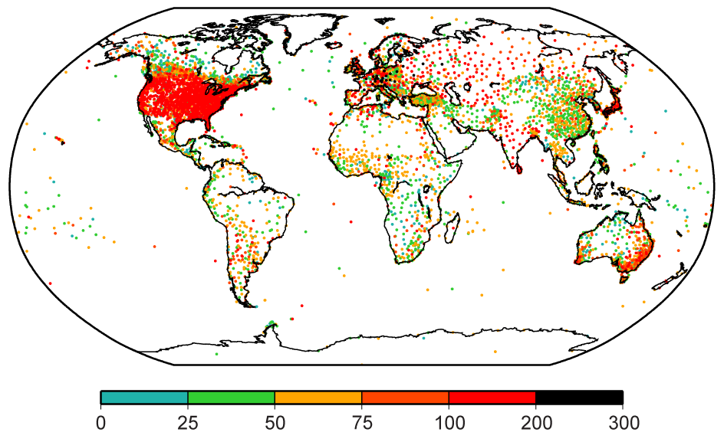
Number of Stations in GHCN-Monthly

Slide 6
Ultimate Goal
A suite of verified estimates of land surface temperatures that can be used to answer scientific and societal demands of the 21st Century?
  Open and transparent
  Better understanding of fundamental instrument performance
  Consistent performance evaluation
  User tools
  Not just monthly at the largest scales. Daily, sub-daily, regional and local

Slide 7
How the initiative was started
2010 Submission to World Meteorological Organization Commission for Climatology
  Call for creating new suite of products to meet 21st Century demands / expectations
September 2010 instigation workshop
  80 international experts including climate scientists, metrologists, statisticians, software engineers
  White papers posted online and public comments solicited
  Agreed project outline and governance structure
  Agreed outcomes published in Bull. Amer. Met. Soc. doi: 10.1175/2011BAMS3124.1

Slide 8
3 Aspects of Initiative
Development of Global Databank
  Chair: Jay Lawrimore
QC/Homogeneity Adj/Benchmarking
  Chair: Kate Willett
Data Access
  Chair: Peter Thorne
Steering Committee; Chair: Peter Thorne

Slide 9
Global Land Surface Databank Stages
Stage 0: Original paper record or digital image
Stage 1: Keyed data in the native format
Stage 2: All data converted to a common format and Data Provenance flags added
Stage 3: Data combined into a single integrated dataset with duplicate source data reconciled
Stage 4: Quality controlled data
Stage 5: Bias corrected data

Slide 10
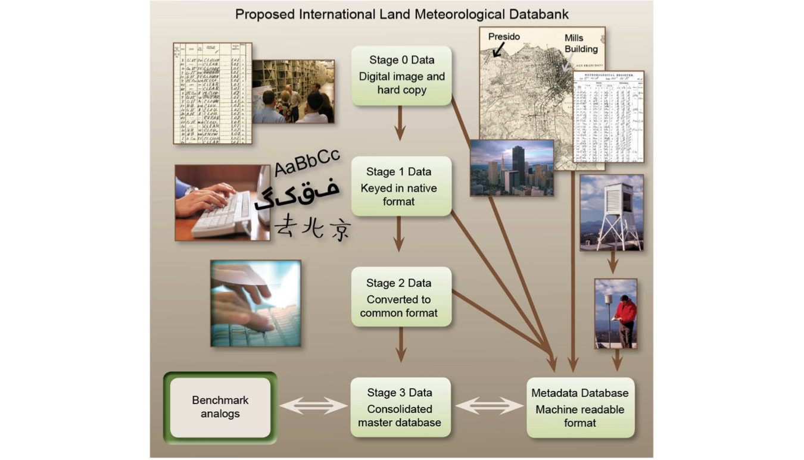
Data rescue and provision

Slide 11
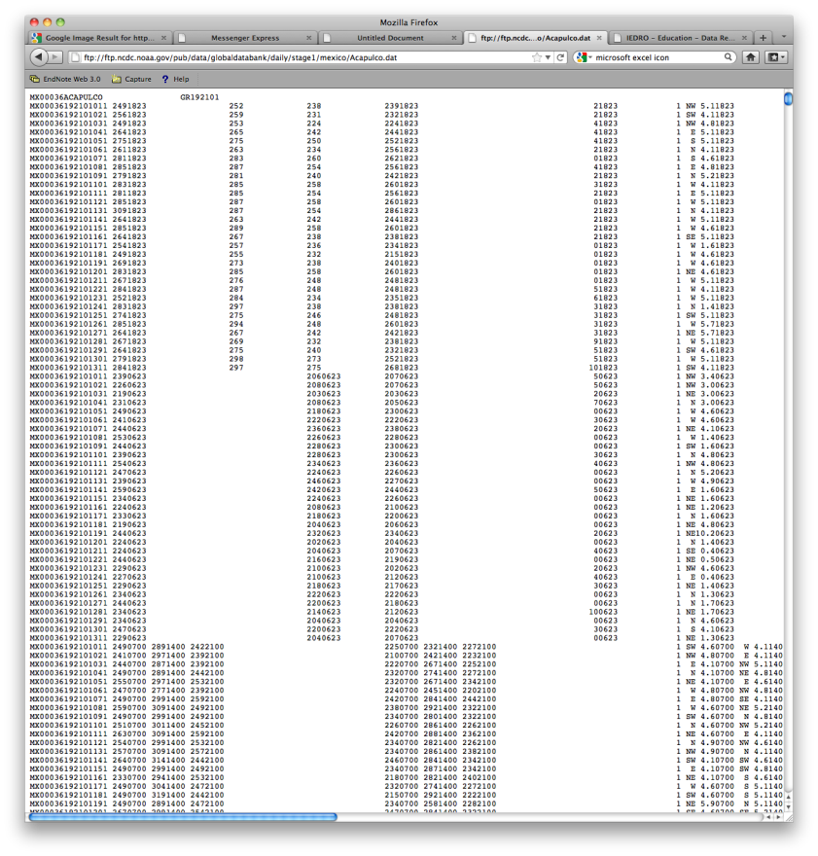

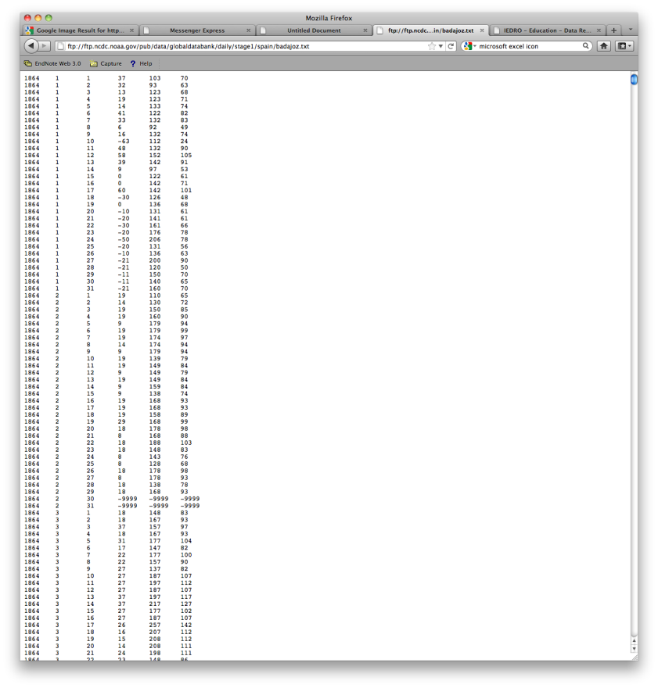
Stage 1 - Native format digitized

Slide 12
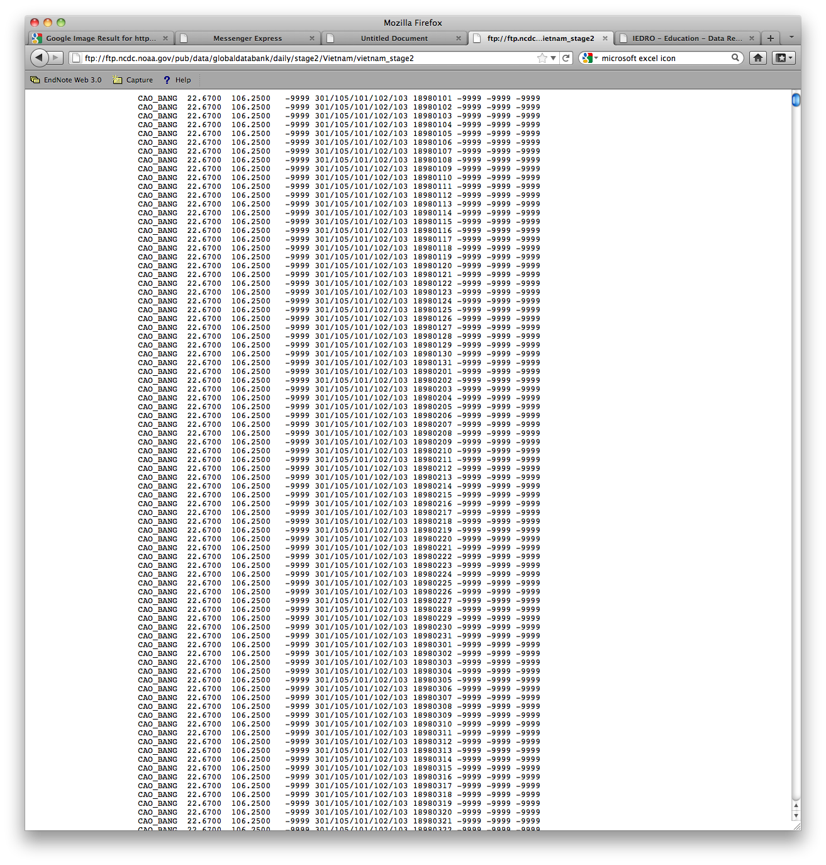
Stage 2 – common format
Provenance / version control flags

Slide 13
Stage 3 Data
Same format as stage 2
One unique version for each station – recommended version for most users
Protocols used in merging sources are currently being established
Provenance tracking will ensure an unbroken chain to earlier stages
Release of version 1 planned April 2012

Slide 14
Stage 4 and Stage 5 Data
The Stage 3 data provide the foundation for further development through
  Application of various Quality Control methods (Stage 4) and
  Various Homogeneity Adjustment methods (Stage 5)
Need multiple independent efforts with different choices
  Quality control choices
  Homogenization decisions
  Averaging procedures
Should not just be climate scientists as need broad range of approaches
  Statisticians, metrologists, software engineers, citizen scientists etc.
Distinct approaches pinpoint key uncertainties so redundancy is of fundamental scientific value.

Slide 15
Databank Working Group
Working Group has been in place since 2010
  Data rescue task team
  Provenance and version control task team
Development version posted
  http://www.gosic.org/GLOBAL_SURFACE_DATABANK/GBD.html
First version release and accompanying documentation / paper to be submitted spring 2012

Slide 16
Contributions to the Databank
Contributions to the Databank have already begun and include new data sources from Brazil, Uruguay, the Netherlands, Japan, Spain, Antarctica, and many other countries
Data provided by NMSs in their native format are considered Stage 1
As part of initial processing they are converted to a common format and have data provenance tracking flags added to each data value
  These flags provide traceability back to the original source and help guarantee data authenticity, integrity, and quality

Slide 17
Databank Online
The Databank has been established at two sites, providing data in Stage 1 and Stage 2 formats at
ftp://ftp.ncdc.noaa.gov/pub/data/globaldatabank/
And a Mirror Site at World Data Center B
ftp://ftp.meteo.ru/pub/data/globaldatabank/

Slide 18
Ways to Contribute
Help to find raw data sources
  Data submissions are accepted in any format.
  Data can be provided via FTP, E-mail, or CD-ROM.
  Our Databank submission guidance letter provides additional details:
    available at http://www.surfacetemperatures.org/databank
Come up with novel ways of analyzing the data
Provide feedback

Slide 19
A Few Comments About Metadata

Slide 20
Metadata Needs
Metadata collection at NCDC for stations outside U.S. networks has received little attention in comparison to U.S. networks
Detailed station histories have yet to be fully exchanged internationally
  Is a standard station history format needed? or more attention needed?
Most available global metadata at NCDC is outdated
Little to no information on observing instruments, practices, and surrounding areas
In the last two decades greater capabilities emerged such as higher density gridded topographical data and mapping capabilities such as Google Maps

Slide 21
Metadata
Metadata for stations outside the U.S. are contained primarily in ASCII flat files of the Global Historical Climatology Network-Monthly and -Daily datasets and the newly established International Surface Temperature Databank
Metadata often consists of no more than station location and elevation

Slide 22
Metadata
The GHCN-Monthly version 2 dataset development process included development of additional metadata using other sources such as
  Digital Elevation Models
  Night-Light data from Satellites to determine urban versus rural areas
  Operational Navigation Charts to assess distance to airports, oceans, lakes, and other topographical features.

Slide 23
Metadata Options
Some potential options to consider:
  Photographs of present conditions, coordinates, station contacts, instrument type, etc.
  General description of surroundings (in addition to option (a))
  Assign a code of 0-9 which best describes the current predominant land use within circles around each station at radii of 100 m, 1 km, and 10 km
  The intent should be to code the predominant types of land use; not all types.

Slide 24


Questions and Answers
www.surfacetemperatures.org
General.enquiries@surfacetemperatures.org
Data.submission@surfacetemperatures.org

