Slide 1
Landing Club case study
Contributor
Ratnesh Zinzuwadia
Rajesh Sharma
C-45, Sep-22 Batch

Slide 2
Abstract
Lending Club is the largest online loan marketplace, facilitating personal loans,
business loans, and financing.
Borrowers can easily access lower-interest-rate loans through a fast online
interface.
The objective of the analysis is to use the information about past loan applicants
and find whether they ‘defaulted’ or not.

Slide 3
Problem-solving methodology
Data Cleaning
Data Understanding
Univariate Analysis
Segmented Univariate Analysis
Bivariate Analysis

Slide 4
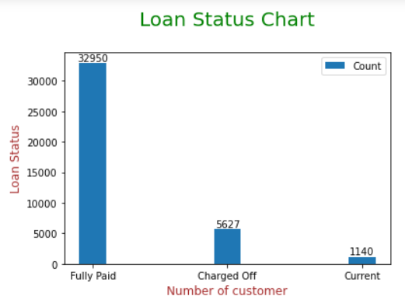
Univariate Analysis of Loan Status

Slide 5
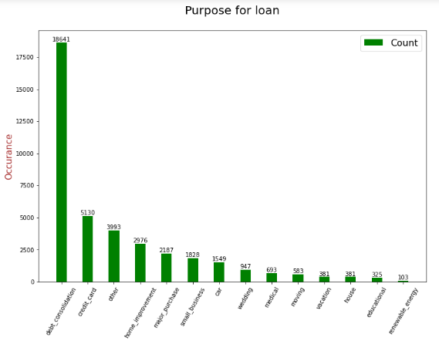
Below Purpose distribution chart tells, mostly borrower applied for a loan
with purpose of “debt consolidation”.

Slide 6
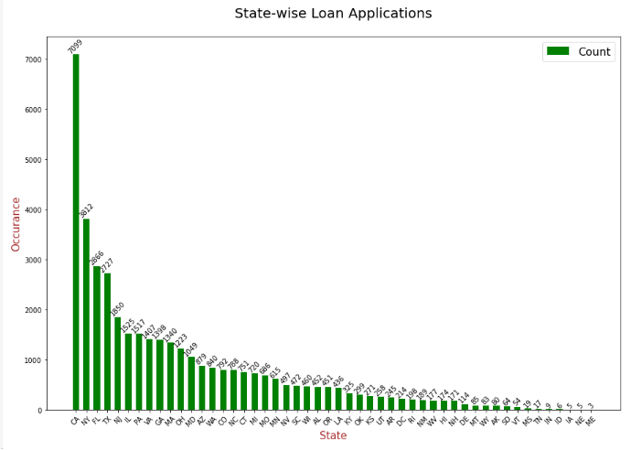
State Loan distribution

Slide 7
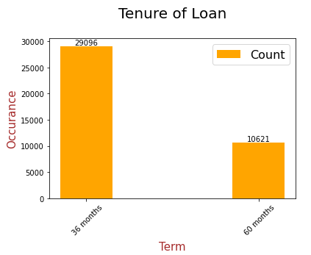
Term Distribution
AS per this chart, loan with
36 month tenure option
available with more borrowers.

Slide 8
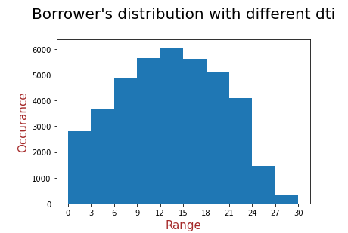
Histogram DTI range
Distribution of DTI borrowers in histogram

Slide 9
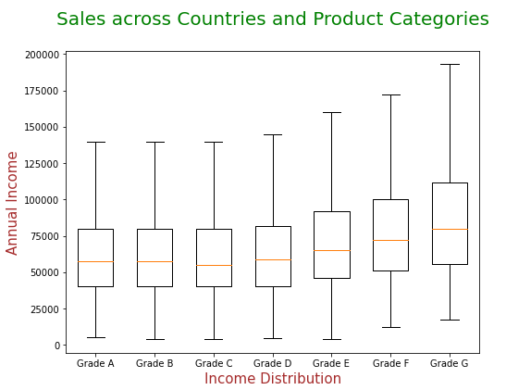
Box plot for annual income
This graph shows, the Annual Income of borrower are high for Grade F and Grade G

Slide 10
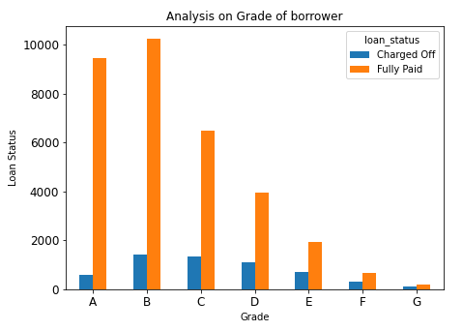
Grade vs Loan Status
- It is observed that Grade of borrower have relation on loan status.
- Here is the graph which provides comparison between different
grade of borrowers

Slide 11
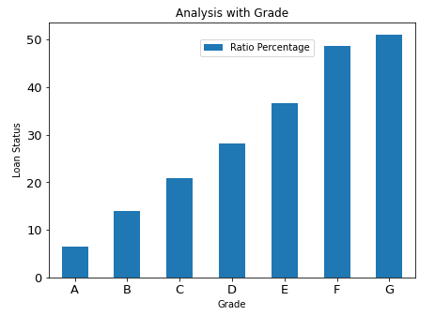
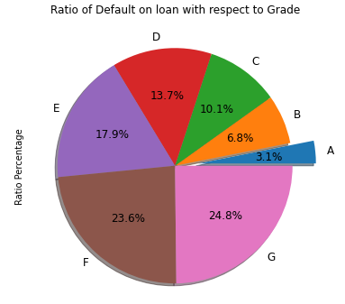
Grade Analysis In Percentage
- As per given Bar chart Grade A have lowest
Loan default rate
If we show information in pie chart format,
The relative percentage comes lowest
around 3 % ratio For Grade A borrowers.

Slide 12
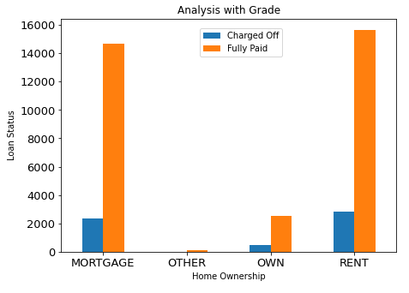
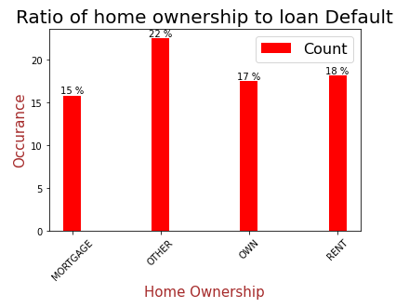
Home Ownership vs Loan Status Analysis
Mortgage home ownership have
lowest default rate in percentage
Also The borrowers whose home
Ownership is “Other” have high default rate

Slide 13
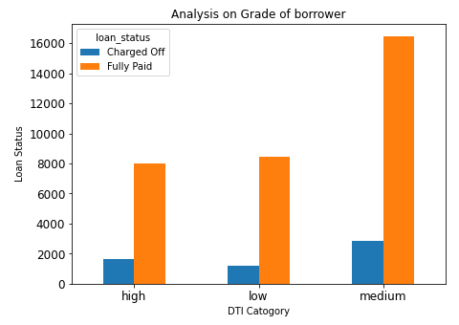
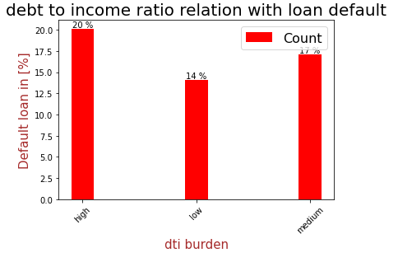
DTI vs Loan status
Dti is the ratio which Provide monthly
debt/expense ratio of borrowers.
Lower the dti ratio lower the change
of loan default
It is likely that low dti ratio borrower
Likely to pay full loan.

Slide 14
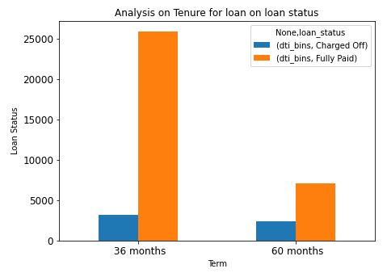
Term vs Loan Status
- As per above bar chart, We have taken two tenure 36 month and 60 month.
- Borrower with tenure 36 month are likely to fully pay the loan.

Slide 15
Conclusions
Lending club should check borrowers grade in order to reduce risk.
Grade A candidate more likely to pay full loan.
Lending club should reduce the loans for 60 months tenure,
they are prone to loan default.
Opposite to that 36 month term shows less loan default average
Home ownership with Other are likely to default the loan. And Mortgage
May have more chance to fully pay the loan.
Lower the dti ratio lower the change of loan default. It is likely
that low dti ratio borrower Likely to pay full loan.

Slide 16
Thank you

