Slide 1
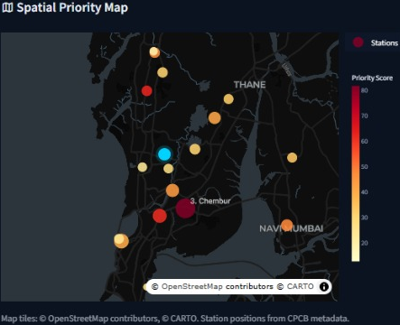
City Pulse: Mumbai
HACKAMATCH 1.0 · DATA MAVERICKS × NSDC
Where should limited inspection teams go this week, and why?
Ratnesh Pathak · Rishi Chaurasiya · Shreya Pandey
Decision-support prototype. Not an official warning system.
Live: citypulse-mumbai.streamlit.app
Notes:
0:00-0:25. HOOK. Picture a Mumbai officer on Monday morning. There are 36 monitoring stations, a handful of inspection teams, and one question: where do we send them this week? Right now the answer is usually gut feeling or whoever complained loudest. We built CityPulse to make that decision faster, fairer and explainable. (Slow down, make eye contact.)

Slide 2
Where do we send the teams?
A Mumbai officer, Monday morning: 36 stations, a handful of inspection teams, one question.
64 → 185
153 vs 89
36
Mean station-day AQI: monsoon (Jun–Sep) vs winter (Dec–Feb)
Average AQI: Mazgaon vs Borivali East. Where you look matters.
CAAQMS stations, one weekly allocation decision
Officers need a ranking they can trust and defend, not another dashboard of raw numbers.
Notes:
0:25-0:50. THE PROBLEM. Air quality here swings hard. Our data shows an average station-day AQI of about 64 in the monsoon and about 185 in winter. Mazgaon averages 153 while Borivali East averages 89. So where you look matters, and when you look matters. Officers need a ranking they can trust and defend, not another dashboard of raw numbers.

Slide 3
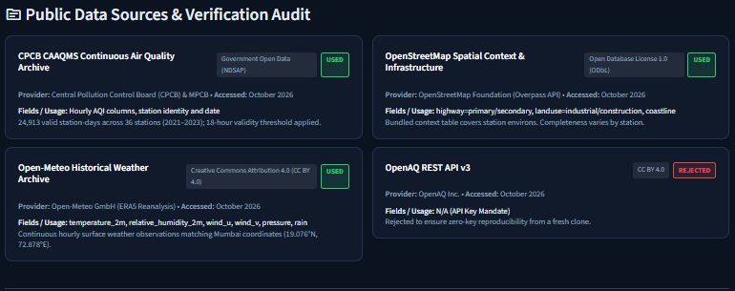
Open data only, fully reproducible
597,912
hourly AQI records, 36 stations (2021–2023)
26,280
hourly weather observations (Open-Meteo)
OpenAQ was rejected: its API needs a key, which would break a fresh-clone run.
No API keys. No synthetic data. Runs from a fresh clone.
Notes:
Data slide. 597,912 deduplicated hourly AQI records from 36 CPCB/MPCB stations (Jan 2021 to Dec 2023), plus 26,280 hourly weather observations from Open-Meteo. Licences: CPCB government open data (NDSAP), Open-Meteo CC BY 4.0, OpenStreetMap ODbL. Provenance is in the Audit tab and DATA_SOURCES.md. We rejected OpenAQ v3 because it needs an API key and would break reproducibility from a fresh clone. Likely judge question: 'Is it licensed?' - answer from this slide.

Slide 4
A transparent five-part score
1
Discover
Seasons, stations and wind show where and when air quality turns bad.
2
Predict
Next-day AQI plus the risk of a severe day (AQI > 200).
3
Explain
A waterfall shows how each criterion built a zone's score.
4
Act
Top-N zones for your capacity, a route and an action dossier.
Notes:
0:50-1:40 (part 1). CityPulse ranks every zone with a five-part priority score: current exposure, how persistent the problem is, which way it is trending, the forecast risk of a severe day, and a vulnerability gap for under-monitored places. These are the default weights; the officer can change them. Workflow is Discover, Predict, Explain, Act.

Slide 5
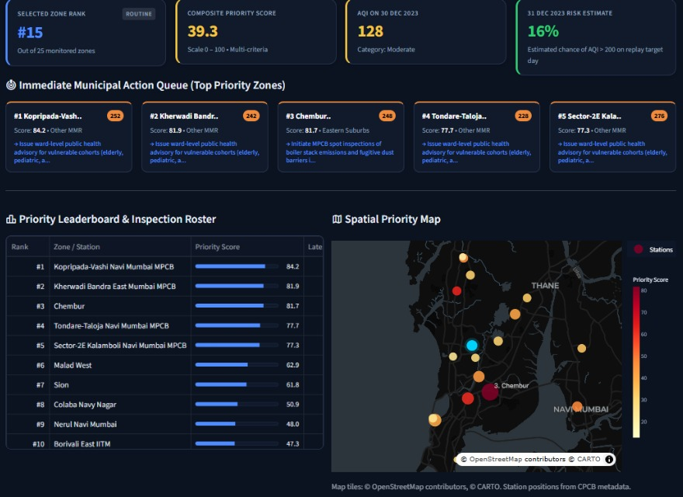
Demo: rank, flag, assign
Set capacity
Say 5 zones: the top 5 are flagged for inspection.
Read the queue
Each flagged zone carries a one-line intervention.
See Where
Leaderboard and map show the same ranking.
Notes:
DEMO, tab 1 (Priority Rankings). The officer sets a capacity, say 5 zones, and the top 5 are flagged. The Immediate Municipal Action Queue shows each flagged zone with its score and a suggested intervention. The leaderboard and the spatial priority map show the same ranking. Note: this is a historical replay (data through 30 Dec 2023), not a live alert.

Slide 6
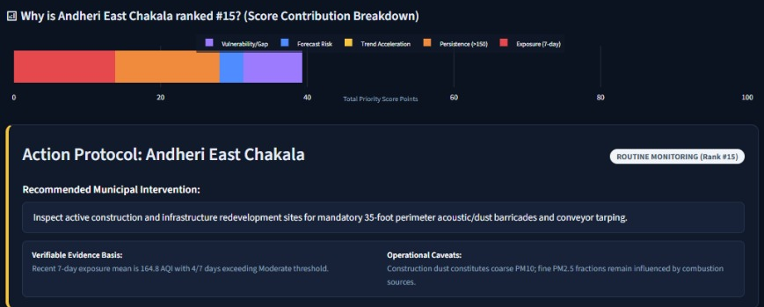
Every rank comes with its reasons
Waterfall = score by criterion. Dossier = rule-based action, evidence, and operational caveats.
Notes:
DEMO, waterfall (your strongest visual). A waterfall chart shows how each criterion contributed to the zone's score, so every rank can be explained and audited. Below it, the action dossier gives a rule-based suggestion such as wet suppression or mechanical sweeping, with the evidence basis and operational caveats. Stay on this slide a little longer.

Slide 7
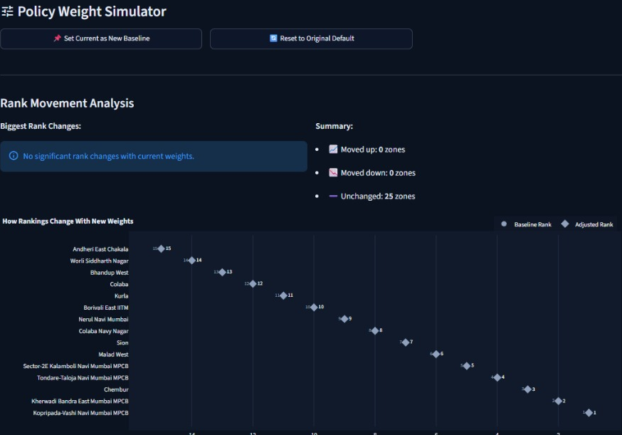



What if the policy changes?
What-if simulator
Change the weights; 500 Monte Carlo runs show which zones stay on top.
Route planner
Flagged zones become a field tour with distances.
Briefing export
One click for a printable weekly briefing.
Notes:
DEMO, tabs 2-4. A what-if simulator lets the officer change the weights and runs 500 Monte Carlo trials to show which zones stay in the top list no matter what. A route planner turns the flagged zones into a field tour with distances. One click exports a printable weekly briefing. Use the live app here; for the route planner, select a top-5 set so the tour shows several stops.

Slide 8
What the data told us
Wind speed and AQI correlate at r = −0.25. A signal, not proof: season and location may confound it.
Notes:
1:40-2:00. WHAT THE DATA TOLD US. Wind matters. Wind speed and AQI correlate at about minus 0.25, and severe days above 200 happen on 16.2 percent of station-days in the calmest wind quintile versus 5.8 percent in the windiest. We flag that season and location may confound this, so we treat it as a signal, not proof. Seasonal means: 63.9 (monsoon) and 185.0 (winter).

Slide 9
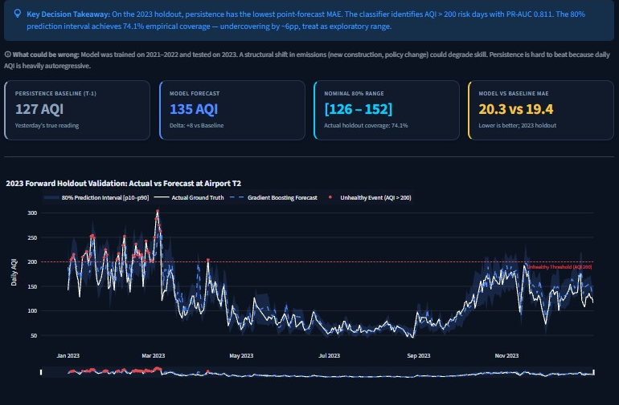
Honest validation
Next-day mean AQI · strict time split · 2023 holdout
Model | MAE | RMSE
Persistence (t−1) | 19.42 | 30.38
Ridge regression | 19.58 | 28.65
Gradient boosting | 20.35 | 29.92
Seasonal naive (t−7) | 34.57 | 50.01
0.87 vs 0.72
0.59 vs 0.72
Classifier vs persistence. PR-AUC 0.81, ROC-AUC 0.95. The 80% interval covered 74.1%: exploratory only.
recall on AQI > 200 days
precision: more false alarms
On MAE, no point forecaster beats yesterday's value, and we say so.
Notes:
2:00-2:35. YOUR CREDIBILITY MOMENT. We tested on a strict time split: train on earlier years, test forward, no shuffling. For next-day AQI, yesterday's value is a very hard baseline. On the 2023 holdout, persistence has MAE 19.42, Ridge 19.58, gradient boosting 20.35. None of our point forecasters beat it on MAE (Ridge is slightly better on RMSE, 28.65 vs 30.38). Where ML helps is risk screening: for severe days above 200, recall is 0.87 versus 0.72 for persistence, with PR-AUC 0.81 and ROC-AUC 0.95. The trade-off is lower precision, 0.59 versus 0.72: it catches more severe days at the cost of more false alarms. We also backtest the decision itself: simulated weekly inspection cycles show double-digit lift over random allocation (CHECK the exact figure on Tab 8 and say it here). Speak the numbers slowly: 0.87 vs 0.72; 19.42.

Slide 10






Limits and responsible use
Hard to beat persistence
Ranges under-cover
Historical replay
Daily AQI is strongly autoregressive; no point model beat yesterday.
The nominal 80% range covered 74.1%. Exploratory, not a guarantee.
Data runs 2021–2023. The app replays history; it is not a live alert.
Point stations
Not causal
Triage, not enforcement
Stations cluster on highways; unmonitored wards need proxies.
Diwali 2023 showed no clear effect (AQI −8); weather may mask it.
Guides inspections. Never the sole basis for punitive action.
Notes:
2:35-2:50. RESPONSIBLE USE. CityPulse is a screening and triage tool. It tells you where to look first, not who to punish. It should guide physical inspections, never serve as the sole basis for enforcement. Stations are point measurements and cluster along highways, so coverage is uneven, and we say that up front. Also say: the app replays history through 30 Dec 2023; it is not a live alert. The Diwali 2023 case study shows no clear effect and carries an explicit non-causal caveat. Judge question on intervals: nominal 80% reached about 74% coverage, so they are not perfectly calibrated.

Slide 11
Limited resources should go where the evidence points, and every ranking should come with its reasons.
NEXT: DATA THAT WOULD IMPROVE CONFIDENCE
Satellite AOD
Denser local sensors
Live traffic data
Construction permits
Live app: citypulse-mumbai.streamlit.app
Code: github.com/RishiBuilds/CityPulse
Thank you. Questions?
Ratnesh · Rishi · Shreya
Notes:
2:50-3:00. CLOSE. CityPulse does not claim to out-predict yesterday. It claims something more useful: that limited resources should go where the evidence points, and that every ranking should come with its reasons. Thank you. We would love your questions. Prepare for Q&A using the Likely judge questions page of the pitch script.

