Slide 1
ZOP
Made with lots of ♥
By The Oreo

Slide 2
Background
Purpose:
make the backend better******
Scope:
Intended for beginner game developers
Casual gamers
Python enthusiasts
Inspiration:
Found on github
Simple game design → open ended

Slide 3
Zop by Zolmeister
https://zop.zolmeister.com/#/

Slide 4
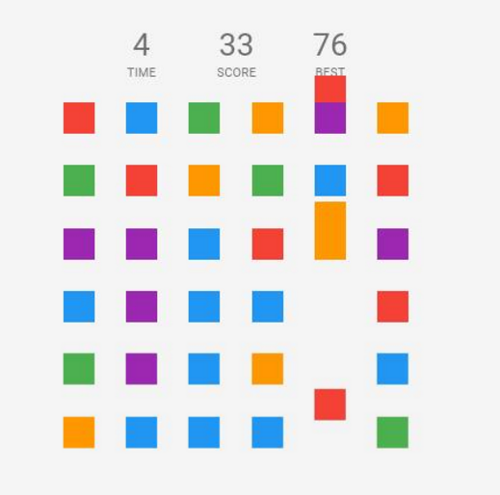
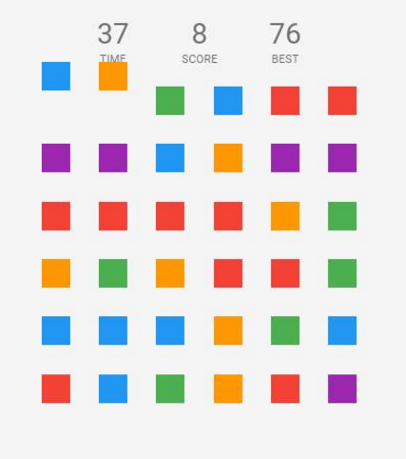
Zolmeister hates organization
PROS | CONS
Portability | Lack of documentation and comments
GUI | Code design is flawed
 | Bugs and Glitches are very common

Slide 5
Zop Demo by The Oreo

Slide 6
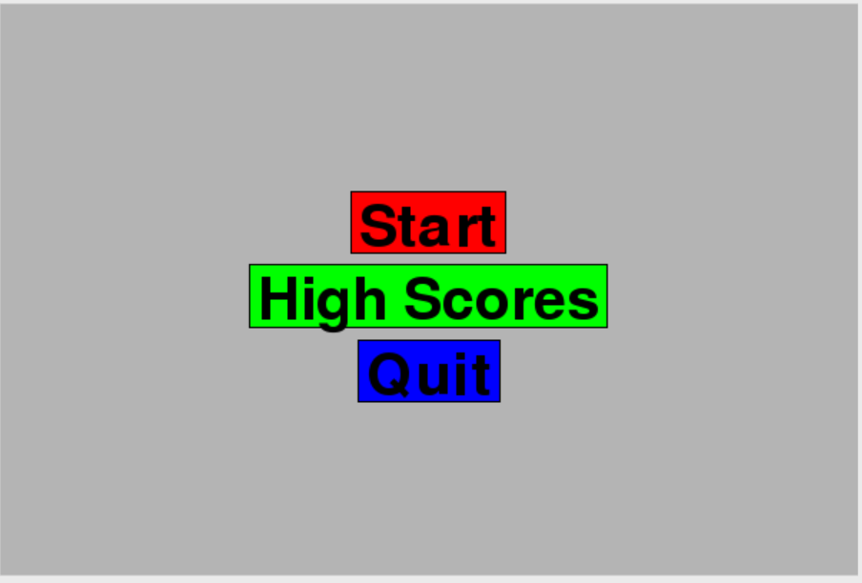
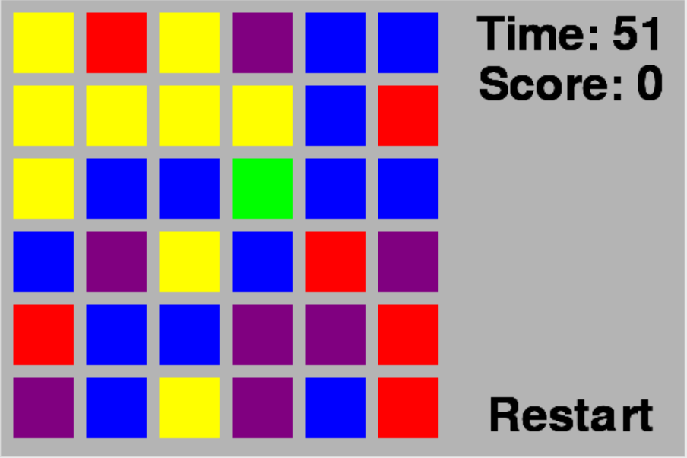
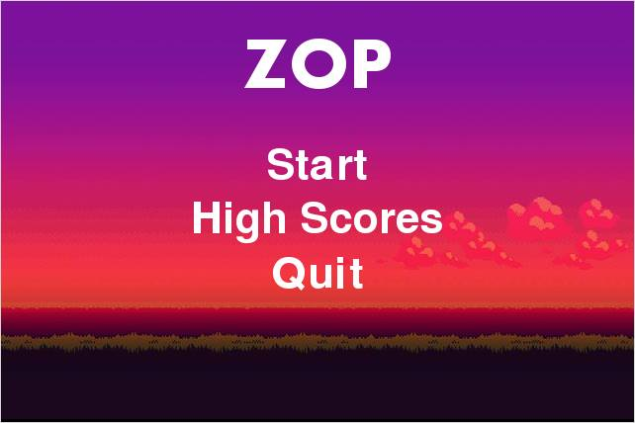
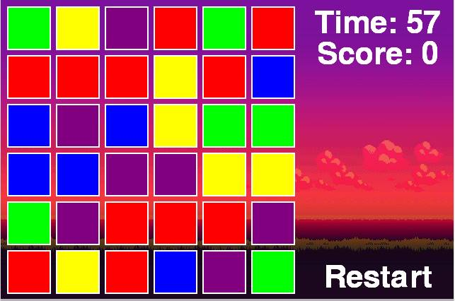

Slide 7
The Oreo’s Tale
Changes Made by us:
Switched languages
Testing
Got rid of bugs
Pre-set window size
Additional features
Why?
Modularity
Robustness
Usability

Slide 8
So Now What?
Endless possibilities
Great learning tool for starting developers
Endless spinoffs
Changed Objective
Bonus Rounds
Different Grids

Slide 9
We’re Open for your Questions

