Slide 2
Infrastructure as Code, Terraform, PowerShell, ARM ili nešto treće
Ratomir Vukadin

Slide 4
whoami
Ratomir Vukadin
DevOps Engineer – Mistral www.mistral.ba
https://www.linkedin.com/in/ratomir-vukadin-rvs/
https://twitter.com/Ratko_V
https://github.com/Ratomir
https://www.ratomirvukadin.com
Network 9, WinDays19, Azure Bootcamp, Tarabica19, Sinergija19, MS Community 8…

Slide 5
Today’s agenda
Infrastructure as Code
Different ways, how to deploy IaC to Azure
Pros/cons
Terraform/Pulumi
Demo – deployment to Azure

Slide 6
Infrastructure as Code
Deployment of resources using templates
Resources are JSON objects
Customize the deployment parameterizing some of the property values
Very powerful; deploy large and complex architectures
Authoring is not for the faint of heart
Source Control

Slide 7



People
Process
Products
Have a Vision
This is a big change
Iac/DevOps Movement
A way of life
Required to be successful
Simplicity
Modular
Flexible
Versioning
Powershell/Bash
Azure Quickstart Templates
VS Code
GitHub
Azure Automation, Ansible, VSTS

Slide 8
DevOps and IaC
Scripts / SDKs (automation)
Pros:
Process integration (DevOps / ITSM)
Removes human / less error prone
Unopinionated / total flexibility
Cons:
Requires scripting knowledge / environment
Complex logic needs to be hand built

Slide 9
Methods for Azure resource deployments
Azure Portal (manual)
Pros:
Browser based, quick setup, no fuss
Nice for exploration and visual inspection
Fully featured
Cons:
Everything is performed manually
Error prone
Lack of process integration (DevOps, ITSM)

Slide 10
Azure Resource Manager Templates
What are Azure Resource Manager Templates?
Written in JSON
Tooling for Visual Studio and Visual Studio Code
Native Azure portal integration
Generated directly from REST / Swagger

Slide 11
Azure Resource Manager Template Example
{
"$schema": "https://schema.management.azure.com/..json#",
"contentVersion": "1.0.0.0",
"parameters": {},
"variables": {},
"resources": [{
"type": "Microsoft.Resources/resourceGroups",
"apiVersion": "2018-05-01",
"location": "eastus",
"name": "demo-storage",
"properties": {}
},
{
"type": "Microsoft.Storage/storageAccounts",
"name": "demo-storage",
"apiVersion": "2018-02-01",
"location": "eastus",
"sku": {
"name": "Standard_LRS"
},
"kind": "Storage",
"properties": {}
}
]
}
Resource Group
Storage Account

Slide 12


Terraform
What is Terraform?
Open source project
Cross computing environment templating language
Provision, Update, and Delete resources
Authored in HashiCorp Configuration Language (HCL) or JSON

Slide 13
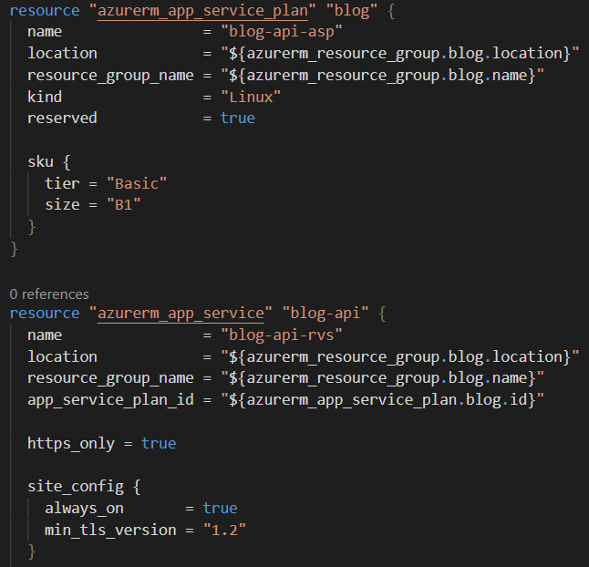
Terraform Example
App Service Plan
App Service

Slide 14
Terraform flow
Init
Plan
Apply
Destroy

Slide 15


Pulumi concept
Create modern applications.
Real programming languages. Define infrastructure in JavaScript, TypeScript, Python, or Go, and .NET Core.
Your favorite tools. Use familiar IDEs, test frameworks, and tools.
Share and reuse. Codify best practices and share them with your team or a growing community of practitioners.

Slide 16

Pulumi deploy
Deploy to any cloud.
Many clouds, one workflow. Use the same language, tools, and workflow, no matter the cloud.
Collaborate. Harmonize your engineering practices between developers and operators.
Easy continuous delivery. Deploy from the CLI, or integrate with your favorite CI/CD system, and review all changes before they are made.

Slide 17
Pulumi flow
New
Preview
Up
Destroy

Slide 18
https://www.pulumi.com/docs/get-started/
@"%SystemRoot%\System32\WindowsPowerShell\v1.0\powershell.exe" -NoProfile -InputFormat None -ExecutionPolicy Bypass -Command "[Net.ServicePointManager]::SecurityProtocol = [Net.SecurityProtocolType]::Tls12; iex ((New-Object System.Net.WebClient).DownloadString('https://get.pulumi.com/install.ps1'))" && SET "PATH=%PATH%;%USERPROFILE%\.pulumi\bin“
Set AWS_PROFILEas an environment variable, or
pulumi config set aws:profile <profilename>
mkdir quickstart && cd quickstart
pulumi new aws-typescript

Slide 19
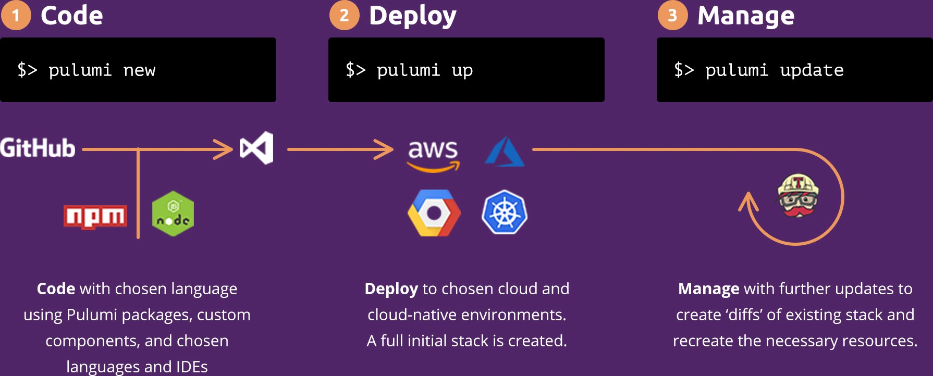
Pulumi flow

Slide 20
Where is the trap?
Our team, 7 strong DevOps + 1 (me)
AWS/Azure/GCP
Full stack developer
Involve too much programming
OOP
Terraform is simple
Base framework

Slide 21
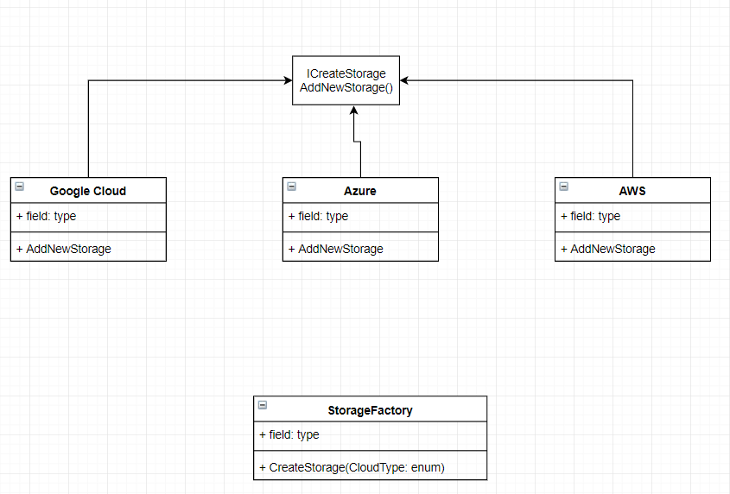
Factory pattern

Slide 22
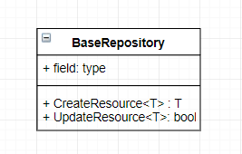
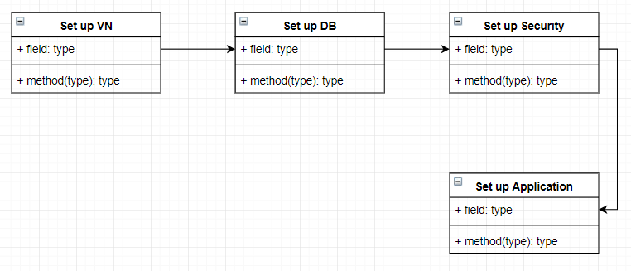
Generics

Slide 23
Get started with Pulumi
https://www.pulumi.com/azure/
https://github.com/pulumi/examples
https://mikhail.io/
https://github.com/mikhailshilkov/
@MikhailShilkov

