Slide 2
Kubernetes i Azure Functions
Ratomir Vukadin

Slide 4
whoami
Ratomir Vukadin
DevOps Engineer – Mistral www.mistral.ba
https://www.linkedin.com/in/ratomir-vukadin-rvs/
https://twitter.com/Ratko_V
https://github.com/Ratomir
https://www.ratomirvukadin.com
Network 9, WinDays19, Azure Bootcamp, Tarabica19, Sinergija19, MS Community 8…
IaC Pulumi/Terrafrom – Pulumi .NET Core - https://github.com/Ratomir/ATD15

Slide 5
Agenda
Azure Functions
Azure functions on Docker containers
Kubernetes - HPA
KEDA – KEDA Deployment
How to start?
Demo – Event Hub

Slide 6
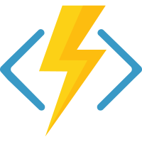
Azure functions from other perspective
Serverless is about building event based applications on a function by function basis without worrying about traditional “servers”.
Azure Functions can easily be hosted in different environments
Open sourced
Docker image
Azure Container Instance/Fargate
https://github.com/Azure/azure-functions-host

Slide 7
What we need?
.NET Core
Docker
Docker Registry (Docker Hub, ACR, ECR, …)
Kubernetes cluster (AKS, Minikube, GCP… )
Functions Core Tools 2.0 (Azure Functions CLI) - https://github.com/Azure/azure-functions-core-tools
Visual Studio Code/Visual Studio + Visual Studio Code extension

Slide 8
Horizontal Pod Autoscaler
The Horizontal Pod Autoscaler automatically scale the number of pods in a replication controller, deployment or replica set based on observed CPU utilization or custom metrics

Slide 9
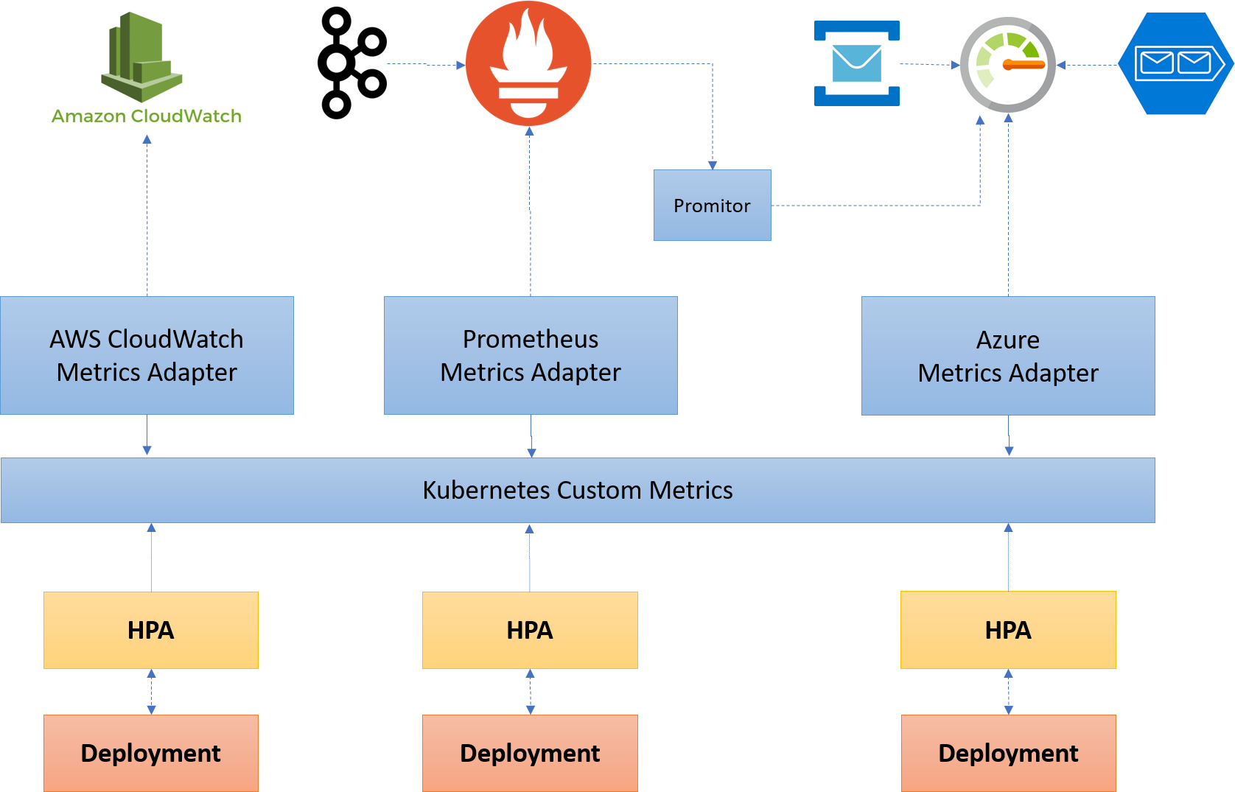
Where is the problem?

Slide 10
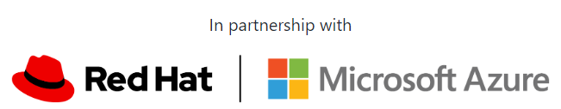
KEDA Kubernetes-Event-Driven-Autoscaling
Monitors the rate of events to proactively scale any container
Feeds the data into the Kubernetes system to drive scaling
KEDA can run on both, any cloud, any Kubernetes, integrates natively HPA
Open source (MIT License) and onboarding to CNCF
Extensible and pluggable scalers to grab metrics from any event source
https://github.com/kedacore
https://keda.sh/

Slide 11
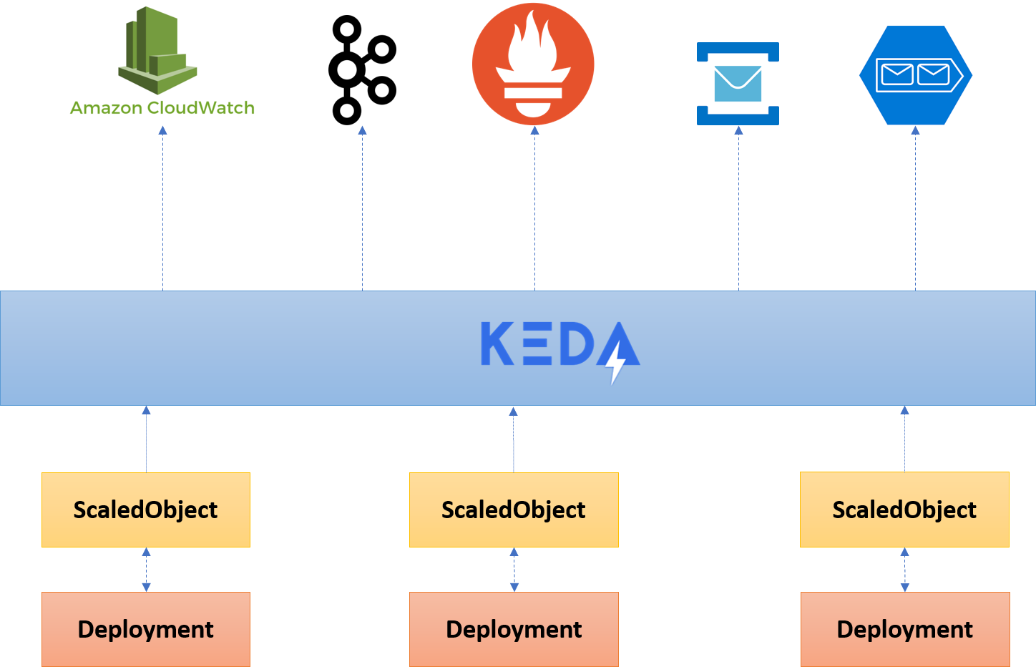

Slide 12
KEDA 1.0

Slide 13
How KEDA works
Agent, activate deactivate a deployment to scale, or to zero on no events
As HPA, expose rich event data, like queue length or stream to HPA to drive scale up or out

Slide 14
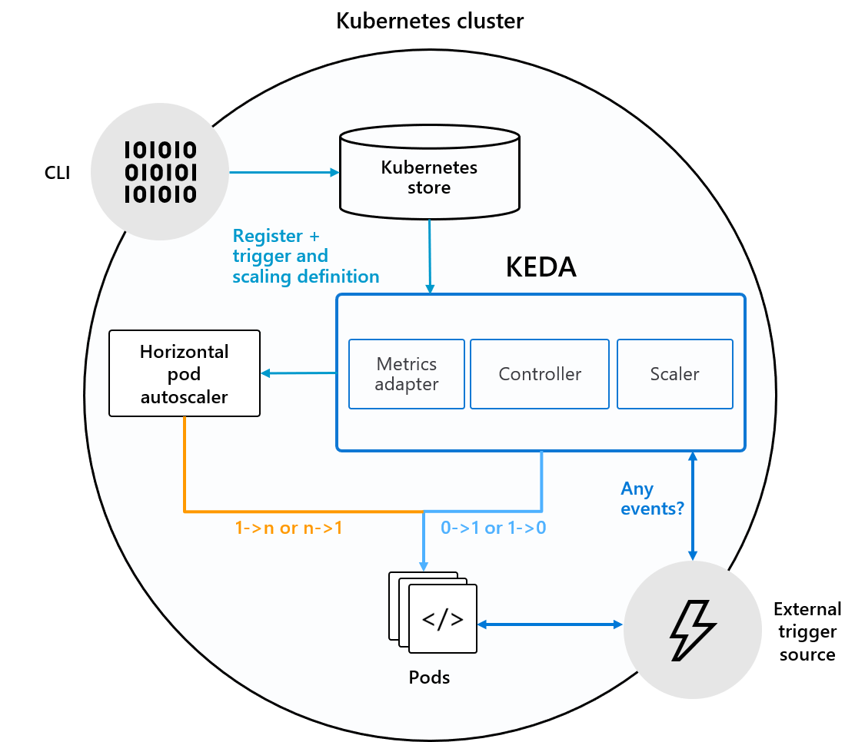
KEDA Architecture

Slide 15
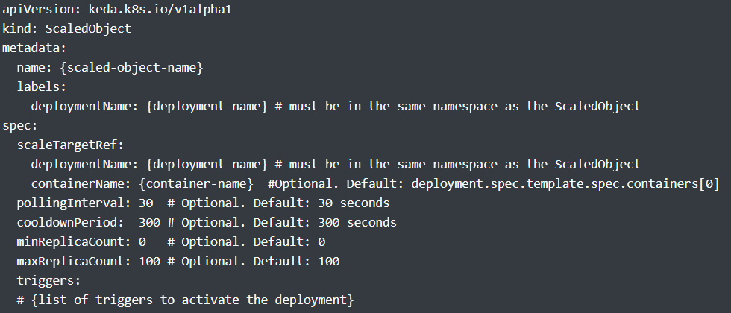
The magic

Slide 16
Event sources
Apache Kafka Topic
AWS SQS Queue
Azure Service Bus
Huawei Cloudeye
NATS Streaming
RabbitMQ Queue
AWS CloudWatch
Apache Event Hub
Azure Storage Queue
Google Cloud Pub/Sub
Prometheus
Redis Lists

Slide 17
Demo

Slide 18
Keda set up
func kubernetes install --namespace keda
mkdir sample-queue
cd sample-queue
func init . –docker
func new
docker build –t myregisty.registry.com/remo:v1
func kubernetes deploy --name name-deplo --registry myregisty.registry.com/remo:v1

Slide 19
Q/A session

