Slide 1
Azure DevOps for Azure Databases
Ratomir Vukadin

Slide 2



Thanks to our partners!

Slide 3

Who am I?
Ratomir Vukadin – DevOps engineer
MCT 2019-2020, MCSA for web application, MTA…
@Ratko_V
GitHub Ratomir
Linkedin - ratomir-vukadin-rvs
MS-Community 17, MS-Network 8, Local Meetups…
https://github.com/Ratomir/AzureBootcamp2019

Slide 4
Agenda
Why we need a DevOps role?
The business value of DevOps in Database development?
RedGate statistical/analytics report
CI/CD Database migration
Demo
Summary

Slide 5
DevOps

Slide 6
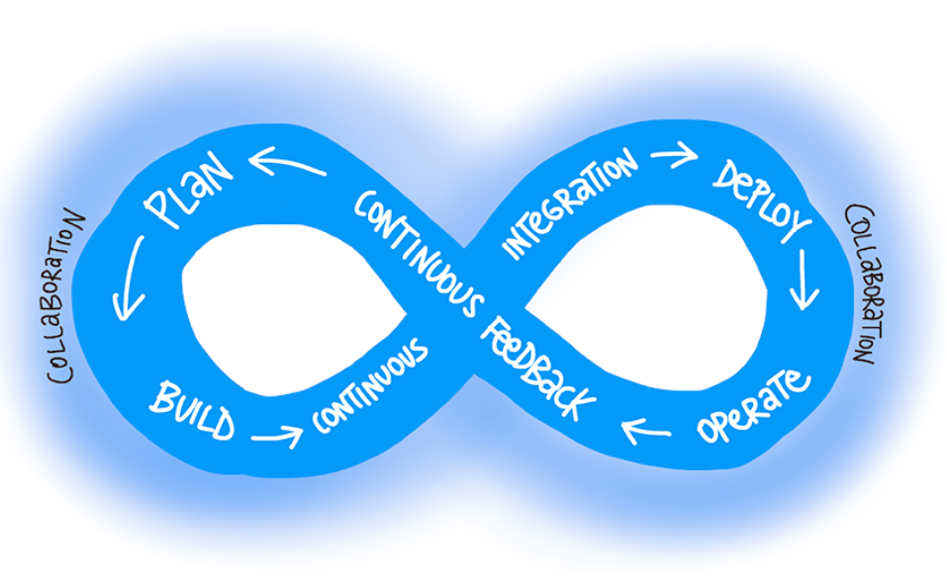
What is DevOps?
DevOps is the union of people, process, and products to enable continuous delivery of value to our end users. – Donovan Brown - http://donovanbrown.com/post/what-is-devops

Slide 7
Database deployment effects
Databases become a bottleneck in agile process delivery
Small quantity releases
Deployments require Dev and DBA
Rollback to previous version of a database
Schema mismatch in different environments
Multiple clients have their database instances

Slide 8
Database deployment benefits
Faster speed of response to change request
Deploy smaller units
Providing automated test before deployment
Unit tests for database???

Slide 9
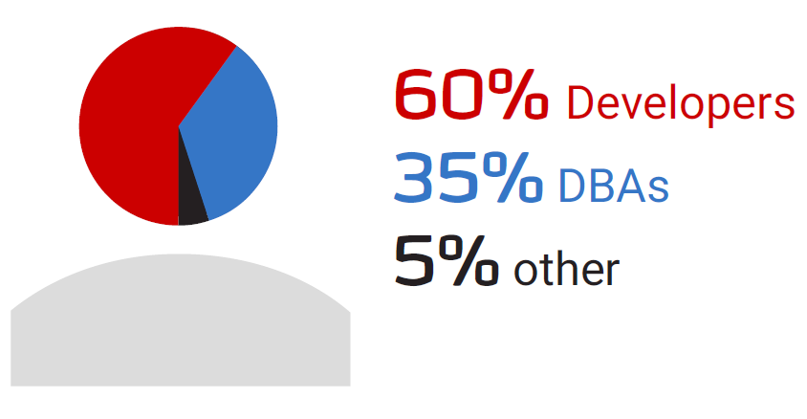
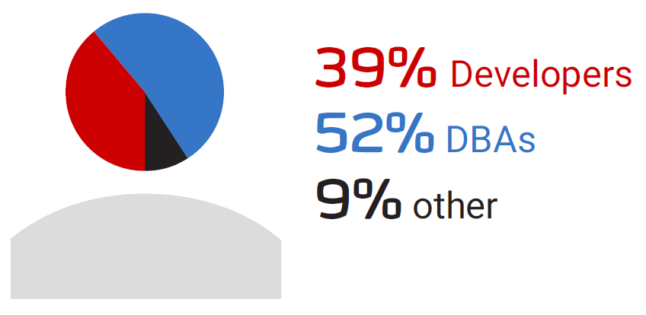
Database development
Who typically builds database deployment scripts?
Who is responsible for the deployment of database changes to production?

Slide 10
RedGate state of database DevOps 2018 report
https://www.red-gate.com/solutions/database-devops/report-2018

Slide 11
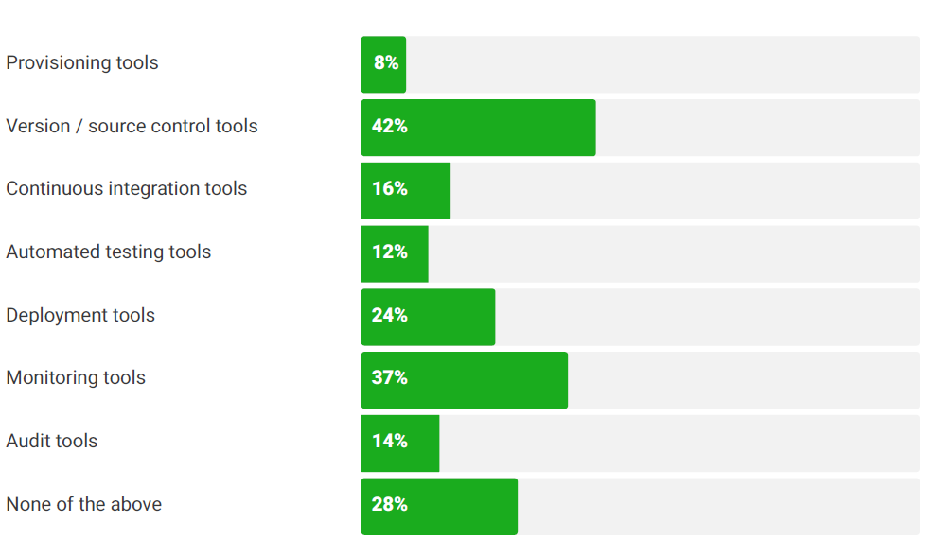
Tool third-party into database development

Slide 12
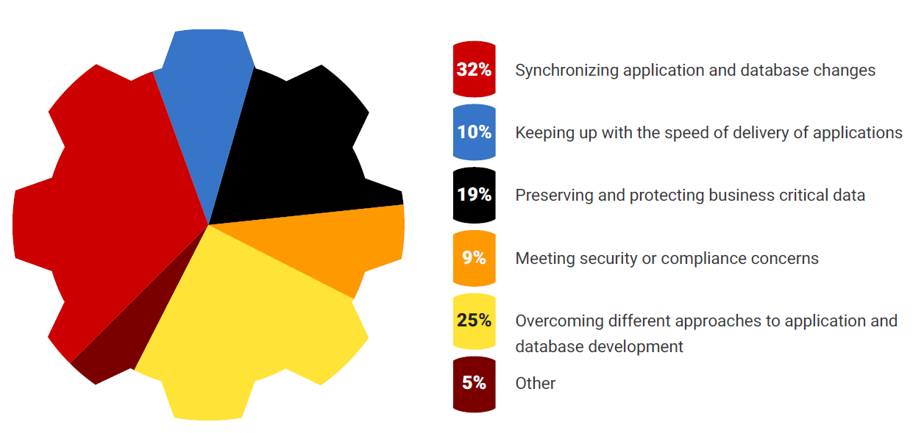
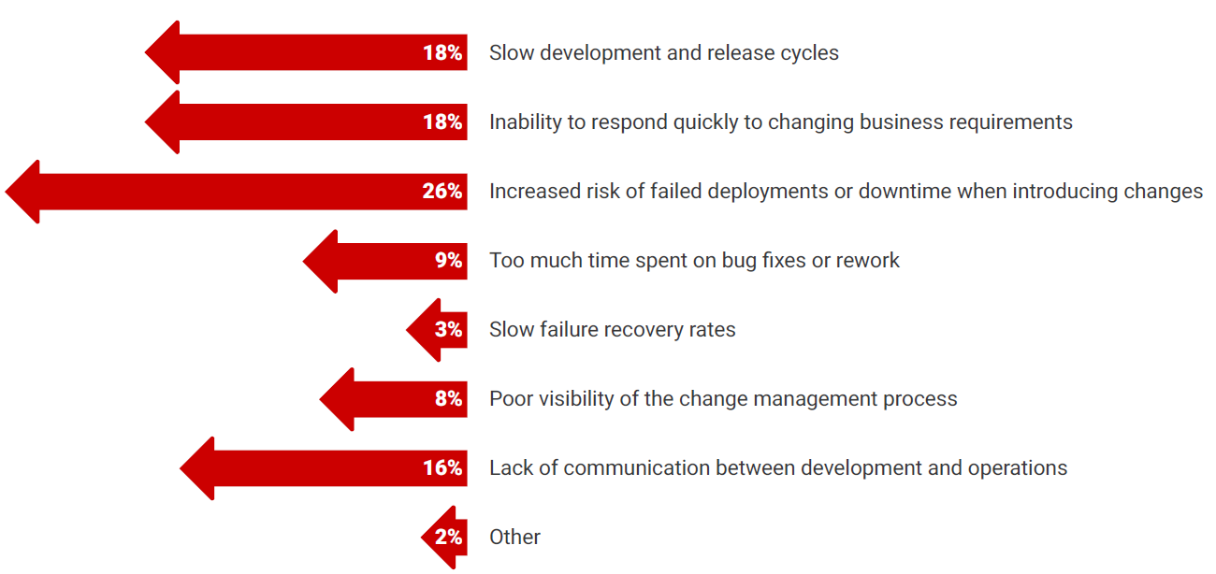
The greatest challenges and drawback in traditional practices

Slide 13
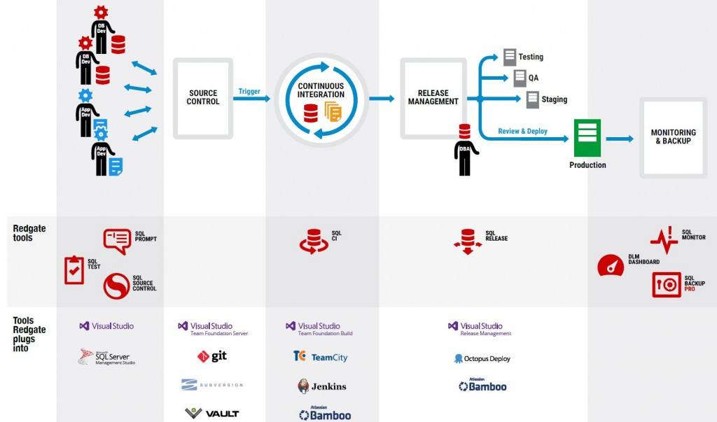
Database lifecycle management

Slide 14
State vs Migration

Slide 15
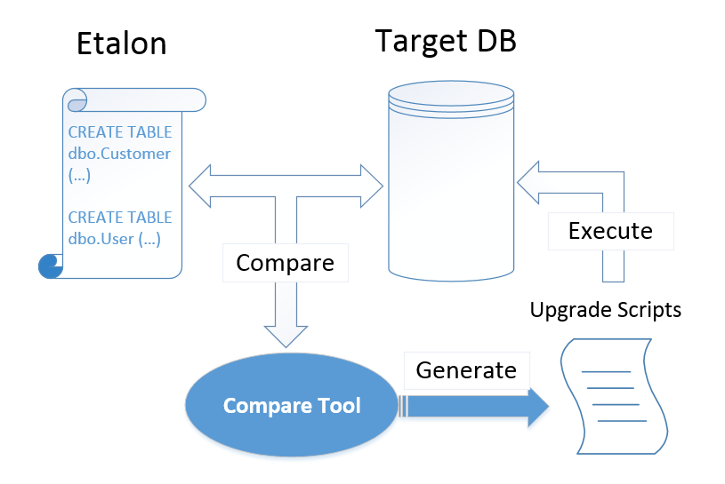
State approach
The snapshot of database structure
Compare tool generates the scripts
You need do that in database snapshot
Like code class

Slide 16
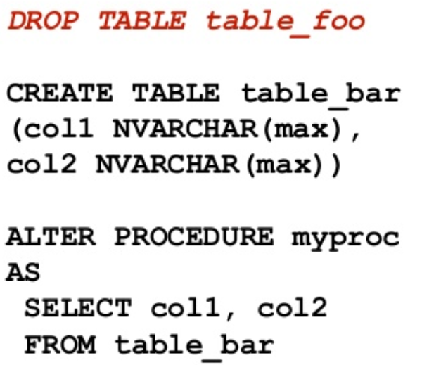
Lifecycle
State
State 1
State
State 2
State
State 3

Slide 17
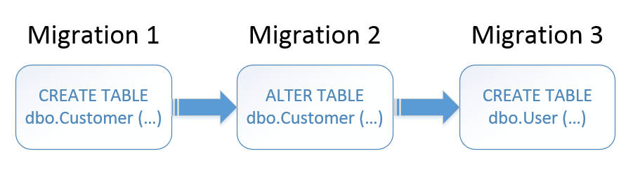
Migration approach
Migrations
Migrations must become immutable after deployments
Entity framework code first approach
YII2 – PHP framework - MySQL

Slide 18
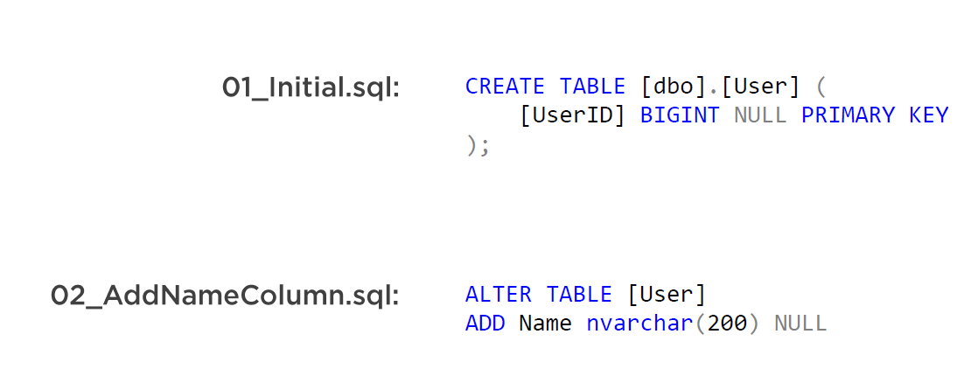
Migration example

Slide 19
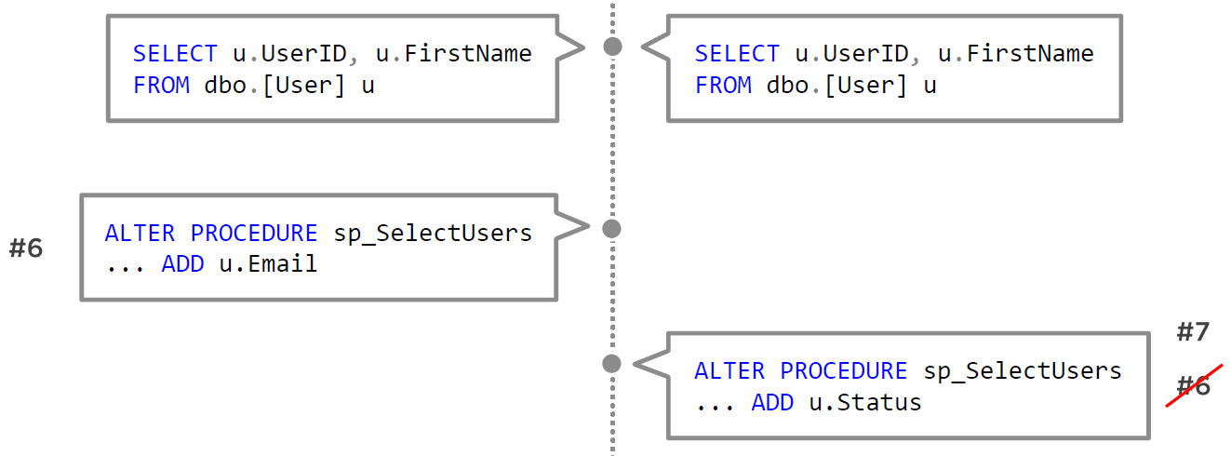
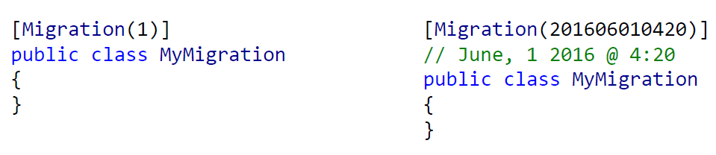

Slide 20
1000000000000000 migrations
Migration 1
Migration 2
Migration 56…
100_Baseline.sql

Slide 21
What is better?
State
Easier (less control)
Better for sprocs/functions
Better for large teams
Better for frequent changes
Better for dependency
Easy to merge conflicts
Need to understand your tool
Test for data loss automatically
Migration
More control (harder/needs discipline)
Better for data migrations
Better for small teams
Better for infrequent changes
Hard to handle merge conflicts
Orders matters (Last script wins)
Review changes, much reading, getting the right code

Slide 22


Slide 23
Transitioning from one Approach to Other
State-based
Migration based
Self solution for database deployment
https://github.com/vkhorikov/DatabaseUpgradeTool

Slide 24
Couple of notes
Replication
Server farm

Slide 25
Q/A session

