Slide 1



Azure Cosmos DB, rješenje za globalno distribuirane sisteme
Ratomir Vukadin, DevOps Engineer
BL bit User group
26th May, Banja Luka

Slide 2


About me
DevOps Engineer, Azure Cloud…
Software Engineer, Full-stack
Student at ETF Banja Luka, master degree, BA at ETF ES
MCP
Speaker at Microsoft Community 2017, MS Network 2018, BL bit US
LinkedIn, GitHub, Blog coming soon

Slide 3

Agenda
Azure Cosmos DB
Cosmos DB model and API projections
Migration to Azure Cosmos DB
Document DB SDK
MongoAPI
Demo (WebAPI, Client library, Blog API etc.)

Slide 4
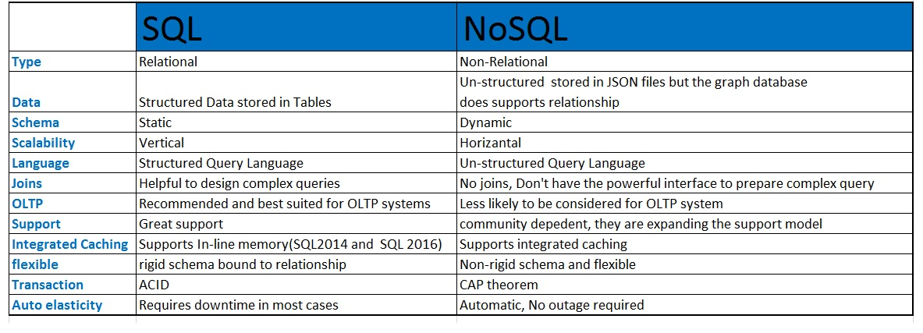
SQL vs NoSQL

Slide 5



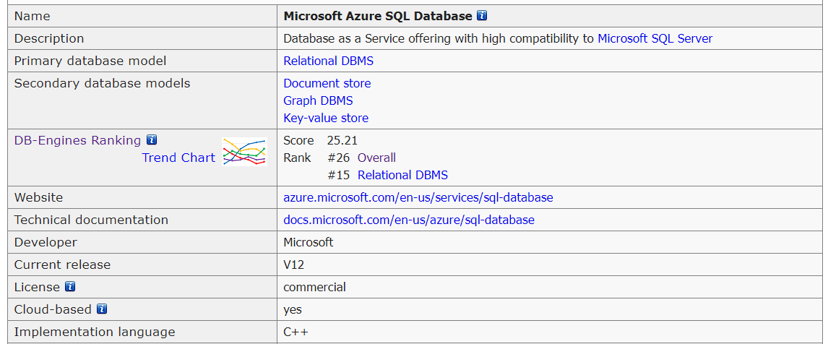

Azure Cosmos DB
Multi-model database
Database models
Storage across all Azure regions
Foundational service

Slide 6
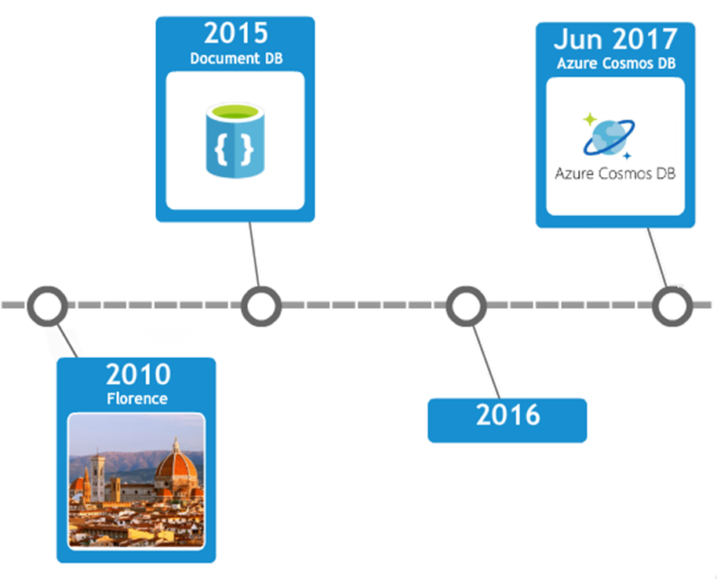

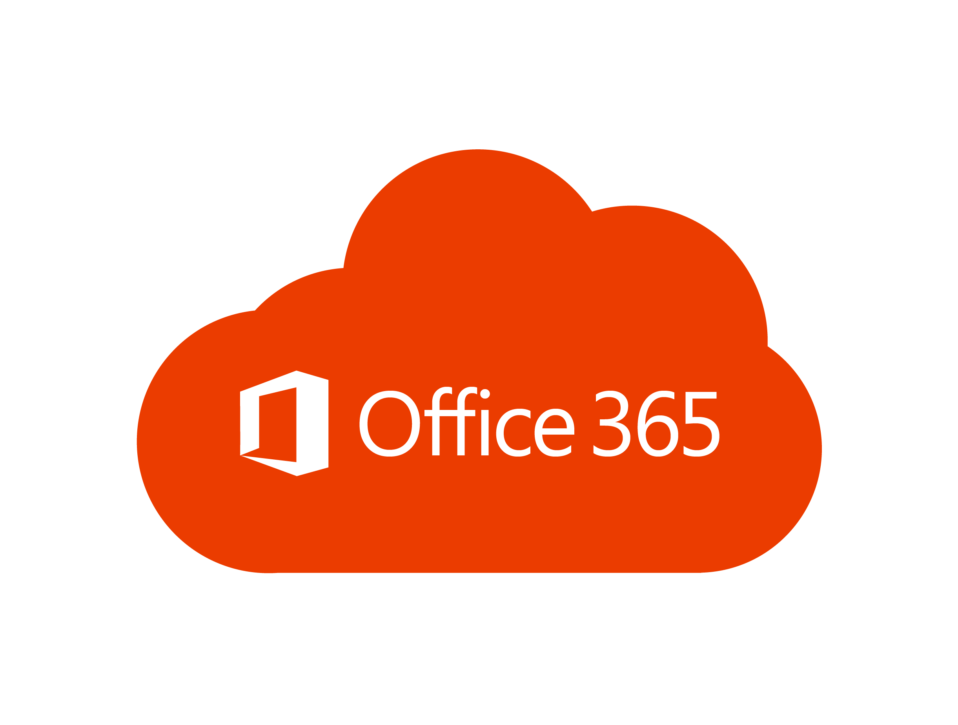


Data engine, multi-model
DB engine, all data translate to ARS (atom-record-sequence)
Atom (A) – Primitive data types like number, string and Boolean.
Record (R) - Structs composed of types stored in Atom.
Sequence (S) - Arrays consisting of atoms, records, or sequences.

Slide 7

Azure Cosmos DB
Data global distribution
Highly responsive systems
Read and write latencies on 99%, 99% reads in < 10ms, writes in < 15ms
The system is “always on”
99.99% availability, end-to-end
Write correct global distributed applications
Relieve the developers from database schema/index, versioning
Keep it in sync
APIs for data, native and popular
A very low cost

Slide 8




DATA APIs

Slide 9

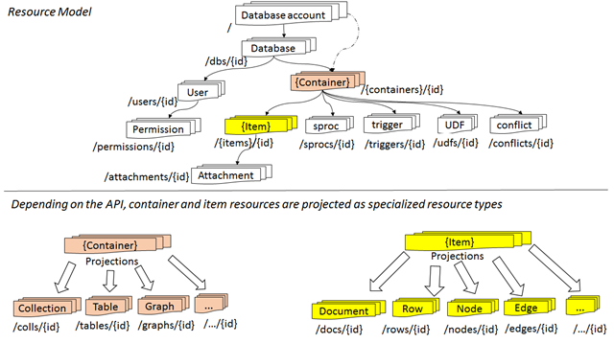

Resource Model Database and API projections
Resource is uniquely identified by URI, represented as JSON document

Slide 10
API | Container | Item
DocumentDB SQL | Collection | Document
MongoDB | Collection | Document
Azure Table Storage | Table | Item
Gremlin | Graph | Node and Edge
API, containers, items

Slide 11





Slide 12

Solutions for me
Data cashing
Bottleneck
Data analytics
Big Data
Log analytics
IoT
Real time data-science

Slide 13
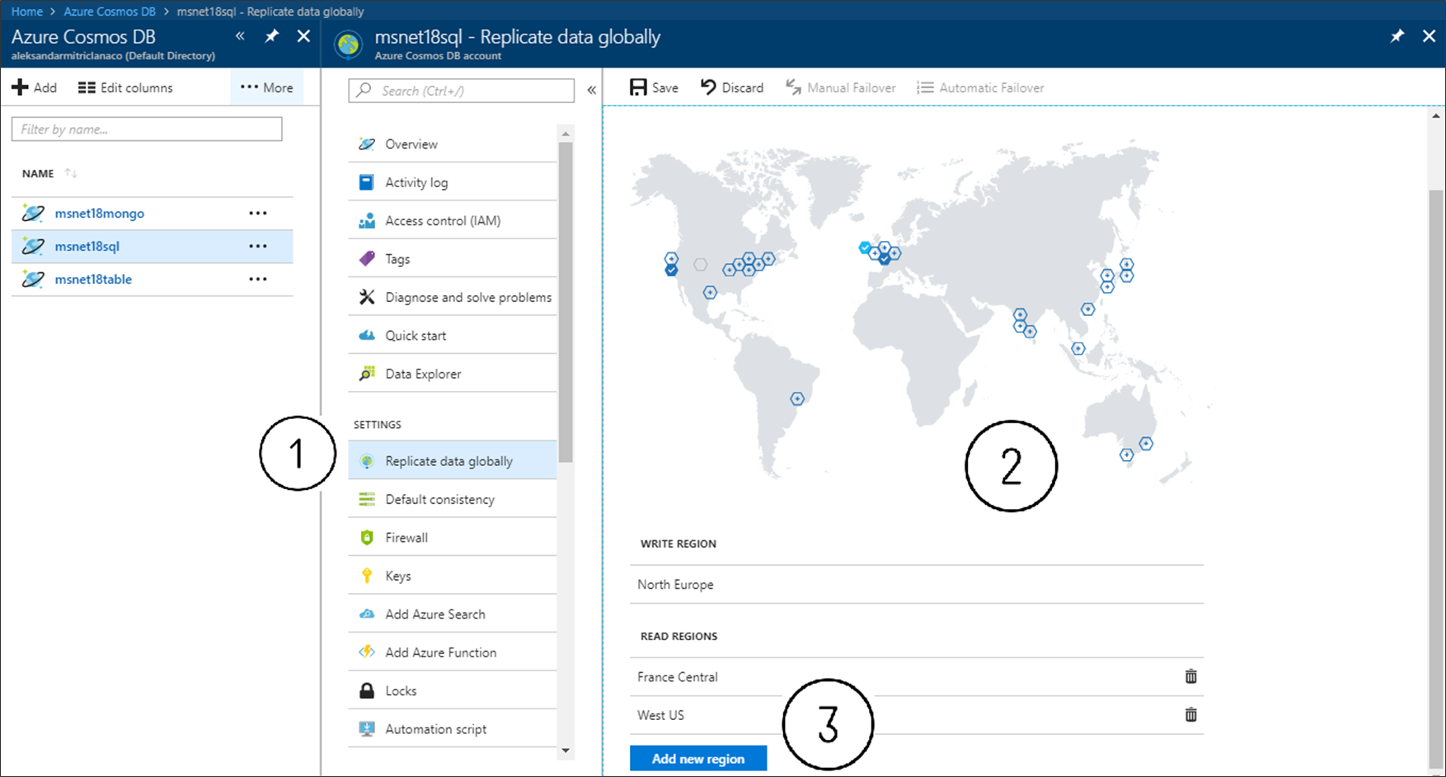

Slide 14
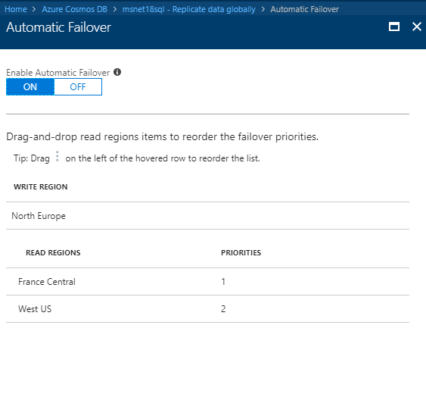
Automatic failover

Slide 15

https://github.com/Ratomir/MSNETWORK-18
GitHub
https://docs.microsoft.com/en-us/azure/cosmos-db/introduction
Introduction to Azure Cosmos DB
https://docs.microsoft.com/en-us/azure/cosmos-db/use-cases#web-and-mobile-applications
Most use cases with Azure Cosmos DB
https://azure.microsoft.com/en-us/blog/a-technical-overview-of-azure-cosmos-db/
Technical overview

Slide 16

Phone: +387 62 996 996 Email: info@klika.ba Web: www.klika.ba

Slide 17
Thank you!
Phone: +387 62 996 996 Email: info@klika.ba Web: www.klika.ba

