Slide 1
Skin Lesion Classification using Convolutional Neural Network
Supervised by:
Dr. Pintu Chandra Shill
Professor
Department of Computer Science and Engineering
Khulna University of Engineering & Technology
Khulna,Bangladesh
Presented by:
Abdullah Al Shafi
Roll:1807004

Slide 2
Table of Contents
Introduction
Literature Review
Proposed Method
Work Progress
Gantt Chart
Result
Conclusion
References

Slide 3
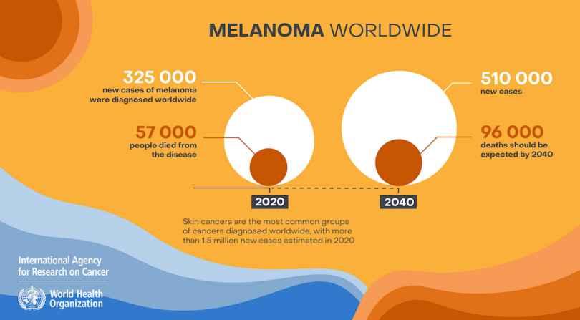
Introduction
Skin cancer is one of the most widespread and fatal cancer types globally.
Develops due to exposure to ultraviolet (UV) rays from the sun.
Melanoma is a skin cancer
tends to be deadly
Figure 1: Dermatology statistics in 2020 and forecast for 2040

Slide 4
Introduction
However, survival rate can be significantly increased
if the skin lesions are identified in dermoscopic images at an early stage
But the classification of skin lesions(SLC) is incredibly challenging.
SLC using DL has provided better results in classifying skin diseases than those of dermatologists
lifesaving in terms of diagnosis
Leveraging CNNs for SLC can significantly improve the accuracy and efficiency of diagnosis.

Slide 5
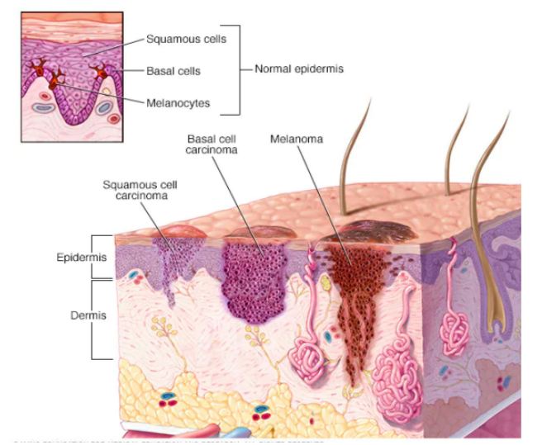
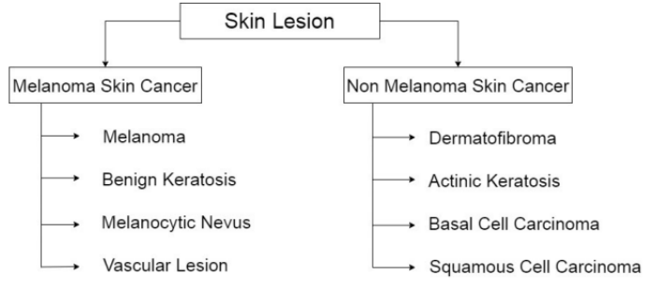
Skin Lesion
Skin: Outer covering of the body+the largest organ
Skin Lesion: Any skin area that has different characteristics from the surrounding skin, including color, shape, size, and texture.
Figure 2: Skin cancer affected skin image
Figure 3: Classification of skin lesion

Slide 6
Literature Review
There have been several researches in this field in last few decades:
Machine learning model
pre-trained ResNet-18 algorithm
achieves 94.47% classification accuracy, 93.57% precision, 94.01% recall and 94.45% F1-score.
Deep learning models
MobileNetV2 and DenseNet201
accuracy of 95.50%, sensitivity of 93.96%, and specificity of 97.03%
custom CNN
maximum achieved accuracy is 82.7% and 78% of precision.

Slide 7
Literature Review
4. Deep CNN
a solution for both skin lesion segmentation and classification
exhibiting an average AUC of 93.8% and 97.7% in categorizing skin lesions on ISIC 2017 and PH2 dataset.

Slide 8
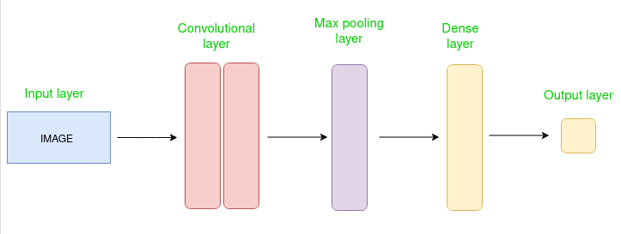
CNN Architecture
Convolutional Neural Network consists of multiple layers like the input layer, Convolutional layer, Pooling layer, and fully connected layers.
Figure 2: Simple CNN architecture

Slide 9
CNN Architecture Components
Input Layers: Layer in which input(an image or a sequence of images) is given to the model.
Convolutional Layers: Used to extract the feature from the input dataset.
applies a set of learnable filters(kernels) to the input images
kernels are smaller matrices usually 2×2, 3×3, or 5×5 shape.
slides over the input image data and computes the dot product between kernel weight and the corresponding input image patch.
output is referred ad feature maps.
Activation Layers: Add nonlinearity to the network.
RELU: max(0, x), Tanh, Leaky RELU

Slide 10
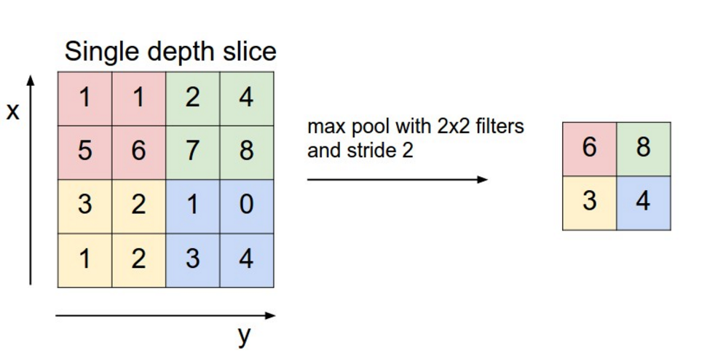
CNN Architecture Components
Pooling layer: Main function is to reduce the size of volume.
Makes the computation fast.
reduces memory.
prevents overfitting.
Two common types: max pooling and average pooling
Figure 3: Max pool with 2x2 filters and stride 2

Slide 11
CNN Architecture Components
Flattening: The resulting feature maps are flattened into a one-dimensional vector.
Fully Connected Layers: It takes the input from the previous layer and computes the final classification task.
Output Layer: Logistic function for classification tasks.
sigmoid or softmax
converts the output of each class into the probability score of each class.

Slide 12
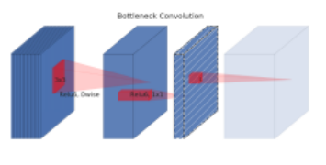
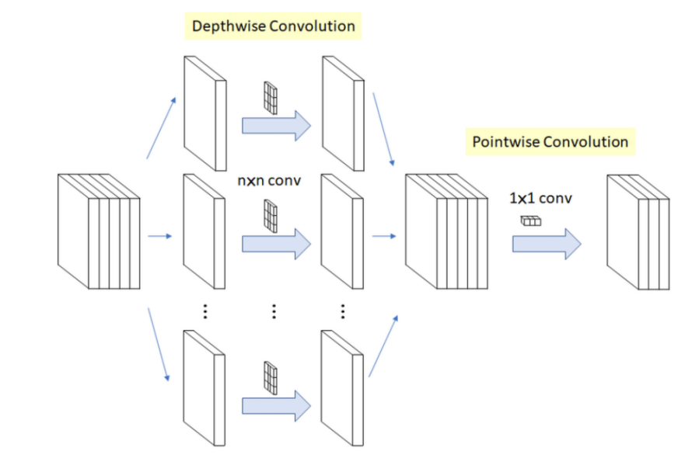
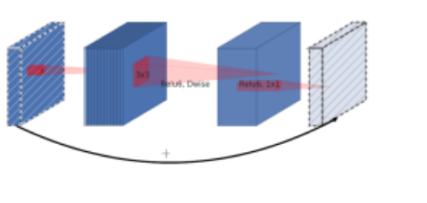
MobileNetV2 Key Features
Depthwise Separable Convolutions
Linear Bottleneck
Inverted Residuals
Figure 7: Linear Bottleneck
Figure 6: Depthwise Separable Convolution
Figure 8: Inverted Residual Block

Slide 13
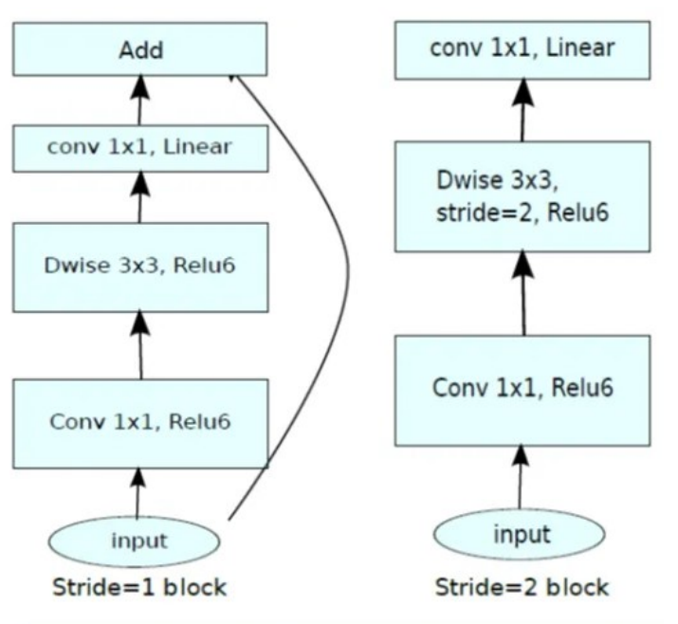
MobileNetV2 Convolutional Blocks
Two types of blocks.
Three layers for both.
First layer is 1x1 convolution with ReLU6.
Second layer is depthwise convolution.
Third layer is another 1x1 convolution but without any non-linearity.
Figure 9: MobileNetV2 Convolutional Block

Slide 14
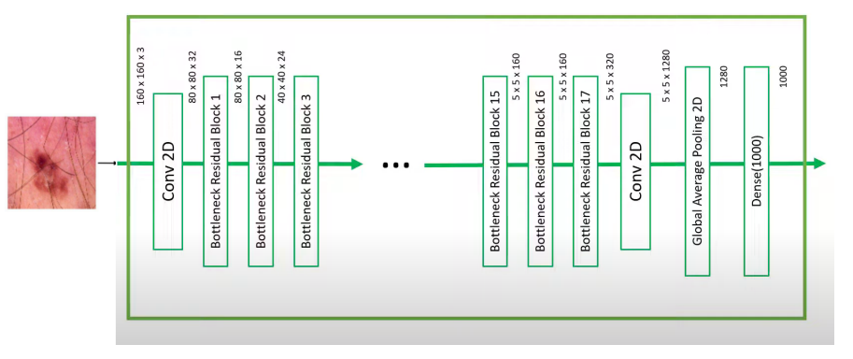
MobileNetV2 Architecture
Figure 10: Architecture of MobileNetV2 Model

Slide 15
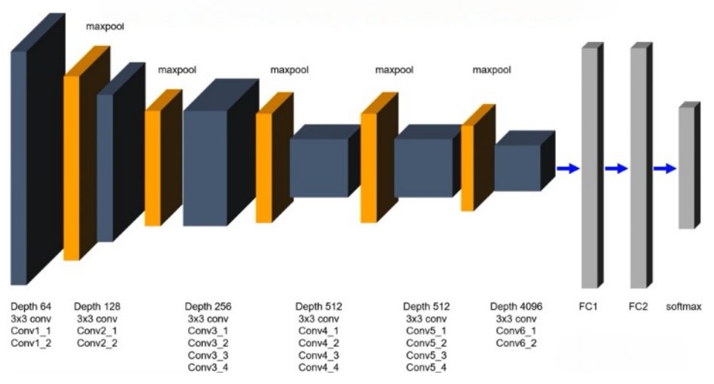
VGG19 Architecture
Figure 11: Architecture of VGG19 Model

Slide 16
VGG19 Architecture
16 Convolution layer grouped into 5 blocks.
Each convolution layer is comprised of different number of feature kernel filter.
Size of each filter is 3x3.
After each block there is a Maxpool layer.

Slide 17
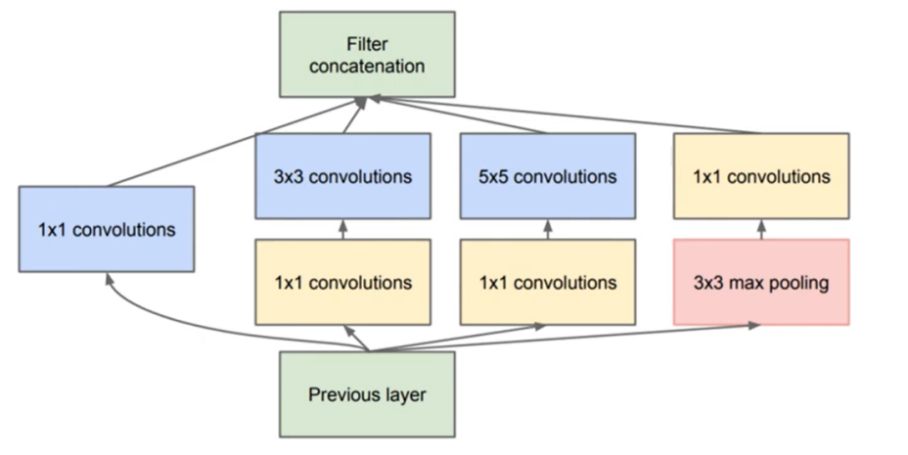
InceptionV3 Model
Question: what type of convolution at each layer: 3x3 or 5x5?
Solution: Do all the convolution and pick the best.
Wider model.
Allows to recover local feature via smaller convolutions and high abstract feature with larger convolutions.
Figure 12: Inception Module

Slide 18
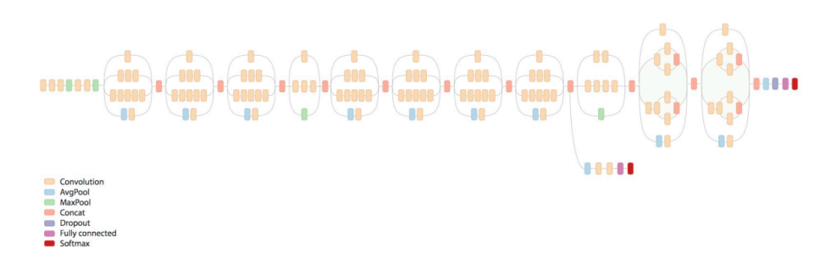
InceptionV3 Architecture
Figure 13: Architecture of InceptionV3

Slide 19
Fine-Tuning Consideration
In Keras, Batch Norm(BN) of the discussed pre-trained CNN model is implemented such that during training the network will always use the mini-batch statistics either the BN layer is frozen or not.
Also during inference it will use the previously learned statistics of the frozen BN layers.
As a result, if we fine-tune the top layers, their weights will be adjusted to the mean/variance of the new dataset.
However, during inference they will receive data which are scaled differently because the mean/variance of the original ImageNet dataset will be used.

Slide 20
Fine-Tuning Consideration
But if BN layer is frozen, it can lead to reduced accuracy especially when using transfer learning.
Solution: Update BN layer to use learned statistics rather than mini-batch statistics if frozen during training.

Slide 21
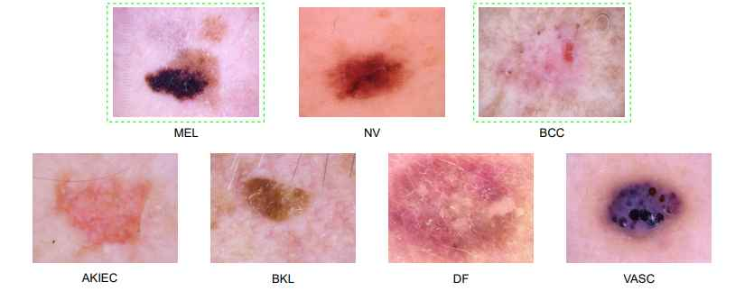
Datasets
HAM10000
ISIC 2016
ISIC 2019(includes ISIC 2018 & ISIC 2017)
Figure 14: Samples of each type of skin lesion from the ISIC 2018 dataset

Slide 22
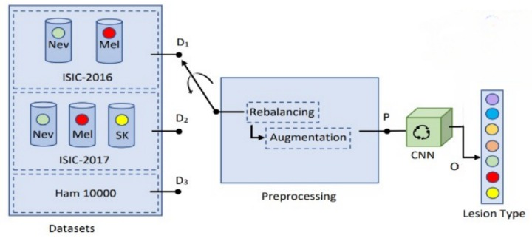
Proposed Model
Figure 15: Overview of proposed method for skin lesions classification.

Slide 23
Data Pre-processing
Main aim of pre-processing is image enhancement and image restoration.
Different for different application.
Class rebalancing.
Different image augmentation.

Slide 24
Class rebalancing
Class imbalance is a common phenomenon in the medical imaging domain as manually annotated images are very complex and arduous to achieve.
Such a class imbalance can be partially overcome using two commonly used approaches.
The data-level method and the algorithmic-level method.
combined additional images to the underrepresented class.

Slide 25
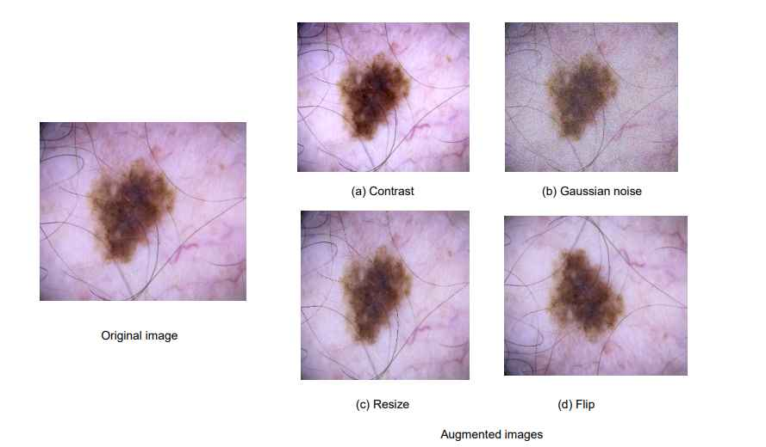
Data Augmentation
A manipulation applied to images to create different versions of similar content.
Expose the model to a wider range of training examples.
Improve generalization capability.
For example, flip and rotation, translation, scaling and cropping,shearing etc.
Figure 16: The difference between original skin lesion image (left) and the images after data augmentation (right)

Slide 26
Algorithm: Ensemble of MobileNetV2, VGG19 and InceptionV3
Input: Training data X_{train}, training labels Y_{train}, validation data X_{val}, validation labels Y_{val}, test data X_{test}, test labels Y_{test}.
Output: Ensemble accuracy(acc).
Procedure:
Load the pretrained model:
Freeze the weights of pretrained model to prevent overfitting.
MobileNetV2 = LoadMobileNetV2Model()
VGG19 = LoadVGG19Model()
InceptionV3 = LoadInceptionV3Model()

Slide 27
Algorithm
3. Add a global average pooling layer to the output of pre-trained model.
4. Concatenate the outputs:
z = Concatenate(w,x,y)
5. Add a dense layer with a ReLU activation function for classification.
6. Combine the three models into a single model:
ensemble_{model} = CombineModels(MobileNetV2.input,vgg19.input,InceptionV3.input)
w = GlobalAveragePooling(MobileNetV2.output)
x = GlobalAveragePooling(VGG19.output)
y = GlobalAveragePooling(InceptionV3.output)

Slide 28
Algorithm
7. Compile the ensemble model using categorical cross-entropy as the loss function and Adam as Optimizer with initial learning rate = 0.0001.
8. Train the ensemble model.
9. Make prediction on X_{test}.
10. Average the prediction.
average_{prediction} = AveragePrediction(ensemble_{prediction})
11. Calculate the accuracy using Y_{test}.
12. return acc.

Slide 29
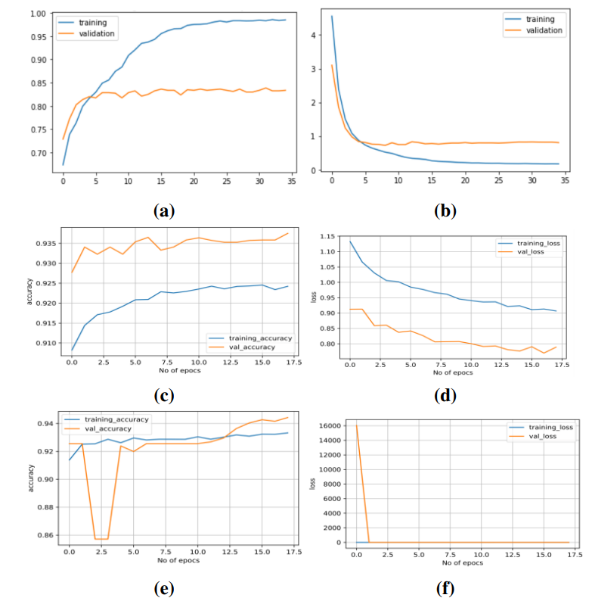
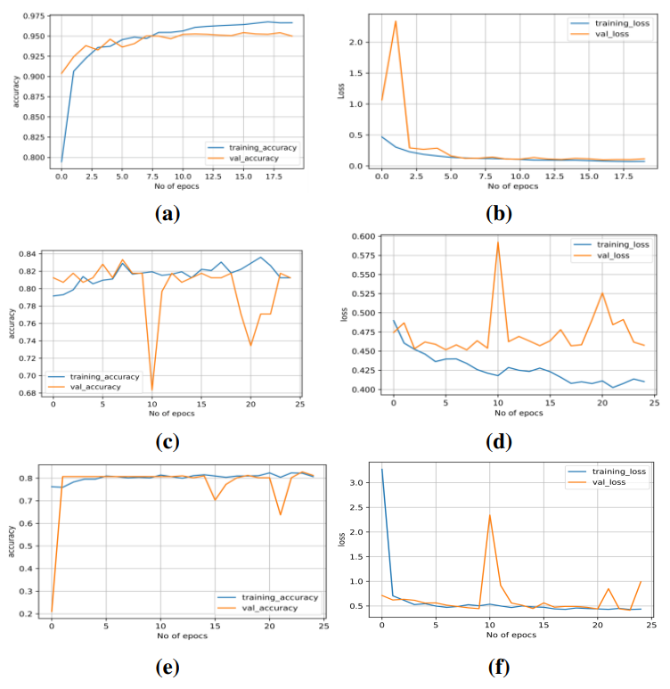
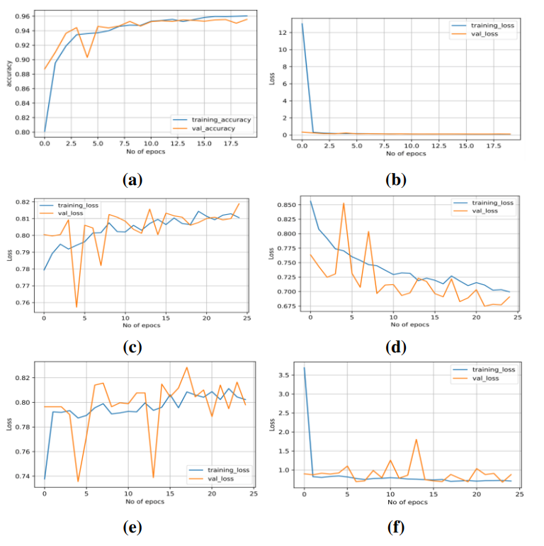
Training and Validation Graph
(1) HAM10000
(2) ISIC-16
(3) ISIC-19
Figure 17: Training and validation (a) accuracy on MobileNetV2 (b) loss on MobileNetV2 (c) accuracy on VGG19 (d) loss on VGG19 (e) accuracy on InceptionV3 and (f) loss on InceptionV3

Slide 30
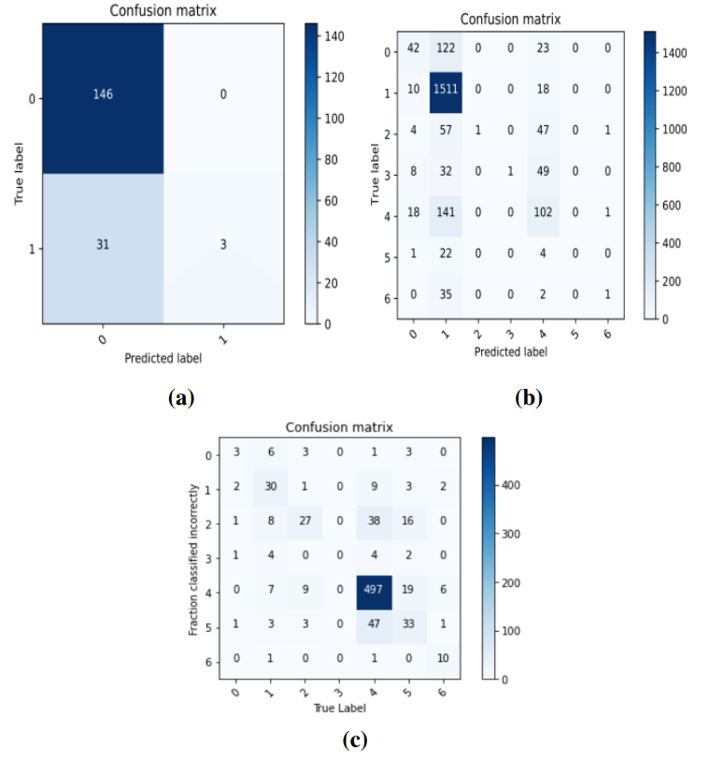
Confusion Matrix
Figure 18: Confusion matrix for (a)ISIC-16 (b) ISIC-19 (c) HAM10000

Slide 31
Quantitative Result
Table 1: Quantitative result on HAM1000
Table 2: Quantitative result on ISIC-16
Model | Precision | Recall | F-score | Accuracy
MobileNetV2 | 0.8602 | 0.8528 | 0.8566 | 0.8527
VGG-19 | 0.8253 | 0.7023 | 0.7552 | 0.8354
InceptionV3 | 0.8273 | 0.7069 | 0.7599 | 0.8616
Ensemble | - | - | - | 0.8753
Model | Precision | Recall | F-score | Accuracy
MobileNetV2 | 0.8118 | 0.8321 | 0.8248 | 0.8286
VGG-19 | 0.8202 | 0.8022 | 0.8108 | 0.8208
InceptionV3 | 0.8102 | 0.8108 | 0.8104 | 0.8302
Ensemble | - | - | - | 0.8486

Slide 32
Quantitative Result
Table 3: Quantitative result on ISIC-19
Model | Precision | Recall | F-score | Accuracy
MobileNetV2 | 0.7922 | 0.7690 | 0.7778 | 0.8326
VGG-19 | 0.7619 | 0.7262 | 0.7444 | 0.8288
InceptionV3 | 0.7858 | 0.7439 | 0.7688 | 0.8499
Ensemble | - | - | - | 0.8592

Slide 33
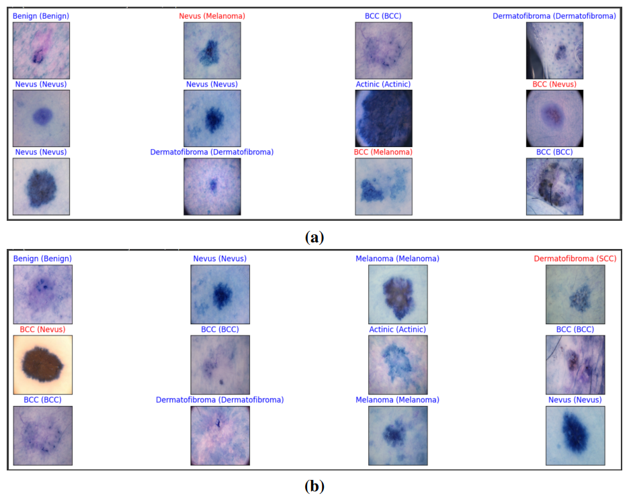
Qualitative Result
Figure 19: Sample prediction from images of (a) HAM10000 (b) ISIC-19. Blue and red indicates right and wrong prediction respectively.

Slide 34
Analysis of the result
Table 4: Comparison of classification results with related methods
Authors | Dataset | Accuracy(%)
Hekler et al. | HAM10000 | 82.95
Sae et al. | HAM10000 | 83.93
Muhammad et al. | HAM10000 | 88.39
Proposed method | HAM10000 | 87.53

Slide 35
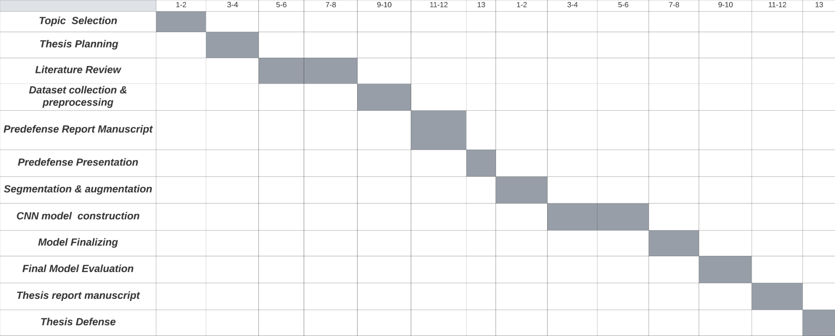
Gantt Chart
Task Name | 1st term | 2nd term

Slide 36
Complex Engineering Problems
Table 5: Complex engineering problems associated with the current project/thesis
Attributes | Addressing the Attributes
Depth of knowledge required | analysis of images using deep learning models, the knowledge of transfer learning.
Range of conflicting requirements | Recall is a more important evaluation metric than precision.However, precision is more useful when we want to affirm the correctness of model.
Depth of analysis required | The transfer of knowledge from particular pre-trained models,analysis of accuracy,precision,recall and F-score of the proposed model.
Familiarity of issues | Skin cancer is one of the most common diseases that can be deadly.
Extent of applicable codes | The segmentation of lesion image using deep learning model like U-net before running the classification model can improve accuarcy significantly.

Slide 37
Complex Engineering Activities
Table 6: Complex engineering activities associated with the current project/thesis
Attributes | Addressing the Attributes
Range of resources | Skin lesion classification and detection have emerged as critical areas of research in medical imaging and computer vision.
Level of interaction | There are various CNN model for this purpose.An ensemble of several such models can improve model accuracy.
Innovation | set all Batch Normalization layer to trainable, so during inference, batch norm layers will statistics of the mini-batch from our training set.
Consequences of society and the environment | By providing free medical resources and tools, the project directly addresses societal issues related to medical inequality.
Familiarity | Skin lesion classification methods using CNN exhibit improved results, which is lifesaving in terms of diagnosis.

Slide 38
Conclusion
Survival rate of skin cancer can be significantly increased if the skin lesions are identified in dermoscopic images at an early stage.
Initially, rebalancing and augmentation of the skin images are performed.Then classification is done through ensemble of CNNs.
The proposed method demonstrates praiseworthy success in lesion recognition, providing an accuracy of 87.53%, 84.86%, and 85.92% respectively for HAM10000, ISIC-16 and ISIC-19 respectively.
The classification performance is measured with different well known measures designed for skin lesion detection and recognition and the result is appreciable.

Slide 39
References
Xiaojing Yuan, Ning Situ, George Zouridakis, “Automatic segmentation of skin lesions images using evolution strategies.” In: vol. 295. Jan. 2012, pp. 333–342. ISBN: 978-3-642-32825-1. DOI: 10.1007/978-3-642- 32826-8_34
I. Iqbal, M. Younus, K. Walayat, M. U. Kakar, and J. Ma. ”Automated multi-class classification of skin lesions through deep convolutional neural network with dermoscopic images”. In: Computerized medical imaging and graphics 88 (2021), p. 101843.
C. Karimkhani et al. ”The global burden of melanoma: results from the Global Burden of Disease Study 2015”. In: British Journal of Dermatology 177.1 (2017), pp. 134–140.
D. Gutman et al. ”Skin lesion analysis toward melanoma detection: A challenge at the international symposium on biomedical imaging (ISBI) 2016, hosted by the international skin imaging collaboration (ISIC)”. In: arXiv preprint arXiv:1605.01397 (2016)

Slide 40
Thank You !

