Slide 1

Department of Information and Communication Technology Course Code : ICT-3201
Course Name: Computer Networks
Presentation Topic: SNMP Network Protocol
Project Superviser:
Dr. Nazrul Islam
Associate professor
Dept. of ICT
Mawlana Bhashani Science and Technology University , Tangail
Presented By:
Md. Rabbikul Islam Ratul
IT-22012

Slide 2
Welcome to the Presentation Contents:
What is SNMP?
The Challenge: Why We Need SNMP
Core Components of SNMP Architecture
The SNMP Dictionary: MIB & OID
SNMP Protocol Operations (Commands)
SNMP Security Models
SNMP Versions: A Comparison
Real-World Use Cases & Applications
Limitations & Challenges
Conclusion

Slide 3
What is SNMP?
Definition: SNMP is an application-layer protocol used to manage and monitor network devices (routers, switches, servers, printers, etc.) on an IP network.
Primary Goal: To allow network administrators to monitor network performance, detect faults, and configure devices remotely.
Standardized by: IETF (Internet Engineering Task Force).

Slide 4
Why do we need SNMP?
Without SNMP:
Manual checks on hundreds or thousands of devices.
No real-time visibility into problems.
Difficulty in proactive maintenance.
Inefficient and error-prone.
With SNMP:
Centralized Monitoring: See the entire network from one console.
Automated Alerts: Get notified of issues before users do.
Performance Trending: Collect data to plan for capacity upgrades.
Fault Isolation: Quickly pinpoint the root cause of a problem.

Slide 5
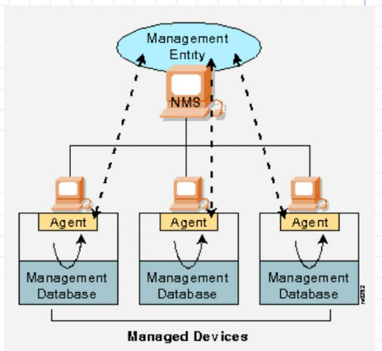
Core Components of SNMP Architecture
SNMP Manager:
The "boss" or central system.
Runs the network management software.
Queries agents and processes the responses.
SNMP Agent:
The "worker" software residing on the managed device.
Collects and stores local management data.
Sends data to the manager upon request.
Managed Device:
The network element that is managed (e.g., router, switch).
Contains the SNMP Agent.

Slide 6
The Management Information Base (MIB)
A MIB is a hierarchical, virtual database that defines the data points (objects) that can be collected from a device.
Standardization: Contains standardized (e.g., interface status, CPU load) and vendor-specific (e.g., special hardware sensors) objects.
The OID (Object Identifier):
A unique address for each manageable object in the MIB.
Looks like a numbered tree (e.g., 1.3.6.1.2.1.1.5.0 for System Name).
Analogy: The MIB is the menu, and the OID is the specific item you can order.

Slide 7
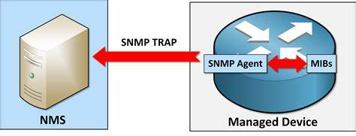
How SNMP Works

Slide 8
Event Occurrence: A significant event occurs on the Managed Device (e.g., a router, switch, or server). Examples include:
A network interface goes down (or comes up).
The device CPU utilization crosses a critical threshold.
A system reboot is initiated.
A hardware failure (like a fan or power supply) is detected.
Trap Generation: The SNMP Agent software running on the Managed Device is constantly monitoring for these predefined events. When such an event occurs, the agent automatically generates an SNMP TRAP message. This message is a notification that contains specific information about what just happened.
Information Retrieval from MIBs: To create the TRAP message, the Agent consults the Management Information Bases (MIBs). MIBs are databases that define the structure and meaning of all the data on the device.
The Agent uses the MIB to find the correct Object Identifier (OID) for the event (e.g., 1.3.6.1.6.3.1.1.5.3 for a "linkDown" trap).
It then populates the TRAP message with this OID and any other relevant data (e.g., which specific interface went down).

Slide 9
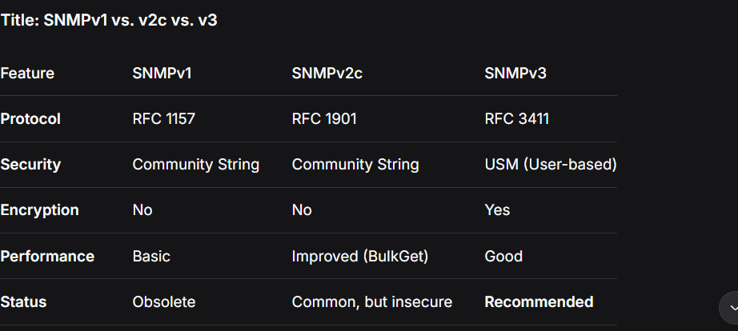
SNMP versions comparism

Slide 10
Real-world use cases
Performance:
Bandwidth utilization on interfaces.
CPU and Memory usage.
Availability:
Device up/down status (via ICMP ping + SNMP).
Interface/port status (up/down).
Fault Management:
Traps for system reboots, link failures, high temperature.
Inventory:
Serial numbers, hardware models, software versions.

Slide 11
Limitations and Challenges
Security in v1/v2c: The lack of encryption is a critical flaw.
Configuration Overhead: Setting up v3 security and MIBs can be complex.
Polling Overhead: Frequent polling of many devices can generate significant network traffic.
Not a Push Protocol (mostly): Relies on the manager polling, which can cause delays in detection (except for Traps).
Limited Data Depth: Good for status and metrics, but not for deep packet inspection or complex log analysis.

Slide 12
Conclusion
SNMP remains a vital, universal tool for network monitoring. Its simple Manager-Agent model and MIB structure provide critical insights. While older versions are insecure, SNMPv3 offers the necessary security. Its proactive TRAP mechanism enables immediate fault detection. Despite newer technologies emerging, SNMP's reliability ensures its continued relevance. Mastering it is essential for maintaining any modern network.

Slide 13
THANK YOU..

