Slide 1


Mawlana Bhashani Science and Technology University
Semantic Communication for Image Reconstruction in 6G Wireless Networks
MD. Rabbikul Islam Ratul (IT-22012)
Department of Information and Communication Technology

Slide 2

Presentation Outline
01
Introduction and research problem
02
Related work and research gap
03
Proposed solution and methodology
04
Experiments and results
05
Conclusion
Semantic Communication for 6G
02

Slide 3
Introduction and Research Problem
Conventional communication transmits the original message, while semantic communication aims to convey task-relevant meaning using a compact representation.
01
Future 6G applications may require efficient transmission of important information under limited communication resources and unreliable channel.
02
Reducing payload size does not necessarily improve task success, particularly when the receiver requires multiple semantic elements.
03
To compare conventional and simplified semantic communication in terms of payload size and task success rate under different packet-loss conditions.
Semantic Communication for 6G
03

Slide 4
Related Work and Research Gap
Study / approach | Key idea | Relevant limitation
ViT-Based Semantic Communications (2025) | Uses a Vision Transformer to encode and reconstruct images | Focuses on image reconstruction, not emergency-message packet evaluation
Explicit Semantic-Base-Empowered Communications (2026) | Uses semantic bases, a knowledge base, and unequal error protection. | More complex than our keyword-based simulation
Generative Feature Imputing (2026) | Uses generative recovery and semantic-aware power allocation | Requires a more advanced feature-based system
Research gap
This demo investigates the trade-off between payload reduction and task success under increasing packet loss in a simple, reproducible message-transmission simulation.
Semantic Communication for 6G
04

Slide 5
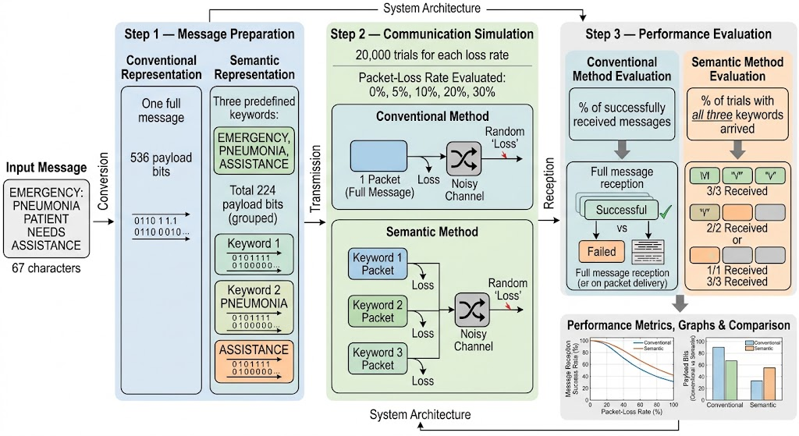
Methodology
Comparative Machine Learning Framework for Water Potability Prediction
01
[Step 1: Data preparation]
Semantic representation reduces 536-bit messages to 224 bits using keywords.
02
[Step 2: core procedure]
Simulate 20,000 trials per loss rate, comparing conventional and semantic packet delivery.
03
[Step 3: output]
Calculate message success rates, compare payload bits, and visualize results.
Semantic Communication for 6G
05

Slide 6
Experimental Setup
Data / study setting
Synthetic emergency message, three keywords, five packet loss rates.
Baselines / comparisons
Conventional sends one full message packet semantic sends three keyword packets under loss rates
Evaluation metrics
Payload size , Payload reduction, Task success rate
Implementation / protocol
Google Colab and Python with NumPy, Pandas etc.
Semantic Communication for 6G
06

Slide 7
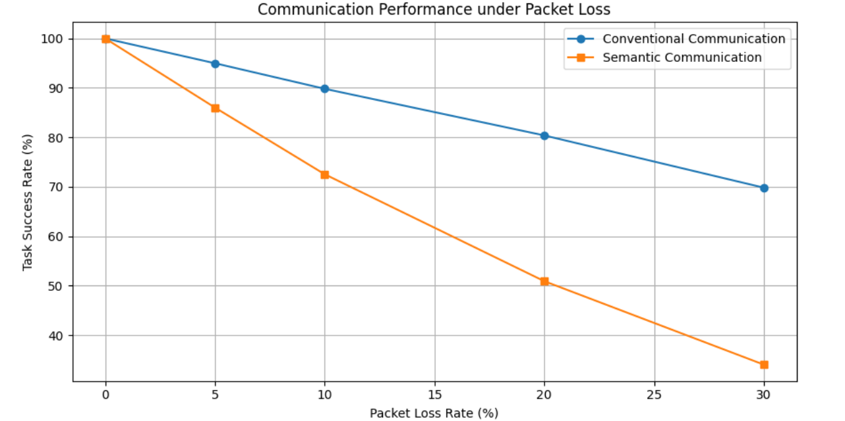
Results and Discussion
Main finding
Semantic representation reduces the payload from 536 bits to 224 bits, a reduction of 58.21% which is comparatively better than a conventional representation.
Semantic Communication for 6G
07

Slide 8
Quantitative Comparison
Method | Payload | Success at 30% loss | Payload reduction
Logistic Regression | 536 | 69.93% | 0%
SVM | 224 | 34.05% | 58.21%
Semantic transmission reduces the payload by 58.21% but under the current three-packet success condition, its task success rate at 30% packet loss is 35.78% points lower than that of conventional method.
Semantic Communication for 6G
08

Slide 9
Conclusions and Future work
Semantic communication can reduce message payload, but reduced payload alone does not guarantee better reliability.
01
A reproducible Python simulation compares conventional and keyword-based semantic message transmission under five packet-loss conditions.
Uses one message and manual keywords; excludes coding, retransmission, overhead, and real 6G channels.
02
03
Evaluate matched packetization, priority-based protection, error correction, diverse messages, and realistic wireless channels.
Semantic Communication for 6G
09

Slide 10
Selected References
[1] M. A. Mohsin, M. Jazib, Z. Alam, M. F. Khan, M. S. Saad, and M. A. Jamshed, “Vision Transformer Based Semantic Communications for Next Generation Wireless Networks,” 2025 IEEE International Conference on Communications Workshops (ICC Workshops), 2025. DOI: 10.1109/ICCWorkshops67674.2025.11162294.
[2] F. Wang, Y. Zheng, W. Xu, J. Liang, P. Zhang, and Z. Han, “Explicit Semantic-Base-Empowered Communications for 6G Mobile Networks,” Engineering, vol. 56, pp. 34–44, 2026. DOI: 10.1016/j.eng.2025.08.039.
[3] J. Huang, Q. Zeng, H. Du, and K. Huang, “Generative Feature Imputing—A Technique for Error-Resilient Semantic Communication,” IEEE Transactions on Wireless Communications, vol. 25, pp. 18410–18423, 2026. DOI: 10.1109/TWC.2026.3700909.
Semantic Communication for 6G
10

Slide 11
Thank you
Questions and Discussion
Md. Rabbikul Islam Ratul
Mawlana Bhashani Science and Technology University
Email Address – it22012@mbstu.ac.bd
Semantic Communication for 6G
11
Notes:
Replace the contact details and use this slide during questions. An optional paper, project or code link can be added if appropriate. Remove unused placeholders. Keep backup slides after this slide if they help answer questions.
Branding sources: official COMPAS 2026 logo and University of Dhaka crest downloaded unchanged from https://www.compasconf.org/ on 2 October 2026. IEEE Computer Society Bangladesh Chapter logo extracted unchanged from the user-supplied COMPAS2025_Oral_Presentation_Template.pptx.

