Slide 1
SHIFTING
THE BATTLE OF NEIGHBORHOODS

Slide 2
INTRODUCTION
THIS PROGRAMME WILL
FIND THE SIMILARITY BETWEEN TWO LOCALITIES
SHOW THE LOCATIONS OF THE LOCALITIES TO MAKE DECISION MAKING SIMPLER

Slide 3
IMPORTANCE
USEFUL TO PEOPLE WHO WANT TO SHIFT LOCATION
USEFUL TO BUSINESSMEN TO UNDERSTAND DEMAND OF A GOOD IN A PARTICULAR LOCALITY

Slide 4
CASE STUDY 1-
ONLY NEW YORK COMMUNITY BOARDS CONSIDERED
FINDING PLACES SIMILAR TO BRONX CB 4

Slide 5
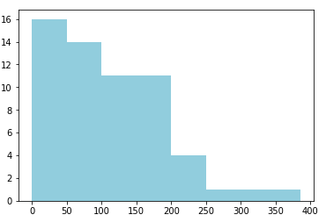
HISTOGRAM OF THE DATA
SCORE(OUT OF 385) IS WELL DISTRIBUTED
LOT OF AREAS WITH 150+ SCORE

Slide 6
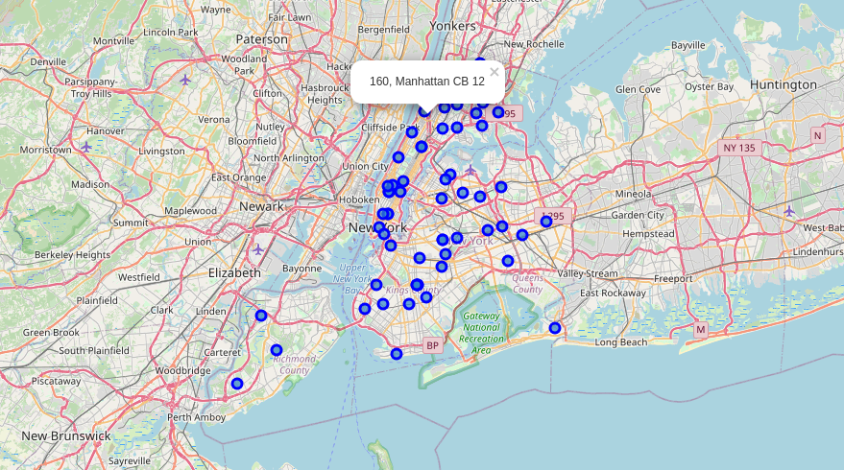
MAP
CAN BE VERY EASILY USED TO SELECT AREA SPECIFIC LOCATION

Slide 7
RESULT OF CASE 1
REPRESENTS THE STANDARD
HIGHLIGHTS THE BASIC IMPORTANCE OF THE PROJECT

Slide 8
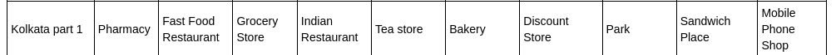
CASE STUDY 2-
USED KOLKATA PART 1 AS A RANDOM VARIABLE TO STORE THE FEATURES I WANT A LOCALITY TO HAVE, RATHER THAN MY CURRENT LOCALITY HAS
THEN COMPARED IT WITH ALL THE AREAS IN NEW YORK

Slide 9
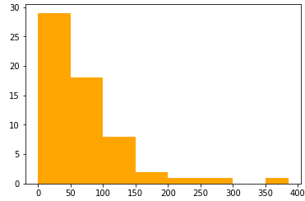
HISTOGRAM OF DATA
MANY AREAS WITH LOW SCORE
THUS A LARGE NUMBER OF LOCALITIES CAN BE EXCLUDED FROM CONSIDERATION
THUS THIS PROCESS ACTS AS A VERY EFFECTIVE FILTERING TECHNIQUE

Slide 10
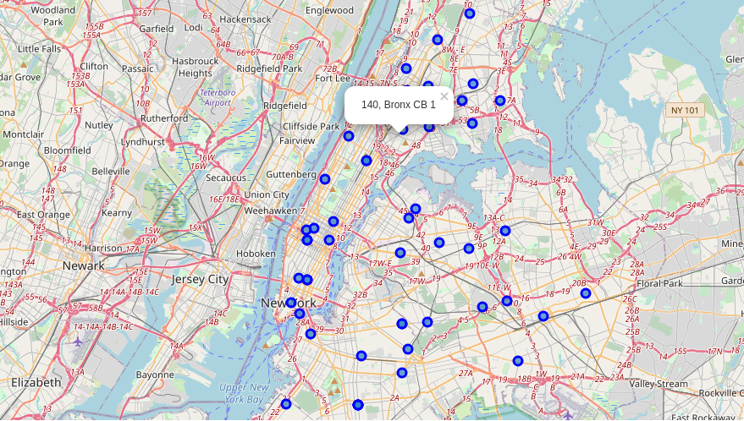
MAP
THOUGH NONE OF THE LOCALITIES IN MANHATTAN GOT A 100+ SCORE, BRONX CB 1 GOT 140, AND IS VERY CLOSE TO MANHATTAN
SO IT IS A VERY GOOD CHOICE IF STAYING NEAR MANHATTAN IS NECESSARY

Slide 11
RESULT OF CASE 2
WE SEE HOW THE MAP CAN BE EXTREMELY SIGNIFICANT FOR DECISION TAKING

Slide 12
CASE STUDY 3-
CONSIDER KOLKATA PART 1 TO BE A PART OF KOLKATA AND THE INPUT VALUES TO BE THE INFORMATION ON THE LOCALITY
WE WILL NOW COMPARE THE LOCALITIES TO MANHATTAN CB 10

Slide 13
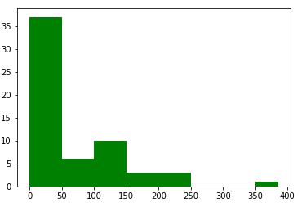
HISTOGRAM OF DATA
LIKE THE PREVIOUS CASE, THERE ARE
A LOT OF LOCALITIES WITH LOW SCORES
THUS ELIMINATING THEM WILL LEAVE US
WITH A VERY WELL FILTERED SET OF DATA

Slide 14
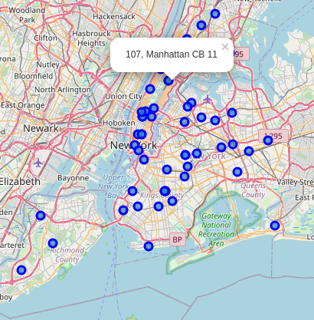
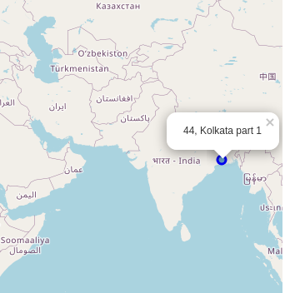
MAP(S)
A COMPARISON WITH
THE PLACE IN KOLKATA HAS BEEN
MADE WITHOUT ANY
ADDITIONAL INFORMATION

Slide 15
RESULT OF CASE 3
IT CAN BE SEEN THAT IT IS A VERY POWERFUL, YET SIMPLE TOOL TO COMPARE LOCALITIES
NOT MUCH DATA IS REQUIRED TO COMPARE 2 CITIES

Slide 16
RESULTS
OTHER FACTORS (LIKE OPERATIONAL/LIVING EXPENSES) CAN BE ADDED TO FUTURE MODELS TO MAKE THEM MORE EFFECTIVE
THOUGH INCAPABLE OF GIVING A CONCLUSIVE RANK, IT CAN GIVE USEFUL INFORMATION THAT CAN BE USED TO FILTER DATA, MAKING THE WORK OF CHOOSING A LOCALITY CONSIDERABLY SIMPLER.

