Slide 1

Compiler Design
Team Members
Arka Choudhuri - 63
Avigyan Bhattacharya -71
Anirban Das - 77
Ratul Chakraborty - 88
PROJECT 2

Slide 2

Problem Statement
Consider a simple C-like language with:
Data Types: integer, real and character
Declaration statements: identifiers are declared in declaration statements as basic data types and may also be assigned constant values (integer of floating)
Condition constructs: if, then, else. Relational operators used in the if statement are < (less than), > (greater than), == (equal) and != (not equal). Example:
if(a<10) then a=a*a; else a-a/2;
Nested statements are supported. There may be if statement without else statement.
Assignments to the variables are performed using the input/output constructs:
cin >> x - Read into variable x.
cout << x - Write variable x to output.
Arithmetic operators ... %) and assignment operator = are supported
Only function is main(), there is no other function. The main() function does not contain arguments and no return statements.
Part I - Construct a CFG for this language.
Part II - Write a lexical analyser to scan the stream of characters from a program written in the above language and generate stream of tokens.
Part III Maintain a symbol table with appropriate data structures.
Part IV Write a bottom-up parser for this language (modules include Item-set construction, computation of FOLLOW, parsing table construction and parsing).

Slide 3

File Tree Structure
├── DFA
- Lexical Analyzer implementation to extract, detect and classify tokens
├── analyser.cpp
- main function giving the output
├── dfa.h
├── dfa_initiator.h
- helper header files for dfa
├── input.txt
- input code of C-like language
├── output.txt
- output of all the tokens
├── SYMBOLTAB
├── symtab.cpp
- Symbol table implementation using multiple hash tables as data structure to store identifiers
├── symbol_table.txt
- Output of symbol table scope wise showing name, type and line no of the variables
├── PARSING
├── bottom-up.cpp
- SLR parser implementation involving constructing the parsing tree and item sets
├── graph.pdf
- Parse tree output
├── input.txt
- Productions of our grammar
├── output.txt
- Item sets output
├── compile_unix.sh
├── compile_windows.sh
- Compiles entire file tree and gives output one by one to respective output text files – separate for windows and unix environment

Slide 4
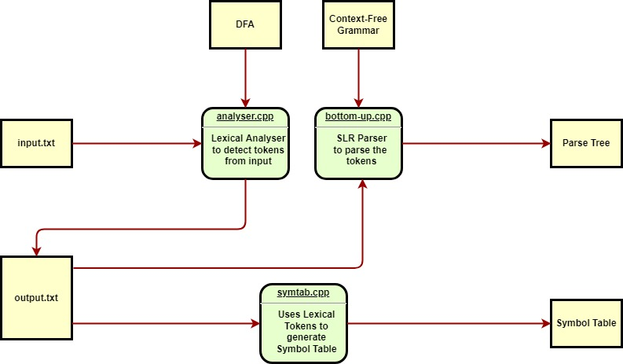

Overall Flow Diagram

Slide 5

Context - Free Grammar
Grammar supports all the features mentioned in the problem statement.
Every program is must start with a main.
The main contains no arguments and doesn't return anything.
Int, real and char are the supported data types.
Arithmetic operators: +,-,*,% are supported along with assignment operator: =
Nested if-else statements are supported.
If statements don't need to followed by an else statement.
Relational operators: <, >, == ,!= are supported in if statement
Nonterminals - S, St, statements, statement, dec_st, math_st, io, if_st, d_prod, d_nat, VALUE, inp, opt, comp_st, CONT, TERM, FAC
Terminals- main, (, ), {, }, ε, ;, int, char, real, ,, ID, =, cin, cout, <<,>>, if, then, else, <, >, <=, >=, !=, ==, and, or, +, -, *, /, %, real_number, integer_number, character

Slide 6
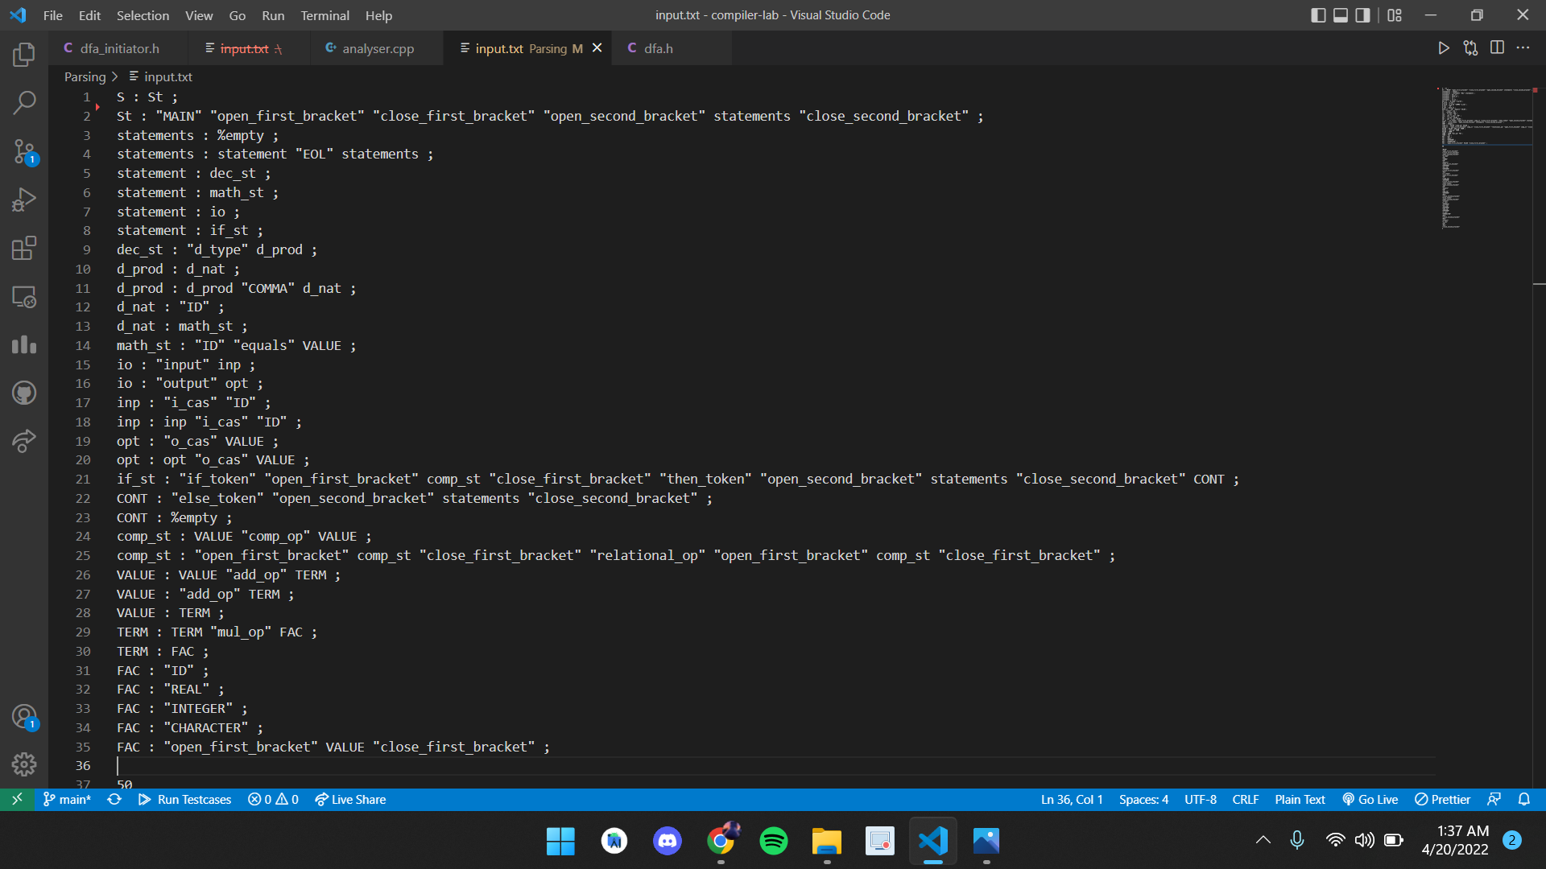
Context - Free Grammar (Productions)

Slide 7
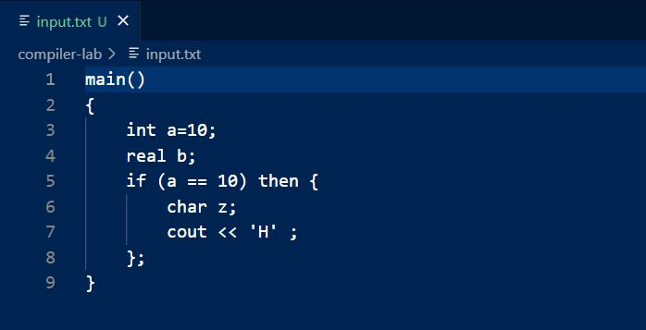

Sample Input Code
We demonstrate our compiler components and their working using a simple code in the C-like language as instructed

Slide 8

Lexical Analyser
A 62 - state DFA is used as a basis of lexical analyser (LA), with 57 final states. Each state is associated with a token class, with non-final states having "null" and final states having the tokens or keywords of the CFG.
Input to the Lexical Analyser is read each line at a time. The line is fed into the DFA.DFA generates all the tokens for the given line, corresponding to the token classes of the states.
A dictionary is maintained to store the lexeme and its token class, which is written back to the output file.
Note: DFA also checks for lexical errors. In case there is any error class ("null") detected, the user is given a prompt, before the output file is generated.

Slide 9
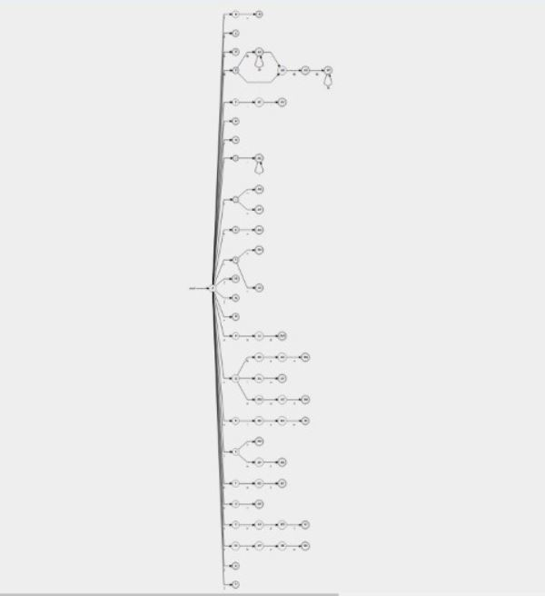
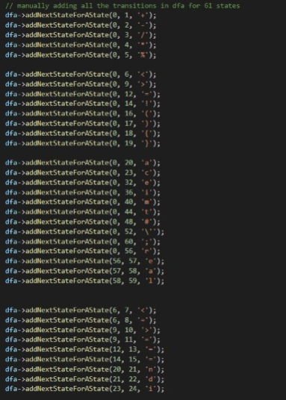

Lexical Analysis (Sample DFA and its implementation)

Slide 10
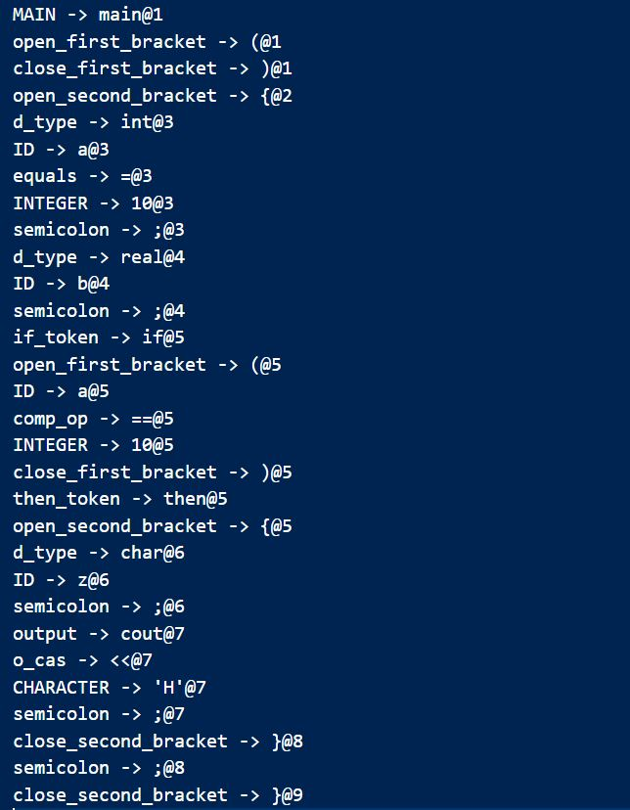


Lexical Analyser (Output)
Line number
Token Class
Tokens

Slide 11

Symbol Table
Designed Symbol Table using Multiple Hash Tables, implemented as a dynamic list of hash tables.
One hash table for each currently visible scope.
Whenever a token is inserted in the symbol table, the name of the id(identifier) is the key, and the values alongside consists of attributes - data type and the line number of usage.
During scanning, whenever it enters a new block of code, a new hash table is generated in the head of the list, and when it exits the block, the hash table in the head of the list is deleted and the symbol table of that scope is displayed in the terminal.
If it encounters an error(usage without declaration or in wrong scope), it breaks out of loop and gives us the line in which error has occurred.

Slide 12
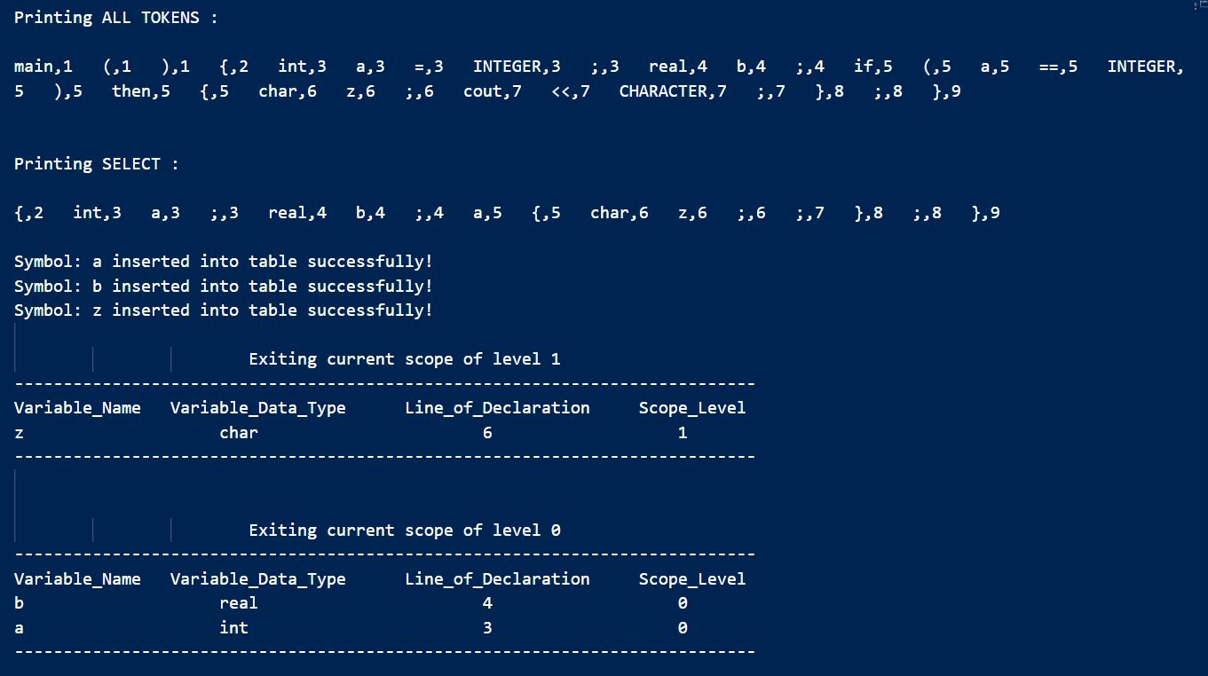

Symbol Table (Output)
SELECT prints tokens that help in building the symbol table

Slide 13

Bottom Up Parser
The Bottom-up Parsing is done using the SLR parsing technique.
The program receives the tokens (from lexical analyser) and the grammar as input and:
generates the LR(0) item set with transitions
does the calculation of first and follow sets of the grammar
simulates the parsing process on the tokens
prints the resulting parse tree

Slide 14
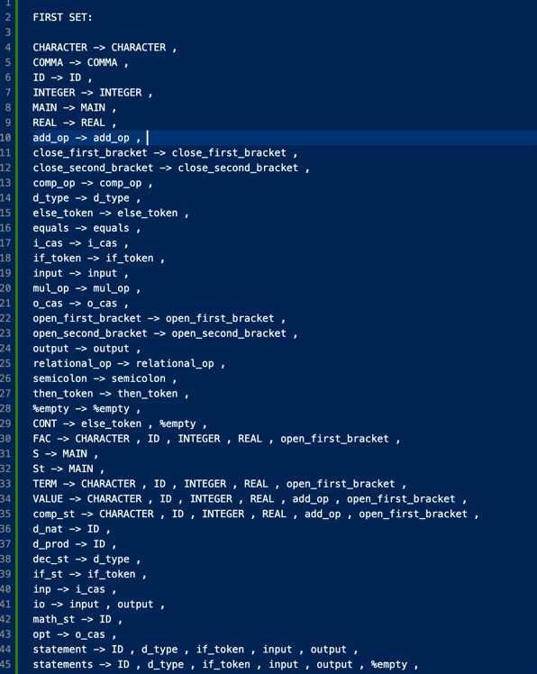
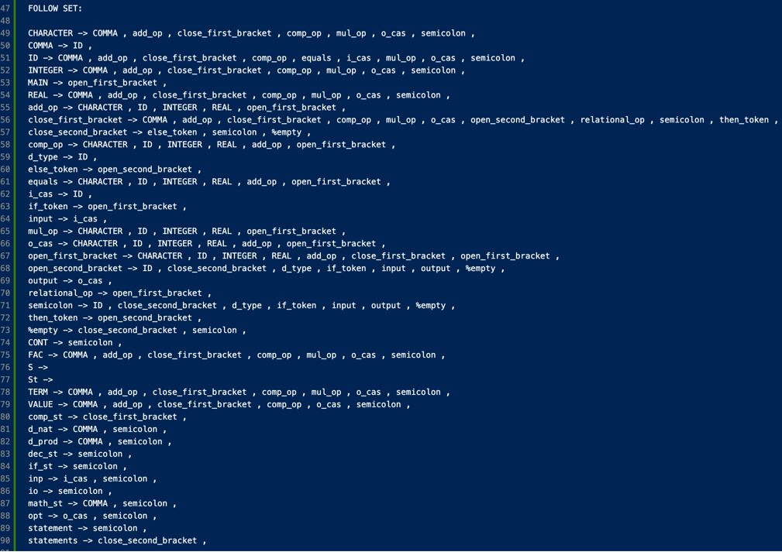

FIRST and FOLLOW Set

Slide 15
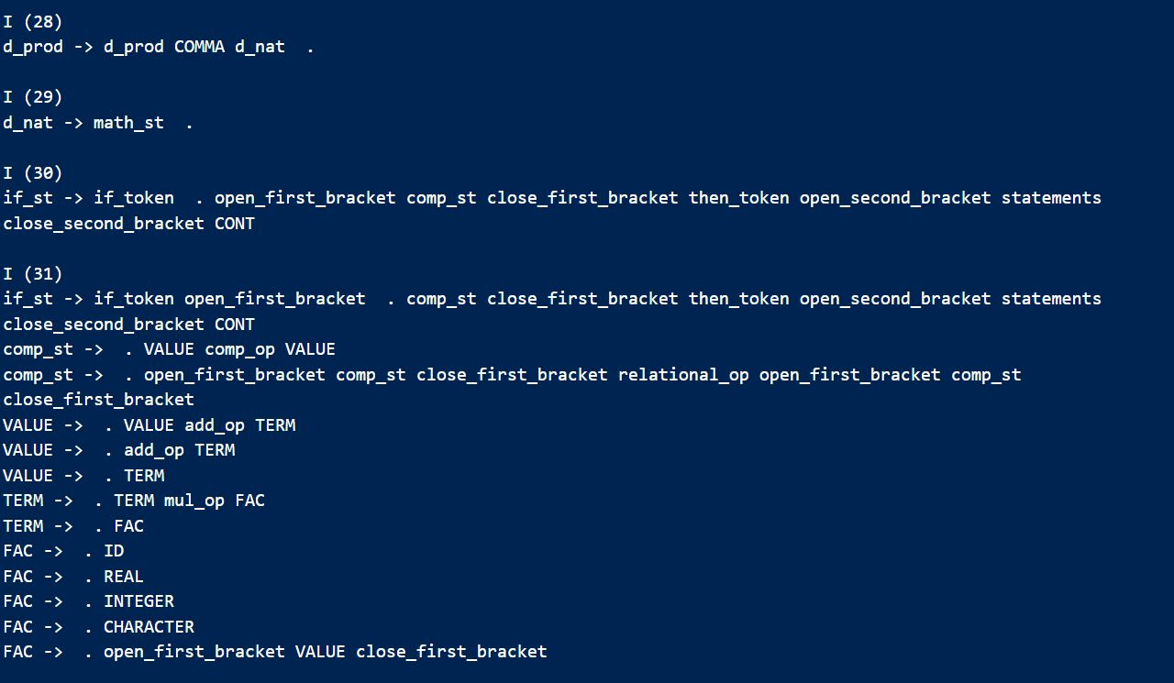
Bottom Up Parser (sample Item set)

Slide 16
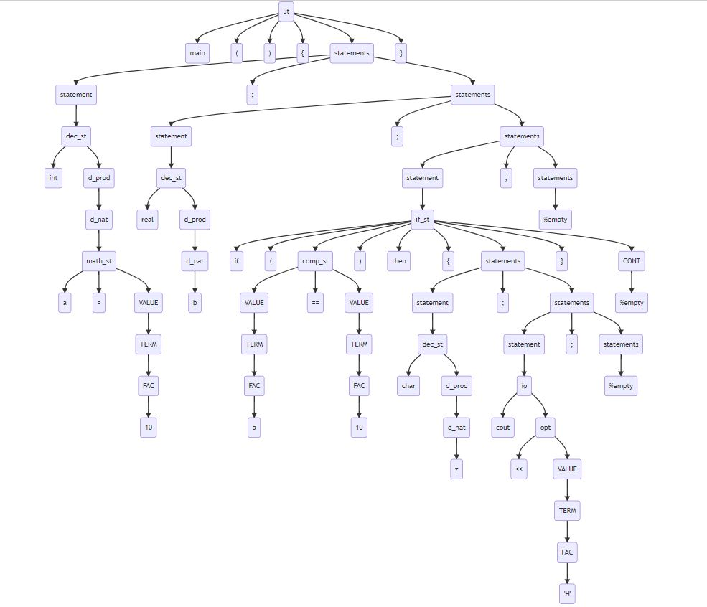

Parse Tree Example

Slide 17



