Slide 1

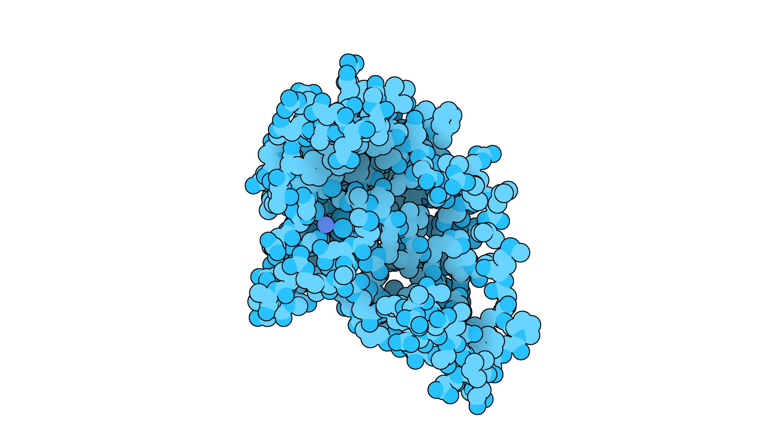

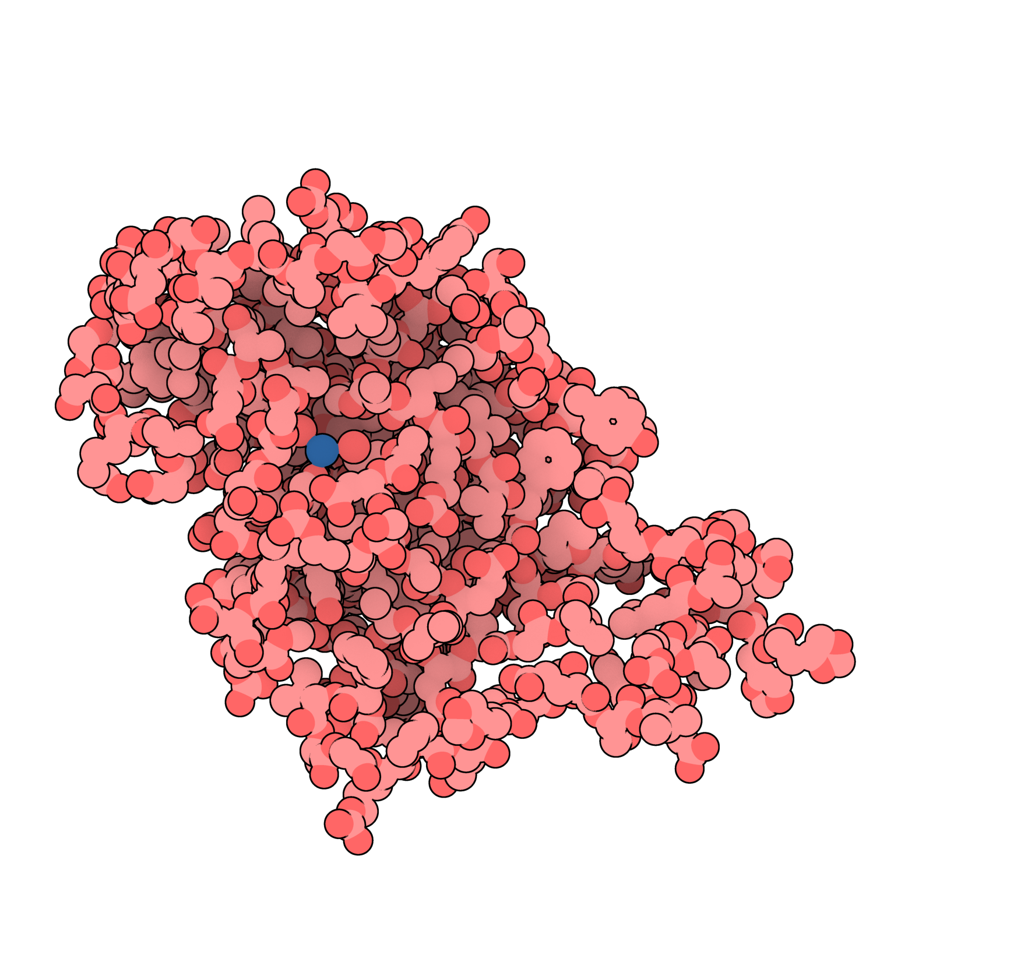



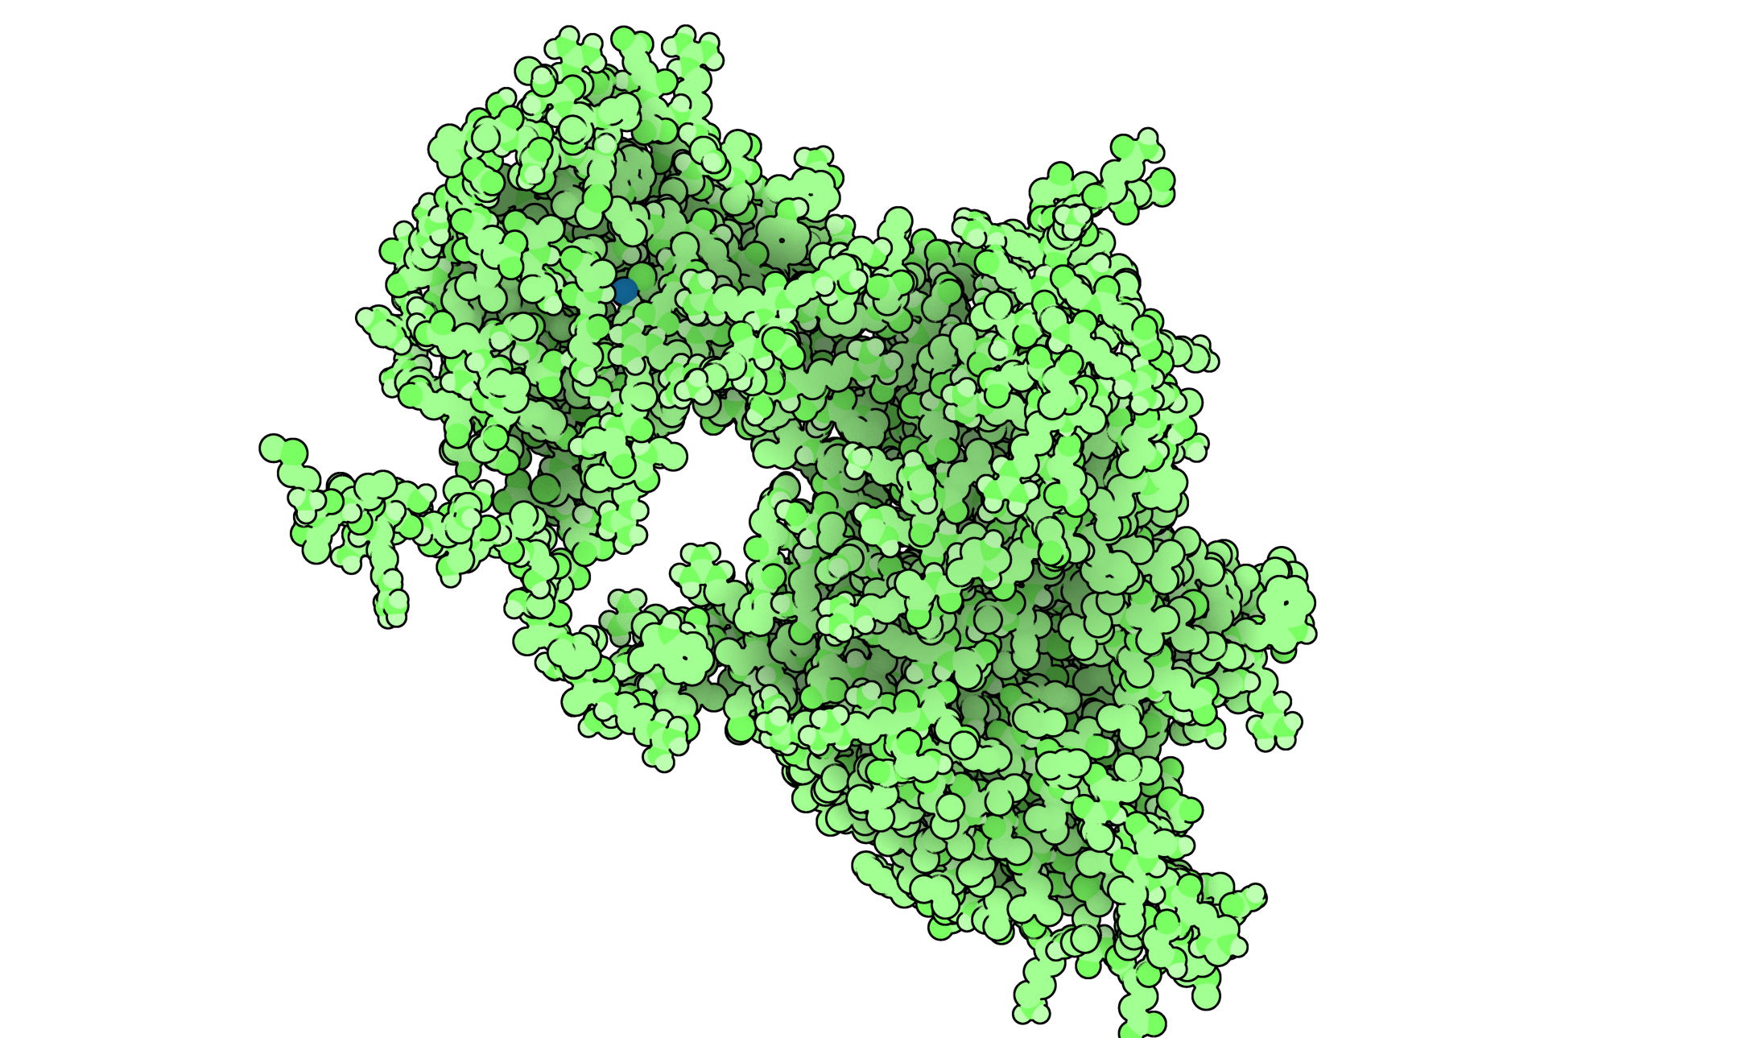
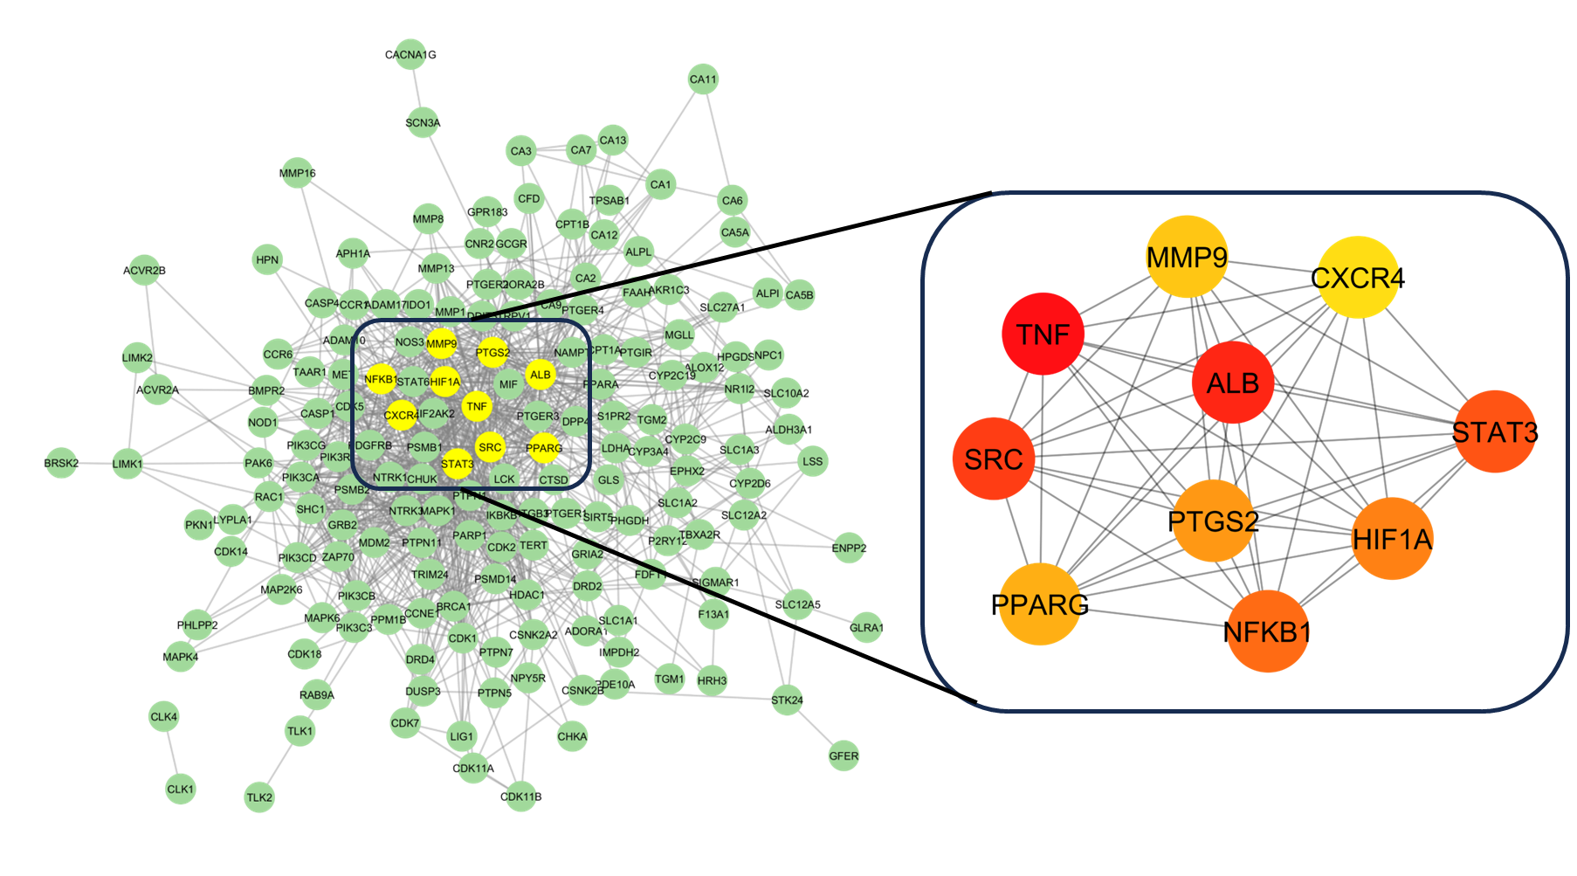

Nanomolar range efficient inhibitors
MtbCA1
In-vitro Biological evaluation
against Mtb β-ca1-3
Inhibition
of Mtb infection
MtbCA3
Rational Synthesis
Based on
computational
predictions
Mechanistic interpretation
and ML-QSAR models
Immune modulation
MtbCA3
Mtb β-ca1-3 bioactivity dataset
Systems biology analysis to elucidate MOA

