Slide 1

CS360 Final Project
Ratul Pradhan & Alexandria Yao
Notes:
This is our CS360 Final Project: 26Live as you can see by the logo here!

Slide 2
Introduction
Notes:
Let’s jump into it!

Slide 3
What is 26Live?
26Live is a space scheduling website that both students and schedulers can use to cohesively schedule events together. Students can view locations, view events, add/request events, and check their own requested events. Schedulers can delete events, add/request events, view locations, view events, check their own events, add locations, delete locations, and view flagged events.
Notes:
You may be asking what is 26Live? 26 Live is a space scheduler that allows students and schedulers to request to use locations for events. Students are able to request locations to be used for their events and check the status of their requested events. They are also able to search up locations and events going on. Schedulers are able to delete events, add/request events, view locations, view events, check their own events, add locations, delete locations, and view flagged events.
Some helpful logins to explore the project with are:
Scheduler UID = 200
Password = 12345678,
Student UID = 10001
Password = 12345678, and
Student UID = 10040
Password = 87654321

Slide 4
Functionalities
Notes:
Now for some functionalities!

Slide 5
Functionality List
Completed | In-Progress
Dashboard Upcoming Events Event Details Location Search Event Search Delete Event Scheduler Login Student Login Schedule An Event Student Schedule An Event Scheduler Event Location Clashing Event Flagging Add Locations Delete Locations Checking My Events | Flag events when a location is deleted and events have that location.
Notes:
Our completed functionalities on 26Live are Dashboard, Upcoming Events, Event Details, Location Search, Event Search, Delete Event, Scheduler Login, Student Login, Schedule An Event Student, Schedule An Event Scheduler, Event Location Clashing, Event Flagging, Add Locations, Delete Locations, and Checking User Events. Our in-progress functionalities are flagging events when a location is deleted and events have that location.

Slide 6
Demonstrations
Notes:
Now for demonstrations of all the pages in our project!

Slide 7
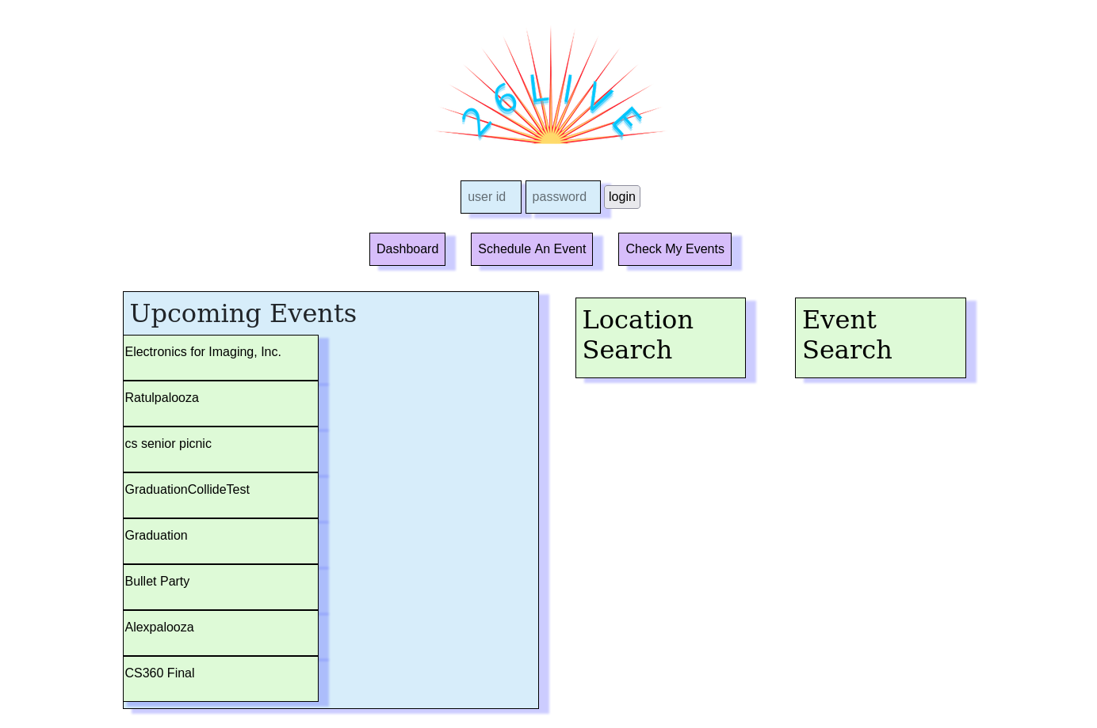
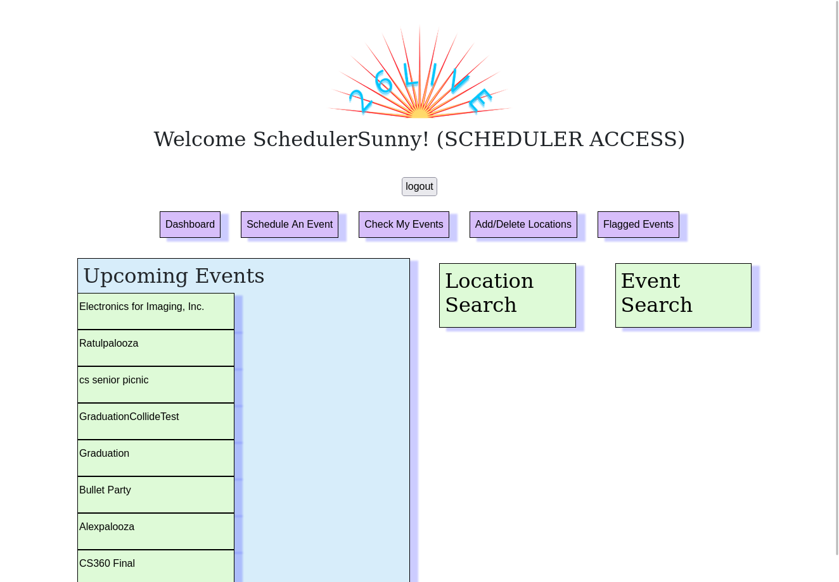
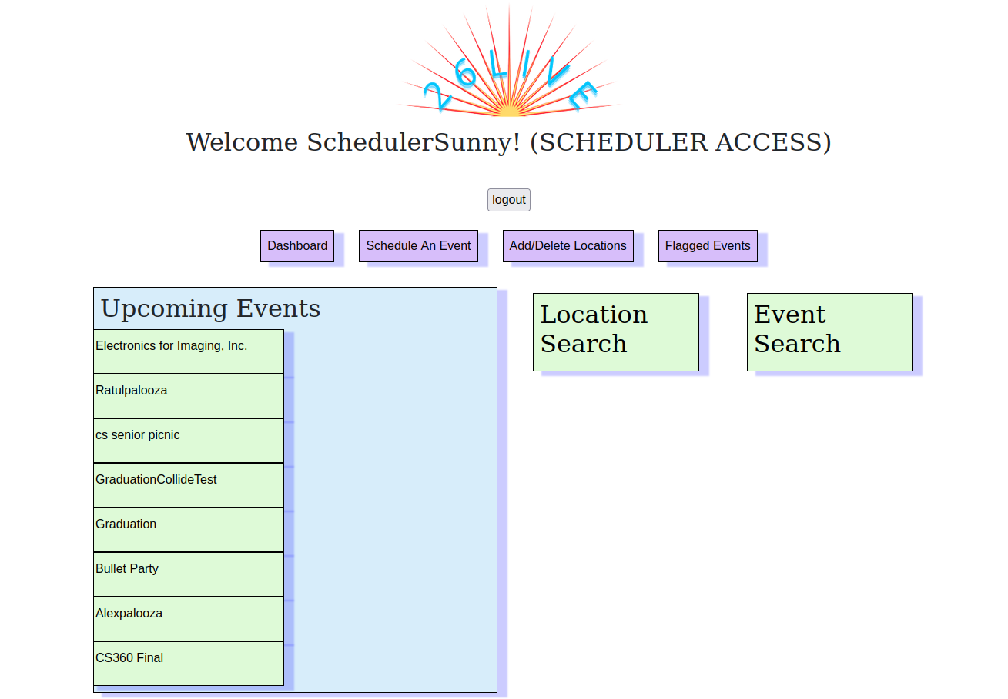
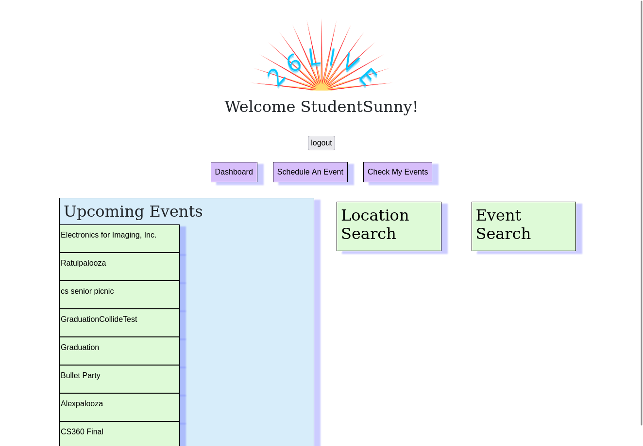
Dashboard
Notes:
This is our dashboard page! As you can see here, certain functionalities become available or unavailable based on if you are logged in and who is logged in. Schedulers have access to a wider variety of functionalities since they need to maintain, flag, and schedule as opposed to students who do not. When not logged in, users are able to use Location Search and Event Search as well as look at the Upcoming Events. However, they are not able to schedule an event or check their events as they are not logged in. They cannot access event details without logging in either to maintain privacy. When students are logged in they can also use Location Search, Event Search, Upcoming Events, Event Details, Schedule An Event, and Check their Events. When schedulers are logged in they are able to do everything that Students can as well as Add/Delete Locations, Delete Events, and see Flagged Events. It should be noted Scheduler’s do not have a Check My Events tab since Scheduler’s schedule events using sid (that is manually selected)

Slide 8
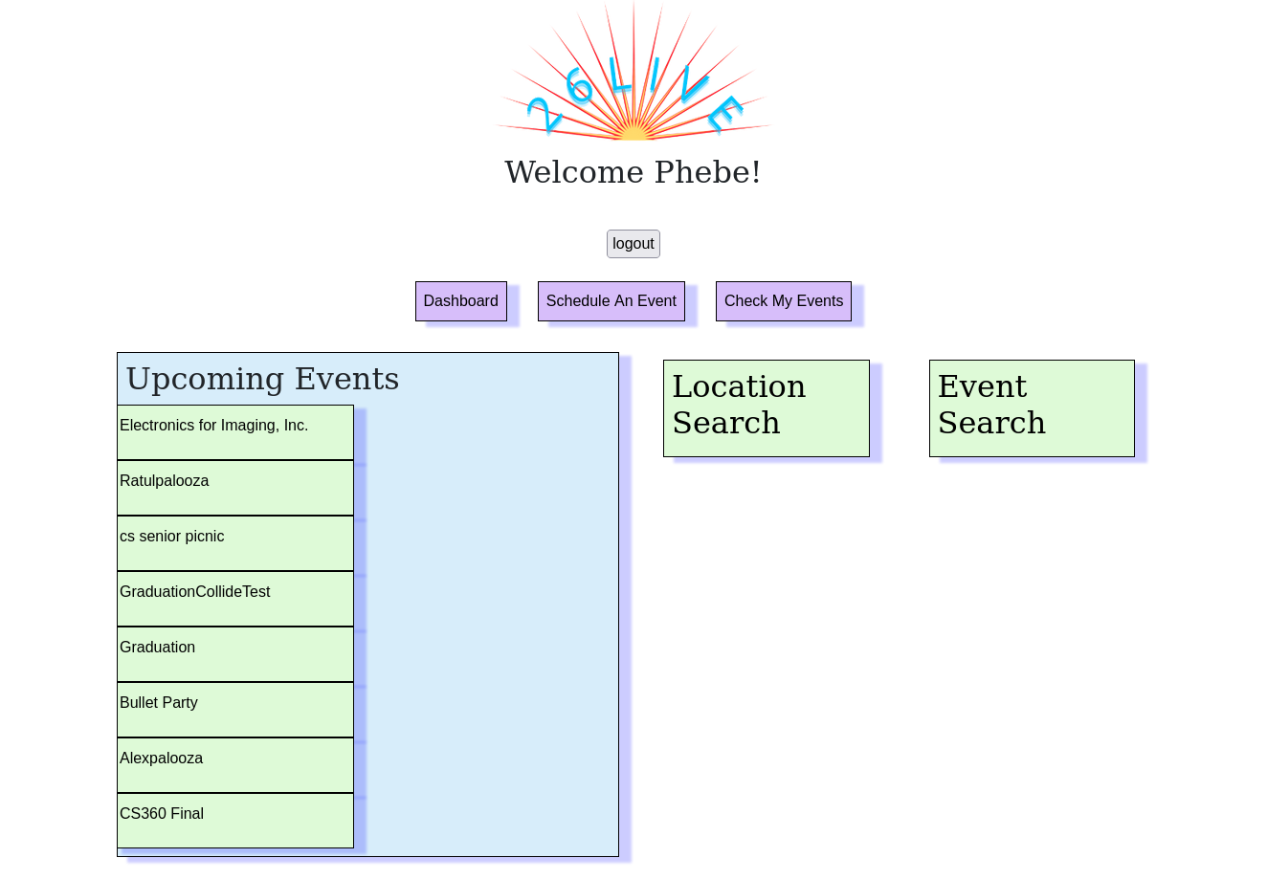
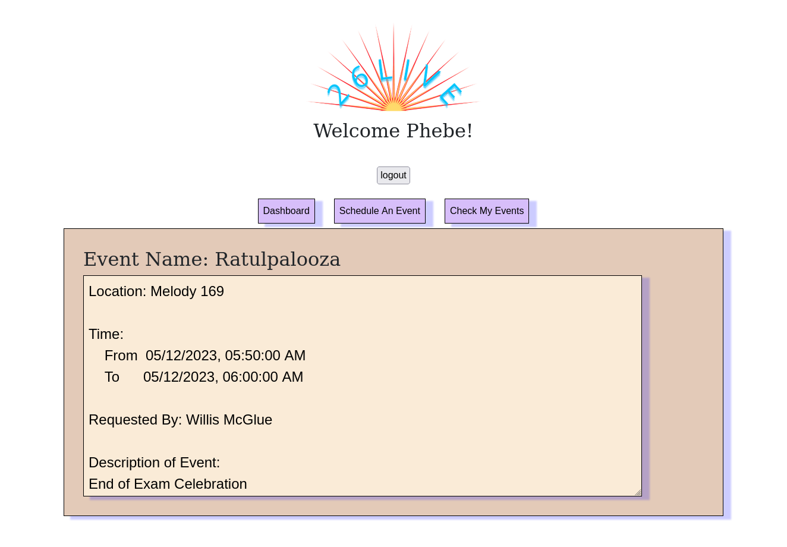
Upcoming Events
Notes:
When on the dashboard, you can see the upcoming events! This functionality takes the current date and finds all of the events that are coming up within the time frame of now to next month. They are sorted by the date of the event, so the events that are coming up soon will be at the top. If they are curious, those who are logged in can view the event details of the upcoming events by clicking on the box which will bring up a information page that goes into detail about that event’s details.

Slide 9
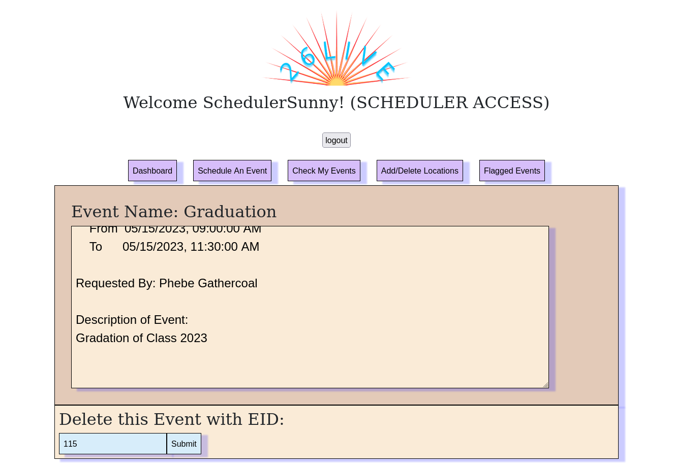
Event Details
Notes:
The event details differs based on who is logged in. For students, the Event Details page shows the Building, Room Number, Start Time, End Time, Requester, and a Description of the event if there is one. If a scheduler is logged in, it will show the same information but it will also give it the power to delete the event with a filled in event id of that clicked event.

Slide 10
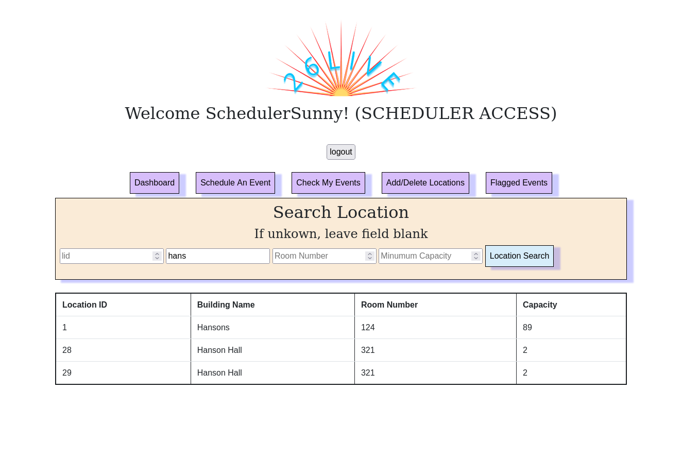
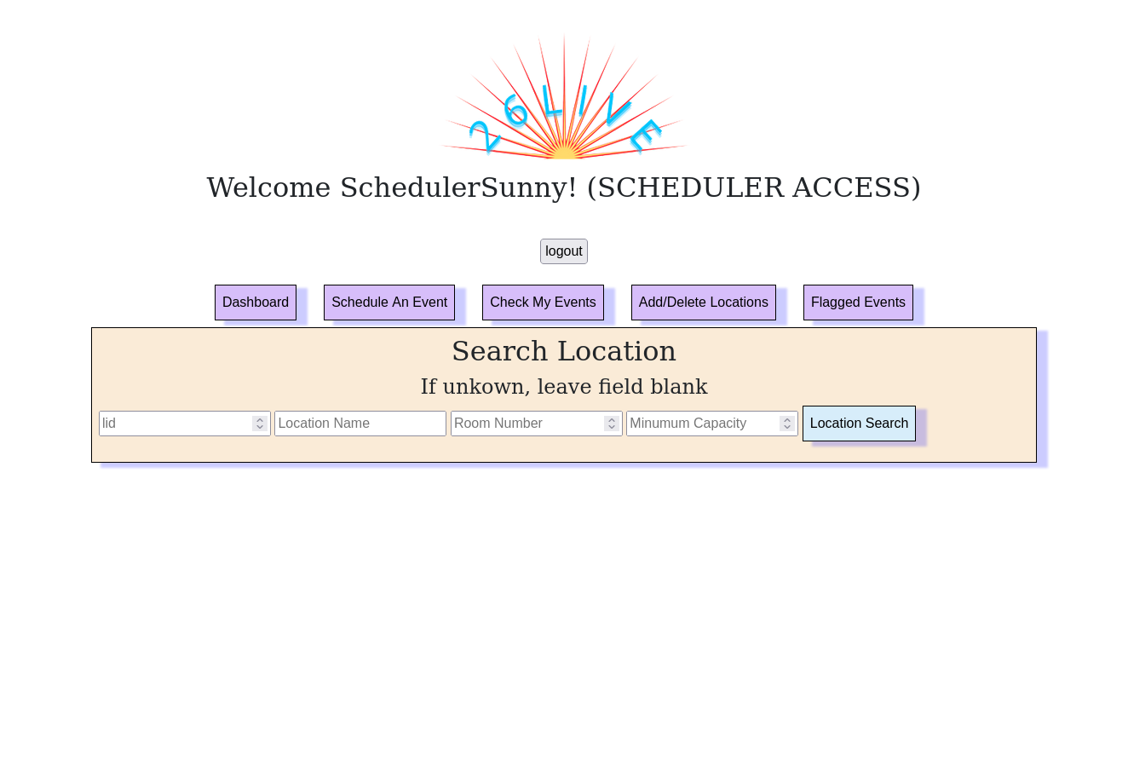
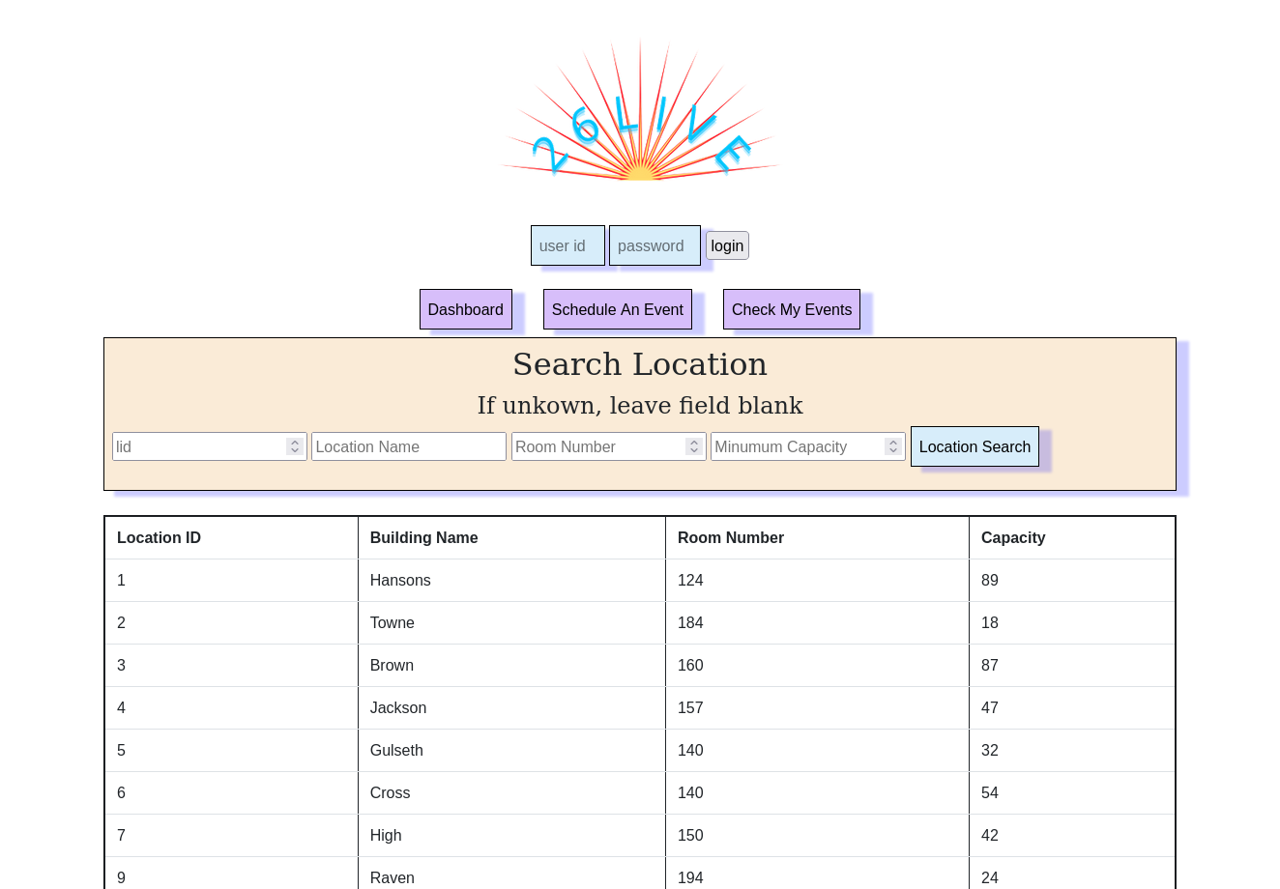
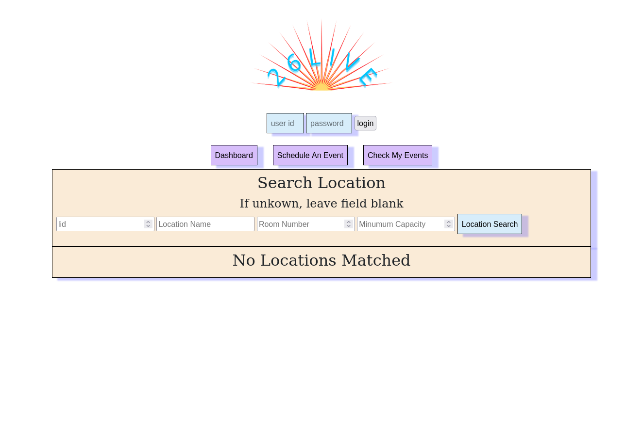
Location Search
Notes:
Location search is the same regardless of who is logged in and if they are logged in. After going to dashboard, location search can be clicked to bring up a location form that will ask for optional inputs to sort the location results by. If no inputs are given, it will return all of the locations sorted by location id. If any input is given, ex. “hans” in Location Name will return the locations that have hans in their name which can be seen in the top right picture. If no locations match, it will return No Locations Matched.

Slide 11
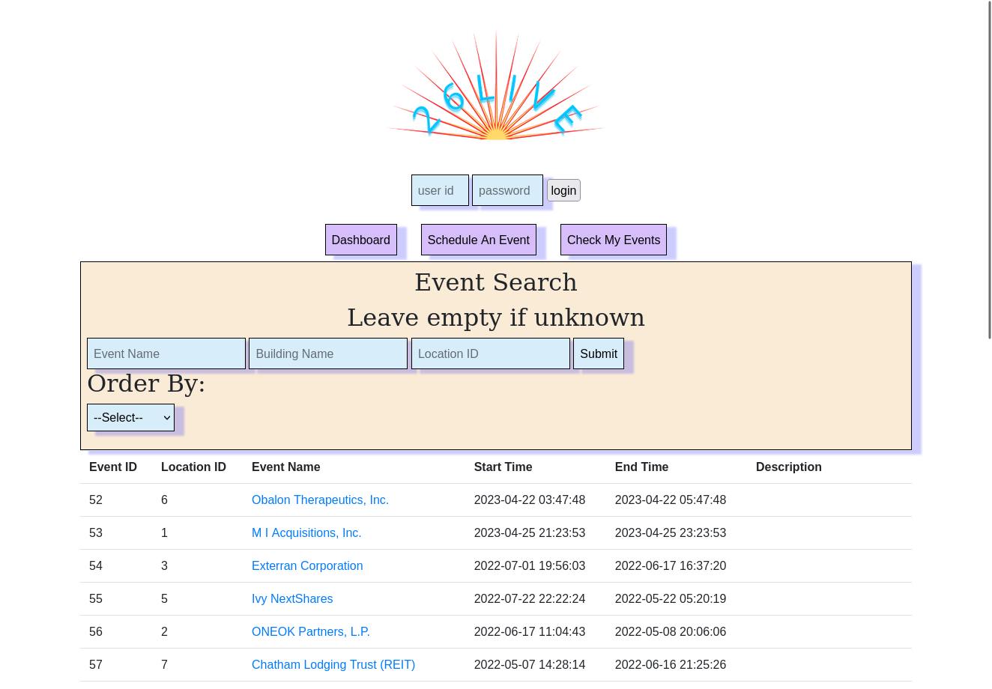
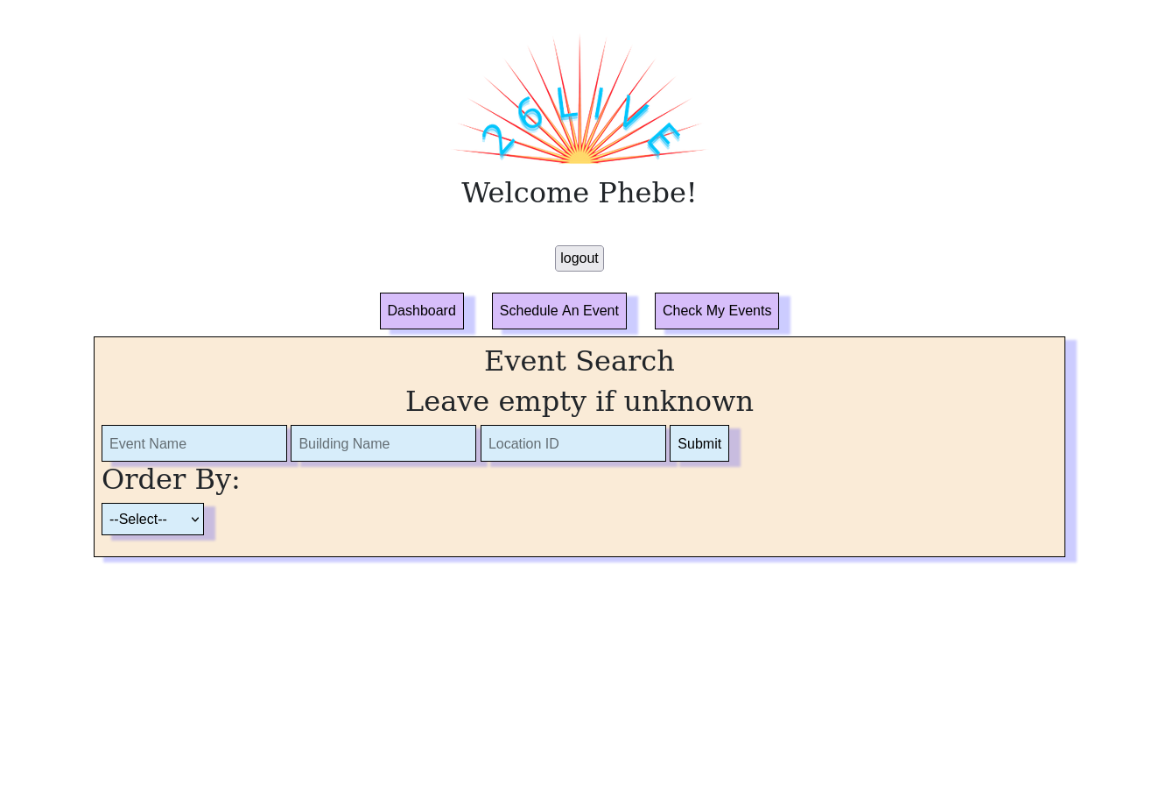
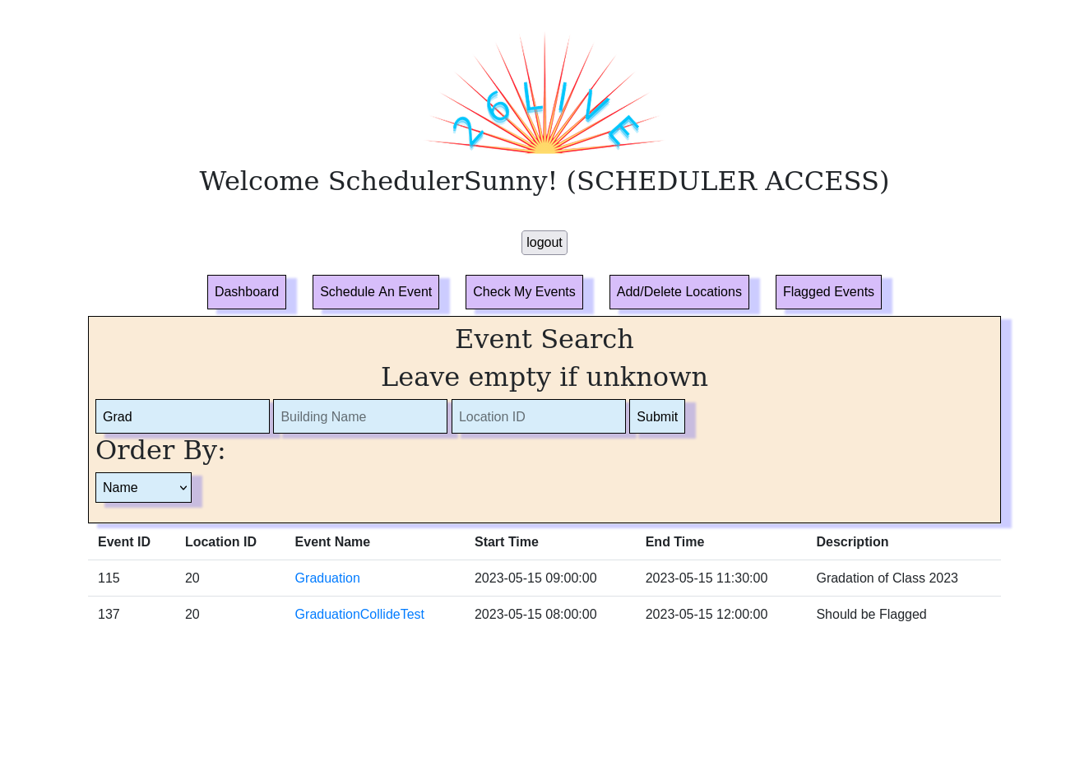
Event Search
Notes:
Event search is also the same regardless of who is logged in and if they are logged in. After going to dashboard, event search can be clicked to bring up an event search form. There are optional event search field that can be filled out similar to location search. There is also a sort by dropdown button that can sort the results by event name, event start time, event end time, building/location name, or location id. If nothing is clicked it will be sorted by event id. If nothing in the event form is filled out it will return all events. If there are no events that fit the form requirements, it will return No Events Found.

Slide 12
Delete Event
Notes:
From Event Search, deleting events is easy. After searching for the events, schedulers can click on the blue hyperlink which bring up that event’s detailed information page. If you are logged in as a scheduler, you can automatically delete this event with the pre filled event id by simply hitting the submit button.

Slide 13
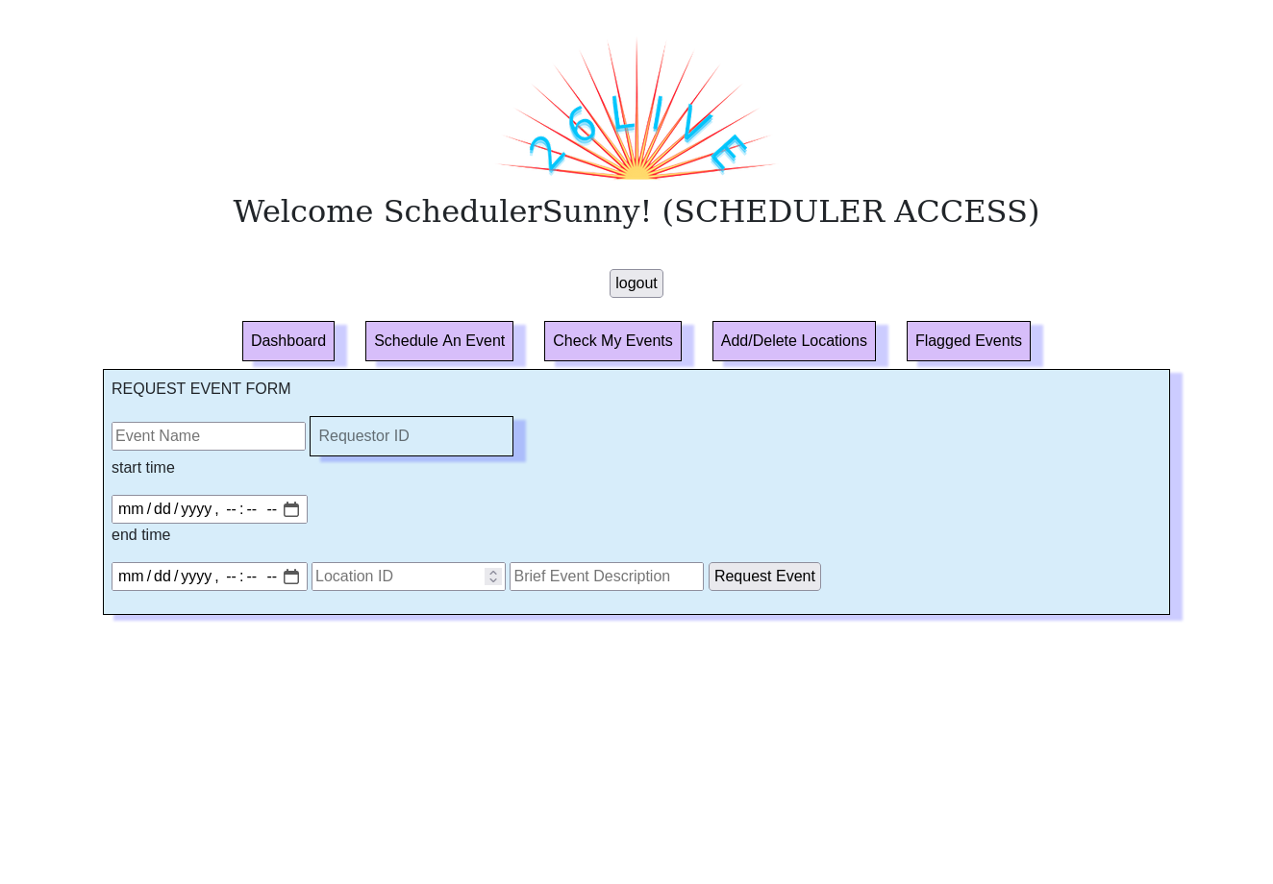
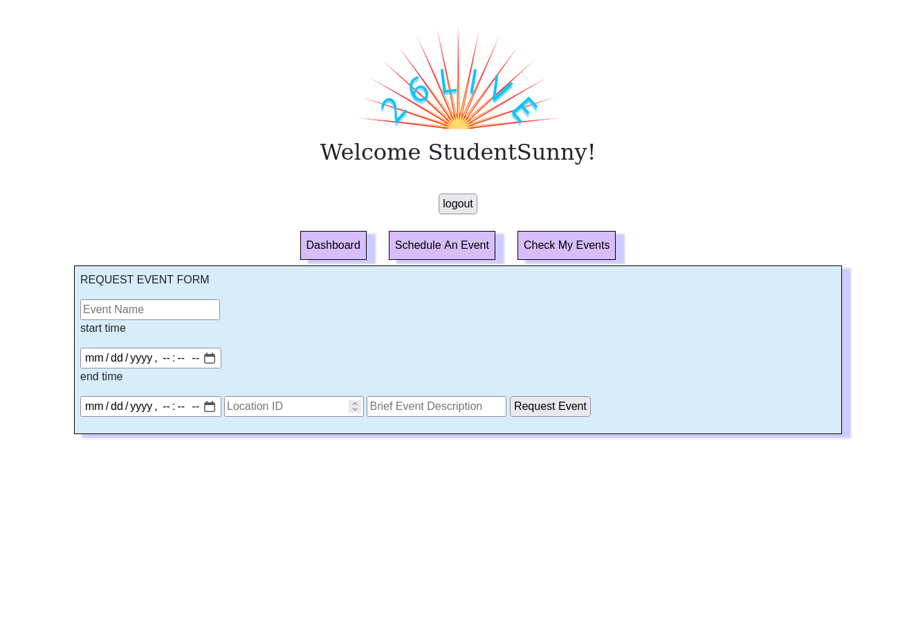
Schedule An Event
Notes:
The Schedule An Event Tab is available to everyone who is logged in. The form asks for Event Name, Start Time, End Time, Location ID, and a optional brief description of the event. As a student, you can fill out the form and hit the request event button to request an event. If the event times are not valid (either by the start time being later than the end time or the start time and end time being too close to today’s date) or the location id is not valid or certain fields are not filled in, it will not allow you to request the event. As a scheduler, users have the same access to the form as students do, but are allowed to override the Requester ID (which is automatically inputted with student users) with any ID. If these events have overlapping location and time issues as other events, they will automatically get flagged and given to schedulers to delete.

Slide 14
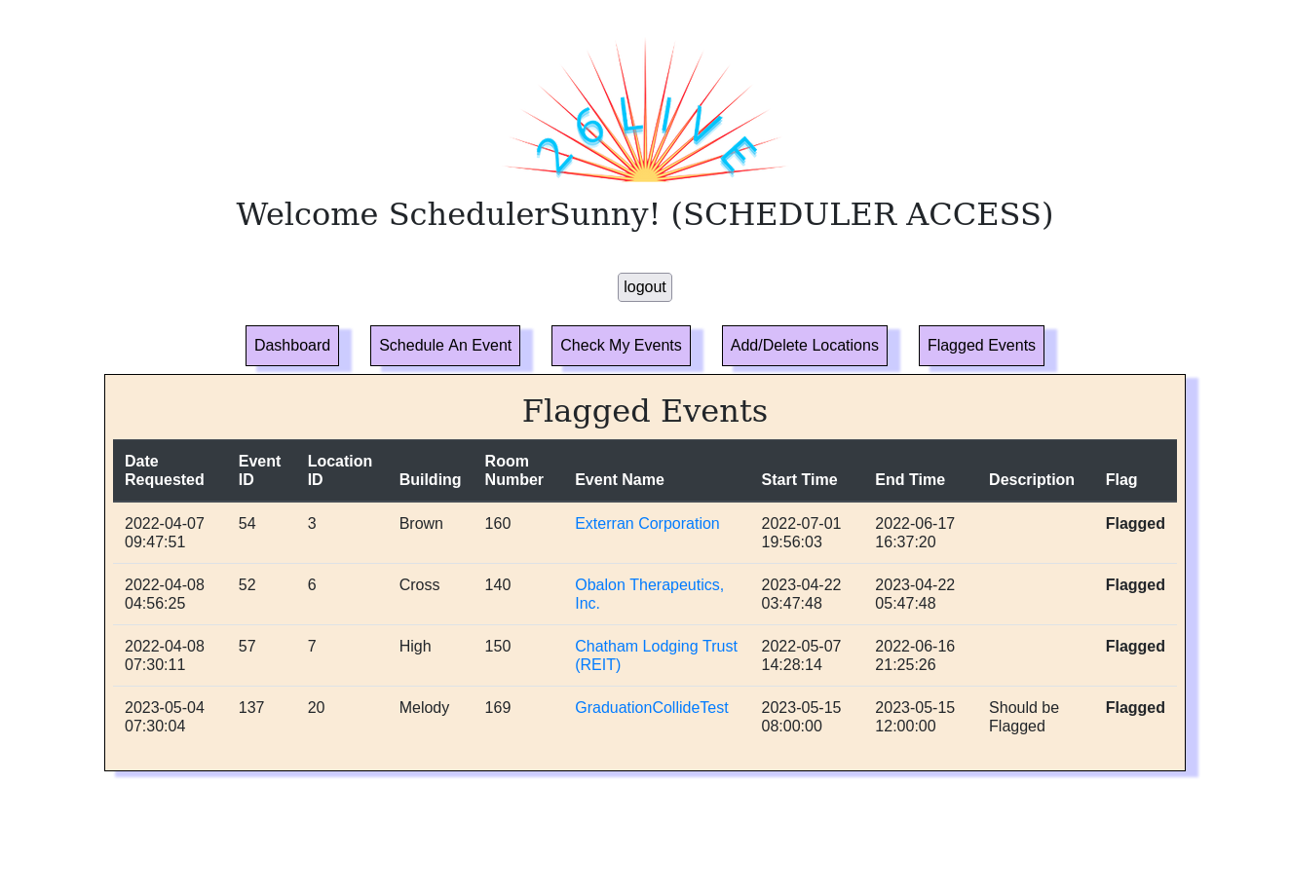
Event Flagging
Notes:
If the user is logged in and a scheduler, they have access to the scheduler-specific page, Flagged Events, where schedulers can view and delete all flagged events. If people request an invalid event where the event collides with another event time and location-wise, that event will get flagged and listed for schedulers to delete.

Slide 15
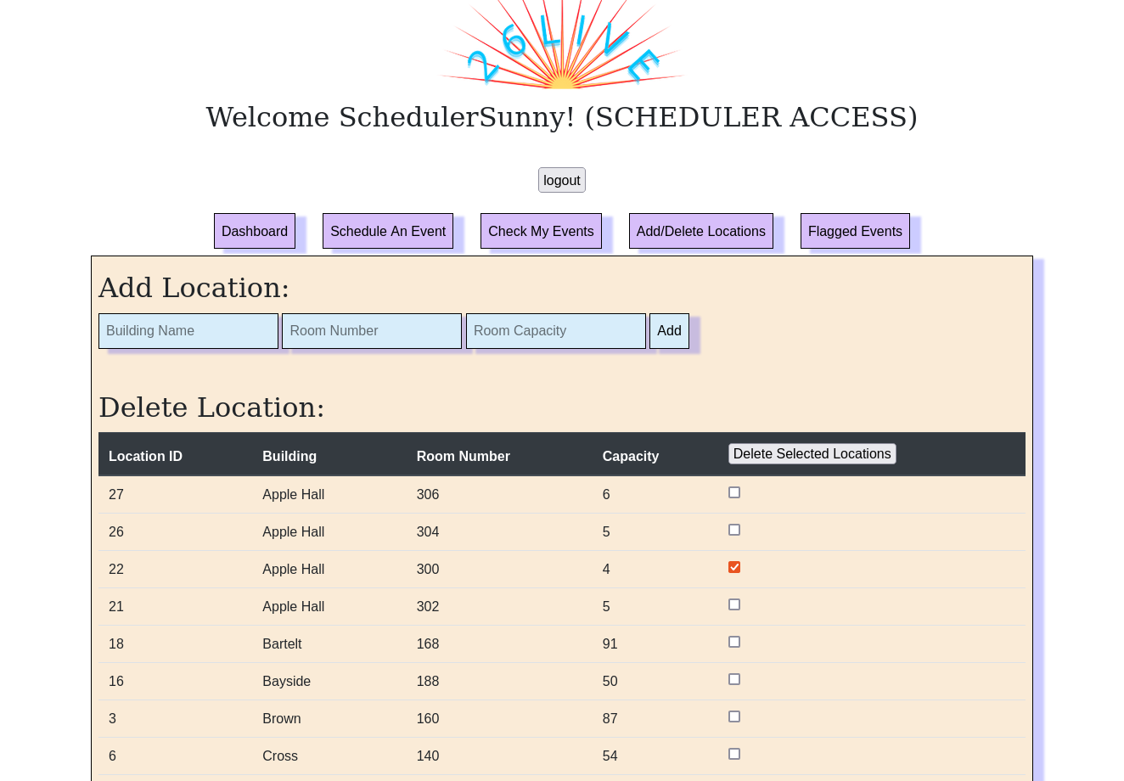
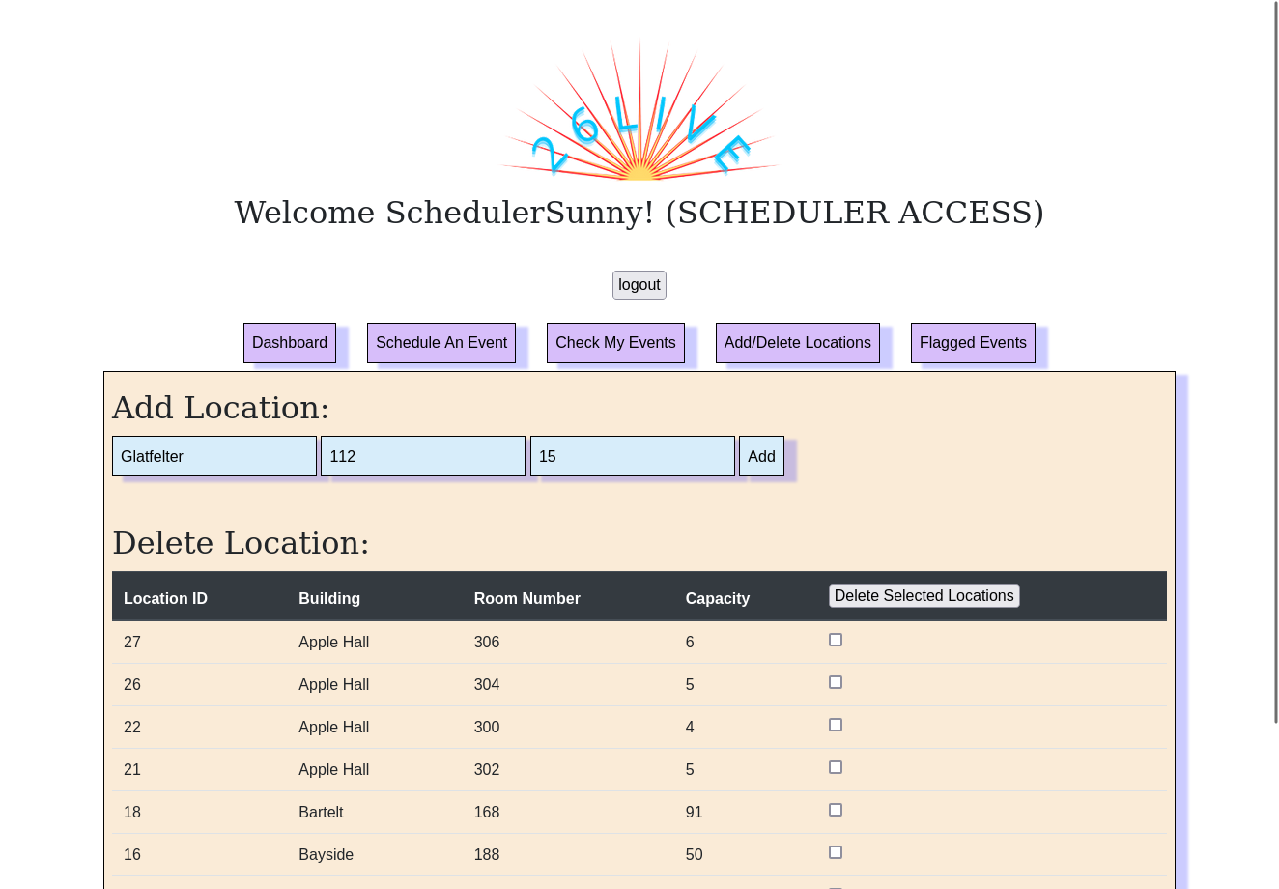
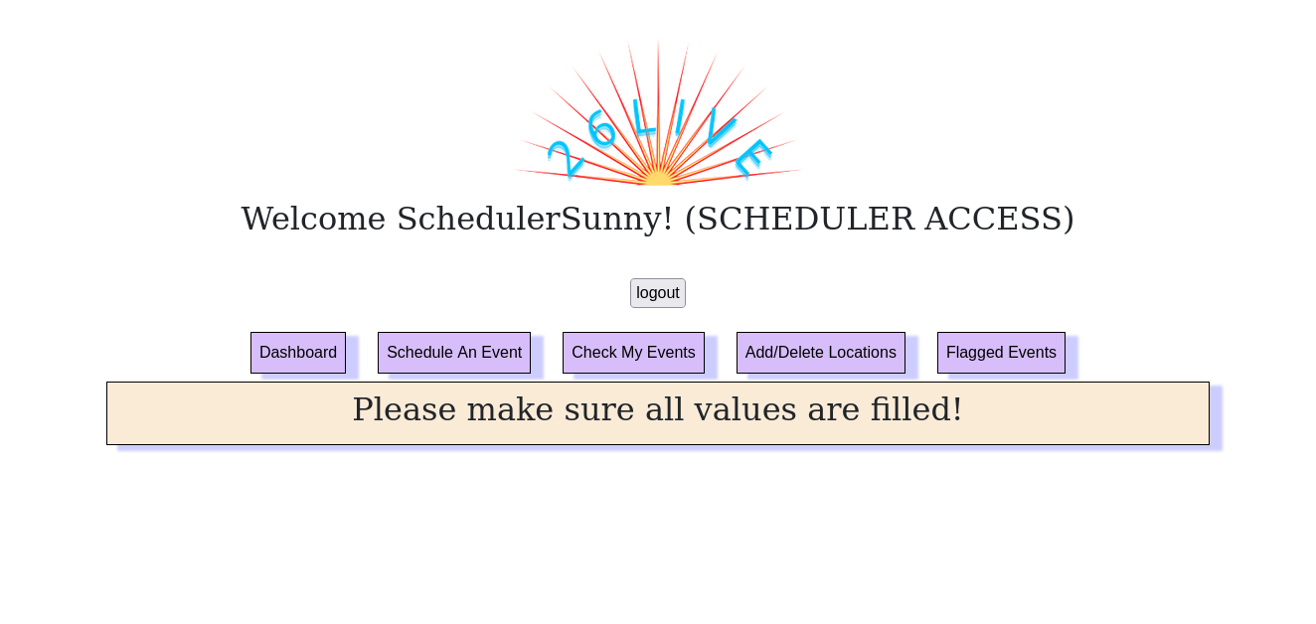
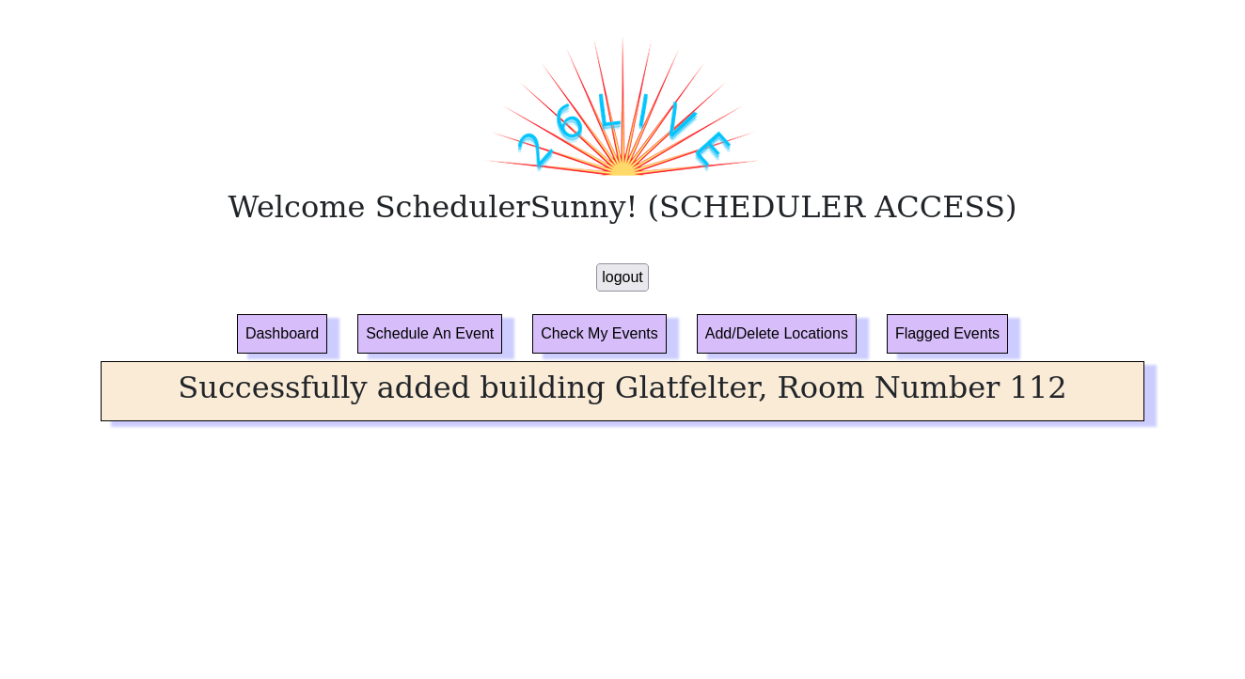
Add/Delete Locations
Notes:
Another scheduler-specific page, Add/Delete Locations is where schedulers can add new locations as well as view and delete locations. If a scheduler wishes to add a new location, they must fill out a form of the building name, room number, and capacity of that new location. If a scheduler tries to add a new location without filling out all of the values in the form, they will be denied and get the message please make sure all values are filled! If a scheduler is successful in adding a new location, it will return the a success message with the Building name and room number of the location they just added. Below the add location form, there is a delete location form, where schedulers can scroll through all the locations and delete whichever locations they want using a checkbox.

Slide 16
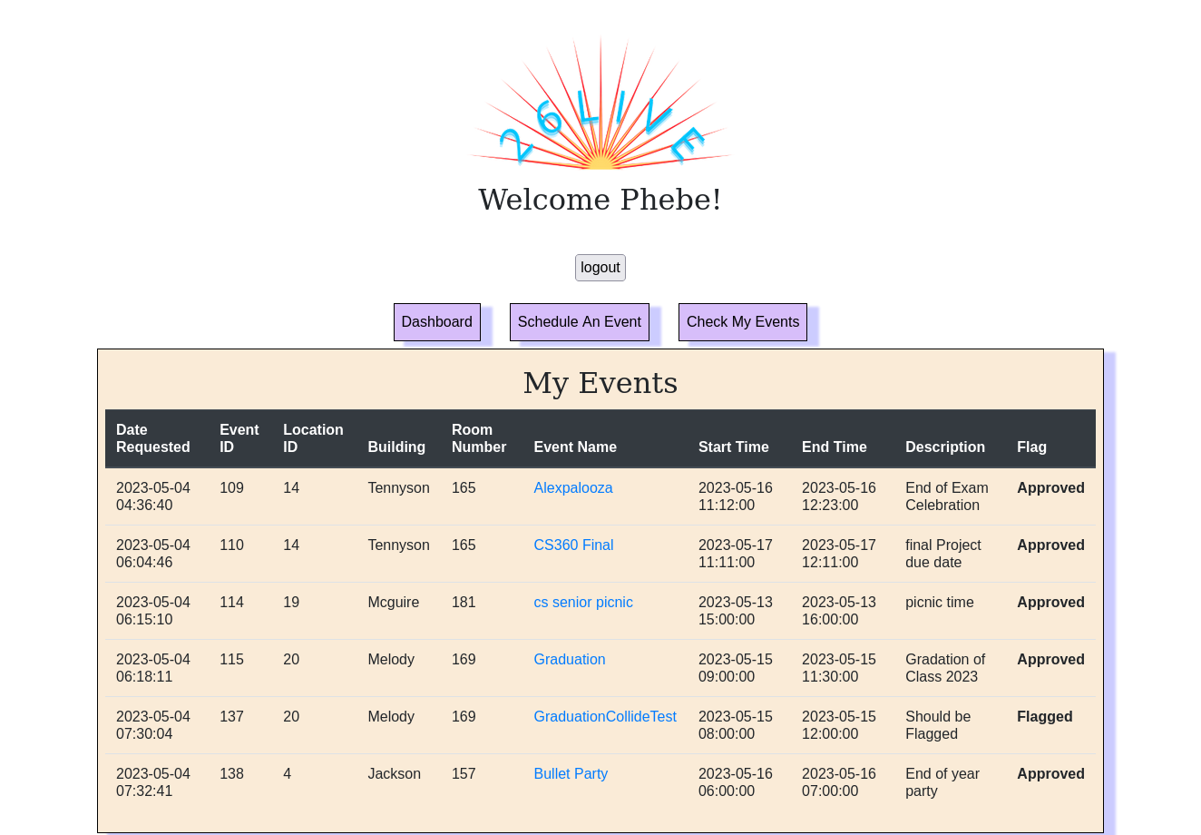
Checking My Events
Notes:
This functionality is available for anyone who is logged in. Since we used the student id of 10040 for testing, you can see all of the events that have been requested by that user in that tab. This page shows all of the events requested by whoever is logged in sorted by the date requested. It returns the date requested, event id, location id (building name and room number), event name, start time, end time, description, and their status/ flag. Here students and schedulers can see the events requested and if they have been approved (flag is equal to 0) or flagged/not approved (flag is not equal to 0). This page allows them to see the current status of all the events they have requested.

Slide 17
Future Work
Notes:
That was all of the pages in our website, now for our functionality wish list or future work we wish to implement.

Slide 18
Future Functionality Wish List
More Advanced Event Searching
Flagging Deleted Location Events
Keeping Deleted Events
Update Existing Events
Notes:
Some functionalities we wanted to implement were a more advanced event searching much like 25Live where there are more parameters to input and ways to filter and refine the results. We also wanted to implement flagging events from deleted locations. We also thought that it might be nice to keep deleted events for record keeping purposes. Lastly, we thought it would be good if there was a way to update existing events if the requester was the one who logged in.

Slide 19
Thank You!
Notes:
Thank you all for listening!

